Slide 1
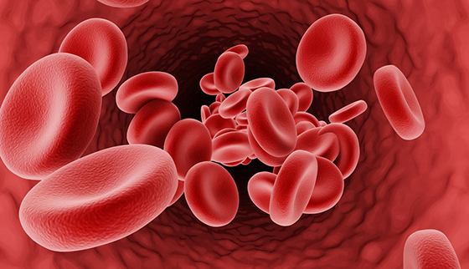
thalassemia presented by khushi ansari

Slide 2
INTRODUCTION
The word thalassemia is derived from a greek word ‘thalassa' meaning sea. The disease was firstly described by colley in 1925. It was firstly notice in patients originating from the littoral countries of the mediterranean sea. At present the disease has been found in several countries all over the world. The prevalence of the disease in india is high among gujaraties, sindhis and punjabis. There are millions of people as carriers of thalassemia gene and every year thousands of thalassemic children are born in our country.

Slide 4
DEFINITION
The thalassemia are a group of hereditary anemia characterized by hypochromis (an abnormal decrease in the hemoglobin content of erythrocytes), extreme microcytosis (smaller-than-normal erythrocytes), destruction of blood elements (hemolysis), and variable degrees of anemia.
[OR]
Thalassemia is an inherited blood disorder characterized by less oxygen-carrying protein (haemoglobin) and fewer red blood cells in the body than normal.

Slide 5
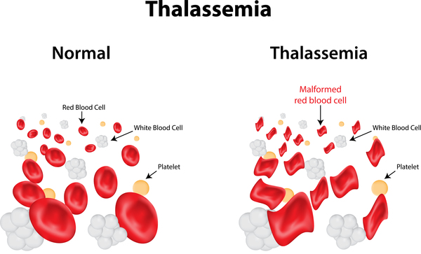

Slide 6


Slide 7
TYPES
There are two main type of thalassemia:
1.Alpha thalassemia: It occurs when a gene or genes related to alpha globin protein are missing or changed (mutated).
2. Beta thalassemia: It occurs when gene defect affects production of beta globin protein. It is more common than alpha type.

Slide 8
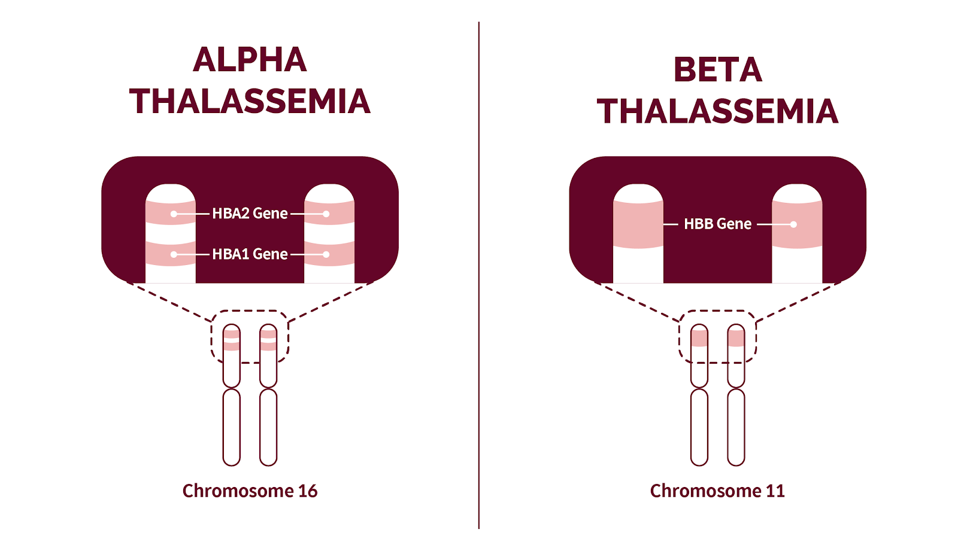

Slide 9
Depending on the severity, thalassemia is of two types:
1. Thalassemia minor:
It is associated with decreased beta chain synthesis and is heterozygous form of disease, i.E., Defective gene is received from one parent. It generally produces little effect on the child, except mild anemia with microcytosis(small RBCs) and hypochromia(less color RBCs). Persons with this form of disease are carriers of disease and are usually asymptomatic.

Slide 10
2. Thalassemia major:
It is also known as "cooley's anemia or mediterranean anemia". It is homozygous form of disease, i.E., The defective gene is received from both parents. Persons with thalassemia major have severe anemia and all the clinical manifestations of the disease

Slide 11
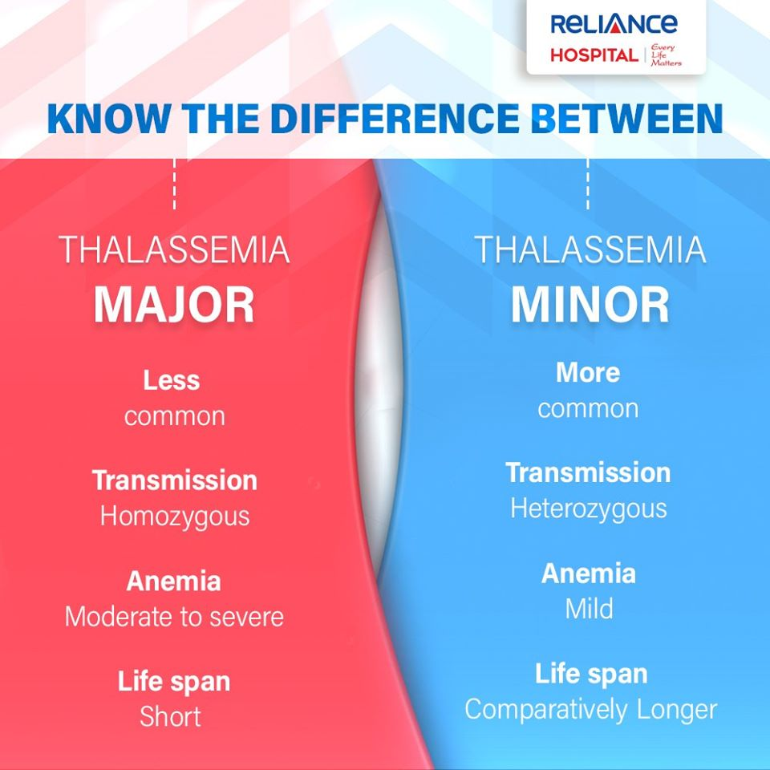

Slide 12
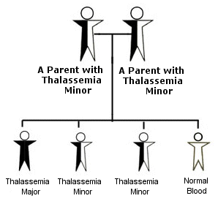

Slide 14
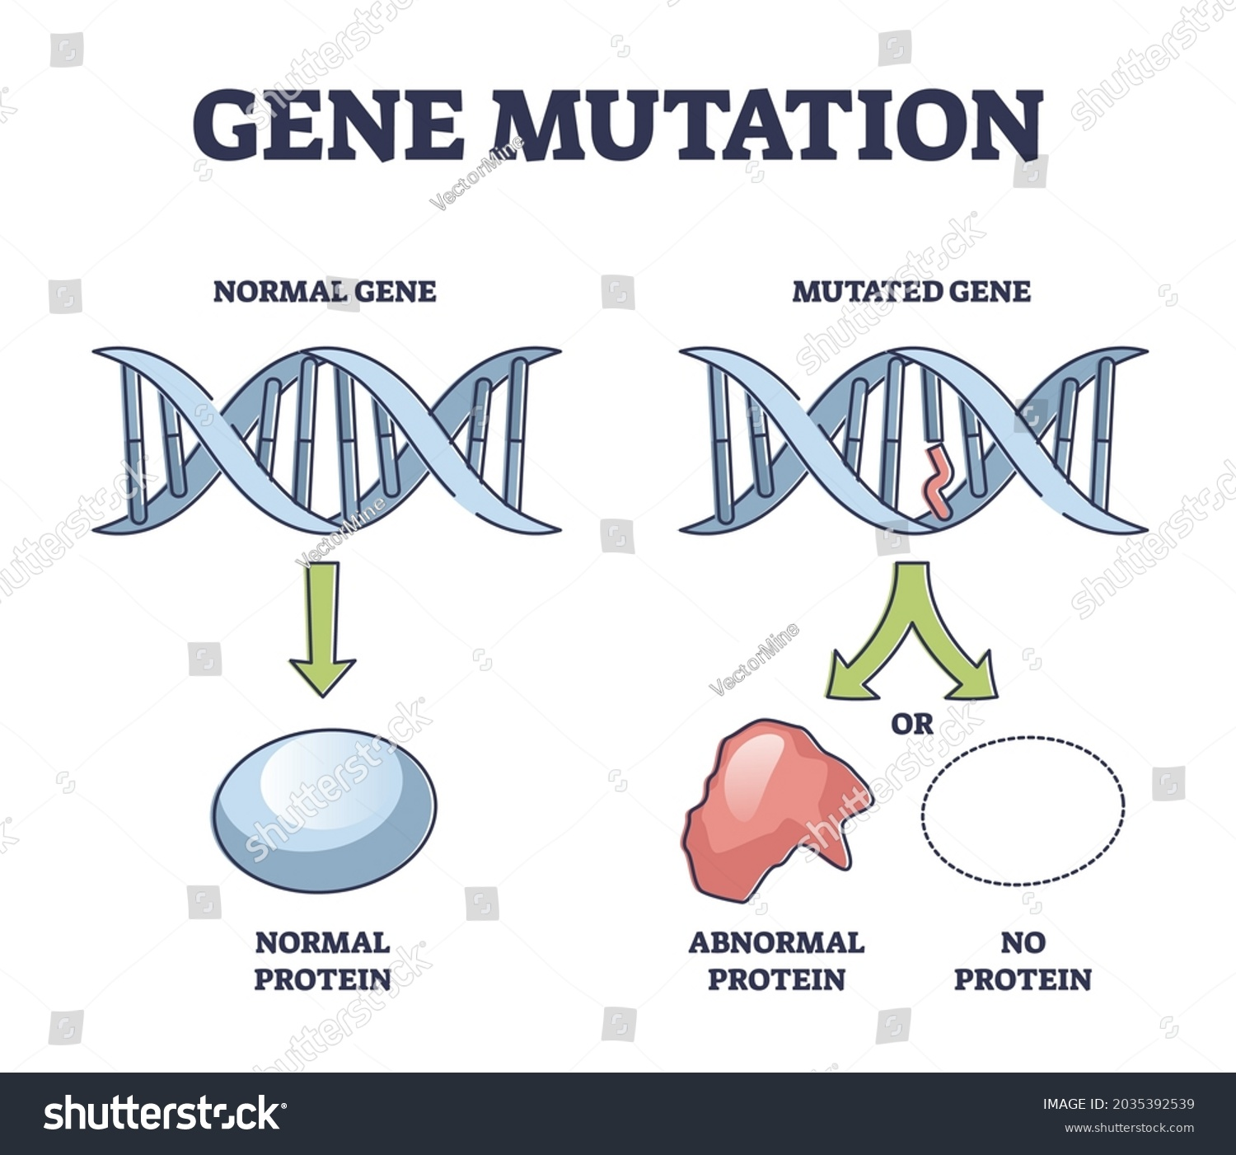
ETIOLOGY
Genetic
Mutation in gene. PATHOGENESiS
The basic defect is the hereditary inability to synthesis globin polypeptide chain (alpha or beta) which results in ineffective erythropoiesis and hemolysis(breakdown of RBC)due to immature, thin rbcs with short life span.

Slide 15
Alpha chain synthesis is reduced due to deletion gene(loss of one or two neuclotides from DNA chain) which reduces the level of all three normal hemoglobin A, A₂, and F and causing alpha-thalassemia. Beta- thalassemia is usually caused by point mutations rather than large deletions. Features of thalassemia usually develop after 6 months of age, Beta thalassemia is the most common than other types.

Slide 16


Slide 17
PATHOPHYSIOLOGY
Due to etiological factor
Disturbance of ratio between the alpha and beta globin chain synthesis.
Decrease production of one or more globin chain.
Formation of abnormal hb structure.
Ineffective erythropoiesis
Excessive RBC destruction.
Iron overload.
Extramedullary hematopoiesis.
Thalassemia.

Slide 18
CLINICAL MANIFESTATION
Inadequate structure of RBC
Decrease life span of RBC
Anemia
Weakness
Exercise intolerance
Headache
anorexia
Precordial pain

Slide 19
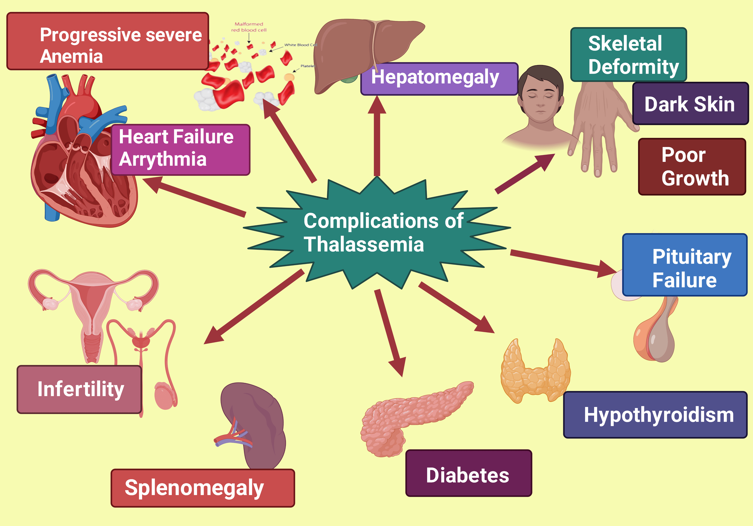
SYMPTOMS

Slide 20
CLINICAL MANIFESTATION
Rapid hemolysis(breakdown of RBCs) affects almost all organs and systems of the body in the following manner:
Skin: excessive iron released from rapid hemolysis deposits under the skin causing greenish-brown or bronze discoloration of skin.
Heart: hemochromatosis(too much iron in the body) causes fibrotic changes in myocardium which may lead to development of cardiac failure.

Slide 21
CLINICAL MANIFESTATION
Spleen: due to rapid destruction of rbcs splenomegaly occurs. Splenomegaly causes abdominal distension and interferes with respiration and functioning of other abdominal organs.Hemochromatosis leads to fibrotic changes in spleen.
Liver: hemochromatosis leads to fibrosis of liver cells, which progresses to liver cirrhosis.

Slide 22
CLINICAL MANIFESTATION
Pancreas: hemochromatosis leads to fibrosis of pancreas, leading to possible insulin dependent diabetes mellitus.
Endocrine system: chronic anemia results in delayed or absent sexual maturation. Secondary sex characters rarely develop at puberty because of endocrinal abnormalities.

Slide 23
DIAGNOSTIC EVALUATION
Hemoglobin estimation: hemoglobin level is reduced it is usually between 2-6 g/dl.
Complete blood count:
Total erythrocyte count is low, usually in the range of 2-3 million/mm³
Hematocrit is reduced.
Mcv, mch, and mchc are low.
].

Slide 24
DIAGNOSTIC EVALUATION
Reticulocyte count is elevated.
Wbc count reveals mild leukocytosis(increaselevel of WBCs).
Thrombocyte count reveals thrombocytosis.
Peripheral blood smear(in this find large no. of immature RBCs).
RBCs show hypochromia(less color of RBCs), anisocytosis(defferent size of RBCs), and poikilocytosis(abnormal RBCS).
Microcytes and macrocytes are present.

Slide 25
DIAGNOSTIC EVALUATION
Immature wbcs like myelocytes and metamyelo cytes may be present.
Bone marrow examination: bone marrow is hypercellular with erythroid hyperplasia (immature RBCs in bone marrow)is present.
Serum bilirubin: it is moderately elevated between 1-3 mg/dl due to increased hemolysis.

Slide 26
DIAGNOSTIC EVALUATION
Serum iron: serum iron levels are high as a result of increased absorption and ineffective utilization of iron and continuous hemolysis of red cells leading to release of iron.

Slide 27
MANAGEMENT
Repeated Blood Transfusion
It is given at regular interval to maintain the hemoglobin level at least 10 to 11 gm/dl. Interval and amount of blood transfusion depends upon the level of hemoglobin of the child. Usually 10-15 ml/kg every 2-3 weeks washed packed rbcs are transfused. Special precautions to be taken during transfusion to prevent complications. Transfusion related infections can be prevented by specific protection with immunizing agents.

Slide 28
Iron Chelation Therapy
Rapid hemolysis and repeated blood transfusions result in iron overload which causes hemochromatosis (too much iron in bodyand hemosiderosis(excessive accumulation of iron in tissue). Each unit of transfused blood provides 200 mg of elemental iron. This excessive iron deposits in various organs leading to multiple organ failure. Chelation therapy is used to excrete excessive iron in urine . The iron status of child should be monitored by repeated serum ferritin measurement. Desferrioxamine is available as iron-chelating agent that may be given by parenteral route. It should be given subcutaneously in dose of 40-60 mg/kg/day over a period of 8-12 hours. Chelation therapy should be started by 10th-15th transfusion.

Slide 29
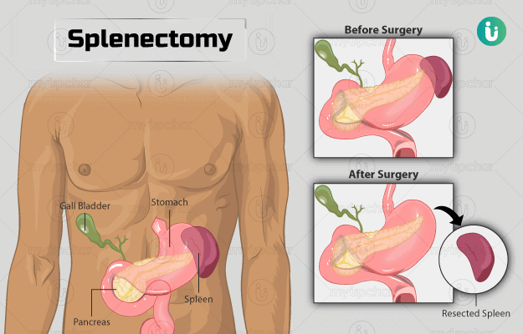
Splenectomy
Splenectomy is indicated when the child need very frequent blood transfusion and develop hypersplenism or big spleen causing discomfort.

Slide 30
Folic Acid Supplementation
Folic acid supplementation are recommended whereas iron therapy and dietary iron should be avoided to prevent more iron deposition.

Slide 31
Supportive Management
Supportive management is important to manage associated problems and to treat complications (like CCF, hepatic failure). Vaccination with hepatitis 'B' to be given to prevent transfusion related infection along with other routine immunization. Emotional support is very essential to the parents and child. Basic supportive nursing care are very important to prevent various complications.

Slide 32
Bone Marrow Transplantation
Bone marrow transplantation is a effective treatment modality with potential of curing thalassemia. Defective stem cells are replaced by normal stem cells. It is extremely expensive and possible in only very selective cases.

Slide 33
New Approaches
New approaches in the management of thalassemia are gene therapy and gene manipulation. In this defective gene are change by normal gene.

Slide 34
NURSING MANAGEMENT
The nurse's role in care of children with thalassemia include:
Early assessment: The nurse who takes history of an infant or child, should become alert to identify the sign and symptoms of the disease so that early diagnosis of the disease can be made.
Preparation of child for diagnostic procedures: The nurse should counsel the parents and the child so that they are well prepared for laboratory tests.

Slide 35
Care during blood transfusion:
Role of nurse during blood transfusion includes the following:
Blood grouping and cross matching should be ensured before transfusing the blood.
The blood should be screened for blood-borne diseases like hepatitis b, hepatitis c, hiv, malaria, cytomegalovirus, etc. So as to reduce the risk of transmission of these infections to the child. Routine donor screening for these infections is essential.

Slide 36
Observe the patient for transfusion reactions causing chills, itching, rash, headache, and back pain. In case transfusion reaction occurs, stop the transfusion and immediately inform the physician.
Always prewarm the blood before administration.
Monitor vital signs during blood transfusion. Infuse the blood slowly to prevent circulatory overload.
Observe the child for early signs of circulatory overload like dyspnea and distended neck vein.
Follow strict aseptic techniques during the procedure.

Slide 37
Administration of chelation therapy:
The nurse must tell the parents about the need to excrete excessive iron and goal of chelation therapy.
Parents must be warned that because the chelating agent binds with excessive iron and is then excreted in urine, the urine of child will become orange in color.
Parents should be told to provide low-iron diet to the child. Food items like spinach, apple, brinjal, grams,
Jigger, etc. Should not be given to the child. Vitamin C should be avoided (e.G., Citrus fruits) as they increase iron absorption from diet.

Slide 38
Prevention of infection: It is important that the nurse not only observes these children for evidence of infection but also teach the parents about recognizing the signs of infection so that appropriate management can be done.
Strict aseptic techniques should be followed while blood transfusion, administration of chelation therapy, and collection of specimens, because the child repeatedly undergoes these invasive procedures and chances of infection are very high.

Slide 39
Education and support of parents and child:
The parents of children with thalassemia may have guilt feeling. The nurse can help them by exploring their feelings.
The nurse must help the parents to understand the cause of disease and how they can help their child in leading a normal life.
Parents must be counselled and referred to appropriate community agency from where they can get the needed help.
.

Slide 40
SUMMARY
Thalassemia is an inherited (i.E., Passed from parents to children through genes) blood disorder caused when the body doesn't make enough of a protein called hemoglobin, an important part of red blood cells.It is characterized by decrease life span of rbcs,inadequate structure of rbcs etc.

Slide 41
REFERENCES
1.Datta parul.pediatric nursing:2nd edition.4838/24 ansari road ,daryaganj,New delhi-110002,India:jaypee brothers;2009.P 342-345.
2.Hinkle L. janice, cheever H. kerry:medical surgical nursing.13th edition.volume 1st.new delhi,India:wolters kluwer;2016.P 915-917.
3.CDC. What is thalassemia? [Internet]. Centers for Disease Control and Prevention. 2023 [cited 2023 Jun 7]. Available from: https://www.cdc.gov/ncbddd/thalassemia/facts.html
4.Sharma rimple.essentials of pediatric nursing.3rd edition.EMCA House,23/23-B ansari road,daryaganj new Delhi 110002,India:jaypee brothers;2021.P 261-265.
5.Sharma rimple.essentials of pediatric nursing.2rd edition.EMCA House,23/23-B ansari road,daryaganj new Delhi 110002,India:jaypee brothers;2017.P 442-44
6.Olivieri NF, Weatherall DJ. Thalassemias. In: Pediatric Hematology. Oxford, UK: Blackwell Publishing Ltd; 2007. p. 281–301.

