Slide 1
SUBINVOLUTION, BREAST CONDITIONS OF PUERPERIUM AND THROMBOPHLEBITIS
PRESENTED BY:
MRS. PREETI BAHUGUNA

Slide 2
PUERPERIUM
Puerperium is defined as the period following child birth during which the body tissues, especially pelvic organs ,revert approximately to the pre-pregnant state both automatically &physiologically.

Slide 3
COMPLICATIONS DURING PUERPERIUM

Slide 4
SUBINVOLUTION
DEFINITION : when involution is impaired or retarded it is called sub involution. Uterus is most common organ affected in sub involution.

Slide 5
PREDISPOSING FACTORS
Grand multipara
Over distention of uterus
Maternal ill health
Caesarean section
Prolapse of uterus
Uterine fibroid

Slide 6
Aggravating factors
Retained placental tissues.
Oxytocin level.
Activity level.

Slide 7
SIGN AND SYMPTOMS
Uterine height is greater than normal
Abnormal lochial discharge
Irregular uterine bleeding
Irregular cramps

Slide 8
MANAGEMENT
Antibiotics in Endometritis
Exploration of uterus in retained products
Pessary in prolapse or retroversion
Early ambulation
Provide nutritious diet
Methergin

Slide 9
BREAST COMPLICATIONS
INTRODUCTION:
The common breast complications in post partum period are breast engorgement, cracked and retracted nipple, mastitis, breast abscess and failing lactation.

Slide 10
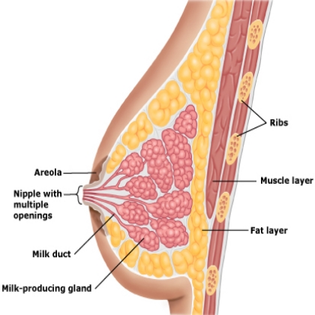

Slide 11
BREAST ENGORGEMENT
During the first week postpartum ,whether the mother breastfeeding or not ,the breast milk come in & the breast will engorge and the may become bigger , tender and hard.

Slide 12
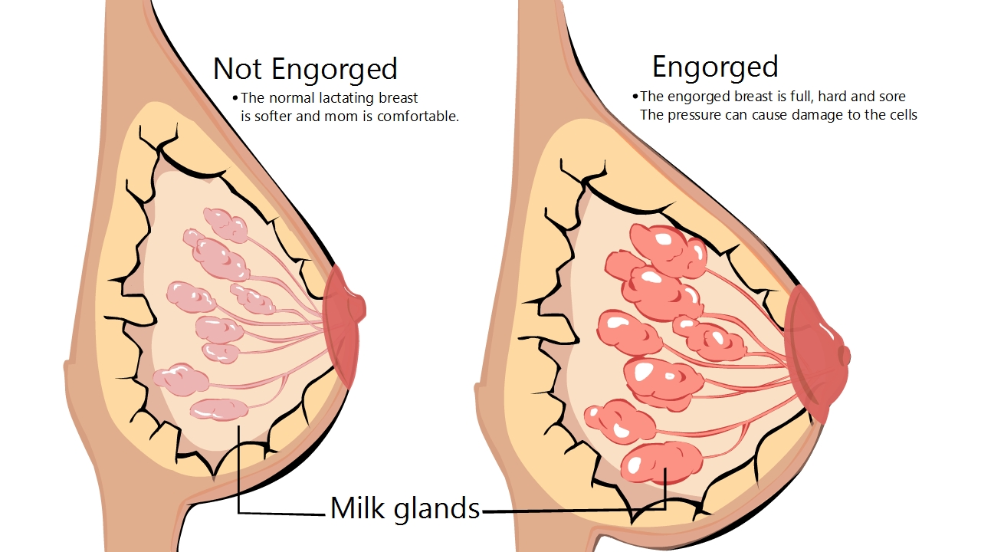

Slide 13
Causes
Starting breast feeding too late.
Not giving enough feed to baby.
SIGN AND SYMPTOMS
BOTH BREAST ARE:
Swollen
Warm
Tender
Shiny and firm
Painful breast

Slide 14
2)NIPPLES BECOME:
Edematous
Hard areola
Flushed
Flattened out nipples
3)VEINS OVER BREAST:
Prominent

Slide 15
4) Low grade fever
5)Generalized malaise
6)Swollen and tender lymph nodes
7)Pain on feeding

Slide 16
MANAGEMENT
BEFORE BREASTFEEDING
Gentle breast massage from the chest wall the nipple area before nursing.
Cool compression.
Moist warm bath before breastfeeding .
If the baby is having difficulty laching due to engorgement due to engorgement than following things should be done:

Slide 17
Hand expression
Reverse pressure softening.

Slide 18
While Breastfeeding
Gentle breast compression and breast massage.
Feed your baby frequently.
For severe pain take acetaminophen .

Slide 19
Other treatment
Apply cabbage leaf
Fenugreek seed poultice.

Slide 20
BREAST INFECTION
MASTITIS: it is an infection of milk ducts of breast tissue . It occurs most frequently during the time of breast feeding by cross infection from baby to mother.
CAUSATIVE ORGANISM: staphylococcus aureus.

Slide 21
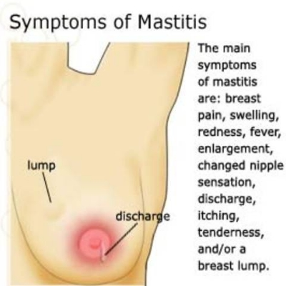

Slide 22
Clinical manifestations
Fever
Headache
Malaise
Pain and swelling in breast
Redness and fatigue
Tenderness in breast

Slide 23
MODE OF INFECTION
Two types depending upon the site of infection:
Infection that involves the breast parenchymal tissues leading to cellulitis.
Infection gains access through the lactiferous ducts leading to development of primary mammary adenitis.

Slide 24
Non –infectious mastitis may be due to milk stasis. Breast feeding solves the problem.
ONSET: in superficial cellulitis the onset is acute during first 2-4 weeks postpartum.
Acute mastitis may occur even several weeks after the delivery.

Slide 25
COMPLICATION
Due to variable destruction of breast tissue it leads to the formation of breast abscess.

Slide 26
Treatment
Antibiotic therapy
Analgesics and sedatives
Bromocriptine

Slide 27
CRACKED AND RETRACTED NIPPLES
DEFINITION: formation of raw area on the nipple or fissure situated at the tip or base of the nipple due to this the nipples become painful.
CAUSES:
Harder sucking of nipple by baby.
Pulling away the mouth of baby without breaking the feeding.
Retracted nipples.
Inadequate breast care

Slide 28
PREVENTION
Prophylaxis includes local cleanliness during pregnancy and in the puerperium before and after each breast feeding to prevent crust formation over the nipples.

Slide 29
TREATMENT
Application of tincture benzoin.
Use antiseptic cream if infected.
Keep nipple clean.
Manually express breast milk if does not heal.
If nipple is retracted pull out the nipple by suction action of disposable syringe.

Slide 30
BREAST ABSCESS
It is the formation of abscess in the breast. The main features are :
Flushed breasts not responding to the antibiotics promptly.
Brawny edema of overlying skin.
Marked tenderness.
Swinging temperature.

Slide 31
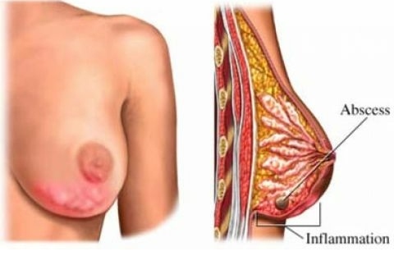

Slide 32
Signs are:
breast pain.
Infection.
mastitis.
nipple trauma.

Slide 33
MANAGEMENT
SYMPTOMATIC MANAGEMENT:
Appropriate nursing technique.
Positioning
Use of miconazole lotion or gel

Slide 34
SURGICAL MANAGEMENT:
Abscess is to be drained under general anesthesia by deep radial incision.
The abscess can also be drained by serial percutaneous needle aspiration under ultrasound guidance.

Slide 35
LACTATION FAILURE
It is also called as inadequate milk production.
CAUSES:
Infrequent suckling
Depression or anxiety
Ill development of nipples
Painful breast lesions
Prolactin inhibition

Slide 36
MANAGEMENT
ANTENATAL:
To counsel the mother regarding the advantages of nursing her baby with breast milk.
To take care of any breast abnormality specially a retracted nipple and to maintain adequate breast hygiene specially in the last two months of pregnancy.

Slide 37
PUERPERIUM:
To encourage adequate fluid intake.
To nurse the baby regularly
Metoclopramide, intranasal oxytocin and sulpride have been found to increase milk production.
Metoclopramide given in a dose of 10 mg thrice daily is found helpful.

Slide 38
PUERPERAL VENOUS THROMBOSIS
Introduction : it is the thrombosis of the deep vein calf, thigh or pelvis, clot formation in the absence of infection. Deep vein thrombosis is usually manifested during the first 2 weeks after delivery. Thrombosis of leg vein and pelvic veins are one of the common and important complication.

Slide 39
RISK FACTORS
Vascular stasis.
Hyper coagulability of blood.
Vascular endothelial trauma.

Slide 40
Other risk factors
Advanced age and parity.
Operative delivery.
Obesity.
Heart disease.
Trauma to venous wall.
Immobility.
Smoking and prior DVT.

Slide 41
Venous thrombus-embolic disease include
DEEP VEIN THROMBOSIS
THROMBOPHLEBITIS
PULMONARY EMBOLISM

Slide 42
DEEP VEIN THROMBOSIS
Deep vein thrombosis is the formation of blood clots in the deep veins, most commonly the legs.
SYMPTOMS:
Pain in calf muscles.
Leg edema.
Rise in skin temperature.
On examination asymmetric legs.
Positive Homan’s sign.

Slide 43
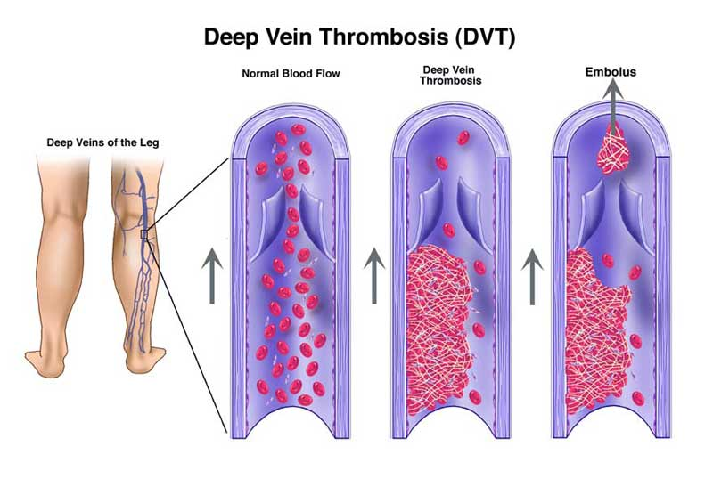

Slide 44
INVESTIGATIONS
Doppler ultrasound.
Venography.
Magnetic resonance imaging (MRI)

Slide 45
THROMBOPHLEBITIS
Postpartum thrombophlebitis originates in the thrombosed vein at the placental site by organisms such as anaerobic streptococci or becteroids when localised in the pelvis it is called pelvic thrombophlebitis.

Slide 46
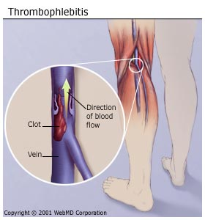

Slide 47
Extra pelvic spread
Through the right ovarian vein into inferior vena cava and thence to the lungs.
Through the left ovarian vein to the left renal vein and then to the left kidney.
Retrograde extension to ilio femoral veins to produce the cliniopathological entity of “phlegmasia alba dolens” or white leg.

Slide 48
CLINICAL FEATURES
Mild pyrexia.
Chills.
Rigor.
Constitutional disturbances.
Swollen and painful leg.

Slide 49
INVESTIGATIONS
Doppler ultrasound.
Venography.
Magnetic resonance imaging (MRI)

Slide 50
PREVENTIVE MEASURES
Prevention of trauma, sepsis, anemia in pregnancy and labour.
Dehydration during pregnancy should be avoided.
Use elastic compression stocking.
Leg exercises, early ambulation are encouraged.

Slide 51
MANAGEMENT
Bed rest with elevated legs.
Analgesics.
Antibiotic.
Anticoagulants
Vanacava fillers.
Fibrinolytic agents.
Venous thrombectomy.

Slide 52
RESEARCH ARTICLE
Liji. John, et all (2015) conducted a study to assess the knowledge of antenatal mothers regarding breast feeding problems and create awareness of breast problems. In this study non-experimental descriptive design was adopted. Data collected from 100 postnatal mothersattending OPD of MCH mangluru.

Slide 53
Result: it revealed that majority of antenatal mothers had inadequate knowledge(76%). 23% had average knowledge and 1% had adequate knowledge regarding breast problems.

Slide 54
Summary
Today we have discuss about subinvolution, brest conditions of puerperium, thrombophlebitis and its management in which we discussed about:
Introduction
Definition
Sign and symptoms
Treatment & management

Slide 55
Conclusion
Postnatal period is the most crucial period during which the mother face many discomfort . If the mother has the knowledge of these minor disorders and their measures she can manage the problem very easily.

Slide 56
BIBLIOGRAPHY
Jacob annama .A comprehensive textbook of midwifery and gynecological nursing .7th Edition.New delhi:jaypee brother publisher.p.55-9.
Dutta D.C. Text book of obstretics . Sixth edition . New delhi: new central book agency;2004.P.432-443.
WWW.the free dictinary .com.
Http/www.netplaces.com.

