Slide 1
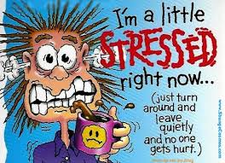
Motivation, Emotion & Stress: Stress & Health
Designated Unit:
Unit II
The Biological Bases

Slide 2
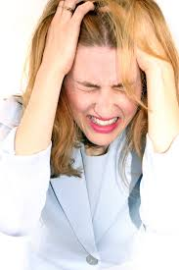
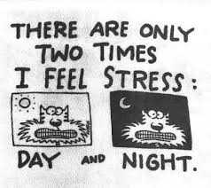
Stress & Health:
The Basics
Part one

Slide 3
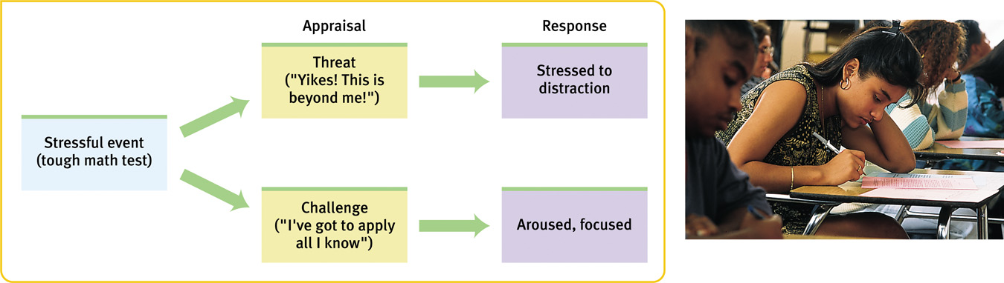
Stress & Health: The Basics
Stress
  The process by which we perceive & respond to certain events (known as stressors) that we appraise as threatening and/or challenging
    Stress is not…
      A simple stimulus or response
      Necessarily a negative thing

Slide 4
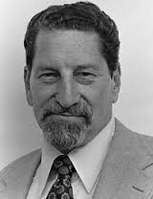
Stress & Health: The Basics
Richard Lazarus (1991)
  Cognitive Appraisal Approach
    Primary Appraisal
      An initial evaluation of whether
      an event is…
        (1) irrelevant to you
        (2) relevant but not threatening
        (3) stressful
    Secondary Appraisal
      An evaluation of your coping
      resources & options for dealing with the stressor
    Other factors?

Slide 5
Stress & Health: The Basics
Two major classifications of stress…
  Acute Stressors
    Relatively short in duration with a clear endpoint
      An encounter with a belligerent customer
      A major exam
      An impending natural disaster
  Chronic Stressors
    Relatively long in duration with no apparent endpoint
      Persistent financial strains
      A sick family member
      A hostile boss

Slide 6
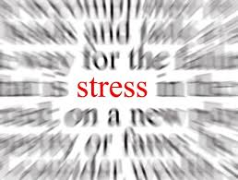
Stress & Health:
Types of Stress
Part two

Slide 7
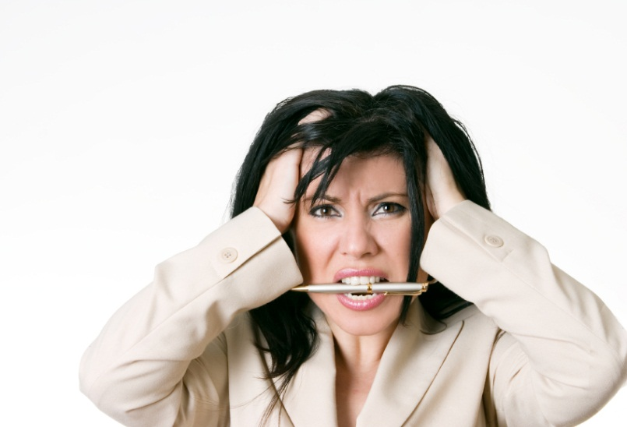
Stress & Health: Types of Stress
Frustration
  Occurs in any situation in which the pursuit of some goal is thwarted
    Insignificant (in terms of
    stress)
      Traffic jam/difficult
      commute
      Broken air conditioner
    Significant (in terms of stress)
      Failure and/or loss

Slide 8
Stress & Health: Types of Stress
Conflict
  Occurs when two (or more) incompatible motivations or behavioral impulses compete for expression
    Approach-Approach Conflict
      A choice must be made between two attractive goals
    Avoidance-Avoidance Conflict
      A choice must be made between two unattractive goals
    Approach-Avoidance Conflict
      A choice must be made about whether to pursue a single goal that has both attractive & unattractive aspects
        Often produce vacillation…

Slide 9
Stress & Health: Types of Stress
Life Changes
  Any significant alterations to one’s circumstances that require readjustment
    Social Readjustment Rating Scale (Holmes & Rahe, 1967)
      Death of a spouse (100)
      Divorce (73)
      Marital Separation (65)
      Jail Term (63)
      Death of a close family member (63)
      Personal injury or illness (53)
      Marriage (50)

Slide 10
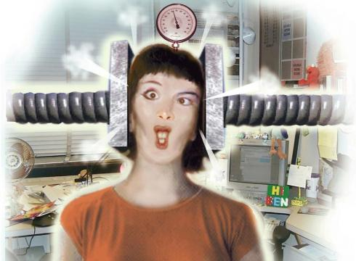
Stress & Health: Types of Stress
Pressure
  Involves expectations or demands that one behave in a certain way
    Salespeople
    Professors
    Stand-up comedians
    Suburban homeowners
    Teenagers

Slide 11
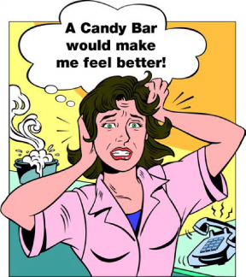
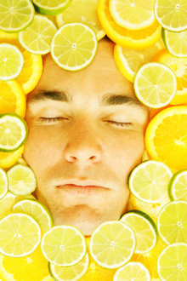
Stress & Health:
Stress Responses
Part three

Slide 12
Stress & Health: Stress Responses
Emotional Responses
  Dependent on the stimulus (and one’s personality)…
    Common responses to stress typically occur along three dimensions of emotion
      (1) Annoyance, anger, rage
      (2) Apprehension, anxiety, fear
      (3) Dejection, sadness, grief
    Positive emotions?
  Yerkes-Dodson Law
    Asserts that there is an optimal level of emotional arousal for any given task (i.e. coping with stress)

Slide 13
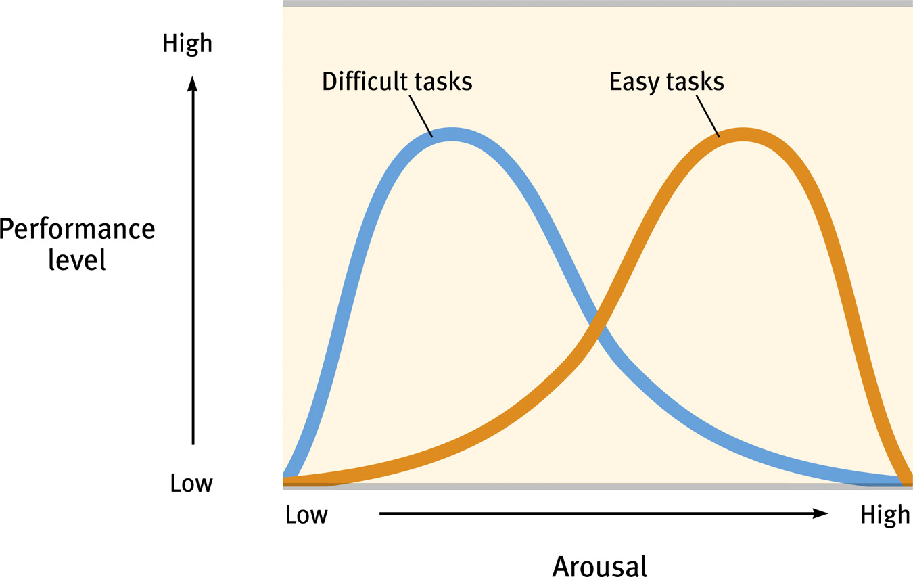

Slide 14
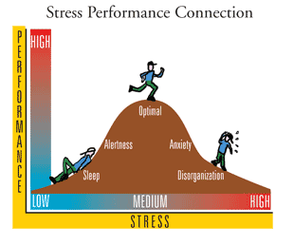

Slide 15
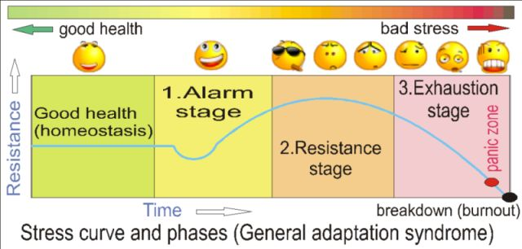
Stress & Health: Types of Stress
Physiological Responses
  Selye’s General Adaptation Syndrome
    A model of the body’s stress response, consisting of three separate stages
      Alarm
      Resistance
      Exhaustion
  Fight-or-Flight
  Response

Slide 16
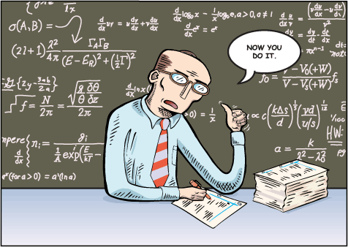
Stress & Health: Types of Stress
Behavioral Responses
  Most behavioral responses to stress involve coping
    Active efforts to master, reduce or tolerate the demands created by stress; can be helpful or maladaptive
  Coping Mechanisms
    Learned helplessness
    Self-blame
    Aggression
    Catharsis
    Self-indulgence
    Defense mechanisms

Slide 17
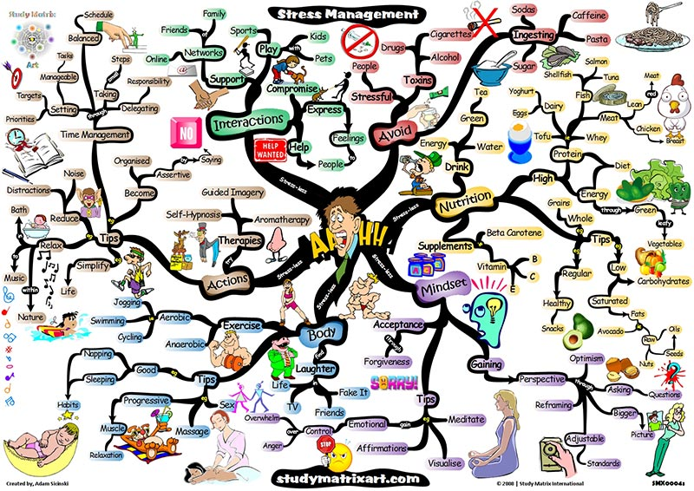
Stress & Health: Types of Stress
Constructive Coping
  Healthy efforts to deal
  with stressful events
    How?
      Direct confrontation of
      the problem
      Realistic appraisal of
      the stress & coping
      resources
      Learning to recognize, and in some cases regulate, potentially disruptive emotional reactions to stress

Slide 18
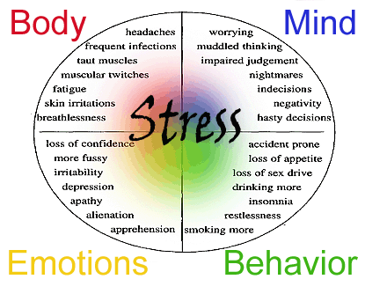
Stress & Health:
Effects of Stress
Part four

Slide 19
Stress & Health: Effects of Stress
Psychological Effects
  Burnout
    Physical & emotional exhaustion, as well as cynicism and a lowered sense of self-efficacy
    Generally brought on by work-related stress
  Psychological problems & disorders
    Poor academic performance, sleep disturbances, sexual difficulties, alcohol & drug abuse, etc.
  Positive effects?
    Resilience
      Successful adaptation to significant stress & trauma

Slide 20
Stress & Health: Effects of Stress
Physical Effects
  Heart disease
    Specifically coronary heart disease (90% of heart related deaths)
    Emotional reactions & depression also linked to heart disease
  Immune functioning
    Reduced immune activity
      Asthma, cancer, chronic pain, common cold, herpes, IBS, migraine headaches, rheumatoid arthritis, skin disorders, ulcers, etc.

Slide 21
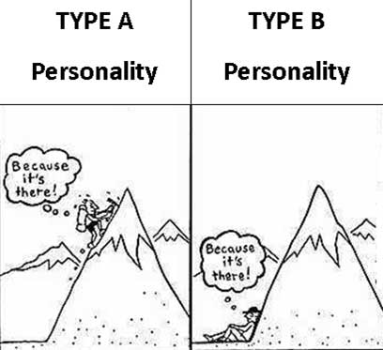
Stress & Health: Personality Factors
Part Five

Slide 22

Stress & Health: Personality Factors
Type A
  General Characteristics
    Competitive & ambitious
    Time urgency & impatience
    Anger & hostility
    Easily annoyed
  In life…
    Tend to be workaholics
    Often successful, but frequently unsatisfied
    Find it very difficult to relax/to do nothing
  More prone to..?

Slide 23

Stress & Health: Personality Factors
Type B
  General Characteristics
    Less competitive & driven
    Easygoing & slow to anger
    Relaxed & amicable
    Charismatic

Slide 24
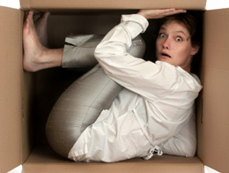
Stress & Health: Personality Factors
Type C
  General Characteristics
    People-pleasers
    Peace-keepers
    Often lonely
    Find it difficult to express emotions, especially negative ones
  More prone to..?

Slide 25

Stress & Health: Personality Factors
Type H (Hardy Personality)
  General Characteristics
    Type A individuals who thrive on stress, rather than succumbing
    to it
    Different from the traditional
    Type A in three key ways…
      Commitment
      Control
      Challenge

Slide 26
Stress & Health: Personality Factors
In conclusion…
  If life gives you lemons…
    Type A people get enraged & throw the lemons back, having a minor heart attack while doing so…
    Type B people gather all of the lemons & make lemonade…
    Type C people don’t say anything, but fume inside where no one can see…
    Type H people gather the lemons, make lemonade, sell it, turn it into a franchise business & make millions…

