Slide 1
SPINA BIFIDA

Slide 2
DEFINITION
Spina bifida is “a malformation of spine, in which posterior portion of lamina of vertebra fail to close with or without defective development of spinal cord.”

Slide 3
ETIOLOGY
Genetic
Maternal age
Environmental
Diet

Slide 4
CLASSIFICATION

Slide 5
SPINA BIFIDA
SPINA BIFIDA OCCULTA
SPINA BIFIDA CYSTICA
MYELOMENINGOCELE
MENINGOCELE

Slide 6
SPINA BIFIDA OCCULTA
Results from failure of formation of bony arch around the spinal cord.
But spinal cord and meninges are normal
Asymptomatic

Slide 7
SPINA BIFIDA CYSTICA
Defect in the closure of posterior vertebral arch with protrusion of spinal cord and meninges through the defect.

Slide 8
SPINA BIFIDA CYSTICA (continued)
Consists of the development of a cystic mass in the midline of the spine.

Slide 9
MENINGOCELE TERMINOLOGY
Meningo= membrane
Cele = tumor

Slide 10
MENINGOCELE
Sac like herniation through the bony malformation, containing meninges and CSF.
May be thin and translucent or membranous.

Slide 11
MYELOMENINGOCELE
Sac like protrusion of spinal cord, CSF and meninges through spinal cleft.

Slide 12
CLINICAL FEATURES (Spina Bifida Occulta)
Asymptomatic
Dimple in the skin or growth of hair over malformed vertebra
He may develop foot weakness

Slide 13
CLINICAL FEATURES (Spina Bifida Occulta)
Disturbances of bladder and bowel sphincter

Slide 14
CLINICAL FEATURES (Spina Bifida Cystica) - Meningocele
Sac is composed only of meninges and is filled with CSF.
Spinal cord and nerves are normal.
Weakness of legs or lack of sphincter control.

Slide 15
CLINICAL FEATURES (Spina Bifida Cystica) - Myelomeningocele
Sac is composed only of meninges and is filled with CSF.
Spinal cord and nerves are normal.
Weakness of legs or lack of sphincter control.

Slide 16
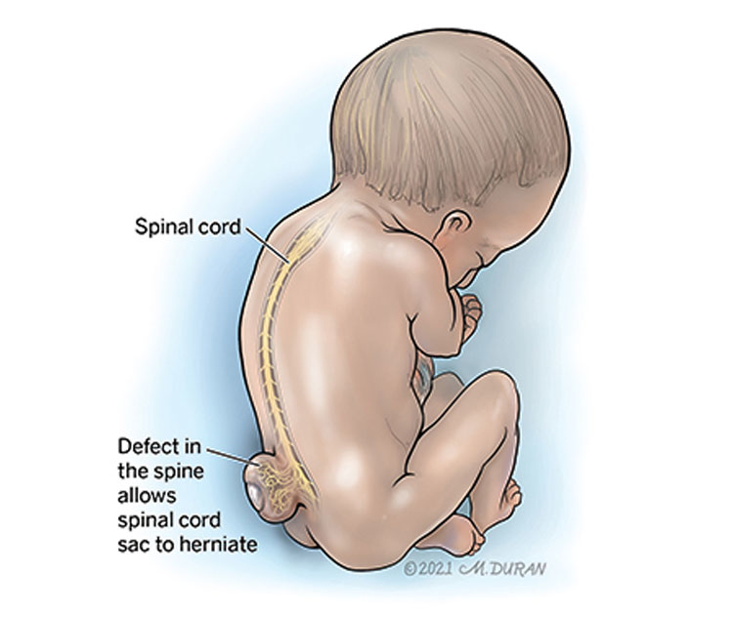

Slide 17
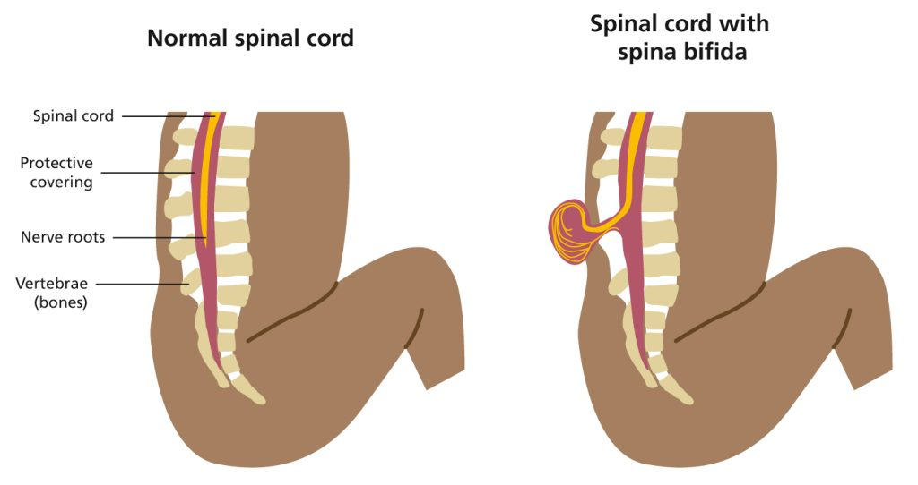

Slide 18
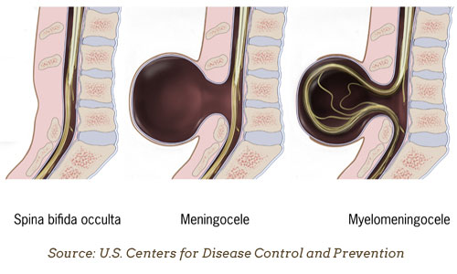

Slide 19
SPINA BIFIDA
Often undetected and occurs most commonly at L5 and S1 levels.

Slide 20
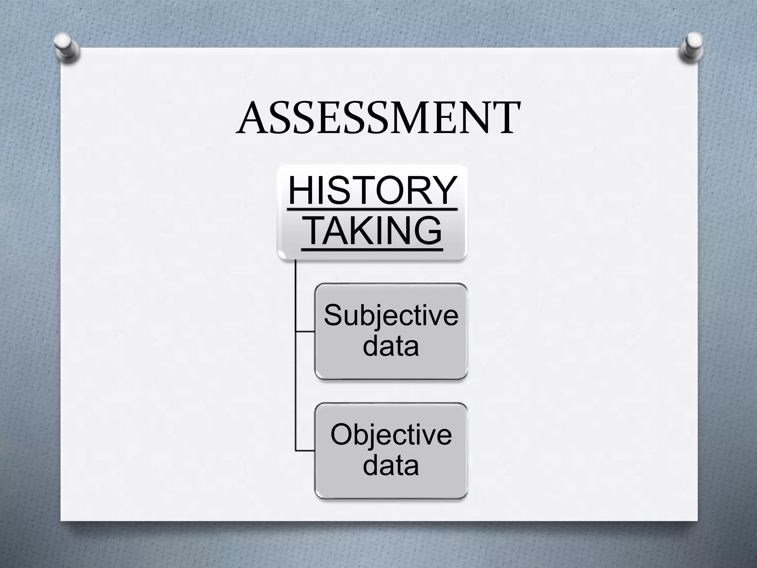

Slide 21
NURSING MANAGEMENT (PRE OPERATIVE CARE NURSING DIAGNOSIS)

Slide 22
1) Risk of impaired skin integrity related to altered motor and sensory functions
Avoid positioning the baby on back to prevent pressure on the sac
Change the position of the baby frequently

Slide 23
Provide meticulous skin and back care to keep the skin clean and dry.
Skin may be massaged periodically to stimulate blood circulation.

Slide 24
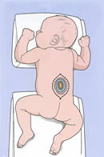
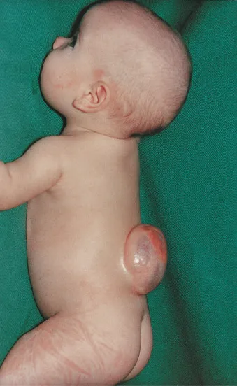

Slide 25
2) Risk of injury and infection to the sac
Do not position the baby on the back
Clean the sac aseptically using NS
Cover the sac with sterile gauze pieces dipped in NS.

Slide 26
Change the wet saline gauze dressings every 2 to 4 hours
Prevent contamination of the sac with urine and feces.
Frequently check the sac for any CSF leakage.

Slide 27
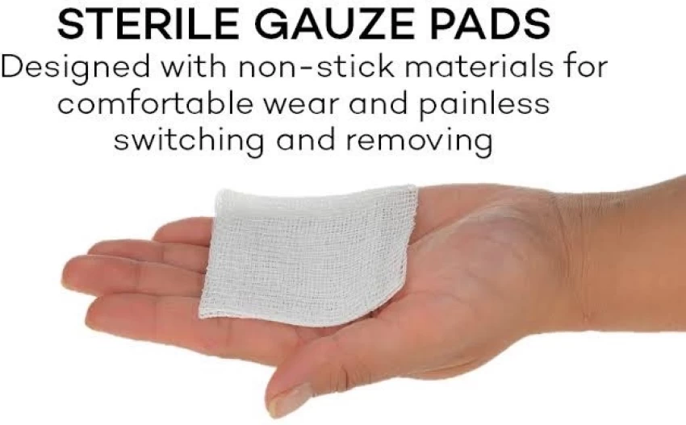

Slide 28
Prophylactic antibiotics must be administered
Keep a pillow behind the back to prevent sudden rolling of infant on the back.

Slide 29
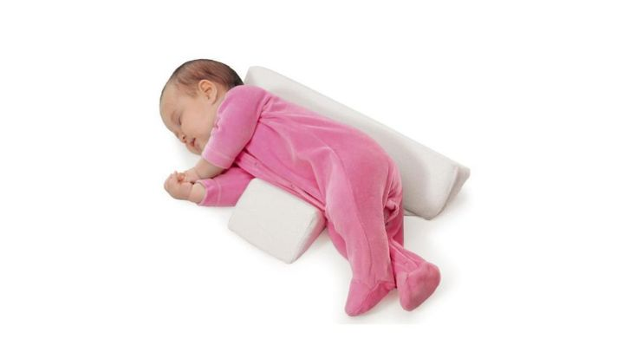

Slide 30
3) Impaired bladder and bowel function related to neurological deficit
Monitor for sign and symptoms of UTI
Pressure is applied gently on the lower abdomen to manually express urine

Slide 31
Intermittent catheterization is done
Provide perineal care to infants
Provide soft and bland food
Administer increased amount of fluids to the child

Slide 32
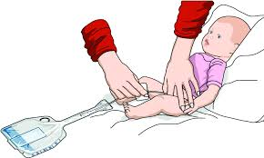

Slide 33


Slide 34

4) Inadequate cerebral tissue perfusion related to complications
Monitor for signs for hydrocephalus
Administer diuretics like mannitol and acetazolamide

Slide 35
NURSING MANAGEMENT (POST OPERATIVE CARE NURSING DIAGNOSIS)

Slide 36
1) Ineffective thermoregulation related to surgery
Monitor the vital signs frequently after surgery
Keep the infant warm, using radiant warmer

Slide 37
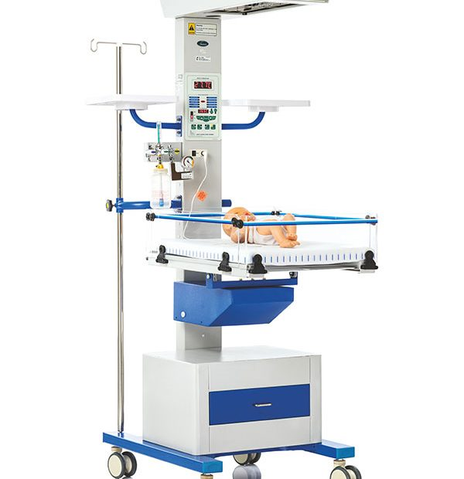
Avoid exposing the child unnecessarily
Maintain thermoneutral environment

Slide 38
2)Risk of development of infection related to surgery
Keep the operated site clean and dry.
Keep the baby in prone position
Dressing of the site should be done
Administer the prescribed antibiotics

Slide 39
3) Imbalanced nutrition less than body requirements related to disease process
Administer IV fluids
Maintain intake and output chart
Begin oral feeds

Slide 40
Feed the infant in side lying position
Baby can be held gently for feeding
Burp the infant frequently between the feeds

Slide 41
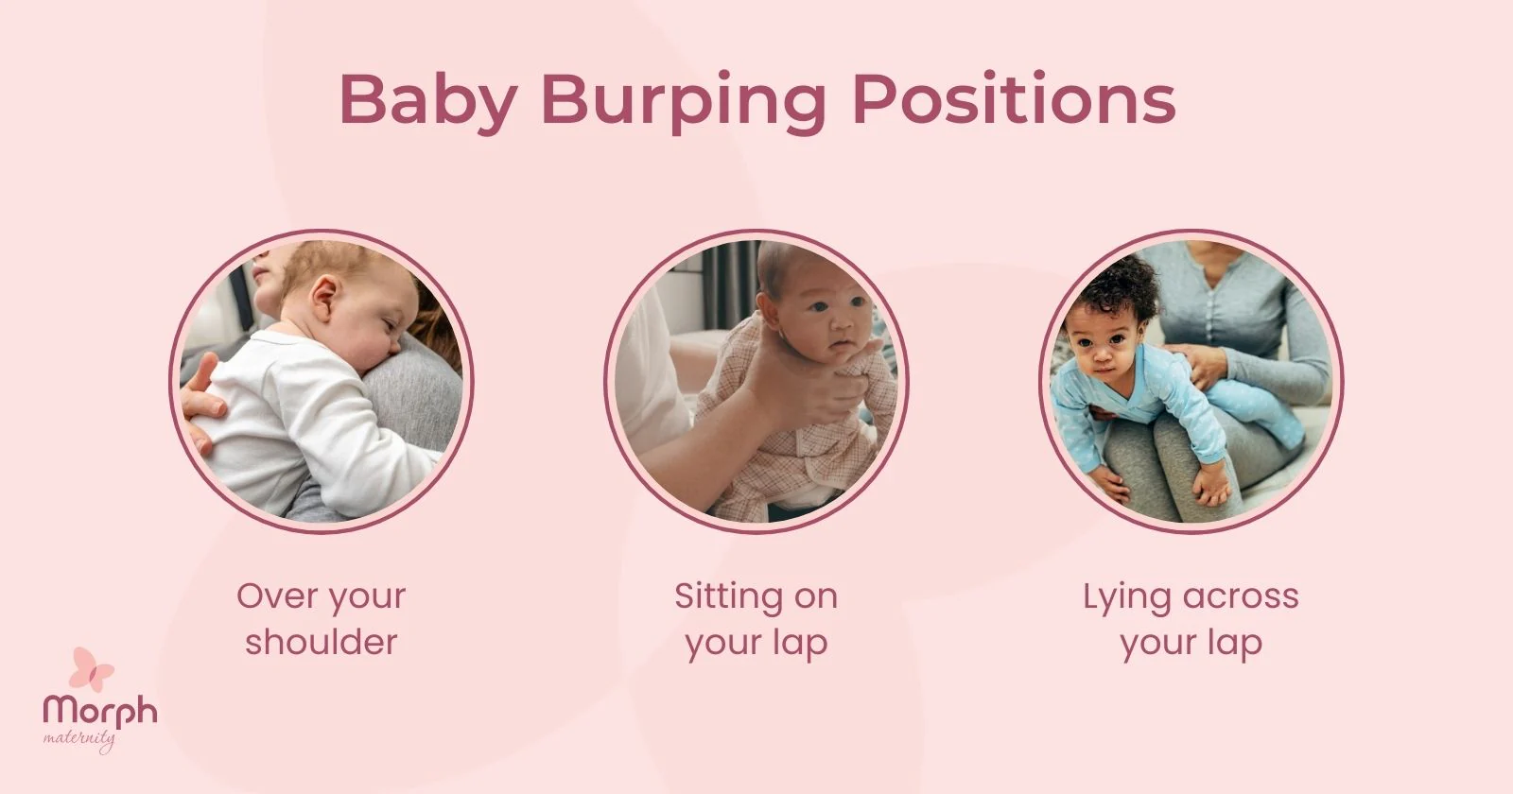

Slide 42
4)Risk of development of complications related to the disease process
Elevate the head end of the bed
Provide passive ROM
Educate the parents regarding surgeries that may needed.

Slide 43
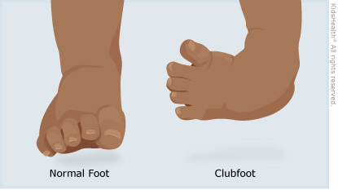
Club foot may be corrected by repeated application of plaster cast
Infant may be placed in Trendelenburg's position

Slide 44
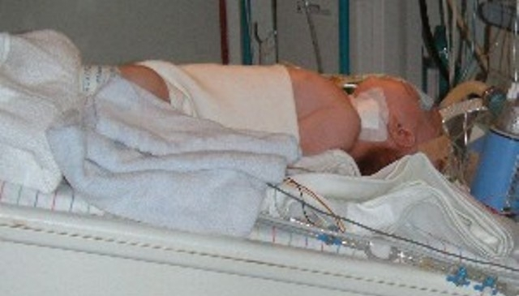

Slide 45
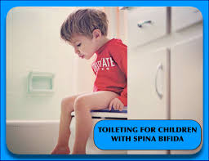

Slide 46
5) Impaired bowel and bladder functions related to neurological deficit
Provide bowel training to the child
Medications such as stool softeners, suppositories and enema
Encourage fluid intake

Slide 47


PREVENTION

Slide 48
Genetic counselling
if severe, therapeutic abortion may be considered
Pregnant women needs 1 mg folic acid per day

Slide 49
