Slide 1
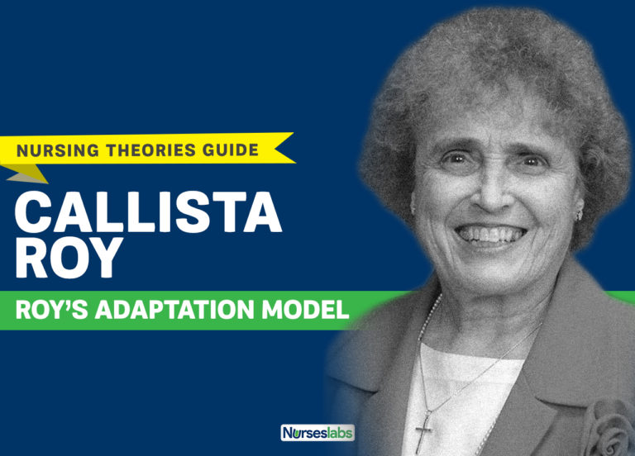
Sister Callista Roy

Slide 2
Objectives
Introduction
Assumption
Concept
Major concept
Model
Process
Strength and weakness
Example
Summary
Reference

Slide 3
Course : M.Sc. Nursing
Subject Name : Advance Nursing Practice
Unit with Title :VI-Philosophy with Nursing theories
Topic : Nursing theories -part 2
Roy Adaptation Model
Prepared by : Prof. Mrs. R.Radha

Slide 4
Introduction
In 1976, sister Callista Roy devloped the Adaptation Model of Hursing, a prominent nursing theroy.
Nursing theroies frame, explain or define the practice of nursing. Roy s model sees the individual a a set of intertrlated sysetms like Biological, psychological,and social.

Slide 5
Introduction
Roy focuses on the concept of adaptation of man. Her concepts of Nursing, the Person, Health and the Environment are all interrelated to this central concept.
Helson's view that adaptation is a process of responding positively to environmental changes was used by Roy as the foundation for the model

Slide 6
Conti…
. This view, combined with Rapoport's definition of a "system" lead to Roy's theory of the person as an adaptive system. The model has been further refined using concepts from other theorists including Hans Selye and Abraham Maslow.

Slide 7
Assumptions
The person is a bio-psycho-social being. The person is in constant interaction with a changing environment.
To cope with a changing world, person uses both innate and acquired mechanisms which are biological, psychological and social in origin.
To respond positively to environmental changes, the person must adapt.
The person has 4 modes of adaptation: physiologic needs, self- concept, role function and inter-dependence.

Slide 8
Major Concepts
Adaptation -- goal of nursing
Person -- adaptive system
Environment -- stimuli
Health -- outcome of adaptation
Nursing- promoting adaptation and health

Slide 9
Adaptation
Responding positively to environmental changes.
The process and outcome of individuals and groups who use conscious awareness, self reflection and choice to create human and environmental integration

Slide 10
Person
Bio-psycho-social being in constant interaction with a changing environment
Uses innate and acquired mechanisms to adapt
Includes people as individuals or in groups-families, organizations, communities, and society as a whole.

Slide 11
Environment
Focal - internal or external and immediately confronting the person
Contextual- all stimuli present in the situation that contribute to effect of focal stimulus
Residual-a factor whose effects in the current situation are unclear

Slide 12
Conti…
All conditions, circumstances, and influences surrounding and affecting the development and behavior of persons and groups with particular consideration of mutuality of person and earth resources, including focal, contextual and residual stimuli

Slide 13
Health
Represented by a health-illness continuum
A state and a process of being and becoming integrated and whole

Slide 14
Nursing
To promote adaptation for individuals and groups in the four adaptive modes, thus contributing to health, quality of life, and dying with dignity by assessing behaviors and factors that influence adaptive abilities and by intervening to enhance environmental interactions

Slide 15
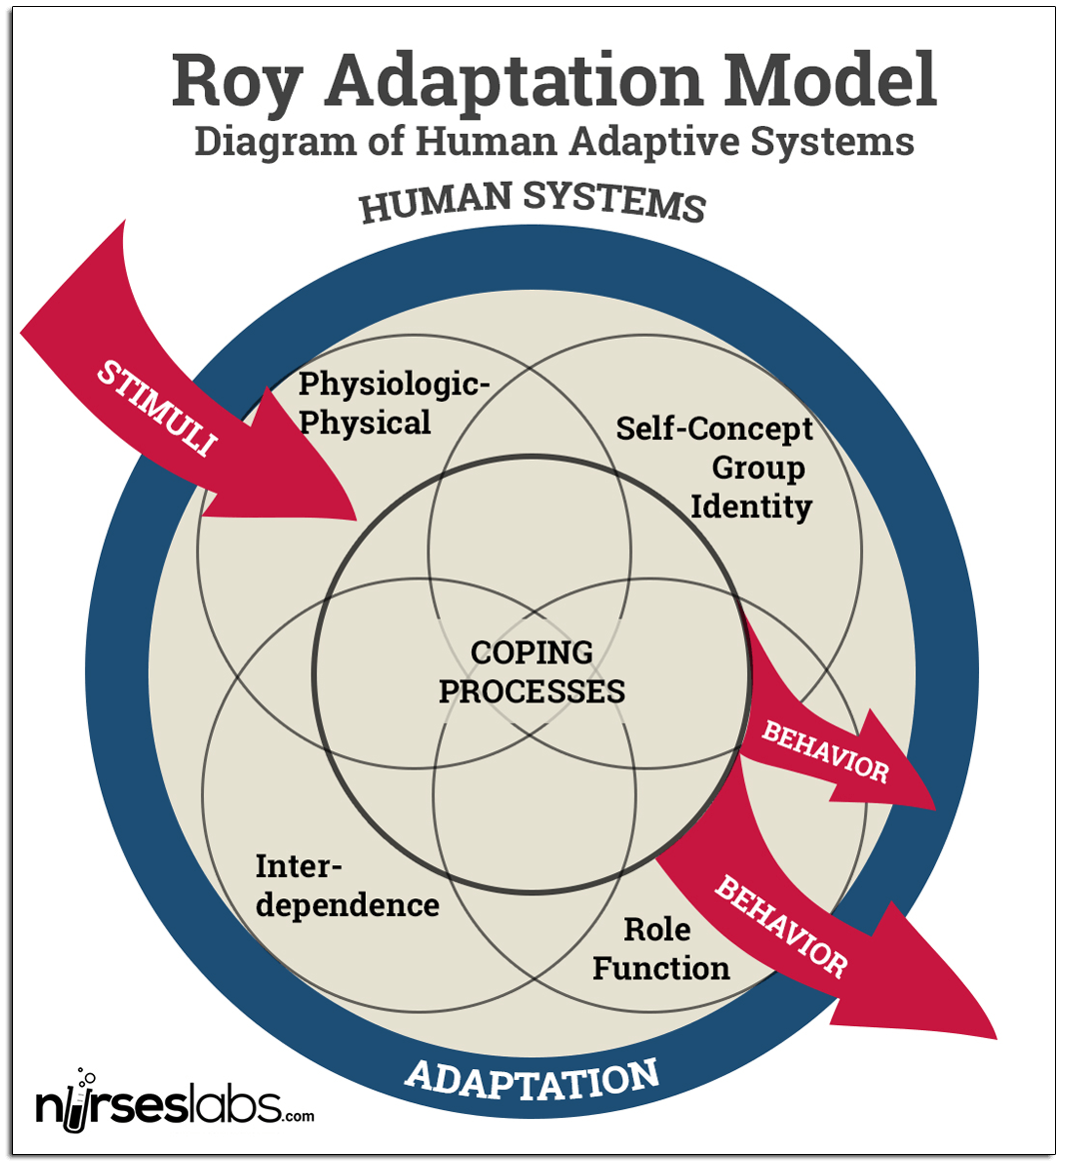

Slide 16
Adaptive Model
Four Adaptive Model
Physiological,
Self-Concept,
Role Function,
Interdependence

Slide 17
Physiological mode
Behavior in this mode is a manifestation of the physiological activity of all the cells, tissues, organs,
systems of the body.
  5 needs serve to promote physiological integrity, (oxygenation, nutrition, elimination, activity and rest, and protection).
  4 processes which help maintain physiological integrity (senses, fluid and electrolytes, neuro, and endocrine function)

Slide 18
Self-concept model
Deals with the person’s beliefs & feelings about himself/herself. Basic underlying need: psychic integrity (physical perceptions, ideals, goals, moral/ethical beliefs)
Physical self: how one sees his own physical being

Slide 19
Conti…
body sensation: ability to express sensations/feel symptoms
body image: how one sees himself as a physical being Personal self: how one views his qualities, values, worth

Slide 20
Conti…
self-consistency: one’s self-description of qualities; also includes self-organization behavior
self-ideal/self-expectancy: what one would like to do or be
moral-ethical-spiritual self: values, beliefs, religion self-esteem: the value one places on himself/herself

Slide 21
Role function model
involves the position one occupies in society; behaviors associated with one’s position (role) in society.
Basic underlying need: social integrity
Primary role: role based on age, sex, developmental state
Secondary role: role(s) a person assumes to complete tasks associated with a primary role or developmental stage
Tertiary role: a role freely chosen; temporary; associated with accomplishments of tasks or goals

Slide 22
Interdependence mode:
associated with one’s relationships and interactions with others and the giving and receiving of
love, respect, and value. Basic underlying need: nurturance and affection
Significant others: intimate relationships (spouse, parent, God)
Support systems: less intimate relationships (coworkers, friends)
Giving behaviors: giving love, nurturance, affection
Receiving behaviors: receiving/taking in love, nurturance, affection

Slide 23
Roy Model and the Nursing Process
Utilizes a bi-level assessment to problem solve
Assessment of behaviors:
Behavior is an action or reaction under specified circumstances; behavior may be observable, or not.

Slide 24
Conti …
Normally, a person adapts to stimuli positively, maintaining a “steady state” but in times of stress when coping mechanisms are overwhelmed (i.e., illness), the person’s ability to adapt to a new situation is impaired.
The nurse observes behaviors (signs/symptoms) or responses of the patient and makes a judgment as to whether the behavior is adaptive or ineffective.
How does the nurse do this? Assessment phase of nursing process

Slide 25
Assessment of stimuli:
Stimuli are the underlying causes or factors contributing to the behaviors observed in first level assessment; those things which provoke a response.
Nurse identifies stimuli in all 4 adaptive modes; stimuli are manipulated via interventions to achieve patient goals

Slide 26
Strengths of the Roy’s Adaptation Model
The Adaptation Model of Callista Roy suggests the influence of multiple causes in a situation, which is a strength when dealing with multi-faceted human beings.
Roy’s model follows logically. In the presentation of each of the key concepts, there is the recurring idea of adaptation to maintain integrity. Every concept was operationally defined.

Slide 27
Conti…
The concepts of Roy’s model are stated in relatively simple terms.
A major strength of the model is that it guides nurses to use observation and interviewing skills in doing an individualized assessment of each person. The concepts of Roy’s model are applicable within many practice settings of nursing.

Slide 28
Weaknesses
Painstaking application of the model requires significant input of time and effort.
Roy’s model has many elements, systems, structures and multiple concepts.

Slide 29
S u m m a r y
5 elements - person, goal of nursing, nursing activities, health and environment
Persons are viewed as living adaptive systems whose behaviors may be classified as adaptive or ineffective.
These mechanisms work within 4 adaptive modes.

Slide 30
Example
Activity Read the profile of Andrew Smith over the page and examine the assessment documentation and care plan
Profile of Mr Andrew Smith
Mr Andrew Smith is a 42 year-old man with severe learning disabilities. He lives in an eight-bedded unit in the grounds of an old institution which is currently being developed as a housing estate. The unit has a sister eight-bedded unit next door . These units are primarily for residential care, but the unit that Andrew lives on also has 3 short-stay beds within the units.

Slide 31
conti…
The goal of nursing is to promote adaptive responses in relation to 4 adaptive modes, using information about person’s adaptation level, and various stimuli.
Nursing activities involve manipulation of these stimuli to promote adaptive responses.

Slide 32
Reference
George B julia , nursing theories – the base for professoional nursing practice, 3rd ed . Norwalk,Appleton& lange
- Potter A Patricia, perry G Anne (1992) FON – Concepts process & practice, london Mosby year book

Slide 33

Thank you

