Slide 1
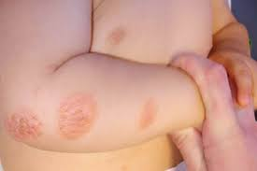
RINGWORM
PARUL GANGWAR
BSC.(N) 3 YEAR

Slide 2
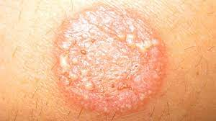
INTRODUCTION
Ringworm often causes a ring-shaped rash that is itchy, scaly and slightly raised. The rings usually start small and then expand outward. Ringworm of the body (tinea corporis) is a rash caused by a fungal infection. It's usually an itchy, circular rash with clearer skin in the middle.

Slide 3
DEFINITION
Ringworm infection are aerobic fungi present in the soil. It is a highly specialized fungal infection of skin and its appendages. It maybe superficial or deep.
It is also known as Dermatophytoses.

Slide 4
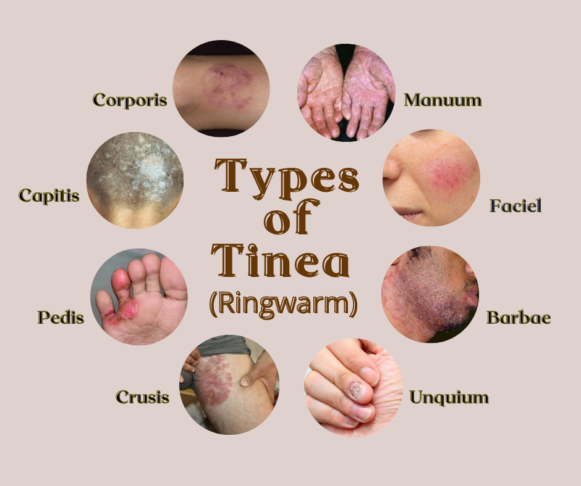
TYPES OF RINGWORM

Slide 5
Cont…
Athlete’s foot(Tinea pedis)- This common condition mostly affects teen and adults males. Contributing causes include sweating, not drying the feet well after swimming& bathing, wearing tight socks and shoes . And symptoms are; Whitening of the skin between the toes , itchy rash ,blisters on the feet.
Jock itch(tinea cruris)- its occurs more often during warm weather comdition. It is very rare in females. Symptoms are; red , ring like patches,pain in the groin area.
Scalp ringworm (tinea capitis)- scalp ringworm is highly contagious,especially aomg children occurs in between the age of 2-10 yrs. Symptoms are; hair loss.

Slide 6
Cont…
Nail ringworm ( tinea unguium)- its occurs more oftern in adolescents and adults rather than young children.It is an infection of the finger or toenail. Symptoms are ; yellow color and thickening of the nails.
Body ringworm(tinea corporis)- this is skin infection is charaterized by a ring like rash anywhere on the body and the face.it seen more frequently in children.symptoms are-red ,circular lesion with raised edges.

Slide 7
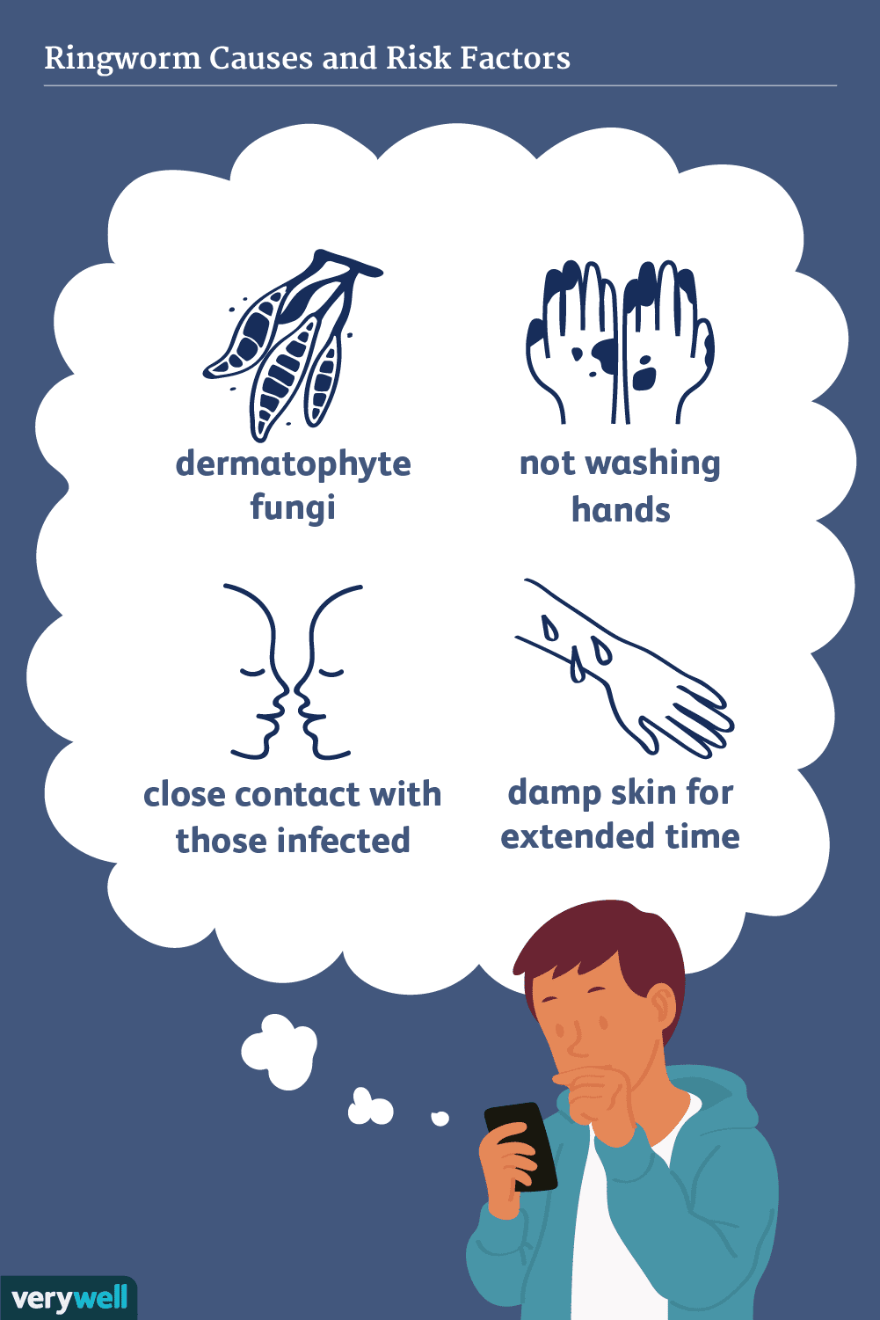
ETIOLOGY & RISK FACTORS flash card

Slide 8
SIGN & SYMPTOMS
darkening of the skin, peeling, red rashes, or scaly patches
Also common: hair loss or itchy scalp
Pain
Blisters on the feet.

Slide 9
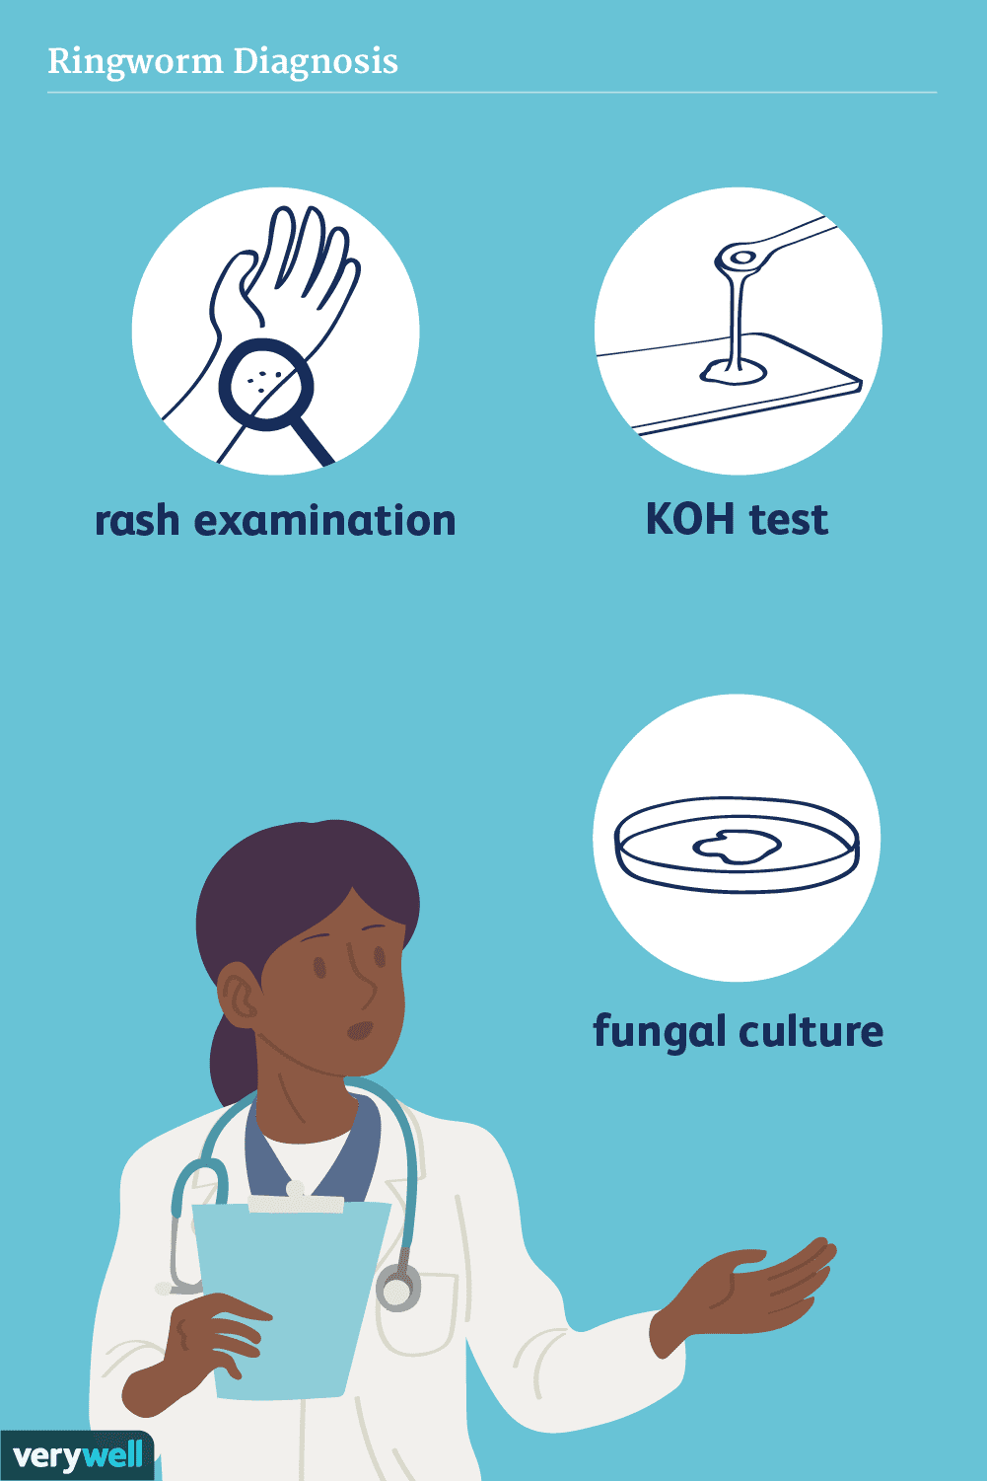
DIAGNOSE EVALUATION
History collection
Physical examination
Culture of skin scraping of the lesion is done to confirm the diagnosis.

Slide 10

MEDICAL MANAGEMENT
Used topical antifungal agent such as clotrimazole.
Oral anti fungal medication ; this medication is usually prescribed for 4-8weeks. Some children require longer treatment.
Use a special shampoo( to help eliminate the fungus).
Also steroids are prescribed to help reduce the swelling.

Slide 11
Home remedies chart
Nursing management pamplets

Slide 12
PREVENTIONS;
keeping skin clean and dry
never walking barefoot in communal showers or changing areas
wearing open-toed or loose shoes whenever possible to allow air to circulate around the feet
changing socks daily
keeping fingernails and toenails clipped and clean
avoiding sharing clothing, towels, or bed linen with a person who has a ringworm infection
washing hands with soap and water regularly — especially after contact with animals, which can be carriers of ringworm.
taking a shower immediately after games or practice sessions
washing sports gear regularly

Slide 13
SUMMARY
Ringworm is a common infection of the skin and nails that is caused by fungus. The infection is called “ringworm” because it can cause an itchy, red, circular rash. Ringworm is also called “tinea” or “dermatophytosis.” The different types of ringworm are usually named for the location of the infection on the body.

Slide 14
CONCLUSION
Ringworm doesn't always go away on its own and should be treated. When not treated properly, ringworm can lead to a number of complications (including the spread of the infection to other parts of the body,6 bacterial skin infections, and skin disorders such as contact dermatitis

Slide 15
REFRENCES
Sharma rimple. essentials of pediatric nursing 2ndedition EMCA House 23/23-B ansari road,daryaganj new- Delhi 110002, India jaypee brothers 2017 P.455
Sharma rimple essentials of pediatric nursing 3rd edition EMCA House,23/23-B ansari road daryaganj new Delhi 110002 India jaypee brothers 2021 P.357-58
Datta parul pediatric nursing 2nd edition 4838 24 ansari road daryaganj New delhi-110002,India jaypeebrothers 2009 P. 382-83
Piyush essential pediatric nursing II edition, CBC plaza, 4819 XI prahalad street, 24 ansari road Dayaganj, new Delhi- 110002, India 2007 P. 455-56
Viswanathan Desai J III edition orient Longman private Limited 1/24, Asaf Ali road new Delhi 110 002 Asaf Ali road new Delhi P 372-73 .
https://www.healthline.com/health/home-remedies-for-ringworm.
https://www.mayoclinic.org/diseases-conditions/ringworm-body/symptoms-causes/syc-20353780#:~:text=Ringworm%20is%20a%20contagious%20fungal,contact%20with%20an%20infected%20person.

Slide 16
ASSIGNMENT -2 NCP ON RINGWORM INFECTION.

Slide 17



Slide 18


