Slide 1
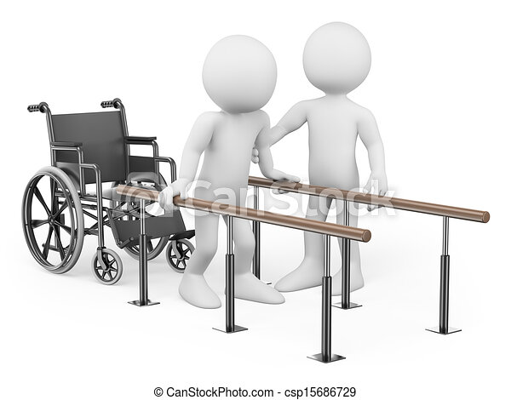
REHABILITATION

Slide 2
OBJECTIVE
Meaning of rehabilitation
Definition
Principles of rehabilitation
Roles of rehabilitation nurses
Types of rehabilitation
Based on the treatment types
Types of team
Function of team members

Slide 3
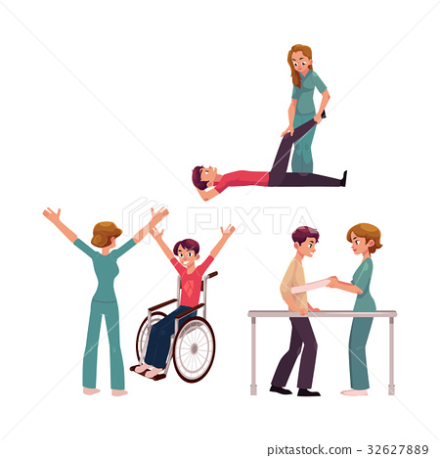
MEANING OF REHABILITATION
It is restoration of ability to function.
It is to support the patient with an injury or disability illness to achieve maximum function and independence.

Slide 4
DEFINITION
Rehabilitation is a treatment designed to facilitate the process of recovery from injury, illness, or disease to as normal a condition as possible.

Slide 5
PRINCIPLES OF REHABILITATION
Rehabilitation should begin during the initial contact with the patient.
He must be an active participant.
Motivates the patient and help him to attain social independence.
Every patient has right to the rehabilitation services.

Slide 6
Role of rehabilitation Nurse
Essential nursing skills
Advisor and counselor
Therapeutic practice
Advocator
Co-ordinator
Educator

Slide 7
TYPES OF REHABILITATION
Medical rehabilitation
Social rehabilitation
Psychological rehabilitation
Vocational rehabilitation

Slide 8
1. MEDICAL REHABILITATION
Help a person better in all his daily physical and mental activities.

Slide 9
2. SOCIAL REHABILITATION
Implies social life: restoration of family, social interactions or relationship.
3. PSYCHOLOGICAL REHABILITATION
Include psychological restoration of personal dignity and confidence of the disabled.

Slide 10

4. VOCATIONAL REHABILITATION
Help those patient who find it difficult to get employment.

Slide 11
BASED ON THE TREATMENT TYPES
Cardiopulmonary rehabilitation
Physical rehabilitation
Speech rehabilitation
Occupational rehabilitation
Psychological rehabilitation

Slide 12
Cardiopulmonary rehabilitation
Cardiac rehabilitation program is committed to providing comprehensive risk factor management to our patients with cardiovascular disease.

Slide 13
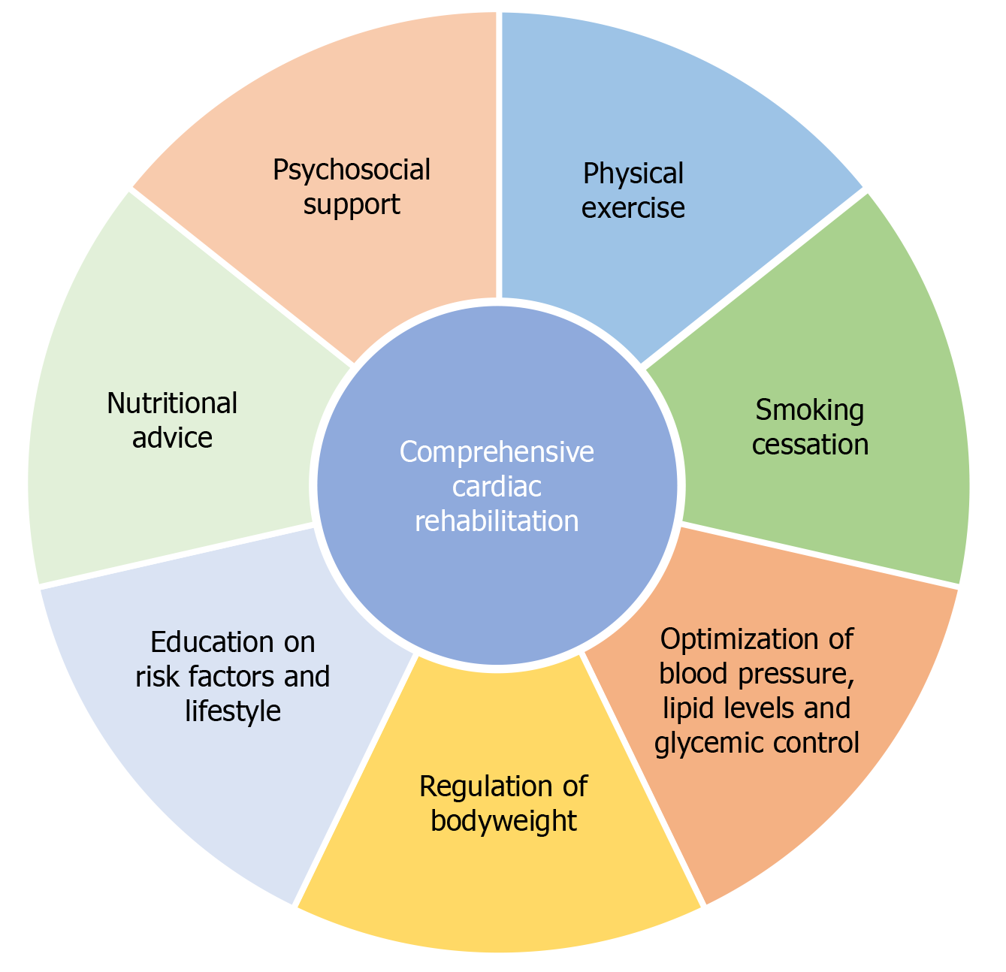

Slide 14
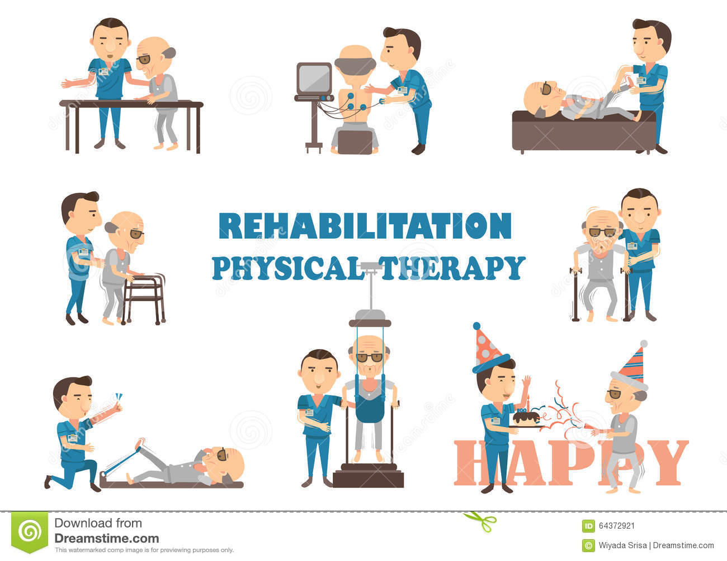
Physical rehabilitation
Help the patient restore the use of muscle, bone and the nervous system through exercise and other technique.

Slide 15
Speech rehabilitation
Speech therapy helps the patient correct speech disorder or restores speech. It involves regular meeting with in the therapist in an individual or group setting and home exercise.

Slide 16
Occupational rehabilitation
Help the patient regain the ability to do normal every day tasks. This may be achieved by resting old skills, or teaching the patient new skill to adjust to disability through adaptive equipment, orthotics and modification of the patient home. The therapist will visit the patient home and analyze what the patient can and cannot do.

Slide 17
Psychiatric rehabilitation
Involves helping people with mental illness, gain or improve skills while obtaining the necessary resource and support in reach their goals.

Slide 18
TYPES OF TEAM
Multi-disciplinary team
Intra-disciplinary team
Trans-disciplinary team

Slide 19
FUNCTION TEAM MEMBERS
Physical
Therapist
Recreational therapist
Nutritionist
Psychologist
Social worker
psychiatrist

Slide 20
SUMMARY
So we have to discussed about meaning of rehabilitation, definition, principles of rehabilitation, role of rehabilitation nurse and types of rehabilitation nurse, based on the treatment types, types of team and function team members.

Slide 21
CONCLUSION
Rehabilitation is needed by an increasing number of individual because the ability to live longer, productive life with multiple chronic condition.
Nurses in acute care setting have an important role to identifying who will benefit from rehabilitation services.

Slide 22
BIBLIOGRAPHY
K park textbook of prevention and social medicine, bhanot publication, 18th edition, page no- 381-384
B.T. Basavanthappa, community health nursing, jaypee publication, 6th edition, page no- 584.

