Slide 1
PUERPERAL INFECTION
&
COMPLICATION IN PUERPERIUM
Mrs. Preeti Bahuguna
Assistant Professor

Slide 2
INTRODUCTION
Puerperium also referred to as the fourth trimester is the period between childbirth and the return of the uterus to its normal size . The mother may develop complications that may associated with significant morbidity and mortality if they are not diagnosed in the early stages. Common complication are hemorrhage ,infection , hematoma

Slide 3
Puerperal infection and pyrexia
Postpartum infection occur after hospital discharge which is usually 24 hrs. after delivery. The chief of puerperal infection and pyrexia include endometritis, wound infection, mastitis, urinary tract infection

Slide 4
Puerperal pyrexia
An elevation of temperature to 38.c (100.F) or more occurring on two separate occasions at 24 hours apart ( excluding the first 24 hours )within the first 10 days

Slide 5
Causes
Urinary tract infection:
E. coli
Dysuria
Hematuria
Frequency
Genital tract infection:
Tender and bulky uterus
Prolonged bleeding
Discolored lochia

Slide 6
Painful inflamed perineum
Caused by E.coli
Mastitis:
Flu like symptoms
Painful , hard , red breast
Nipple trauma and cellulitis

Slide 7
Postoperative infection: Lscs is the most important risk factor for puerperal pyrexia
“ In uk there is an 8% risk of infection following Lscs”
Painful suture line
Deep tenderness
Lochia pink
Deep vain thrombosis:
a low grade pyrexia can be caused by venous thromboembolism
Painful or swollen calf

Slide 8
Other infection
Pyrexia is a recently delivered mother may also be due to such as viral infection of chest infection
Glandular fever is probably a common cause of fever in postpartum period

Slide 9
HISTORY:
Full history should be taken to include a full history of the delivery establish
When the membrane ruptured
The length of the labor
Instrumentation used
Sutures required
Whether the placenta was complete
Whether there was any bleeding during or after delivery

Slide 10
examination
Take temp. and B.P
Palpate uterus to assess size and tenderness
Assess perineal wound and lochia
Examine breast
Examine chest for sign of infection
Examine the legs

Slide 11
INVESTIGATIONS:
High vaginal swab
Urine culture
FBC
Blood culture
Ultrasound
Sputum culture

Slide 12
MANAGEMENT
General Measures:
Ice packs may be helpful for pain
Rest and adequate fluid intake

Slide 13
The following sign and symtoms should be prompt urgent referral for hospital assessment if the women appears seriously unwell:
Pyrexia
Sustained tachycardia
Breathlessness
Abdominal or chest pain
Diarrhea and vomiting
Uterine or renal angle pain

Slide 14
Pharmacological
Analgesia may be required
if the fever is prolonged then treatment with heparin should also be considered
NSAIDs should be avoided for pain relief in case of sepsis
Surgical:
If the abscess formed in that case the fever will not settle until the abscess has be incised and drained.

Slide 15
Prevention
Scrupulous attention to hygiene should be used during all examination and use of instrumentation during and after labor
Any gas identified during pragnancy should be treated aggressively
Early mobilization

Slide 16
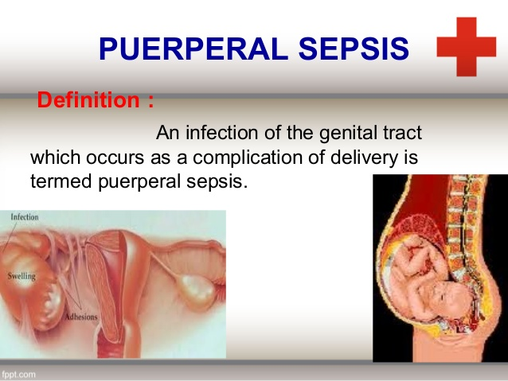
definition
Puerperal infection is an infection of the genital tract which occurs as a complication of delivery

Slide 17
Puerperal sepsis
Even in 21st centaury at least 75,000 women die annually worldwide of puerperal sepsis mostly in the low income countries.
In Uk sepsis in the puerperium remain important cause of maternal death.
incidence:
puerperal infection morbidity affects 2-10% of patient.
5-10 times higher in cesarean delivery.

Slide 18
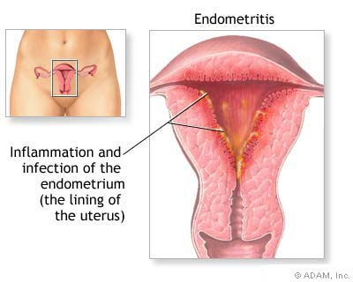
Common puerperal infections
Endometritis
Endomyometritis
Endoparametritis

Slide 19
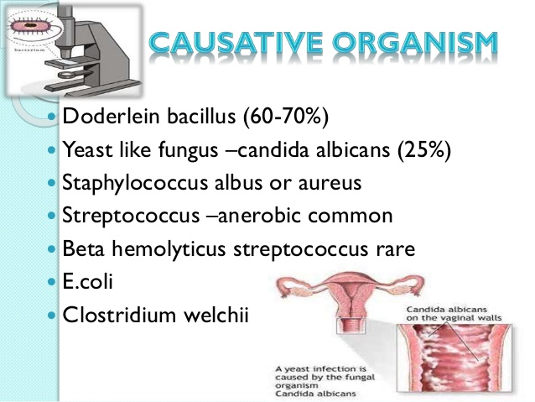
Causative organism
Doderlein bacillus(60-70%)
Yeast like fungus- candida albicans (25%)
Staphlyococcous albus or aureus
Streptococcous- anerobic common
Beta hemolyticus streptococcous rare
e.coli
Clostridium welchii

Slide 20
predisposing factors

Slide 21
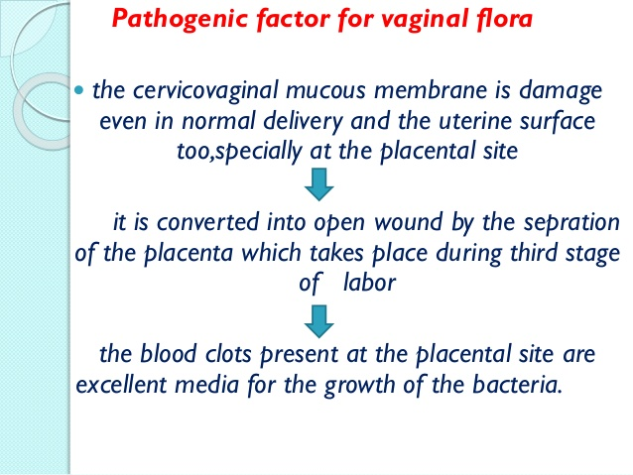

Slide 22

Antepartum factor
Malnutrition
Pre eclampsia
Preterm labor
Sexual intercourse during late pregnancy
Premature rupture of membrane
Prolonged rupture of membrane
diabetes

Slide 23
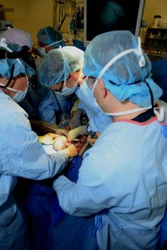
Intrapartum factor
Repeated vaginal examination
Dehydration and ketoacidosis during labor
Traumatic operative delivery
Hemorrhage
Retained bits of placenta tissue
Placenta Previa
Cesarean delivery

Slide 24

Mode of infection

Slide 25
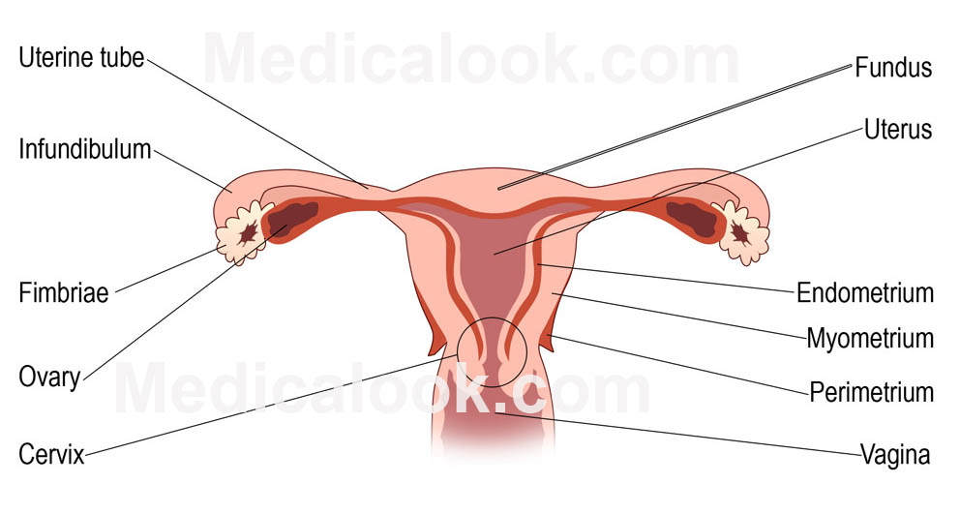
Pathology
Puerperal infection is wound infection the primary site of infection
Perineum‘
Vagina
Cervix
Uterus

Slide 26
perineum
Laceration of the perineum are likely to infected
The wound edges become red and swallon
There may be collection of purulent discharge resulting in complete disruption of the wound
Vagina:
Vaginal laceration are infected directly or by extension from the perineal infection
The mucosa is swallon and hyperemic resulting in necrosis and sloughing

Slide 27
cervix
The cervical laceration become the site of infection
Uterus:
the uterus is the most common site infection
The decidua over the placental site is the common site to be infected first

Slide 28
Spread of infection
Pelvic cellulitis:
infection the pelvic peritoneum and levator ani muscles

Slide 29
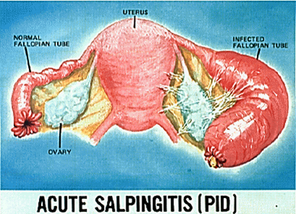
salphingitis
Infection of the fallopian tube and ovaries with the formation of tubo ovarian mass

Slide 30
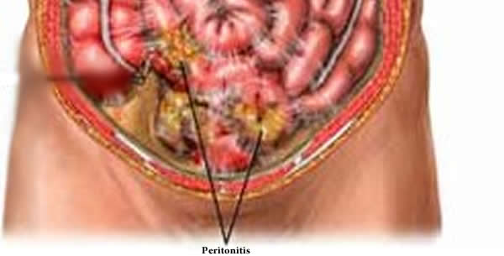
Peritonitis
Localised pelvic abcess
Thrmobophelebitis: ovarian vein of one side is usually involved
Uterine vein may also be involved

Slide 31
Septicemia and pyemia
These may lead to endocarditis , pericarditis , renal abscess , lung abscess , meningitis

Slide 32
Clinical features
Local infection:
slight raise in temp. , generalized malaise and headache
Redness and swelling of the local wound
Pus formation and disruption of wound
Uterine infection:
Pyrexia of variables degree and tachycardia
Red copious and offensive lochia
Subinvoluted , tender and soft uterus

Slide 33
Severe infection
Fever with chills and rigor
Rapid pulse
Scanty , odorless lochia
Involutes uterus
Pare metritis:
Sustained rise in temperature(7th to 10th day)
Constant pelvic pain
Tenderness on the either side of hypogastrium
leukocytosis

Slide 34
Pelvic peritonitis
Pyrexia with increased pulse rate
Lower abdominal pain and tenderness
Collection of the pus in pouch of douglas

Slide 35
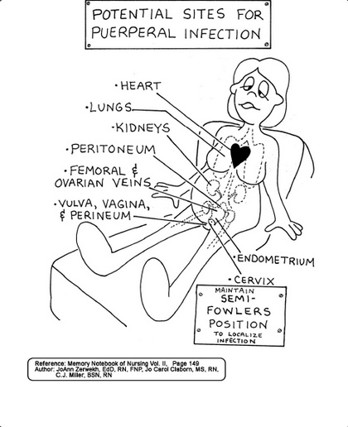
Generalized peritonitis
High fever with rapid pulse
Vomiting
Abdominal pain
Tender and distended abdomen
Thrombophlebitis:
swinging fever with chills
and rigor
Features of pyemia

Slide 36
septicemia
High temperature with rigor
Rapid pulse
Headache , insomnia or mental confusion
Positive blood culture
Sign / symptoms of infection in the lungs, meninges or joint

Slide 37
Investigation
Bacteriological study:
Smear
Culture and antibiotic sensitivity of purulent material
High vaginal and cervical swab
Peritoneal fluid
Blood culture

Slide 38
urine
Routine and microscopic examination
Culture if infection is suspected
Complete blood count

Slide 39
ultrasonography
For diagnosis of pelvic mass
Pelvic abscess
Pelvic peritonitis
Retained bits of placenta or membrane

Slide 40
Other specific investigation
X-ray
blood for malaria parasite

Slide 41
prevention
Antenatal :
improvement of general condition
Treatment of septic cocci
Abstinence from sexual intercourse in the last two months
Care about personal hygiene
Avoiding contact with people having infection
Avoiding unnecessary vaginal examination

Slide 42
intrapartum
Staff attending on labor client should be free of infection
Full surgical asepsis to be taken while conducting delivery
Women having respiratory tract infection should be admitted in single room
Membrane should be kept intact as long as possible and vaginal examination should be restricted

Slide 43
Traumatic vaginal delivery and intrauterine manipulation should be avoided
Prophylactic antibiotic must be administered in cases of premature rupture of membrane

Slide 44
postpartum
Take aseptic precautions while dressing the perineal wound
Restriction of the visitors in the postpartum ward
Mothers to be instructed to use sterile sanitary pads and to change them frequently
Infected mothers and babies are to be isolated
To keep the floor of the in – patient ward dust free by frequent mopping

Slide 45
treatment
The women should be placed in sterile room / ward with adequate light and ventilation
Analgesics and sedative are administered to enforce rest
Broad spectrum antibiotics are given iv until antibiotics sensitivity report are available
Stool softener are administered tokeep the bowel open
Anemia to be corrected by blood transfusion

Slide 46
Surgical treatment
The stitches of the perineal wound may have to be removed to facilitate drainage of pus and relieve pain .After the infection is controlled secondry suture may begin later
Infected retained product should be removed as early as possible under cover of antibiotics

Slide 47
Pelvic abcess should be drained by colpotomy
Abscess above the poupart’s ligaments should be incised and the pus drained

Slide 48
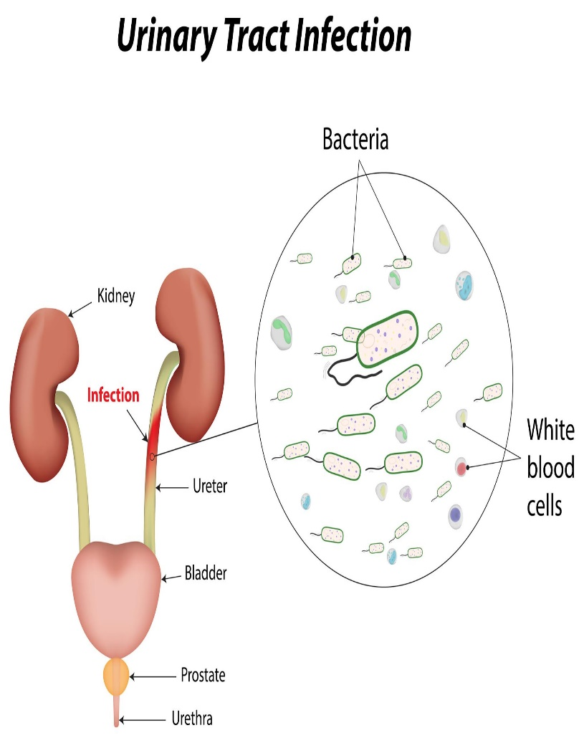
URINARY TRACT INFECTION

Slide 49
DEFINITION
It is an infection of the urinary organs such as kidney , ureter, urinary bladder and urethra
Incidence: It is one of the common cause of puerperal pyrexia . The incidence being 1-5 % of all deliveries

Slide 50
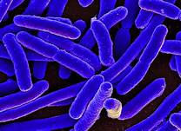
Causative organism
E.coli
Klebsiella
Proteus
Staphlyococcous aureus

Slide 51
Other causes are
Reoccurrence of previous cystitis and pyletitis
Infection contracted for the first time during pregnancy is due to : effect of frequent catheterization either during labor or in early puerperium to relative retention of urine
Stasis of urine during early puerperium due to lack of bladder tone and less desire to pass the urine

Slide 52
Clinical features
Raised temp.
Costovertebral angle pain
Suprapubic discomfort
Frequent and often painful micturition
Nausea and vomiting

Slide 53
Diagnosis
Uti is confirmed by examination of an uncontaminated midstream clean catch sample for urinalysis and culture and antibiotics sensitivity test

Slide 54
management
High fluid intake
Adequate drainage of urine
Appropriate antimicrobial therapy

Slide 55
PULMONARY EMBOLISM
It is the leading cause of maternal death in many center especially in the developed countries. Death usually occurs within short time shock and vagal inhibition

Slide 56
Sign / symptoms
Tachypnea
Dyspnea
Pleuritic chest pain
Cough
Tachycardia
Hemoptysis
Rise in temperature

Slide 57
diagnosis
X-ray
ECG
ABG
D dimer
Doppler USG
Lung scan
MRI
Pulmonary angiography

Slide 58
management
Active management : resuscitation
IV fluid
Tachycardia: digitalis

Slide 59
Summarization
Introduction of puerperium
Puerperal infection / pyrexia
Causes of puerperal pyrexia
Management
Puerperal sepsis
Urinary complication
Pulmonary embolism

Slide 60
Conclusion
Puerperal sepsis and infection is the 3rd major cause of maternal deaths in country. Early diagnosis and treatment helps in reducing the rate of maternal morbidity due to infection.

Slide 61
References
Dutta Dc. A text bok of obstetrics “ 8th editon published by jaypee page no 500 to 508
http://www. Puerperal pyrexia .com

Slide 62


