Slide 1
PSYCHIATRIC EMERGENCIES

Slide 2
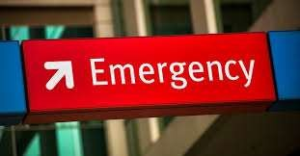
Psychiatric emergency
Is a condition wherein the patient has disturbances of thought, affect and psychomotor activity
leading to a threat to his existence (suicide), or threat to the people in the environment (homicide).

Slide 3
This condition needs immediate intervention to
  safeguard the life of the patient,
  bring down the anxiety of the family members and
  enhance emotional security to others in the environment.

Slide 4
Common psychiatric emergencies are
Suicidal threat
Violent, aggressive behaviour and excitement
Panic attacks
Stupor and catatonic syndrome
Hysterical attacks
Transient situational disturbances

Slide 5
Organic psychiatric emergencies are
Delirium tremens
Epileptic furor
Acute drug induced extra pyramidal symptoms
Drug toxicity

Slide 6
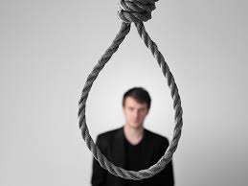
Suicidal threat
Suicide is a type of deliberate self-harm and is defined as an intentional human act of killing oneself.

Slide 7
Etiology
Psychiatric Disorders
  Major depression
  Schizophrenia
  Drug or alcohol abuse
  Dementia
  Delirium
  Personality disorder
Physical Disorders
  Patients with incurable or painful physical
disorders like, cancer and AIDS.

Slide 8



Psychosocial Factors
  Failure in examination
  Dowry difficulties
  Marital difficulties
  Loss of loved object
  Isolation and alienation from social groups
  Financial and occupational difficulties

Slide 9
Risk Factors for Suicide
Age
  males above 40years of age
  females above 55years of age
Sex
  men have greater risk of completed suicide.
  suicide is 3 times more common in men
  women have higher rate of attempted suicide
Being unmarried, divorced, widowed or separated
Having a definite suicidal plan
History of previous suicidal attempts
Recent losses

Slide 10
Major depression:
one of the commonest conditions associated with a high risk
of suicide.
Suicide is due to pervasive and persistent sadness;
pessimistic cognitions concerning the past, present and future; delusions of guilt, helplessness, hopelessness and worthlessness;
and derogatory voices urging him to take his life.
The risk of suicide is more when the acute phase has passed and the characteristic psychomotor retardation has improved.
This is so because the patient has more energy to carry out his
suicidal plans now

Slide 11
Schizophrenia:
the presence of associated depression,
young age and
High levels of premorbid functioning (especially during college education).
People in this risk group are more likely to realize the devastating significance of their illness more than other groups of schizophrenic patients do, and see suicide as a reasonable alternative.

Slide 12
Mania:
This is usually the result of grandiose ideation: the patient may believe that he is a great person, or wish to prove his supernatural powers.
With this intent in mind, he may carry out some dangerous
activity that can cost him his life.
Drug or alcohol abuse:
Suicide among alcoholics
can be due to depression in the withdrawal phase.
Also, the loss of friends and family, self-respect, status, and a general realization of the havoc alcohol has created in his life can cause the individual to wish to die.

Slide 13
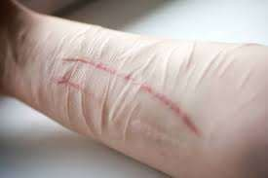
Personality disorder:
Individuals with histrionic and borderline traits may occasionally attempt suicide.
Organic conditions:
Conditions such as
delirium and dementia due to changes of mood like anxiety and depression may also induce suicidal tendency.

Slide 14
Management
Beware of suicidal signs.
Monitor the patient’s safety needs.
Encourage verbal communication of suicidal ideas.
Enhance self-esteem of the patient.

Slide 15



SUICIDAL SIGNS
suicidal threat
writing farewell letters
giving away treasured articles
making a will
closing bank accounts
appearing peaceful and happy after a period of depression
refusing to eat or drink, maintain personal hygiene.

Slide 16
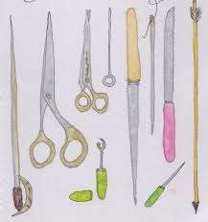
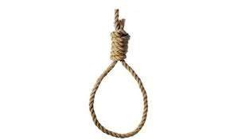
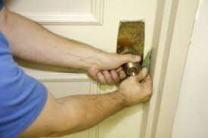
2. Monitoring the patient's safety needs:
take all suicidal threats or attempts seriously and notify psychiatrist
search for toxic agents such as drugs/ alcohol
do not leave the drug tray within reach of the patient, make sure that the daily medication is swallowed
remove sharp instruments such as razor blades, knives, glass bottles from his environment.
remove straps and clothing such as belts, neckties
do not allow the patient to bolt his door on the inside, make sure that somebody accompanies him to the bathroom

Slide 17

patient should be kept in constant observation and should never be left alone
have good vigilance especially during morning hours
spend time with him, talk to him, and allow him to ventilate his feelings
encourage him to talk about his suicidal plans Imethods
if suicidal tendencies are very severe, sedation should be given as prescribed

Slide 18
Encourage verbal communication of suicidal ideas as well as his/her fear and depressive thoughts.
A 'no suicidal' pact may be signed, which is a written agreement between the client and the nurse, that client will not act on suicidal impulses, but will approach the nurse to talk about them.
Enhance self-esteem of the patient by focusing on his strengths rather than weaknesses. His positive qualities should be emphasized with realistic praise and appreciation. This fosters a sense of self-worth and enables him to take control of his life situation.

Slide 19
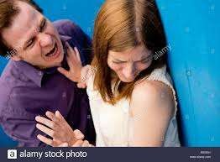
Violent behaviour
This is a severe form of aggressiveness.
patient will be irrational, uncooperative, delusional and assaultive.

Slide 20

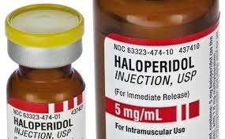
Management
The first step should be to remove the
chains – to remove humiliation
Talk to the patient and see if he responds. Firm and kind approach by the nurse is essential.
Usually sedation is given. Common drugs used are: diazepam 10-20mg, IV haloperidol 10-20mg; chlorpromazine 50-100mg IM.
Once the patient is sedated, take careful history from relatives; rule out the possibility of organic pathology. In particular check for history of convulsions, fever, recent intake of alcohol, fluctuations of consciousness.

Slide 21
Carry out complete physical examination.
Send blood specimens for hemoglobin, total cell count, etc.
Look for evidence of dehydration and malnutrition.
If there is severe dehydration, glucose saline drip may be
started.
• Have less furniture in the room and remove sharp instruments, ropes, glass items, ties, strings, match boxes, etc. from patient's vicinity.
• Keep environmental stimuli, such as lighting and noise levels to a minimum; assign a single room; limit interaction with others.

Slide 22
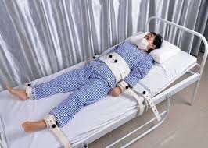
Stay with the patient as hyperactivity
increases to reduce anxiety level and foster a feeling of security.
Redirect violent behavior with physical outlets such as exercise, outdoor activities.
Encourage the patient to 'talk out' his aggressive feelings, rather than acting them out.
If the patient is not calmed by talking down and refuses medication, restraints may become necessary.
Following application of restraints, observe patient every 15 minutes to ensure that nutritional and elimination needs are met. Also observe for any numbness, tingling or cyanosis in the extremities. It is important to choose the least restrictive alternative as far as possible for these patients.

Slide 23
be sure that the patient has no weapons in his possession
before approaching him.
if patient is having a weapon ask him to keep it on a table or floor rather than fighting with him to take it away.
keep something like a pillow, mattress or blanket wrapped around arm between you and the weapon.
distract the patient momentarily to remove the weapon (throwing water in the patient's face, yelling etc).
Give prescribed antipsychotic medications.

Slide 24
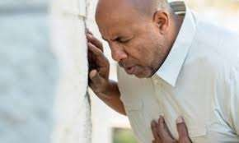
Panic attacks
Episode of acute anxiety or panic as a part of psychotic or neurotic illness.
The patient will experience palpitations, sweating, tremors, feelings of choking, chest pain, nausea, abdominal distress, fear of dying, paresthesias, chills or hot flushes.

Slide 25
Management
Give reassurance.
Search for causes.
Diazepam 10 mg or Lorazepam 2 mg

Slide 26
Catatonic stupor
Stupor is a clinical syndrome of akinesis and mutism but with relative preservation of conscious awareness.
Catatonic signs are : mutism, negativism, stupor, ambitendency, echolalia, echopraxia, automatic obedience, posturing, mannerisms, stereotypies, etc.

Slide 27
Management
Ensure patent airway
Administer IVfluids
Collect history and perform physical examination
Draw blood for investigations before starting any treatment
Other care is same as that for an unconscious patient

Slide 28
Hysterical attacks
A hysteric may mimic abnormality of any function which is under voluntary control.
  Hysterical fits
  Hysterical ataxia
  Hysterical paraplegia

Slide 29
Management
Hysterical fit must be distinguished from genuine fits for differences between hysterical and epileptic seizures).
As hysterical symptoms can cause panic among relatives, explain to the relatives the psychological nature of symptoms. Reassure that no harm would come to the patient.
Help the patient realize the meaning of symptoms, and help him find alternative ways of coping with stress.
Suggestion therapy with IV pentothal may be helpful in some cases.

Slide 30
Transient situational disturbances
These are characterized by disturbed feelings and behaviour occurring due to overwhelming external stimuli.

Slide 31
Management
Reassurance.
Mild sedation
Promoting ventilation of feelings
Counseling

Slide 32
Delirium tremens
It is an acute condition resulting from withdrawal of alcohol.

Slide 33
Management
Keep the patient in quiet and safe environment.
Sedationdiazepam 10mg or lorazepam 4 mg IV, followed by oral administration.
Fluid and electrolyte balance
Reassure the patient and family

Slide 34
Epileptic furor
Following epileptic attack patient may behave in a strange manner and become excited or violent.

Slide 35
Management
Sedation
  Inj. Diazepam 10 mg IV
  Inj. Haloperidol 10 mg IV

Slide 36
Acute drug induced EPS
Antipsychotics can cause a variety of movement related side effects, collectively known as EPS.
Neuroleptic malignant syndrome is the complication.

Slide 37
Management
Stop the causative drug.
Cool the patients body temperature
Maintain Fluid and electrolyte balance
Diazepam for muscle relaxation
Dantrolene to treat malignant hyperthermia
Bromocriptine, amantadine and Ldopa have been used.

Slide 38
Drug toxicity
It can be accidental or suicidal.
A detailed history should be collected and symptomatic treatment instituted.
Very common drug is Lithium
The symptoms include drowsiness, vomiting, abdominal pain, confusion, blurred vision, acute circulatory failure, stupor and coma, generalized convulsions, oliguria and death.

Slide 39
Management
Administer oxygen
Start IV line
Assess for cardiac arrhythmias
Refer for hemodialysis
Administer anticonvulsants

Slide 40
Thank you

