Slide 1

PSYCHIATRIC EMERGENCY

Slide 2
INTRODUCTION
Conditions in which there is alteration in behaviors, emotion or thought, presenting in an acute form, in need of immediate attention and care.
Any condition/ situation making the patient & relatives to seek immediate treatment.
Disharmony between subject and environment.
Sudden disorganization in personality which affects the socio- occupational functioning.

Slide 3

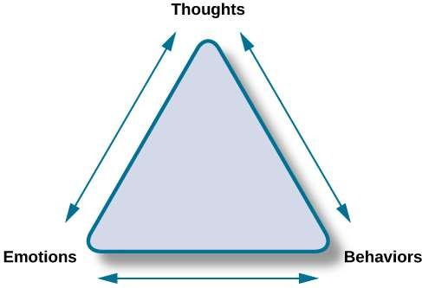

Slide 4

DEFINITION
“A psychiatric emergency is defined as an unforeseen combination of circumstances which calls for an immediate action.”
Condition which is in need of immediate attention and care if situation is avoided then there is a risk for individual as well as for others.

Slide 5
OBJECTIVE FOR EMERGENCY INTERVENTION
To safeguard the life of patient.
To bring down the anxiety of family members.
To enhance emotional security of others in the environment.

Slide 6
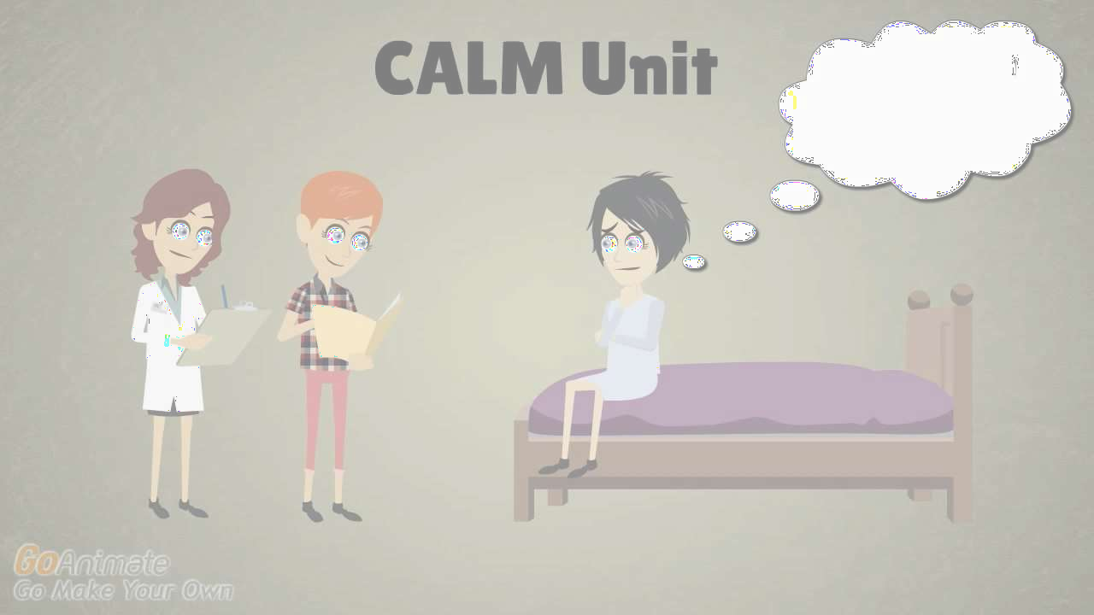
TYPES OF PSYCHIATRIC
EMERGENCY

Slide 7
ORGANIC PSYCHIATRIC
COMMON PSYCHIATRIC
EMERGENCIES
EMERGENCIES
1.1. Suicidal Threat
1.1. Delirium Tremens
1.2. Violent,
Aggressive Behavior and Excitement
1.2. Epileptic Furor
1.3. Acute Drug - Induced Extrapyramidal
Symptoms
1.3. Panic Attacks
1.4. Stupor and Catatonic Syndrome
4. Drug Toxicity
1.5.Hysterical Attacks

Slide 8

SUICIDAL THREAT
In psychiatry a suicidal attempt is considered to be one of the commonest emergencies.
Suicide is a type of deliberate self-harm and is defined as an intentional human act of killing oneself.
Types
Suicide- self murder or deliberate self-harm in males
Parasuicide/pseudocide- attempted suicide or non-fatal deliberate self-harm in females

Slide 9
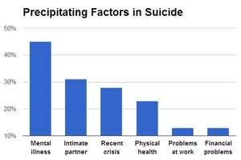

Slide 10



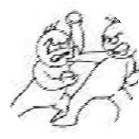
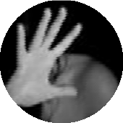
Etiology
Psychiatric Disorders
  Major depression 1.Schizophrenia
1.Drug or alcohol abuse 1.Dementia

Slide 11







1.Delirium
Personality disorder
  Physical Disorders
Patients with incurable or painful physical disorders like, cancer and AIDS.
  Psychosocial Factors 1.Failure in examination

Slide 12






1.Dowry difficulties
1.Marital difficulties
1.Loss of loved object Isolation and alienation from social
groups
1.Financial and occupational difficulties

Slide 13

Risk Factors for Suicide-
1. Age-
males above 40 years of age
females above 55 years of age
2. Sex-
men have greater risk of suicide
suicide is 3 times more common in men than women.
Being unmarried, divorced, widowed or separated
History of previous suicidal attempts
Recent losses

Slide 14

Management

Slide 15
VIOLENT BEHAVIOR
This is a severe form of aggressiveness. During this stage, patient will be irrational, uncooperative, delusional and assaultive.
Etiology-
Organic psychiatric disorders like, delirium, dementia, Wernicke-Korsakoff's psychosis also known as Korsakoff's amnesic syndrome(memory disorder).
Other psychiatric disorders like, schizophrenia, mania, agitated depression, withdrawal from alcohol and drugs, epilepsy, acute stress reaction, panic disorder and personality disorders.

Slide 16
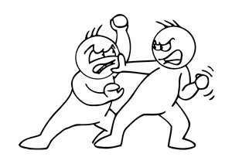
MANAGEMENT

Slide 17

PANIC ATTACKS
Episodes of acute anxiety and panic can occur as a part of psychotic or neurotic illness.
The patient will experience palpitations, sweating, tremors, feelings of choking, chest pain, nausea, abdominal distress, fear of dying, paresthesia’s, chills or hot flushes.

Slide 18
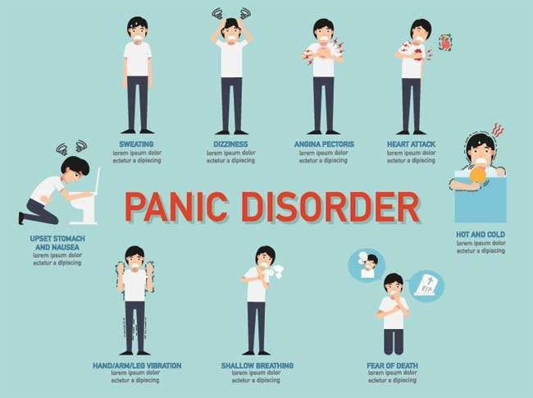

Slide 19

Management
Give reassurance first.
Search for causes.
Diazepam 10mg or lorazepam 2 mg may be administered.

Slide 20
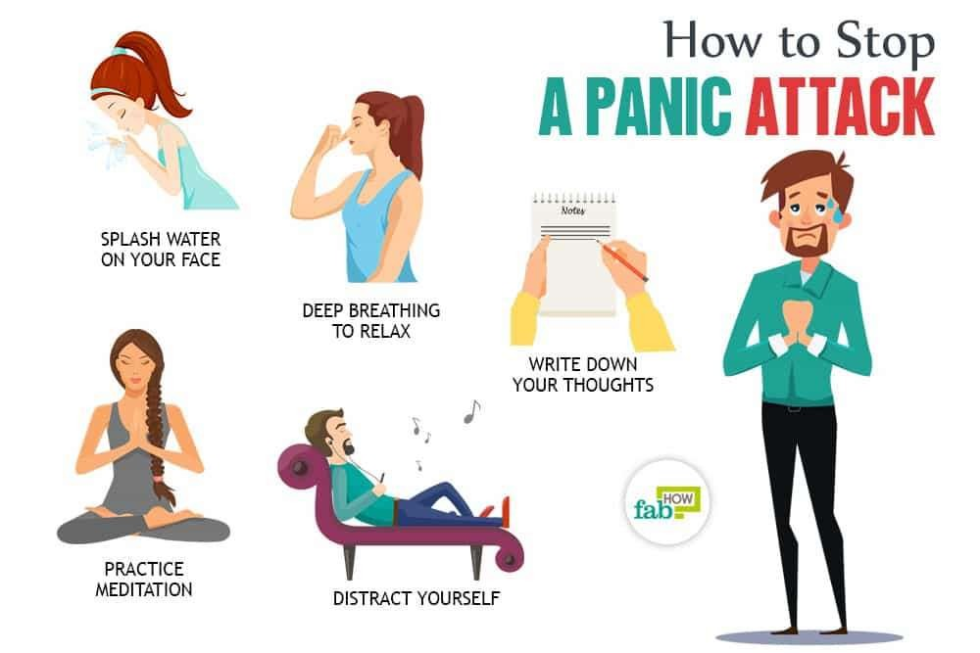

Slide 21
CATATONIC STUPOR
Stupor is a clinical syndrome of akinesias (loss of the power of voluntary movement) and mutism but with relative preservation of conscious awareness.
Catatonic is a psychomotor disorder, meaning it involves the connection between mental function and movement. Catatonia affects a person’s ability to move in a normal way.
People with catatonia can experience a variety of symptoms. The most common symptom is stupor, which means that the person can’t move, speak, or respond to stimuli. However, some people with catatonia may exhibit excessive movement and agitated behavior.

Slide 22
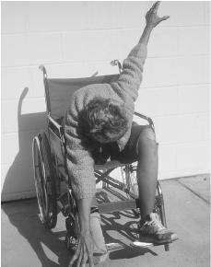
Management
Ensure patent airway.
Administer I.V. fluids.
Collect history and perform physical examination.
Draw blood for investigations before starting any treatment.
Other care is same as that for an unconscious patient.

Slide 23
General support-
Maintaining hydration, Patency of airway.
Checking cardiac function.
Others-
Care for excretory function, preventing bed sores.
Special support-
The identification and treatment of specific cause is also required

Slide 24
HYSTERICAL ATTACKS
A hysteric attack which is under voluntary control. Most common risk in children and also in females. The common modes of presentation may be:
Hysterical fits
Hysterical ataxia
Hysterical paraplegia
All presentations are marked by a dramatic quality and sadness of mood.

Slide 25

Management-
Hysterical fit must be distinguished from genuine fits.
As hysterical symptoms can cause panic among relatives, explain to the relatives the psychological nature of symptoms. Reassure that no harm would come to the patient.
Help the patient to realize the meaning of the symptoms and help him find alternative ways of coping with stress.
Suggestion therapy with I.V pentothal may be helpful in some cases.

Slide 26
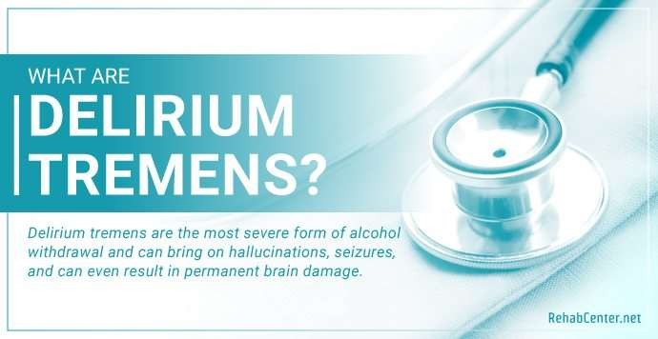

Slide 27
Management-
Keep the patient in a quiet and safe environment.
Sedation is usually given with diazepam 10mg or lorazepam 4mg IV, followed by oral administration.
DOC -Tab. Haloperidol check for side effects.
Maintain fluid and electrolyte balance.
Reassure patient and family.
An adequate intake of Vit B complex is important since its deficiency may contribute to delirium.

Slide 28
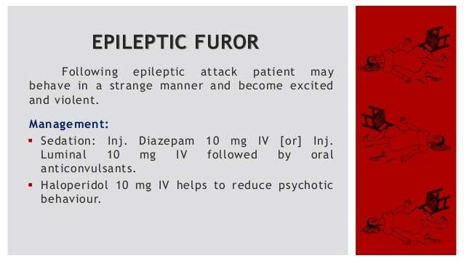

Slide 29
ACUTE DRUG-INDUCED EXTRAPYRAMIDAL SYNDROME
Antipsychotics can cause a variety of movement related side-effects, collectively known as extrapyramidal symptoms (EPS).
Neuroleptic malignant syndrome is rare but most serious of these symptoms and occurs in a small minority of patients taking neuroleptics, especially high potency compounds.

Slide 30
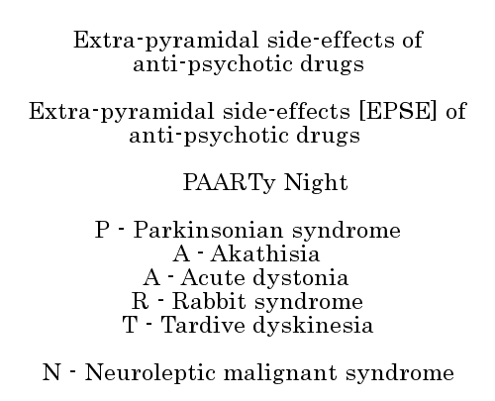

Slide 31
Management
The drug should be stopped immediately.
Treatment is symptomatic and includes cooling the patient, maintaining fluid and electrolyte balance and treating intercurrent infections.
Diazepam can be used for muscle stiffness.
Dantrolene, a drug used to treat malignant hyperthermia, bromocriptine,
amantadine and L-dopa have been used.
Drug toxicity or over-dosage may be accidental or suicidal. In either case all attempts must be made to find out the drug consumed. A detailed history should be collected and symptomatic treatment instituted.
A common case of drug poisoning is lithium toxicity. The symptoms include drowsiness, vomiting, abdominal pain, confusion, blurred vision, acute circulatory failure, stupor and coma, generalized convulsions, oliguria and death.

Slide 32

GENERAL GUIDELINES TO MANAGE WITH THE PSYCHIATRIC EMERGENCY

Slide 33

Handle with the utmost of tact and speech so that wellbeing of other patients is not affected.
Act in a calm and coordinate manner to prevent other clients from getting anxious.
Shift the client as early as possible to a room where they can be safe guarded against injury.
Ensure that all other clients are reassured and the routine activities proceed normally.
Psychiatric emergencies overlap medical emergencies and staff should be familiar with the management of both.

Slide 34

SUMMARY…

Slide 35


