Slide 1

POSTPARTUM HEMORRHAGE
MRS. PREETI BAHUGUNA
ASSISTANT PROFESSOR

Slide 2
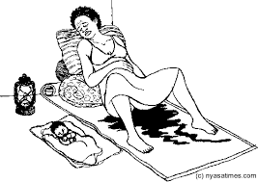
POSTPARTUM HEMORRHAGE

Slide 3
OBJECTIVES
Definition
Incidence
Types
Causes
Clinical features
Prevention
Management

Slide 4

Definition
“Post-partum hemorrhage is defined as a blood loss of more than 500 ml after birth of baby up to the end of puerperium (12 weeks).

Slide 5
Incidence
PPH complicates about 2-11% of all deliveries. Life threatening PPH is rare occurring in 1 per 1000 deliveries.

Slide 6
Types
Primary PPH
Blood loss of more than 500 ml (1 L for cesarean section) from or into the genital tract in the first 24 hours of childbirth” (WHO 1990).
2. Secondary PPH
The bleeding occurring after 24 hours of delivery is termed as secondary PPH.

Slide 7
Causes of PPH
Causes
Thrombosis
Tone
Trauma
Tissue

Slide 8
Clinical features
Tachycardia pulse
Tachyponea respiration
Hypotension blood pressure
Hypothermia temperature
Semi conscious or unconscious

Slide 9
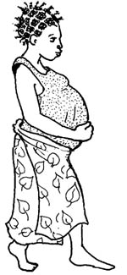

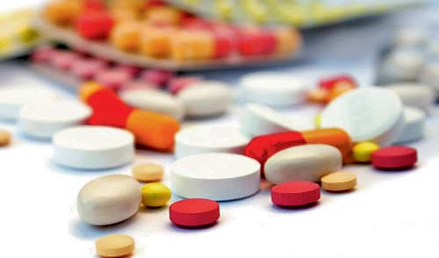
Preventive measures
During antenatal period:
Effective screening for iron deficiency anemia and ensuring the intake of IFA tablets .

Slide 10
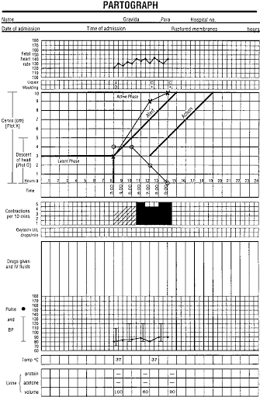
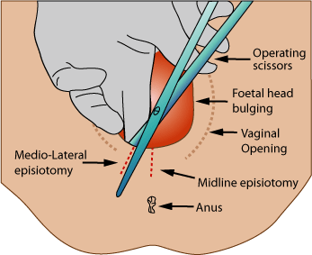
During intrapartum period
Use of partograph
Limiting episiotomy

Slide 11
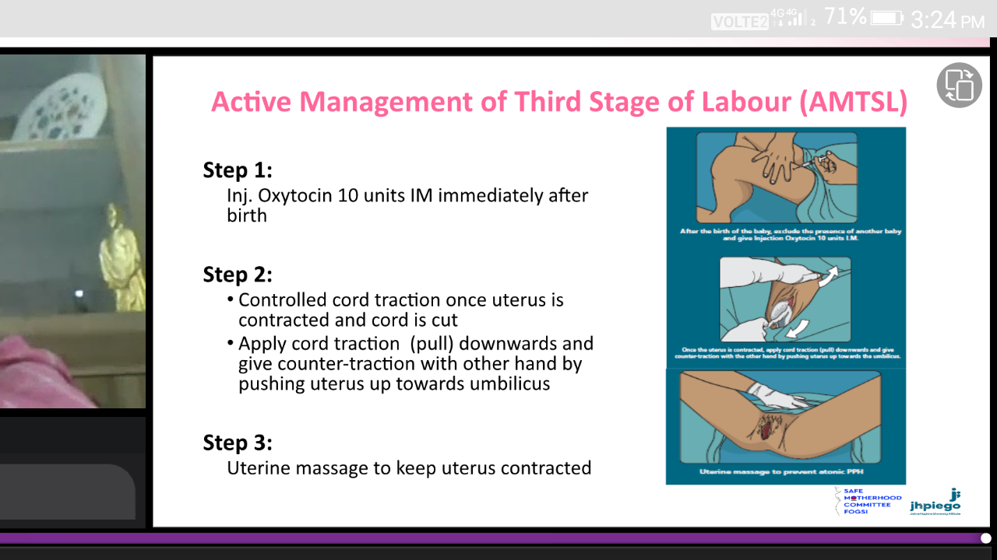

Slide 12
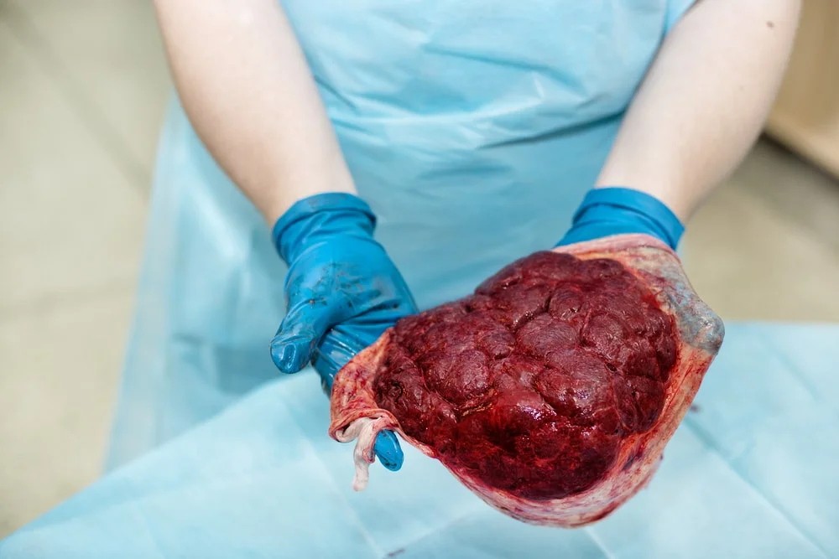
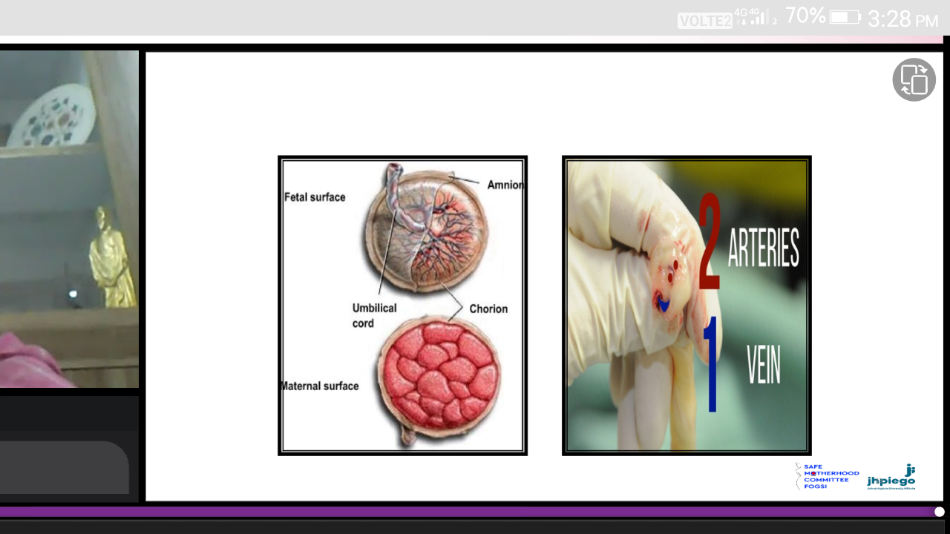
Placental examination

Slide 13

During postpartum period
Routine immediate postpartum care & monitoring

Slide 14
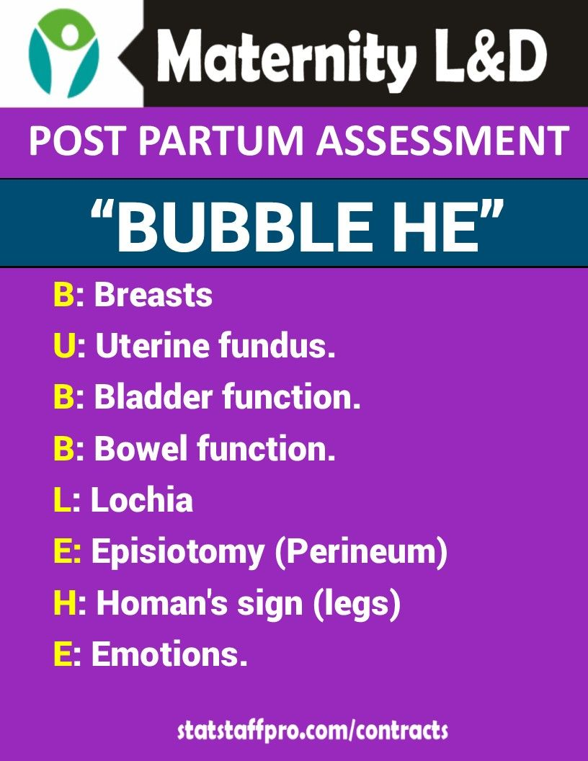

Slide 15
Diagnosis
Estimation of blood loss (this may be done by counting the number of saturated pads, or by weighing of packs and sponges used to absorb blood; 1 milliliter of blood weighs approximately one gram).

Slide 16
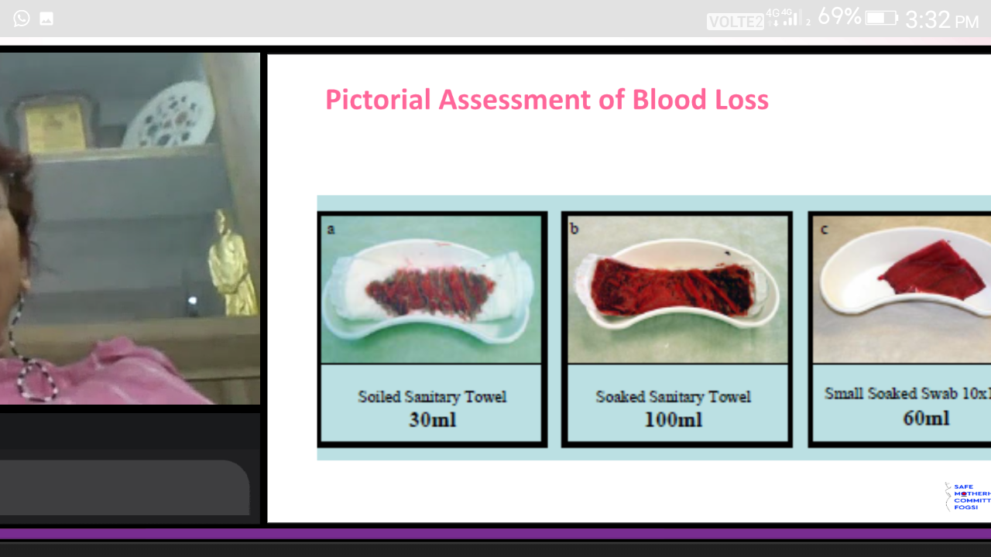

Slide 17
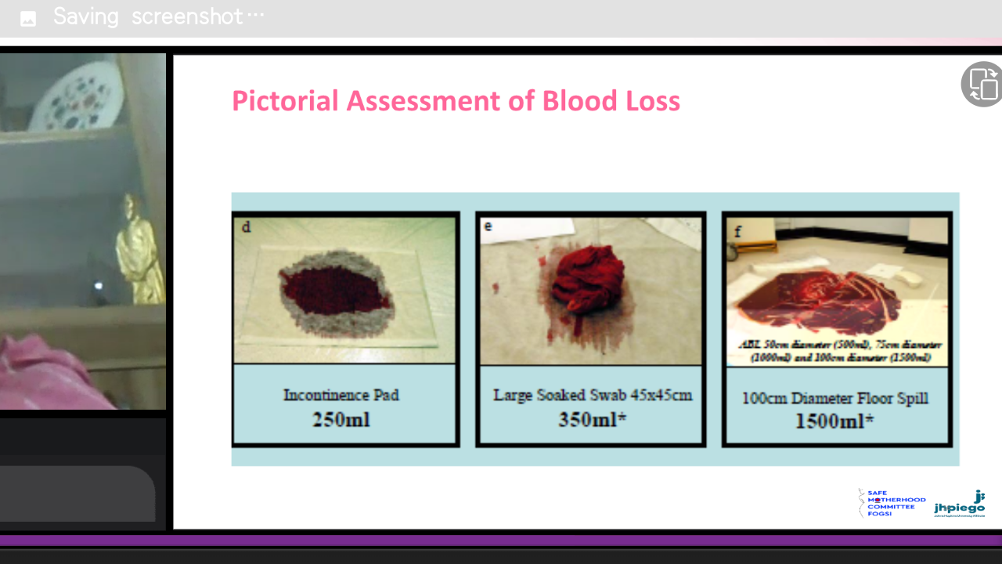

Slide 18
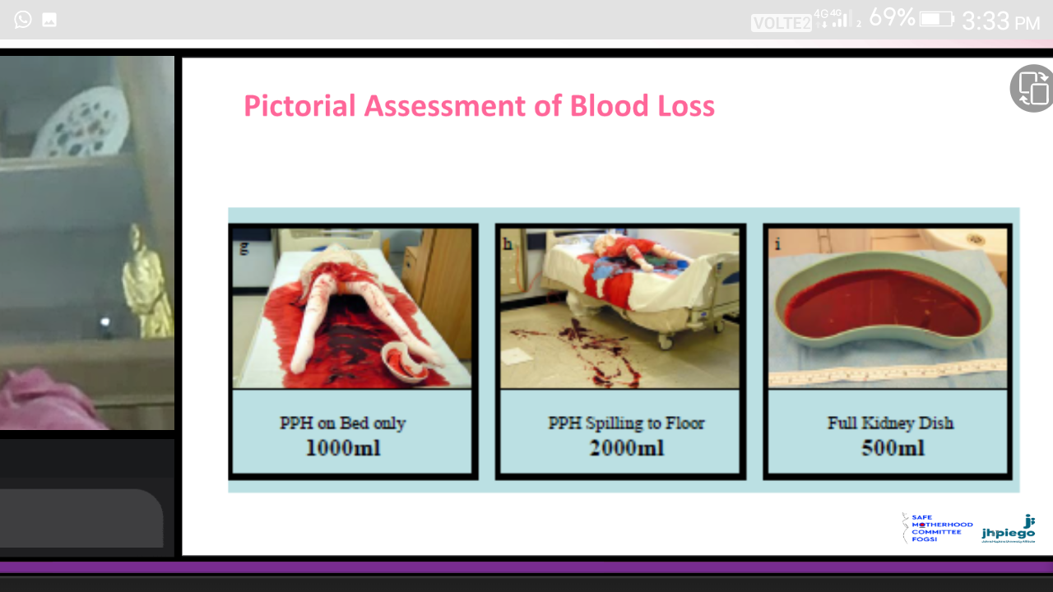

Slide 19

Case Scenario
The nurse is taking the vital signs of a client who delivered a healthy newborn 8 hours ago. The nurse notes that the client’s temperature is 100.2֯ F, B.P. is 60/40 mm Hg, pulse is 100 beat/min and she is bleeding. What should be your initial nursing action?

Slide 20
How do we manage initial PPH?

Slide 21
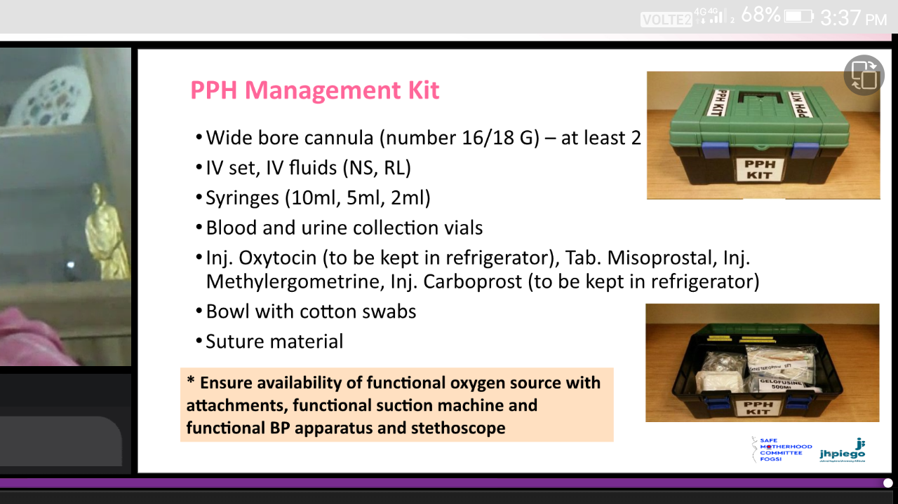

Slide 22
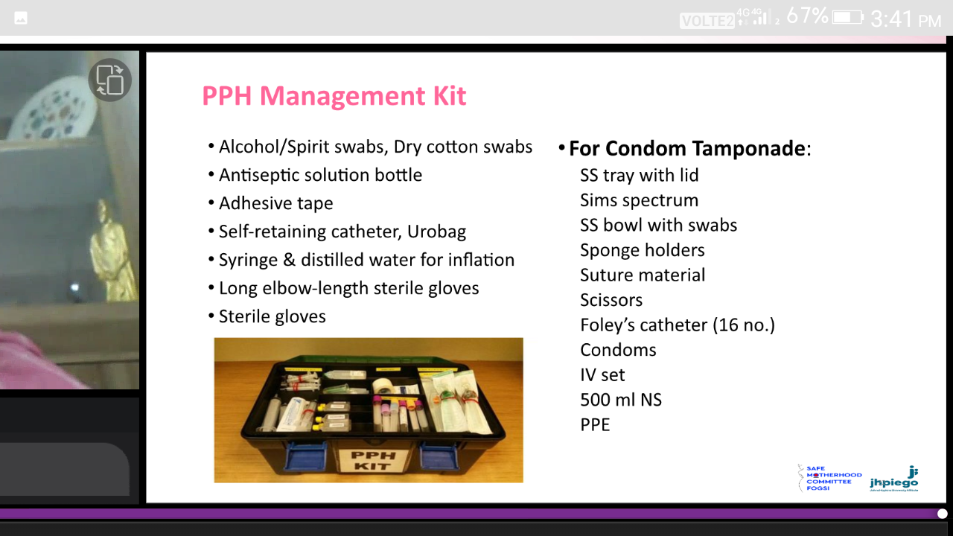

Slide 23

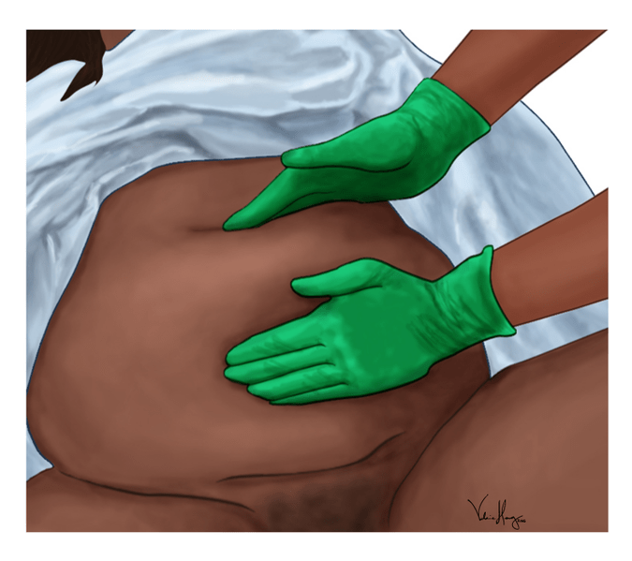
Management of PPH
Call a senior doctor, an anesthetist and extra help.
Massage the uterus abdominally to make it hard.

Slide 24
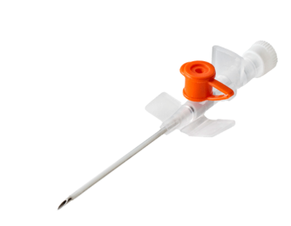
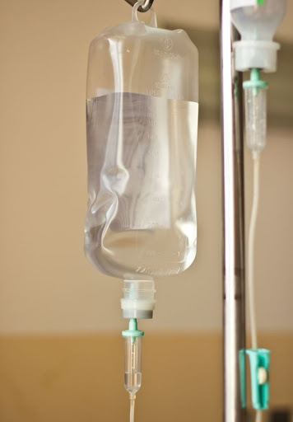
3. Attain intravenous access by using two large bore cannulae (size 14,16).
4. Quick infusion of isotonic crystalloids (normal saline, ringer lactate, dextrose saline) 1-2 litres

Slide 25
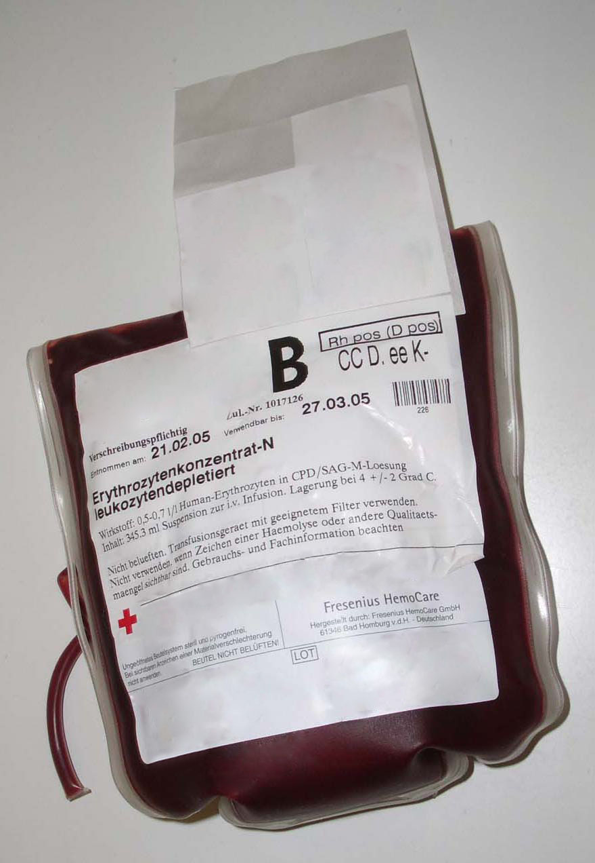
5. At least 2 units of blood should be arranged after grouping and cross matching the blood.
Blood component therapy: One unit of fresh frozen plasma (FFP) should be given for every 3 packed RBCs transfusions.

Slide 26
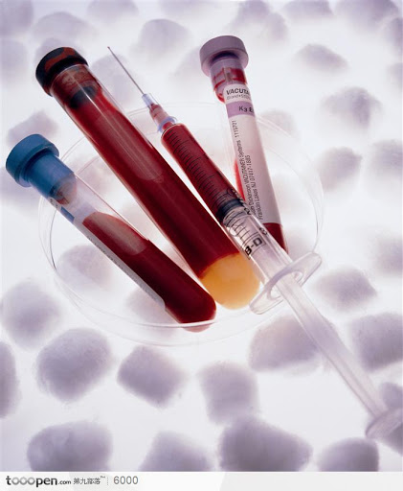
6. Monitoring of vital signs and maintenance of airways.
7. Confirmation of diagnosis.

Slide 27
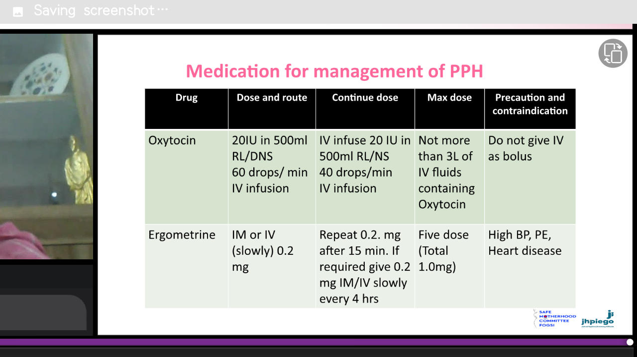
8. medical

Slide 28
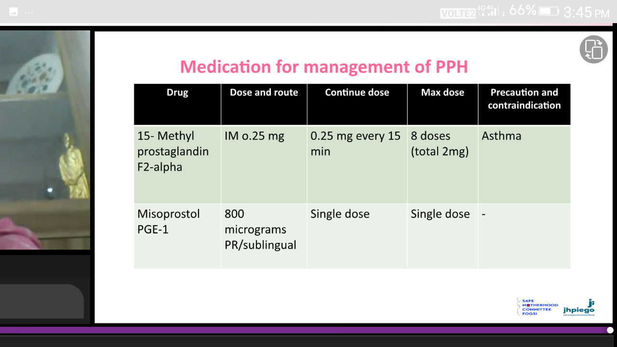

Slide 29
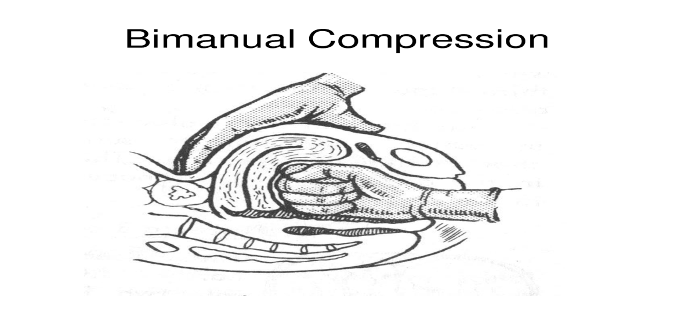
9. Uterine massage and bimanual compression.

Slide 30
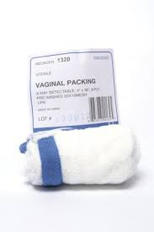
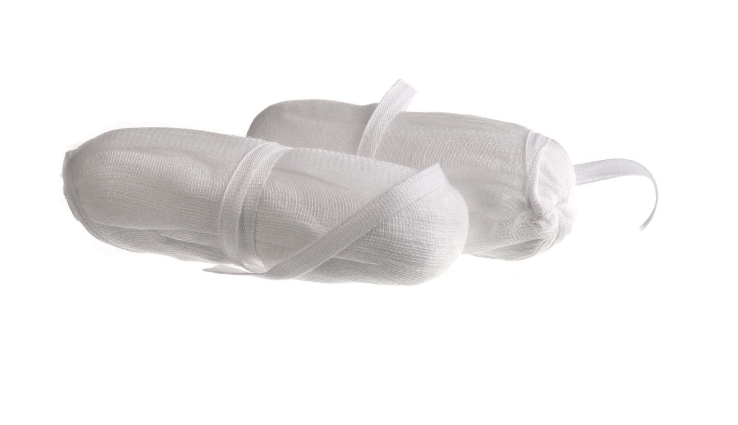
10. Intrauterine packing (uterine tamponade) done under general anesthesia.

Slide 31
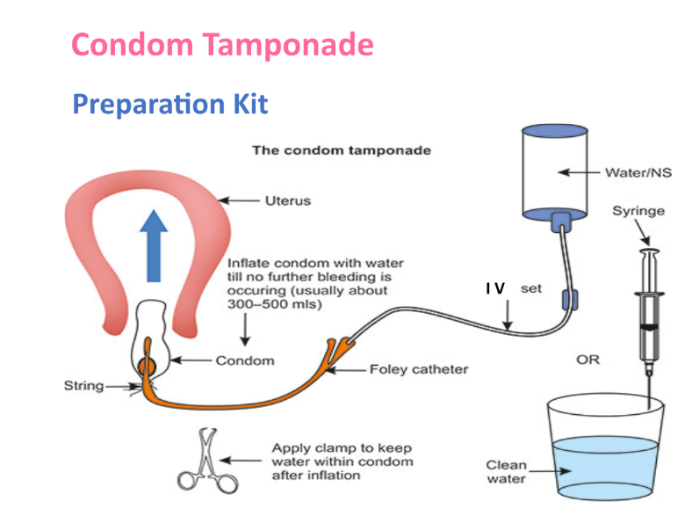

Slide 32
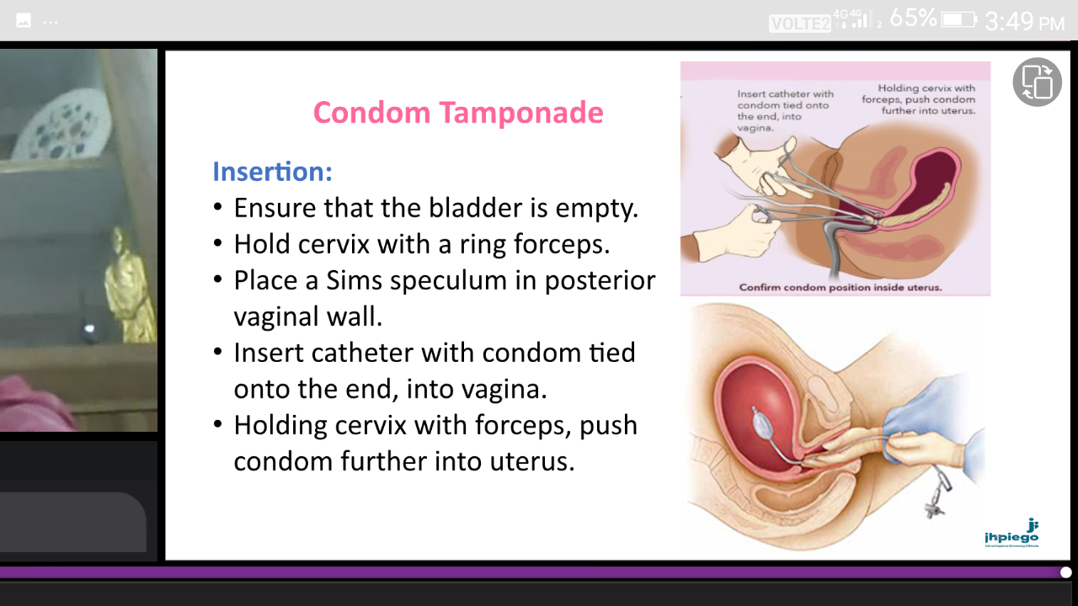

Slide 33
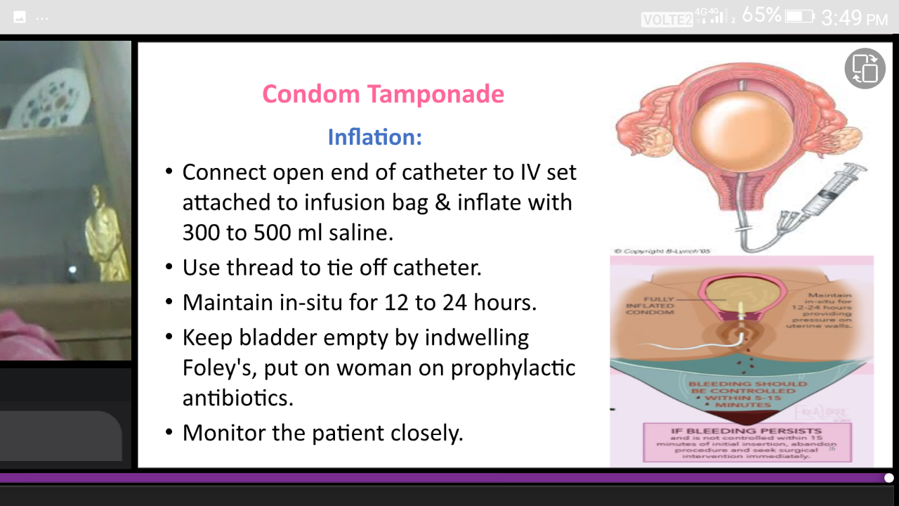

Slide 34

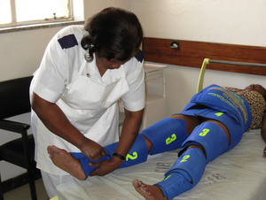
11. The military anti-shock garment or treatment (MAST): it is a giant pressure cuff that applies external counter pressure to legs and abdomen.

Slide 35
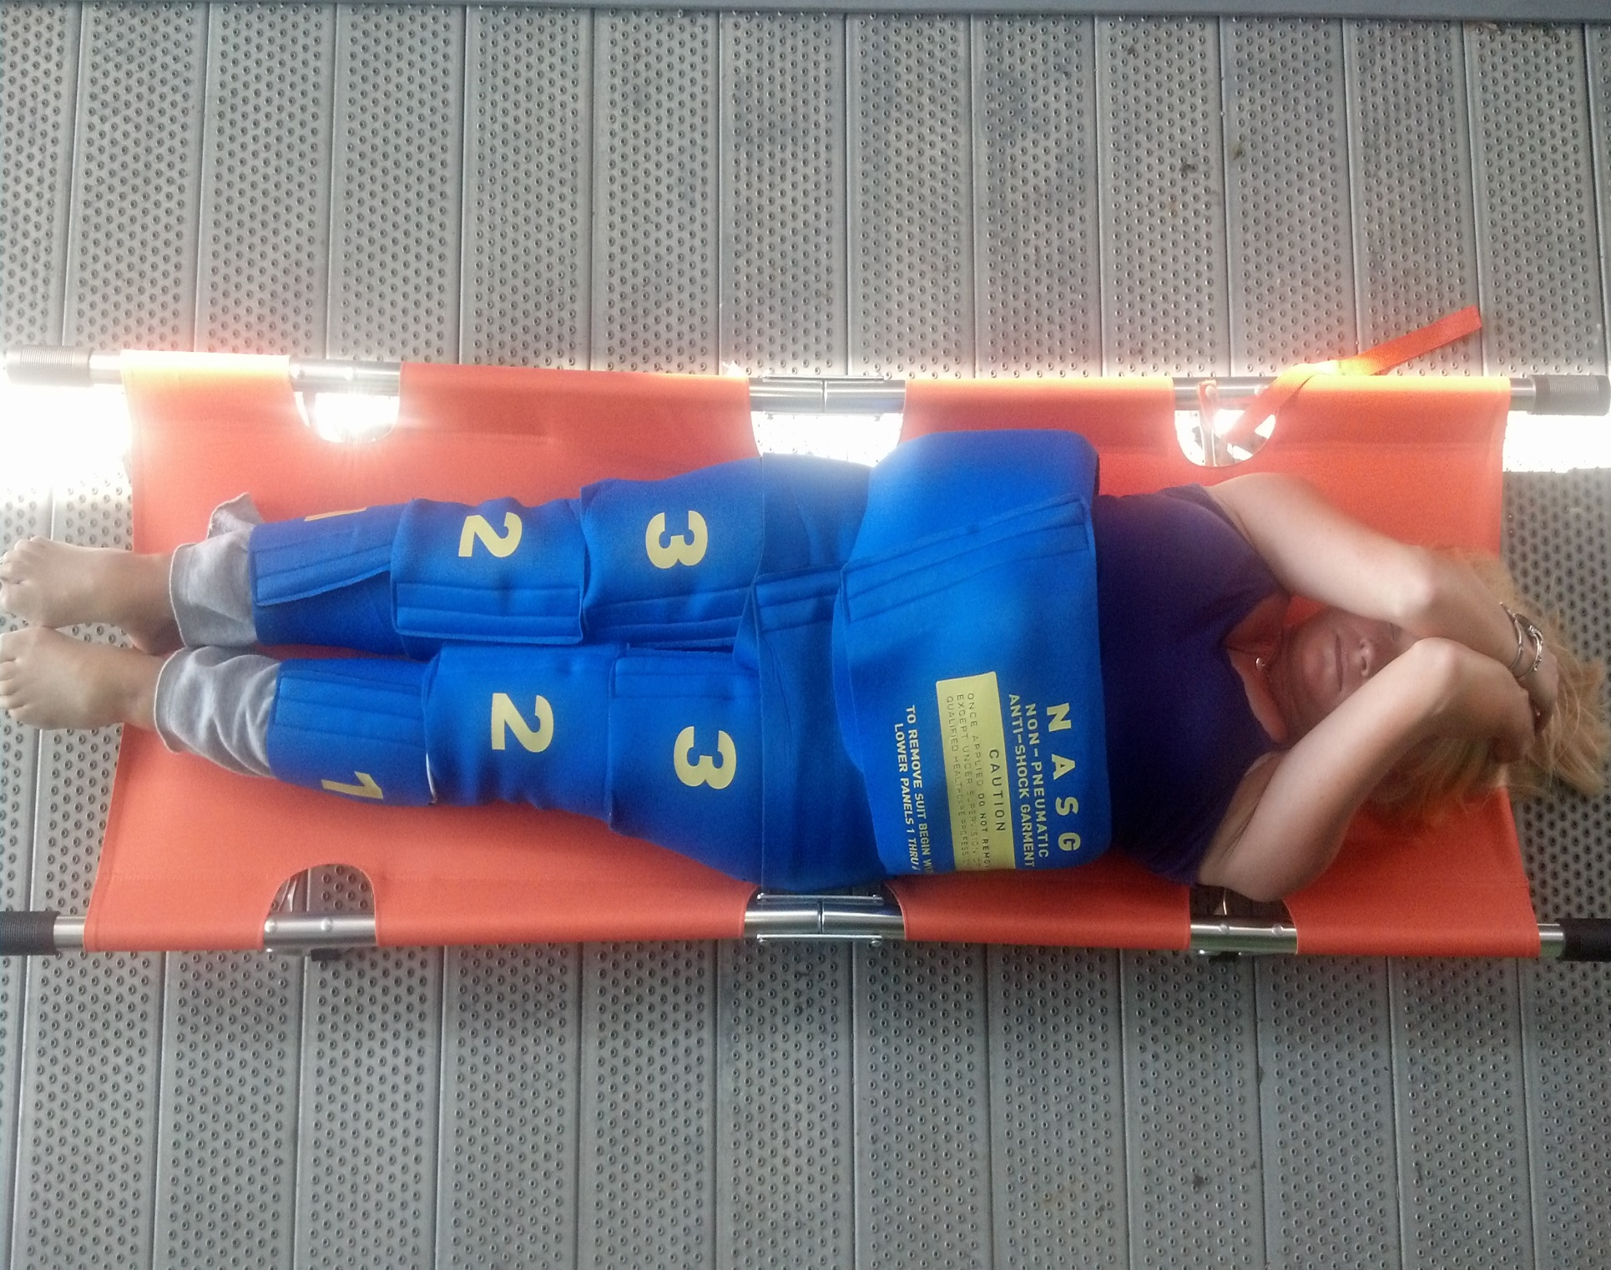

Slide 36
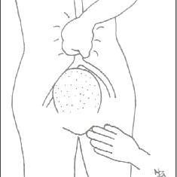
12. External Aortic compression
Apply downward pressure with closed fist over abdominal aorta directly through abdominal wall.
Maintain compression until bleeding is controlled.

Slide 37
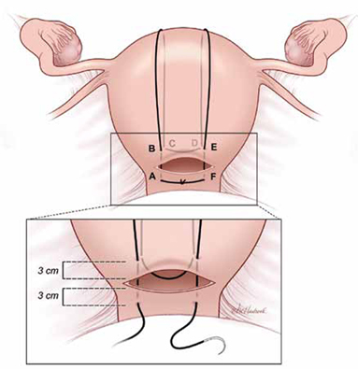
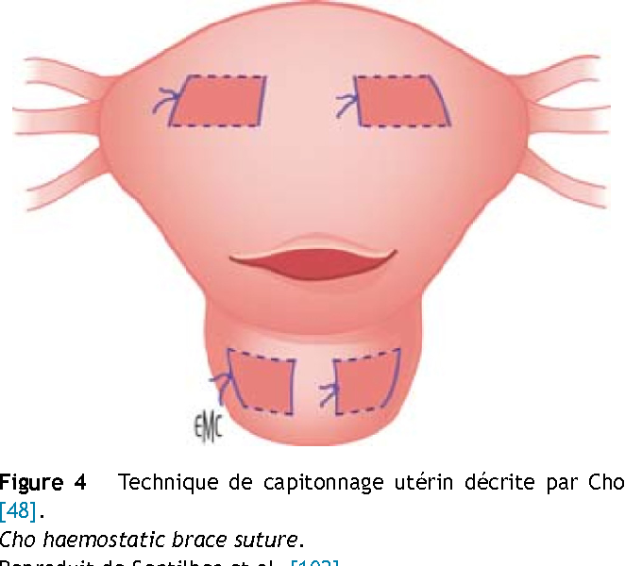
13. Compression sutures
B Lynch sutures
Cho’s multiple square sutures
Hayman’s sutures

Slide 38
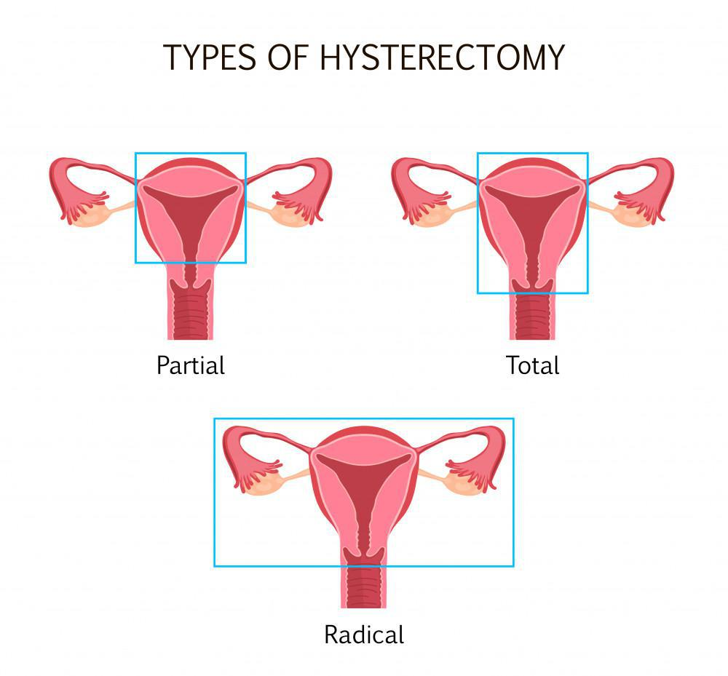
14. a) bilateral uterine artery ligation
b) bilateral ovarian artery ligation
c) bilateral or unilateral ligation of internal iliac artery
15. Hysterectomy

Slide 39

Prompt diagnosis & management of PPH saves the life of the mother

Slide 40
References
Dr. J. B Sharma. Textbook of obstetrics, first edition; 2018, New Delhi, Avichal Publishing Company: p.p. 334-341.

Slide 41


