Slide 1



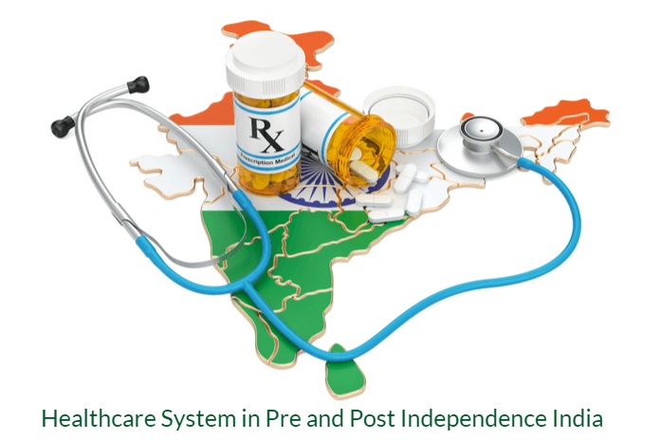

HEALTH CARE DELIVERY SYSTEM IN INDIA: ADMINISTRATION & ORGANIZATION
BY: ANAND PRAKASH
, DEPT. OF CHN ROHILKHAND COLLEGE OF NURSING
BAREILLY (UK)

Slide 2


INTRODUCTION
Health is a state of complete Physical, Mental and Social well being and not merely an absence of disease or infirmity which allows a person to live a socio- economically productive life.
Illness is a state in which a person’ s physical, emotional, intellectual, social or spiritual functioning is diminished or impaired.

Slide 3
INTRODUCTION
Health care is multitude of services rendered to individuals or communities by the agents of health services or professional for the purpose of :
Promoting
Restoring and
Maintaining health

Slide 4
INTRODUCTION
Health Care provider: A person or organization that provides services and/or health care personnel to deliver proper health care in a systematic way to any individual in need of health care services.
Could be a government…or the health care industry,
A health care equipment company,
An institution such as a hospital or laboratory.
Health care professionals may include doctors, nurses and other support staff.

Slide 5
INTRODUCTION
Health services: Permanent countrywide system of established institutions with the objective of coping with the various health needs and demands of population thereby provide health care to individuals and community with preventive and curative activities utilizing health care workers.
Health services consist of medical professionals, organizations, and ancillary health care workers who provide medical care to those in need. Health services serve patients, families, communities and populations. They cover all types of care.

Slide 6
INTRODUCTION
The purpose of health care services is to improve the health status of the population. The goals to be achieved have been fixed in terms of mortality and morbidity reduction, increase in expectation of life , decrease in population growth rate, improvements in nutritional status, provision of basic sanitation, health manpower requirements and resources development and certain other parameters such as food production, literacy rate, reduced levels of poverty, etc.

Slide 7
INTRODUCTION
Health System includes:
Concepts ( e.g health and diseases)
Ideas(e.g equity)
Objects(e.g hospitals, health centres)
Persons (health care workers viz. physician, nurses)
Together these forms a system interacting with each other, supporting and controlling each other

Slide 8
INTRODUCTION
Health system covers a whole extent of health activities, health programmes, institutions providing medical care such as hospitals, clinics and primary health care centres and the policies enunciated by governments to provide optimal health care for its citizens.
Health System as described by WHO is the "sum total of all the organisations, institutions and resources whose primary purpose is to improve health."

Slide 9






INTRODUCTION
The health care system is intended to deliver the health care services. It constitutes the management sector and involves organisational matters.
Health Care Delivery System: A health care delivery system is an organization of people, institutions, and resources to deliver health care services to meet the health needs of a target population.

Slide 10
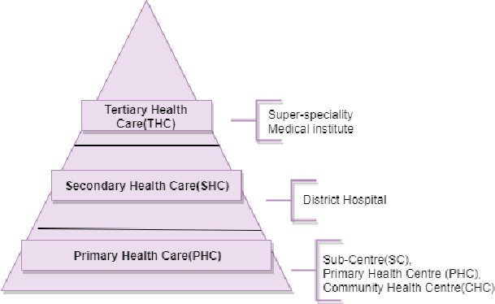
LEVELS OF HEALTH CARE

Slide 11
Organization & Administration of Health Care Delivery System in India
Health administration is the science of the organizing and coordinating government agencies whose purpose is to improve the physical, mental and social well-being of the people of the country.
India is a Union of 28 States and 8 Union territories.
The Central responsibility of an organization of policy making, planning, guiding, assisting, evaluating, and coordinating the work of the State Health Ministries, so that health services cover every part of the country.

Slide 12









Organization & Administration of Health Care Delivery System in India
The health system in India has 3 main links :
Central
State and
Local or Peripheral (District).

Slide 13




Organization & Administration of Health Care Delivery System in India
HEALTH SYSTEM IN INDIA
AT THE LOCAL OR PERIPHERAL
AT THE CENTRE
AT THE STATE

Slide 14
A. AT THE CENTRE
The official "organs" of the health system at the national level consist of :
The Ministry of Health and Family Welfare
The Directorate General of Health Services (DGHS); and
The Central Council of Health and Family Welfare.

Slide 15
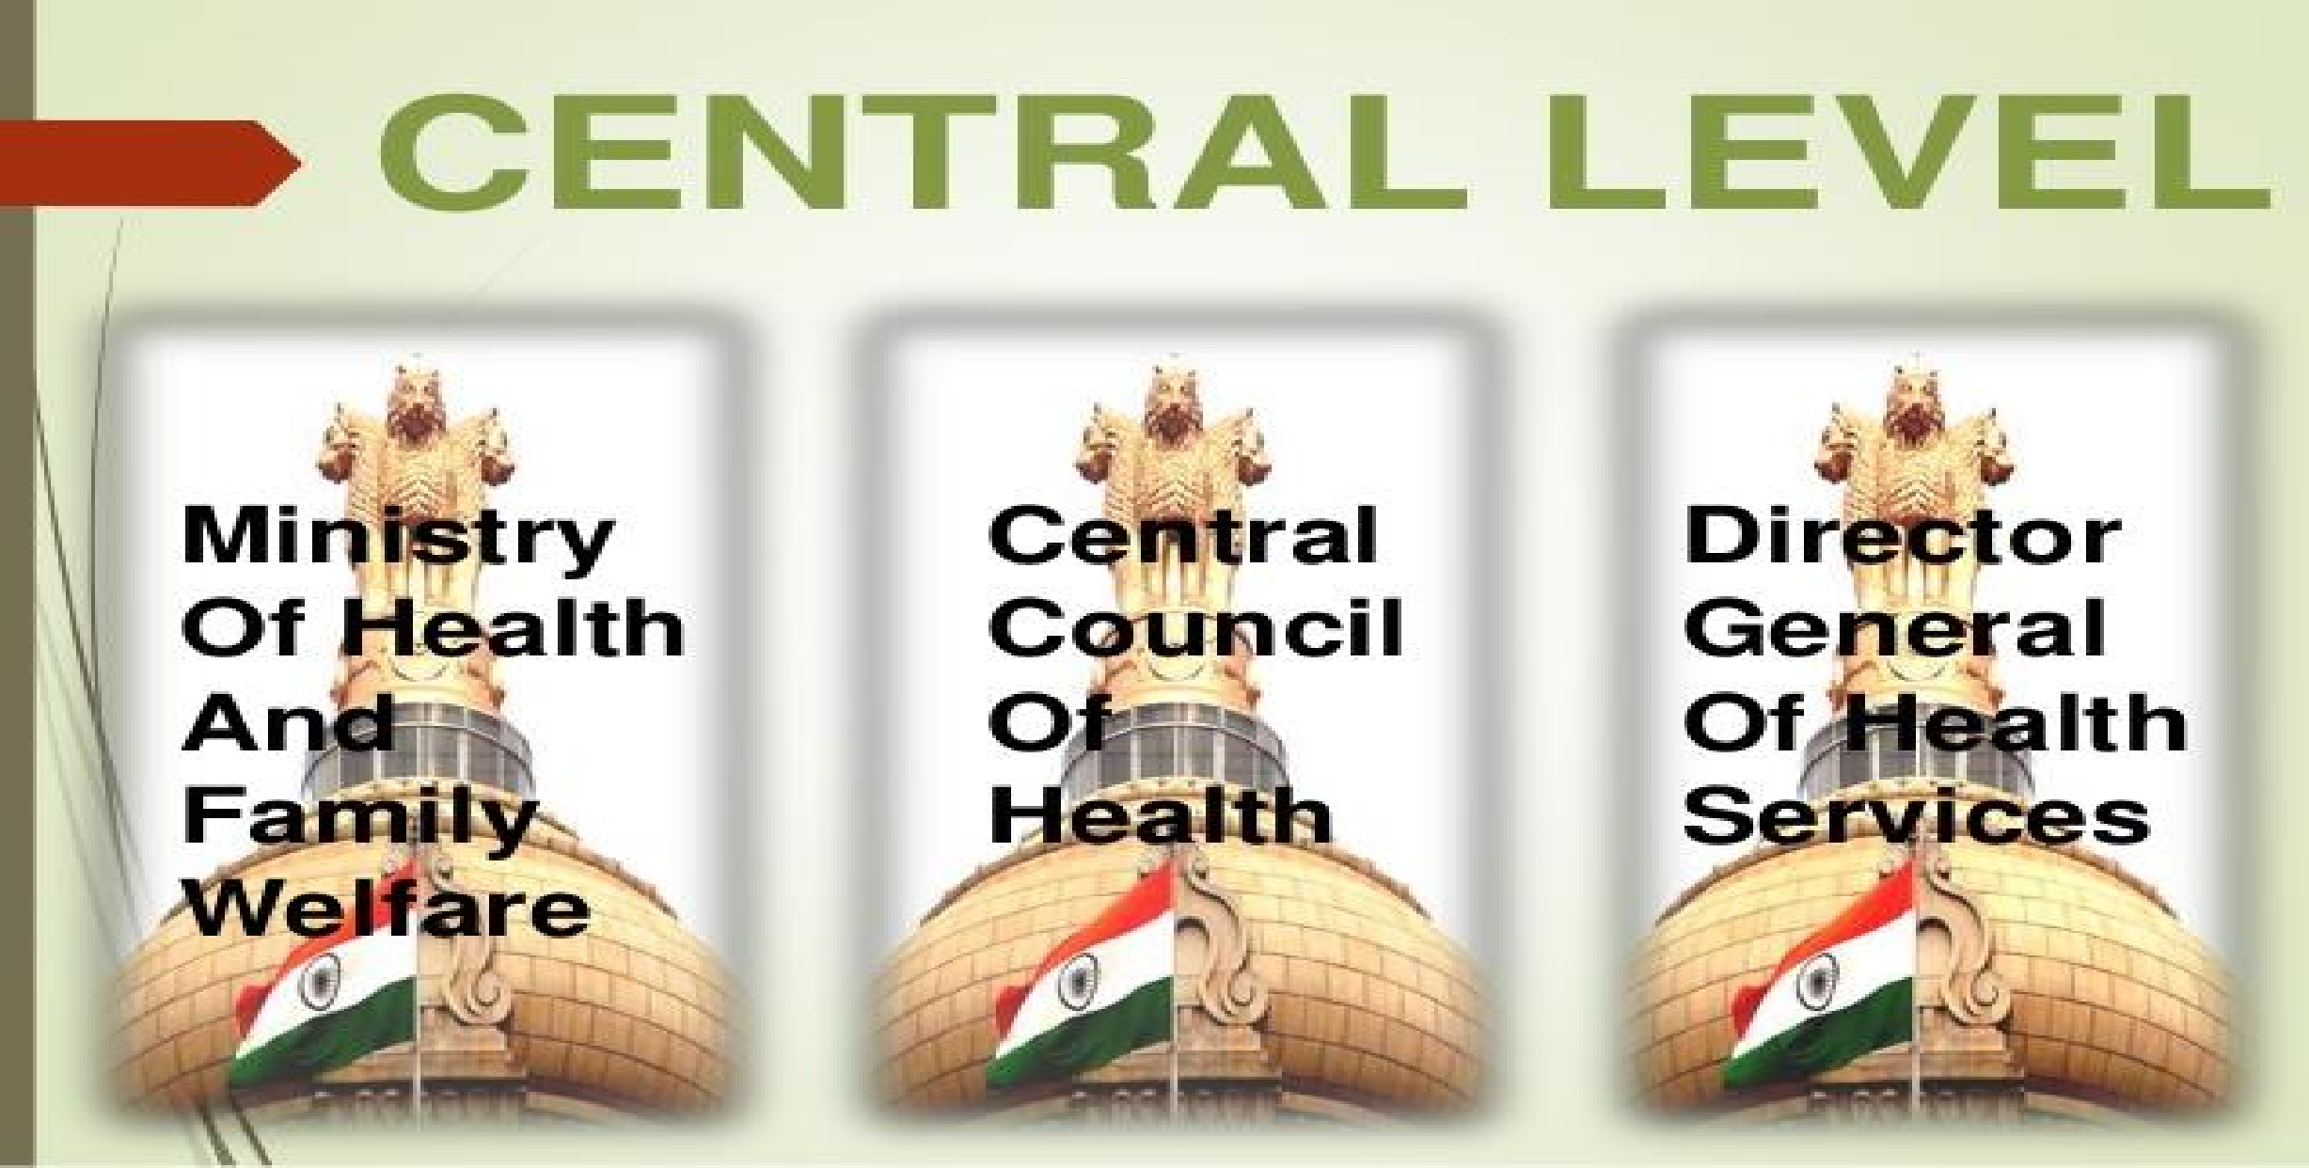

Slide 16
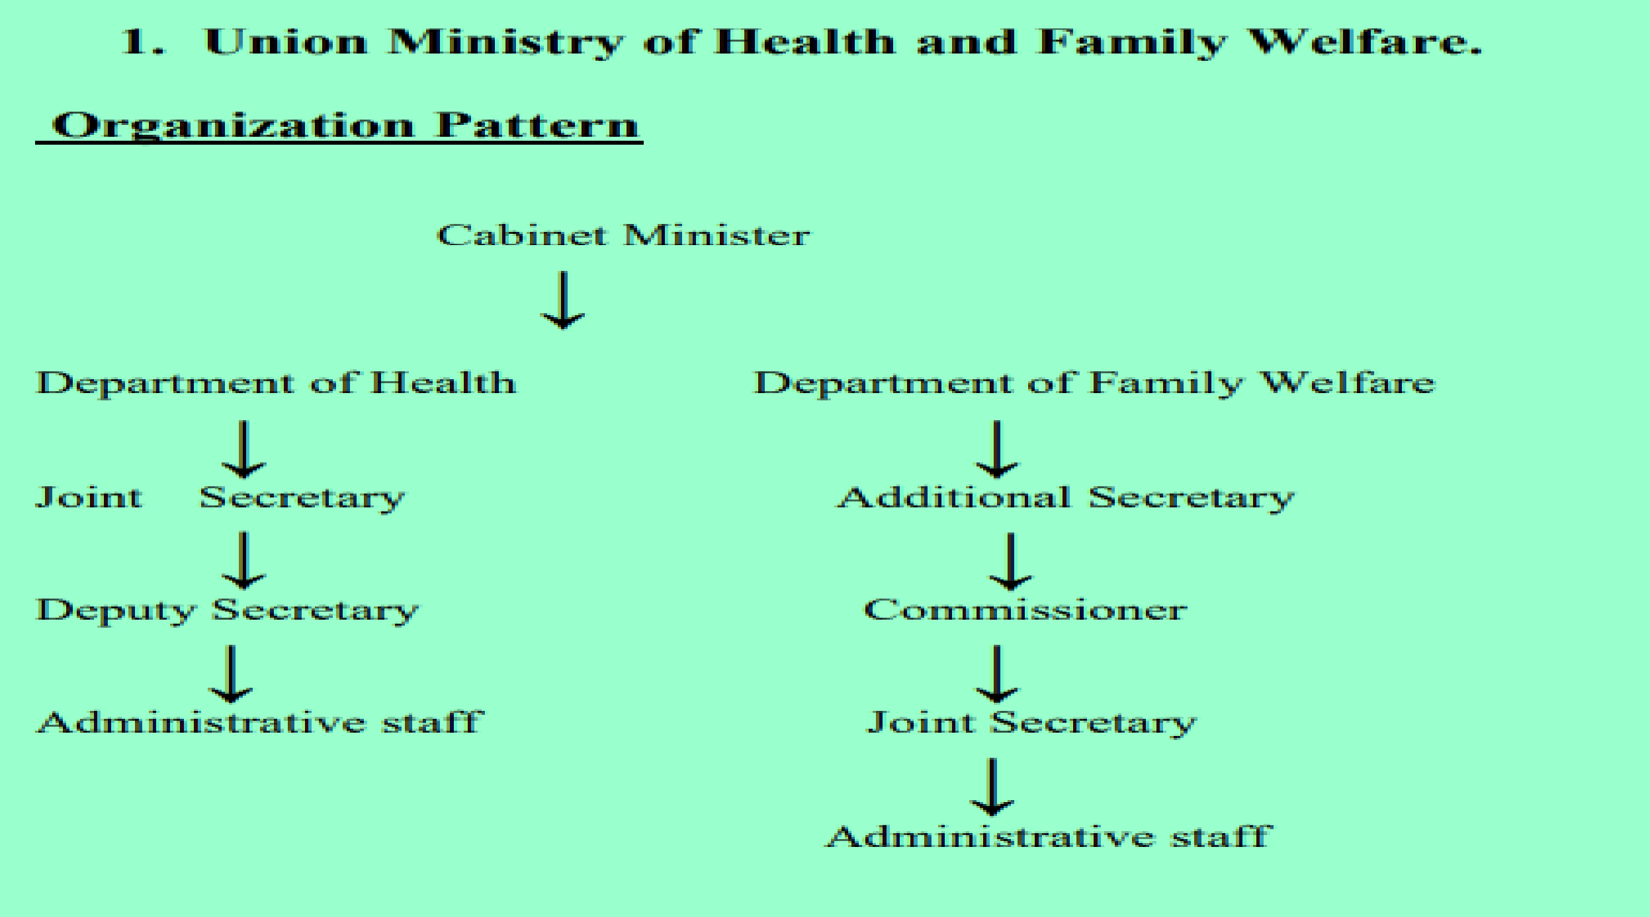

Central Health Minister
(1) The Ministry of Health and Family Welfare

Slide 17

(1) The Ministry of Health and Family Welfare
FUNCTIONS:
The functions of the Union Health Ministry are set out in the seventh schedule of Article 246 of the Constitution of India under
(a ) The Union list and
(b) The Concurrent list.

Slide 18
(1) The Ministry of Health and Family Welfare
(a ) The Union list Functions:
International health relations and administration of port quarantine.
Administration of central institutes such as the All India Institute of Hygiene and Public Health, Kolkata; National Institute for the Control of Communicable Diseases, Delhi, etc.
Promotion of research through research centers and other bodies.

Slide 19

(1) The Ministry of Health and Family Welfare
Regulation and development of medical, pharmaceutical, dental and nursing professions.
Establishment and maintenance of drug standards.
Census, and collection and publication of other statistical data.
Immigration and emigration.
Regulation of labour in the working of mines and oil fields and
Coordination with States and with other ministries for promotion of health.

Slide 20
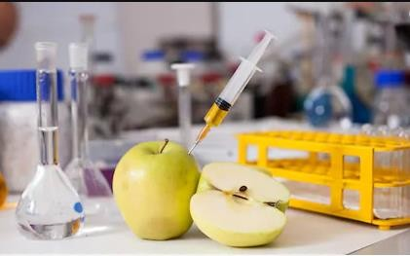
(1) The Ministry of Health and Family Welfare
(b) Concurrent list: The functions listed under the concurrent list are the responsibility of both the Union and State governments.
Prevention of communicable diseases
Prevention of adulteration of foodstuffs
Control of drugs and poisons
Vital statistics

Slide 21

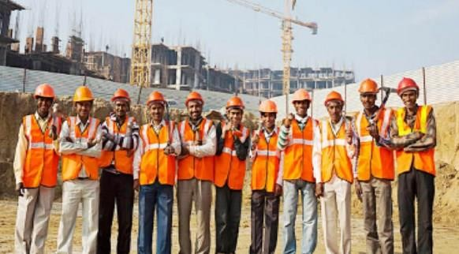
(1) The Ministry of Health and Family Welfare
Labour welfare
Economic and social planning, and
Population control and Family Planning

Slide 22
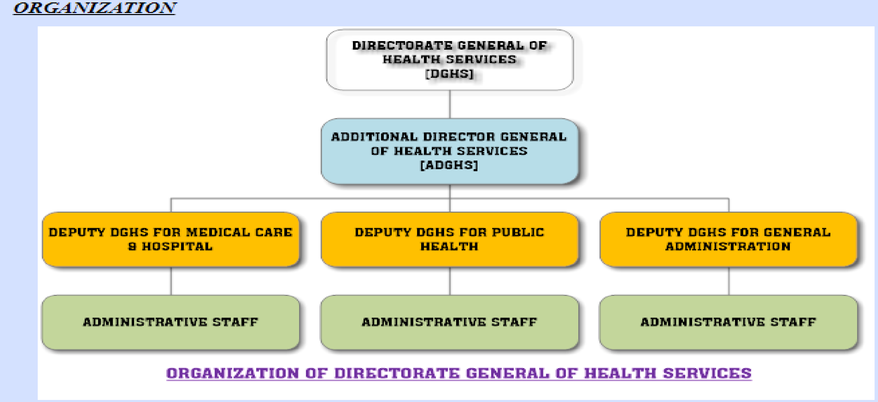
2). The Directorate General of Health Services (DGHS)

Slide 23
2). The Directorate General of Health Services (DGHS)
The general functions are surveys, planning, coordination, programming and appraisal of all health matters in the country.
The specific functions are:

Slide 24
2). The Directorate General of Health Services (DGHS)
The general functions are surveys, planning, coordination, programming and appraisal of all health matters in the country.
The specific functions are:
International health relations and quarantine
Control of drug standards
Medical store depots

Slide 25
2). The Directorate General of Health Services (DGHS)
Post graduate training
Medical education
Medical Research
Central Govt. Health Scheme
National Health Programmes
Central Health Education Bureau

Slide 26
2). The Directorate General of Health Services (DGHS)
Health Intelligence
National Medical Library

Slide 27
3). Central Council of Health
The Central Council of Health was set up by a Presidential Order on 9 August, 1952 under Article 263 of the Constitution of India for continuous consultation, mutual understanding and cooperation between the Centre and the States in the implementation of all the programmes and measures pertaining to the health of the nation.

Slide 28
3). Central Council of Health
ORGANIZATION:
The Union Health Minister is the Chairman and the State Health Ministers are the members.

Slide 29

3). Central Council of Health
FUNCTIONS:
To consider and recommend broad outlines of policy in regard to matters concerning health in all its aspects such as the provision of remedial and preventive care, environmental hygiene, nutrition, health education and the promotion of facilities for training and research.
To make proposals for legislation in fields of activity relating to medical and public health matters and to lay down the pattern of development for the country as a whole

Slide 30
3). Central Council of Health
To make recommendations to the Central Government regarding distribution of available grants-in-aid for health purposes to the States and to review periodically the work accomplished in different areas through the utilization of these grants-in-aid.
To establish any organisation or organizations invested with appropriate functions for promoting and maintaining cooperation between the Central and State Health administrations.

Slide 31





B). AT THE STATE LEVEL
AT THE STATE LEVEL
STATE MINISTRY OF HEALTH & FAMILY WELFARE
STATE HEALTH DIRECTORATE
MEDICAL EDUCATION
HEALTH SERVICES

Slide 32
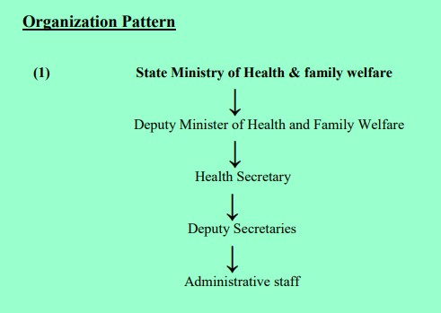

Slide 33
1). State Ministry of Health & Family Welfare
The State Ministry of Health is headed by a Minister of Health and Family Welfare and a Deputy Minister of Health and Family Welfare. These are political appointments and they are elected members of legislative assembly.
They have political responsibilities, responsibilities towards their constituencies as per their political agenda, and responsibilities for formulating policies, monitoring the implementation of these policies and programmes, administration and management of Health and Family Welfare services in their state.

Slide 34


Health Secretariat
Functions: The major functions which are performed by the secretariat include helping minister in:-
Formulation, review and modification of broad policy outlines.
Execution of policies programmes etc.
Coordination with Government of India and other state Governments.
Control for smooth and efficient functioning of administrative machinery.

Slide 35
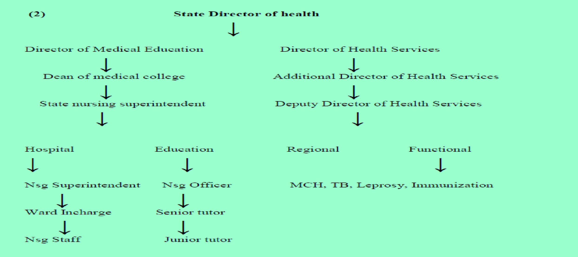
ORGANIZATION PATTERN OF STATE HEALTH DIRECTORATE

Slide 36

FUNCTION OF STATE HEALTH DIRECTORATE
Studies in depth the health problem and needs in the state and plans scheme to solve them.
Implementation of national health programmes and evaluating their achievements.
Promoting providing and supervising all types of health services in the state such as primary health services; school health services; family planning services; MCH; occupational health services etc.

Slide 37
FUNCTION OF STATE HEALTH DIRECTORATE
Collection of vital statistics.
Encouraging reproductive and child health (Family welfare. maternal health etc.)
Improvement of nutrition programme and Controlling food adulteration and also sanitation in milk and edibles
Medical and nursing education, training of nurses, female health workers and other health workers.

Slide 38
FUNCTION OF STATE HEALTH DIRECTORATE
Controlling rural and urban health services through district medical officer.
Providing feedback to the state health ministry regarding health.
Following the directives of union ministry of health/state health ministry.

Slide 39
C). AT THE LOCAL / DISTRICT LEVEL
The principal unit of administration in India is the district under a Collector. There are 707 (year 2016) districts in India.
District is Peripheral most Planning unit.

Slide 40

C). AT THE LOCAL / DISTRICT LEVEL
Within each district again , there are 6 types of administrative areas :
Sub-divisions
Tahsils (Talukas)
Community Development Blocks
Municipalities and Corporations
Villages
Panchayats.

Slide 41
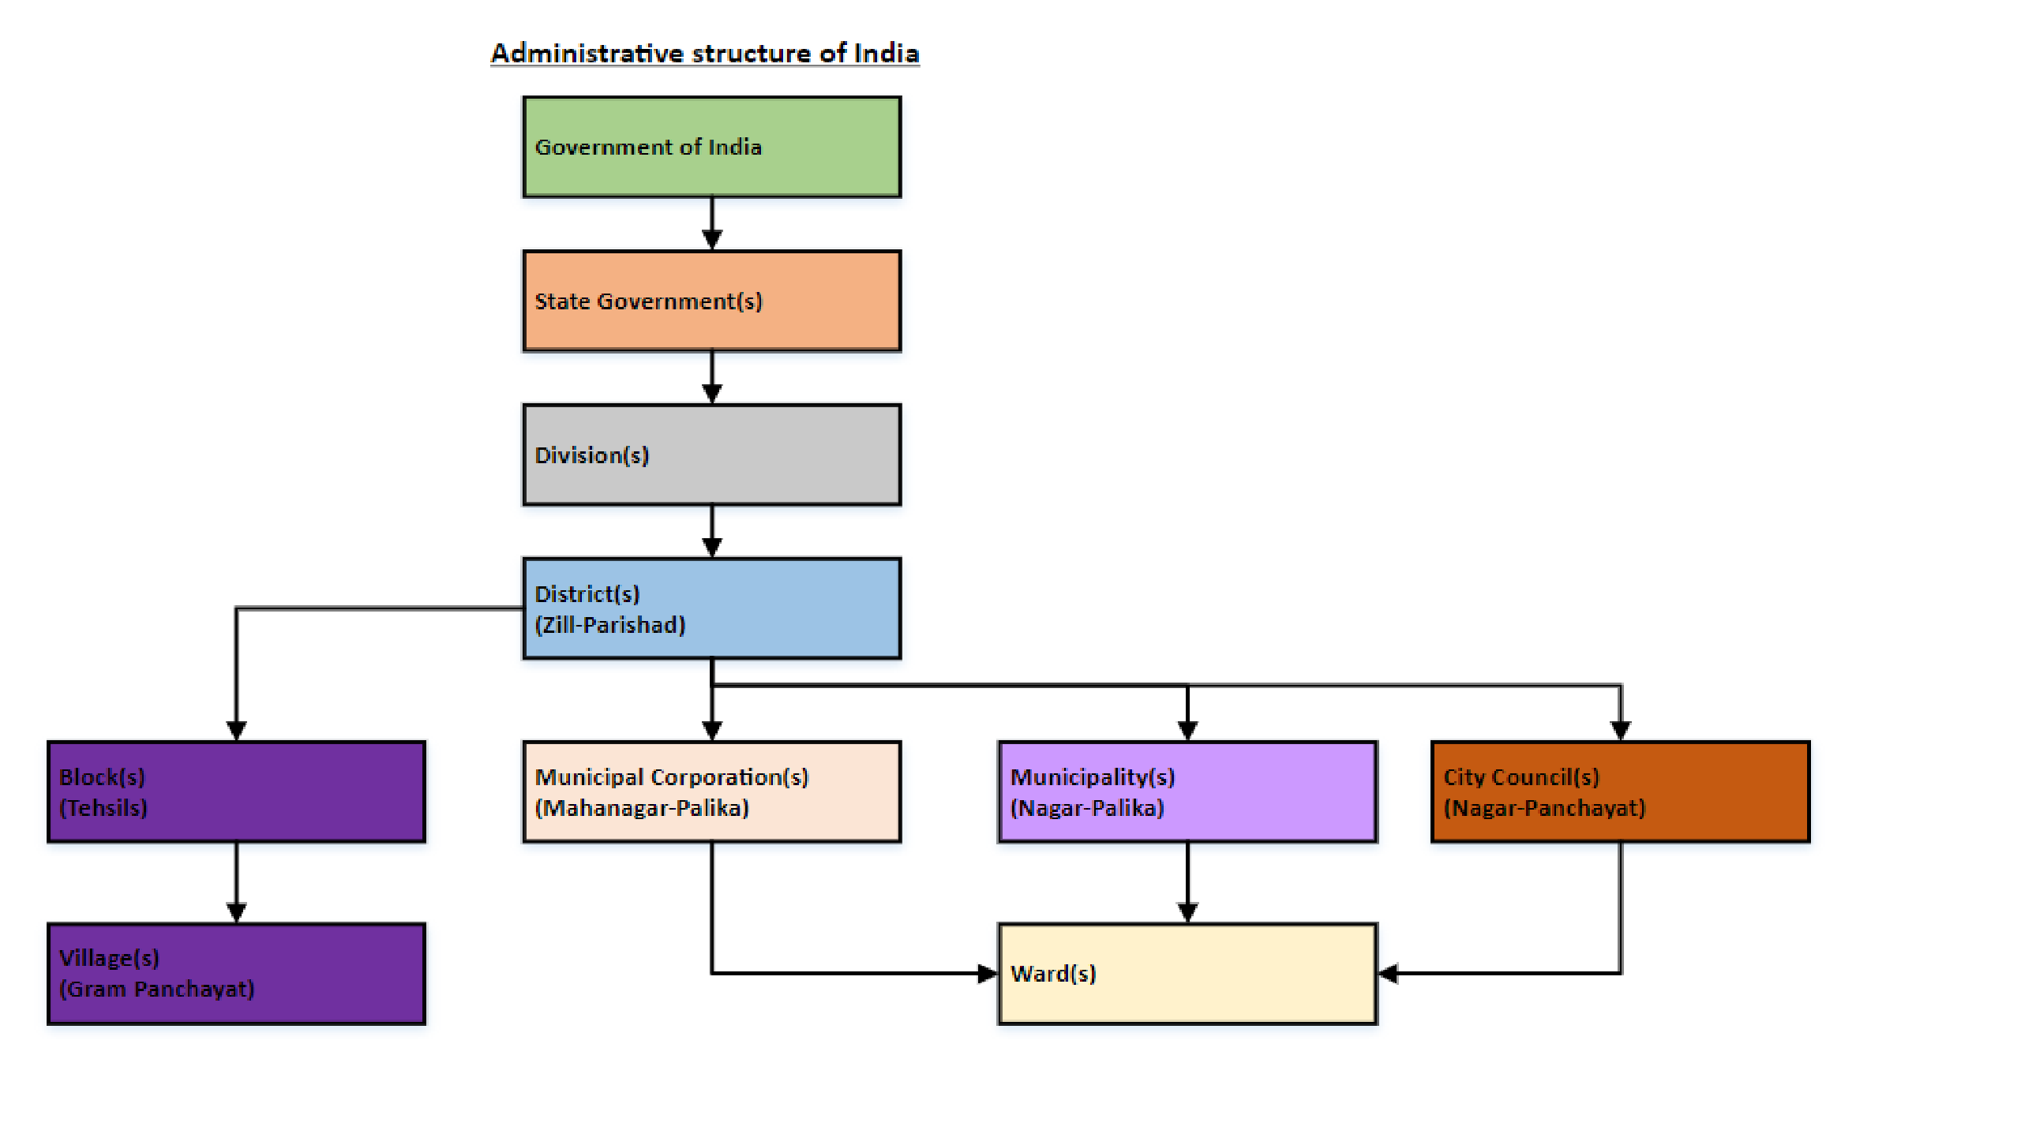
C). AT THE LOCAL / DISTRICT LEVEL

