Slide 1

Nutrition
Yengkhom Sonia Devi
Nursing Tutor

Slide 2
LEARNING OBJECTIVES
At the end of the class, the Students will be able to:
• Define the some important terms.
• Define the health.
• Understand about malnutrition.
• Elaborate the role of nutrition in maintaining health.
• Explain the factors affecting food and nutrition.

Slide 3
INTRODUCTION
Food is the basic necessity of life.
The study of how the food nourishes the body is nutrition.
It is a field of knowledge that consists of fact which scientist have obtained by systematically observing what people eat and noting how healthy they are.

Slide 4
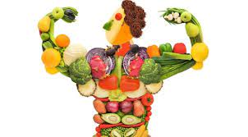
CONCEPTS OF NUTRITION
The word nutrition is derived from ‘nutrius’ meaning “to suckle”.
Nutrition is defined as the science of food and its relationship to health.
Nutrition is the study of nutrients and processes by which they are used by the body. It is concerned with the part played by nutrients in the body growth development and maintenance.
Food is vital for human existences just air and water. Food may be defined anything eaten or drunk, which meets the needs the of tissue building, regulations and protection of the body and its energy needs.

Slide 5

Diet refers to whatever people eat, drink each day. It includes the normal diet people consume in groups, but will also be modified for the sick as part of their therapy.
Dietetics are the practical application of the principles of nutrition, which includes planning of meals for the healthy as well as sick.
Nutrients are the organic and inorganic complexes contained in the food we eat daily. These includes water, proteins, carbohydrates, fats , vitamins, minerals etc.
Nutrients are two types: Micronutients and Macronutrients

Slide 6

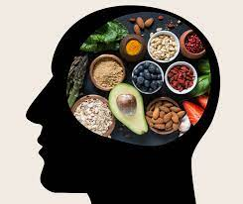

DEFINITION OF HEALTH
Health is define as ‘a state of complete physical, mental and social wellbeing and not merely the absence of disease or infirmity’.
- (WHO, 1948).

Slide 7
Question.
WHO stand for –
World Health Organization
World health obese
World health ordinance
World healing ordinance
Answer: A. World Health Organization.

Slide 8
MALNUTRITION
Malnutrition occurs when an individual gets too few (deficient) or too many (excess) nutrients, resulting in health problems.
Malnutrition is categorized into undernutrition and overnutrition.
Undernutrition is a lack of nutrients, which can result in stunted growth, wasting, and underweight.
Excessive consumption of energy-dense foods and drinks and limited physical activity causes overnutrition. Overnutrition is linked to chronic non-communicable diseases like diabetes, certain cancers, and cardiovascular diseases

Slide 9
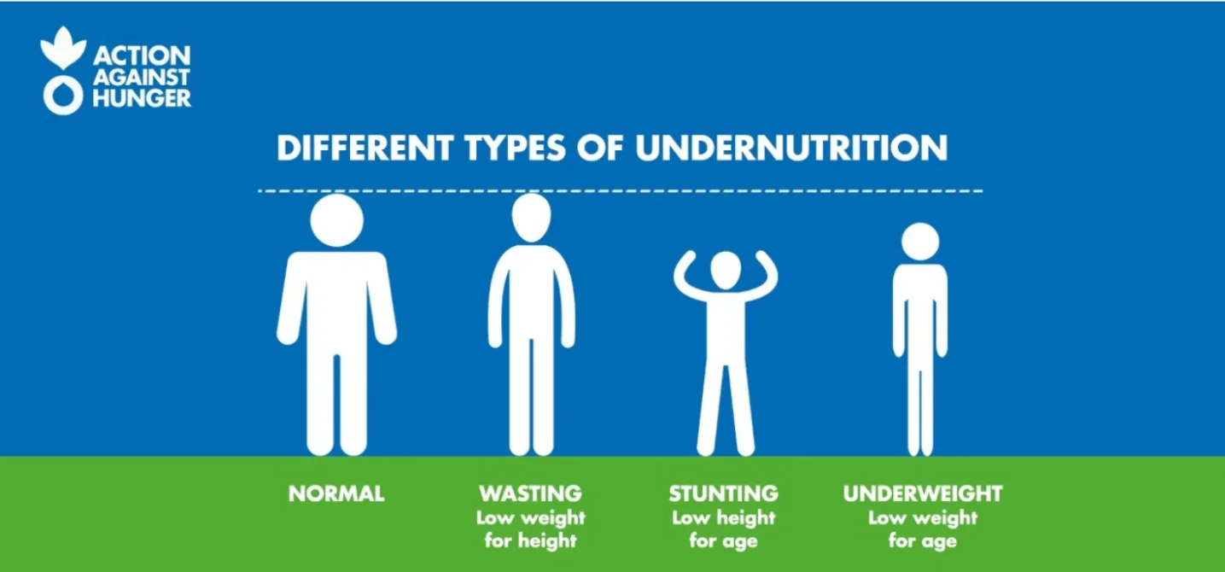
Undernutrition - Micronutrient malnutrition
Micronutrient malnutrition results from inadequate intake of vitamins and minerals.Worldwide, deficiencies in iodine, Vitamin A, and iron are the most common. Children and pregnant women in low-income countries are at especially high risk for micronutrient deficiencies.
Micronutrients deficiency diseases:
- Blindness
- Anaemia
- Goitre
- Osteoporosis

Slide 10
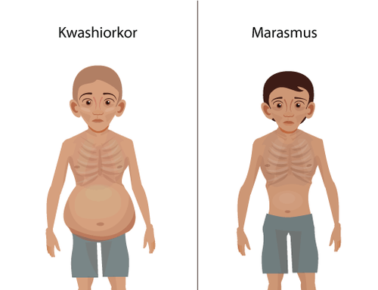
Undernutrition - Protein-energy malnutrition(PEM)
This undernutrition occur due to the deficiencies of protein and energy in the diet.
Two forms of PEM are kwashiorkor and marasmus; both commonly coexist.

Slide 11
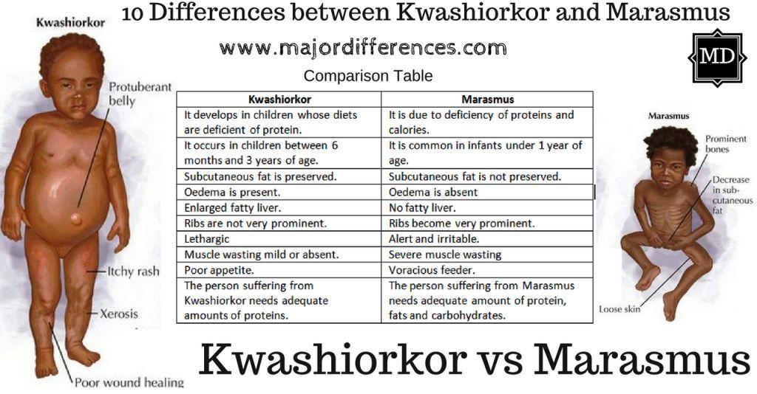

Slide 12
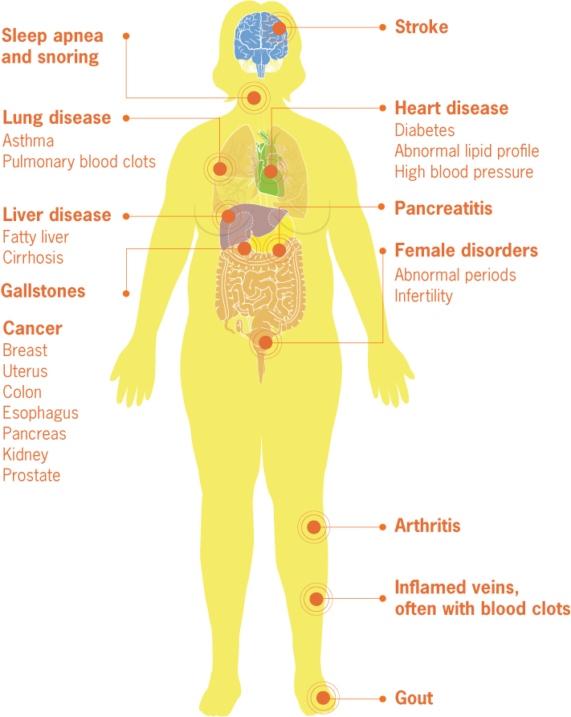
Overnutrition
The amount of nutrients exceeds the amount required for normal growth, development and metabolism
Overnutrition can develop obesity, which increases the risk of serious health [problems such as cardiovascular diseases, hypertension diabetes etc.

Slide 13
Q. The overeating of nutrients or excess intake of the nutrients is classified as –
A. Overnutrition B. Malnutrition
C. Saturated nutrition D. Over nutrition & malnutrition
Answer: D. Overnutrition & malnutrition

Slide 14
Q. The night blindness is caused by deficiency of –
A. Vitamins C B. Vitamin B
C. Vitamin A D. Vitamin D
Answer: C. Vitamin A

Slide 15

ROLE OF NUTRTION IN MAINTAINING HEALTH
Promotes growth and development
Role of nutrition
Specific deficiency
Resistance to infection
Mortality and morbidity

Slide 16
Growth and development:
Good nutrition is essential for growth and development.
Malnutrition during pregnancy affect the fetus.
Malnutrition during early childhood delays physical and mental growth.
Good nutrition is essential for in adult life for maintenance of optimum.

Slide 17
Specific Deficiency:
Kwashiorkar
Marasmus
Blindness
Anaemia
Goitre
Osteoporosis

Slide 18
Resistance to infection:
Malnutrition predisposes to infection such as Tuberculosis (TB).
Infection may aggravate malnutrition.

Slide 19
Mortality & Morbidity:
Increase death rate
Increase Infant death rate
Increase morbidity rate
Lower life expectancy
Overnutrition leads to obesity, diabetes, hypertension, cardiacvascular disorders, renal diseases, disorder of liver and gallbladder.

Slide 20
FACTORS AFFECTING FOOD & NUTRITION
Basal Metabolic Rate (BMR)
Weight of the person
Age
Sex
Climate and environment
Physical activities
Specific dynamic action of food
Physiological state
Socioeconomic factors
Cultural factors
Religious
Traditional factors
Food production and distribution

Slide 21
Summary
Nutrition is the study of nutrients and processes by which they are used by the body.
Health is define as ‘a state of complete physical, mental and social wellbeing and not merely the absence of disease or infirmity’.
Malnutrition occurs when an individual gets too few (deficient) or too many (excess) nutrients, resulting in health problems. Malnutrition is categorized into undernutrition and overnutrition.
Role of nutrition in maintaining health includes – growth & development, specific deficiency, resistance to infection and mortality and morbidity.
There are various factors that affect the food and nutrition such as sex, age, climate, BMI, religion, beliefs etc.

Slide 22
Reference:
• Darshan Sohi. PV A text book of applied nutrition and dietetics. S.
Vikas and company medical publisher, Punjab; 2022.
• Deepti Chauhan. Applied nutrition & dietetics: For B.Sc. and post
basic nursing students; 1st edition. Lotus publisher, Punjab; 2022.
• Darshan Sohi. A comprehensive textbook of nutrition and therapeutic
diets for BSc nursing students; 2nd edition Jaypee brothers medical
publisher, New Delhi; 2018.
• Monika Sharma.Textbook of nutrition: For B.Sc. Nursing students: 2nd
edition,CBS publishers & distributors Pvt. Ltd. 2020.
• Anjana Agarwal, Shobha A U. Textbook of human nutrition; 1st edition.
Jaypee brothers medical publisher, New Delhi; 2014

