Slide 1

Maintenance of record & report, drug dispensing

Slide 2
INTRODUCTION
All professional persons need to be accountable for the performance to their duties to the public.
Since nursing has been considered as profession, nurses need to record their work on completion.
Report summarizes the services of the person or personnel and of the agency.

Slide 3

definition
RECORDS-:
A records is a permanent written communication that documents information relevant to a client’s health care management.
A records is a clinical, scientific, administrative and legal document relating to the nursing care given to the individual family or community.

Slide 4
Conti…
Reports are oral or written exchanges of information shared between caregivers or workers in a number of ways.
Reports is the summary of the services of person or personnel and of the agency.

Slide 5

Nursing records…
Records are a practical & indispensable aid to doctor, nurses and paramedical personnel in giving the best possible services to their clients.

Slide 6
Purposes of records
Supply data that are essential for programme planning and evaluation.
Tools of communication between health workers, the family & other development personnel.

Slide 7

Purposes of records
Effective health records show the health problem in the family and other factors that for future.
Indicates plans for future.
Help in research for improvement of nursing care.

Slide 8
Principles of records writing
Nurse should develop their own method of expression and form in record writing.
Written clearly, appropriately and adequately.
Contain facts based on observation, conversation and action.
Select relevant facts and the recording should be neat, complete and uniform.
Valuable legal documents and so it should be handled carefully, and accounted for.

Slide 9
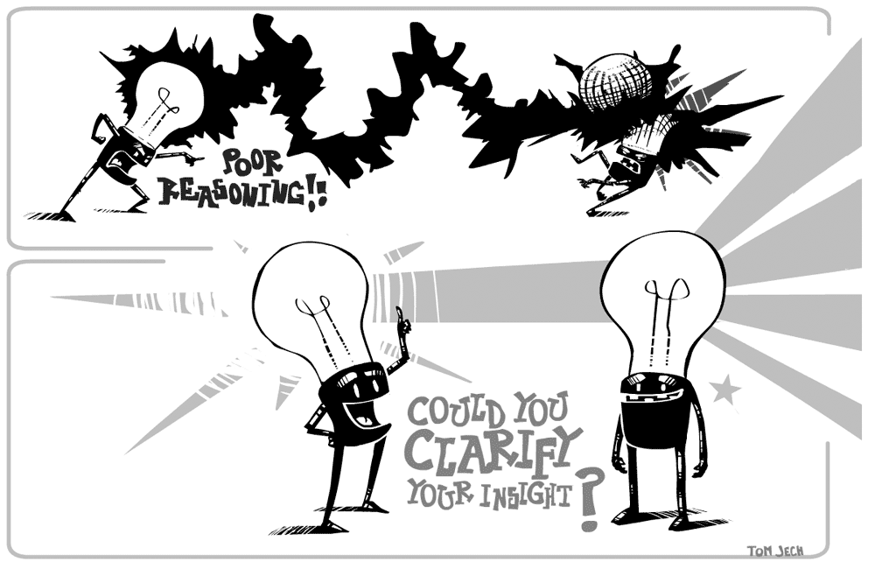
Principles of records writing
Records should be written immediately after an interview.
Records are confidential documents.
Accurately dated, timed and signed.

Slide 10

Values & uses of records in hospital or health centers
For the individual and family
For the Docters.
For the Nurses.
For authorities.

Slide 11
Values & uses of records in hospital or health centers
For the individual and family
Records serve to documents the history of the client.
Records assist in the continuity of care.
Records serve as evidence to support or to manage or face the legal question that arise.
Records serve to recognize the health needs and can be used as a research and teaching tool.

Slide 12
Values & uses of records in hospital or health centers
Values & uses of records in hospital or health centers conti…
For the Docters.
Serves as guide for diagnosis, treatment, follow up and evaluation of services.
Indicate progress and continuity of care.
Help self evaluation of medical practice.
Protect the doctor in case of legal issues. Records may be used for teaching and research.

Slide 13
Values & uses of records in hospital or health centers
Values & uses of records in hospital or health centers conti…
For the Nurses.
Provide with documentation of services rendered, i.e shows health condition of the client.
Provide data essential for planning and evaluation of services for further improvement.

Slide 14
Values & uses of records in hospital or health centers
Values & uses of records in hospital or health centers conti…
For the Nurses.
Serve as a guide for professional growth.
Enable to judge the quality and quantity of work done.
Serve as communication tool between staff and other members involved in care .
Indicate plans for the future.

Slide 15
Values & uses of records in hospital or health centers conti…
For authorities.
provide the management with statistical information necessary for decision in regard to utilization of resources, planning for administrative control and future references.
Help the supervisor evaluate the services rendered, teaching done and a person’s action and reactions.

Slide 16
TYPES OF RECORDS
1). CUMALATIVE OR CONTINUING RECORDS
This is found to be time saving , economical and also it is helpful to review the total history of an individual and evaluate the progress of a long
period.

Slide 17
TYPES OF RECORDS
2) FAMILY RECORDS
All records, which relate to members of family, should be placed in a single family folder. Give the picture of the total services and help to give effective, economic services to the family as a whole.
Separate record forms may be needed for different types of services such as TB, maternity etc.

Slide 18
Records maintained in community settings
forms, case cards and registers:-
Family records
Eligible couple and child register
Sterilization and IUD register
MCH Card/ Register
Child Card/ Register
Birth and death register
Sub centers/PHC/ Clinic register
Stock & issue register
Reports of blood test of malaria and filaria.
Malaria parasite positive case register and other.

Slide 19
Records maintained in community settings conti…
2. Diaries:-
3. Return:- Monthly report of Health worker
Complication report of health workers
PHC Monthly report
In addition, each organization should maintain:
Cumulative records
Family records

Slide 20
RECORDS MAINTAINED IN HOSPITAL
The patient clinical records
Records of nurses observation- nurses notes
Records of orders carried out
Records of treatment
Records of admission and discharge
Records of equipment loss and replacement (inventory)
Records of personnel performance.

Slide 21
PATIENT CLINICAL RECORDS
The head nurses responsibility for the clinical records
Protection from loss
Safeguarding its content
Completeness
Responsibility for nurses notes

Slide 22
1. Protection from loss
The head nurse is responsible for safeguarding the patient record from loss or destruction. No individual sheet is separated from he complete record unless as with the doctor’s order sheet, it is kept in a special place where its safety is guarded.

Slide 23
2. Safeguarding its content
The hospital administration usually has a procedure with which the head nurse should be familiar for handling legal matter of this kind. Patient has the right to insist that his record be confidential.

Slide 24
3. Completeness
  Compile records with complete identifying data on each page in the from approved by the hospital. The two parts of the records for which the nursing services is universally wholly responsible are the vital sign, graphic sheet and nurses observation or nurses notes.

Slide 25
4. Responsibility for nurses notes
The form for nurses notes which has been established by the hospital should be used by all nurses.

Slide 26
NURSING
REPORTS

Slide 27
INTRODUCTION
Reports can be compiled daily, weekly, monthly, and annually. Report summarizes the services of the nurse and or the agency. Report may be in the form of an analysis of some aspect of a services.

Slide 28
definition
Reports are the information communicated to the other level of the health services. They are also an important management tools to influence future actions.

Slide 29
Importance of reports
Good reports save duplication of efforts and eliminate the need for investigation to learn the facts in a situation.
Patient receive better care when reports are through and give all pertinent data.
Complete reports give a sense of security .
It help in management of the ward.

Slide 30
Types of reports
The types of the reports are
Oral or by telephone or radio in emergency cases (verbal)
Written in normal circumstances.

Slide 31
Types of reports
24 hours reports
Supervisor’s reports and patient census reports
Night and day reports
Accident report etc. Are the main reports in the field of institutional or hospital nursing, while in the area of community health nursing.
Birth and death report

Slide 32
Anecdotal report
Monthly, quarterly, half yearly and annual report of progress.

Slide 33
LEGAL IMPLICATIONS OF RECORDS AND REPORTS
The legal importance of record and reports are explained under 3 approaches:
Individual approach
Community approach
Nursing approach

Slide 34
Essential of good reporting
Accurate
Legible
Complete
Short and clear
timeliness

Slide 35
Maintenance of records and reports
Records & reports are the essential components of implementation and evaluation of community health activities. Some of the important facts related to the filling and maintenance of records and reports are as follow:

Slide 36
Conti…
Filling of records: records can be kept in many ways.
It is essential to have proper and systematic filling of records.
Properly filed records save time and effort.
Filing of records depends upon the objective and method adopted by the health agency or enterprise.

Slide 37
Method of filling the records
Alphabetically
Numerically
geographically

Slide 38
FILLING THE REPORTS
Reports can mainly filed on the following basis:
PLACE
TIME
ALPHABET
NUMBER

Slide 39
GUIDELINES FOR REPORTS
A general method or outline of writing the reports should be prepared before actually writing report.
As far as possible, printed forms should be used for writing the reports.
It is necessary to collect all information and material to make the reports complete.
Style of reports writing should make it easy to understand.

Slide 40
5.

