Slide 1
NEUROLOGICAL EXAMINATION

Slide 2
Terminology
Clonus- abnormal movement marked by alternating contraction and relaxation of a muscle occurring in rapid succession.
Photophobia- inability to tolerate light. increase in muscle tone at rest
Rigidity- characterized by increased resistance to passive stretch.
Spasticity- sustained increase in tension of a muscle when it is passively lengthened or stretched

Slide 3
INDICATIONS
PATIENT SUFFERING UNDER DISEASE SUCH AS
MENNINGITIS
HEAD INJURY
BRAIN TUMOR
UNCONSCIOUS PATIENT
HIGH GREAD FEVER
TETANUS
COMA

Slide 4
INTRODUCTION…
The purpose of neurological examination is to determine the presence or absence of disease in the nervous system.
Nurses are involve in examining the neurological & physical status of the patient as part of the total physical assessment.

Slide 5
History
Presenting complaint
Ask about the symptoms:
What are they?
Which part of the body do they affect? Are they localised or more widespread?
When did they start?
How long do they last for?
Were they sudden, rapid or gradual in onset? Is there a history of trauma?

Slide 6
Continue….
Ask about any associated symptoms (other features of neurological disease):
Headache
Numbness, pins and needles, cold or warmth
Weakness, unsteadiness, stiffness or clumsiness
Nausea or vomiting
Visual disturbance
Altered consciousness

Slide 7
Aspects of Neurological Examination…
Levels of consciousness
Mental status examination
Special cerebral functions
Cranial nerve function
Motor function
Sensory function
Cerebellar function
Reflexes

Slide 8
1. Levels of consciousness:
Assessment of levels of consciousness includes following categories:
Alertness: Patient is awake, responds immediately & appropriately to all verbal stimuli.
Lethargic: Patient is drowsy & inattentive but arouses easily, frequently off to sleep.
Stuporous: He arouses with great difficulty & co-operates minimally

Slide 9
Count…
Semi-comatose: The patient has lost his ability to respond to verbal stimuli. There is some response to painful stimuli. Little motor function is seen.
Comatose: When the patient is stimulated there is no response to verbal or painful stimuli, no motor activity is seen. The Glasgow coma scale is widely used to measure the patient’s level of consciousness.

Slide 10
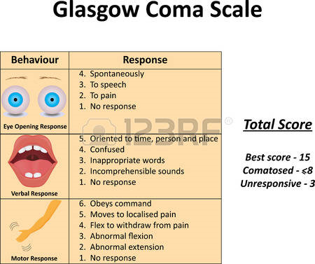

Slide 11
2. Mental status examination:
The components of mental status examination include the assessment for following categories; General appearance, speech, thought process, mood, cognitive functions, attention, concentration, orientation, memory, general knowledge, Perception

Slide 12
3. Special cerebral functions:
Assess for agnosia, apraxia & aphasia.
Agnosia – inability to recognize common objects through the senses
Apraxia – patient cannot carry out skilled act in the absence of paralysis.
Aphasia – inability to communicate.

Slide 13
4. Cranial nerve examination
Cranial nerve (CN) examination provides information about the brainstem & related pathways.
Vestibulocochlear or Acoustic nerve (CN VIII)
Glossopharyngeal (CN IX)
Vagus (CN X)
Spinal accessory nerve (CNXI)
Hypoglossal nerve (CN XII)
Olfactory nerve (CN I)
Optic nerve (CN II)
Oculomotor (CN III)
Trochlear (CN IV)
Trigeminal (CN V)
Abducens (CN VI)
Facial nerve (VII)

Slide 14
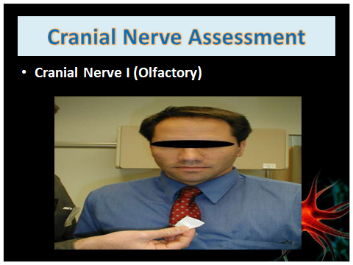

Slide 15
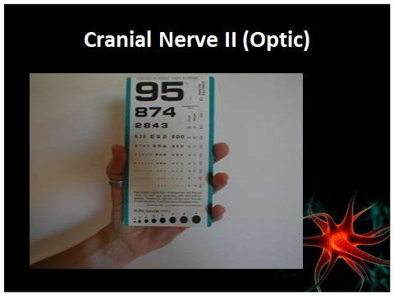

Slide 16
Oculomotor (CN III)
Assess pupil size and light reflex.
PERRLA

Slide 17
Trochlear CN IV & VI
Eye ball movement

Slide 18
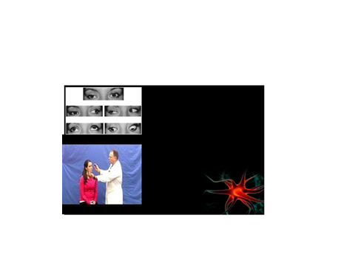

Slide 19
V cranial nerve
Use a sharp implement.
Ask the patient to close their eyes so that they receive no visual cues.
Touch the sharp tip of the stick to the right and left side of the forehead, assessing the Ophthalmic branch.
Touch the tip to the right and left side of the cheek area, assessing the Maxillary branch.
Touch the tip to the right and left side of the jaw area, assessing the Mandibular branch

Slide 20
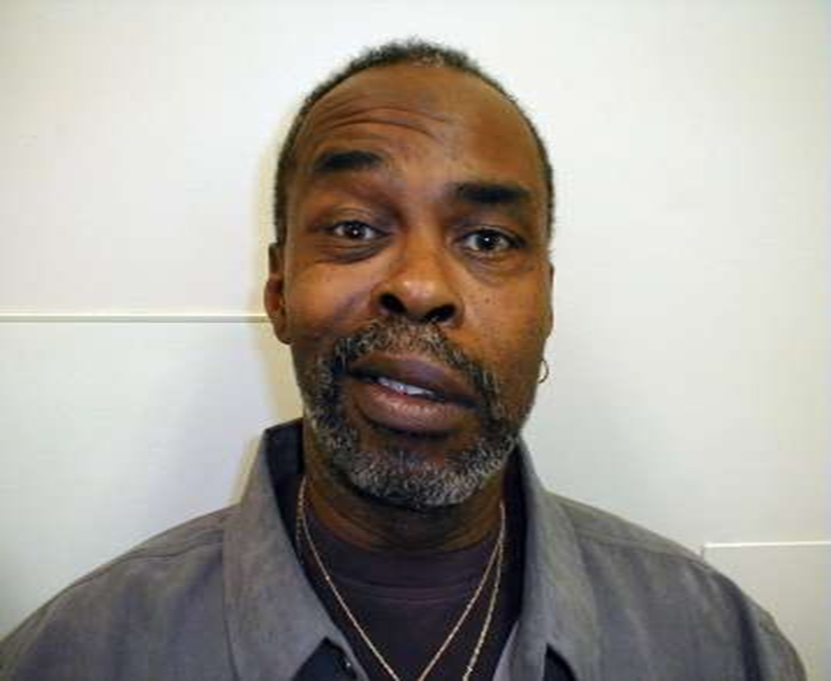
VII cranial nerve

Slide 21
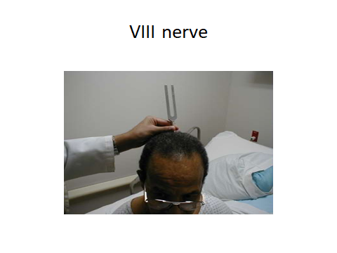

Slide 22
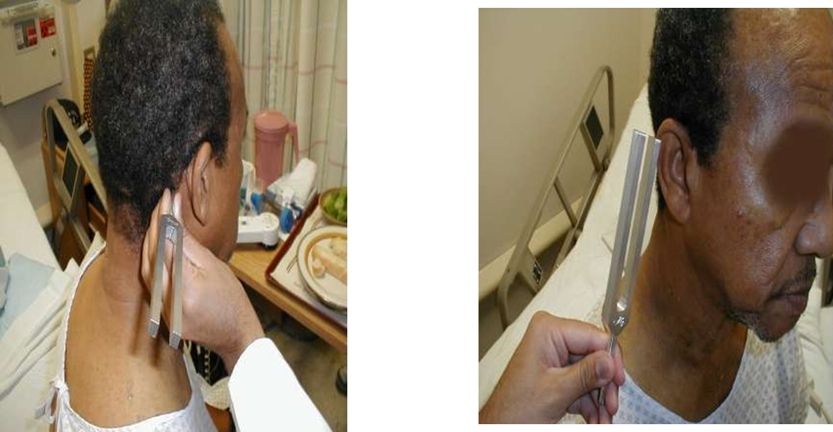
Rinne Test

Slide 23
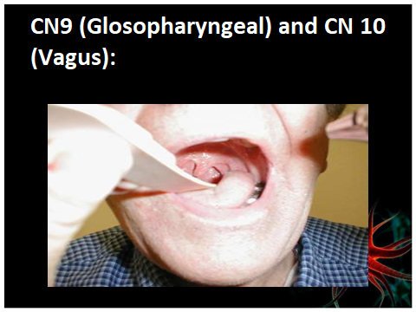

Slide 24
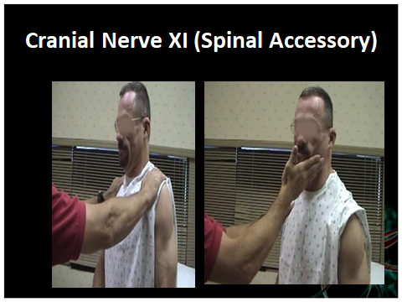

Slide 25
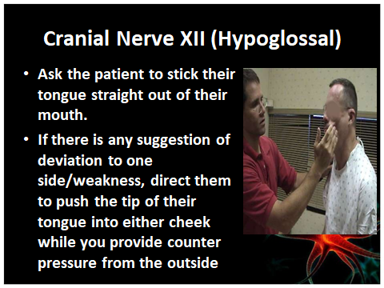

Slide 26
5. Motor function:
Assessment of motor function involves assessing for muscle size, muscle strength, muscle tone, muscle co-ordination, gait & movement.
Muscle size: Inspect all major muscle groups bilaterally for symmetry, hypertrophy, & atrophy.
Muscle Strength: Assess the power in major muscle groups against resistance. Assess & rate muscle strength on a 5-point scale in all four extremities, comparing one side with other.

Slide 27
Count…
Muscle tone: Assess muscle tone while moving each extremity through its range of passive motion. When tone is decreased (hypotonicity), the muscle are soft, flabby, or flaccid; when tone is increased (hypertonicity), the muscles are resistant to movement, rigid, or spastic. Note the presence of abnormal flexion or extension posture.
Muscle coordination: Disorders related to coordination indicate Cerebellar or posterior column lesions.

Slide 28
Count…
Gait & station: Assess gait station by having the patient stand still, walk & in tandem (one foot in front of the other in a straight line). Walking involves the functions of motor power, sensation & coordination. The ability to stand quietly with the feet together requires coordination & intact proprioception (sense of body position).
Movement: Examine the muscles for fine & gross abnormal movements. Move all the points through a full range of passive motion. Abnormal findings include pain, joint contractures, & muscle resistance.

Slide 29
Muscle Strength
Grade | Description
0/5 | No muscle movement/ Flacccid
1/5 | Visible muscle movement, but no movement at the joint
2/5 | Movement at the joint, but not against gravity
3/5 | Movement against gravity, but not against added resistance
4/5 | Movement against resistance, but less than normal
5/5 | Normal strength

Slide 30
6. Sensory function:
Sensory assessment involves testing for touch, pain, temperature, vibration & discrimination.
A complete sensory examination is possible only on a conscious & co-operative patient.
Always test sensation with patient’s eye closed.
Help the patient relax & keep warm.
Conduct sensory assessment systematically.
Test a particular area of the body, & then test the corresponding are on the other side.

Slide 31
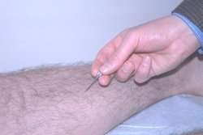
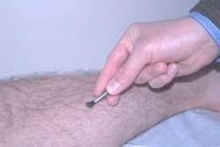
Pain and Light Touch Sensation:

Slide 32
Stereognosia
Test stereognosis by asking the patient to close their eyes and identify the object you place in their hand. Place a coin or pen in their hand. Repeat this with the other hand using a different object

Slide 33
Astereognosis
Astereognosis refers to the inability to recognize objects placed in the hand. Without a corresponding dorsal column system lesion, these abnormalities suggest a lesion in the sensory cortex of the parietal lobe.

Slide 34
Graphesthesia
Test graphesthesia by asking the patient to close their eyes and identify the number or letter you will write with the back of a pen on their palm. Repeat on the other hand with a different letter or number

Slide 35
7. Assessment of cerebellar function:
For evaluation of balance & co-ordination the tests used are:
Finger to finger test: It is performed by instructing the patient to place her index finger on the nurse’s index finger. He is asked to repeat this for several times in succession on both sides.
Finger to nose test: Tell the patient to extend his index finger & then touch the tip of his nose several times in rapid succession. This test is done with patient’s eyes both open & closed.

Slide 36
Count…
Romberg test: Here the nurse instructs the patient to stand with his feet together with arms positioned at his sides. He is told to close his eyes. This position is maintained for 10 seconds. This test is considered positive only if there is actual loss of balance.
Tandom walking test: This is tested by having the patient assume a normal standing position. He is then instructed to walk over heel on a straight line. Any unsteadiness, lurching or broadening of the gait base is noted.

Slide 37
8. Reflex activity:
Reflex testing evaluates the integrity of specific sensory & motor pathways.
Reflex activity assessment, always a part of neurologic assessment, provides information about the nature, location, & progression of neurologic disorders.
Normal reflexes: Two types of reflexes are normally present:
Superficial or cutaneous reflexes
Deep tendon muscle-stretch reflexes

Slide 38
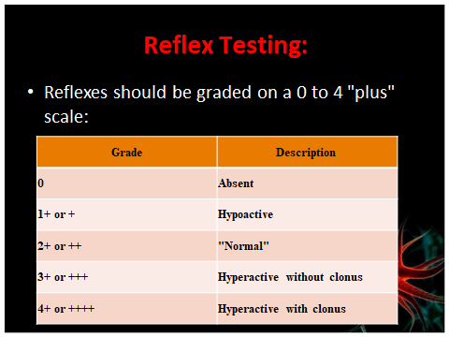

Slide 39
I. Superficial (cutaneous) reflexes:
Abdominal reflex
Plantar reflex
Corneal reflex
Pharyngeal (Gag) reflex
Cremasteric reflex
Anal reflex
II. Deep tendon (muscle- stretch) reflexes:
A biceps jerk (forearm flexion)
A triceps jerk (forearm extension)
A brachioradial jerk
A knee jerk, quadriceps jerk or patellar reflex
An ankle jerk (plantiflexion of the foot)

Slide 40
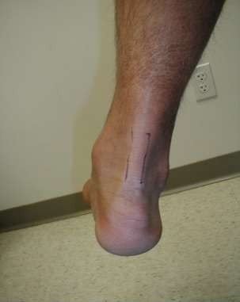
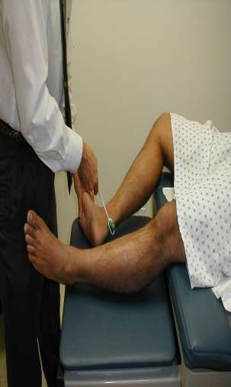
Achilles: (S1, S2)

Slide 41
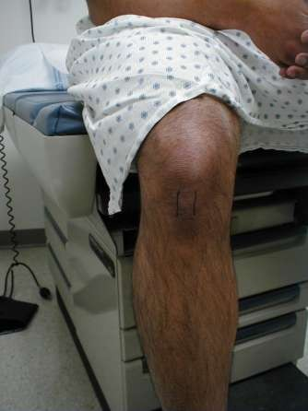
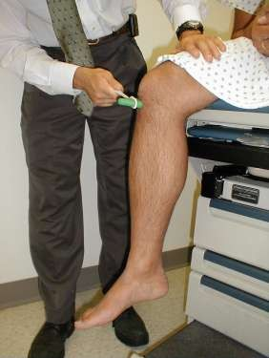
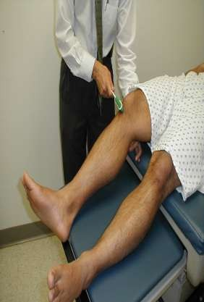
Patellar: (L3, L4)

Slide 42
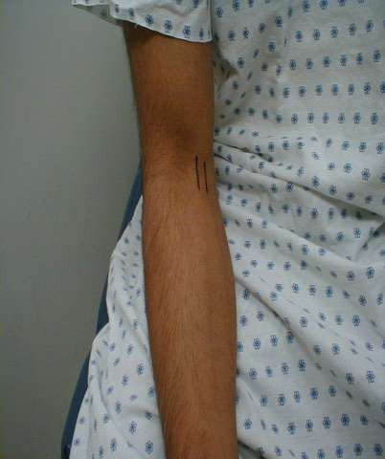
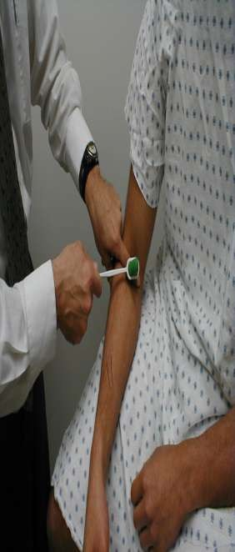
Biceps: (C5, C6)

Slide 43
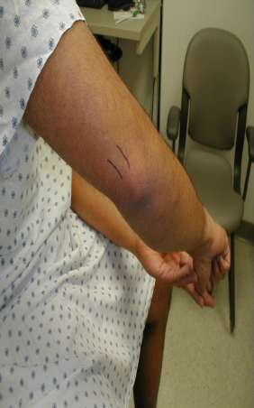
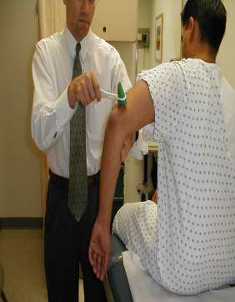
Triceps: (C6, C7)

Slide 44
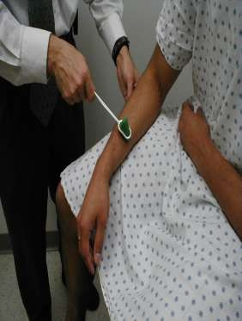
Brachioradialis (C5, C6) :

Slide 45
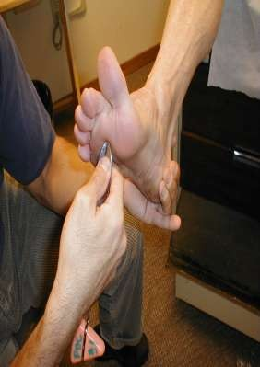
Babinski reflex:

Slide 46
Tray containing
BIG TRAY WITH COVER
SHEET FOR COVER PATIENT
GLOVES
Reflex Hammer
128 and 512 (or 1024) Hz Tuning Forks
A Snellen Eye Chart or Pocket Vision Card
Pen Light or Otoscope
Cotton Swabs
BOWL

Slide 47
B P Apperatus
Stethoscope
Steel Kidney Tray
Test Tube-2( One For Cold Water And One For Hot Water)
Tourch
Common Pin Or Needle

Slide 48
Nurses role in neurological examination…
Provide a clam, suitable environment
Collect the personal data with patient & family members
Set the equipment needed for neurological examination
Assess the current level of consciousness, monitor vital parameters – temperature, pulse, respiration, blood pressure, pupillary reaction, whether decerebrating or decorticating.
Thorough mental status examination should be done & recorded accurately.

Slide 49
Count…
Assessment of cranial nerves should be done correctly & recorded.
Assessment of motor, sensory & cerebellar functions should be done & be recorded accurately.
During the examination, she should maintain a good support with patient & family members
She should instruct the procedure correctly & then they should be asked to do it.
Should be informed to the concerned unit doctors if there is any change.

