Slide 1
IMNCI
(INTEGRATED MANAGEMENT OF NEONATAL AND CHILDHOOD ILLNESS)
MRS. ASHVANI SINGH
P.G. NURSING TUTOR

Slide 2
Specific Objective
Introduction
Objectives
IMNCI Guidelines
Components of the Integrated Approach
Principles of Integrated Care
IMNCI Case Management Process
Management Of Young Infants up to 2 Months of age
Management Of sick child age 2 Months – 5 Years.
Counselling a mother or caretaker.

Slide 3
INTRODUCTION
Every year more than 10 million children die in developing countries before they reach their fifth birthday.
According to National Family Health Survey III (NFHS III), In India, the common illness in children, younger than 5 years of age include fever (27%), acute respiratory infection (17%), diarrhoea (13%) and malnutrition (43%) and often combination of these conditions.

Slide 4
Integrated Management of Childhood Illness (IMNCI) Strategy, developed by World Health Organization in Collaboration with UNICEF and many other agencies in 1990’s.
The Objective of this strategy was to reduce death and frequency and severity of illness and disability and also to improve growth and development.
This Strategy has been adopted in India as ‘INTEGRATED MANAGEMENT OF NEONATAL AND CHILDHOOD ILLNESS’.

Slide 5
The current infant mortality rate for india in 2023 is 26.619 deaths per 1000 live births, a 3.89% decline from 2022.
The infant mortality rate for india in 2022 Was 27.695 deaths per 1000 live births, a 3.74% decline from 2021.
The infant mortality rate for india in 2021 Was 28.771 deaths per 1000 live births, a 3.48% decline from 2020.

Slide 6
OBJECTIVES-
Reduce Mortality
Reduce Frequency and Severity of Illness and Disability
Improve Growth and Development during the first 5 years of child’s life

Slide 7
IMNCI GUIDELINES
IMNCI Clinical guidelines target children less than 5 years.
An evidence based syndromic approach can be used to detrmine:
Health Problem(s) the child may have;
Severity of the child’s condition;
Actions that can be taken to care for the child (e.g. Refer the child immediately, manage with available resources, or manage at home).

Slide 8
In addition, IMNCI Promotes:
Adjustment of interventions to the capacity and functions of the health system; and
Active involvement of family members and the community in the health care process.

Slide 9
Components of the Integrated Approach
The IMNCI strategy includes both preventive and curative interventions that aim to improve practices in health facilities, the health system and at home.
The strategy includes three main components:
  Improving case-management skills of health care staff
  Improvements in the overall health system
Improvements in family and community health care practices.

Slide 10
Principles

Slide 11


Principles of Integrated Care
PRINCIPLE-1
All sick young infants age up to 2 months must be examined for signs of “possible serious bacterial infection” and all children 2 months to 5 years must be examined for “general danger signs” which indicate the need for immediate referral or admission to a hospital.

Slide 12


PRINCIPLE-2
All sick children must be routinely assessed for major symptoms, nutritional and immunization status, feeding problems, and other problems.

Slide 13

PRINCIPLE- 3
Only a limited number of specific clinical signs are used to diagnosed the disease.

Slide 14

PRINCIPLE- 4
A combination of individual signs leads to a child’s classification(s) rather than a diagnosis.
Needs urgent hospital referral or admission
Needs specific medical treatment or advice
Can be managed at home

Slide 15


PRINCIPLE- 5
IMNCI guidelines address most common, but not all major pediatric problems.

Slide 16


PRINCIPLE- 6
IMNCI procedures use a limited number of essential drugs.

Slide 17


PRINCIPLE- 7
It encourages active participation of caretakers in treatment of children.

Slide 18

PRINCIPLE- 8
IMNCI including counseling of caretakers about home care including feeding, fluids and follow up.

Slide 19
IMNCI CASE MANAGEMENT PROCESS
Assess the young infant or child
Classify the illness
Identify treatment
Treat the infant or child
Counsel the mother
Give follow-up care

Slide 20
CLASSIFICATION
PINK means the child has a severe classification and needs urgent attention and referral or admission for inpatient care
YELLOW means the child needs a specific medical treatment such as an appropriate antibiotic, an oral anti-malarial or other treatment; also teaches the mother how to give oral drugs or to treat local infection at home. The health worker teaches the mother how to care for her child at home and when she should return.
GREEN means do not provide any specific medical treatment such as antibiotics or other treatments. The health worker teaches the how to care for her child at home

Slide 21
INTEGRATED CASE MANAGEMENT PROCESS
Check for danger signs
Convulsions
Lethargy
Inability to drink/breast feeding
Vomiting
Assess Main Symptoms
1.Cough/ Difficulty in breathing
2. Diarrhea
3. Fever
4. Ear Problem
Assess
Nutritional Status
Immunization Status
Potential breast feeding problem
Check for other problem
Classify the condition of the child and assign to one of the three colour codes and identify the treatment actions as per the actions listed in that clour band
Urgent referral
Pre-referral treatments
Advice parents
Refer the child
At the referral facility
Emergency triage and treatment
Diagnosis and treatment
Monitoring and follow-up
Treat at OPD
Treat local infection
Give oral drugs
Advice and teach mother
Follow -up
Home Management
Counsel care taker on how to:
Give oral drugs
Treat local infections at home
Continue feeding
Keep the young infant warm

Slide 22
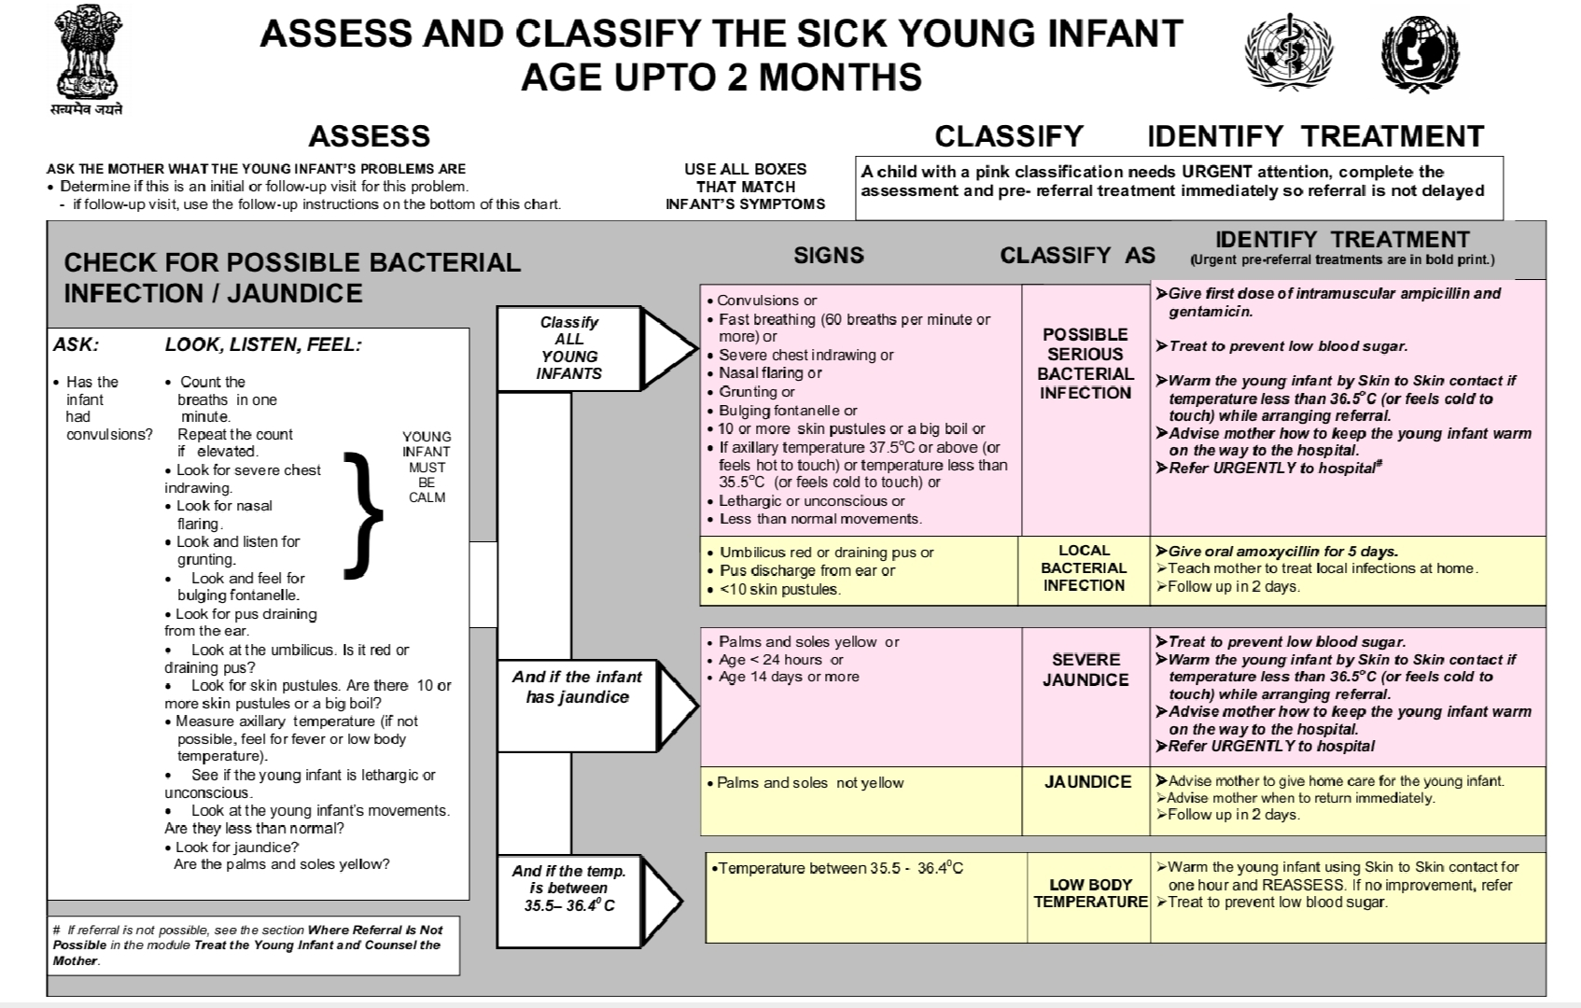

Slide 23
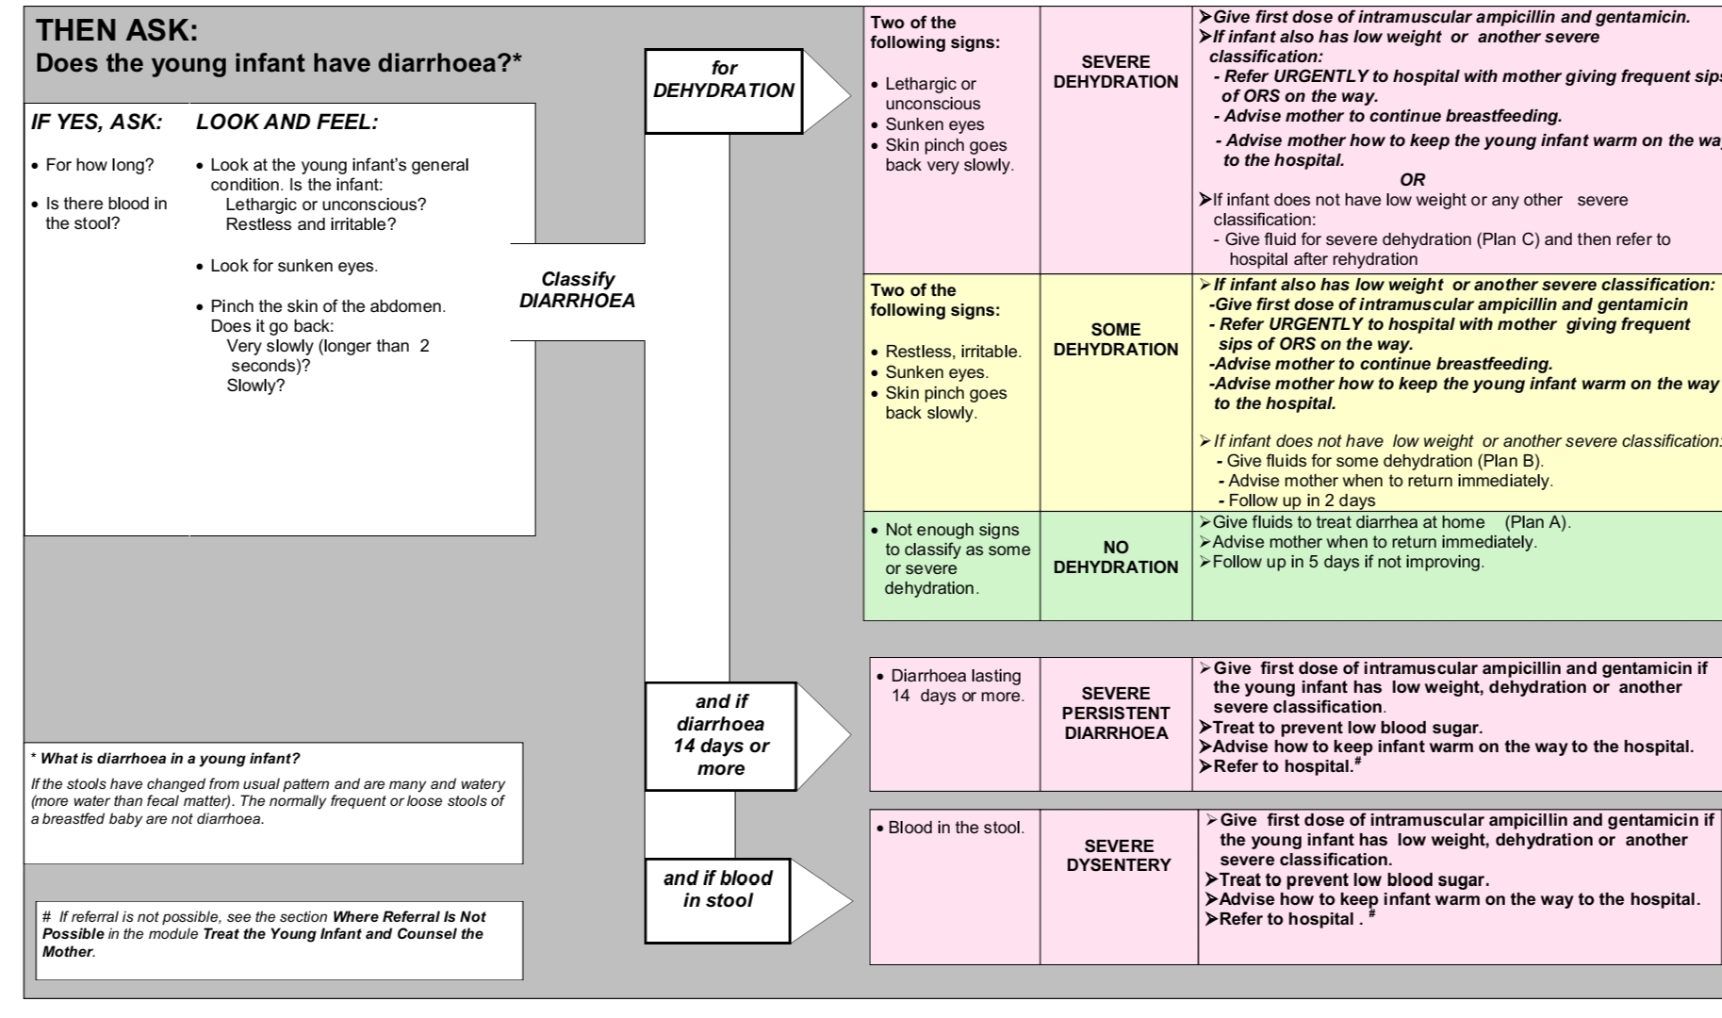

Slide 24
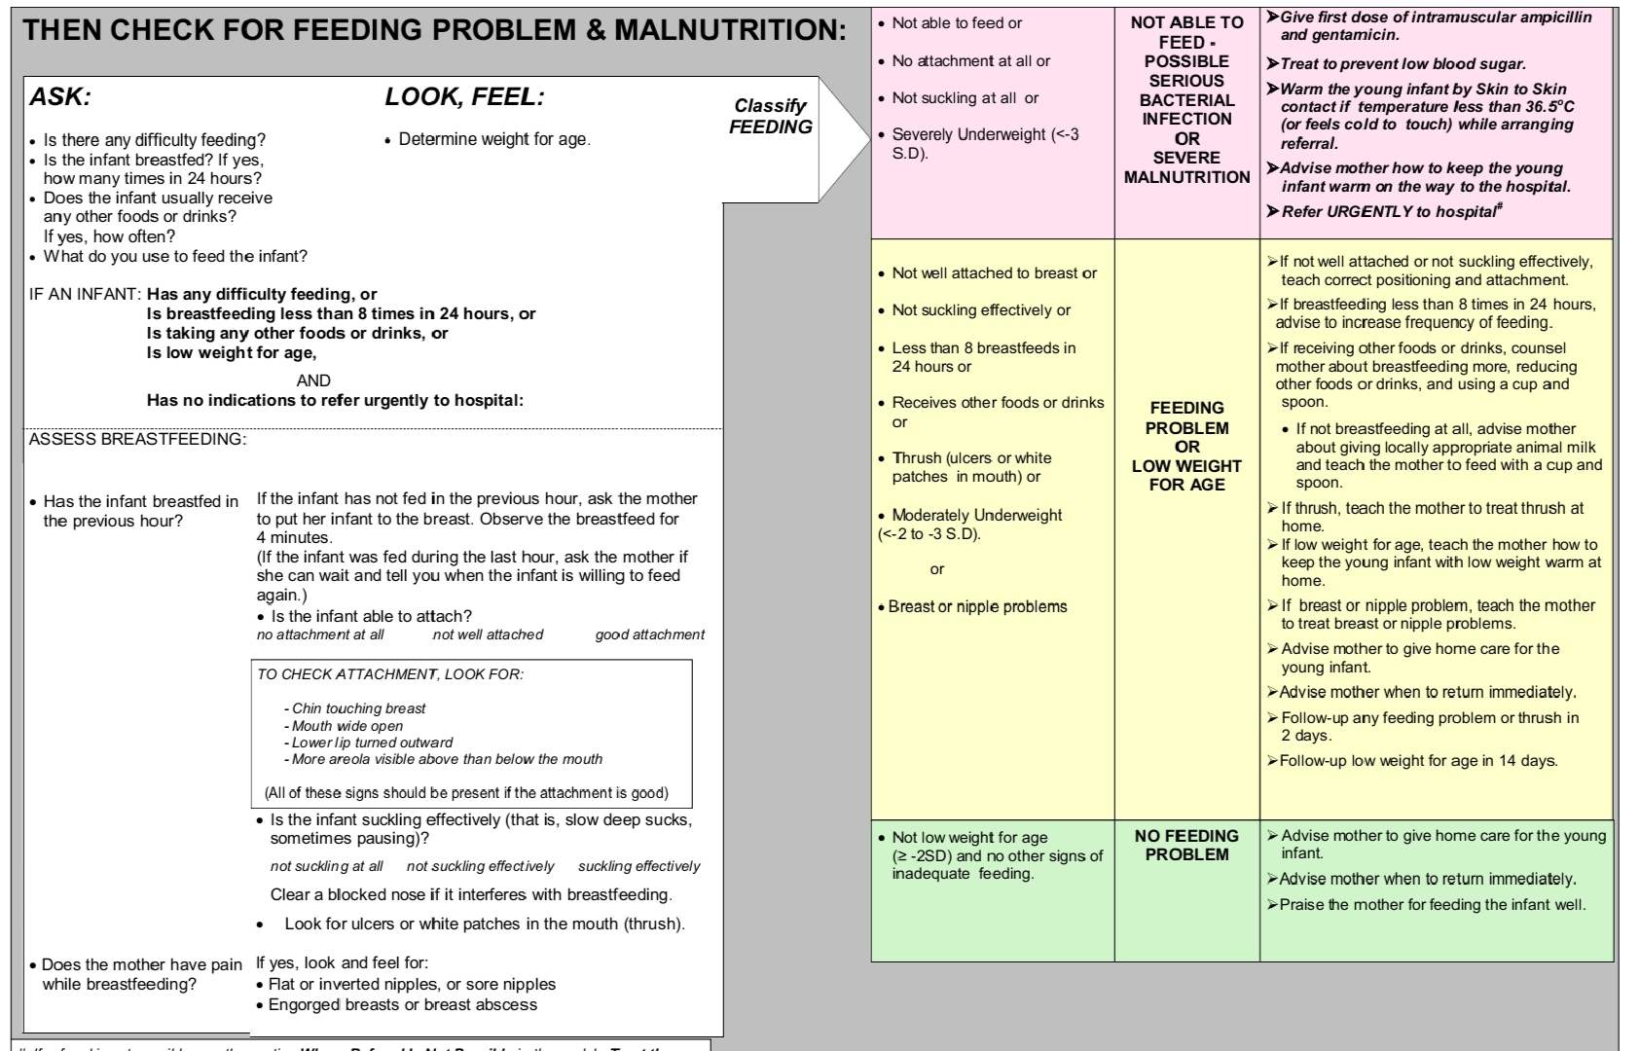

Slide 25
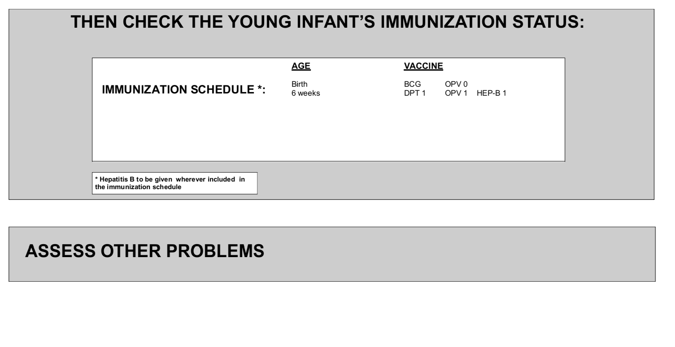

Slide 26
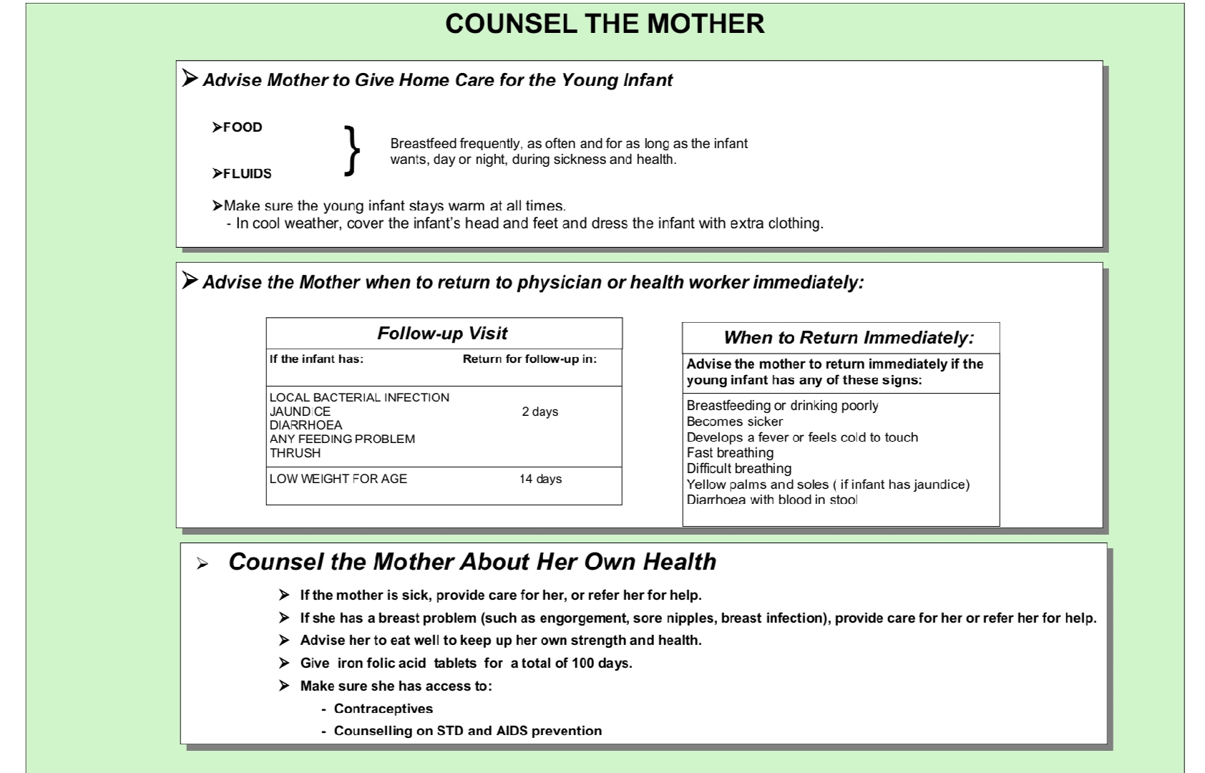

Slide 27
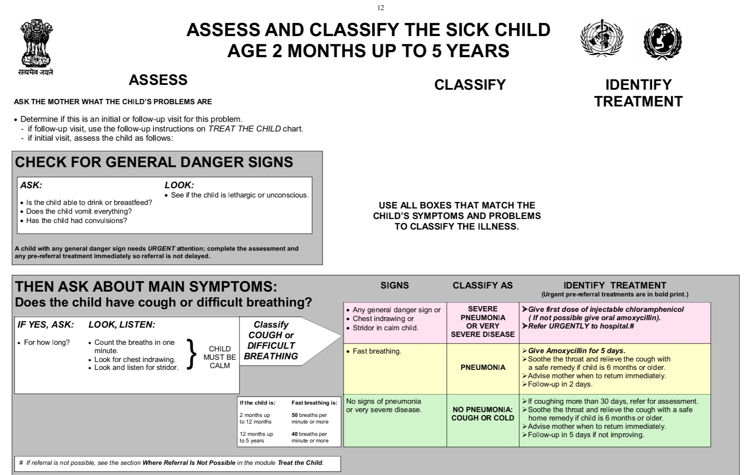

Slide 28
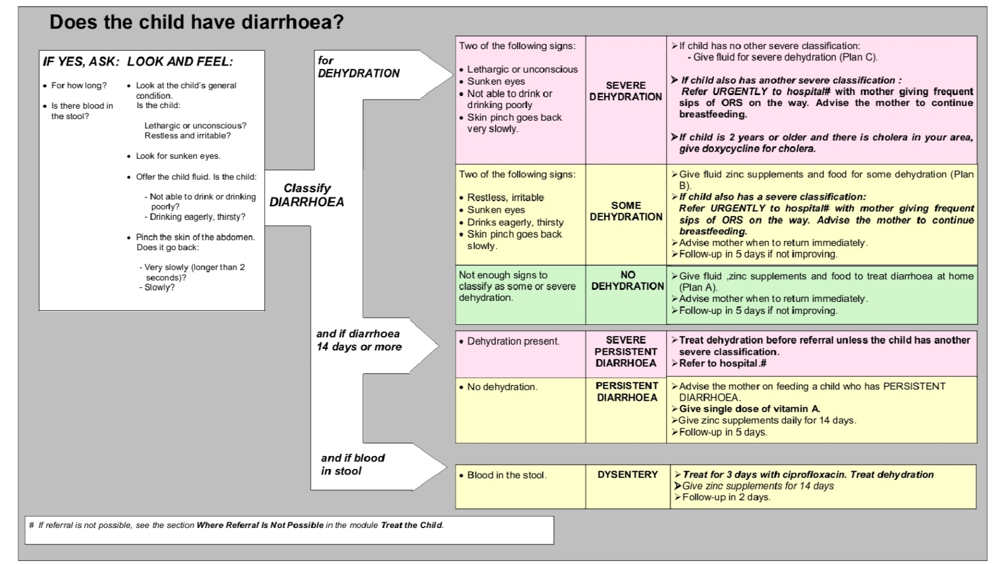

Slide 29
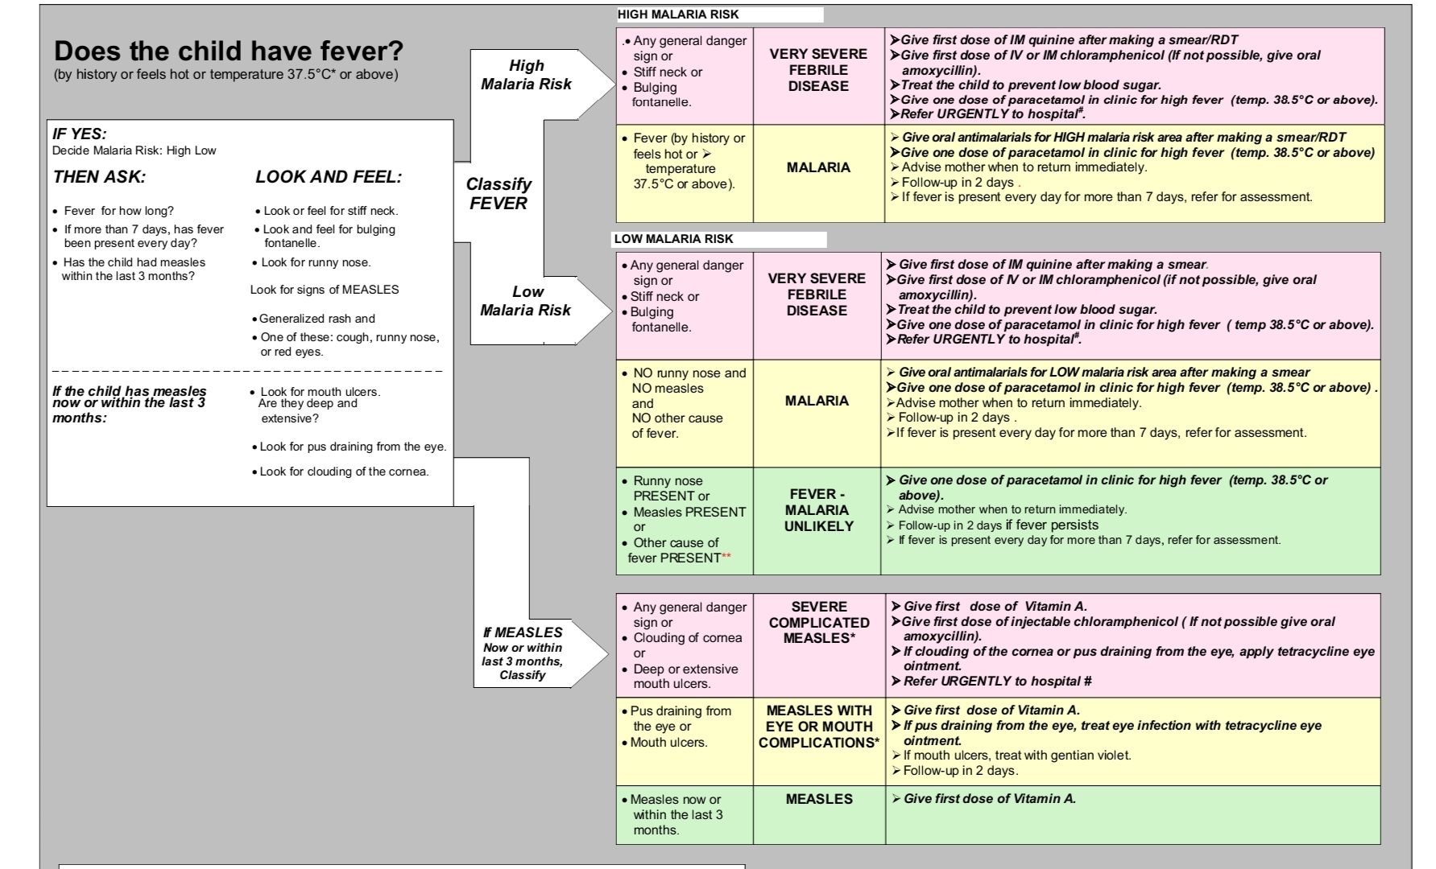

Slide 30
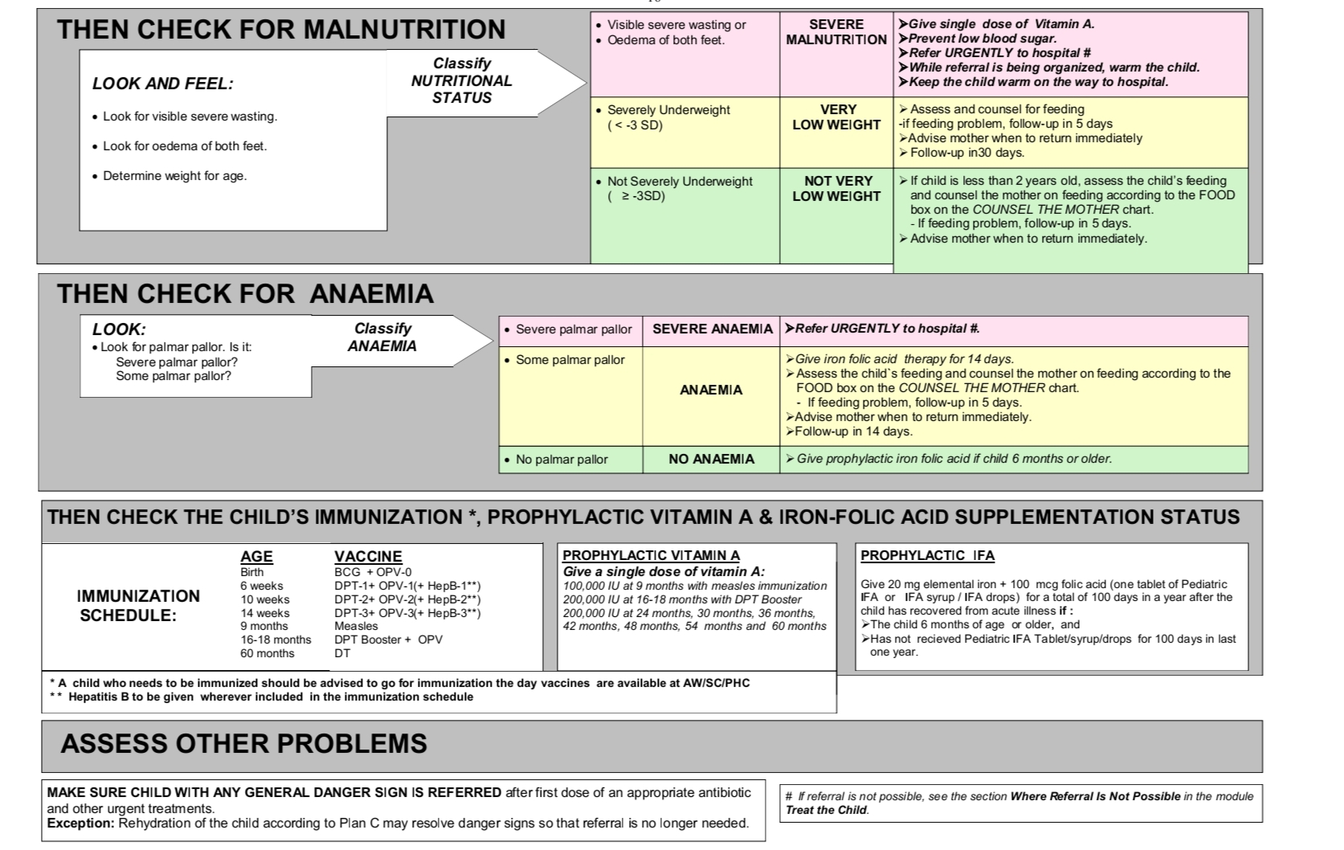

Slide 31
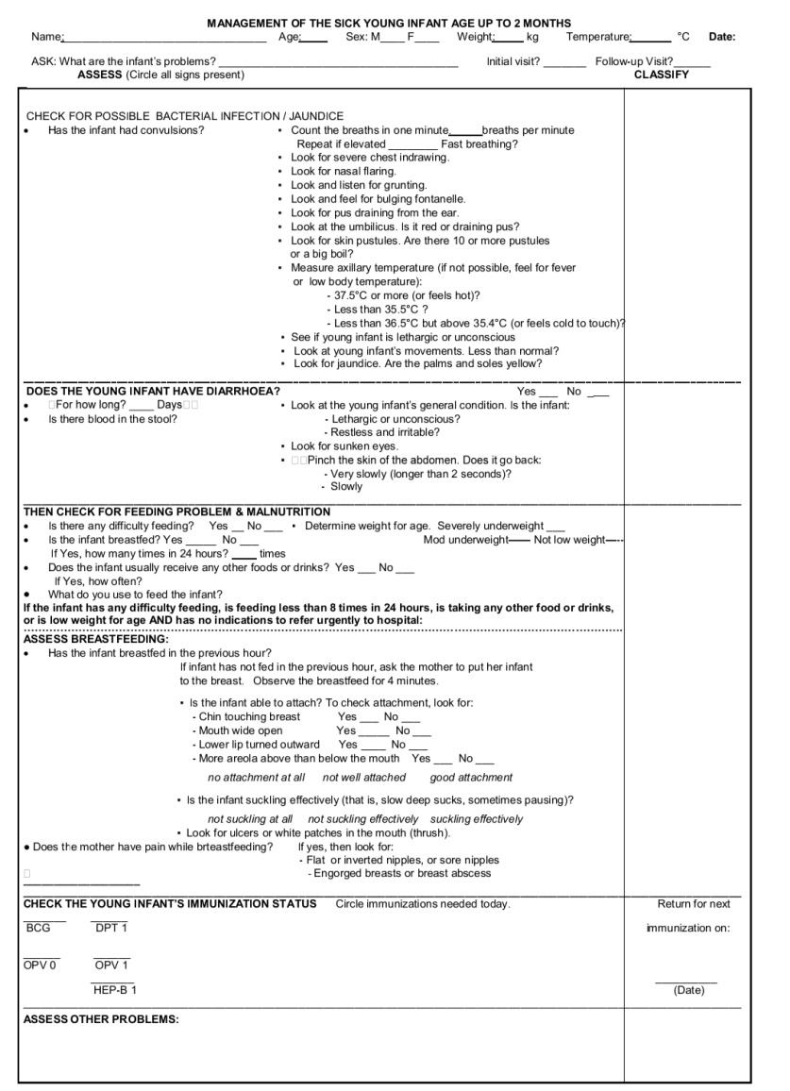

Slide 32
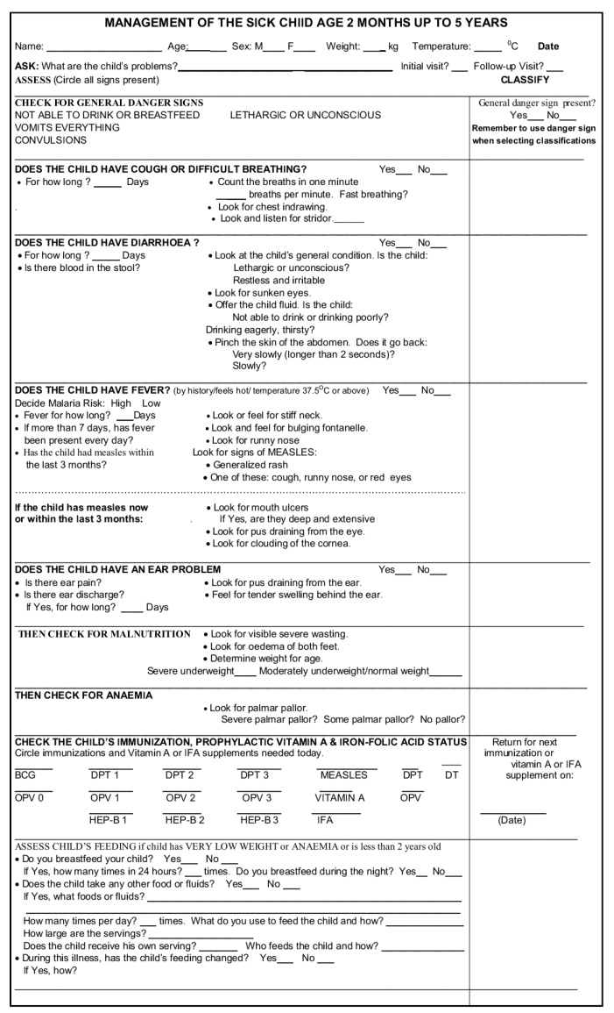

Slide 33
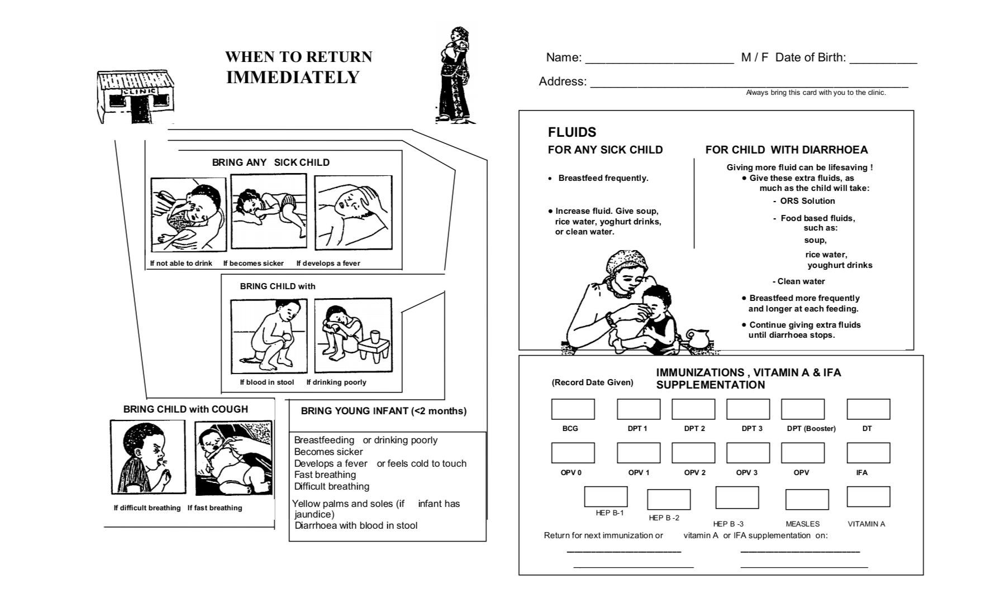

Slide 34
Counselling a mother or caretaker
Use good communication skills
It is important to have good communication with the infant’s mother or caretaker from the beginning of the visit.
Ask and Listen to find out what the infant’s problems are and what the mother is already doing for the infant.
Praise the mother for what she has done well.
Advice her how to care for her infant at home.
Check the mother’s understanding.

Slide 35


