Slide 1
HYDROCEPHALUS

Slide 2


Slide 3
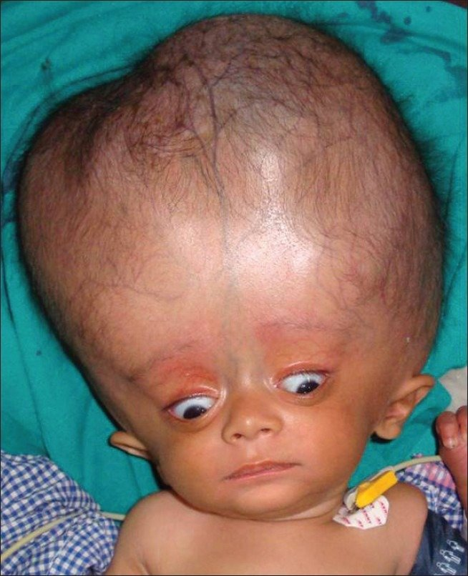

Slide 4
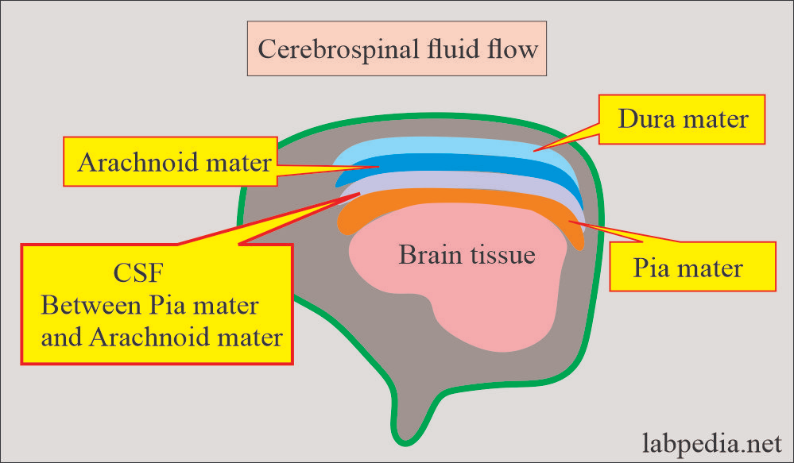

Slide 5
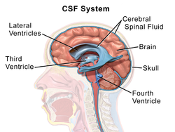

Slide 6
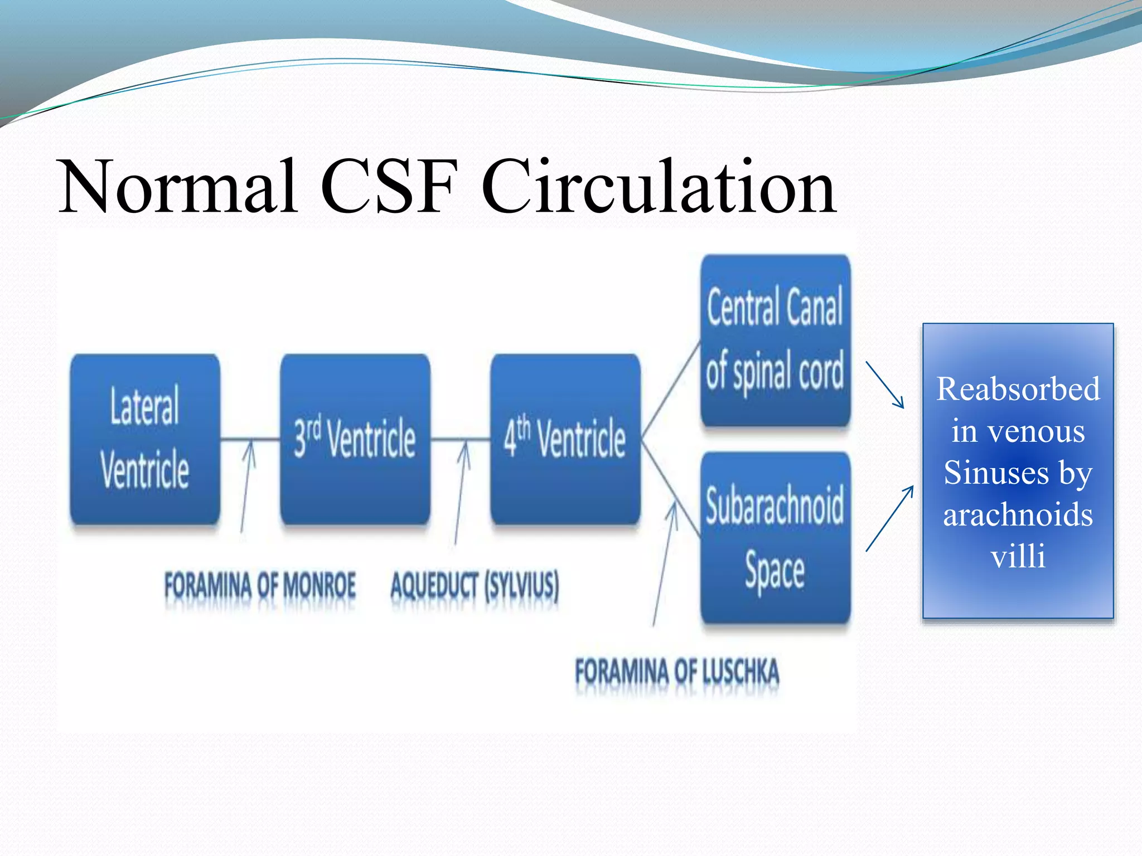

Slide 7
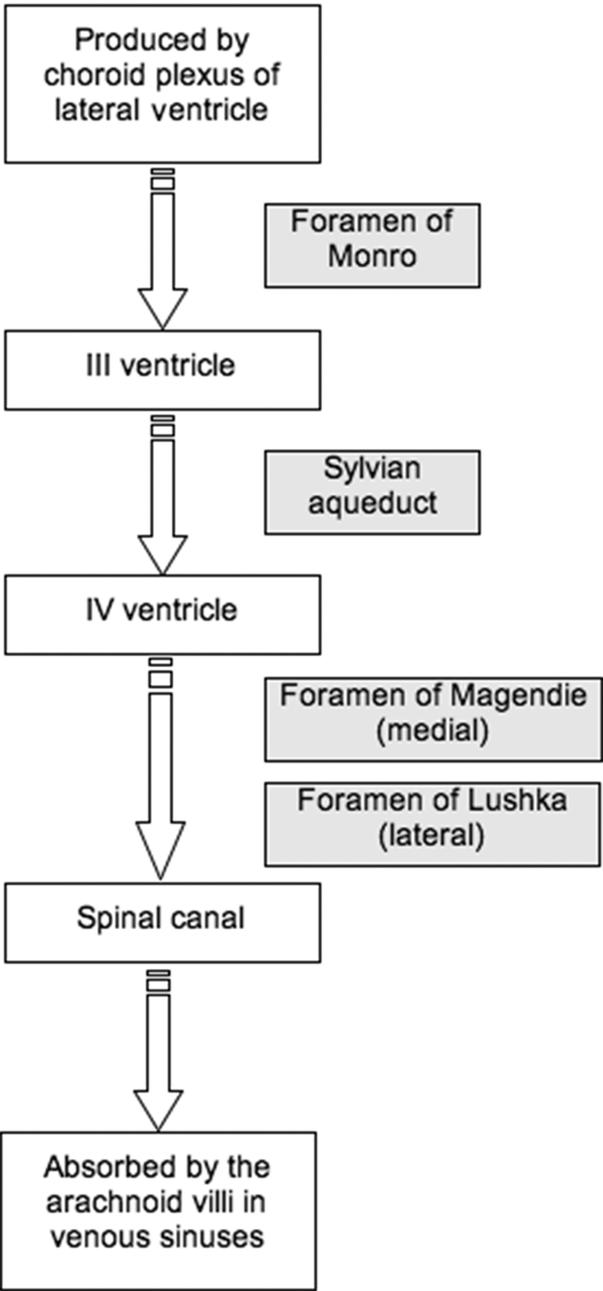

Slide 8
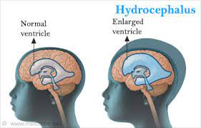

Slide 9
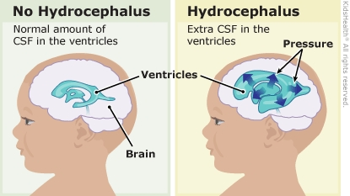

Slide 10
DEFINITION
An imbalance between the production and absorption of CSF and it is characterized by abnormal increase in the volume of CSF within the intracranial cavity resulting in enlargement of the infant’s head.

Slide 11
CLASSIFICATION

Slide 12
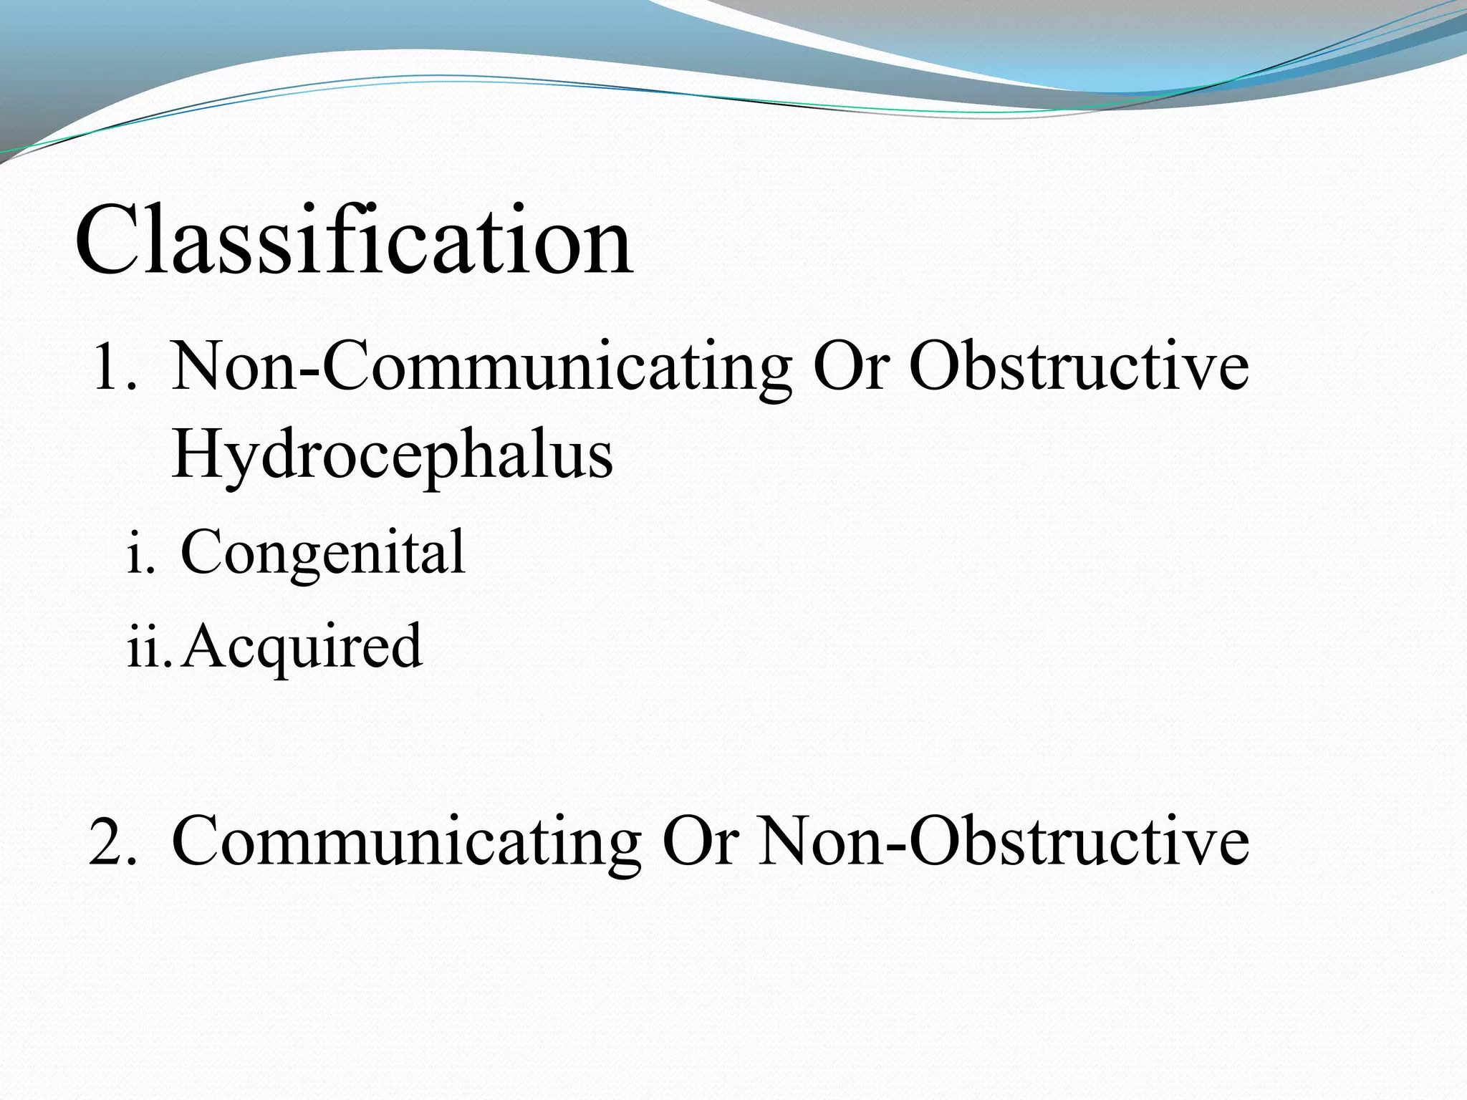

Slide 13
COMMUNICATING HYDROCEPHALUS
Normal flow of CSF within the ventricular system
There is interference outside the ventricles causing decreased absorption of CSF in the subarachnoid villi

Slide 14
NON - COMMUNICATING HYDROCEPHALUS
Obstruction in the flow of CSF within the ventricles and subarachnoid space.
Results in interference with the circulation and absorption of CSF.

Slide 15
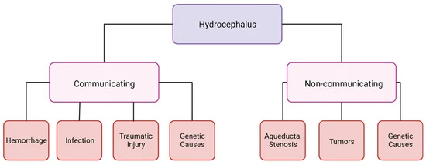

Slide 16
CLINICAL FEATURES
Enlargement of the skull
Sutures become widely separated
Delayed closure of anterior fontanelle
Tense bulging fontanelle

Slide 17
Hollow or cracked pot sound is heard (MacEwan's sign)
Scalp veins are prominent and appears shiny
Fussy, restless, irritable and diminished LOC
Feeding difficulty

Slide 18
Mental developmental retardation
High pitch cry

Slide 19
SUN SETTING SIGN
Eyes may have wide range between them and visible sclera above the iris

Slide 20

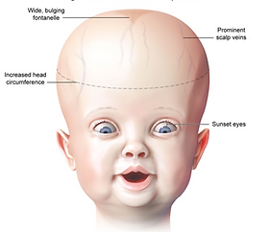

Slide 21
CLINICAL FEATURES (Older Children)
No enlargement of head
Increase in ICP
Nausea and vomiting
Headache

Slide 22
CLINICAL FEATURES (Older Children)
High pitch cry
Lethargy
Apathy
Confusion

Slide 23
CLINICAL FEATURES (Older Children)
Affected motor abilities
Irritability

Slide 24
DIAGNOSTIC EVALUATION
Rapid head enlargement
CT scan
MRI
USG
X ray of skull

Slide 25
MANAGEMENT OF HYDROCEPHALUS
Relief of hydrocephalus
Prevention and management of complications
Managing problems caused by the pathology

Slide 26
MEDICAL MANAGEMENT
Use of osmotic diuretic- acetazolamide and frusemide

Slide 27
MAIN MANAGEMENT
Surgery for removal of any space occupying lesion of a shunt.

Slide 28
A shunt is made up of radio opaque plastic and has a ventricular catheter.
Unidirectional pressure valve, pumping chamber and a distal catheter.

Slide 29
Directs the flow of CSF from the ventricles to other areas of the body from where it is absorbed.

Slide 30
FOUR TYPES OF SHUNT AVAILABLE
Ventriculoperitoneal shunt
Ventriculoatrial shunt
Ventriculopleural shunt
Ventriculoureteric shunt

Slide 31
VENTRICULOPERITONEAL SHUNT
Shunt carries the CSF from ventricles to the peritoneal cavity.
Most commonly used.

Slide 32
VENTRICULOATRIAL SHUNT
Shunt carries the CSF from ventricles to the left atrium.

Slide 33
VENTRICULOPLEURAL SHUNT
From ventricles to the pleural cavity

Slide 34
VENTRICULOURETERIC SHUNT
From ventricles to the ureter.

Slide 35
VENTRICULOURETERIC SHUNT
From ventricles to the ureter.

Slide 36
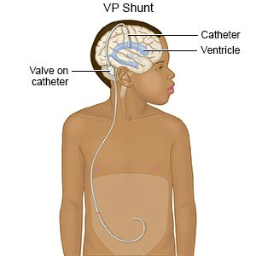

Slide 37
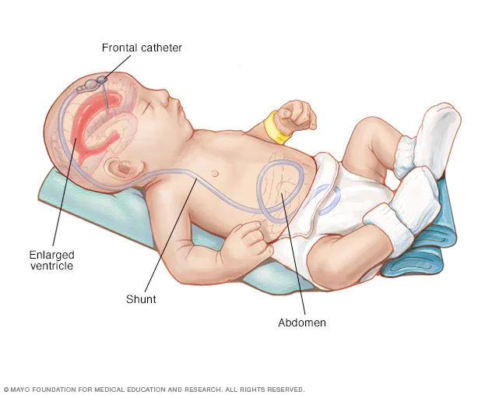

Slide 38
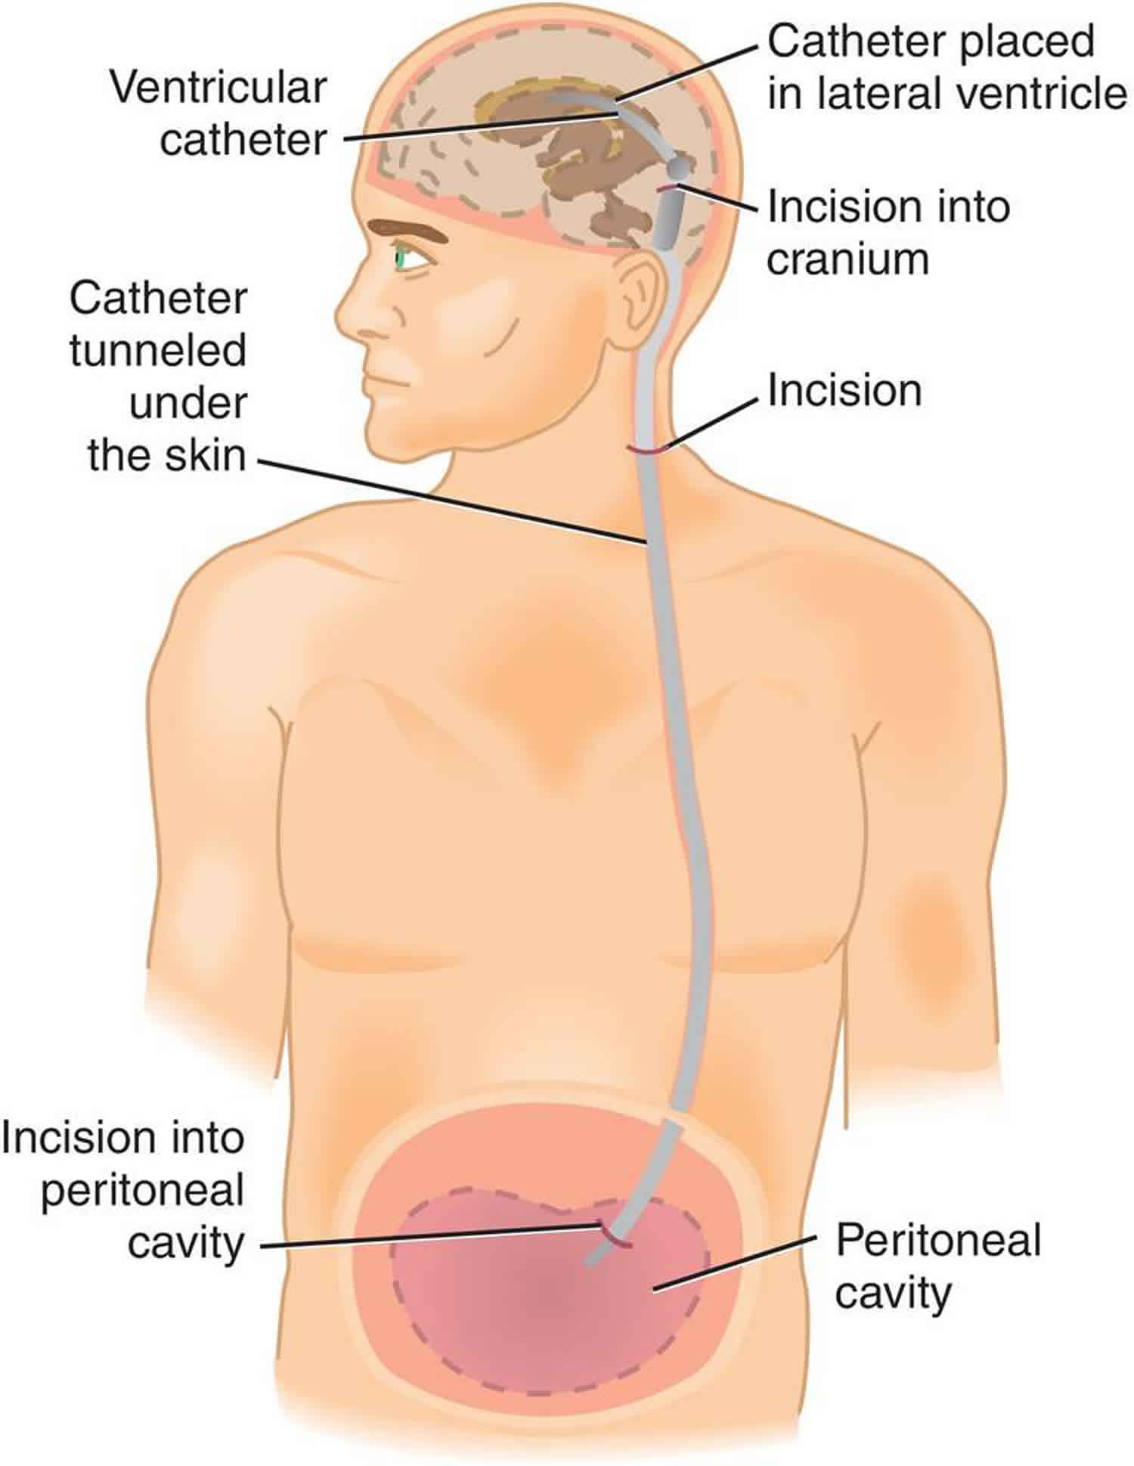

Slide 39
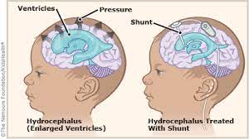

Slide 40
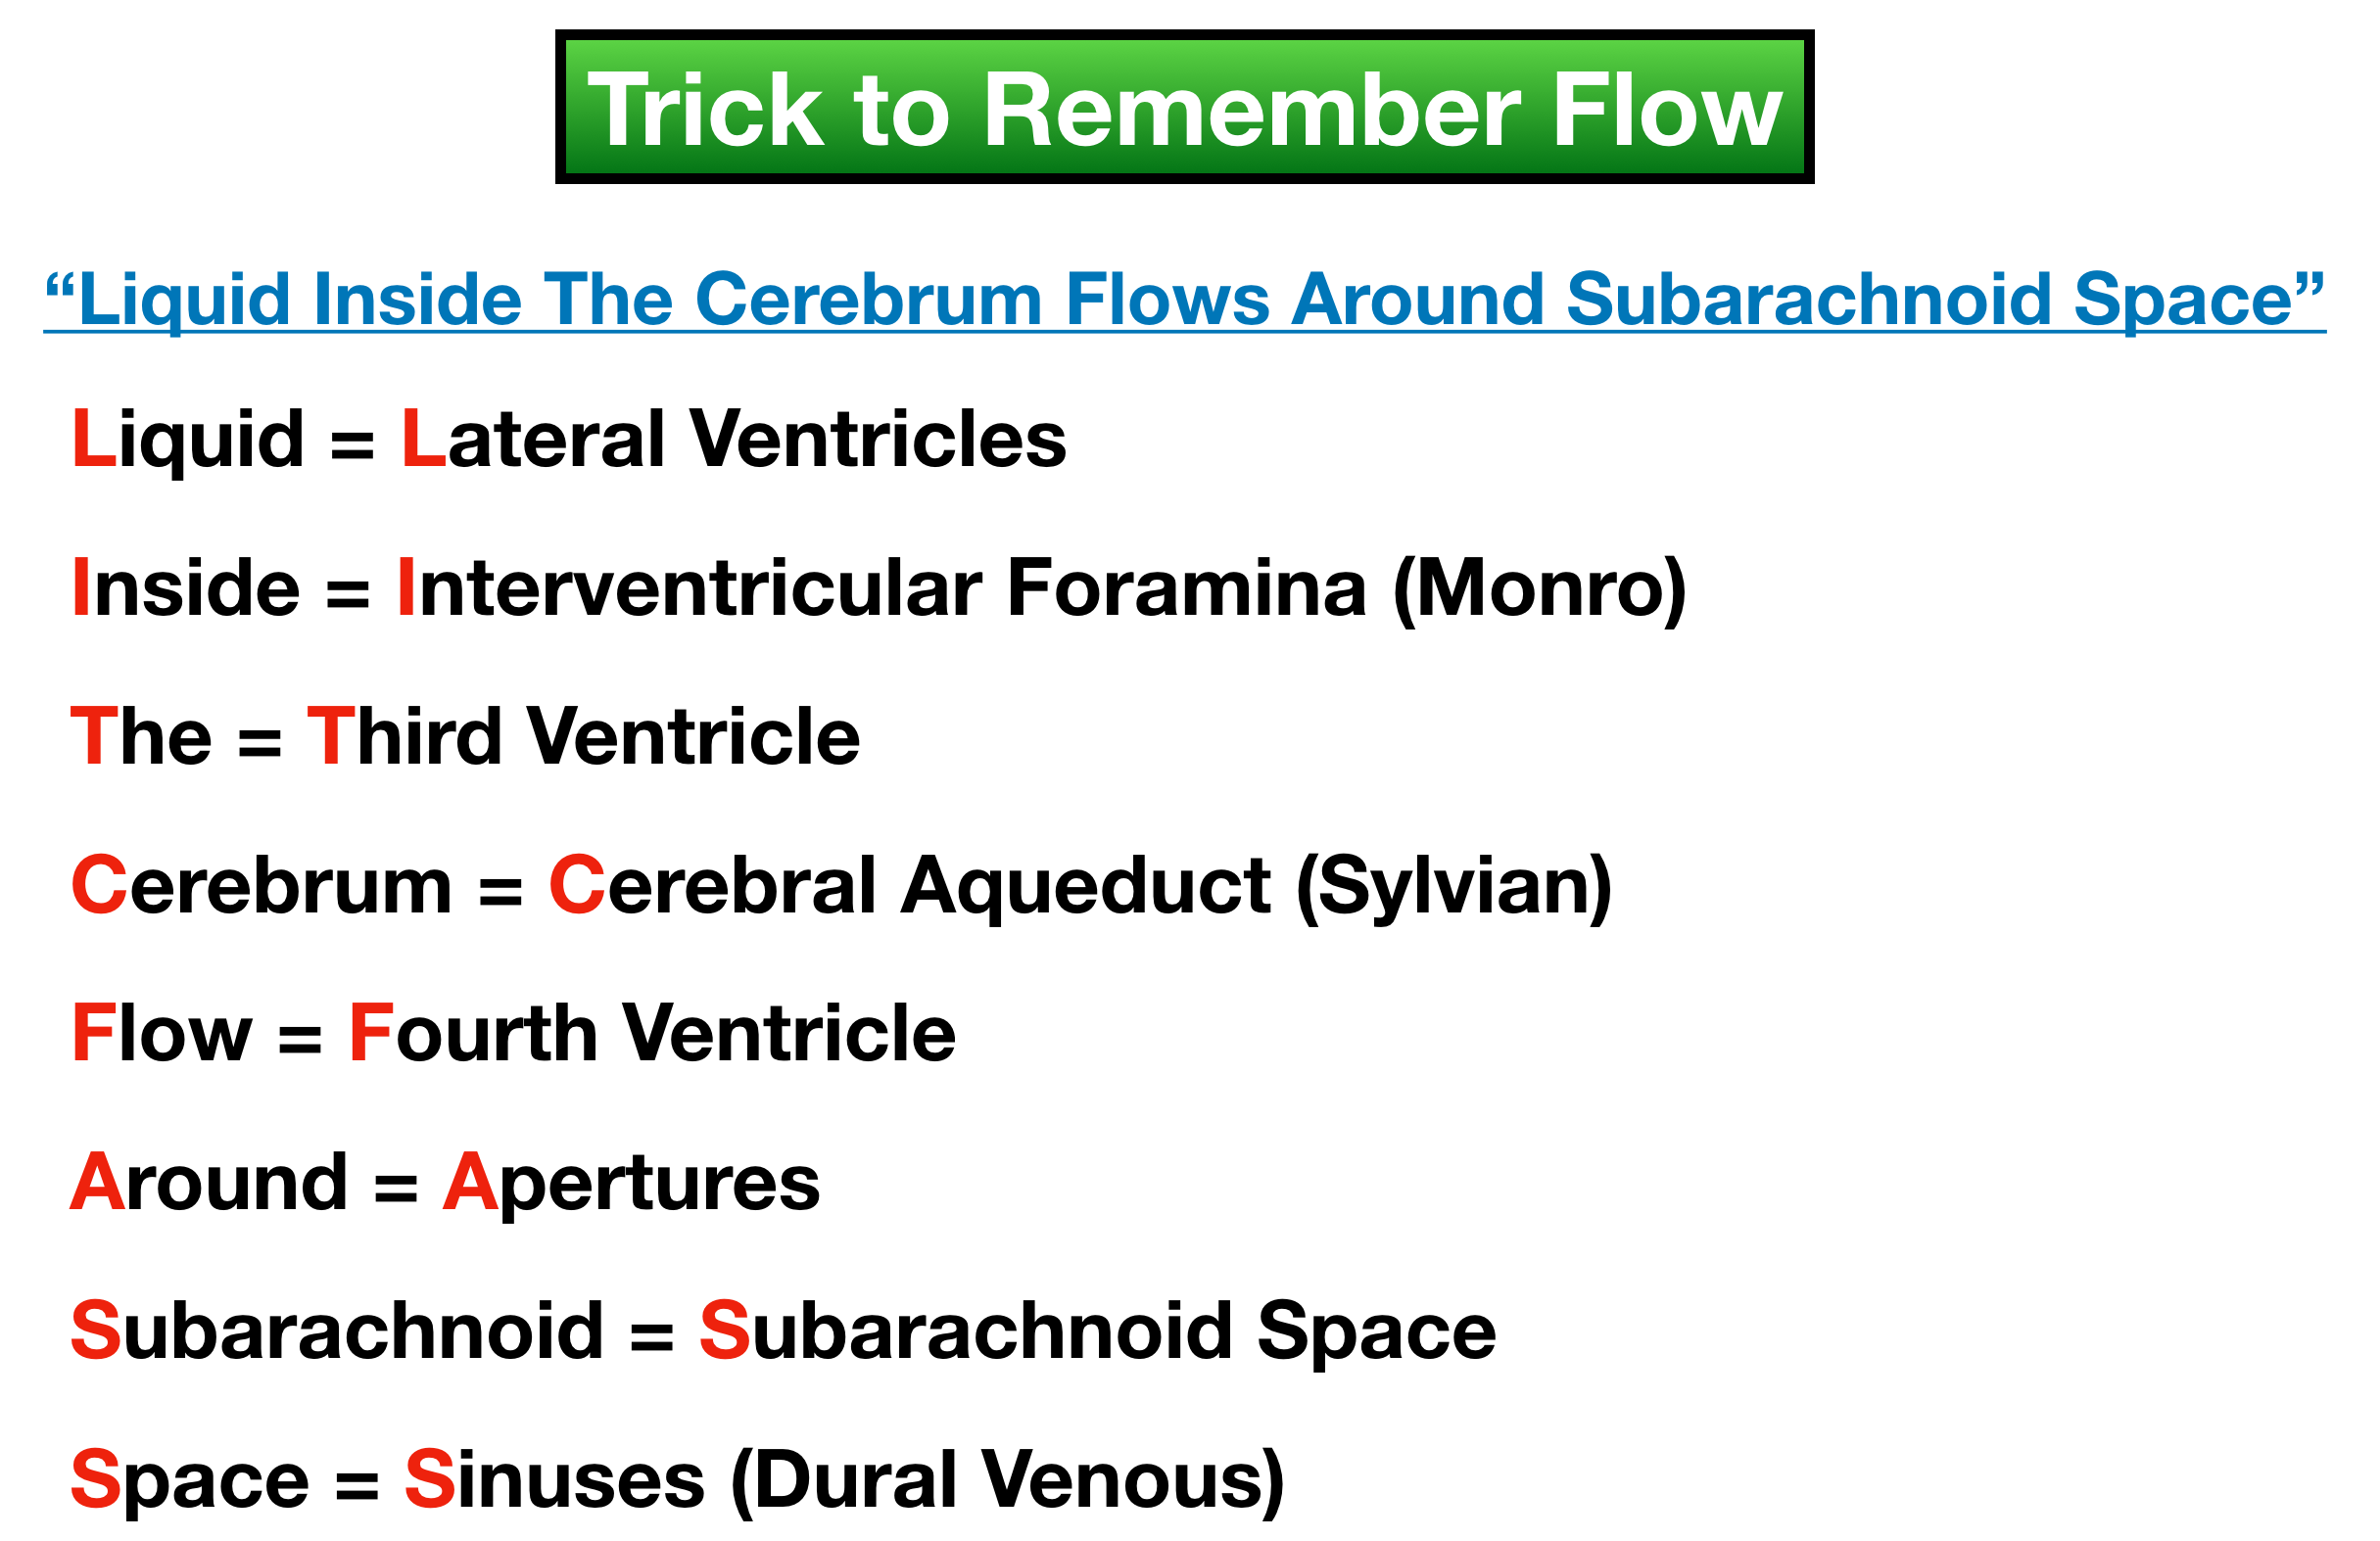

Slide 41
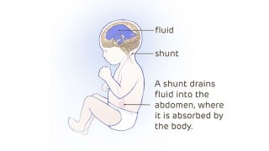

Slide 42
NURSING CARE
Child may be barely able to raise the head
Mental development is delayed
Position of the patient must be changed frequently

Slide 43
Child may be barely able to raise the head
Mental development is delayed
Position of the patient must be changed frequently

Slide 44
Pad of lamb’s wool or sponge rubber placed under the head.

Slide 45


