Slide 1
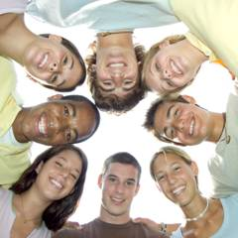
GROWTH AND DEVELOPMENT OF ADOLESCENT

Slide 2
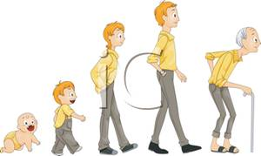
INTRODUCTION
The period of growth and development extend through out the life. However the principle growth and development takes place from consumption till adolescence.

Slide 3
ADOLESCENCE PERIOD
Early adolescence(pubescent period)
          Girls 10 -14 years
          Boys 12-16 years
Middle adolescence
          14-16 years
Late adolescence
          17-20 years

Slide 4
OVERVIEW OF GROWTH AND DEVELOPMENT
BIOLOGIC GROWTH | EARLY ADOLESCENCE | MIDDLE ADOLESCENCE | LATE ADOLESCENCE
WEIGHT MALE FEMALE | 38-60 Kg 40-60 Kg | 50-60 Kg 42-64 Kg | 56-80 Kg 48-72 Kg
HEIGHT MALE FEMALE | 154-172 cm 153-167 cm | 164- 180 cm 155- 169 cm | 163-182 cm 156-170 cm

Slide 5
Cont…
BIOLOGIC GROWTH | EARLY ADOLESCENCE | MIDDLE ADOLESCENCE | LATE ADOLESCENCE
PULSE (bt/min) | 65+/-8 | 66+/-8 | 70+/- 8
RESPIRATION (bt/min) | 19 +/-3 | 17 +/-3 | 17 +/-3
BLOOD PRESSURE (Mm hg) MALE FEMALE | 114/68+/-10/14 112/66+/-10/12 | 116/70+/-12/14 114/70+/-14/12 | 126/74+/-26/16

Slide 6
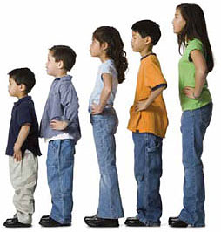
BODY PROPORTIONS
The skeletal system grows faster than its supporting muscles , which tends to cause clumsiness and poor posture. The extremities , hand and feet grow out of proportion to the rest of the body and cause more co-ordination problems.

Slide 7
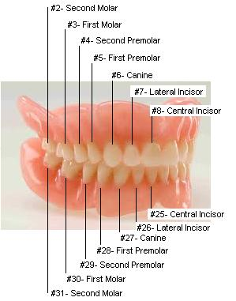
DENTITION
Early adolescence -2nd molar and cuspid ,bicuspid teeth erupts.
Late adolescence -3rd molar erupts.(wisdom teeth)

Slide 8
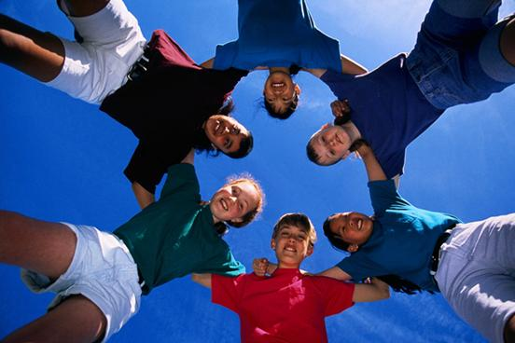
PHYSIOLOGIC DEVELOPMENT
Nero hormonal stimulation of pituitary gland
Stimulation of testes and ovary
Action of adrenal cortex
Secondary sexual characteristics.

Slide 9
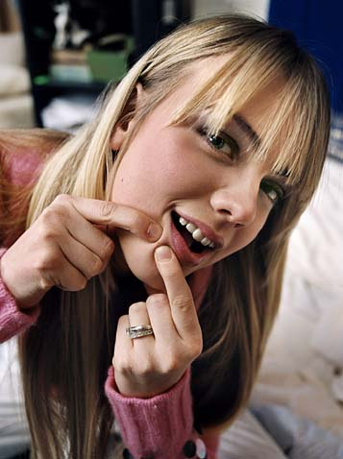
INTEGUMENTARY SYSTEM
The sebaceous glands of the face , back and chest become more active. if the pores are too small sebaceous material cannot escape ; it collects beneath the skin and produce pimples . perspiration is increased.

Slide 10
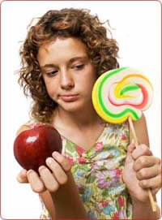
CARDIOVASCULAR /RESPIRATORY SYSTEM
Since the heart and lungs usually grow more slowly than the rest of the body, the supply of oxygen may be inadequate , causing them to feel constantly tired.

Slide 11
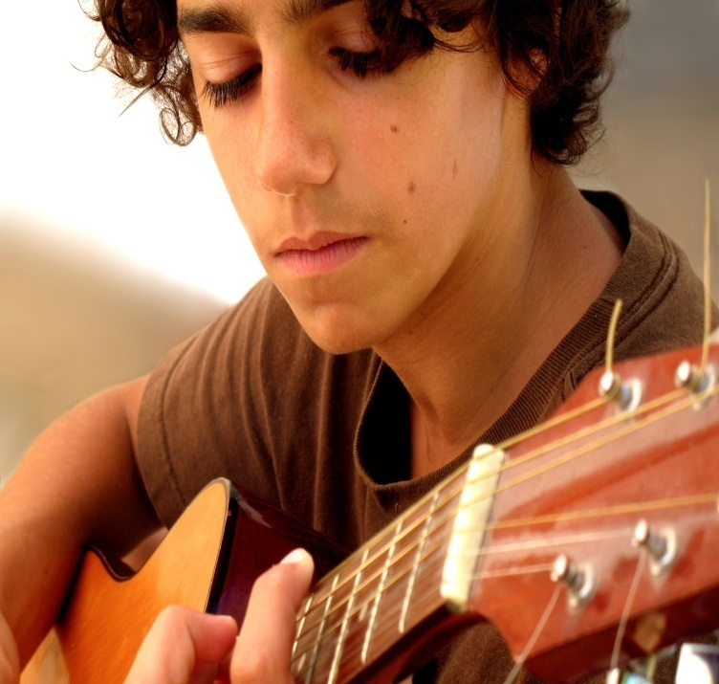
MOTOR AND SELF CARE
Clumsiness occurs due to rapid physical growth.
Motor function is comparable to adult.
Eye-hand co-ordination at adult level.
Possesses manual dexterity.

Slide 12
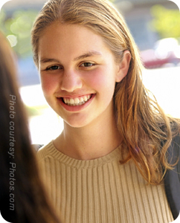
VISUAL ACUITY
20/20

Slide 13
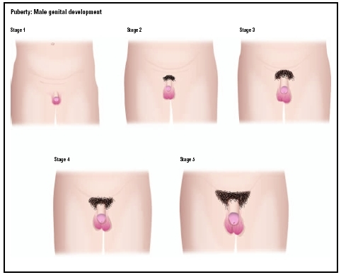
TANNERS STAGES IN THE DEVELOPMENT OF GENITALS IN MALE

Slide 14
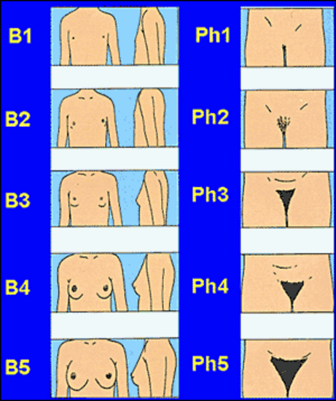
IN FEMALE

Slide 15
PSYCHOSOCIAL DEVELOPMENT
EARLY ADOLESCENCE | MIDDLE ADOLESCENCE | LATE ADOLESCENCE
SENSE OF IDENTITY “WHO AM I” VS SELF DIFFUSION. EGOCENTRISM | SENSE OF IDENTITY VS SELF DIFFUSION EGO CENTRISM DIMINISHES SEPARATION FROM PARENTS CONTINUE HETEROSEXUAL RELATIONSHIPS AND INTERESTS COMMON | SENSE OF INTIMACY VS ISOLATION TIES WITH PARENTS. INTERDEPENDANT RELATIONSHIP WITH PARENTS HETEROSEXUAL RELATIONSHIPS

Slide 16

Puberty changes effect on attitude and behavior
Desire for Isolation
Boredom
Inco-ordination
Social –antagonism
Heightened emotionality
Loss of self -confidence

Slide 17

Social changes during adolescence
Peer group identity
Crowds
Organized group
Gangs
Body image
Adolescent interest
Recreational
Personal
Educational

Slide 18
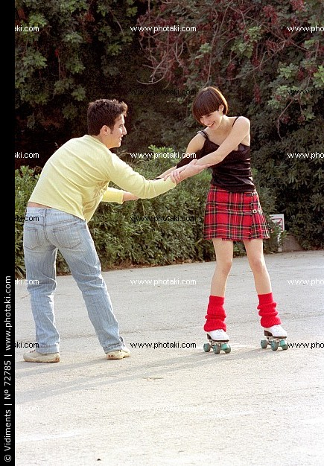
PSYCHOSEXUAL DEVELOPMENT
Genital stage
        Masturbation
        Sexual fantasies
        Secondary sexual characters develop
        Sexual identity and roles

Slide 19
SPIRITUAL DEVELOPMENT
EARLY | MIDDLE | LATE
SYNTHETIC- CONVENTIONAL FAITH | SYNTHETIC – CONVENTIONAL FAITH | INDIVIDUATING- REFLECTING FAITH

Slide 20
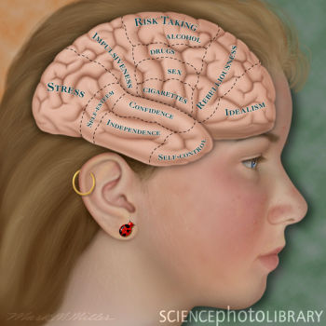
COGNITIVE DEVELOPMENT
Formal operational thought
Generates hypothesis
Uses the scientific method for problem –solving
Expresses concern for education vs. Vocational choice.
Pursues further education or enters the job market

Slide 21
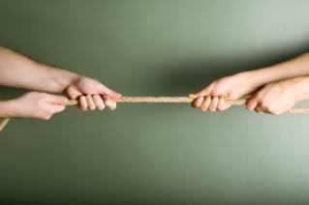
MORAL DEVELOPMENT
Early and middle adolescence:
Post conventional stage : stage 5
Social contract orientation
Late adolescence:
Post conventional stage : stage 6
Universal ethical principle
Idealism

Slide 22
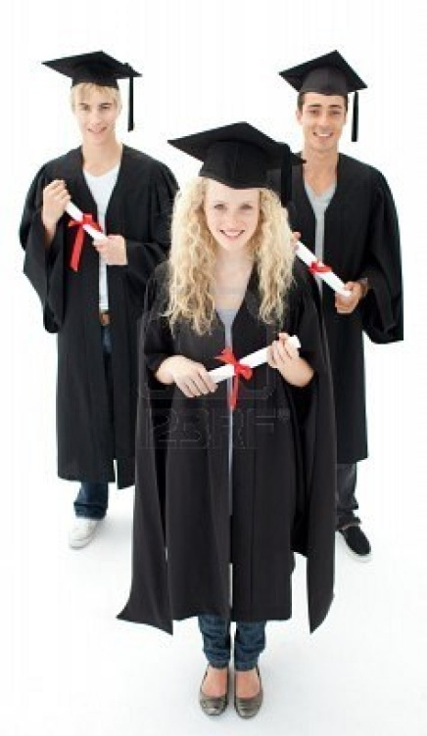
LANGUAGE DEVELOPMENT
Uses slang within and outside
peer group.
Uses distinct meanings for words.

Slide 23
PLAY
EARLY ADOLESCENCE | MIDDLE ADOLESCENCE | LATE ADOLESCENCE
PARTIES HELPING OTHERS INTEREST IN WORLD AFFAIRS. EXPRESSIVE ARTS CRAFTS SOCIAL DRINKING DRUGS | ENGAGES IN ORGANIZED COMPETETIVE SPORTS | RECREATIONAL ACTIVITIES CHOOSES MORE PASSIVE SPECTATOR SPORTS

Slide 24
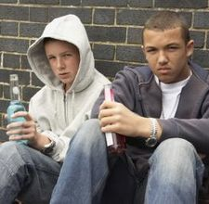
HEALTH NEEDS
Communication techniques
Physical examination
Self care
Nutrition
Eating habits
Prevention of long term illnesses
Dental health
Accident prevention
Prevention of addictive behavior
Sex education
Stress reduction

Slide 25
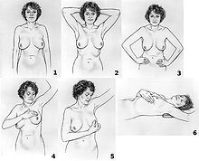
CONTD….
Sex education
        Contraceptive counselling
        Breast self examination
        Testicular examination
        Education for parenthood

Slide 26
HEALTH PROBLEMS
Females
        Menstruation
            Pre menstrual syndrome
            Dysmenorrhea
            Amenorrhea
            Dysfunctional uterine bleeding
        Vulvo vaginitis
        Breast size and shape, Ear piercing

Slide 27
Cont…
Males
    Erections
    Size of genitalia
    Gynaecomastia

Slide 28
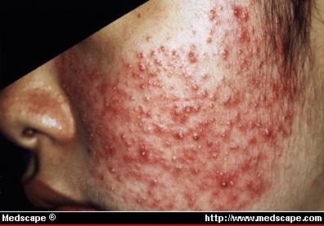
CONT..
Both sexes
    Masturbation and sexual fantasies
    Acne vulgaris
    Infectious mononucleosis
    Pregnancy during adolescence
    Sexually transmitted diseases

Slide 29


