Slide 1
PRESENTED BY:-
MR.SHAILENDRA VERMA
NURSING TUTOR
RCN, BAREILLY

Slide 2
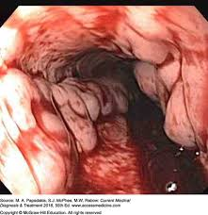
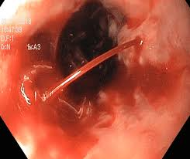

Slide 3
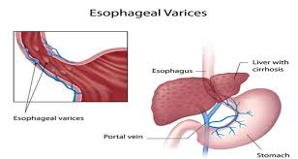

Slide 4
SPECIFIC OBJECTIVES
On the completion of class teaching the group will be able to:-
  Introduce the topic
  Define the Oesophageal varices
  Explain the anatomy and physiology
  Explain the incidence of Oesophageal varices
  Enlist the Etiology of Oesophageal varices
  Describe the pathophysiology of Oesophageal varices
  Explain the Sign and Symptoms Oesophageal varices
  Explain the diagnostic evaluation of Oesophageal varices
  Describe the Management of Oesophageal varices
  Enlist Complications of Oesophageal varices

Slide 5
INTRODUCTION
It is disorder of GI.
Esophageal varices are abnormal, enlarged veins in the tube that connects the throat and stomach (esophagus). This condition occurs most often in people with serious liver diseases.

Slide 6
DEFINITION
Esophageal varices (Sometimes spelled esophageal varix or oesophageal varices) are extremely dilated sub-mucosal veins in the lower third of the esophagus. They are most often a consequence of portal hypertension, commonly due to cirrhosis; people with esophageal varices have a strong tendency to develop bleeding

Slide 7
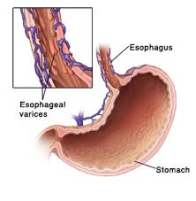
ANATOMY AND PHYSIOLOGY OF OESOPHAGEAL OBSTRUCTION

Slide 8
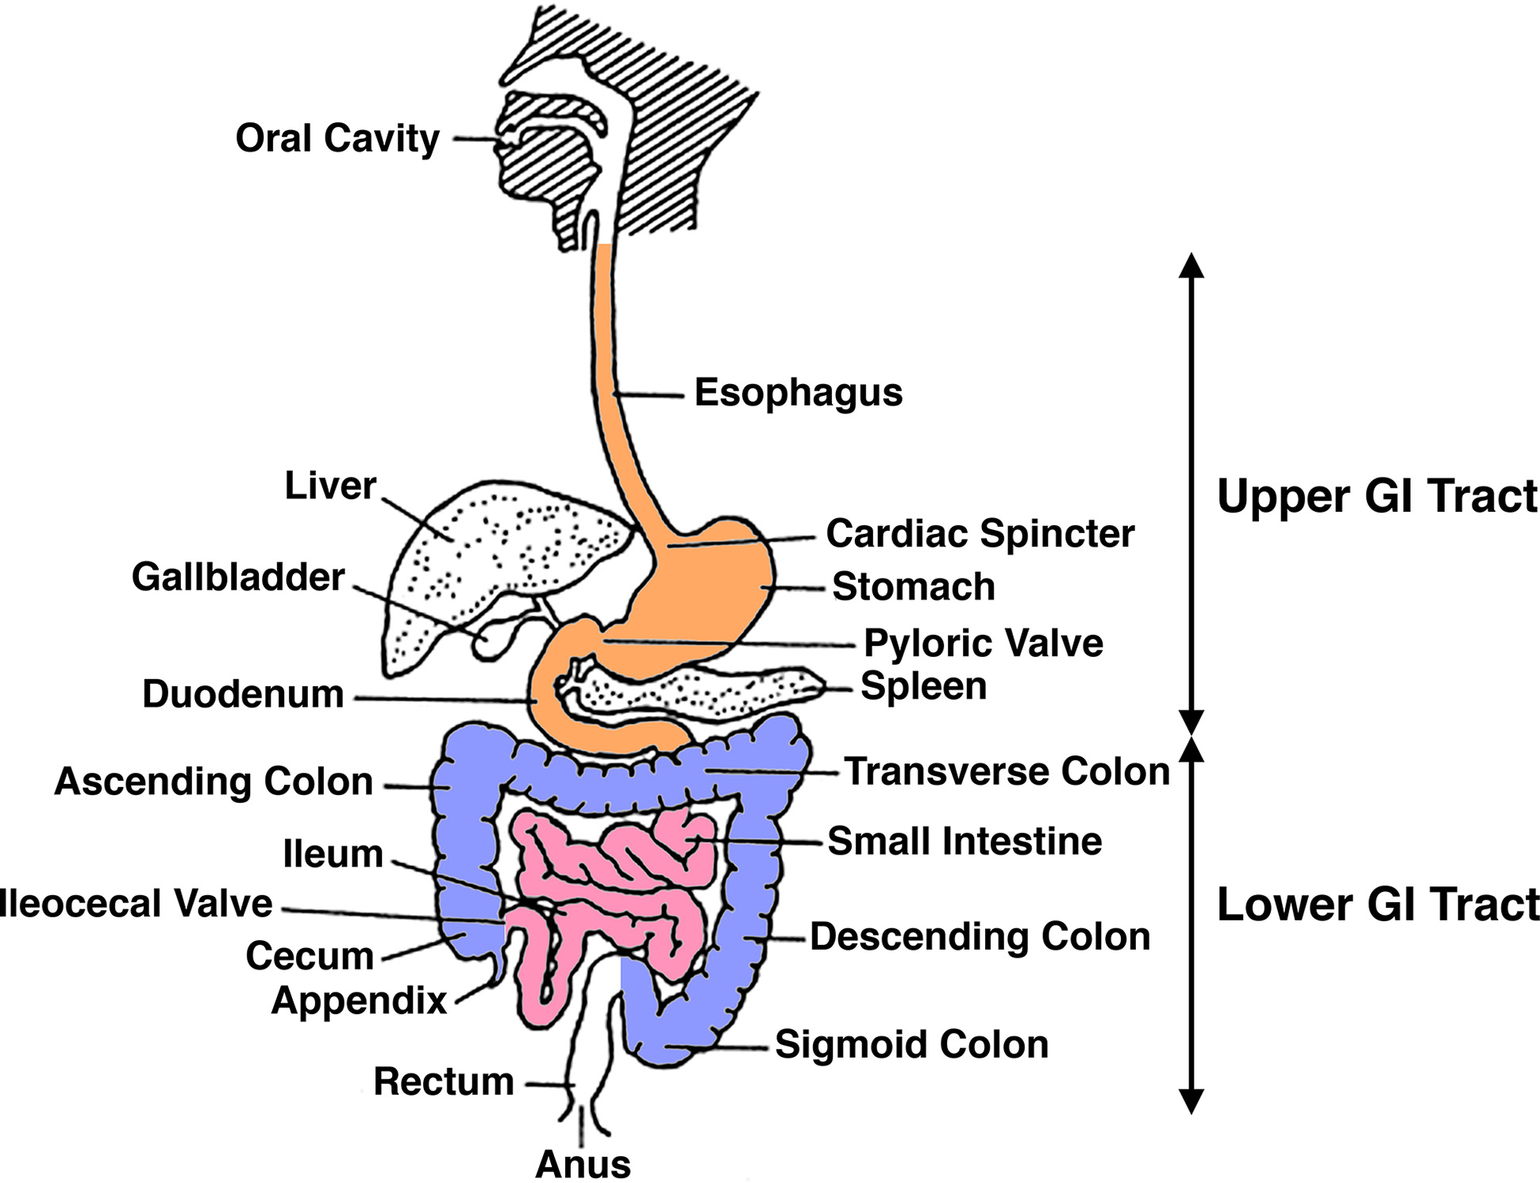

Slide 9
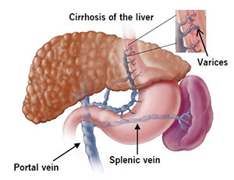

Slide 11
INCIDENCE
It is more common in males than in females. 50 % of patients with esophageal varices will experience

Slide 12
ETIOLOGY / RISK FACTORS
Causes of esophageal varices include:
  Severe liver scarring (cirrhosis).
  Blood clot (thrombosis). A blood clot in the portal vein or in a vein that feeds into the portal vein (splenic vein) can cause esophageal varices.
  A parasitic infection. The parasite can damage the liver, as well as the lungs, intestine and bladder

Slide 13
High portal vein pressure. (portal hypertension).
Large varices. The larger the varices, the more likely they are to bleed.
Red marks on the varices.
Severe cirrhosis or liver failure.
Continued alcohol use.

Slide 14
PATHOPHYSIOLOGY
Due to etiological factors
Portal venous hypertension
Increased resistance to flow in portal venous system
Increased pressure
Portal systemic shunting (abnormal venous communication between portal system and systemic venous circulation)
Appearing a large submucosal vein at lower end of esophagus and gastric fundus
Hemmorhage due to increased intravariceal pressure
Esophageal varices

Slide 15
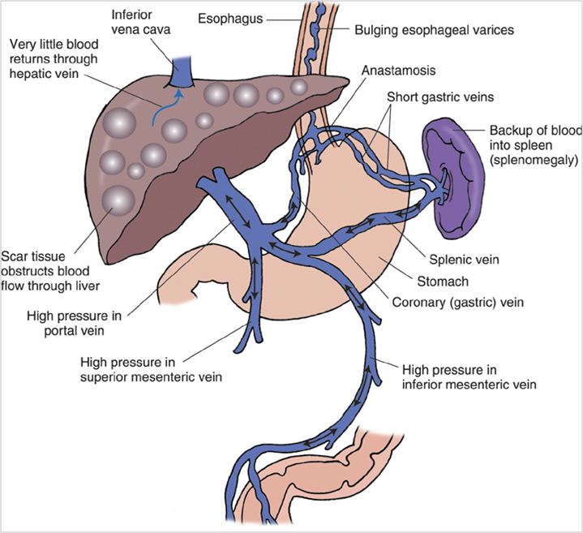

Slide 16
CLINICAL MANIFESTATION
Signs and symptoms can include:
  Vomiting and seeing significant amounts of blood in your vomit
  Black, tarry or bloody stools
  Light-headedness
  Loss of consciousness (in severe case)
  Yellow coloration of your skin and eyes (jaundice)
  Easy bleeding or bruising
  Fluid buildup in your abdomen (ascites)

Slide 17
DIAGNOSTIC EVALUATION
History collection & physical examination
Blood investigation (if needed)
Endoscope exam.
Imaging tests.
Capsule endoscopy. In this test, you swallow a vitamin-sized capsule containing a tiny camera, which takes pictures of the esophagus as it goes through your digestive tract. This might be an option for people who are unable or unwilling to have an endoscope exam. This technology is more expensive than regular endoscopy and not as available.

Slide 18
MANAGEMENT
Medications to reduce pressure in the portal vein. A type of blood pressure drug called a beta blocker may help reduce blood pressure in your portal vein, decreasing the likelihood of bleeding. These medications include propranolol (Inderal, Innopran) and nadolol (Corgard).

Slide 19
Surgical Management
Using elastic bands to tie off bleeding veins. If your esophageal varices appear to have a high risk of bleeding, your doctor might recommend a procedure called band ligation.
Using an endoscope, the doctor snares the varices and wraps them with an elastic band, which essentially "strangles" the veins so they can't bleed. Esophageal band ligation carries a small risk of complications, such as scarring of the esophagus

Slide 20
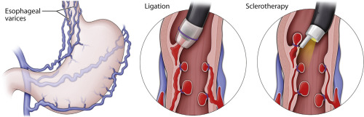

Slide 21
NURSING ASSESSMENT:
Assessment – ABCD
Initial acute
  Airway – Does the patient have a patent airway? Are they at significant risk of losing their airway?
  Breathing – Respiratory rate, oximetry, respiratory effort, air entry?
  Circulation – Heart rate, blood pressure, central and peripheral capillary refill time? IV access? How much blood is the patient losing?
  Disability: Level of consciousness? Are they distressed? Irritable (consider encephalopathy)? Are they in pain? Are they febrile? Receiving antibiotics?

Slide 22
PREVENTION
Don't drink alcohol.
Eat a healthy diet.
Maintain a healthy weight.
Use chemicals sparingly and carefully.
Reduce your risk of hepatitis.

Slide 23
COMPLICATIONS
Rebleeding,
Shock, which can lead to
Death,

Slide 24
SUMMARY
After completed my teaching session group improve their knowledge, skills in identifying patient with oesophageal obstruction, and also apply in your future regarding:-
  Introduce the topic
  Define the Oesophageal varices
  Explain the anatomy and physiology
  Explain the incidence of Oesophageal varices
  Enlist the Etiology of Oesophageal varices
  Describe the pathophysiology of Oesophageal varices
  Explain the Sign and Symptoms Oesophageal varices
  Explain the diagnostic evaluation of Oesophageal varices
  Describe the Management of Oesophageal varices
  Enlist Complications of Oesophageal varices

Slide 25
CONCLUSION

Slide 26
RECAPTUALIZATION
Define Oesophageal varices
Cause of Oesophageal varices
Explain pathophysiology of varices
Describe the management of varices

Slide 27
ASSIGNMENT / APPLICATION :-
Assignment on NCP of pre and post surgical management.
Date of Submission ---------------

Slide 28
REFERENCES
“Lippincott Williams and Wilkins, text book of ‘Manual of Nursing Practice’ Ninth Ed, publisher by wolters kluwer, New Delhi” page no 685-687
“Arlene L. Polaski and Suzanne E. Tatro, text book of ‘Luckmann’s Core Principle of Medical Surgical’ 2010 , publisher by Elsevier, India” page no 484-487
Brunners And Suddharths, 2010, “Text book of ‘Medical Surgical Nursing, 12th edition ,volume 2, publisher by wolters kluwer , page no 104-107
Linda S. Williams and Paula.D Hopper ,2003, “Understanding Medical Surgical Nursing”, 2nd Ed, FA Davis publisher, page no 836-838
BT Basavanthappa, text book of ‘Medical Surgical Nursing’ 2nd Ed, publisher by Jaypee Brothers, page no 520-524

Slide 29


