Slide 1
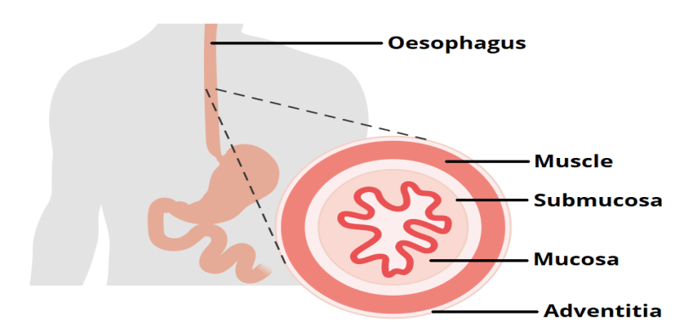

Slide 2
OESOPHAGIAL OBSTRUCTION
PRESENTED BY:-
MR.SHAILENDRA VERMA
NURSING TUTOR
RCN, BAREILLY

Slide 3
SPECIFIC OBJECTIVES
On the completion of class teaching the group will be able to:-
  Introduce the topic
  Define the Oesophageal obstruction
  Explain the anatomy and physiology of Oesophageal obstruction
  Explain the incidence of Oesophageal obstruction
  Enlist the Etiology of Oesophageal obstruction
  Describe the pathophysiology of Oesophageal obstruction
  explain the Sign and Symptoms Oesophageal obstruction
  explain the diagnostic evaluation of Oesophageal obstruction
  Describe the Management of Oesophageal obstruction
  Enlist Complications of Oesophageal obstruction

Slide 4
INTRODUCTION
It is disorder of GI. Oesophageal obstruction, also known as 'steakhouse syndrome', is a type of medical emergency caused due to the obstruction of oesophagus.

Slide 5
DEFINITION
Dysphagia is difficulty swallowing — taking more time and effort to move food or liquid from your mouth to your stomach. Dysphagia can be painful. In some cases, swallowing is impossible

Slide 6
ANATOMY AND PHYSIOLOGY OF OESOPHAGEAL OBSTRUCTION

Slide 7
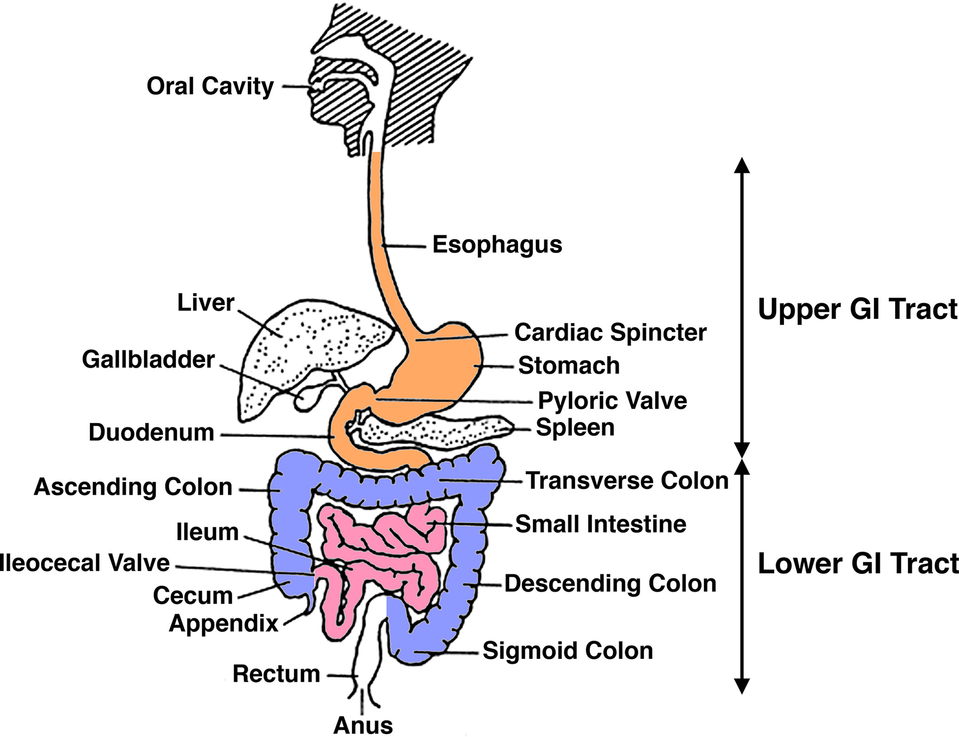

Slide 8
INCIDENCE
There is overall low disease prevalence for the condition. One study reported an incidence rate of 1.1 per 10000 person-years, which also increases with age.

Slide 9
ETIOLOGY / RISK FACTORS
Some of the causes of oesophageal dysphagia include:
Achalasia. When the lower oesophageal muscle (sphincter) doesn't relax properly to let food enter the stomach, it can cause food to come back up into the throat.
Diffuse spasm. This condition causes high-pressure, poorly coordinated contractions of the oesophagus, usually after swallowing.

Slide 10
Esophageal stricture. A narrowed esophagus (stricture) can trap large pieces of food. Tumors or scar tissue, often caused by gastroesophageal reflux disease (GERD), can cause narrowing.
Esophageal tumors. Difficulty swallowing tends to get progressively worse when esophageal tumors are present due to narrowing of the esophagus.
Foreign bodies. Sometimes food or another object can partially block the throat or esophagus. Older adults with dentures and people who have difficulty chewing their food may be more likely to have a piece of food become lodged in the throat or esophagus.

Slide 11
Radiation therapy. This cancer treatment can lead to inflammation and scarring of the esophagus.
Neurological disorders. Certain disorders — such as multiple sclerosis, muscular dystrophy and Parkinson's disease — can cause dysphagia.
Neurological damage. Sudden neurological damage, such as from a stroke or brain or spinal cord injury, can affect the ability to swallow.
Cancer. Certain cancers and some cancer treatments, such as radiation, can cause difficulty swallowing.

Slide 12
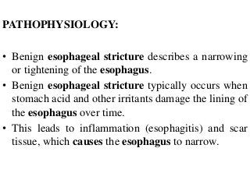

Slide 13
CLINICAL MANIFESTATION
Signs and symptoms associated with dysphagia can include:
  Pain while swallowing
  Inability to swallow
  A sensation of food getting stuck in the throat or chest or behind the breastbone (sternum)
  Drooling
  Hoarseness
  Food coming back up (regurgitation)
  Frequent heartburn
  Food or stomach acid backing up into the throat
  Weight loss
  Coughing or gagging when swallowing

Slide 14
DIAGNOSTIC EVALUATION
History collection & physical examination
Blood investigation (if needed)
Tests can include:
X-ray with a contrast material (barium X-ray). You drink a barium solution that coats your esophagus, making it easier to see on X-rays. Your health care provider can then see changes in the shape of your esophagus and can assess the muscular activity.

Slide 15
Dynamic swallowing study. You swallow barium-coated foods of different consistencies. This test provides an image of these foods as they travel down your throat
A visual examination of your esophagus (endoscopy). A thin, flexible lighted instrument (endoscope) is passed down your throat so that your health care provider can see your esophagus.
Fiber-optic endoscopic evaluation of swallowing (FEES). Your health care provider might examine your throat with a special camera and lighted tube (endoscope) as you try to swallow.

Slide 16
Esophageal muscle test (manometry). In manometry (muh-NOM-uh-tree), a small tube is inserted into your esophagus and connected to a pressure recorder to measure the muscle contractions of your esophagus as you swallow.
Imaging scans. These can include a CT scan, which combines a series of X-ray views and computer processing to create cross-sectional images of your body's bones and soft tissues, or an MRI scan, which uses a magnetic field and radio waves to create detailed images of organs and tissues.

Slide 17
MANAGEMENT
Oropharyngeal dysphagia
For oropharyngeal dysphagia, your health care provider might refer you to a speech or swallowing therapist. Therapy might include:
  Learning exercises. Certain exercises might help coordinate your swallowing muscles or restimulate the nerves that trigger the swallowing reflex.
  Learning swallowing techniques. You might also learn ways to place food in your mouth or position your body and head to help you swallow. Exercises and new swallowing techniques might help if your dysphagia is caused by neurological problems such as Alzheimer's disease or Parkinson's disease.

Slide 18
Oesophageal dysphagia
Treatment approaches for oesophageal dysphagia might include:
  Esophageal dilation. For a tight esophageal sphincter (achalasia) or an esophageal stricture, your health care provider might use an endoscope with a special balloon attached to gently stretch and expand your esophagus or pass a flexible tube or tubes to stretch the esophagus (dilation).

Slide 19
Medications. Difficulty swallowing associated with GERD can be treated with prescription oral medications to reduce stomach acid. You might need to take these medications for a long time.
Corticosteroids might be recommended for eosinophilic esophagitis. For esophageal spasm, smooth muscle relaxants might help.

Slide 20
Surgical Management
The type of surgical treatment depends on the cause of dysphagia. Some examples are:
Laparoscopic Heller myotomy. This involves cutting the muscle at the lower end of the esophagus (sphincter) when it fails to open and release food into the stomach in people who have achalasia.
Peroral endoscopic myotomy (POEM). The surgeon or gastroenterologist uses an endoscope inserted through the mouth and down the throat to create an incision in the inside lining of the oesophagus to treat achalasia Then, as in a Heller myotomy, the surgeon or gastroenterologist cuts the muscle at the lower end of the oesophageal sphincter.

Slide 21
Stent placement. The health care provider can also insert a metal or plastic tube (stent) to prop open a narrowing or blocked esophagus. Some stents are permanent, such as those for people with esophageal cancer, while others are removed later.

Slide 22
COMPLICATIONS
Stricture formation,
Ulceration of esophageal mucosa,
Rebleeding,
Hematoma formation,
Perforation,
Spontaneous bacterial peritonitis, and
Pulmonary infections.

Slide 23
SUMMARY
After completed my teaching session group improve their knowledge, skills in identifying patient with oesophageal obstruction, and also apply in your future regarding:-
  Introduce the topic
  Define the Oesophageal obstruction
  Explain the anatomy and physiology of Oesophageal obstruction
  Explain the incidence of Oesophageal obstruction
  Enlist the Etiology of Oesophageal obstruction
  Describe the pathophysiology of Oesophageal obstruction
  explain the Sign and Symptoms Oesophageal obstruction
  explain the diagnostic evaluation of Oesophageal obstruction
  Describe the Management of Oesophageal obstruction
  Enlist Complications of Oesophageal obstruction

Slide 24
CONCLUSION

Slide 25
RECAPTUALIZATION
Define Oesophageal obstruction
Cause of Oesophageal obstruction
Explain pathophysiology of Oesophageal obstruction
Describe the management of Oesophageal obstruction

Slide 26
ASSIGNMENT / APPLICATION :-
Assignment on NCP of pre and post surgical management.
Date of Submission ---------------

Slide 27
REFERENCES
“Lippincott Williams and Wilkins, text book of ‘Manual of Nursing Practice’ Ninth Ed, publisher by wolters kluwer, New Delhi” page no 685-687
“Arlene L. Polaski and Suzanne E. Tatro, text book of ‘Luckmann’s Core Principle of Medical Surgical’ 2010 , publisher by Elsevier, India” page no 484-487
Brunners And Suddharths, 2010, “Text book of ‘Medical Surgical Nursing, 12th edition ,volume 2, publisher by wolters kluwer , page no 104-107
Linda S. Williams and Paula.D Hopper ,2003, “Understanding Medical Surgical Nursing”, 2nd Ed, FA Davis publisher, page no 836-838
BT Basavanthappa, text book of ‘Medical Surgical Nursing’ 2nd Ed, publisher by Jaypee Brothers, page no 520-524

Slide 28


