Slide 1
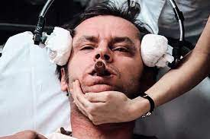
Electro Convulsive Therapy
Presented by:- Dr Abhinav Shekhar
Moderated by:-Dr Rakesh Banal
MBBS,MD

Slide 2
What is ECT
Electroconvulsive therapy (ECT) is a procedure, in which small electric currents are passed through the brain, intentionally triggering a brief seizure.

Slide 3
History
1500-Paracelsus induced seizure by administering camphor.
1785-First report published to treat mania by
using camphor
1938-Cerletti and Bini first used electrical induction of seizures in catatonic patients
1951-First use of unilateral ECT

Slide 4
Electrophysiology in ECT
In ECT, seizures are triggered in normal neurons by application of pulses of current, under conditions that are carefully controlled to create a seizure of a particular duration over the entire brain.
The skull has a high impedance; the brain has a low impedance. Because scalp tissues are much better conductors of electricity than bone, only about 20 percent of the applied charge actually enters the skull to excite neurons.

Slide 5
Mechanism of Action
During ECT, PET shows :-
Hyper metabolic state
-increase in cerebral blood flow(CBF)
-increases cerebral metabolic rate(CBR)
Post ictal state functional suppression
-decreases in CBF
-decreases in CMR
Also during & after ECT, there are delta waves indicating reduction in neuronal activity.

Slide 6
Neurochemical changes:
•Down-regulation of beta-adrenergic receptors(antidepressent t/t)
•Up-regulation & sensitization of 5 –HT receptors.
•Increased natural opioids in brain.
•Increased GABA
•Increased CSF concentration of Ach and down regulation of
cortical muscarinic receptors.

Slide 7
Neuroendocrine changes :
•ECT causes release of hypothalamic & pituitary hormone including prolactin.
Blood brain barrier changes:
•Increase cerebral blood flow & BBB permeability
•May facilitate entry of co –administered psychotropic drugs thus increase their efficacy.

Slide 8
• Recent studies-
– Transient induction of increased pro-inflammatory cytokines,
– Increased expression of brain-derived neurotropic
factor (BDNF),
– Enhanced activity in the GABAergic, glutaminergic and dopaminergic systems,
– Enhance neurogenesis, synaptogenesis and remodelling of synapses in hippocampus.

Slide 9
Indication
Diagnostic indication
1.Major depression, both unipolar and bipolar.
2.Psychotic depression in particular.
3.Mania, including mixed episodes.
4.Schizophrenia with acute exacerbation.
Catatonic subtype
Schizoaffective disorder.
5.Other diagnostic indications
Parkinson’s disease
Neuroleptic malignant disorder

Slide 10
Clinical indications:
– Rapid definitive response required on medical or psychiatric grounds
– Risks of alternative treatment outweigh benefits
– Past history of poor response to psychotropic or good
response to ECT
– Patients preference

Slide 11
– Failure to respond to pharmacotherapy in current episode.
– Intolerance of pharmacotherapy in current episode.
– Rapid definitive response necessitated by deterioration of
patient's condition.

Slide 12
Pre Treatment evaluation
Standard physical neurological and pre anaesthesia examination and a complete medical history
Blood and urine chemistry ,chest x ray ,ECG.
Dental examination
CT/MRI-Brain (if organicity is suspected)

Slide 13
Concomitant medication
Use of TCA, MAOi and anti psychotics are considered acceptable.
Benzodiazepines-withdraw.
Lithium-withdraw, can cause post ictal delirium and can prolong seizure activity
Clozapine and bupropion should be withdrawn because they are a/w the development of late appearing seizures.

Slide 14
NPO -6 hours
Check mouth for dentures and other foreign objects and an IV line should be established.
Bite block should be inserted in the mouth just before the treatment is started to protect teeth and tongue.
100% oxygen is administered at a rate of 5L/minute.

Slide 15
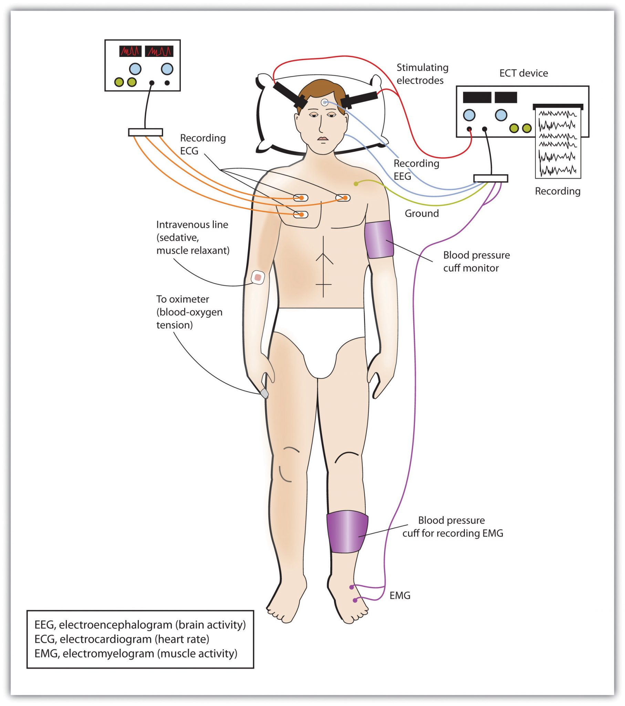
ECT

Slide 16
Muscarinic anti cholinergic drugs
Minimize oral and respiratory secretions and to block bradycardias and asystoles.
Atropine(0.3 to 0.6 mg) IM/SC 30-60 minutes before the anesthetic or 0.4 to 1.0 mg IV 2-3 minutes before anesthetic.
Glycopyrolate (0.2-0.4) IM/IV/SC–less likely to cross BBB and less likely to cause cognitive dysfunction and nausea.

Slide 17
Anesthesia
Depth of anesthesia should be as light as possible, it avoids S/E as well as prevent raising seizure threshold.
Methohexitol(0.75 to 1mg/kg IV bolus)-m/c used anesthetic beacause of its short DOA
Thiopental(2-3 mg/kg)
Etomidate(0.15 to 0.3 mg /kg)
Ketamine(6-10 mg/kg)
Alfentanil(2-9 mg/kg)
Propofol (0.5-3.5/kg)

Slide 18
Muscle Relaxants
After the onset of anesthetic effect, muscle relaxant is administered to minimize the risk of bone fractures and other injuries.
Goal –profound relaxation of the muscles.
Succinylcholine - 0.5 to 1 mg/kg as an IV bolus or drip.(ultrafast)
Tubocurarine (3mg IV) is administered to prevent myoclonus

Slide 19
To monitor the duration of convulsion, a blood pressure may be inflated at the ankle to a pressure in excess of the systolic pressure before infusion of the muscle relaxant to allow observation of relatively innocuous seizure activity in the foot muscles.

Slide 20
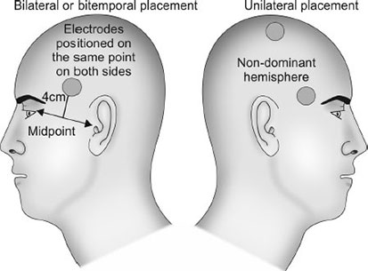

Slide 21
Electrode placement
Bilateral | Unilateral
Electrodes are placed apart over each hemisphere. | Both electrodes placed apart over non dominant hemisphere.
B/L electrode is placed 2.5-4 cm above the midpoint of line joining tragus and lateral canthus | Another electrode at vertex
More rapid therapeutic response | Less marked cognitive deficits and memory difficulties.
MC-Bitemporal | MC-Rt unilateral
Strong anti depressant effect | Lesser

Slide 22
Number and spacing of ECT
• 2 to 3 times /week
• Twice weekly associated with less memory
impairment than thrice weekly treatment.
No. of sessions:-
• Catatonia or delirium – 1 to 4
• MDD- 6 to 12 t/t ( up to 20 sessions are possible)
• Mania – 8 to 20
• Schizophrenia – up to 15

Slide 23
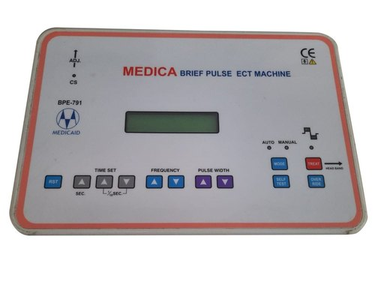

Slide 24
Electrical stimulus
Modern ECT machines use a brief pulse waveform that administers the electrical stimulus usually in 1-2 milliseconds at a rate of 30-100 pulses a second.
During the course of treatment a person’s seizure threshold increases by 25 to 200%.
Seizure threshold Men>women
older>younger adults.

Slide 25
Induced seizures
Brief muscular contraction(jaw and facial muscles)
Followed by plantar extension which marks the tonic phase.
Followed by rhythmic (clonic) contractions that decrease in frequency and finally disappear.
Tonic phase is marked by high frequency sharp EEG activity.
The motor seizure duration has been considered as a standard for determining the therapeutic adequacy, and a motor seizure lasting 20–25 seconds at minimum has been typically recommended.

Slide 26
Failure to induce seizures
If a particular stimulus fails to cause a seizure of sufficient duration, upto 4 attempts at seizure induction can be tried during a course of treatment .
Seizure can be delayed to as long as 20-40 seconds after the stimulus administration.
Check contact between electrodes and skin, and increase stimulus intensity by 25-100 %.

Slide 27
Additional procedures to lower the seizure threshold include hyperventilation and administration of 500 to 1,200 mg IV of caffeine sodium benzoate 5-10 minutes before stimulus.
Prolonged and Tardive Seizures
Prolonged seizures(>180 sec) and status epilepticus can be terminated either with additional doses of anesthetic agent or with IV Diazepam(5-10 mg)
Tardive seizures appearing sometime after the ECT treatment may develop in patients with pre existing seizure disorders.

Slide 28
Cognitive assessment
The MoCA(Montreal Cognitive Assessment) was chosen as a brief generalised cognitive screening measure based on its relative advantages. The MoCA has similarly been recommended in the clinical guidelines for ECT monitoring by the Global ECTMRI Research Collaboration (GEMRIC) international consortium. Alternate measures that may have similar utility include the :-
Modified Mini Mental State Examination (3MSE),
Audio Recorded Cognitive Screen (ARCS) and
ACE-III.
It is important to note that none of these measures were specifically designed for use with ECT, and they are cognitive screening instruments and not standardised neuropsychological tests.

Slide 29
Some domains are more susceptible than others, including verbal and visual anterograde memory, executive function and attention/processing speed.
Others are not so relevant, such as language (e.g. naming, articulation) or writing.

Slide 30
Multiple-monitored ECT
It means giving multiple ECT stimuli during a single session, most commonly two bilateral stimuli within 2 minutes.
Used in severely ill patients
Most frequent occurrence of serious cognitive adverse effects.

Slide 31
Maintenance treatment
Post ECT maintenance should always be considered
Maintenance ECT is effective in relapse prevention treatments.
Indication:-
1.Rapid relapse after initial ECT
2.Severe symptoms
3.Inability to tolerate medication

Slide 32
Adverse Effects
No absolute contraindications
Relative :-
Pregnancy(high risk)
Space Occupying Lesion of CNS- pre-treatment with dexamethasone
Increased Intracerebral pressure/cerebral bleeding risk
Recent MI(risk diminished after 2 weeks)
Hypertension(Propranolol and sublingual nitroglycerin)

Slide 33
Mortality rate-0.002 percent per treatment
&0.01 percent for each patient
CNS effects
Headache, confusion and delirium
Marked confusion may occur in upto 10% of patients within 30 minutes of seizure(T/t barbiturates and benzodiazepines)
Memory
Memory loss(almost all patients are back to normal after 6 months)

Slide 34
Modified ECT | Unmodified ECT
Induction under Central anaesthesia | Induction without Anaesthesia
Nausea,vomiting,dizziness,headache and drowsiness following anaesthesia | Risk of bone fractures,teeth damage,tendon and muscle damage
Prevents hypoxia | Risk of bleeding Pre ECT anxiety .
Overcome Musculoskeletal risk by decreasing motor activity

Slide 35
How to calculate ECT charge?
The stimulus charge is calculated using the following summary metric: stimulus charge equals the product of the current amplitude, pulse width, pulse frequency, and train duration.
Charge = (current amplitude)× (pulse width) ×
(pulse frequency) × (train duration).
The train duration is the total time in which the electrical power is delivered.

Slide 36
Some practical recommendations for brief-pulse ECT are:-
1.Set pulse width at 0.5-1.0 ms
2.Set pulse frequency at 100-200 pulses per second
3.Set pulse amplitude at 0.5-1.0 A
4.Set stimulus duration at whatever length is necessary to create the charge that is desired.
Stimulus duration can be set anywhere between 0.2 and 4 s; stimuli that are 4-8 s in duration mayalso be occasionally administered.

Slide 37
When increasing the ECT dose, an increase in stimulus duration is usually the best way to increase the charge of the stimulus.

Slide 38
Mental health care bill and ECT
Regulations for the use of electroconvulsive therapy as per the Mental Health Care Act, 2017:-
ECT cannot be given as part of the emergency treatment [Section 94]
ECT without the use of muscle relaxants and anesthesia is prohibited,[Section 95 (1) (a)]
ECT in minors can only be given if the treating psychiatrist feels the need to use ECT, after obtaining informed consent from the guardian of the patient and prior permission of the Mental Health Review Board. [Section 95 (1) (b)]

Slide 39
Kaplan and sadock’s synopsis of Psychiatry, Chapter 30,Brain stimulation methods.
Grover S,Avasthi A,Gautam S.Inpatient care and use of ECT in children and adolescents; Aligning with Mental Health Care Act,2017.Indian J Psychiatry 2019;61:155-7.
Dose calculation with brief-pulse ECT demystified by Chittaranjan Andrade.

Slide 40
Thank You

