Slide 1
Maternal Mortality
- Obstetrical Hemorrhage -
Dr. Adiel Fleischer
Chief Maternal Fetal Medicine
NS-LIJ Health System

Slide 2
Maternal Mortality
-All pregnancies-
Etiology | M. M.
Hemorrhage | 28.7%
Embolism | 19.7%
P.I.H. | 17.6%
Infection | 13.1%
Cardiomyopathy | 5.6%
Anesthesia complic | 2.5%
Others | 12.7%

Slide 3
Maternal Mortality
- Obstetrical Hemorrhage -
Peripartum Hemorrhage (PPH)
Predict
Prepare
Handle

Slide 4
Maternal Mortality
- Obstetrical Hemorrhage -
Identify Patients at Risk
Multidisciplinary “Hemorrhage protocol”
Clinical management of PPH

Slide 5
Maternal Mortality
- Obstetrical Hemorrhage -
-Pl previa/accreta
Anticoagulation Rx
Coagulopathy
Overdistended uterus
Grand multiparity
Abn labor pattern
Chorioamnionitis
Large myomas
Previous history of PPH
1.-Identify pat. at risk

Slide 6
Maternal Mortality
- Obstetrical Hemorrhage -
Patients at risk
Pre-delivery management
1.- Prepare for PPH
2.- Optimize patient’s hemodynamic status
3.- Timing of Delivery
4.- Surgical planning
5.- Anesthesia /I.V. access/ invasive monitoring
6.- Modify obsterical management
7.- Increased postpartum/postop surveillance

Slide 7
Maternal Mortality
- Obstetrical Hemorrhage -
1.- Prepare for PPH
Personel
Drugs/Equipment
-Nursing
-Anesthesia
- Surg assistance
- Others (I.R.)
-Methergine
-Hemabate
-Cytotec
-Colloids
- Blood/Bl.products
-Surg. Instruments
-Hemostatic ballons
( Cook, S-B, Foley)

Slide 8
Maternal Mortality
- Obstetrical Hemorrhage -
Patients at risk
Pre-delivery management
1.- Prepare for PPH
2.- Optimize patient’s hemodynamic status
3.- Timing of Delivery
4.- Surgical planning
5.- Anesthesia /I.V. access/ invasive monitoring
6.- Modify obsterical management
7.- Increased postpartum/postop surveillance

Slide 9
Maternal Mortality
- Obstetrical Hemorrhage -
2.- Optimize hemodynamic status
1.- Acute isovolemic hemodilution
2.- Acute hypervolemic hemodilution
3.- Autologous donation
4.- Preoperative transfusion

Slide 10
Maternal Mortality
- Obstetrical Hemorrhage -
Acute hemodilution
Decreases pre-op Hb concentration
For same blood volume lost
Lower RBC’s loss
- 🡫Transfusion rates - 🡩Final Hct’s

Slide 11
Maternal Mortality
- Obstetrical Hemorrhage -
1.- Acute isovolemic hemodilution
Withdraw 2-4u. of Blood
🡫
Replace the volume with crystaloids
🡫
Lower the pre-op Hct
🡫
Replace the blood at end of surgery
2.- Acute hypervolemic hemodilution
Admin 1500-2000cc Crystaloids
🡫
Hemodilution (Lowers pre-op Hct)

Slide 12
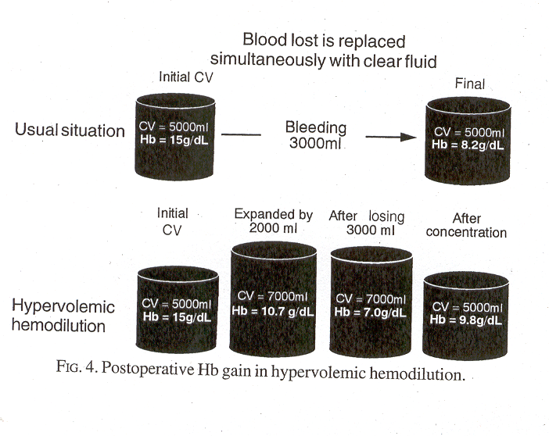
Maternal Mortality
- Obstetrical Hemorrhage -

Slide 13
Maternal Mortality
- Obstetrical Hemorrhage -
- Acute isovolemic/hypervolemic hemodilution
Initial Hb | Blood loss | Hb loss
Preop 45%🡪15g Hb% | 2,000cc | 300g 🡪 (27%)
After hemodilution
Preop 30%🡪 10g Hb% | 3,000cc | 300g 🡪 (27%)

Slide 14
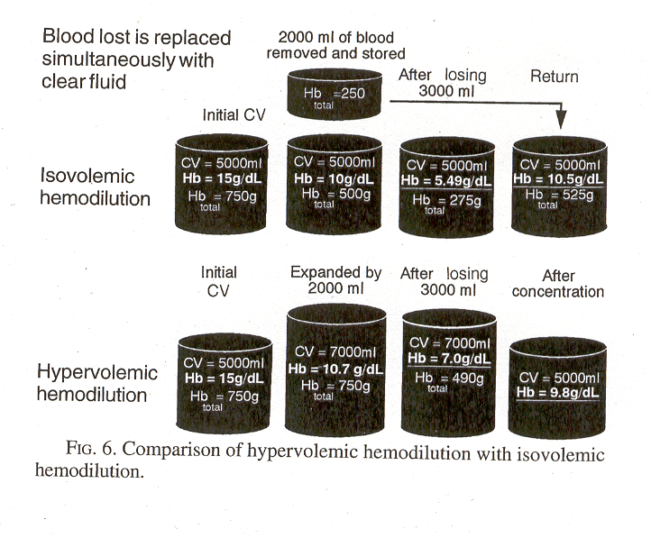
Maternal Mortality
- Obstetrical Hemorrhage -

Slide 15
Maternal Mortality
- Obstetrical Hemorrhage -
Optimize hemodynamic status
1.- Acute isovolemic hemodilution
2.- Acute hypervolemic hemodilution
3.- Autologous donation
4.- Preoperative transfusion

Slide 16
Maternal Mortality
- Obstetrical Hemorrhage -
Patients at risk
Pre-delivery management
1.- Prepare for PPH
2.- Optimize patient’s hemodynamic status
3.- Timing of Delivery
4.- Surgical planning
5.- Anesthesia /I.V. access/ invasive monitoring
6.- Modify obsterical management
7.- Increased postpartum/postop surveillance

Slide 17
Maternal Mortality
- Obstetrical Hemorrhage -
3.- Timing of Delivery
- Placenta previa
- Prev classical
Prev myomectomy
Tumor previa
Schedule C/S
- 36-37wks after Amnio for FLM
- >37 wks if Amnio not possible
Avoids uterine rupture
Avoids significant hemorrhage

Slide 18
Maternal Mortality
- Obstetrical Hemorrhage -
Patients at risk
Pre-delivery management
1.- Prepare for PPH
2.- Optimize patient’s hemodynamic status
3.- Timing of Delivery
4.- Surgical planning
5 .- Anesthesia /I.V. access/ invasive monitoring
6.- Modify obsterical management
7.- Increased postpartum/postop surveillance

Slide 19
Maternal Mortality
- Obstetrical Hemorrhage -
Realistic assessment of a significant PPH episode
4.- Surgical planning
Wants to avoid TAH ? (religious/cultural)
Inability to transfuse ? (Jehovah’s witness, etc)
Desires subsequent pregnancies ?
Tolerates poorly large hemodynamic shifts
🡩Bleeding 🡪 TAH
More Surgery/Embolization
More Tranfusion.
TAH

Slide 20
Maternal Mortality
- Obstetrical Hemorrhage -
Patients at risk
Pre-delivery management
1.- Prepare for PPH
2.- Optimize patient’s hemodynamic status
3.- Timing of Delivery
4.- Surgical planning
5 .- Anesthesia /I.V. access/ invasive monitoring
6.- Modify obsterical management
7.- Increased postpartum/postop surveillance

Slide 21
Maternal Mortality
- Obstetrical Hemorrhage -
4.- Anesthesia / I.V. Access
Obtain Anesthesia consult
- Type of anesthesia
- Need for invasive monitoring (A line,
S-G monitoring, etc)

Slide 22
Maternal Mortality
- Obstetrical Hemorrhage -
Identify Patients at Risk
Multidisciplinary “Hemorrhage protocol”
Clinical management of PPH
1.- How/Who triggers the “H.P.”
2.- Identify “The response team”
3.- Transfusion protocol
4.- Define the logistics involved
5.- Conduct drills
6.- Post-op care

Slide 23
Maternal Mortality
- Obstetrical Hemorrhage -
Identify Patients at Risk
Multidisciplinary “Hemorrhage protocol”
Clinical management of PPH
1.- How/Who triggers the “H.P.”
RN’s, CNM’s, PA’s, MD’s
Labor & Delivery
Postpartum floor
Antepartum floor
E.D.
Code “H”
Response Team
Operator

Slide 24
Maternal Mortality
- Obstetrical Hemorrhage -
Identify Patients at Risk
Multidisciplinary “Hemorrhage protocol”
Clinical management of PPH
2.- The “Response Team”
Nursing
Anesthesia
Ob surgery (MFM, Gyn Onc, Ob-Gyn,)
Intervention Radiology
Urology
Hematology

Slide 25
Maternal Mortality
- Obstetrical Hemorrhage -
Identify Patients at Risk
Multidisciplinary “Hemorrhage protocol”
Clinical management of PPH
3.- Transfusion Protocol
-Immediate release of O neg Blood if required
- How fast can Crossmatched blood be made available
- Physical transport of Blood 🡪 O.R. and samples O.R. 🡪 Lab/Blood Bank

Slide 26
Maternal Mortality
- Obstetrical Hemorrhage -
Identify Patients at Risk
Multidisciplinary “Hemorrhage protocol”
Clinical management of PPH
4.- Logistics
Hospital specific
- Define responsibilities

Slide 27
Maternal Mortality
- Obstetrical Hemorrhage -
Identify Patients at Risk
Multidisciplinary “Hemorrhage protocol”
Clinical management of PPH
5.- Drills
- Conduct Drills 3-4 x/year
- Evaluate the performance
- Review the results with the entire team

Slide 28
Maternal Mortality
- Obstetrical Hemorrhage -
Identify Patients at Risk
Multidisciplinary “Hemorrhage protocol”
Clinical management of PPH
6.- Postoperative care
Insures a smooth transition from the O.R./L&D to the apropriate level of care unit 🡪 In most hospitals L&D/Postpartum units not ideal for these patients

Slide 29
Maternal Mortality
- Obstetrical Hemorrhage -
Identify Patients at Risk
Multidisciplinary “Hemorrhage protocol”
Clinical management of PPH
Diagnosis
- Early shock
- Severity of Shock
Treatment
- Insure hemostasis
- Adequate replacement

Slide 30
Maternal Mortality
- Obstetrical Hemorrhage -
Significant PPH
Etiology
Uterine atony
Placenta previa/accreta
Cervico-vag tears
Uterine rupture
Coagulopathy*
* Any major hemorrhage 🡪 Coagulopathy 🡪 Bleeding

Slide 31
Maternal Mortality
- Obstetrical Hemorrhage -
Significant PPH
- Uterine massage
🡩 I.V. fluids
Empty bladder
Oxytoxic Agents
Methergine 0.2mg
Carboprost 250μg
Cytotec 800-1000μg
⊕ Hemostasis
∅ Hemostasis
Surgery/Embolization

Slide 32
Maternal Mortality
- Obstetrical Hemorrhage -
Significant PPH
Failed Medical Rx
Ut Atony/Tears
Pl previa/accreta
B-Lynch procedure
Uterina a. ligation
Stepwize devascularization
Uterine repair
U.A.E.
🡫
TAH
Local matress sutures
Hemostatic baloons
U.A.E.
Conserv Rx of Pl accreta
🡫
TAH

Slide 33
Maternal Mortality
- Obstetrical Hemorrhage -
Five cases of massive life threatening postpartum hemorrhage were managed by the use of the “B-Lynch surgical technique.
Christopher B-Lynch Br J Ob Gyn 1997

Slide 34
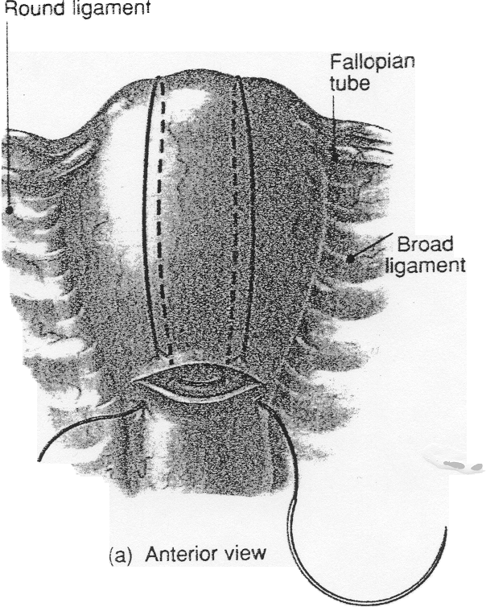

Slide 35
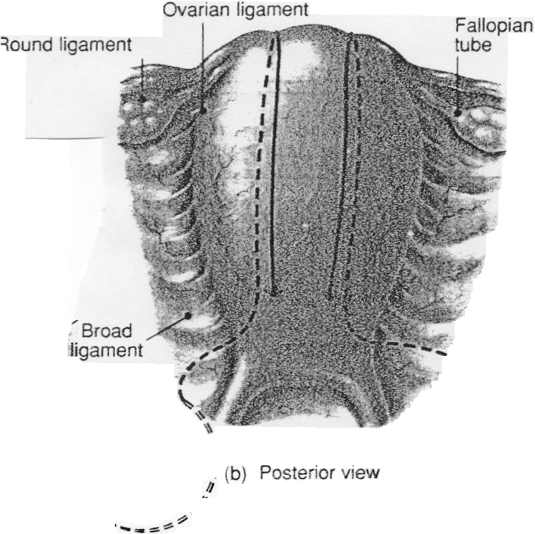

Slide 36
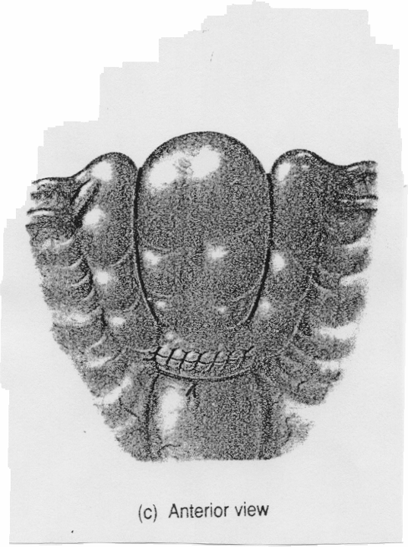

Slide 37
Maternal Mortality
- Obstetrical Hemorrhage -
Hypogastric artery ligation
- Decreases Blood Flow by 🡺 48%
- Controls Severe P.P.H. in 🡺 50% of cases
Clark et al Ob-Gyn 1985

Slide 38
Maternal Mortality
- Obstetrical Hemorrhage -
Uterine artery ligatiaon
Over a 30 yr period 256 Ut artery ligation were performed for PPH.
-Successful 256 cases
- Failed 10 cases
O’Leary,J J Reprod Med 1995

Slide 39
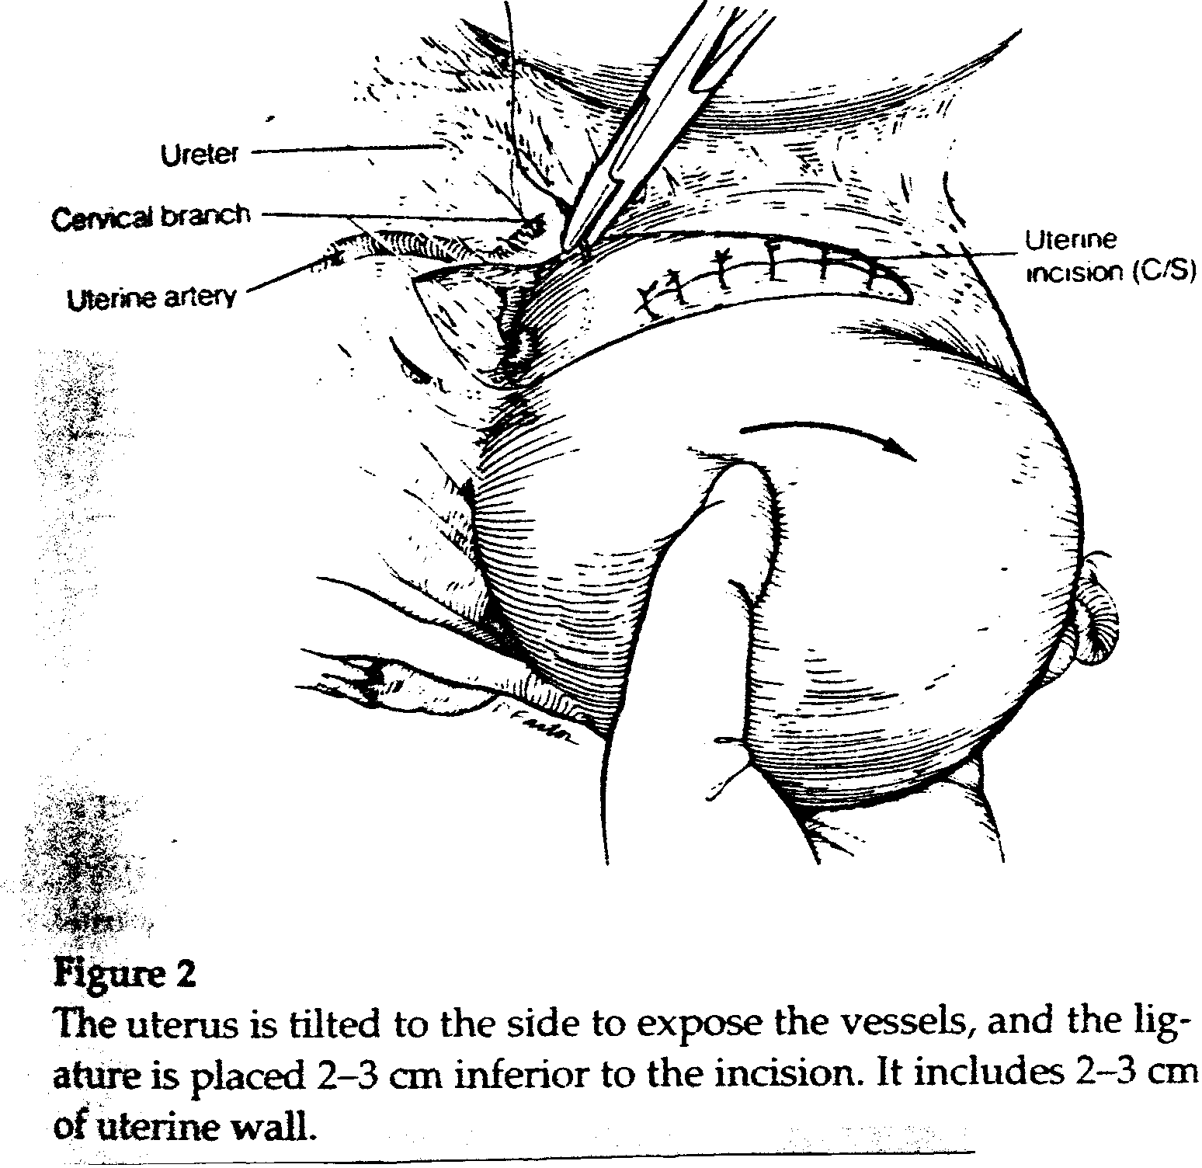

Slide 40
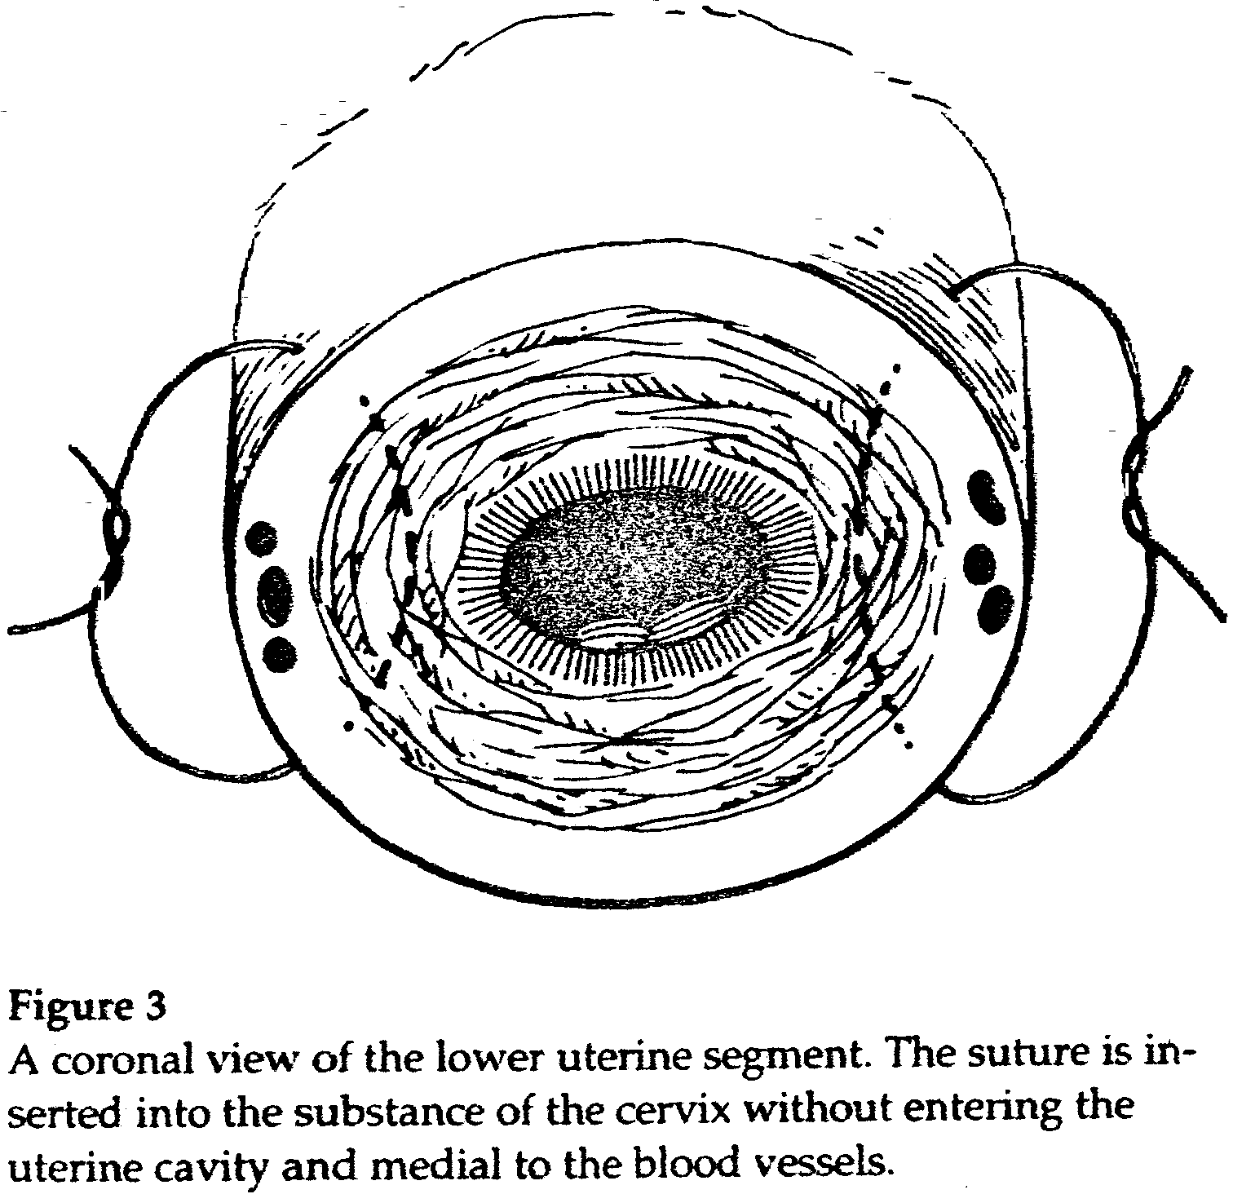

Slide 41
Maternal Mortality
- Obstetrical Hemorrhage -
Stepwise uterine devascularization was performed for 103 patients to control intractable postpartum hemorrhage not responding to clasic management
S.A. AbdRabbo Am J Ob Gyn 1994

Slide 42
Maternal Mortality
- Obstetrical Hemorrhage -
Indication
Patients (n=103)
Uterine atony
66(63%)
Placenta previa
7(7%)
Abruptio placenta
17(16%)
Couvelaire uterus
9(10%)
D.I.C.
4(4%)
S.A. AbdRabbo Am J Ob Gyn 1994

Slide 43
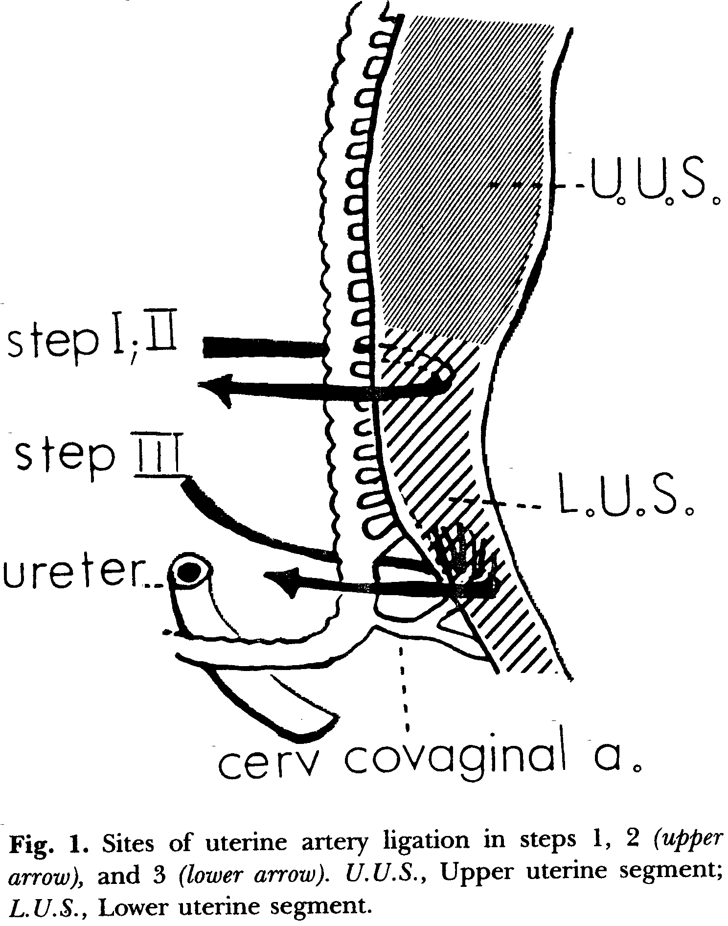

Slide 44
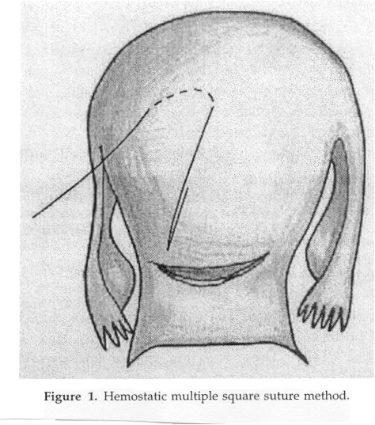

Slide 45
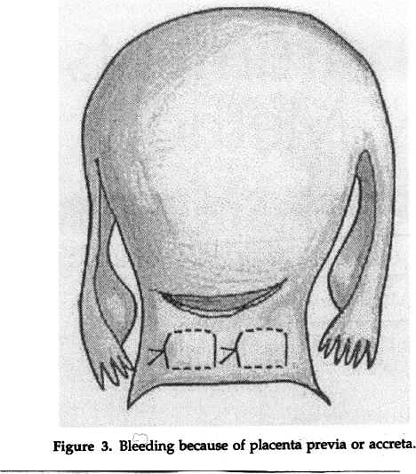

Slide 46
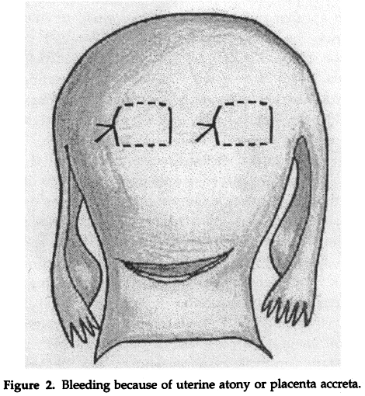

Slide 47
Maternal Mortality
- Placenta Accreta -
Clinical Risk Factors
- Placenta previa
- Previous C/S
- Adv maternal age
Sonographic markers
🡺
Biochemical markers
🢃
Suspect Placenta accreta

Slide 48
Maternal Mortality
- Placenta Accreta -
Classic management
Cesarean Section
Attempt Placental removal 🡪 Hemorrhage
-Local sutures
Uterine artery ligation
Embolization
TAH

Slide 49
Maternal Mortality
- Placenta Accreta -
Classic management
- Significant blood loss
- MOF (ARDS, DIC, ARF )
Injury to other organs -Bladder, Urether
Need for Hysterectomy

Slide 50
Maternal Mortality
- Placenta Accreta -
A survey of members of SPO identified 109 cases of placenta accreta.
- Antepartum Dg suspected in 50%.
- Management
Surgical 93%
Conservative 7%
Maternal Mortality 8 (7%)
Maternal Morbidity
Transfusions 90%
Massive transfusion (>10u.) 40%
Serious infections 28%

Slide 51
Maternal Mortality
- Placenta accreta -
Objective
A group of patients suspected of having Pl. accreta and managed conservatively was compared with a similar group of patients that deliverd during the same time interval but were managed in a traditional fashion
Jurczak,A Fleischer,A et al ACOG-2005

Slide 52
Maternal Mortality
- Placenta Accreta -
Conservative approach
Amnio at 37wks gestation for FLM
Day of C/S catheters are placed in the abd. aorta
Intraop : - Sono maps the position of the Placenta
-Uterine incision just above placental edge
(High transverse incision)
Jurczak,A Fleischer,A et al ACOG-2005

Slide 53
Maternal Mortality
- Placenta Accreta -
Conservative approach
Delivery of infant: - Leave placenta intact
- Insure hemostasis of uterine
incision
Selective embolization of the uterine arteries under fluoroscopic guidance (20-25 min)
Jurczak,A Fleischer,A et al ACOG-2005

Slide 54
Maternal Mortality
- Placenta Accreta -
Conservative approach
Succesful embolization
Attempt made to remove placenta
⊕ Pl accreta
∅ Pl accreta
Leave placenta in situ
Remove placenta
Jurczak,A Fleischer,A et al ACOG-2005

Slide 55
Maternal Mortality
-Placenta Accreta -
Conservative 🡪 A total of 17 patients with the presumptive Dg of Placenta accreta were managed in this fashion.
Traditional 🡪 A total of 18 ptients were managed by removing placenta first then insuring hemostasis .
Jurczak,A Fleischer,A et al ACOG-2005

Slide 56
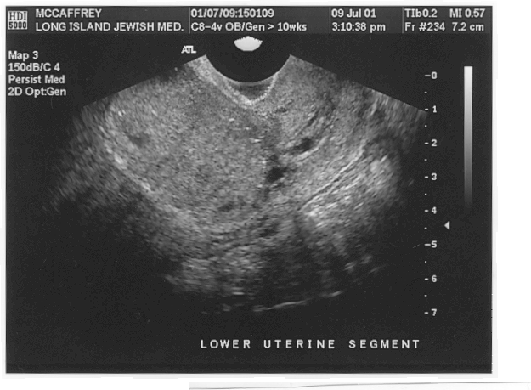
2 wks P-Partum

Slide 57
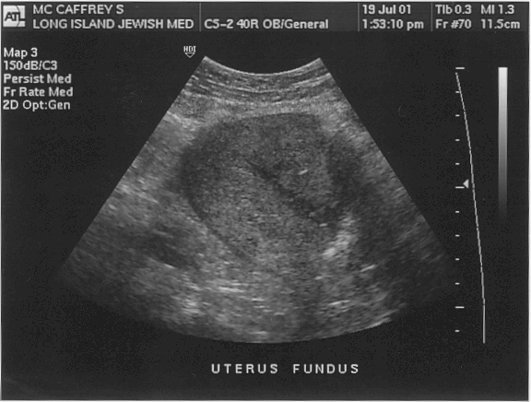
6mo PP

Slide 58
Maternal Mortality
-Placenta Accreta -
Entire Pl 🡪 6pat
Group 1.
n=13
Embolized; Placenta left
Part of Pl 🡪 7pat
Group 2.
n=2
Embolized; Placenta removed (No Pl accreta)
Ut incision through Pl 🡪Bleeding 🡪 TAH
Group 3.
n=2
Not Embolized
Jurczak,A Fleischer,A et al ACOG-2005

Slide 59
Maternal Mortality
-Placenta Accreta -
Group | Blood Tr | Massive Blood Tr | TAH
Traditional (n=18) | 13(72%) | 8(44%) | 11(61%)
Conservative (n=15) | 5* (33%) | 1** (6%) | 2(12%)
*2 pat🡪 Medical reasons for tranfusion
**attempt for vaginal removal of placenta 2mo PP
Jurczak,A Fleischer,A et al ACOG-2005

Slide 60
Maternal Mortality
-Placenta Accreta -
Objective
A retrospective comparison of a new “conservative” approach to the classic management of Placenta accreta
Kayem et al Ob-Gyn 2004

Slide 61
Maternal Mortality
-Placenta Accreta -
Conservative 🡪 A total of 20 patients had their Placenta left in situ after Dg of Pl accreta. UAE not done routinely
Traditional 🡪 A total of 13 ptients were managed by removing placenta first then insuring hemostasis .
Kayem et al Ob-Gyn 2004

Slide 62
Maternal Mortality
-Placenta Accreta -
Group | Blood Tr | Massive Blood Tr | TAH
Traditional (n=13) | 12(92%) | 8(38%) | 11(85%)
Conservative (n=20) | 16 (80%)^{ns} | 1 (5%)* | 3(15%)*
*p< 0.05
Kayem et al Ob-Gyn 2004

Slide 63
Maternal Mortality
-Placenta Accreta -
Intraoperative management
1.-Map exact position of placenta 🡪 Make high transverse uterine incision to avoid cutting through placenta
2.- Deliver fetus 🡪 Rapid hemostasis of uterine incision (clamps, sutures)
Definitive Rx
Dg uncertain
Avoid TAH
Do not remove pl
UAE
UAE
TAH
Remove pl
Leave Pl in situ

Slide 64
Maternal Mortality
-Placenta Accreta -
Conservative approach
Wants to avoid TAH (religious/cultural)
Inability to transfuse (Jehovah’s witness, etc)
Desires subsequent pregnancies
Significant Bladder involvment
Tolerates poorly large hemodynamic shifts (IHSS, Eisenmenger syndrome etc)

Slide 65
Maternal Mortality
-Placenta Accreta -
Follow-up management
1.- Ultrasound exams 🡪 Vascularity
2.- HCG titers (If 🡪 consider Mtx)
3. Daily Temps, Other S&S of infection
4.- Bleeding
5.- Coagulation profile

Slide 66
Maternal Mortality
-Placenta Accreta -
Follow-up management
If Intervention necessary for
- Bleeding
- Infection
- DIC
Proceed directly to TAH

