Slide 1
Disorders of oral cavity
MR. SHAILENDRA VERMA
NURSING TUTOR
RCN, BAREILLY

Slide 2
SPECIFIC OBJECTIVES
At the end of the class teaching the group will be able to:-
Introduce the topic
Definition
Explain the anatomy and physiology
Enlist the Etiology
List down the types
Explain the Sign and Symptoms
Explain the diagnostic evaluatio
Describe the Management
Enlist Complications

Slide 3
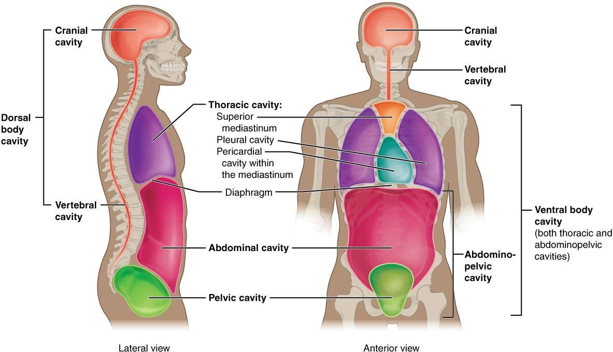
Cavity’s in the body

Slide 4
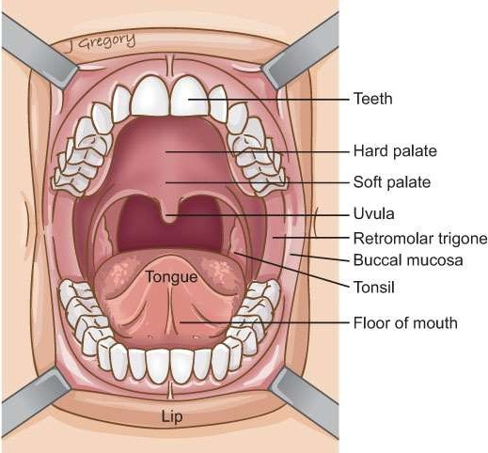
ORAL CAVITY
Oral cavity consist of
1. Lips
2. Gums
3. Tongue
4. Salivary glands
5. teeth

Slide 5
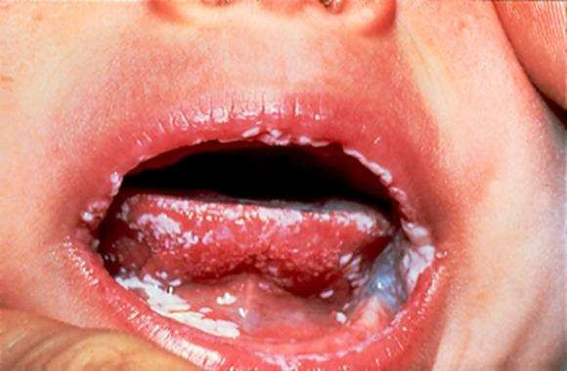
Stomatitis
DEFINITION: Stomatitis is an inflammation of the mucous lining of the mouth , which may involve the cheeks, gums ,tongue ,lips , and roof or floor of the mouth. The word“ stomatitis “ literally means inflammation of the mouth

Slide 6
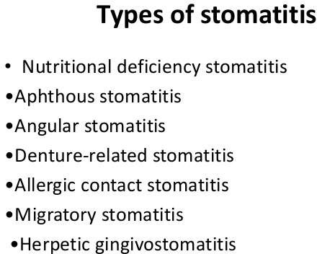
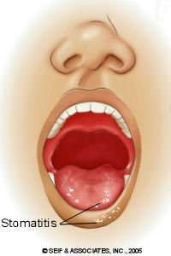

Slide 7
CAUSES
1. Chemotherapy
2. Radiotherapy
3. Loose-fitting dental prosthetics
4. Trauma
5. Poor dental hygiene
6. Smoking
7. Dehydration
8. Medication
9. Burns

Slide 8
Sign & symptoms
1. Pain or discomfort in the mouth.
2. The presence of open sores or ulcers in the mouth.
3. Fever ,sometimes as high as 101– 104°F .
4. Irritability and restlessness
5. Blisters in the mouth
6. Swollen gums , which may be irritated and bleed.
7. Drooling.
8. Dysphagia.
9. Foul-smelling breath.

Slide 9
Management of Stomatitis
1. Medical management :- bismuth salicylate , sucralfate, antacids
• Topical analgesics, such as benzamine hydrochloride
• Topical anesthetics, such as lidocaine viscous
• Oral or parenteral analgesics, including opioids if needed, for pain not controlled with above
● Bitadine gargle 2%
2. Other management :-
• Antiseptic mouth wash
• Avoid excessive brushing
• Denture hygiene measures

Slide 10
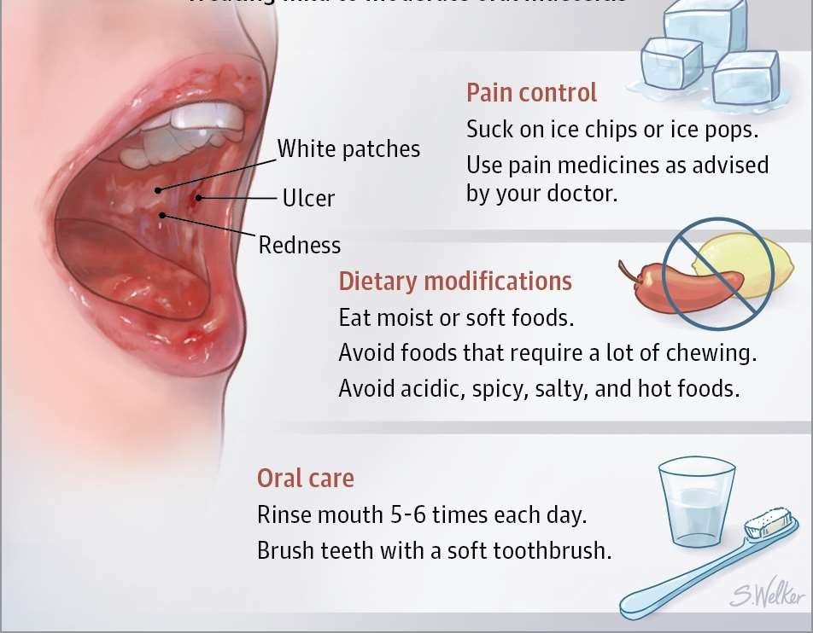

Slide 11
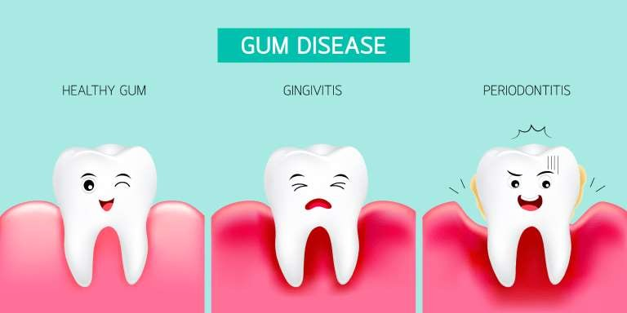
GINGIVITIS

Slide 12
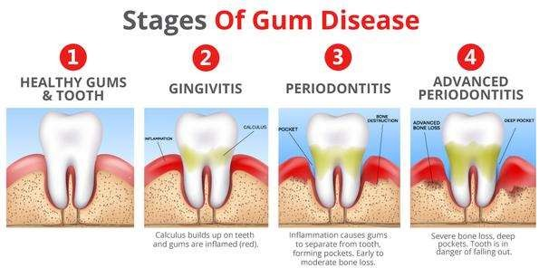
DEFINITION
Gingivitis is a non-destructive type of periodontal disease, but untreated gingivitis can progress
to periodontitis.

Slide 13
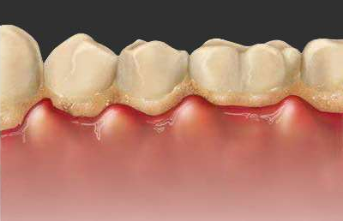
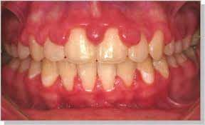
TYPES OF GINGIVITIS
1. Dental plaque-induced gingival disease :- This can be caused by plaque, systemic factors, medications, or malnutrition.
2. Non-plaque induced gingival lesions:- This can be caused by a specific bacterium, virus, or
fungus. It might also be caused by genetic factors, systemic conditions.

Slide 14
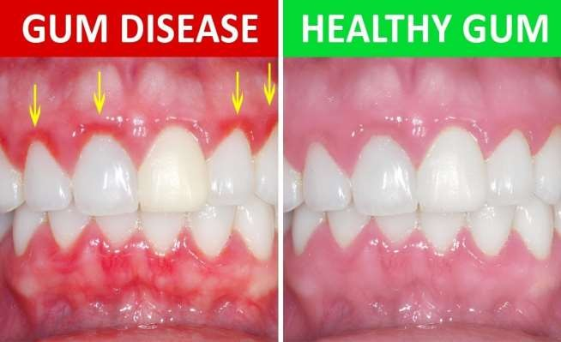
Causes
1. Accumulation of bacterial plaque
2. Some diseases like diabetes , HIV
3. Drugs
4. Smoking
5. Ages
6. Poor diet
7. Family history

Slide 15
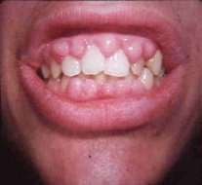
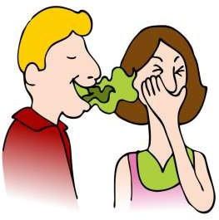
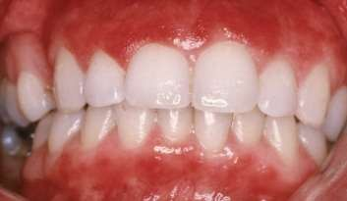
Symptoms
1. Swollen or puffy gums
2. Dusky red or dark red gums
3. Gums that bleed easily when you brush or floss
4. Halitosis
5. Receding gums
6. Tender gums

Slide 16
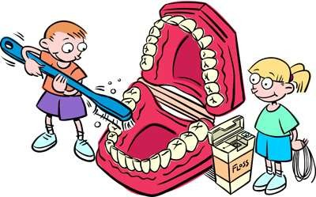
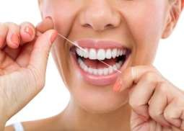

Prevention /Management
1. Good oral hygiene
2. Regular dental visit
3. Good health practices
4. Brush twice a day after meal and snack
5. Use soft brush or electric toothbrush
6. Use electric brush and floss daily
7. Stop smoking

Slide 17
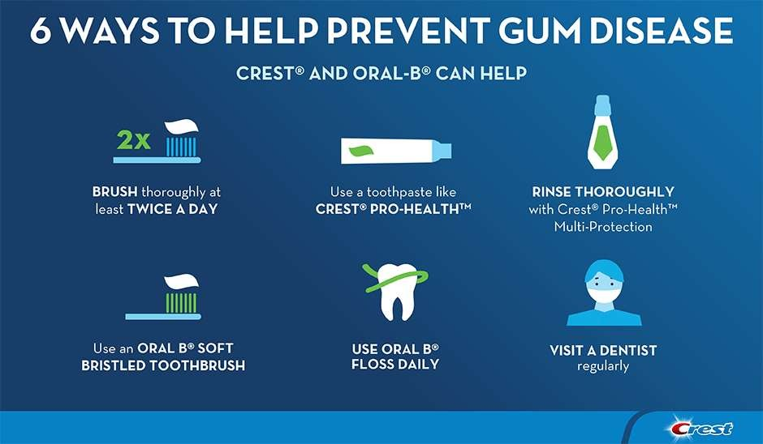

Slide 18
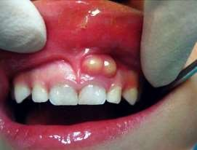
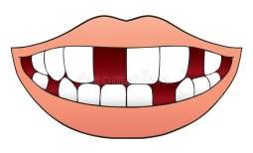
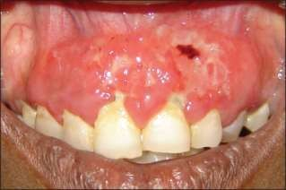
1. Abscess
2. Peri-odontitis can lead to loss of teeth
3. Recurrent gingivitis
4. Ulceration of gums

Slide 19



Slide 20
Introduction
Glossitis is a condition in which the tongue is swollen and changes color. Finger-like
projections on the surface of the tongue (called papillae) are lost, causing the tongue to appear smooth.

Slide 21
DEFINITION
Glossitis refers to inflammation of the tongue.
Cause change in Size, shape, color, taste, movement

Slide 22
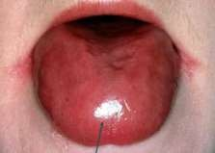
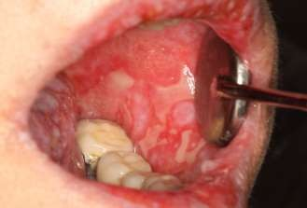
Types
According to their severity its divided into 2 types
1. ACUTE:- Acute glossitis is characterized by swollen papillae occurs
1. CHRONIC :- Chronic inflammation not of the substance of the tongue, but of the mucous covering of that organ

Slide 23
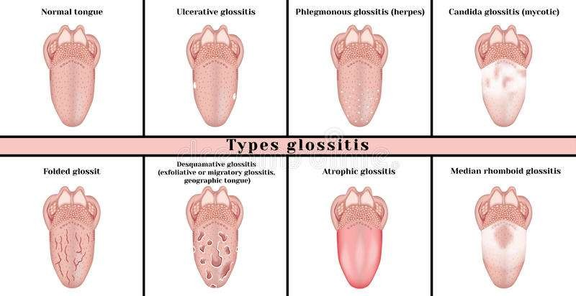
Other types

Slide 24
Causes
1. Primary causes
• Bacterial /viral infection
• Mechanical irritation from dentures
• Tobacco, hot food, alcohol, burns
• Allergy to toothpaste, mouthwash

Slide 25
2. Secondary causes
• Iron deficiency anemia
• Pernicious anemia
• Vitamin B deficiency
• Syphilis
• Ulcer
• HIV /TB

Slide 26

Symptoms
1. Tongue swelling
2. Difficulty in talking ,swallowing, taste, chewing
3. Pain
4. Fatigue
5. Weight loss
6. Sore throat

Slide 27
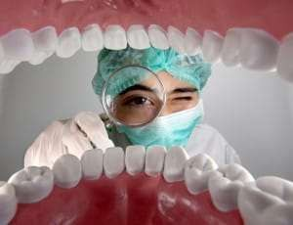
Diagnosis
1. History
2. Examination
3. Blood test
4. Oral swab

Slide 28
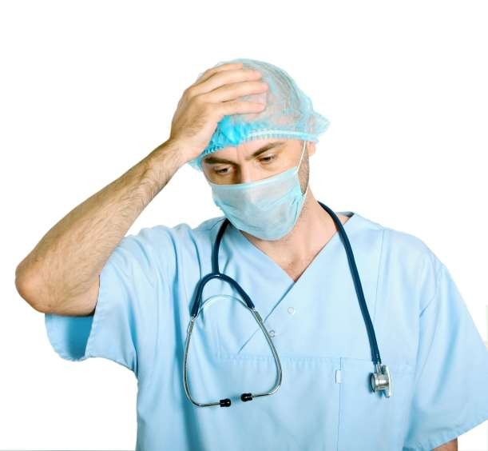
Complication
1. Discomfort
2. Airway obstruction
3. Dysphagia
4. Dysphonia
5. Recurrent oral infection
6. Abscess
7. Oral cancer

Slide 29
Treatment
1. Good oral hygiene is essential
2. Steroids may be used to reduce the inflammation.
3. An oral suspension of Prednisolone may be used in mild cases
4. Antibiotics, antifungal
5. Proper nutrition
6. Avoid irritant like tobacco, hot, spicy food, alcohol

Slide 30
SUMMERY
After completion of my teaching the group will be able to:-
Introduce the topic
Definition
Explain the anatomy and physiology
Enlist the Etiology
List down the types
Explain the Sign and Symptoms
Explain the diagnostic evaluatio
Describe the Management
Enlist Complications

Slide 31


