Slide 1
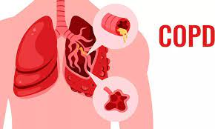
PRESENTED BY:
PRATIBHA CHARAN
NURSING TUTOR

Slide 2
Introduction
COPD is a general term for a group of disease that causes progressive damage to the lungs.
- Chronic bronchitis
- Emphysema
COPD or chronic obstructive pulmonary is progressive disease that makes it hard to breath.

Slide 3
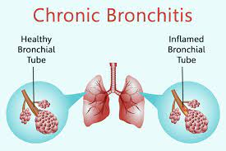
Chronic bronchitis: is a chronic inflammation of the lower respiratory tract characterized by excessive mucous secretion, cough, and dyspnea associated with recurrent infection of the lower respiratory tract.

Slide 4
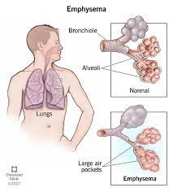
Emphysema
Is a complex lung disease characterized by damage to the gas exchanging surfaces of the lungs (alveoli).

Slide 5
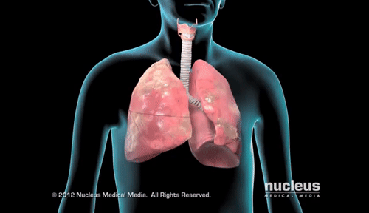
definition
Chronic obstructive pulmonary disease is a disease state characterized by airflow limitation that is not fully reversible.

Slide 6
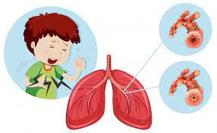
CAUSES
Genetic factors
Environmental factors
Smoking
Alcohol
Tabacco use
Occupational exposure
Alpha 1- antitrypsin deficiency

Slide 7
INCIDENCE
It affects more than 5% of population and is associated with high morbidity and mortality.
It is the third ranked cause of death in the United states, killing more than 1,20,000 individuals each year.

Slide 8
Sign And symptoms
Dyspnea
Persistent Cough
Fatigue
Wheezing
Chest pain
Confusion
Insomnia
Lethargy
Chest pain

Slide 9
Diagnostic evaluation
History collection
Physical examination
Chest X-ray
CT-Scan
MRI
Spirometry
ABG analysis

Slide 10
MEDICAL MANAGEMENT
Bronchodilators
Corticosteriods
Mucolytics
Antibiotics

Slide 11
SURGICAL MANAGEMENT
Bullectomy
Lung volume reduction surgery
Lung transplantation

