Slide 1

COMMON ACCIDENTS IN CHILDREN AND ITS PREVENTION
Prepared by:
Mrs. Ashvani Singh
P.G. Nursing Tutor

Slide 2
SPECIFIC OBJECTIVE
INTRODUCTION
DEFINITION
FACTORS AFFECTING ACCIDENTS
CAUSES OF ACCIDENTS
TYPES OF ACCIDENTS
STAGES AND COMMON CHILDHOOD ACCIDENTS
PREVENTION OF ACCIDENTS AND SAFETY PRECAUTIONS
SAFETY PRECAUTIONS ACCORDING TO VARIOUS AGE GROUPS
NURSING RESPONSIBILITIES IN PREVENTION OF ACCIDENTS

Slide 3

INTRODUCTION:
Children are by nature accident prone. They are curious, investigative, impulsive, impatient and less careful to listen warning. Accidental injuries are the leading cause of hospitalization, disability and death of children.

Slide 4
DEFINITION
An accident is an event, independent of human will caused by an outside force acting rapidly and resulting in physical or mental injury.
- WHO

Slide 5
FACTORS AFFECTING ACCIDENTS
Age: Accidents are more common between 2-10 years of age.
Sex: Boys between 10-14 years of age are more prone to accidents.
Personality: Bright and alert children are more prone to accidents because they are eager to do new activity.

Slide 6
Cont…
Ordinal Position: Elder and Younger children are more protected but middle ones are neglected, so they are more prone to accidents.
Time od day: Most accidents occur in afternoon.
Weather Condition: Accidents occur more in rainy season.
Place: Accidents may occur in home or on road side.

Slide 7
CAUSES OF ACCIDENTS
Curious, interested, hyperactive and daring child has more chance of accidents.
Accidents are more common in aggressive, stubborn poor concentration and unsupervised children.
Lack of play grounds and over crowded streets.

Slide 8
Cont…
Accidents may occur frequently if the parents is having poor knowledge, ignorance, careless or lack of supervision of children.
Impulses of the moment e.g. boys want to show off their bravery so they often indulge in risky acts.
Lack of past experience.
Inability to judge danger.

Slide 9
TYPES OF ACCIDENTS
1. According to the location where accident occurs, they are of two types-
Occurring outside home
Occurring in the Home
2. According to severity, accidents are of two types-
Major
Minor

Slide 10
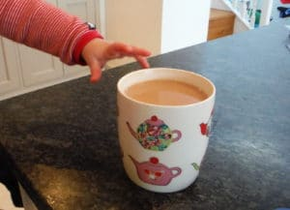
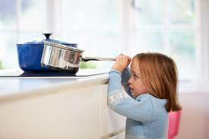
STAGES AND COMMON CHILDHOOD ACCIDENTS
INFANTS
Burns
Extremity fractures
Choking
Head injuries
Near drowning
Toxic ingestions

Slide 11
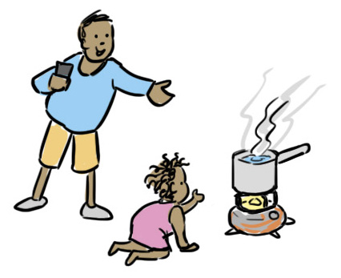
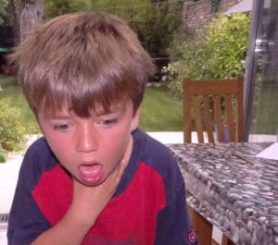
TODDLER
Burns
Extremity fractures
Choking
Head injuries
Motor vehicle accident
Drowning
Toxic ingestions
Bicycle injuries

Slide 12
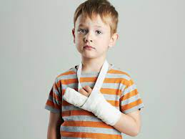

PRESCHOOLER
Burns
Extremity fractures
Motor vehicle accident
Drowning
Toxic ingestions
Bicycle injuries

Slide 13


SCHOOL CHILDREN
Extremity fractures
Motor vehicle accident
Sports injuries

Slide 14
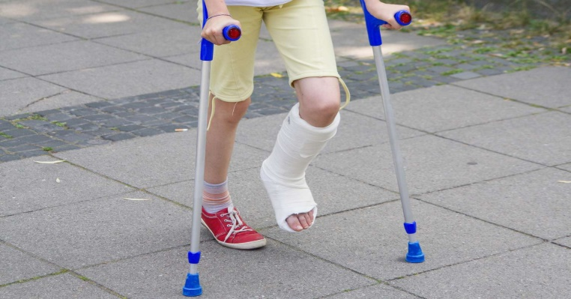


ADOLESCENT
Extremity fractures
Motor vehicle accident
Sports injuries
Drowning

Slide 15
PREVENTION OF ACCIDENTS AND SAFETY PRECAUTIONS
Prevention of accidents requires three things
Forethought
Time
Discipline

Slide 16
Cont..
1. Forethought
The anticipation of possible risk of accidents to the child.
2. Time
Needed sufficiently to supervise and watch the child and his activities.
3. Discipline
Need to be well balanced to prevent the accidental hazards.

Slide 17
SAFETY PRECAUTIONS ACCORDING TO VARIOUS AGE GROUPS
1.INFANTS:
Never leave an infant alone on cot or table or in unprotected place to prevent fall.
Never give very small things to the child.
Toys should not have removable small parts which can be aspirated or put into the ear or nose.
Never feed solids which are difficult to chew, e.g. ground nut.

Slide 18

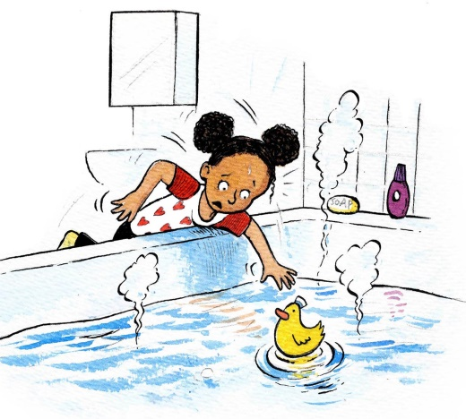

Cont..
Coins, buttons, beads, marbles must not be left within child's reach.
Never leave the infant near water tub or pond and never allow to go out alone.

Slide 19
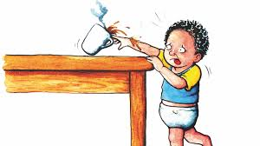
TODDLERS AND PRESCHOOLERS:
Never use negative statement for any activities, i.e. 'don't do that', 'don't go there', etc.
Give proper directions for activity.
Provide constant supervision.
Protect stairs by gate and keep doors closed.
Keep harmful substances like hot things, drugs, poisons, kerosene oil, electrical appliances, sharp objects, etc. out of child's reach.

Slide 20
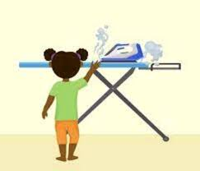
Cont..
Give adequate instructions to the caretaker to look after the child and to follow the precautions.
Provide safe play materials and toys.
Floor should not be slippery.
Furniture should be placed firmly to prevent fall and the child should not be allowed to climb over it.

Slide 21
Cont..
The child must not be allowed to wear inflammable synthetic materials which may catch fire easily.
Mother should not hold the baby in lap when drinking tea or coffee or during cooking.
Children should not be allowed to play with cord, plastic bags or pillow which may cause suffocation.

Slide 22
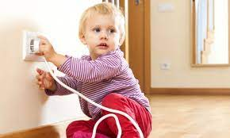
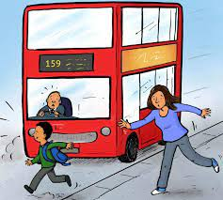
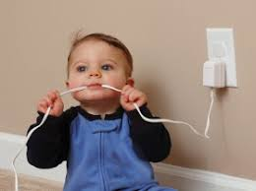
Cont..
Batteries of the torch must not be left free to avoid risk or lead poisoning.
Children must not be allowed to stand in car when in motion.
Electric switch should be out of child's reach.

Slide 23
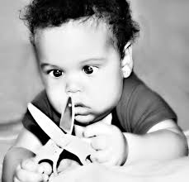
SCHOOL CHILDREN AND ADOLSCENTS
Teach safety precautions with fire, fireworks, match box, electricity, sharp instruments etc.
The child should be taught swimming as soon as he or she is old enough.
Encourage playing in safe places and supervise game whenever needed to prevent sorts injury.

Slide 24
Cont..
Discourage the children from kite flying from rooftops and playing door banging games and from closing the doors with a lot of force.
Children must not be allowed to play on streets, they should be taught about road safety, use of zebra crossing and cautions in bicycles or tricycles riding.
Never left the child alone in the car unless it has been ensured that the keys are not 'in'.

Slide 25
NURSING RESPONSIBILITIES IN PREVENTION OF ACCIDENTS
Health education is considered as vaccination for prevention of accidents. The significant role of nursing personnel is to improve the level of knowledge and awareness about the safety precautions.
Parents should be taught to anticipate the risk to maintain discipline and to provide time to supervise children.
Anticipatory guidance should be provided to the parents, family members, school teacher, grown up children and general public about prevention of accidents.

Slide 26
Cont..
Provision of safe environment to eliminate or reduce the hazardous conditions for the children.
It should be arranged at home, school, community and hospitals.
Safe child care should be organized and provided to prevent accidental hazards.
Assessment of child's characteristics for accidental liability is important.
Parents should be involved in safety programme of child care.
Elimination of causative factors need to be emphasized though health education.

Slide 27
Cont…
Assisting in medical care to prevent disabilities and handicapped condition is an important responsibility of the nurse.
Emergency care at comprehensive trauma care unit improves the survival rate. Rehabilitation facilities should be organized with necessary referral.

Slide 28
Cont…
Public health measures regarding prevention of accidents should be implemented. Traffic rules, restriction of speed, use of helmets, avoidance of alcohol while driving, regular checking of vehicles, etc. must be strictly enforced.
Nurse should make the people aware about the strict implementation of rules.
Participate in policy making and research activities related to accidents prevention and changing of behaviour for controlling accidents.

Slide 29


