Slide 1
COMFORT
By : ms Nimisha Solanki

Slide 2
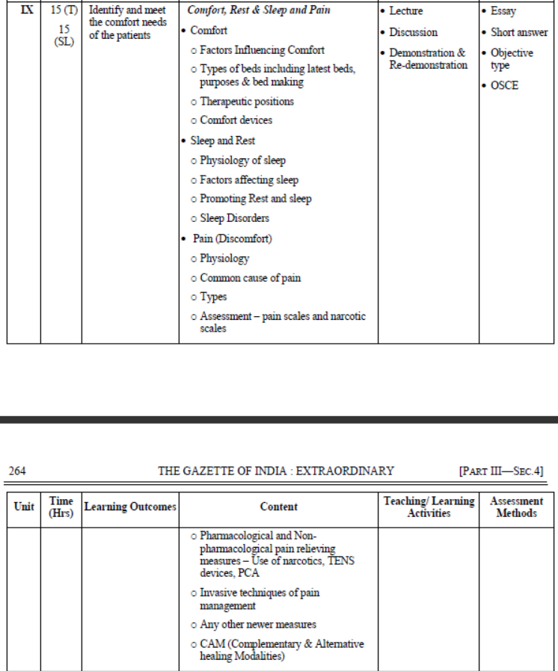

Slide 3
COMFORT- DEFINITION
Comfort is a state of freedom from pain, discomfort, tension and anxiety.
Comfort is defined as contented enjoyment in physical or mental wellbeing, freedom from pain or trouble.

Slide 4
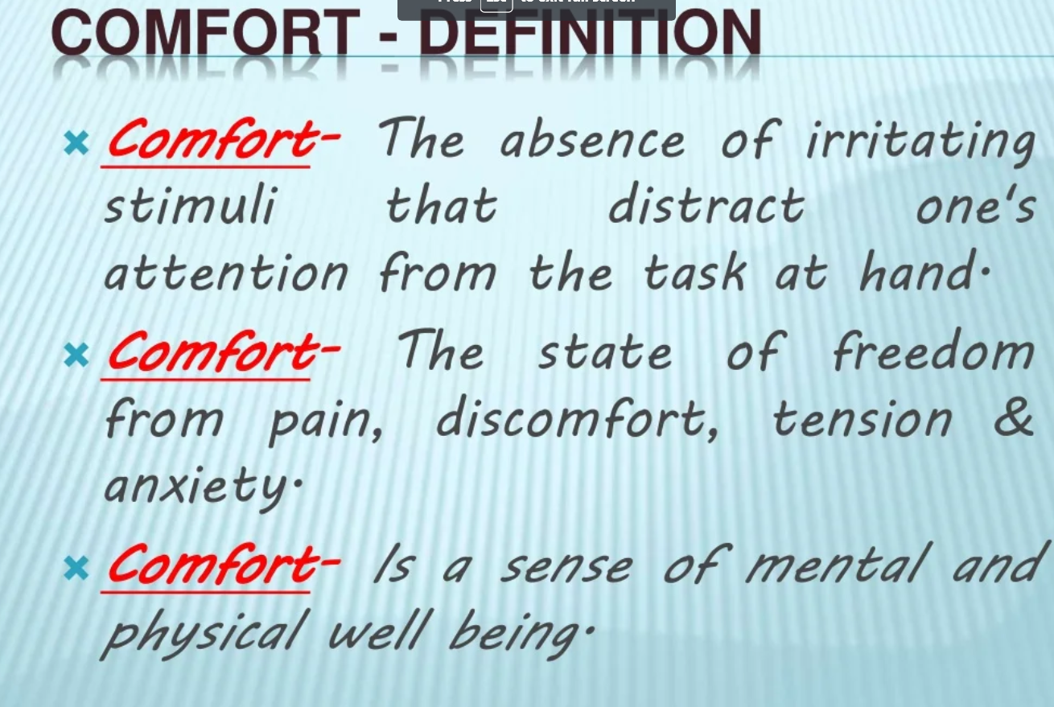

Slide 5
PURPOSE OF COMFORT MEASURES
To promote comfort
To prevent discomfort
To alleviate discomfort
To ensure that the patient has rest
To assist the patient to obtain an adequate sleep to meet his requirement
To maintain correct posture

Slide 6
CAUSES OF DISCOMFORT
1. Pain
2. Restriction of movements due to weakness
3. Wrinkled, soiled and wet sheets
4. Delayed or inadequate attention to meet the personal needs
5. Lack of exercise
6. Temperature extremes
7. Too bright lights and glares
8. Fear and anxiety due to illness
9. Insecurity feeling
10. Lack of sleep
11. Uncomfortable position
12. Indigestion and irregular bowel movements

Slide 7
FACTORS INFLUENCING COMFORT
Pain : Pain in any body part disturbs human activity level and may causes discomfort.
Temperature : extreme temperature such as too much hot and cold inhibit comfort.
Humidity: too much humidity causes perspiration and causes discomfort.
Environment - Quite, clean, safe, unpolluted environment eases life and promote comfort.
Body posture and position: sitting in strange posture for long time causes body strain and stress whereas normal posture and mobility helps individual to live normal life.

Slide 8
Ventilation: Proper ventilation in room gives good sense of feeling whereas congestion causes suffocation and sometimes difficulty in breathing.
Bed linen: wrinkled, soiled and wet linen irritates the skin and increases risk of decubitus ulcers in chronically bed ridden patients whereas neat and clean wrinkle free bed soothes skin and enhance comfort.
Lighting: glaring or dim light poses strain on eyes.
Odour: There is no doubt every individual respond differently to odour and fragrance. It may gives good sensation to somebody and headache to others. Pungent smell disturbs the olfactory sensation. Few persons feel nauseated and get headache from stinky substances/objects, whereas pleasant odours gives good feeling to some people.

Slide 9
Body movement: Restriction of body movement due to organic cause (fracture, paralysis) or mechanical cause (side rails, pillow, belt) also causes discomfort
Psychological factors such as fear, stress and worry causes discomfort whereas happy emotions and peaceful life enhance comfort.

Slide 10
FACTOR PROMOTING PHYSICAL
Immediate Needs
Morning care
Evening care
Bedtime care
Mechanical devices
Pillows
Backrest
Rolls
Foot rest
Sand bags
Air and water mattress
Rings
Bed blacks
Air cushion

