Slide 1
Comfort devices

Slide 2
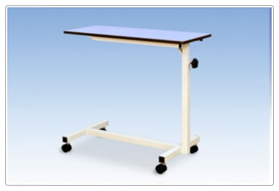
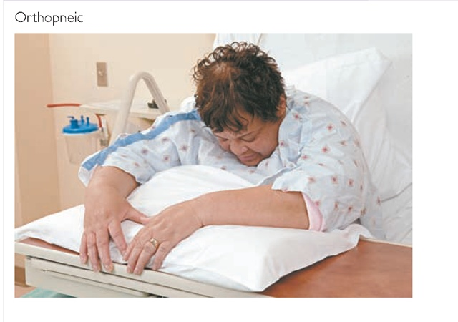
Various comfort/ therapeutic deviCes and their uses
CARDIAC TABLE

Slide 3
It is a device designed as an over bed table, and is placed in front of the patients while they are in fowler’s position. It is so called because it is normally used by cardiac patients, who can lean forward with a pillow. This can be used for writing purpose, serving food and other self care activities.

Slide 4
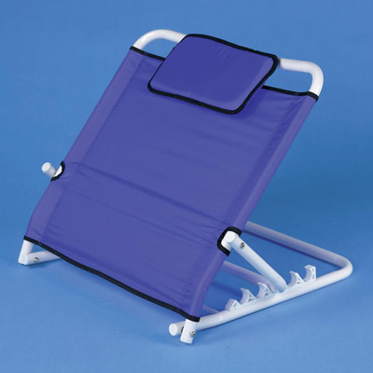
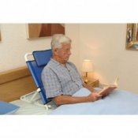
Back rest

Slide 5
It is a mechanical device ,which provides support to the client in a sitting position. Pillows can be placed on the back rest according to the comfort of the patient.

Slide 6
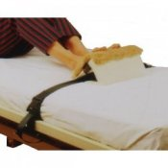
Foot board

Slide 7
It is a flat panel made of wood or plastic and is placed at the foot end of the bed. It provides support to the patient’s feet, keep top bed covers off the patient’s feet and makes the foot comfortable. It helps in preventing foot drops. Sand bags and hard pillows can be used for foot support.

Slide 8
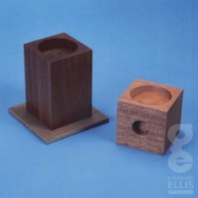
Foot blocks

Slide 9
These are made up of wood or metal and are used to raise the foot end or head end of the bed. They are used to prevent shock, to arrest hemorrhage, to retain enema and after spinal anesthesia.

Slide 10
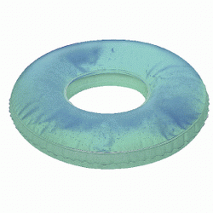
Air cushions

Slide 11
These are made up of rubber and can be inflated with air. They are used to take the weight of the body off the sacral region. They prevent bed sores at the buttocks. They should always be used with cover.

Slide 12
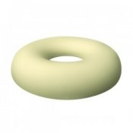
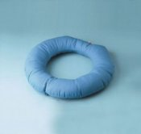
Cotton rings

Slide 13
These are made of cotton. They are used to relieve pressure on certain parts of the body like elbows, heels, occiput etc.

Slide 14
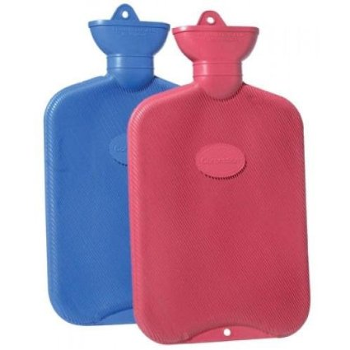
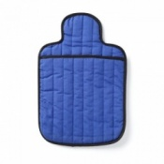
Hot water bottles

Slide 15
These are rubber bags which can be filled with hot water; and are used to provide warmth and to make the patient and environment comfortable.

Slide 16
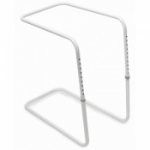
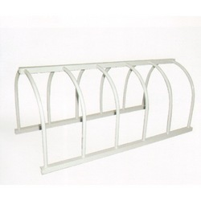
Bed cradle

Slide 17
It is a comfort device, designed to keep the top bed clothes off the feet, legs and abdomen of the patient. It is used in a case of burns or to apply heat for drying plaster casts. It is also used in observing patients with lower limb amputation.

Slide 18
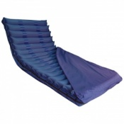
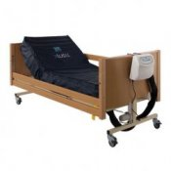
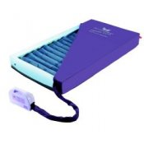
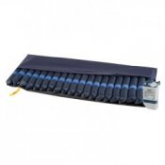
Air/ water mattress

Slide 19
These are used for patients who are prone to develop pressure sores. In this , the pressure exerted by the body is equally distributed in all directions.

Slide 20
THANK YOU

