Slide 1
CIRRHOSIS OF LIVER
MR. SHAILENDRA VERMA
NURSING TUTOR
RCN, BAREILLY

Slide 2
INTRODUCTION
The word "cirrhosis" is a neologism that derives from Greek kirrhos, meaning "tawny" (the orange-yellow colour of the diseased liver).
The destruction of the normal structure and the loss of liver cells prevent the liver from functioning normally

Slide 3
DEFINITION
It is a chronic liver disease characterized by scarring of the liver that involves the formation of fibrous (scar) tissue associated with the destruction of the normal parenchymal cells of the organ.

Slide 4
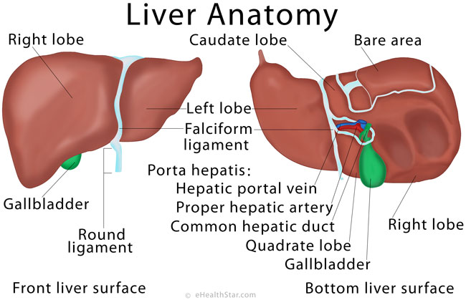

Slide 5
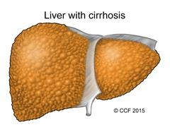

Slide 6
INCIDENCE
Around 10 lakh patients of liver cirrhosis are newly diagnosed every year in India.
- Liver disease is the tenth most common cause of death in India as per the World Health Organization.

Slide 7
TYPES
Alcoholic cirrhosis- Most common, due to chronic alcoholism. Scar tissue characteristically surrounds the portal area.
Postnecrotic cirrhosis- There is broad bands of scar tissue due to late results of acute viral hepatitis, postintoxication with industrial chemicals.
Biliary cirrhosis- Scaring occurs around bile duct in liver, Results from chronic biliary obstruction & infection.
Cardiac cirrhosis (right sided heart failure) and
Nonspecific metabolic cirrhosis (GI diseases).

Slide 8
CAUSES
The most common causes of cirrhosis are chronic (long-term) viral infections of the liver (hepatitis types B, and C), fatty liver associated with obesity and diabetes, and alcohol abuse.
Chronic abuse of alcohol (drinking too much alcohol for a long time)
Chronic hepatitis C (hepatitis C that has lasted at least 6 months)
Alpha-1 antitrypsin deficiency
hemochromatosis
Wilson's disease
Blockage of the bile duct.

Slide 9
RISK FACTORS
Drinking too much alcohol.
Being overweight.
Having viral hepatitis.

Slide 10
PATHOPHYSIOLOGY
Primary event is injury to hepatocellular elements
Initiates inflammatory response with cytokine release->toxic substances
Destruction of hepatocytes, bile duct cells, vascular endothelial cells
Repair through cellular proliferation and regeneration
Formation of fibrous scar
CIRRHOSIS OF LIVER

Slide 11
SIGN AND SYMPTOMS
Loss of appetite
Lack of energy (fatigue)
Weight loss or sudden weight gain
Bruises
Yellowing of skin or the whites of eyes (jaundice)
Itchy skin
Fluid retention (edema) and swelling in the ankles, legs, and abdomen
A brownish or orange color to the urine
Confusion, disorientation, personality changes
Blood in the stool
Fever

Slide 12
DAIGNOSTIC EVALUATION
History and Physical examination
Blood tests:
computerized tomography (CT)
USG
Biopsy:
Surgery: In some cases, cirrhosis is diagnosed during surgery when the doctor is able to see the entire liver. The liver also can be inspected through a laparoscope, a viewing device that is inserted through a tiny incision (cut) in the abdomen

Slide 13
COMPLICATION
Kidney failure
Reduced oxygen in the blood
Diabetes
Changes in blood counts
Increased risk of infections
Excessive bleeding and bruising
Breast enlargement in men
Premature menopause
Variceal bleeding
DEATH

Slide 14
MANAGEMENT
1. NON-SURGICAL
Traditionally, liver damage from cirrhosis cannot be reversed, but treatment could not stop or delay further progression and reduce complications.
Close follow-up is often necessary. Antibiotics will be prescribed for infections.
Treating underlyng cause
Alcoholic cirrhosis caused by alcohol abuse is treated by abstaining from alcohol. Treatment for hepatitis-related cirrhosis involves medications used to treat the different types of hepatitis, such as interferon for viral hepatitis.
Treatment of cirrhosis includes
1) preventing further damage to the liver,
2) treating the complications of cirrhosis,
3) preventing liver cancer or detecting it early.

Slide 15
1) preventing further damage to the liver
Consume a balanced diet and one multivitamin daily.
Avoid drugs (including alcohol) that cause liver damage.
All patients with cirrhosis should avoid alcohol.
Avoid nonsteroidal antiinflammatory drugs (NSAIDs, e.g. ibuprofen).
Eradicate hepatitis B and hepatitis C virus by using anti-viral medications.

Slide 16
2) preventing liver cancer or early detecting
Several types of liver disease that cause cirrhosis are associated with a particularly high incidence of liver cancer, for example, hepatitis B and C, and it would be useful to screen for liver cancer since early surgical treatment or transplantation of the liver can cure the patient of cancer.

Slide 17
3) Treating the complications of cirrhosis
Edema and ascites. Retention of salt and water can lead to swelling of the ankles and legs (edema) or abdomen (ascites) in patients with cirrhosis.
Doctors often advise patients with cirrhosis to restrict dietary salt (sodium) and fluid to decrease edema and ascites.
Diuretics are medications that work in the kidneys to promote the elimination of salt and water into the urine.
A combination of the diuretics spironolactone (Aldactone) and furosemide can reduce or eliminate the edema and ascites in most patients.
It is common to withdraw large amounts (liters) of fluid from the abdomen when the ascites is causing painful abdominal distension

Slide 18
Bleeding from verices
Propranolol (Inderal), a beta blocker, is effective in lowering pressure in the portal vein and is used to prevent initial bleeding and rebleeding from varices in patients with cirrhosis.
Nitrates often are added to propranolol if propranolol alone does not adequately lower portal pressure or prevent bleeding.
Octreotide (Sandostatin) also decreases portal vein pressure and has been used to treat variceal bleeding.
During upper endoscopy (EGD), either sclerotherapy or band ligation can be performed to obliterate varices and stop active bleeding and prevent rebleeding

Slide 19
SURGICAL MANAGEMENT
Band Ligation: - Endoscopy, which consists of a narrow tube mounted with a video camera being inserted into the throat, is used to identify the bleeding site. A rubber band is used to tie off the bleeding portion of the vein.
Transjugular Intrahepatic Portosystemic Shunting (TIPS): - This procedure is done under 2 conditions:
1. Abdominal fluid which does not respond to standard medical treatment
2. Acute bleeding from esophageal varices unresponsive to standard medical or endoscopic treatment

Slide 20
Other Surgical Shunts: -
The splenorenal shunt: - helps to reduce the pressure within the variceal system by connecting the spleen vein to a kidney vein.
portacaval shunt: - reduces pressure in the entire portal system by connecting the portal vein to the inferior vena cava.
Paracentesis It is simply takes fluid out from the abdominal cavity.
In this procedure, a soft catheter is inserted into the abdomen. Usually when large volumes of fluid are to be removed, human albumin is introduced into the abdominal cavity.
LIVER TRANSPLANTATION

Slide 21
NURSING DIAGNOSIS

Slide 22
Acute pain related to liver enlargement secondary to ascites as evidenced by facial grimace.
Activity intolerance related to fatigue and discomfort.
Risk for injury and bleeding related to altered clotting mechanisms.
Fluid volume excess related to ascites and edema formation.
Imbalanced nutritional status, less than body requirements, related to less intake of food
Altered breathing pattern related to decreased lung expansion secondary to intra-abdominal fluid collection (ascites)

Slide 23
ASSIGNMENT :-
Assignment on NCP of pre and post surgical management.
Date of Submission ---------------

Slide 24


Slide 25


