Slide 1
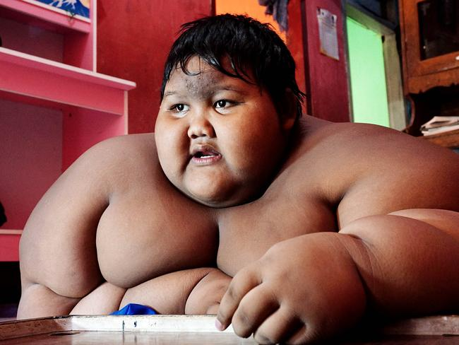

Slide 2
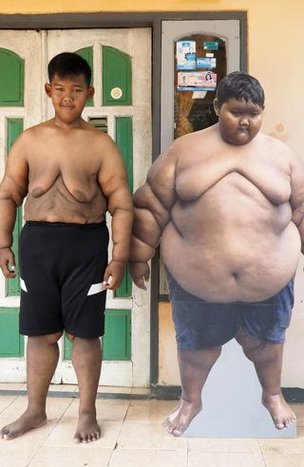


Arya Permana from Indonesia who once used to be the “world’s fattest boy” 190kg at age nine. But he now weighs about 87kg, less than half of what he weighed at his heaviest, after undergoing a huge lifestyle overhaul.

Slide 3
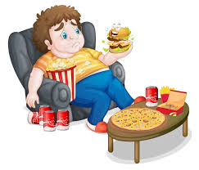
CHILDHOOD OBESITY
Presented By:
Yengkhom Sonia Devi
Nursing Tutor

Slide 4
Learning Objectives
Definition of childhood obesity.
Determine causes of childhood obesity.
Discuss the Sign and symptoms of childhood obesity.
Explain the Diagnosis of childhood obesity.
Discuss the Management of childhood obesity.
Elaborate the Prevention of obesity.

Slide 5
INTRODUCTION
In 2022, 37 million children under the age of 5 were overweight.
Over 390 million children and adolescents aged 5–19 years were overweight in 2022, including 160 million who were living with obesity.
The prevalence of overweight (including obesity) among children and adolescents aged 5–19 has risen dramatically from just 8% in 1990 to 20% in 2022. The rise has occurred similarly among both boys and girls: in 2022 19% of girls and 21% of boys were overweight.

Slide 6
Childhood Prevalence in India
Children obesity is now an epidemic in India.
With 14.4 million obese children, India has the second highest number of obese children in the world, next to China.
The prevalence of overweight and obesity in children is 15%. In private schools catering to upper income families, the incidence has shot upto 35% - 40%, indicating a worrying upward trend.

Slide 7
DEFINITION OF CHIHOOD OBESITY
Obesity is a chronic complex disease defined by excessive fat deposits that can impair health.
The child is obese if above 3 z-score in weight-for-length/height or BMI-for-age for children under 5 years of age.
Obesity is weight-for-height greater than 2 standard deviations above the WHO Child Growth Standards median for children 5 - 19 years of age

Slide 8
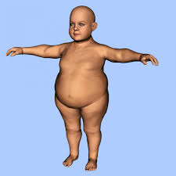
CAUSES OF CHILDHOOD OBESITY
Genetics
Certain medications
Dietary
Socioeconomic
Physical inactivity
Hormonal
Psychological

Slide 9
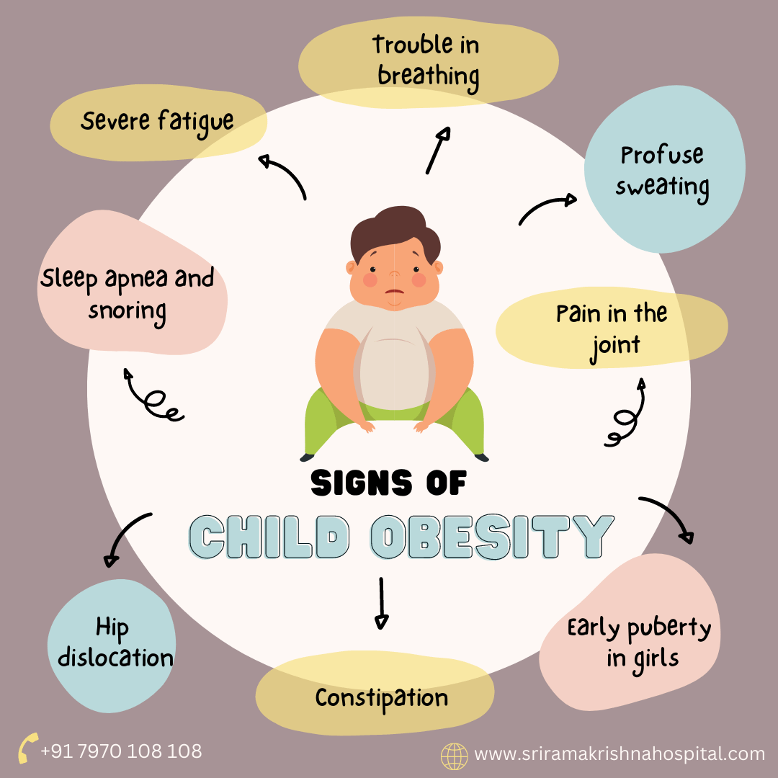
SIGN AND SYMPTOMS

Slide 10


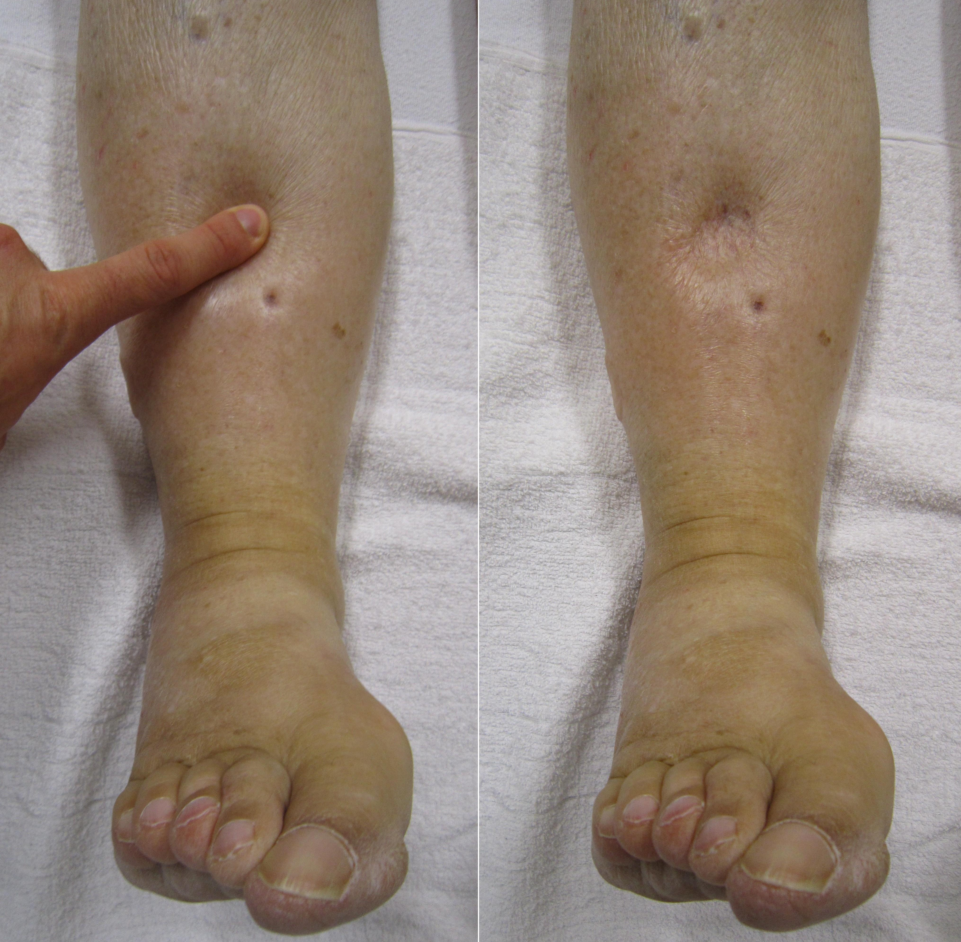


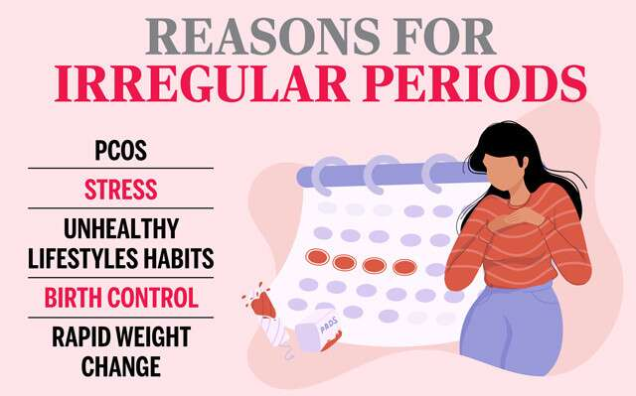
SIGN AND SYMPTOMS
Gastrointestinal
reflux
Depression
Edema
Abdominal Pain
Irregular Mensturation
Elevated BP

Slide 11
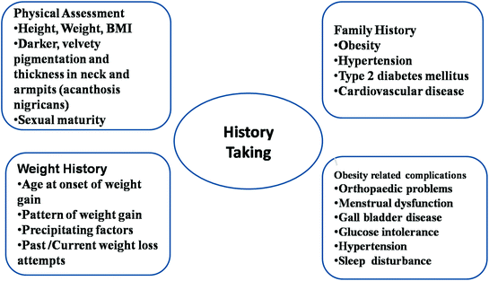
DIAGNOSIS OF CHILDHOOD OBESITY
History Collection

Slide 12
DIAGNOSIS OF CHILDHOOD OBESITY
1. History Collection
Weight history: onset pattern of weight gain, past/current weight loss attempt.
History of dietary intake.
Family history: Obesity, CAD, types 2 Diabetes mellitus , hypertension.
History of breast feeding.
History feeding practices.
History of lifestyles.
History social interaction.
History of any complication.
History of puberty.

Slide 13
DIAGNOSIS OF CHILDHOOD OBESITY
2. Physical assessment: Head to toe examination.
Assess the vital signs
Assess the weight, height of the child.
Calculation of BMI.
Assess for shortness of breath, sleep apnea, heartburn, constipation, depression, edema, joint pain Abdominal pain, irregular periods etc.

Slide 14
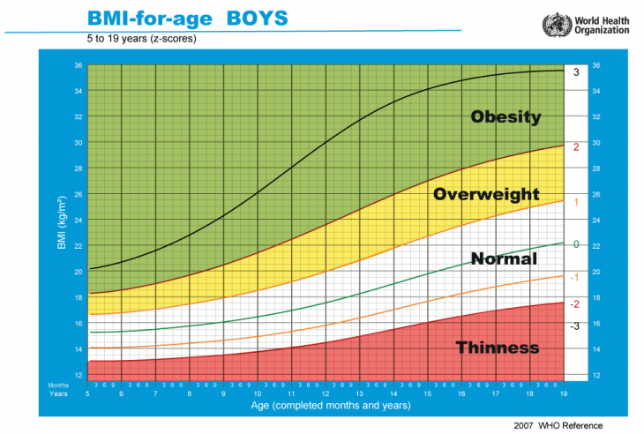

Slide 15
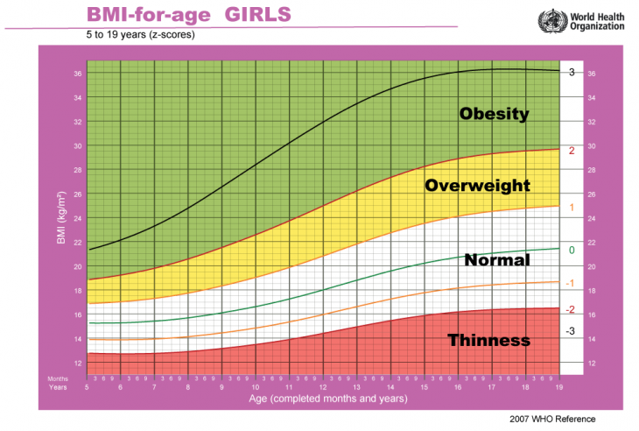

Slide 16
DIAGNOSIS OF CHILDHOOD OBESITY
3. Diagnostic test:
Blood tests to check for elevated cholesterol or triglyceride levels.
Blood test for TSH, T2, T3.

Slide 17
General Management
Regular meals, including breakfast.
45 minutes of regular moderate to vigorous physical activity and screen time below 1 hour daily.
Avoidance of snacking, inactivity, and screen exposure while eating.
Avoid rigorous dieting.
Identify red flag signs for psychosocial impact (school absenteeism, body shaming or teasing by peers regarding weight/appearance, persistent anxiety, depression or self-harm, anger outbursts, substance abuse, eating disorders) and family stressors.
Specialist referral in the presence of complications.
blood tests to check for elevated cholesterol or triglyceride levels.

Slide 18
Medical Management
Metformin: Approved in Type 2 DM after 8 years of age. May consider in causes related to antipsychotic medication, polycystic ovarian disease, and steatohepatitis.
Orlistat: Gastric lipase inhibitor that decreases fat absorption. Approved after 12 years of age.

Slide 19
Bariatric Surgical Management
Should be discouraged as it carries more significant complications than adults.
Indicated only with severe obesity (BMI >40 kg/m2 or >35 kg/m2 with complications) and only after completion of linear growth.
A multidisciplinary obesity team with long-term follow-up is essential to maintain compliance with nutritional recommendations.
Extreme motivation, strict diet, and activity schedule must be maintained after surgery.

Slide 20
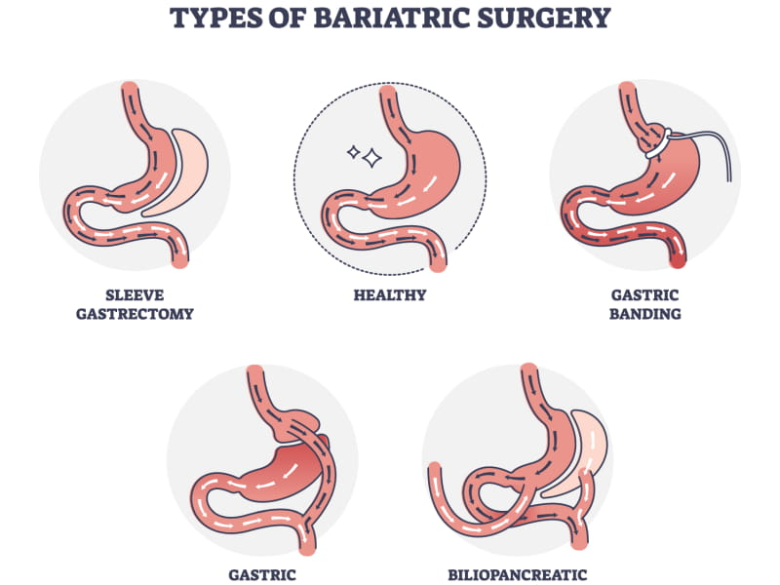

Slide 21
Prevention in different settings
Individual:
Caregiver/Family:
Healthy diet and eating habits
Elimination of sugary beverages
Regular physical activity 4. Reduce screen time
Parenting strategies (Authoritarian).
Parents weight control.
Promotion of healthy diet and lifestyle.
Meal planning, portion control.
Positive feedback.

Slide 22
Prevention in different settings
School:
Community:
Liasion with school teachers
Ensure provision of healthy food and water.
Structured play education
Educational materials, newsletters
Counselling sessions for adolescent
Promote public policy interventions.
Parks/Open areas for physical activity.
Taxation of unhealthy foods and snacks.
Awareness about food assistance programmes.
Promote government initiatives, e.g., Fit India Movement.

Slide 23
Complication of Childhood obesity
Cardiovascular diseases (CVD).
Diabetes Mellitus.
Sleep apnea.
Hypertension.
Depression.
Polycystic Ovarian syndrome (PCOS)

Slide 24
Nurses Role:
Assess risk factors and monitor patient health to determine if they are at risk for obesity.
Educating parents, children, families and communities about the devastating effects of childhood obesity.
Nurses will continue to encourage healthy eating habits and promote adequate physical activity.
School nurses are working to educate students and educational staff about the vital role both healthy eating habits and adequate physical activity play in obtaining optimal health.

Slide 25
Conclusion
Childhood obesity is growing rapidly worldwide.
The growing issue of childhood obesity can be slowed, if society focuses on the cause.
A combined diet and physical activity intervention may be more effective in preventing the obesity in children.
Need encouragement of the parents to create a healthy lifestyle and environment for the children.

