Slide 1
Cells

Slide 2


Slide 3
DEFINITION
Are the body’s smallest functional unit
Grouped together to form tissues each of which has a specialized function.

Slide 4
EXAMPLE
Blood
Muscle
Bone

Slide 5
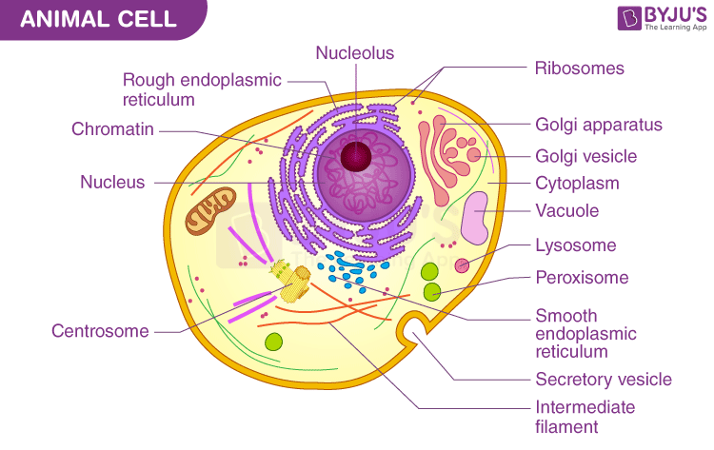

Slide 6
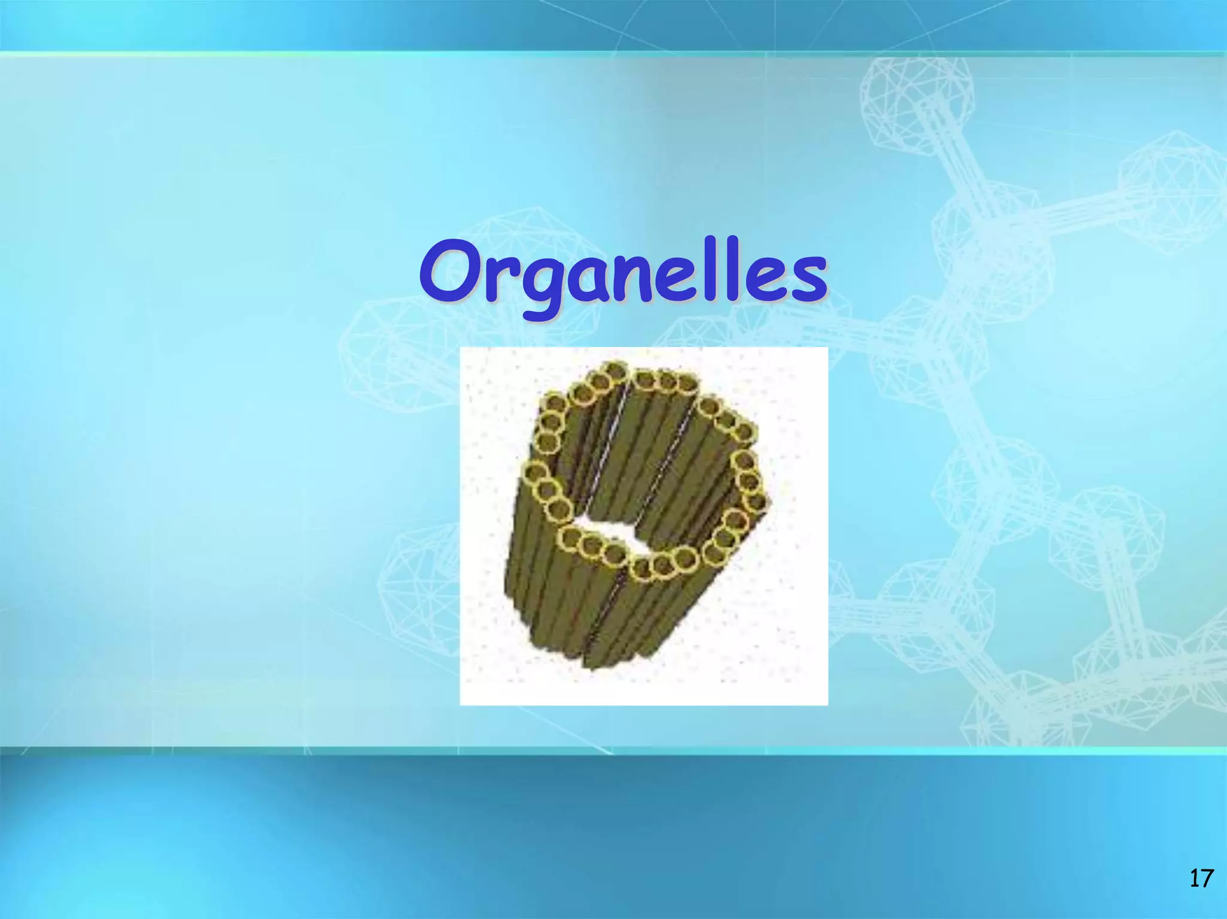

Slide 7
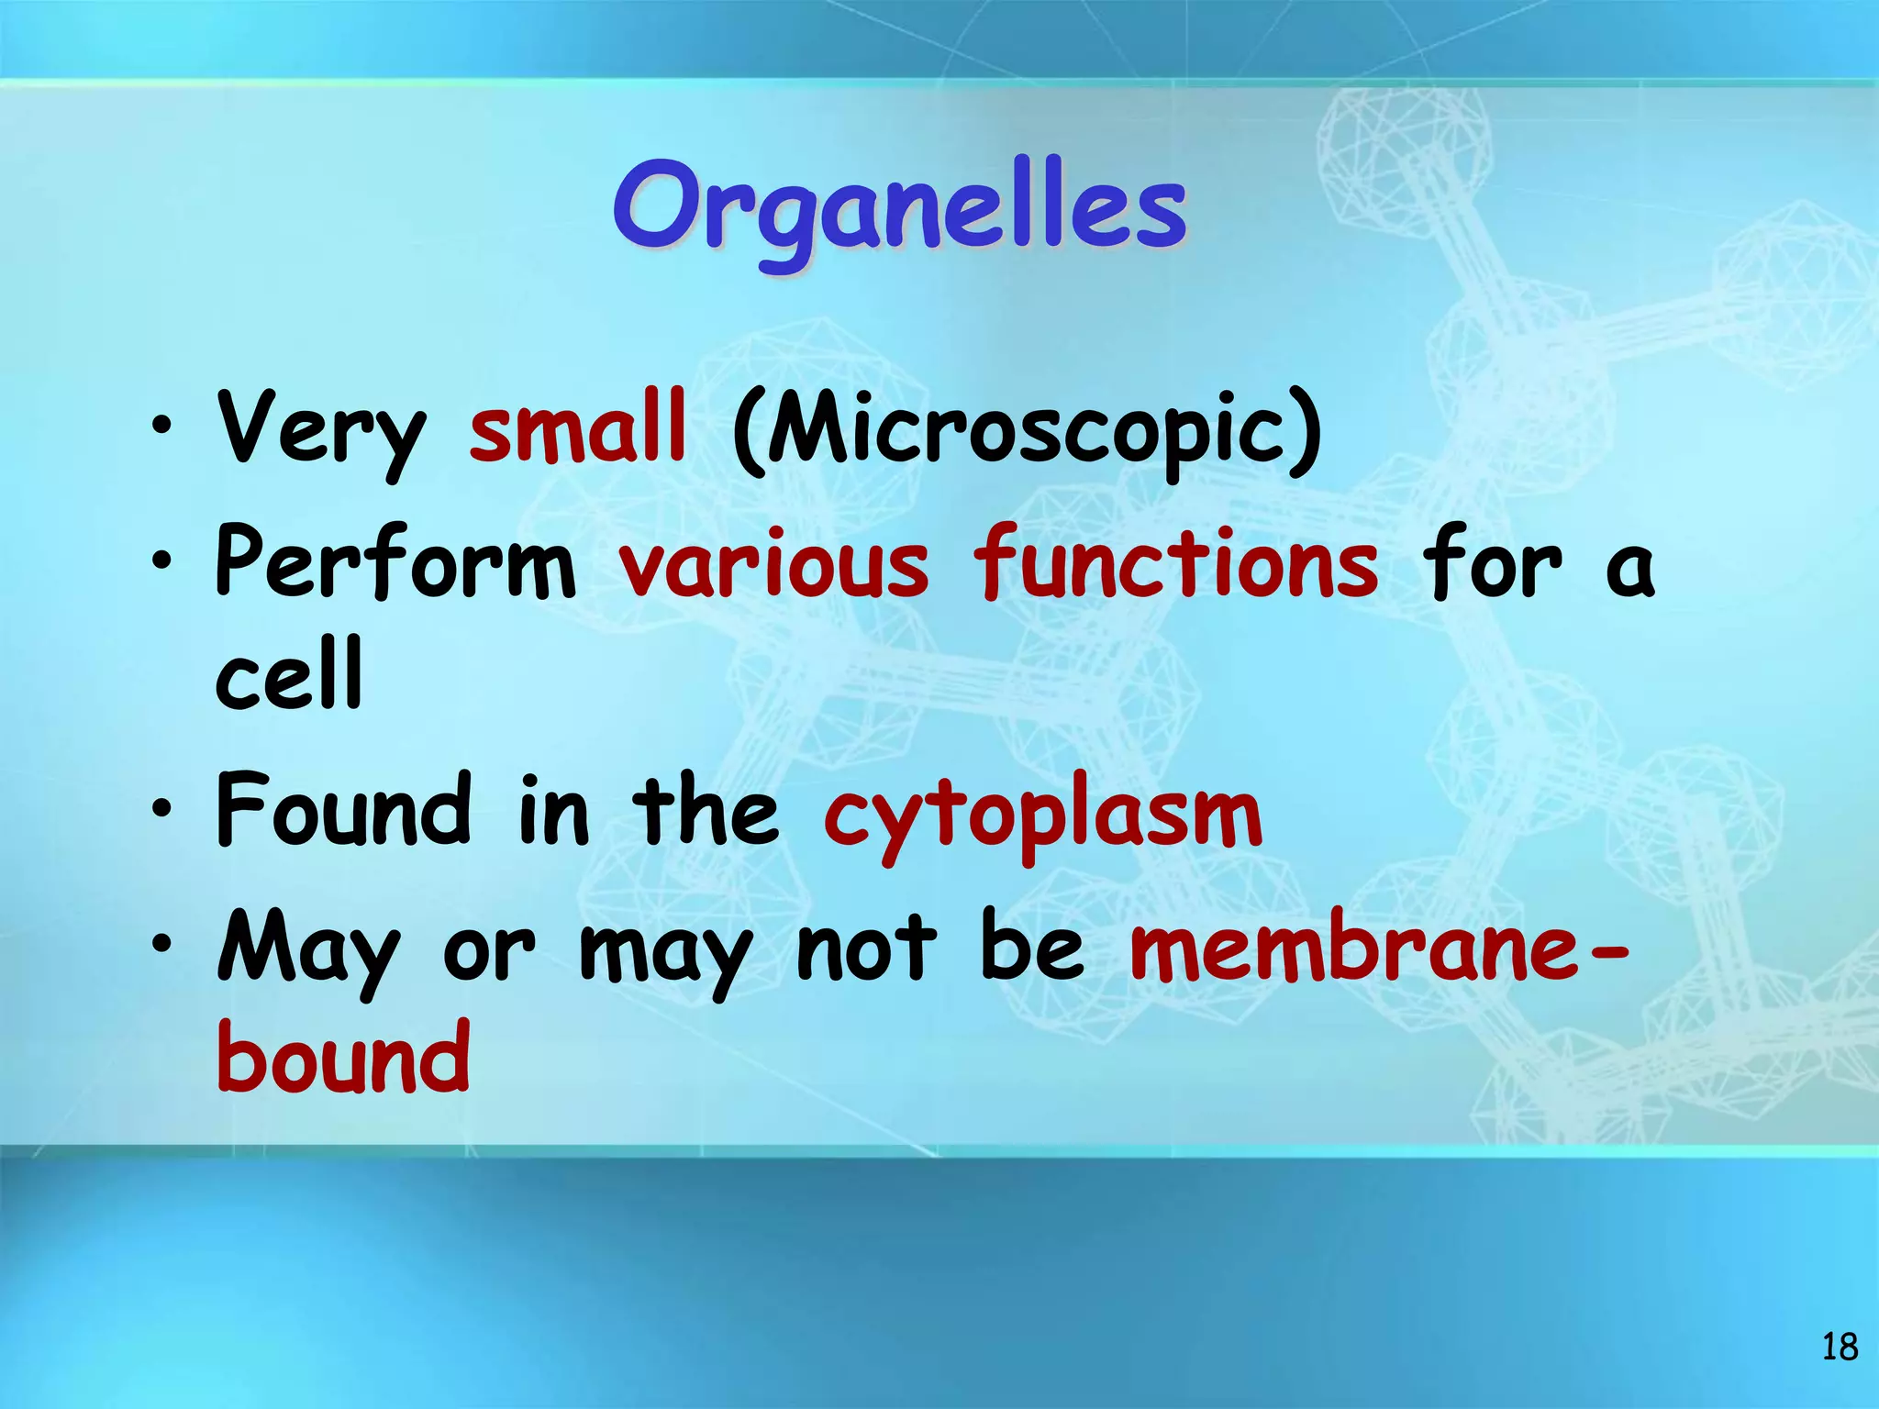

Slide 8
NUCLEUS
Body cells have a nucleus
Exception of mature RBC’s
Largest organelle

Slide 9
Contains nuclear envelope
Tiny pores through which some substances can pass between it and cytoplasm.
Contains genetic material (DNA)

Slide 10
Within the nucleolus there is a roughly spherical structure called the nucleolus.

Slide 11
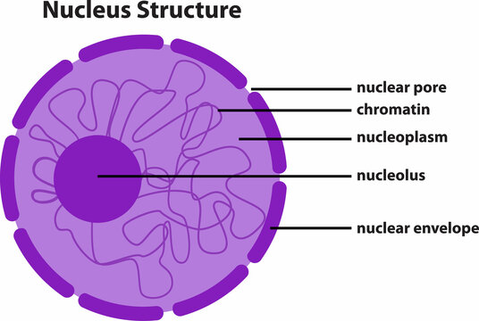

Slide 12
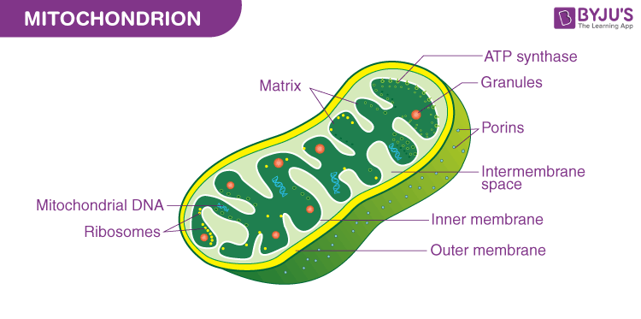

Slide 13
MITOCHONDRIA
Are membranous, sausage shaped structure in the cytoplasm.
Described as “ power house of the cell”
Central to aerobic respiration

Slide 14
This in the form of ATP the chemical energy is made available.
Energy helps out in the cell break down.
Most active cell type has greatest number of mitochondria.

Slide 15
RIBOSOMES
Tiny granules composed of RNA and protein.
Synthesize proteins from amino acids using RNA.

Slide 16
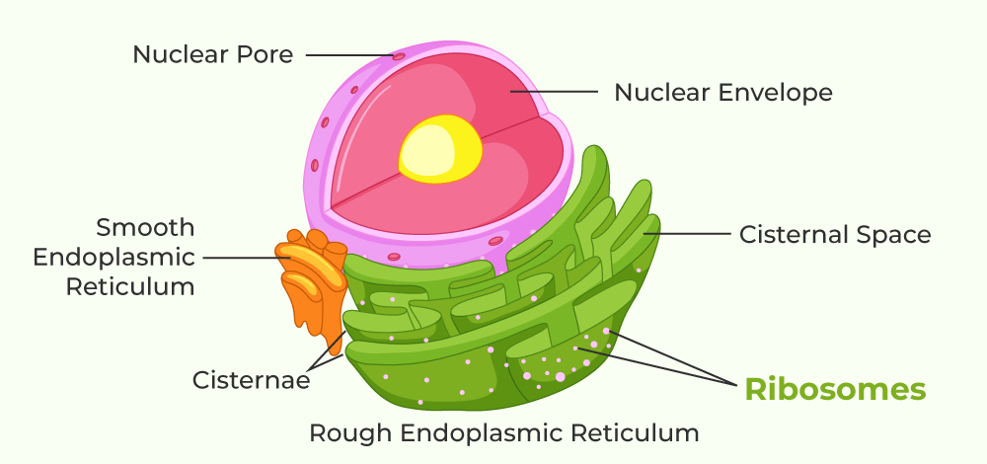

Slide 17
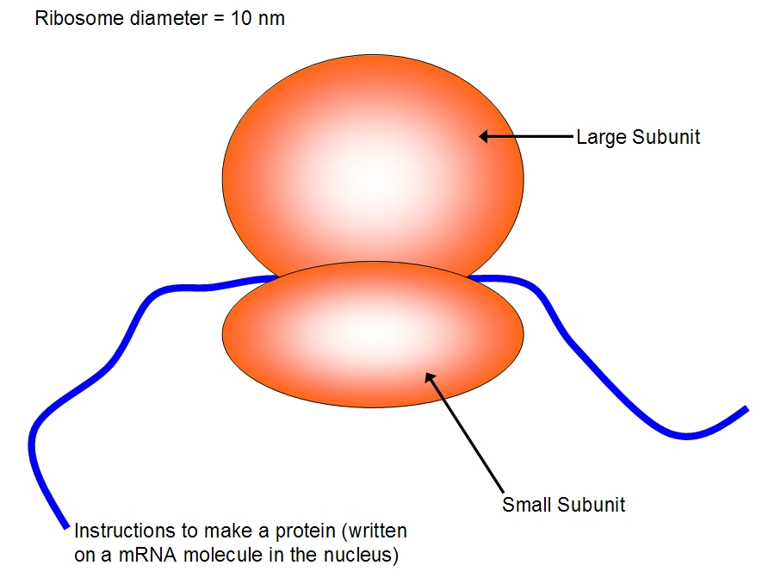

Slide 18
Make proteins for use within the cell
Include enzymes required for metabolism
Also found on the outer surface of the nuclear envelope and rough ER.

Slide 19
ENDOPLASMIC RETICULUM
Extensive series of interconnecting membranous canals in the cytoplasm.
Two types: Rough and Smooth ER

Slide 20
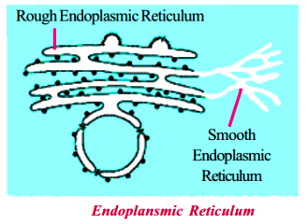

Slide 21
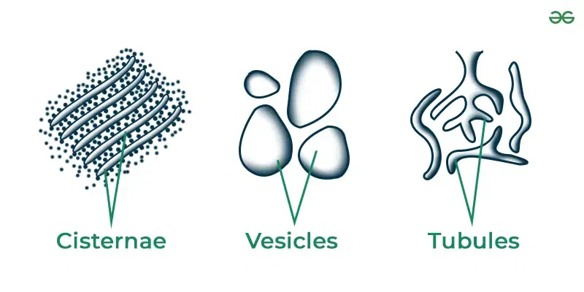

Slide 22
GOLGI APPARATUS
Consists of stacks of closely folded flattened membranous sacs.
Present in all cells but is larger than those that synthesize and export proteins.

Slide 23
GOLGI APPARATUS
Proteins move from the ER to the Golgi apparatus where they are packaged into membrane bound vesicles.

Slide 24
Vesicles are stored and when needed they move to the plasma membrane and fuse with it.
Expels the contents from the cell (exocytosis)

Slide 25
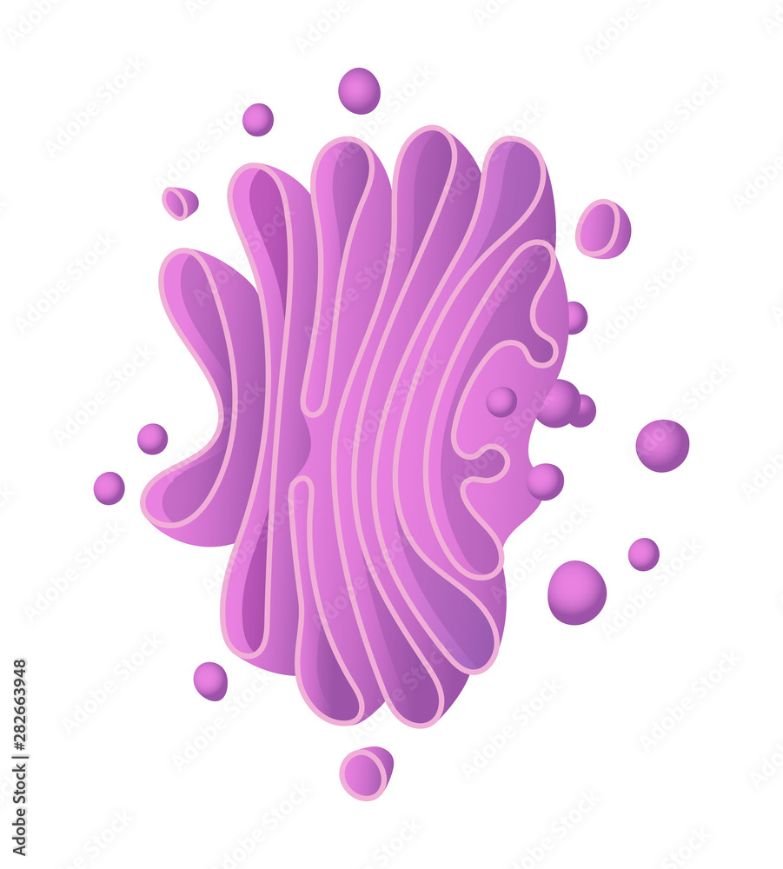

Slide 26
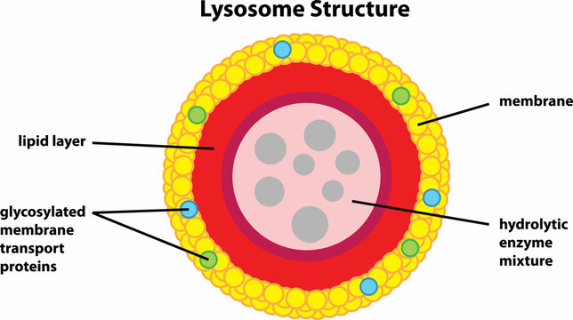

Slide 27
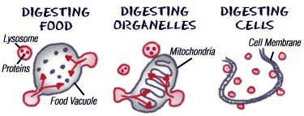

Slide 28
CYTOSKELETON
Consists of an extensive network of tiny protein fibers.
The cytoskeleton provides and internal support system for the cell.

Slide 29
CYTOSKELETON
Guides the movement of materials around the cell interior.

Slide 30
MULTIPLE CHOICE QUESTIONS

Slide 31
QUESTION NO. 1
Cristae are associated with
Mitochondria
Cytoplasm
Vacuole
Ribosomes

Slide 32
QUESTION NO. 2
2) Sodium and potassium pumps are examples of
Passive transport
Plasmolysis
Active transport
Osmosis

Slide 33
QUESTION NO. 3
3) Cell drinking is
Exocytosis
Endocytosis
Pinocytosis
Phagocytosis

Slide 34
QUESTION NO. 4
4) Oxygen enters a cell via
Diffusion
Filtration
Osmosis
Active transport

Slide 35
QUESTION NO. 5
5) Which of the following requires energy
Diffusion
Facilitated diffusion
Osmosis
Active transport

Slide 36
QUESTION NO. 6
6) Protein synthesis occurs at the
Mitochondria
Lysosomes
Within the nucleus
Ribosomes

Slide 37
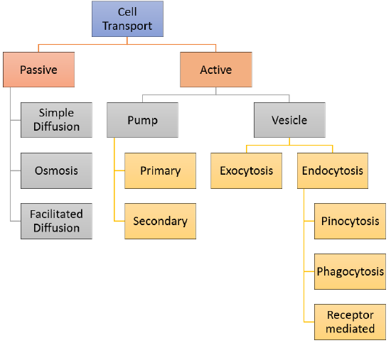

Slide 38
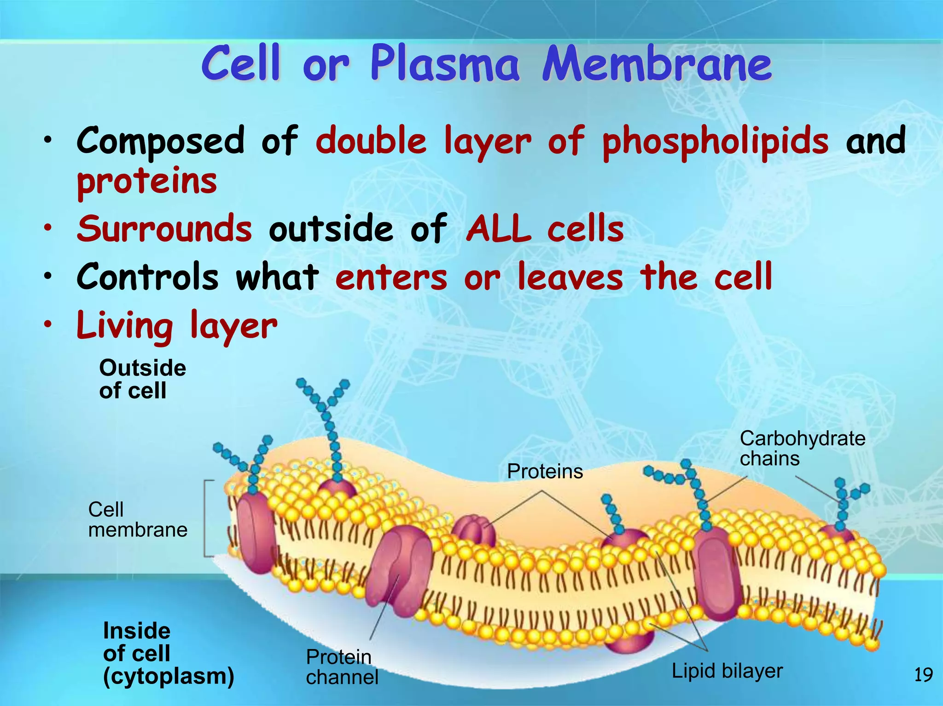

Slide 39
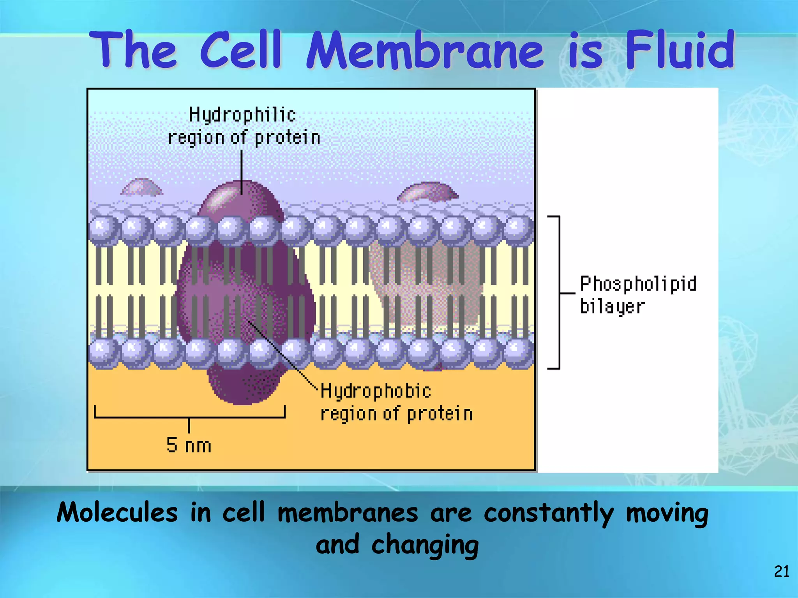

Slide 40
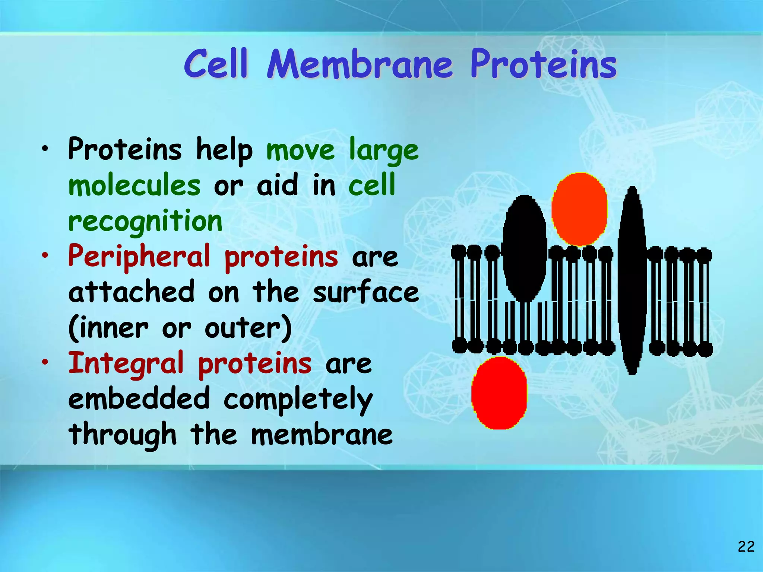

Slide 41
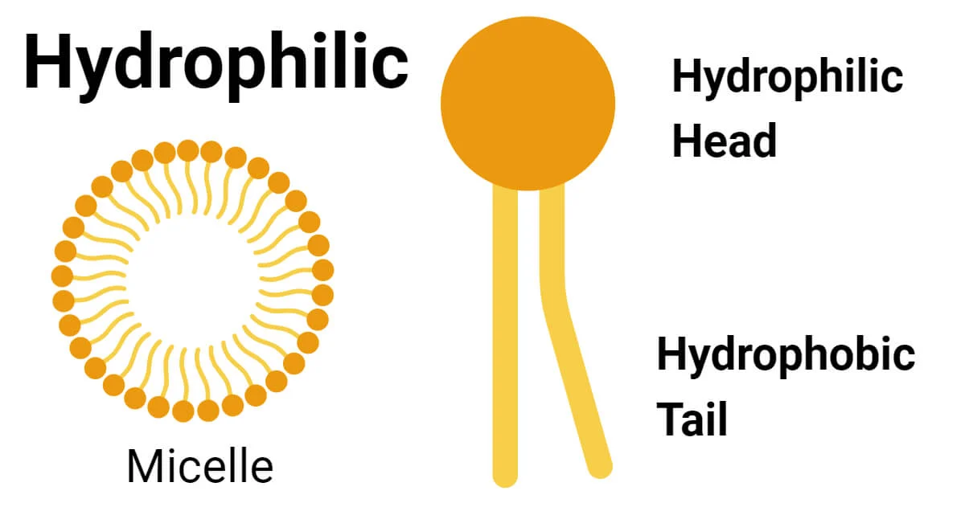

Slide 42
DIFFUSION
Dissolving in the lipid part of the membrane
Passing through water filled channels or pores in the membrane

Slide 43
FACILITATED DIFFUSION
Utilized by some substances that are unable to diffuse through the semipermeable membrane unaided.

Slide 44
Specialized protein carrier molecules in the membrane have specific sites that attract and bind substances to be transferred.

Slide 45
Carrier sites are specific and can be used by only one substance.

Slide 46
OSMOSIS
Is a passive movement of water from higher concentration gradient to lower concentration gradient toward equilibrium across a semipermeable membrane.

Slide 47
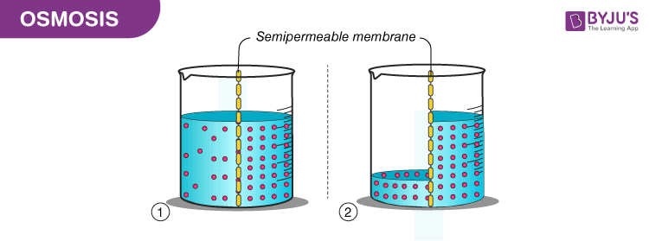

Slide 48
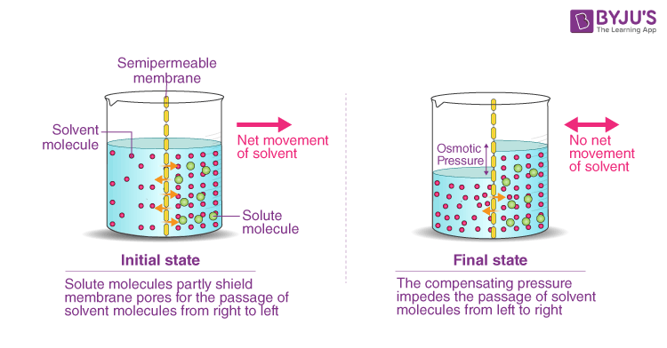

Slide 49
ACTIVE TRANSPORT
Transport of substances up their concentration from lower to higher concentration gradient.

Slide 50
ATP is generated
To drive specialized protein carrier molecules that transport substances across the membrane in either direction

Slide 51
SODIUM POTASSIUM PUMP
Cell possess the pump
Indirectly supports other transport mechanism
Essential in maintaining the electrical gradient to generate action potentials in nerve and muscle cells.

Slide 52
Maintains unequal concentrations of sodium and potassium ions on either side of plasma membrane.

Slide 53
Potassium – higher inside the cell
Sodium – higher outside the cell
To maintain their concentration gradients excess Na+ is constantly pumped out across the cell membrane in exchange of K + ion.

Slide 54
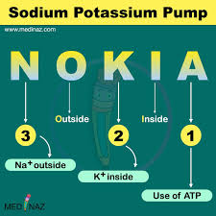

Slide 55
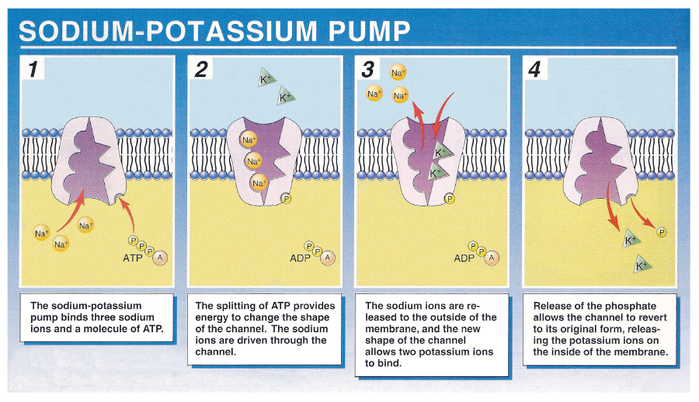

Slide 56
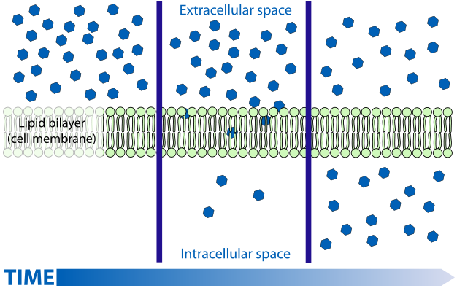

Slide 57
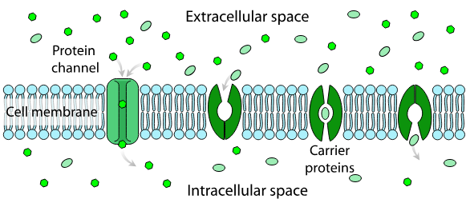

Slide 58
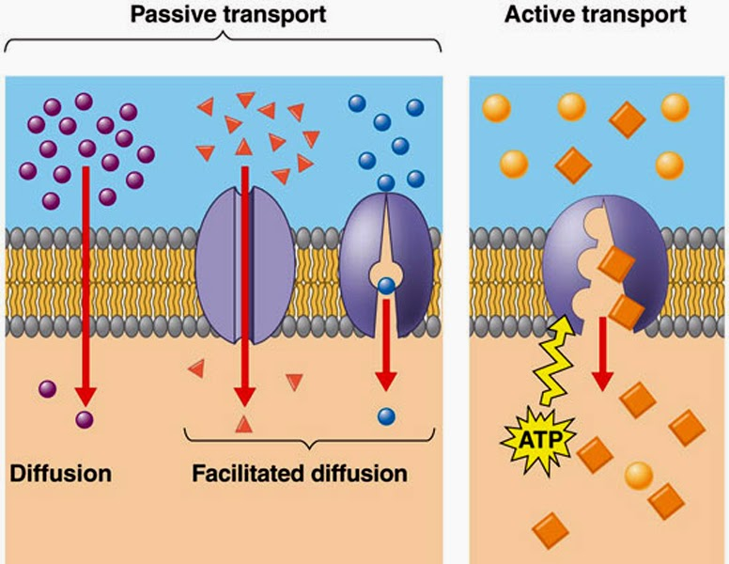

Slide 59
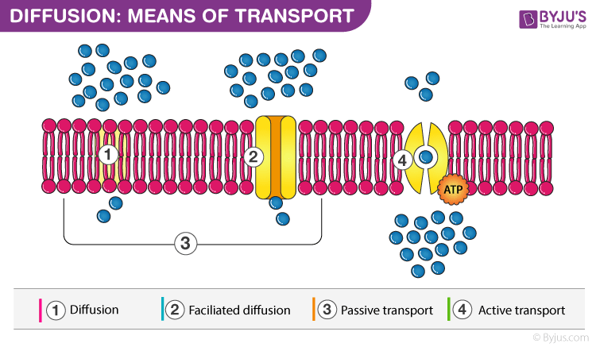

Slide 60
BULK TRANSPORT
Transfer of particles too large to cross cell membranes occurs by pinocytosis (cell drinking) or phagocytosis (cell eating)

Slide 61
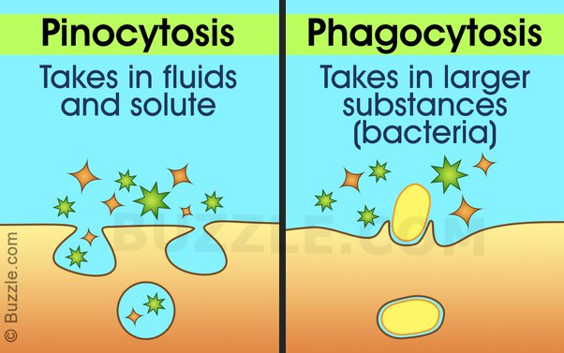

Slide 62
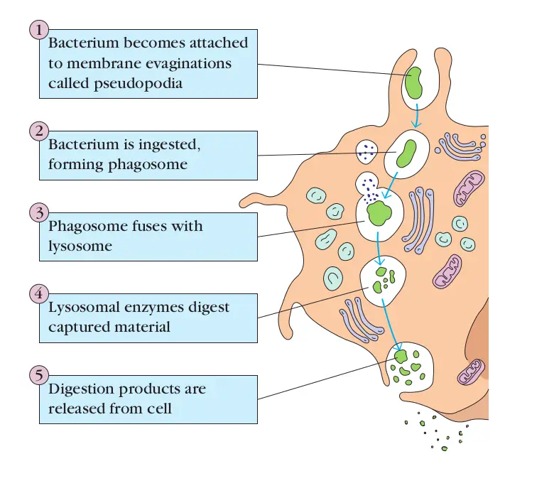

Slide 63
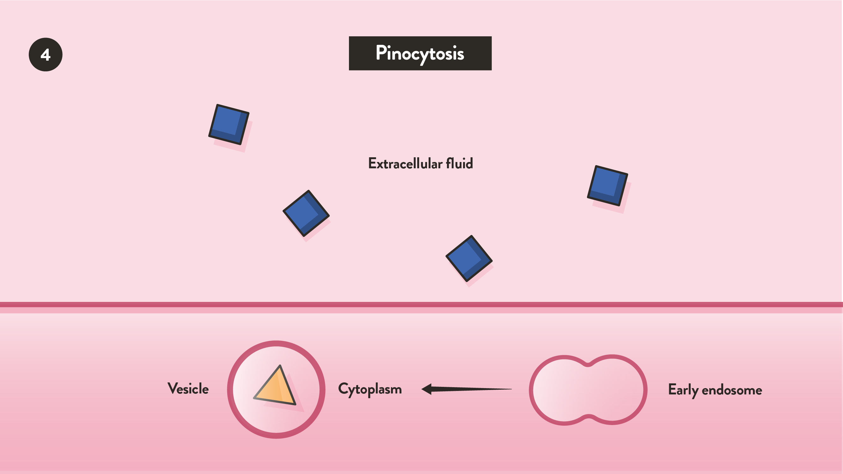

Slide 64
EXOCYTOSIS
Extrusion of waste material by the reverse process through the plasma membrane.

Slide 65
ENDOCYTOSIS

Slide 66
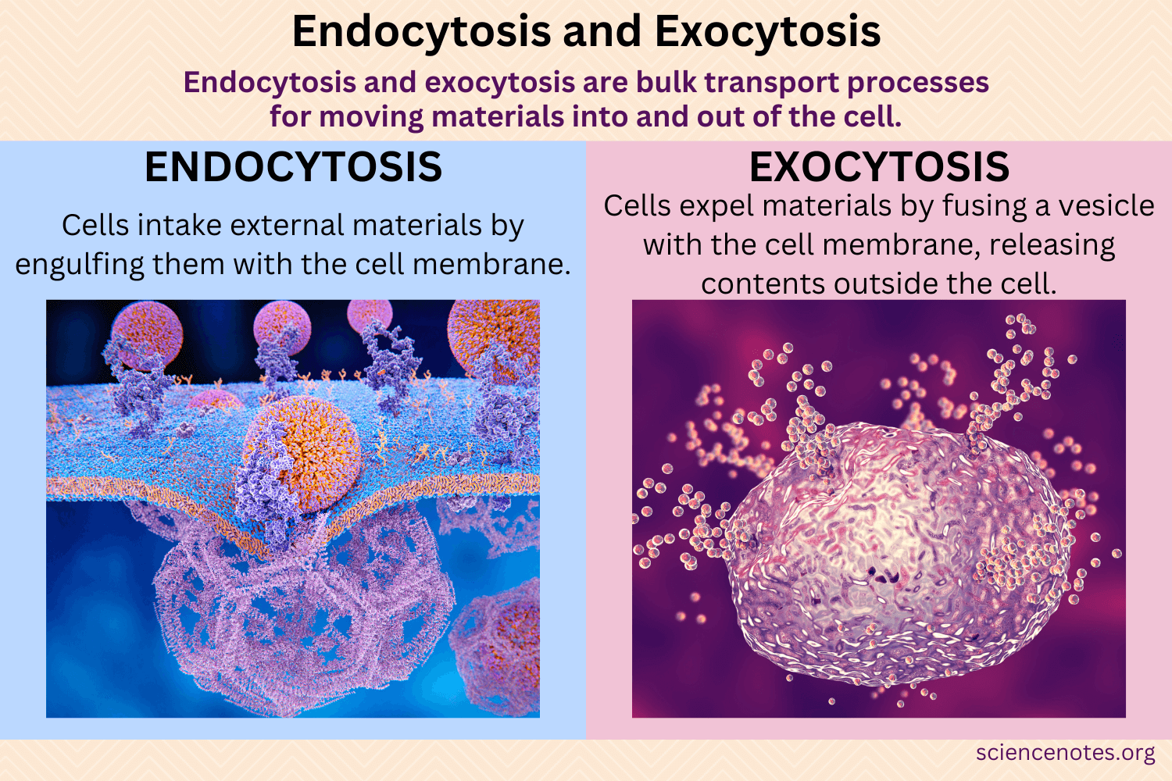

Slide 67
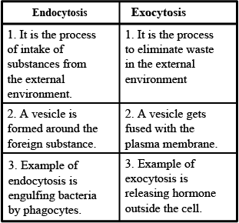

Slide 68
CELL DIVISION

Slide 69
TYPES OF CELL DIVISION
Mitosis
Meiosis

Slide 70
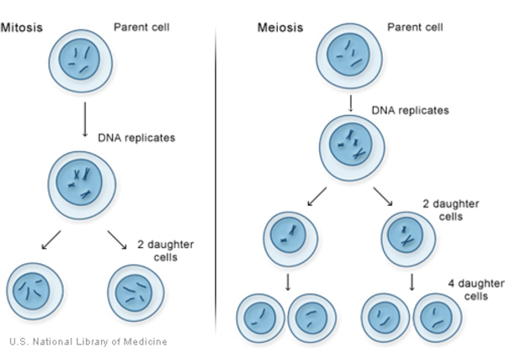

Slide 71
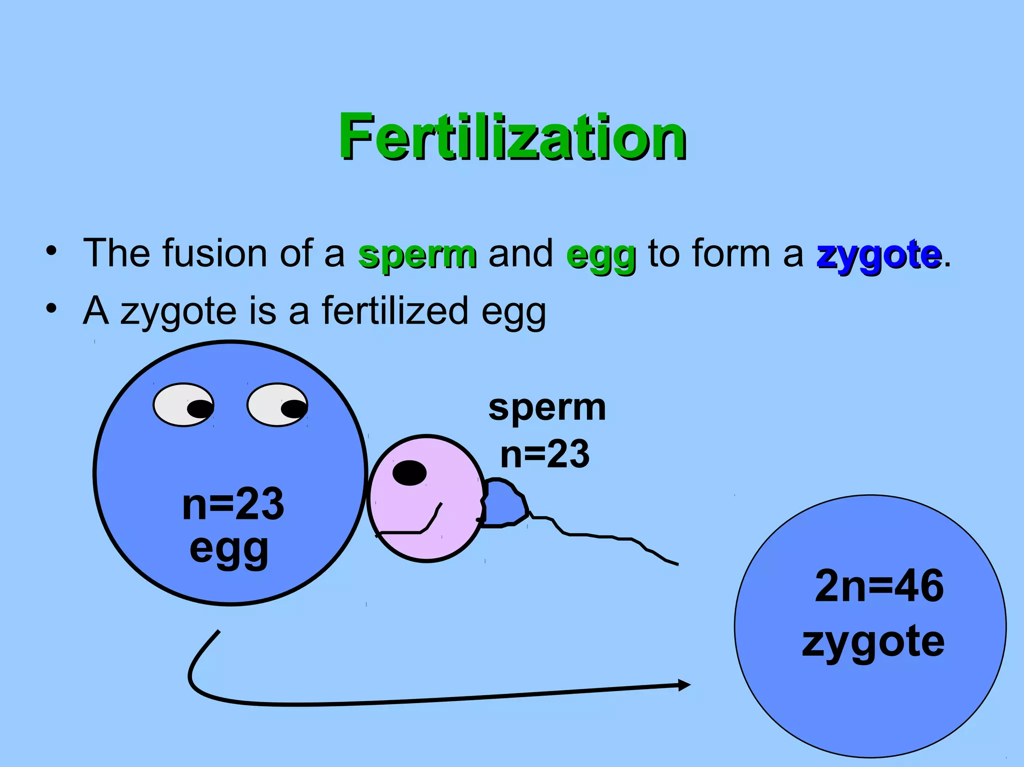

Slide 72
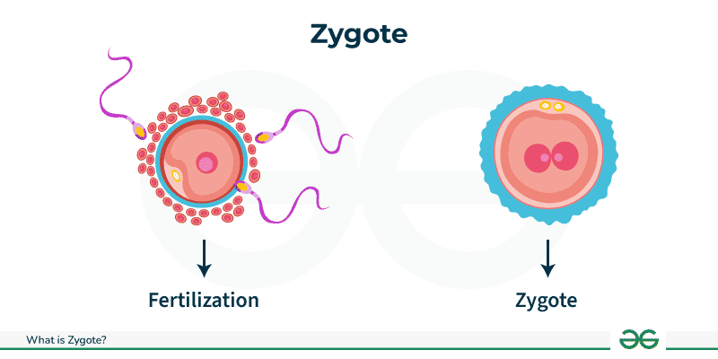

Slide 73
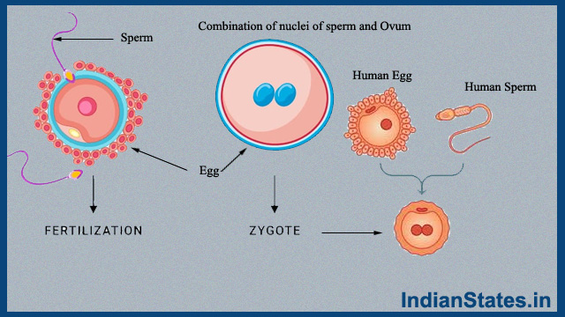

Slide 74
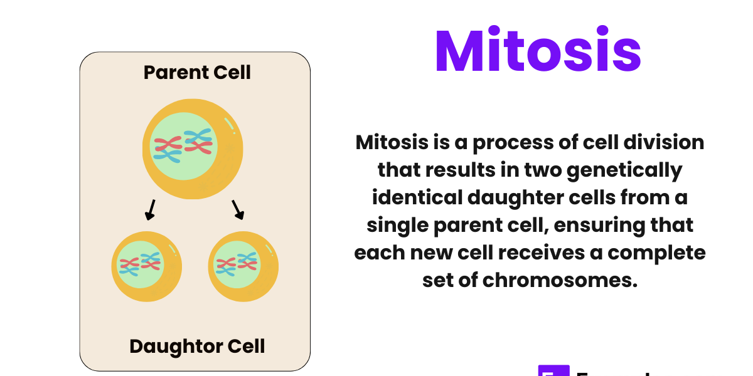

Slide 75
CELLS DIVIDE WHEN
An organism grows
An organism becomes damaged and needs to produce new cells for repair

Slide 76
MITOSIS
Fertilized egg, or zygote is an ongoing process
Fetus develops in the mother’s uterus cells multiply and grow
Life span is limited of individual cells

Slide 77
MITOSIS OCCURS IN TWO STAGES
Replication of DNA in the form of chromosomes (23 pairs)
Division of the cytoplasm

Slide 78
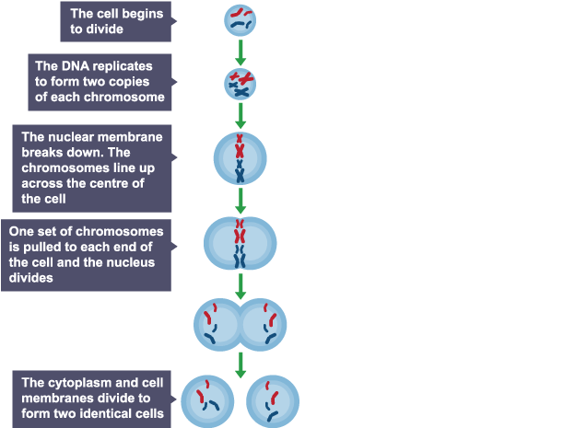

Slide 80
PROCESS OF MITOSIS
DNA is the only type of molecule capable of independently forming a duplicate of itself.

Slide 81
Have moved to the opposite poles of the parent cell a “waist” forms in the cytoplasm and the cell divides.

Slide 82
There is then a complete set of chromosomes in each daughter cell.
The organelles in the cytoplasm of the daughter cells are incomplete at cell division

Slide 83
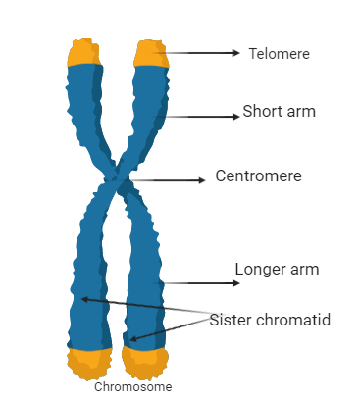
But they develop as the cell grows to maturity.

Slide 84
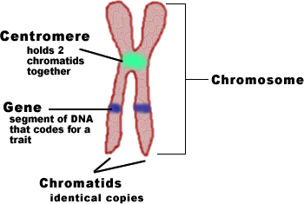

Slide 85
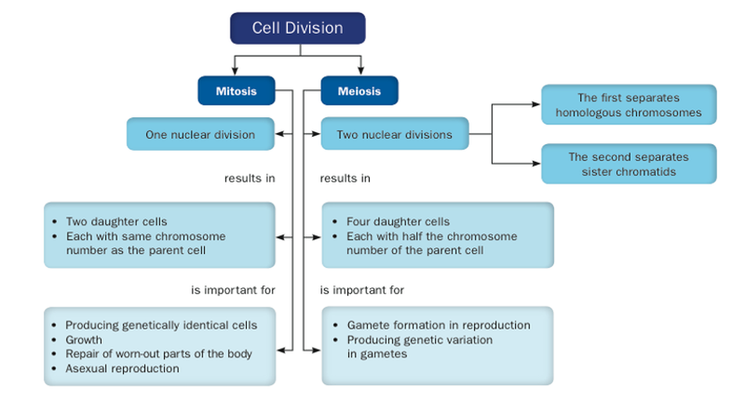

Slide 86
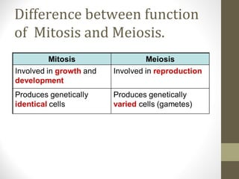

Slide 87
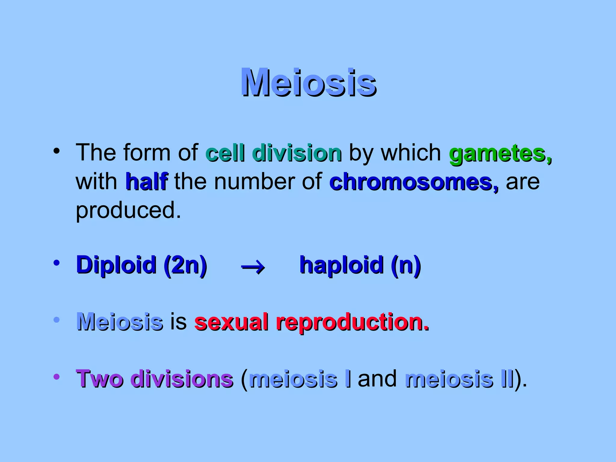

Slide 88
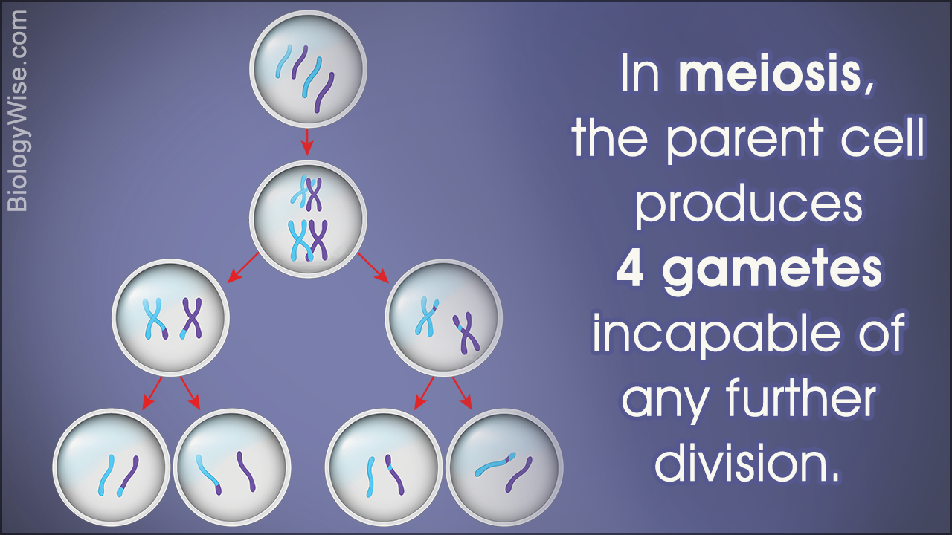

Slide 89
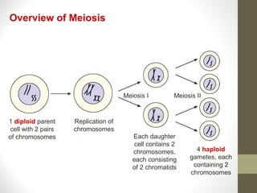

Slide 90
Four daughter cells are formed after two divisions
The pairs of chromosomes separate and one from each pair moves to opposite poles of the parent cell

Slide 91
When it divides, each of the daughter cells has only 23 chromosomes (haploid number)
When the ovum is fertilized the resultant zygote has the full complement of 46 chromosomes

Slide 92
Complement of 46 chromosomes half from the father and half from the mother
Child has some characteristics inherited from the mother & some from the father

Slide 93
Determination of gender depends upon one particular pair of chromosomes (Sex chromosomes)
In the female, both sex chromosomes are the same size and shape and are called X chromosomes

Slide 94
In the male, there is one X chromosome and a slightly smaller Y chromosome.
When the ovum is fertilized by an X bearing spermatozoon the child is female

Slide 95
When it is fertilized by a Y bearing spermatozoon the child is male
Sperm X + ovum X Child XX = Female
Sperm Y + Ovum X Child XY = Male

Slide 96
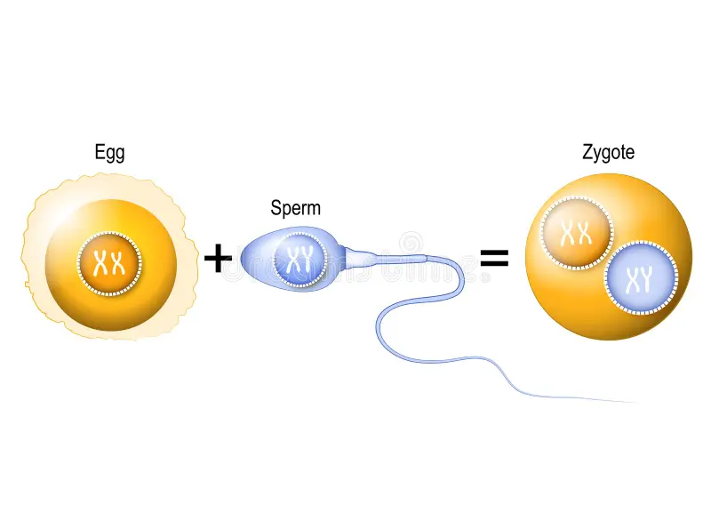

Slide 97
MUTATION
Cells are said to mutate when their genetic make up is altered in any way.

Slide 98
MUTATION MAY CAUSE
No significant change in cell function
Modification of cell function that may cause physiological abnormality but does not prevent cell growth and multiplication

Slide 99
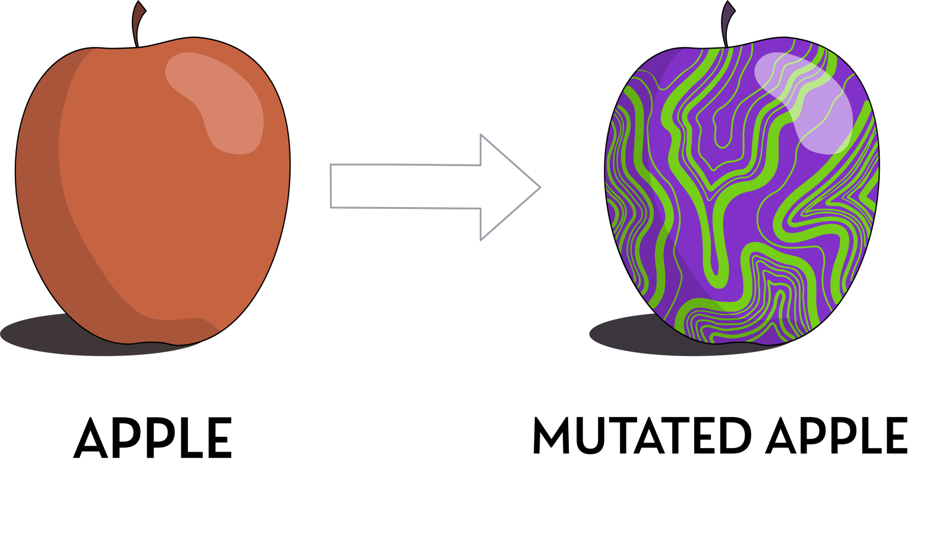
The death of the cell

Slide 100
CELL CYCLE

Slide 101
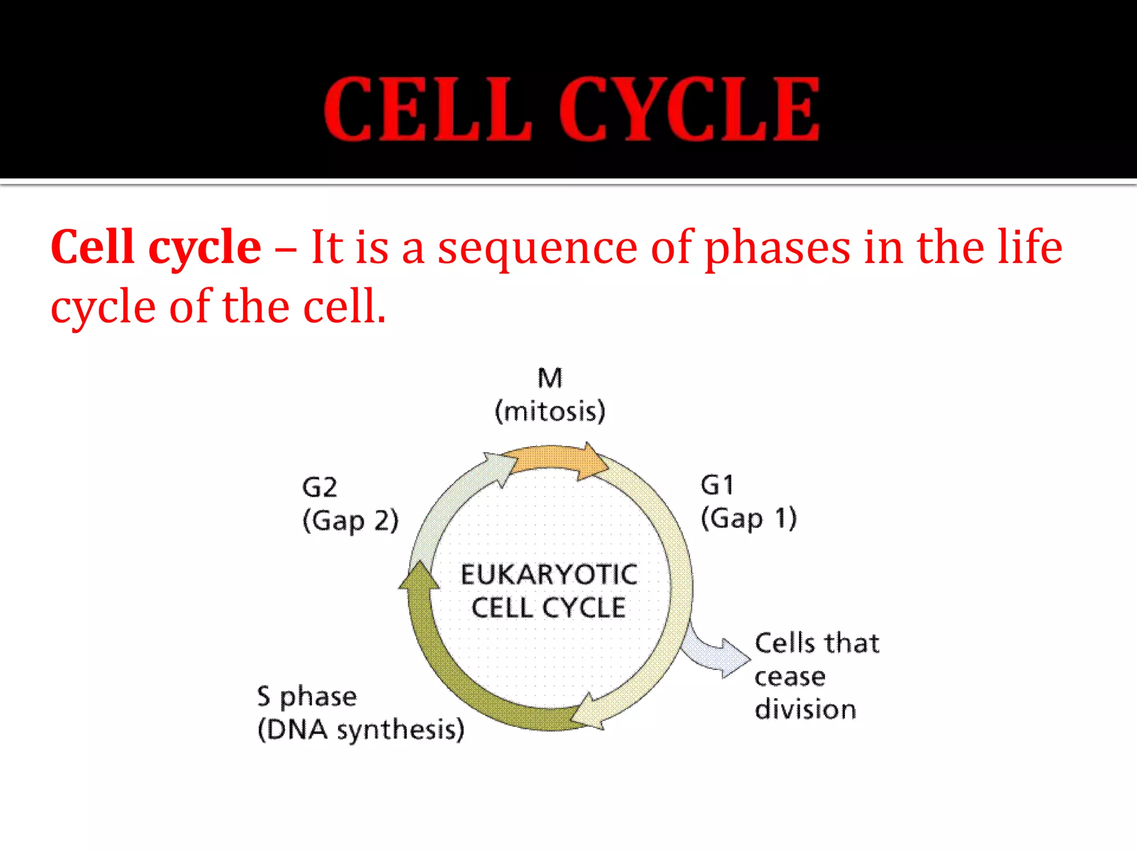

Slide 102
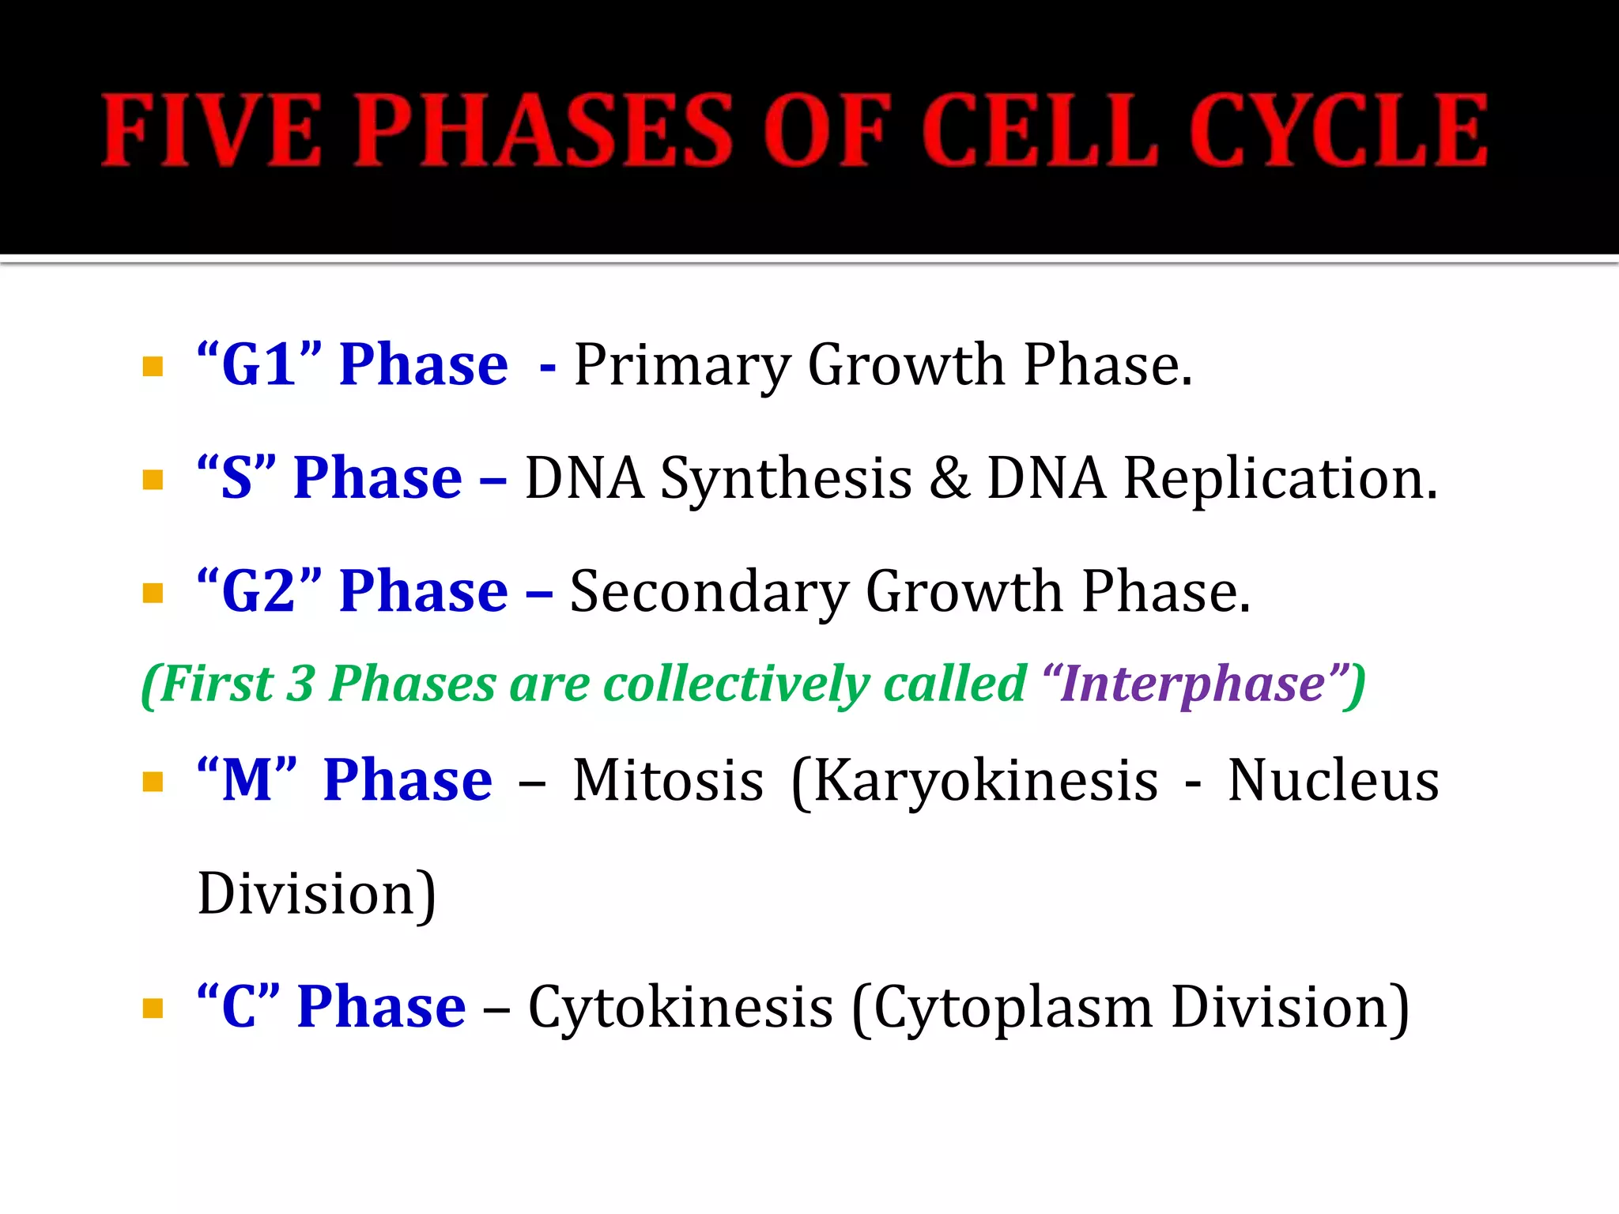

Slide 103
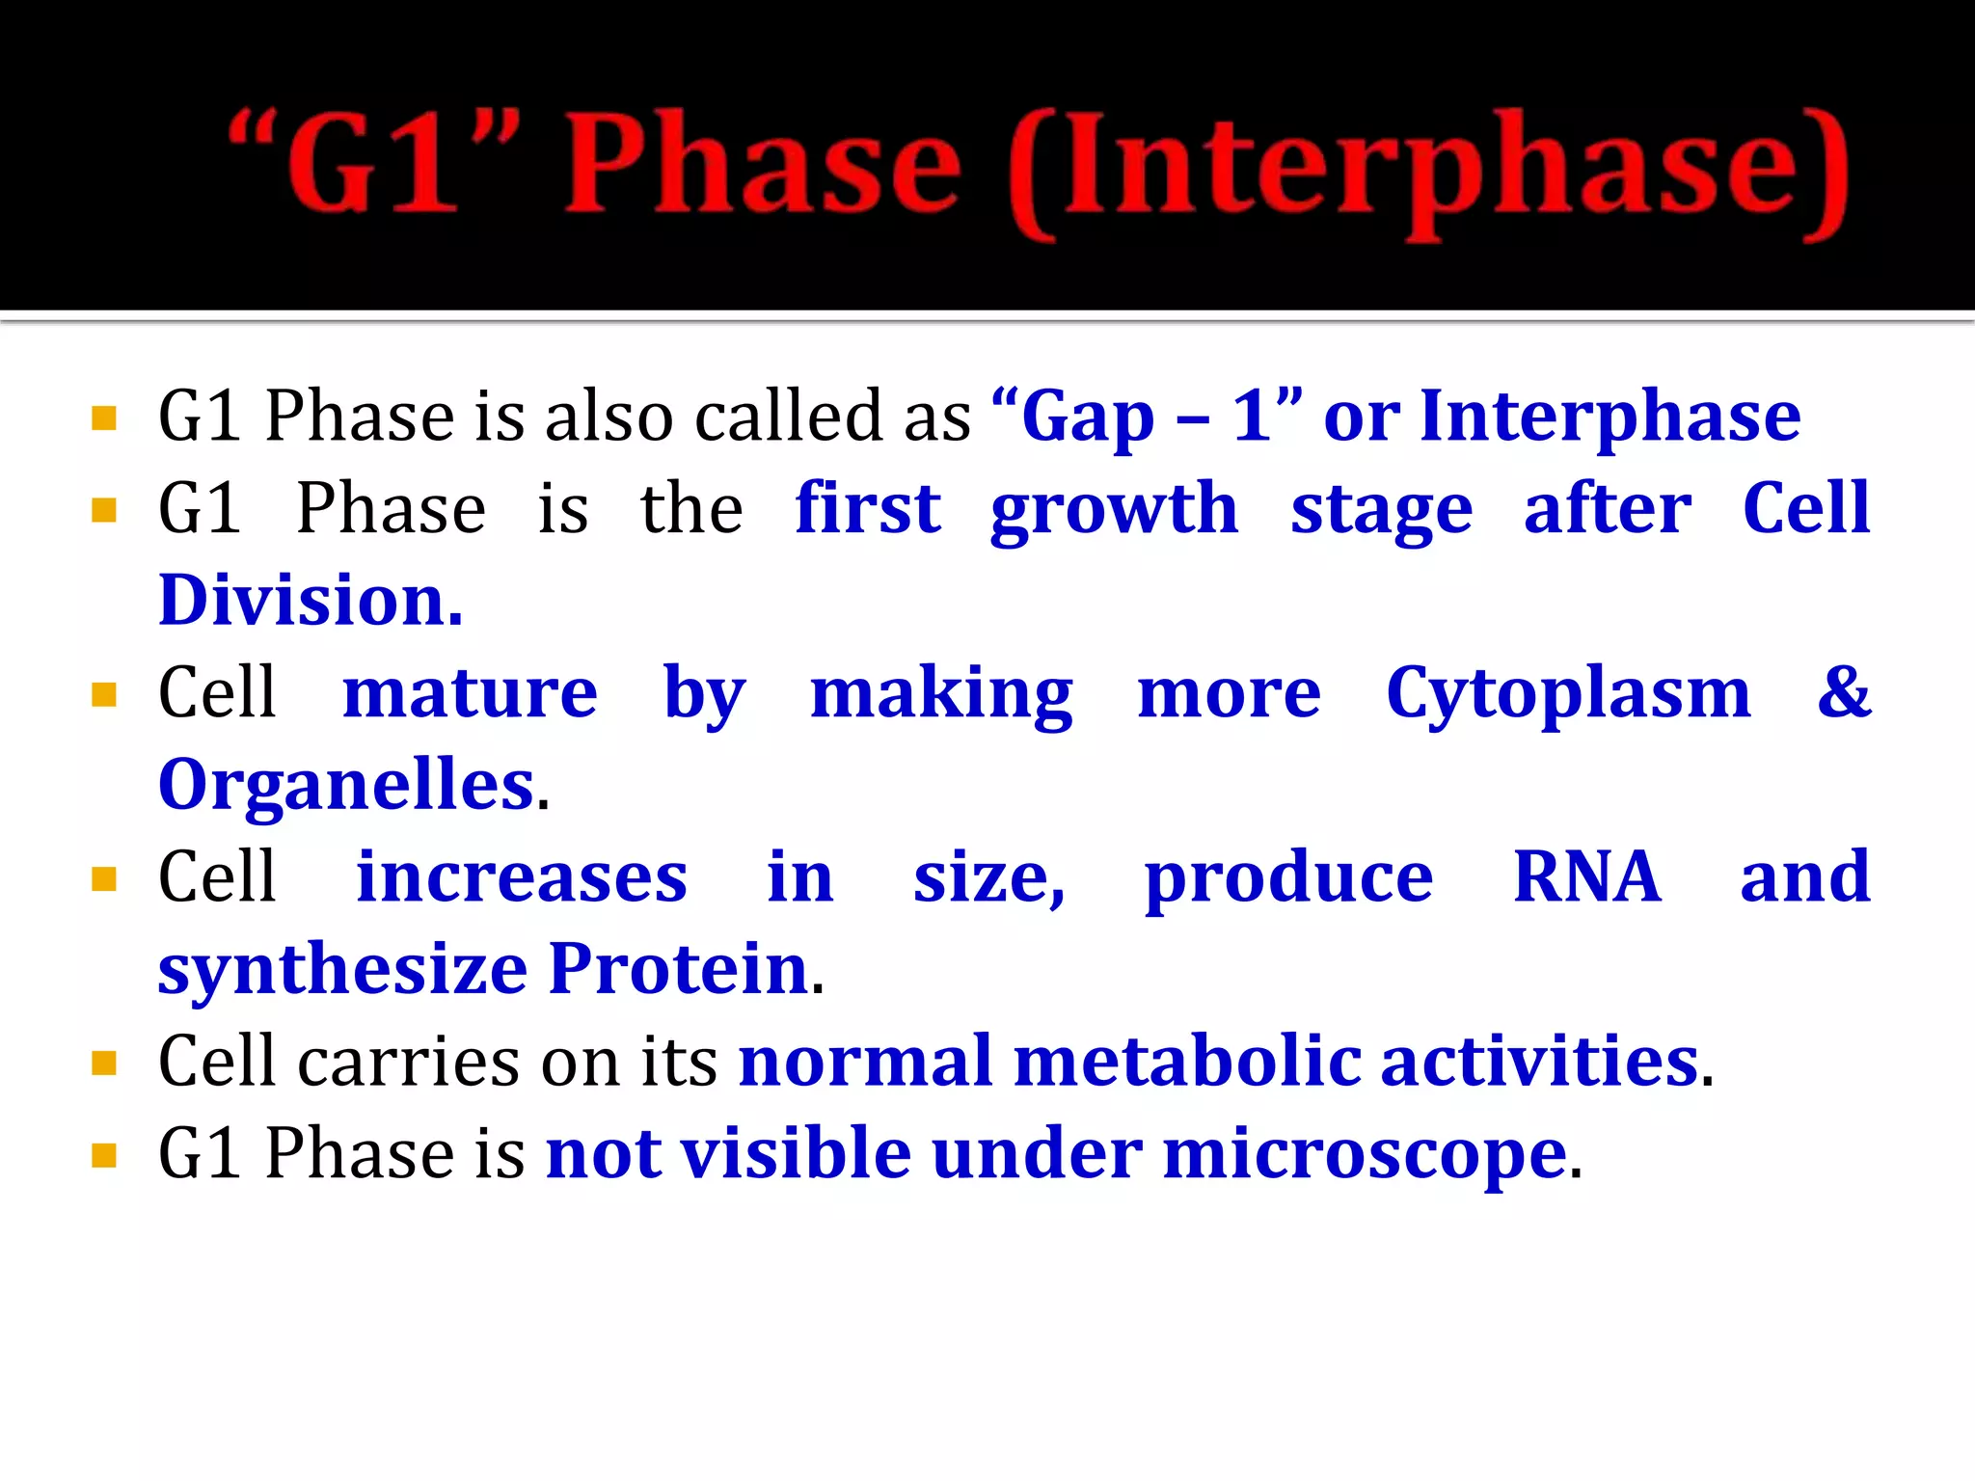

Slide 104
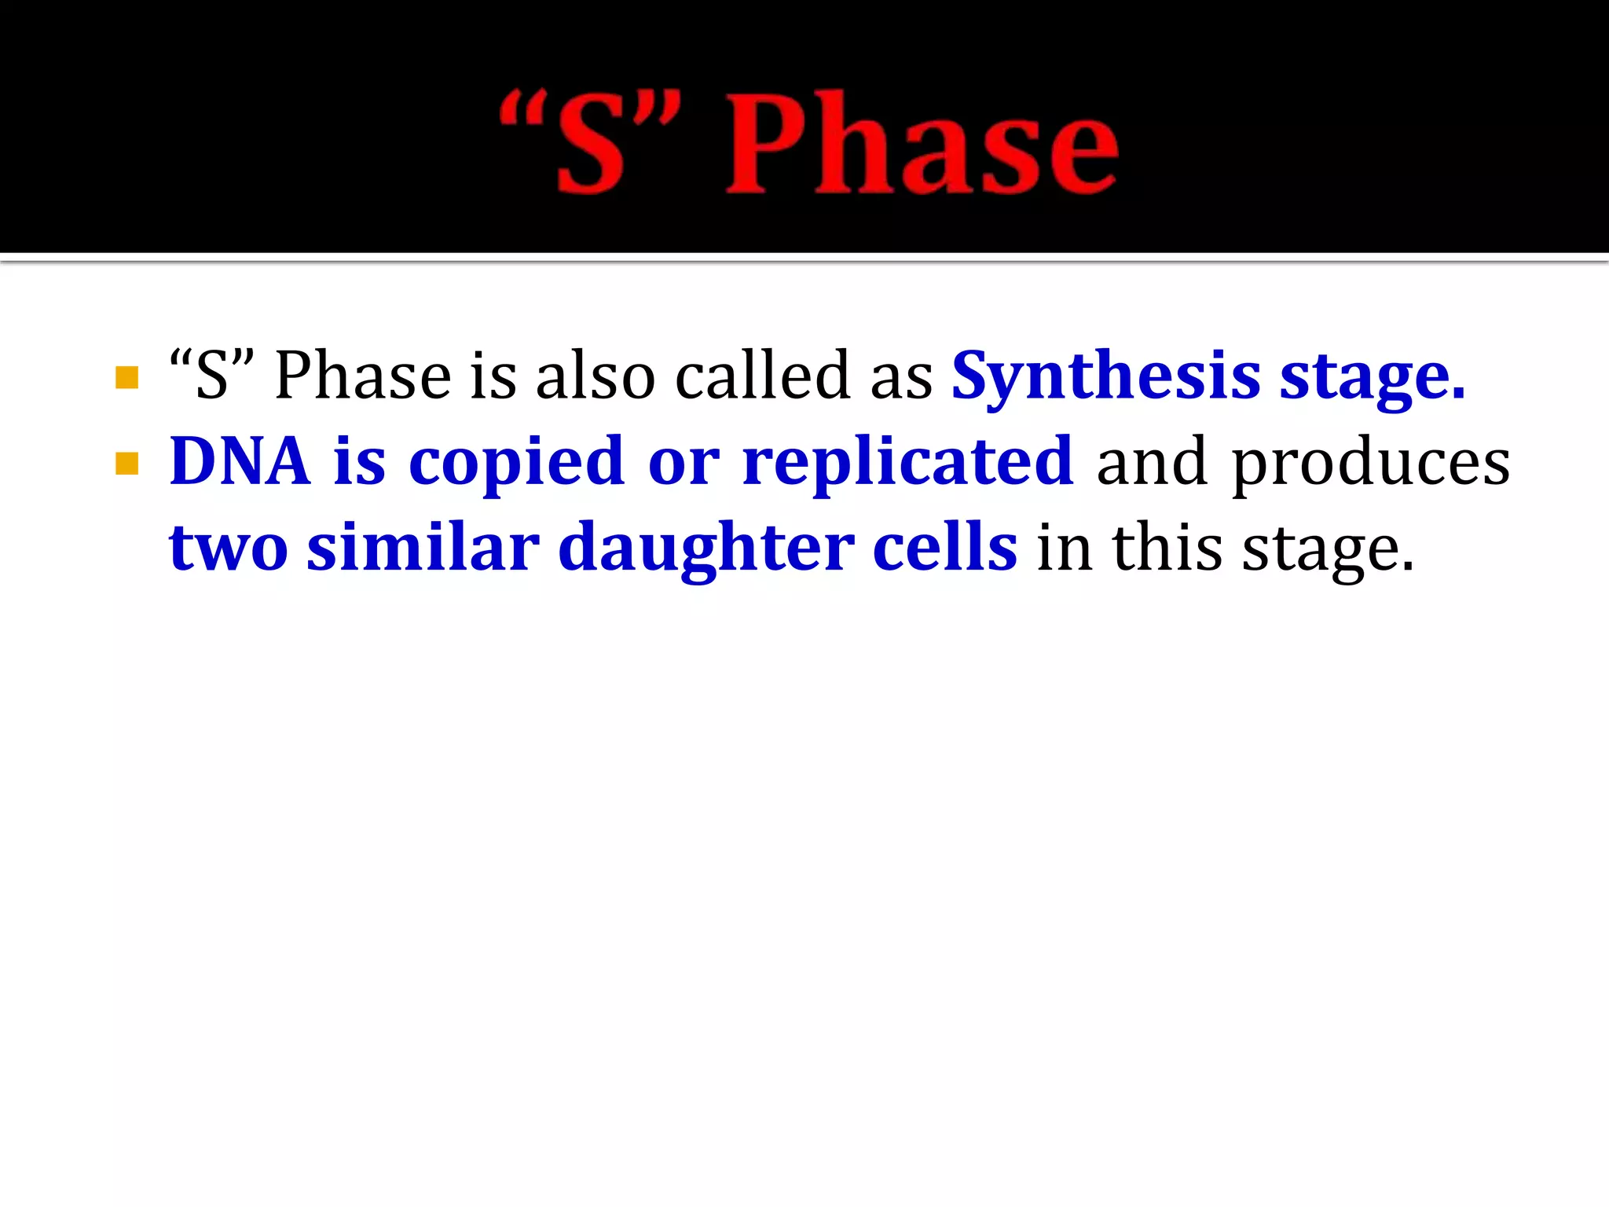

Slide 105
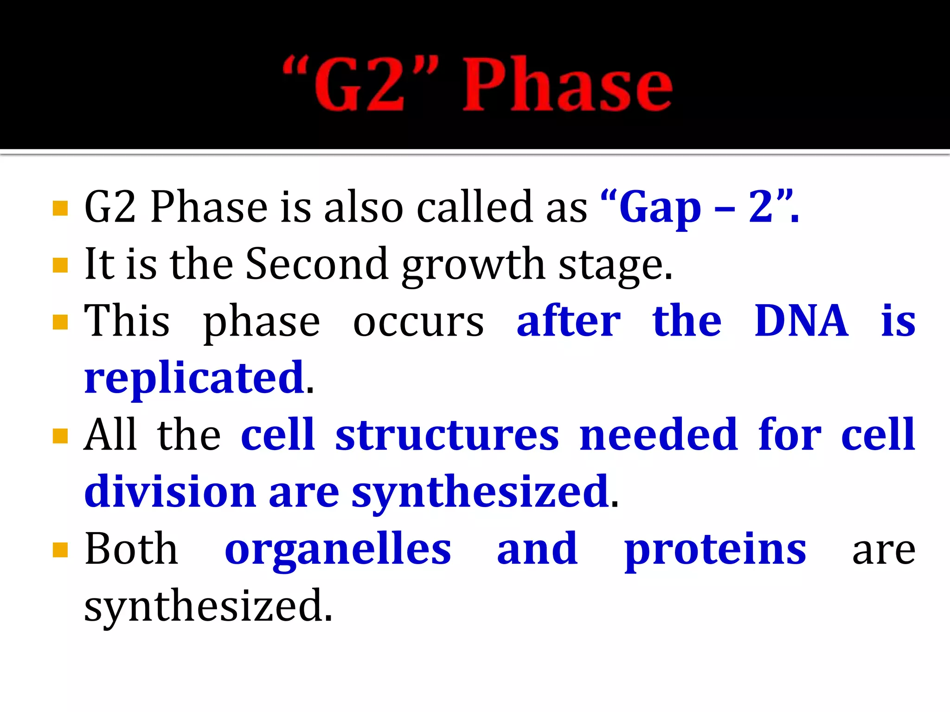

Slide 106


Slide 107


Slide 108


Slide 109


