Slide 1
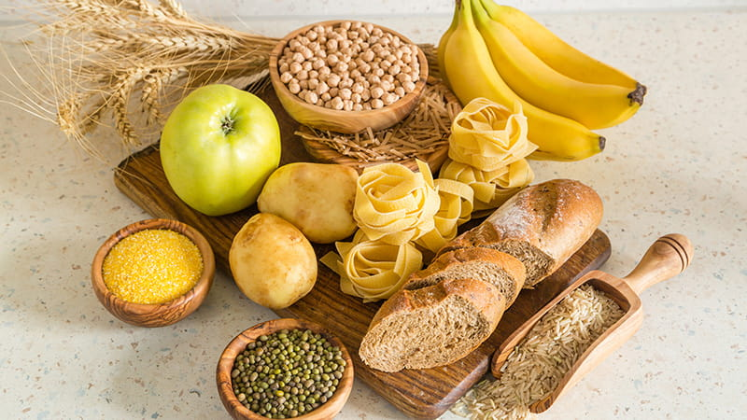

Slide 2

CARBOHYDRATES
Yengkhom Sonia Devi
Nursing Tutor

Slide 3
LEARNING OBJECTIVES
Introduction
Definition
Composition of carbohydrates
Classification of carbohydrates
Digestion, absorption, metabolism & excretion
RDA of carbohydrates
Sources of carbohydrates
Function of carbohydrates
Glycemic Index
Clinical Aspects &

Slide 4
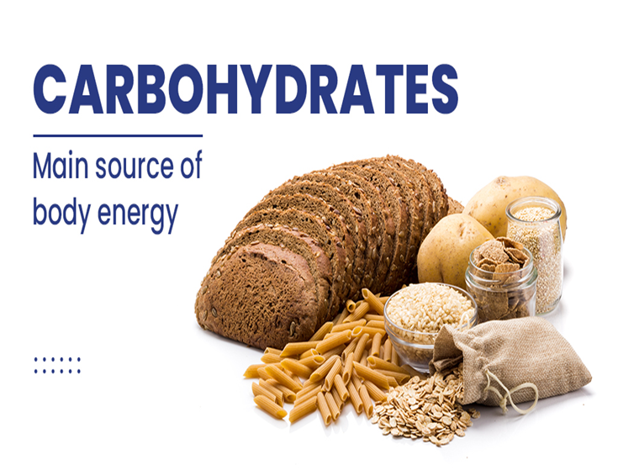
INTRODUCTION
Carbohydrates (also called carbs or saccharides) are a type of macronutrient.
They are the main source of energy for the body and forms the bulk of our diet.
Carbohydrates are found in a wide variety of natural and processed foods.
Carbohydrates are formed by process called “Photosynthesis”. In this process, green plants in the presence of sunlight combine with carbondioxide and water to form carbohydrates.

Slide 5
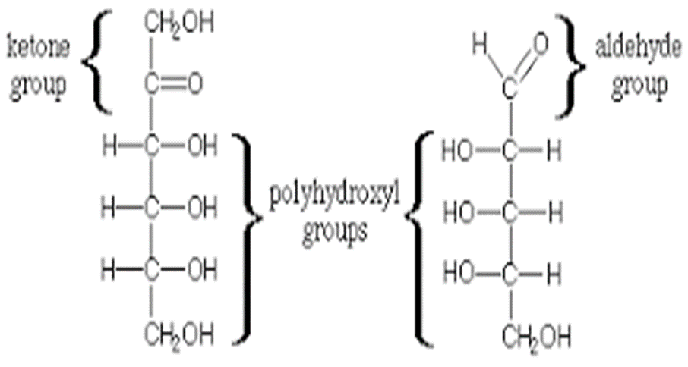
Definition
Carbohydrates are polyhydroxy aldehydes or polyhydroxy ketones or substances which give these on hydrolysis. Carbohydrates are organic compounds made up of carbon, hydrogen and oxygen.
General formula of carbohydrates: C_{n}H_{n}​O_{n}

Slide 6
COMPOSITION OF CARBOHYDRATES
Carbohydrates
Sugar
Starch
Cellulose

Slide 7
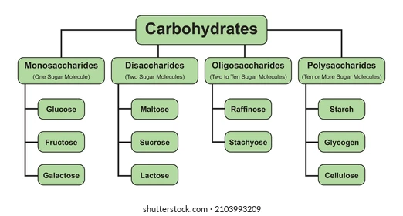
CLASSIFICATION OF CARBOHYDRATES

Slide 8
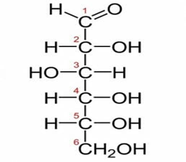
Monosaccharides
Monosaccharides are sugars that cannot be broken down by hydrolysis into other simpler sugars. Examples include glucose, fructose and galactose. Its chemical formula is C₆H₁₂O₆

Slide 9
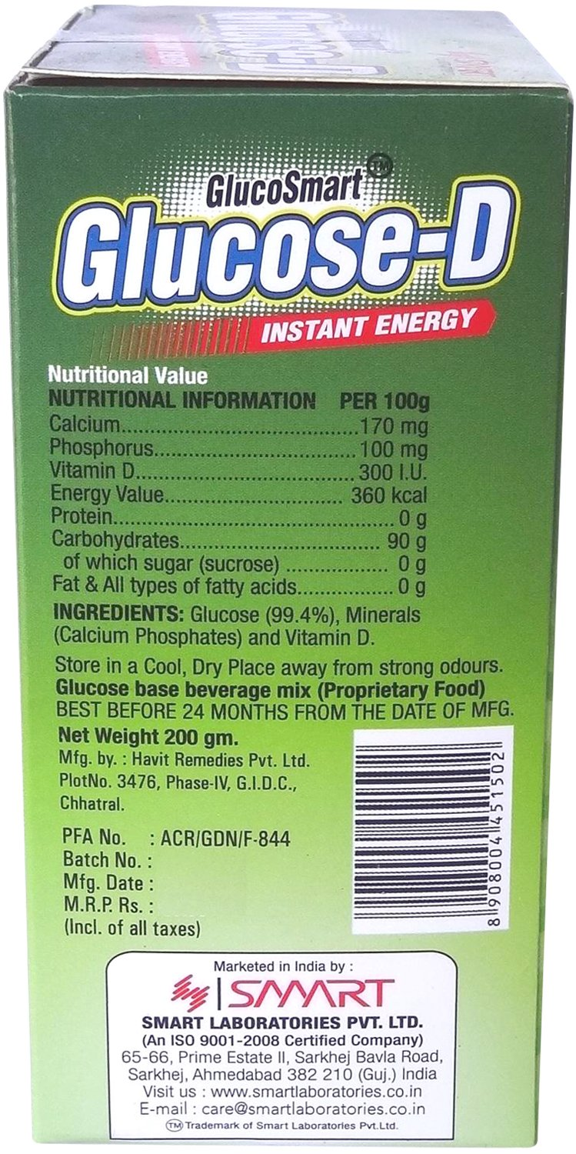
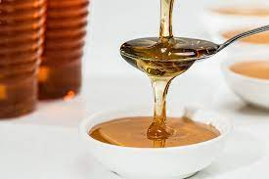
Monosaccharides contd…….
Glucose: - It is the most important of all the monosaccharide as it is the primary carbohydrate used by the body. Glucose is the sugar which is absorbed into the bloodstream after carbohydrates are digested in the body.
Fructose: - It is the sweetest of all sugar and are found in fruits and honey. In human body, it is converted to glucose and oxidised as a source of energy.

Slide 10
Monosaccharides contd…….
Galactose: - Galactose is produced by mammals in the form of milk (Lactose). Lactose is converted to glucose in human body and oxidized as a source of energy.

Slide 11
Disaccharides
A disaccharide (also called a double sugar or biose) is the sugar formed when two monosaccharides are joined by glycosidic linkage. Disaccharides are simple sugars soluble in water. The most common types of disaccharides—sucrose, lactose, and maltose—have 12 carbon atoms, with the general formula C₁₂H₂₂O_{11.}

Slide 12
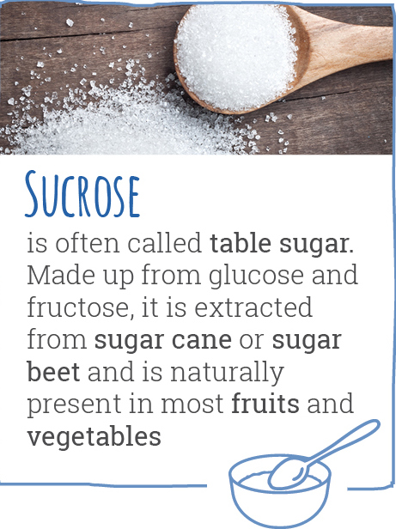
Disaccharides contd……
Sucrose: - It is the name given to sugar which we are use daily. It is obtained from sugarcane and sugar beet. It is made up of one unit of glucose and one unit of fructose.
Sucrose + H2O Glucose + Fructose

Slide 13
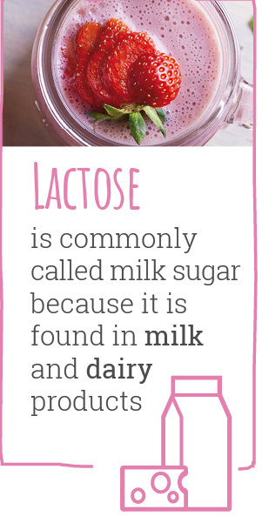
Disaccharides contd……
Lactose: - Lactose is a sugar that is naturally found in milk and milk products. It is made up of one unit of glucose and one unit of galactose. It is the least sweet of all sugars and is easily fermented to lactic acid and cheese.
Lactose + H2O Glucose + Fructose

Slide 14
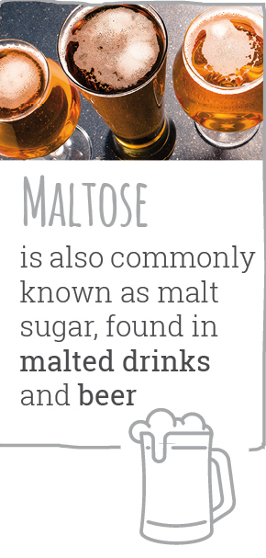
Disaccharides contd……
Maltose:- It is obtained from sprouted cereal grains and in the commercial preparation of malt from starch. In the body, maltose is formed during digestion of starch. It is made up of two units of glucose.
Lactose + H2O Glucose + Glucose

Slide 15
Oligosaccharides
An oligosaccharide from the Greek olígos, "a few", and sácchar, "sugar") is a saccharide polymer containing a small number (typically two to ten) of monosaccharides (simple sugars).
E.g. Raffinose and stachyose.

Slide 16
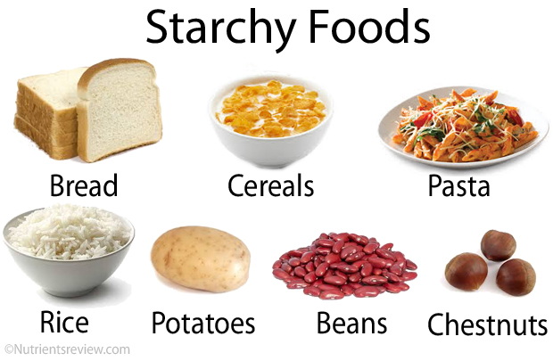
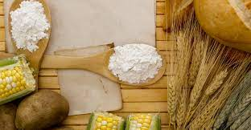
Polysaccharides
Polysaccharides are long chain polymeric carbohydrates composed of 100 to 200 glucose units linked to each other in a chain or branched form.
Starches: - They form half of the carbohydrates which consumed. They are found abundantly in cereals, pulses, tapioca sago roots and tubers.

Slide 17
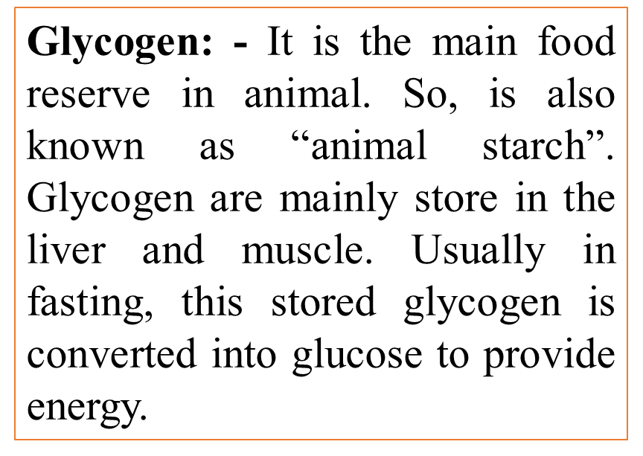
Polysaccharides contd….

Slide 18
Polysaccharides contd……
Dextrin: - It is formed in the breakdown of starch either by enzymes during digestion or by action of dry heat on starch.
Dextrin is sweeter and more soluble than starch.
Dietary fibres: - It refers to the total amount of naturally occurring material in plants. It is the carbohydrate which is not digested in the body. They are made up of many glucoses. Cellulose, hemicellulose, pectin, gums and mucilage are the dietary fibres. Fibres does not provide energy but perform many important functions in the body.

Slide 19
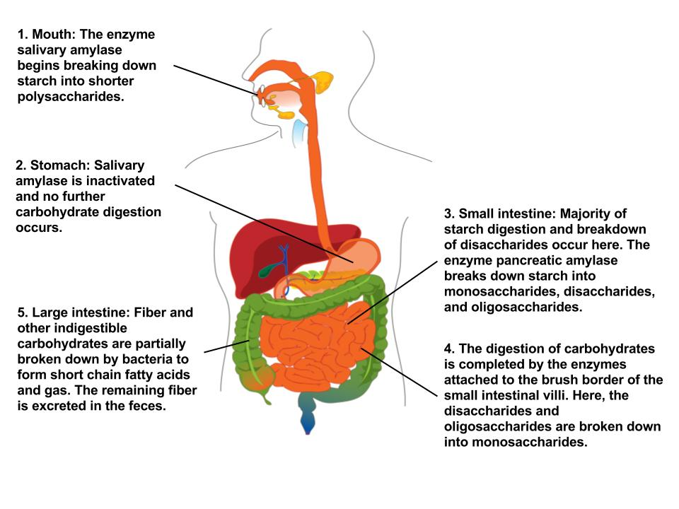
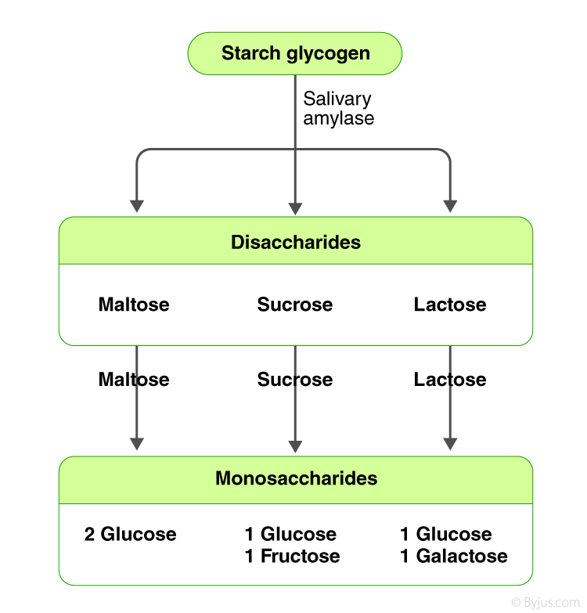
DIGESTION OF CARBOHYDRATES

Slide 20
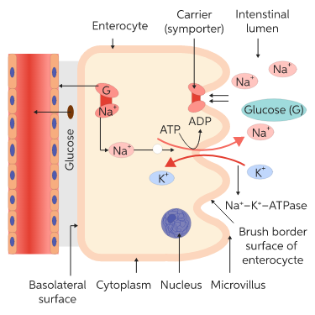
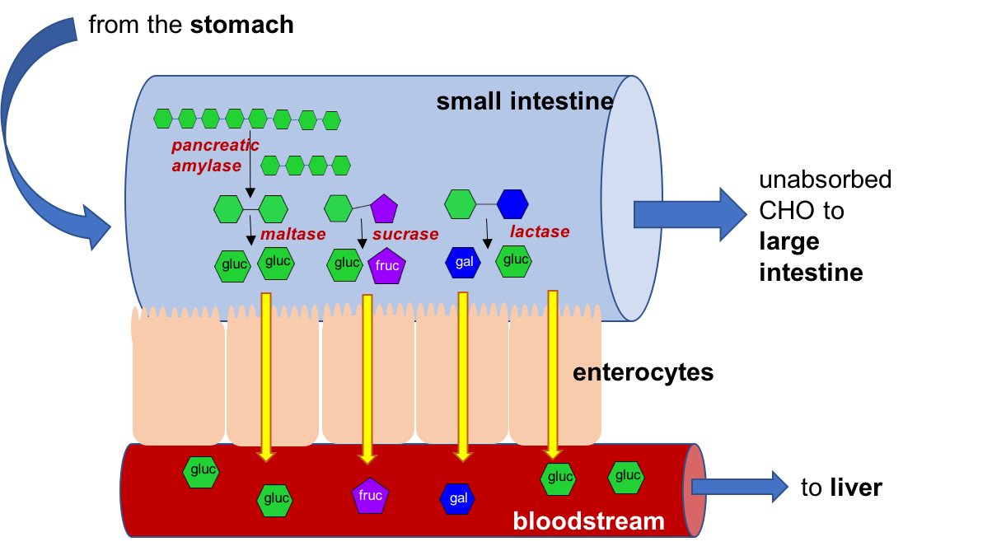
ABSORPTION

Slide 21


Slide 22
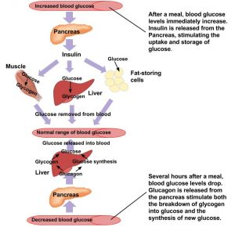
METABOLISM
The oxidation of glucose in the two stages called glycolysis and tricarboxylic acid cycle.
Glycogen glucose pyruvic acid lactic acid
Oxidation of pyruvic acid
Pyruvic acid Carbondioxide + water

Slide 23
EXCRETION
Dietary fibre is one of the carbohydrates which humans cannot digest, thus dietary fibre is the most commonly excreted type of carbohydrate. It is excreted in the form of faeces.

Slide 24
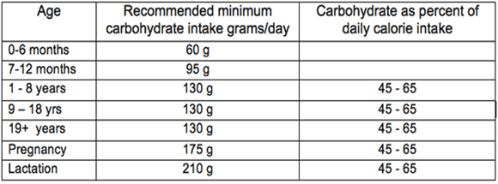
RECOMMENDED DAILY ALLOWANCES (RDA)
A minimum intake of 100 – 130g of carbohydrates/day is recommended for an adult and children. Normally 60 to 70% of our calories should come from carbohydrate.

Slide 25
SOURCES OF CARBOHYDRATES
Name of food | Carbohydrates in g /100 g
Sugarcane | 99
jaggery | 94-95
Sago | 85-90
Arrow root flour | 85-88
Honey | 80
Dried fruits | 67-77
Cereals and millets (rice, wheat, bajra, oats ragi etc.) | 65-80
Pulses and legunes | 55 – 60
Roots and tubers | 22- 38
Nuts and oil seeds | 10-25

Slide 26
FUNCTIONS
Provide energy to the body so it can carry out day to day work
It helps in maintaining body temperature.
It is essential for oxidation of fats.
It acts as protein sparing. Carbohydrates prevent from protein breakdown for energy and are used for building and repair.
It is essential for proper functioning of the central nervous system.
Helps in absorption of the minerals – calcium and phosphorus.
Lactose promotes the growth of normal bacteria in the intestine thus helps in synthesis of B-complex vitamins.
Dietary fibres help in preventing constipation.

Slide 27
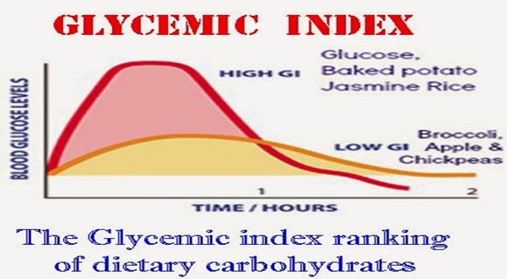
GLYCEMIC INDEX
Glycemic index is defined as the area under the blood glucose curve after ingestion of food compared with the area the blood glucose curve after taking the same amount of carbohydrate as glucose.

Slide 28
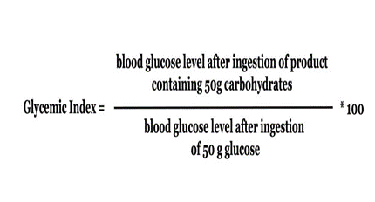
Calculation of glycemic Index

Slide 29
Glycemic index of some food items
Food item | GI
Glucose | 100
Carrots | 90-95
Honey | 80-90
Bread, rice | 70-80
Banana, potato | 60-70
Sweet potato | 50-60
Oranges, apples | 40-45
Ice cream, milk | 35-40
Fructose | 20-25
soybeans | 15-20

Slide 30
CLINICAL ASPECTS
Normal Fasting Blood Glucose level is 70 – 100 mg/dl.
Normal Random blood sugar Level is 100 – 140 mg/dl

Slide 31
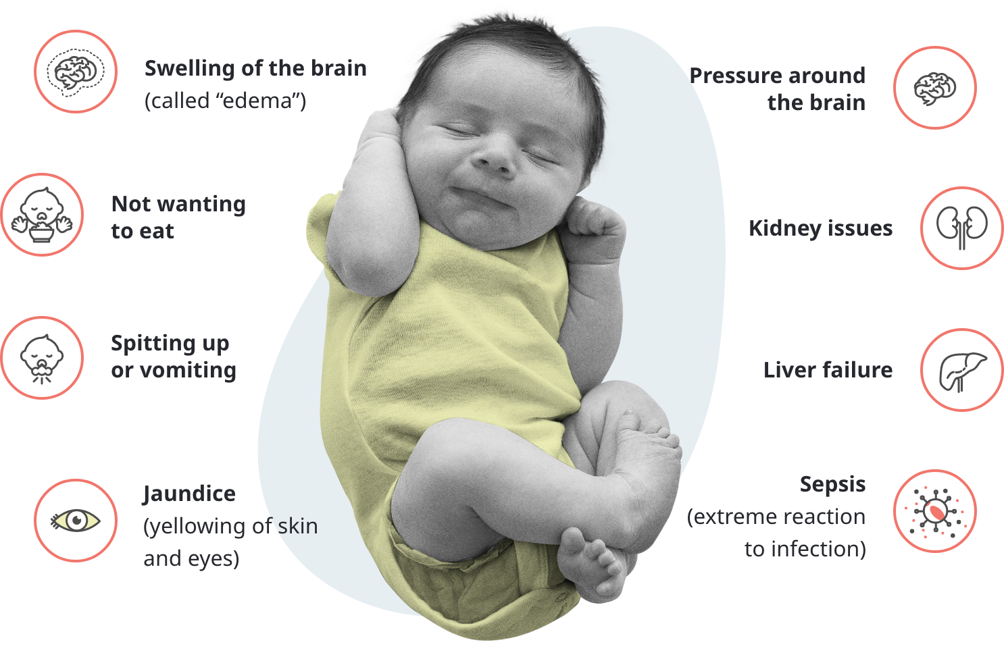
CLINICAL ASPECTS CONTD…..
1. Galactosemia: It is an inherited metabolic disorder in which there is inability to metabolise the galactose. This result in the accumulation of galactose in the blood, RBCs and tissues (Liver).

Slide 32
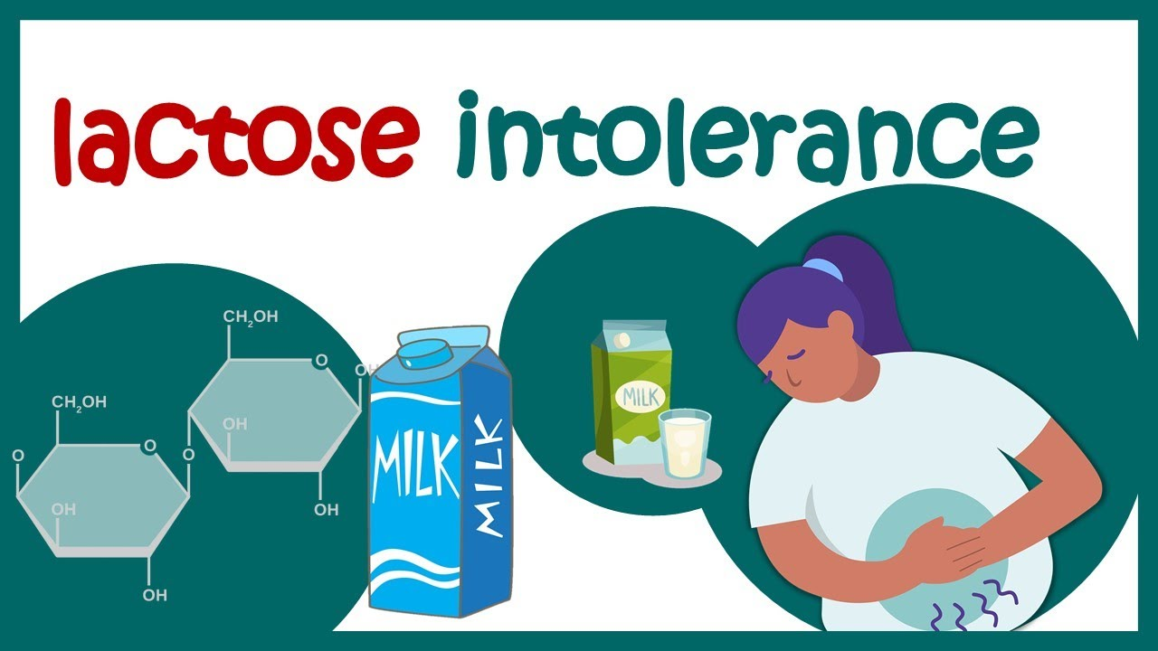
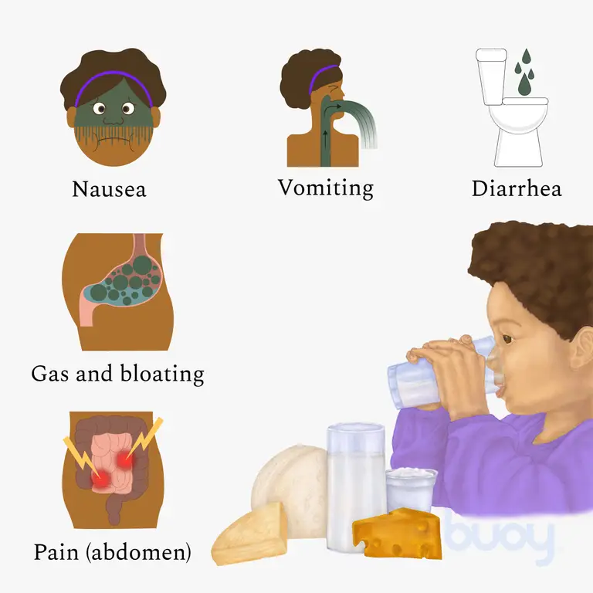
CLINICAL ASPECTS CONTD…..
2.
Signs and symptoms
The inability to digest sugar (lactose) in dairy products (milk). It is usually caused by the deficiency of an enzyme lactase in the body.

Slide 33
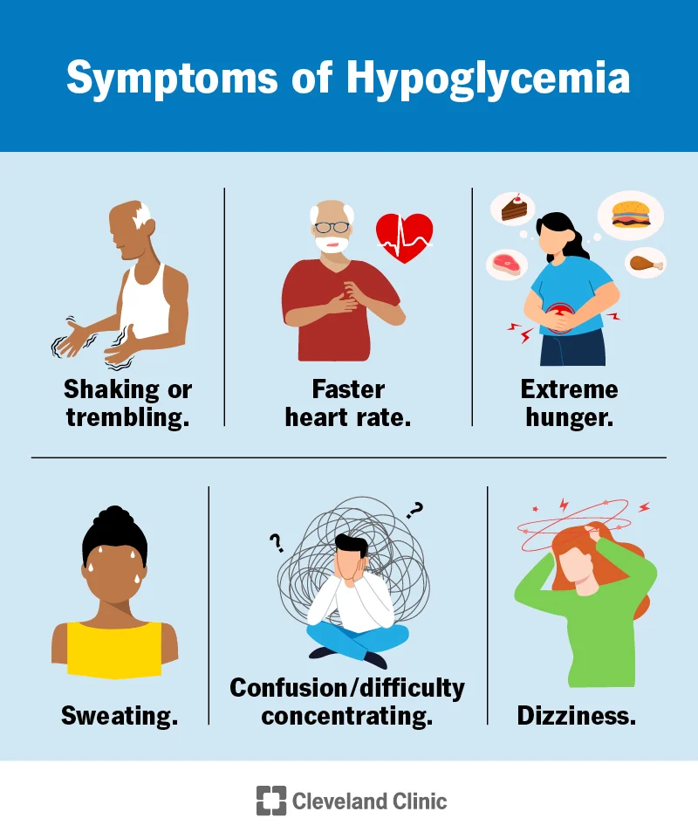
CLINCAL ASPECTS CONTD…..
3. Hypoglycemia: Decrease level of glucose in the blood. These may caused by prolonged fasting or starvation, extreme degree of malnutrition and severe exercise.

Slide 34

CLINCAL ASPECTS CONTD…..
4. Hyperglycemia: Raised in blood sugar level may caused due to excessive intake of carbohydrate or lack of insulin secretion.

Slide 35
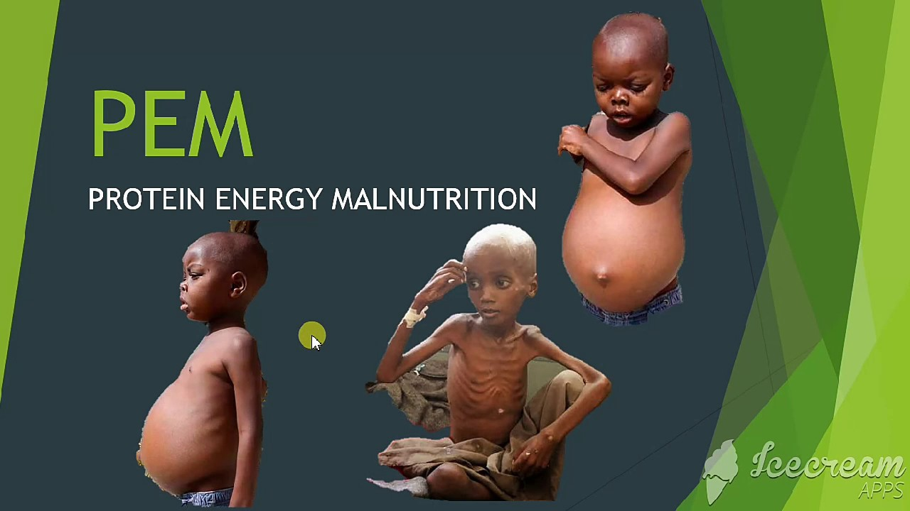
CLINCAL ASPECTS CONTD…..

Slide 36
SUMMARY
Carbohydrates a large group of biological compounds containing carbon, hydrogen, and oxygen, include sugars, starch, glycogen, and cellulose. Carbohydrates are classified into monosaccharides, disaccharides. Oligosaccharides and disaccharides. Cereals, pulses, milks, sugarcane, honey, roots and tubers are rich source of carbohydrates. Average adult RDA of carbohydrates is 130g/day. Carbohydrates helps providing energy, maintain body temperature, absorption of vitamins and minerals, fats metabolism and proper functioning of central nervous system.

Slide 37
Conclusion
In this chapter it concludes, Carbohydrates are the primary macronutrients that humans consume in large quantities in their daily diet to provide the energy needed in order to support various metabolic processes in the human body. Carbohydrates are found in a wide variety of foods, mostly originating from plant tissues. For instance, dietary fiber is a carbohydrate that protects heart and gut health, whereas added sugars can lead to an increased risk of type 2 diabetes, heart disease, and overweight.

Slide 38
Reference:
Darshan Sohi. PV A text book of applied nutrition and dietetics. S. Vikas and company Medical Publisher, Punjab; 2022.
Deepti Chauhan. Applied nutrition & dietetics: For B.Sc. and post basic nursing students; 1st edition. Lotus Publisher, Punjab; 2022.
Darshan Sohi. A comprehensive textbook of nutrition and therapeutic diets for BSc nursing students; 2nd edition Jaypee Brothers Medical Publisher, New Delhi; 2018.
Monika Sharma. Textbook of nutrition: For B.Sc. Nursing students: 2nd edition, CBS publishers & distributors Pvt. Ltd. 2020.
Anjana Agarwal, Shobha A U. Textbook of human nutrition; 1st edition. Jaypee brothers medical publisher, New Delhi; 2014

