Slide 1
MANAGEMENT OF
PATIENT WITH BURNS
1

Slide 2

OUTLINES
• Introduction
• Incidence
• Causes of burn
• Risk factors for burn
• Classification of Burn
• Effects of burn
• Nursing Management of Burn in emergent & acute phase
• Complication of Burn
• Role of nurses in rehabilitation phase
Nursing Management Of Patient With Burn

Slide 3

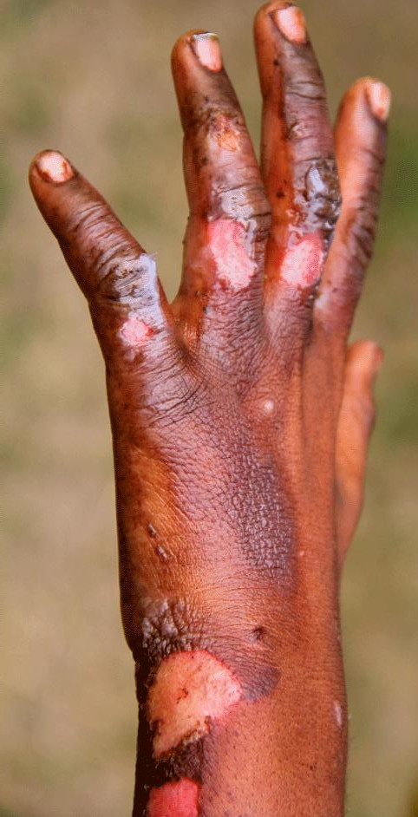
INTRODUCTION
• Burn is a type of skin injury.
• It’s depth is related to the temperature and the duration of exposure .
• Results in catastrophic effect on people in terms of human life, suffering, disability and financial loss.
Nursing Management Of Patient With Burn

Slide 4

INCIDENCE
• According to WHO, burns results in the loss of approximately 18 million daily and more than 2,50,000 deaths each year, more than 90% of which are in low and middle income countries.
Nursing Management Of Patient With Burn

Slide 5
INCIDENCE
A population based national assessment of burns in Nepal done by Gupta S et al in 2015 found that;
• The largest proportion of burns was in the age group 25-54 (2.22%),The upper extremity was the most common anatomic location affected with 36.4% of burns.
• Causes of burns included 60.4% due to hot liquid and/or hot objects, and 39.6% due to an open fire or explosion.
Nursing Management Of Patient With Burn

Slide 6

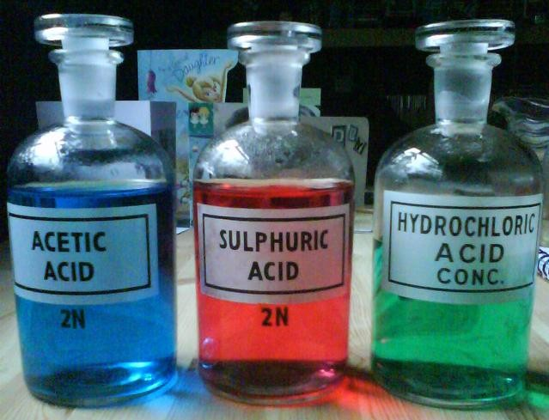
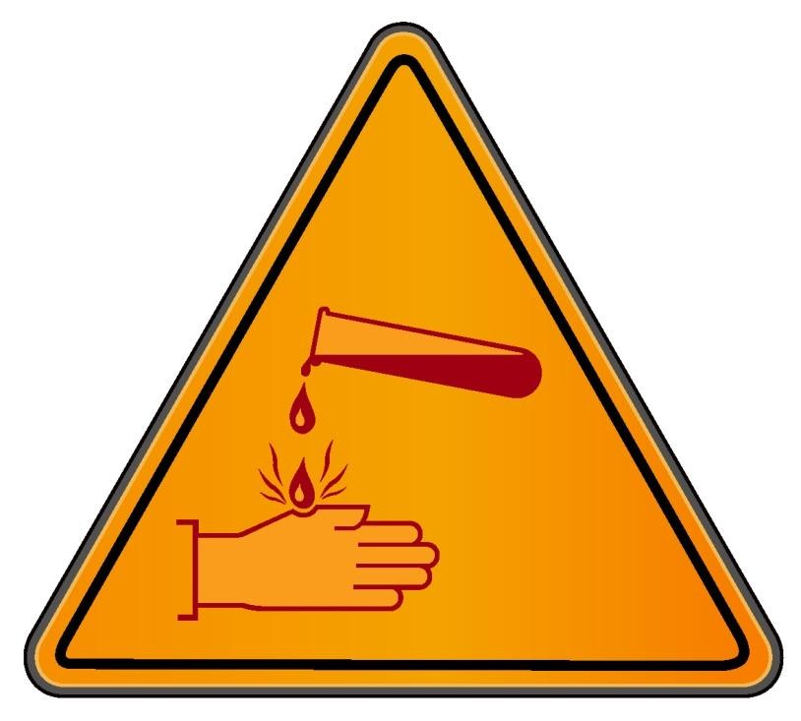
CAUSES
1. Chemical Burn: This type burn is caused when living tissue is exposed to corrosive substances such as acid and base.
Nursing Management Of Patient With Burn

Slide 7

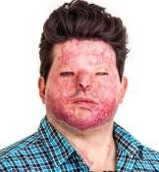
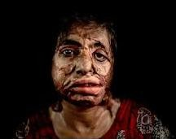
Chemical Burn
These burns tend to be deep, as the corrosive agent continues to cause coagulative necrosis until completely removed.
Nursing Management Of Patient With Burn

Slide 8

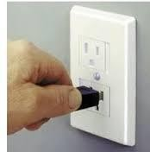
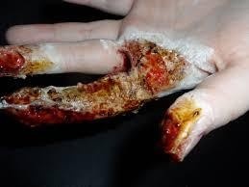
CAUSES
2. Electrical Burn:
• It occurs with faulty electrical wiring.
• It might not be visible but can cause critical internal injuries
Nursing Management Of Patient With Burn

Slide 9
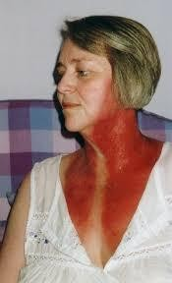
CAUSES
3. Radiation Burn:
• It occurs due to exposure to radiation.
• Most common type of radiation burn is sun burn.
• High exposure to X- rays during medical imaging or radiotherapy can also result in radiation burn
Nursing Management Of Patient With Burn

Slide 10

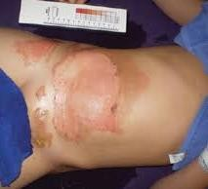
CAUSES
4.Scald Burn:
• It is form of burn from heated fluids such as hot oil, boiling water or steam
Nursing Management Of Patient With Burn

Slide 11
5. Inhalation Injury- It occurs as a result of exposure to Asphyxiants ( e.g carbon monoxide) and smoke. commonly occurs with flame injuries, particularly if the victim is trapped in an enclosed, smoke- filled space.
Nursing Management Of Patient With Burn

Slide 12
6. Cold injuries- Acute cold injuries from industrial accidents and frostbite. Exposure to liquid nitrogen and other such liquids will cause epidermal and dermal destruction.
Nursing Management Of Patient With Burn

Slide 13

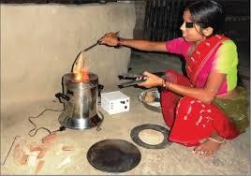
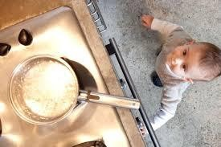
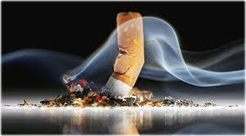
RISK FACTORS
Cooking stoves
Hot liquids
Nursing Management Of Patient With Burn

Slide 14
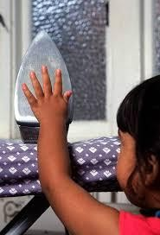
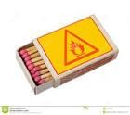
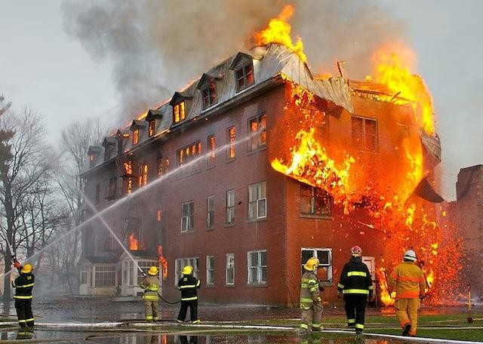
Match
Sticks
Hot objects
N^{A}urs^{c}in^{c}g M^{id}an^{e}ag^{n}em^{t}eªnt^{l}O^{h}f Pªat^{z}ienªt ^{r}W^{d}ith^{s}Burn
14

Slide 15
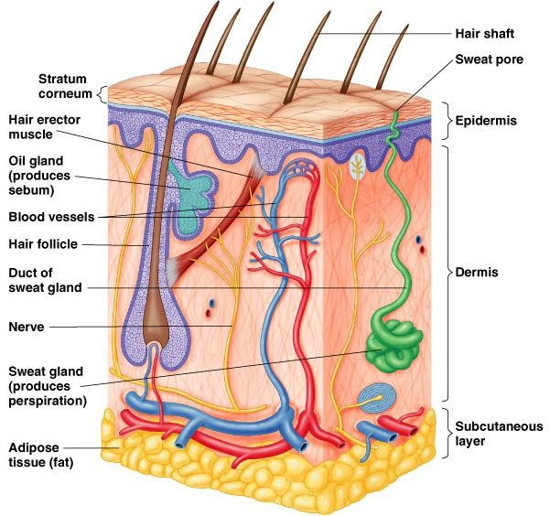

Normal Anatomy of Skin
gement Of Patient With Burn

Slide 16
CLASSIFICATION OF BURN
On the Basis of Depth
On the basis of severity
• Superficial (1st) Degree
• Superficial Partial Thickness (2nd) Degree
• Deep Partial Thickness (3rd) Degree
• Full Thickness (4th) Degree
• Minor Burn
• Moderate Burn
• Major Burn
Nursing Management Of Patient With Burn

Slide 17



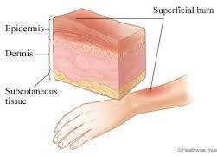
Superficial (1st) degree burn
• Affects only epidermis or outer layer of skin
• Burn site is red, painful, dry, with no blisters
Nursing Management Of Patient With Burn

Slide 18





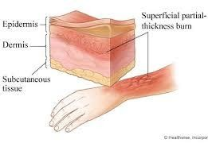
Superficial partial thickness(2nd) degree burn
• Involves epidermis and part of dermis layer.
• Burn site appears red, blister & may be swollen & painful
Nursing Management Of Patient With Burn

Slide 19




Deep partial thickness(3rd) degree burn
• All layer of skin is destroyed
• Extend to subcutaneous tissue
• Nerve ending, sweat glands and hair follicles are destroyed
• No pain
Nursing Management Of Patient With Burn

Slide 20





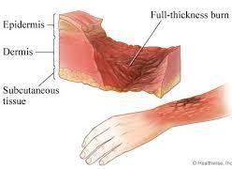
Full thickness(4th) degree burn
• All skin layers including underlying muscle, tendon, & ligament.
• Burn skin is waxy white to a charred black & tend to be painless.
• Slow rate of healing.
• Usually require skin graft and is fatal
Nursing Management Of Patient With Burn

Slide 21

On the Basis of severity
Given By American Burn Association
Minor Burn:
• <10% TBSA burn in adults
• <5% TBSA burn in younger or older patients.
• <2% full-thickness burn.
Nursing Management Of Patient With Burn

Slide 22
On the Basis of severity
Moderate Burn:
▪ 2nd degree burn of 15-25% TBSA in adults or <10- 20% TBSA in children
▪ 3rd degree burn of <10% TBSA without involvement of special areas like eyes, ears, face, perineum
▪ Excludes all electrical, inhalation injury and also extremes of age, poor risk patient .
Nursing Management Of Patient With Burn

Slide 23

On the Basis of severity
Major burn:
• 2nd degree burn >25% TBSA in adults or >20% TBSA in children
• All 3rd degree burn >10% TBSA
• All burn involving special areas like eyes, ears, face, hands, perineum
• All electrical, inhalation injury, concurrent trauma, and all poor risk patient
Nursing Management Of Patient With Burn

Slide 24

Classification by Surface Area
Total body surface area (TBSA): can be calculated in percentage by following methods:
1. Rule of nine
2. Palm method
Nursing Management Of Patient With Burn

Slide 25
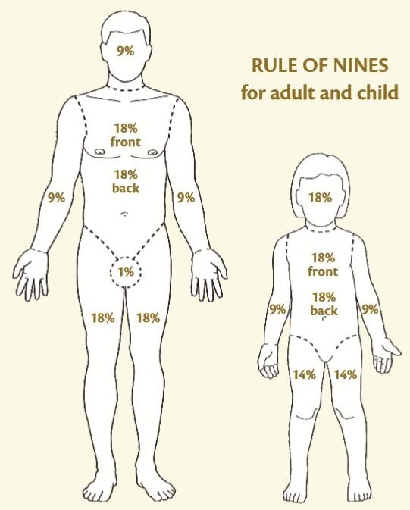
Nursing Management Of Patient With Burn

Slide 26
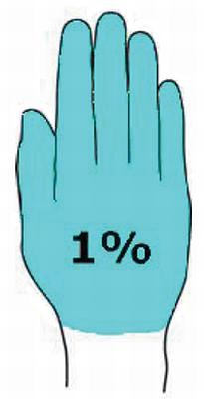
2. Palm method
• In patient with scattered burns, the size of patient palm is approximately 1% of the TSBA.
• It serves as a general measurement for all the age groups.
Nursing Management Of Patient With Burn

Slide 27

EFFECTS OF BURN INJURY
-Thermoregulatory Alteration
-Metabolic Response
-Cardiovascular Response
-Renal Response
-Pulmonary Response
-Gastro Intestinal Alteration
-Immunological Reaction
Nursing Management Of Patient With Burn

Slide 28
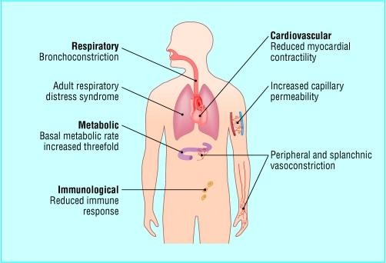
Nursing Management Of Patient With Burn

Slide 29
PATHOPHYSIOLOGY:
Disruption of the skin and alteration to tissues beneath
Skin,nerve endings, sweat glands and hair follicles lose their function
Normal body temperature regulation disturbed and risk for infection, evaporation
Nerve endings become exposed leading to pain or discomfort, insensitive
Hypretrophic scarring, pruritis and increased insensitivity
Results in skin and tissue contractures especially when scar crosses over a joint

Slide 30
Pulmonary system
Hyperventilation due to increase in respiratory rate and tidal volume hypermetabolism
Inhalation injury leads to formation of carboxyhemoglobin Leads to tissue hypoxia
Direct injury leads to edema, erythema and ulceration, decreased broncho ciliary action
Decreased broncho ciliary action leads to tracheobronchitis and ARDS

Slide 31
Persons trapped in enclosed space
Burns of the head and neck
Inhalation of hot gases causes thermal burn to the upper airway
Release of histamine, serotonin and thromboxane leads to bronchospasm

Slide 32
Causes stridor, hoarseness, cough and respiratory
Hypoxia, Acute Respiratory Distress Syndrome and Respiratory failure

Slide 33
Fluid shift
Vasoactive substances ( Catecholamines, Histamine, Serotonin, Leukotrienes, prostaglandin are released
Changes capillary integrity allowing plasma to seep into the surrounding tissues
Increases the capillary permeability which permits sodium ions to enter the cell and potassium ions to exit
Leads to increase in intercellular and interstitial fluid that depletes intravascular fluid volume
Hemodynamics is altered

Slide 34
Shunts blood to brain and may lead to damage of other body organs
Leads to oliguria
Hypovolemia may lead to ARF
Lack of blood supply to intestine causes GI dysfunction
Small, superficial lining erosion in stomach and duodenum occurs
If left untreated leads to Curlings ulcer and GI bleeding

Slide 35
Paralytic ileus ( absence of peristalsis)
Gastric distension and nausea lead to vomiting
Mucosal barrier becomes permeable
Permeability allows overgrowth of GI bacteria
Bacteria may translocate to other organs causing infection.

Slide 36
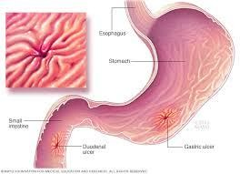
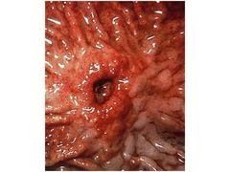
Fig: Curling’s Ulcer

Slide 37
Cardiovascular System
• Hypovolemia as a consequence of fluid loss
• Results in decreased perfusion
• Decreased cardiac output due to fluid loss & decrease in vascular volume & peripheral vasoconstriction
• Decrease in BP & Increased pulse rate
• Activation of sympathetic nervous system due to burn shock
• Decreased Myocardial contractibility
• Anemia due to blood cell damage
• Increased hematocrit value due to plasma loss
• Coagulation disorder, thrombocytopenia, increased clotting & prothrombin time

Slide 38
Integumentary system
Contd.
Decrease in fluid volume due to evaporation of fluid
circulating blood volume decreases and results in shock
Loss of fluid through capillary leakage & evaporation
Hyperkalemia occurs due to massive cell destruction
Hypokalemia occur later with fluid shifts & inadequate potassium replacement
Anemia due loss of RBC

Slide 39
Loss of skin results in inability to regulate body temperature.
May exhibit low body temperatures in the early hours.
Hypermetabolism resets core temperatures Becomes hyperthermic for much of the post burn period even in the absence of infection.

Slide 40
Renal System
Altered renal functions due to fluid loss, hypovolemia and decreased GFR
Hemoglobinuria & Myoglobinuria.
Decreased urine output due to decreased renal blood flow.
Acute tubular necrosis.
Acute renal failure.

Slide 41
Pulmonary system
Hyperventilation due to increase in respiratory rate and tidal volume hypermetabolism
Pulmonary vascular resistance increases and lung compliance may decrease
Inhalation injury leads to formation of carboxyhemoglobin
Leads to tissue hypoxia
Direct injury leads to edema, erythema and ulceration, decreased broncho ciliary action
Decreased broncho ciliary action leads to tracheobronchitis and ARDS

Slide 42
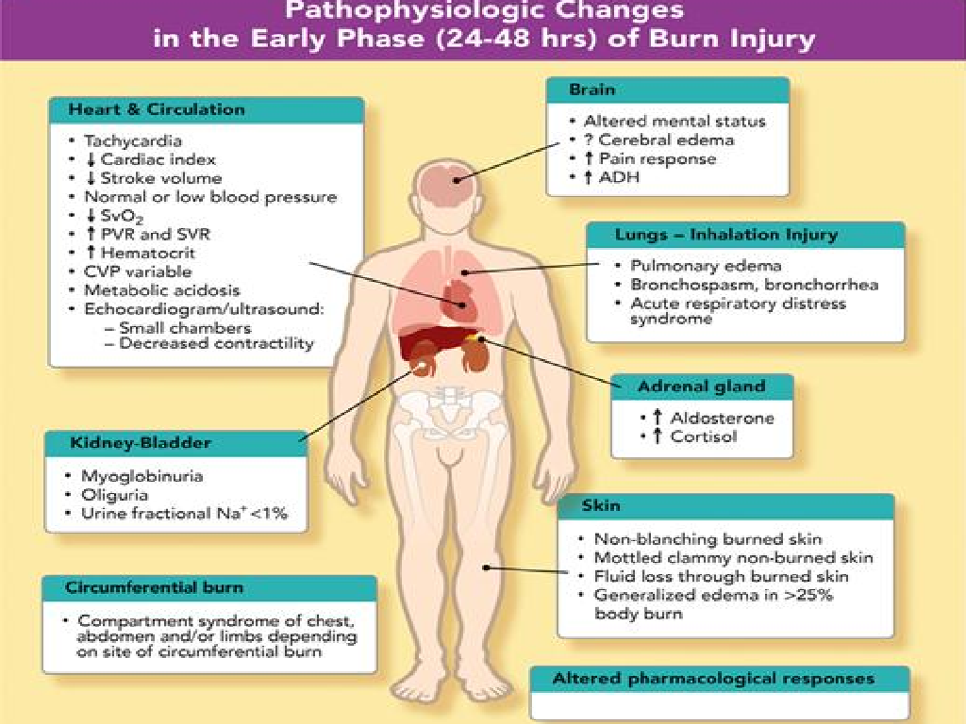

Slide 43
CLINICAL
MANIFESTATIONS:
Depending upon different severity and degree of burn
,following clinical features can be observed:
• Hypothermia- Characterized by core body temperature below 98.6 F. It causes shivering which in turn increases oxygen consumption and caloric demand as well as vasoconstriction. It is common in extensive injuries during the early hours following injury, evacuation and transportation
• Fluid and electrolyte Imbalance-Evaporation of fluid from the body evidenced by low BP, diminished urine output, dry mucous membrane and poor skin turgor

Slide 44
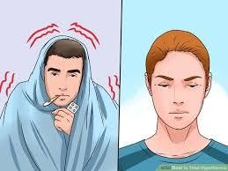
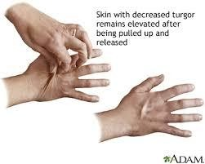
Fig: Hypothermia
Fig: Loss of skin turgor

Slide 45
• Burn >25% result in generalized body edema affecting both burned and in a decreased circulating intravascular blood volume.Urine output for the adult diminishes to 30mllhour. Urine is concentrated.Elevation of BUN. Over ensuring days, the body begins to reabsorb the edema fluid and excess fluid is excreted via diuresis
• GI Alterations- Absence of bowel sounds, stool, nausea and vomiting and abdominal distention
• Decreased cardiac Output-Following an extensive burn, peripheral vascular resisrtance increase in response to the release of catecholamines and to the relative hypovolemia.Cardiac output decreases evidenced by decreased BP, Urine output,weak peripheral pulses.When fluid is provided, it returns to normal and then increases 2 to 2.5 to meet hypermetabolic needs

Slide 46
CONTD…
• Alteration in Respiratory System- Inhalation injury leads to lung parenchyma edema and respiratory insufficency.Diagnosis of CO poisoning is made by measuring the COHb level in the blood. The neurologic problems caused by CO exposure can lead to progressive and permanent cerebral dysfunction. Thermal burns to upper airways appear erythematous and edematous with mucosal blisters or ulcerations leading to obstruction with features of dyspnea, stridor, use of accessory respiratory muscles and cynosis.

Slide 47
CONTD…
• Physical features includes soot on the face and nares. Facial burn, soot in the sputum, coughing and wheezing. Manifestation of tracheobronchitis appear 24 to 48 hours evidenced by wheezing, impaired clearance of secretion like features

Slide 48
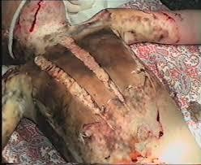
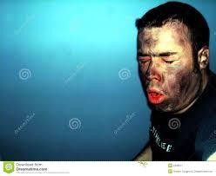
Fig: Burn on chest wall
Fig: Inhalation of smoke

Slide 49
CONTD…
• Altered level of Consciousness-Prolonged exposure to smoke leads to neurological damage. When an alteration in level of consciousness is present on admission, it is associated to neurologic trauma such as ( Fall, motor vehicle accident, hypoxemia, inhalation injury, electrical burn).clients with associated head trauma may have scalp lacerations, swelling, tenderness. Neurologic manifestation may include headache, dizziness, memory loss, confusion or hallucination etc

Slide 50
CONTD…
• Psychological Alterations- Immediately after injury, psychological shock, disbelief, anxiety and feelings of being overwhelmed. Coping with the situation is poor. The most common problems during the acute phase is grief, depression, anxiety. Client may experience nightmares ,flashback, sleep problems. Following hospital discharge, client may continue to suffer from anxiety and depression

Slide 51
CONTD…
• Simple preparatory information especially before procedure is required. Supportive therapy is required such as group discussion e.g Inpatient support group for burn suvivors

Slide 52
Pain response
• The client experiences pain as a result of burn wound and exposed nerve endings from lack of skin integrity
.Burn survivors usually describe three types of pain:
1.Background pain- Experienced when the client is at rest or engages in non-procedural activities such as shifting position, chest or abdominal wall movements. It is continuous in nature and low in intensity lasting till the duration of recovery. It is often managed with the use of long lasting analgesic agent, continuous infusion or sustained release oral agent

Slide 53
CONTD…
Breakthrough pain- It is an increase in the low intensity background pain. Experienced when the client is at rest or engages in activities of daily living or other minor activities. It subsides as the wound heals. Managed with short acting agents
3.Procedural pain- Experienced during the performance of therapeutic measures such as Wound cleansing, dressing changes and physical/ occupational therapy. It is acute and high in intensity
Usually managed with opioids ( Morphine sulphate,fentanyl).

Slide 54
CONTD…
• Clinical response include increase in Blood pressure, heart rate, and respiratory rate, rigid muscle tone. Several pain assessment tool are available. Numeric scale, verbal descriptive scale and visual analog scale

Slide 55
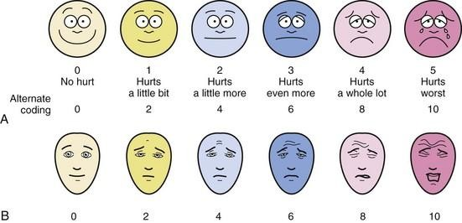

Slide 56
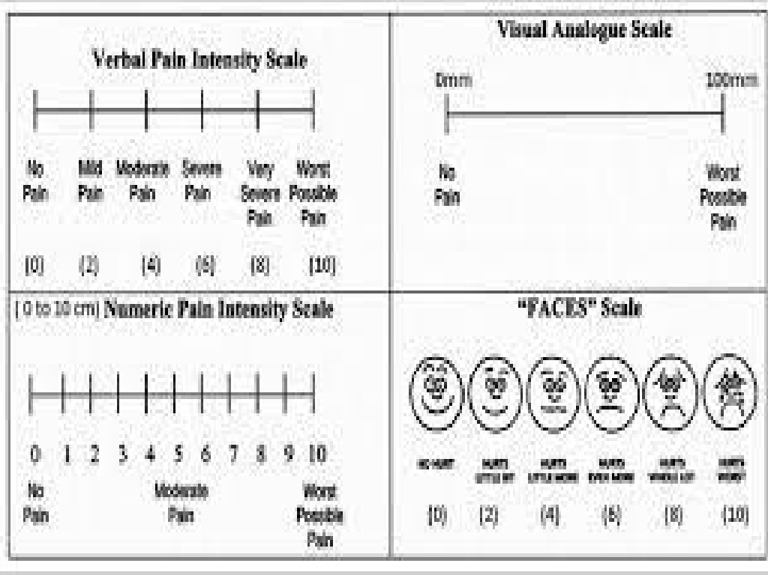

Slide 57


MANAGEMENT OF BURN
Emergent/Resuscitative phase
Nursing Management Of Patient With Burn

Slide 58
Emergent/Resuscitative phase
• The resuscitative phase of burn injury consists of the time between the initial injury and 36- 48 hours after injury.
• This phase ends when fluid resuscitation is complete.
• During this phase, life threatening airway and breathing are of major concern.
Nursing Management Of Patient With Burn

Slide 59
• A Airway control.
• B Breathing and ventilation.
• C Circulation.
• D Disability
• E Environmental control.
• F Fluid resuscitation.
Nursing Management Of Patient With Burn

Slide 60

Recommended fluid
• Ringers lactate
• Normal saline
• Human plasma, albumin, Blood, Plasma expanders
Nursing Management Of Patient With Burn

Slide 61

Parkland formula
• Calculate the fluid to be replaced in the first 24hr.
• 4ml/kg/ each % of TBSA burn
• 50% in first 8 hour and subsequent 50% in remaining 16 hour.
Nursing Management Of Patient With Burn

Slide 62
For example in a 70 kg patient with 50% TBSA burn :
4×70 kg×50TBSA=14000ml/24 hr
Administer 50% i.e. 7000 ml in first 8 hours.
Administer remaining 50% i.e.7000ml in next 16 hours.
Nursing Management Of Patient With Burn

Slide 63


MANAGEMENT OF BURN
Acute/ Intermediate Phase
Nursing Management Of Patient With Burn

Slide 64
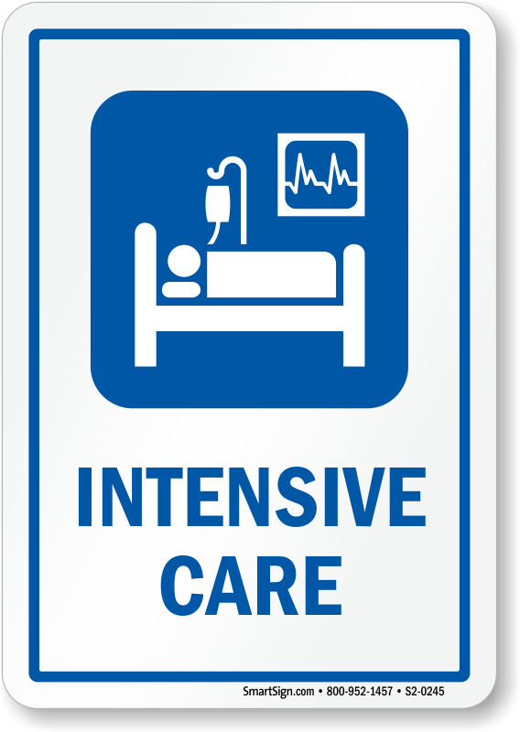
1. Extensive Monitoring
• Major burn or with inhalation injury may require ICU admission.
• Measure vital signs frequently. Respiratory and fluid status remains highest priority.
Nursing Management Of Patient With Burn

Slide 65
Extensive Monitoring
• For patient with inhalation injury, regularly monitor level of consciousness, pulmonary function, and ability to ventilate; if patient is intubated and placed on a ventilator, frequent suctioning and assessment of the airway are priorities.
Nursing Management Of Patient With Burn

Slide 66
Extensive Monitoring
• Assess peripheral pulses frequently for first few days after the burn for restricted blood flow.
• Closely observe hourly fluid intake and urinary output.
• Assess core body temperature frequently.
Nursing Management Of Patient With Burn

Slide 67

2. Infection Prevention
• Major component
• Standard precaution should be followed in caring all clients with burn injury
• change linens regularly.
Nursing Management Of Patient With Burn

Slide 68
3. Pain Management
• Pharmacological agents used to treat burn pain include opioid analgesics, NSAIDS and anxiolytics.
• Recommended dosage of Morphine is 0.03-0.1 mg/kg IV in adults.
• IM& SC injection to be better avoided.
Nursing Management Of Patient With Burn

Slide 69
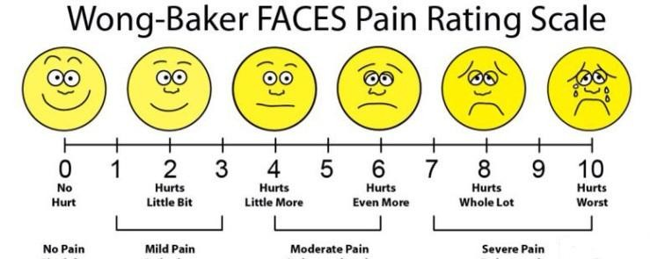
Pain Management
• Assess for pain periodically and document as well.
Nursing Management Of Patient With Burn

Slide 70
Pain Management
• Use of non-pharmacological method of relaxation such as deep breathing exercise
,distraction technique, therapeutic touch, music therapy, play therapy for children etc.
Nursing Management Of Patient With Burn

Slide 71
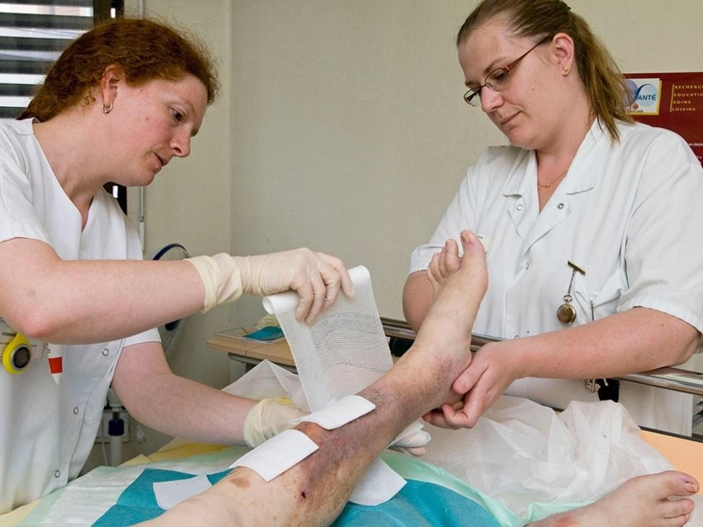
5.Wound Care
• Continue assess depth of wound, and identify areas of full and partial thickness injury.
• Wound dressing should be regularly done.
Nursing Management Of Patient With Burn

Slide 72










Wound care
• Micro organisms may be introduced to the wound from
From attendant
Other patients
Patient’s own flora
Fomites
Wound Infection
Nursing Management Of Patient With Burn

Slide 73

Wound care
• Closely scrutinize wound to detect early signs of infection.
• Do not expose wounds unnecessarily.
• Use radiant warmers, warming blankets Provide a dry top layer for wet dressings to reduce evaporative heat loss.
Nursing Management Of Patient With Burn

Slide 74
Wound care
Three basic methods of wound care are practiced:
1. Exposed (open): Areas difficult to dress such as the face, ear are most easily left exposed to the air. Exudate is removed frequently using sterile saline.
Nursing Management Of Patient With Burn

Slide 75
Wound care
2.Semi-open:
• The wound is covered with a topical agent or biological dressing. A few layers of gauze may be applied to hold the agent in place.
3.Closed:
• Over silver sulphadiazine,silver nitrate many layers of guaze and wool cove the wound and dressings are changed daily or on alternate days.
• The wound is kept warm and moist by dressings
Nursing Management Of Patient With Burn

Slide 76


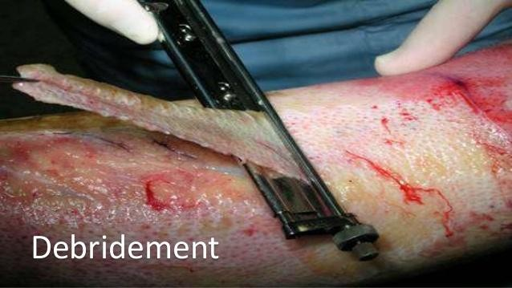
Wound care
• Debridement of devitalized tissue, removal of damaged agents, cleansing and then dressing are important aspects.
Nursing Management Of Patient With Burn

Slide 77


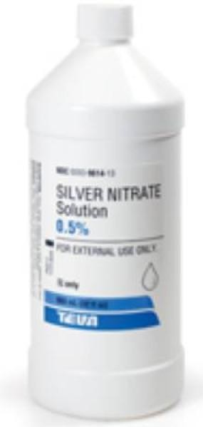
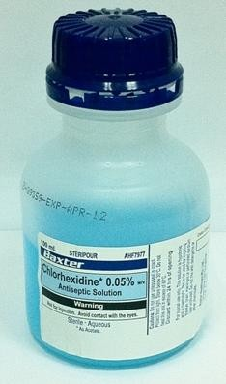
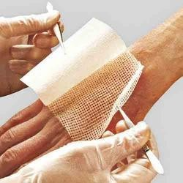
Topical Antiseptic
Nursing Management Of Patient With Burn

Slide 78

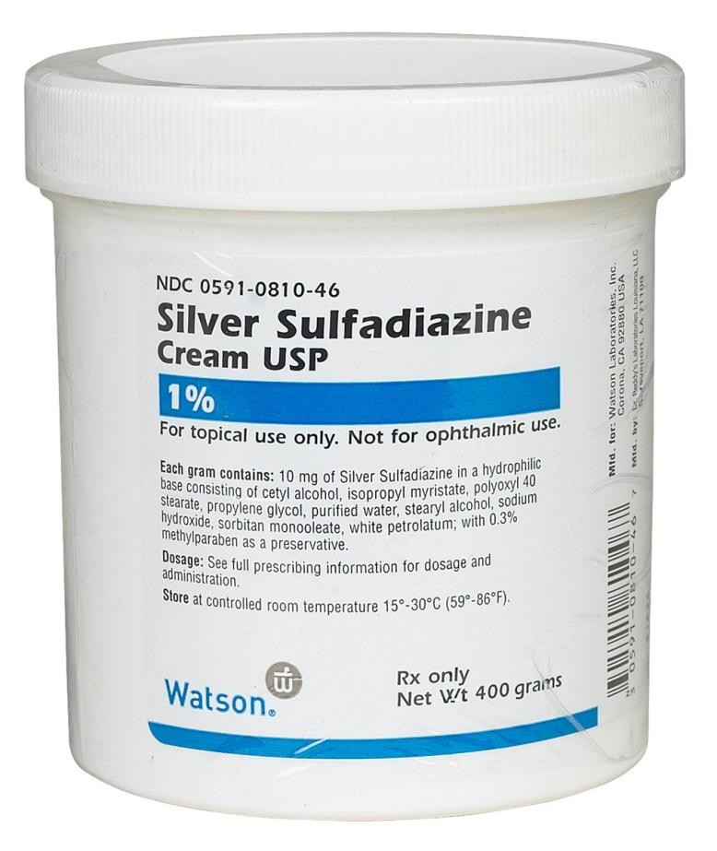
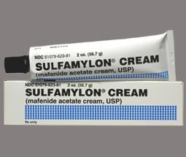
Topical Antiseptic Creams
Nursing Management Of Patient With Burn

Slide 79

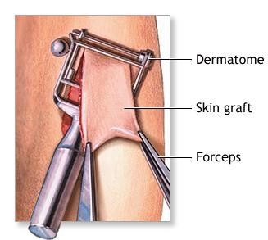
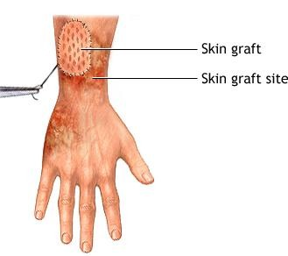
Excision and Skin Graft
Nursing Management Of Patient With Burn

Slide 80



5. Nutritional support
• Goals
– to defend lean body mass
– promote immuno competence,
– optimize wound healing
– reduce subsequent duration of recovery
Nursing Management Of Patient With Burn

Slide 81
• Protein is necessary for wound healing, enhancement of host defense mechanism.
• Micro nutrient such as zinc and copper must also be considered.
• Vitamin C is necessary for collagen synthesis and immune function.
• Vitamin A is required for epithelisation.
Nursing Management Of Patient With Burn

Slide 82
• 15-20% TBSA may achieve nutritional status requirement orally.
• Initiate enteral feed once bowel sounds heard either by orally or Ryles tube
• 30% TBSA = Supplementary enteral feed
• 30-40% TBSA = TPN
Nursing Management Of Patient With Burn

Slide 83



Factors affecting dietary intake
• Nausea or vomiting
• Anorexia
• Pain
• Constipation/diarrhea
• Change of dressing/frequent surgical interventions
Nursing Management Of Patient With Burn

Slide 84

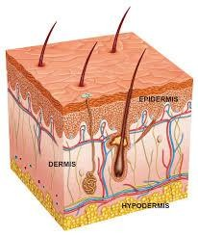
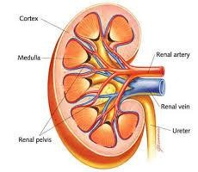
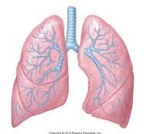
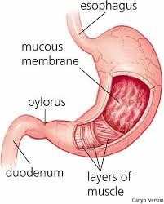
COMPLICATIONS OF BURN

Slide 85


Early Complications
• Shock and electrolyte imbalance.
• Airway obstruction.
• Hypothermia.
• Acute renal failure.
• Compartment syndrome

Slide 86


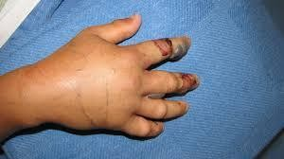
Compartment syndrome
Nursing Management Of Patient With Burn
86

Slide 87

Late Complications
• Wound infection
• Necrotizing fasciitis
• Scar hypertrophy and keloid
• Post burn contracture
• Marjolin’s ulcer
• Curling’s ulcer
• Itching and dermatitis
• Heterotrophic bone formation around joints

Slide 88


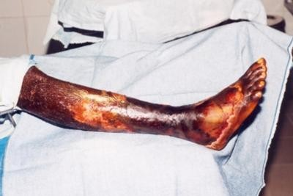
Necrotizing fasciitis.
Nursing Management Of Patient With Burn

Slide 89

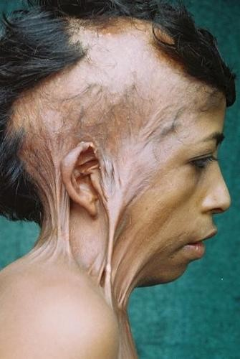
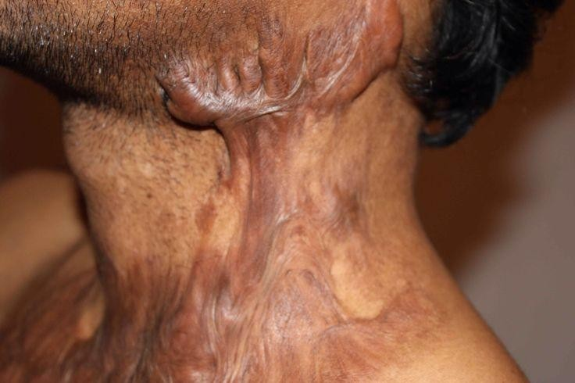
Hypertrophied Scar & keloid
Nursing Management Of Patient With Burn

Slide 90




Post burn contracture
Nursing Management Of Patient With Burn

Slide 91
Role of nurses in Rehabilitation Phase
“Rehabilitation starts on the day of Injury”
Nursing Management Of Patient With Burn

Slide 92


Slide 93

Psychological support
• Allow to express thoughts, feelings, fears, and anxieties regarding injury.
• Support family and friends' communications and visits.
• Assess need for mental health consultation.
Nursing Management Of Patient With Burn

Slide 94


Psychological support
• Arrange for the patient to talk with other patients who have had a similar injury and are progressing satisfactorily.
• Plastic surgery has been a source of tremendous hope and comfort for burn injury patients.
Nursing Management Of Patient With Burn

Slide 95


Plastic surgery
Nursing Management Of Patient With Burn

Slide 96




Mobilization and Positioning
• Early mobilization
- Patient is encouraged to carry out his own activities of daily living.
Nursing Management Of Patient With Burn

Slide 97


Mobilization and Positioning
• Splinting
- care must be taken to ensure the splint does not cause a pressure sore
Nursing Management Of Patient With Burn

Slide 98



Splinting
Nursing Management Of Patient With Burn

Slide 99
Mobilization and Positioning
• Positioning
- In general joint should be positioned in extension.
• Anti contracture positioning is the goal of any splinting and positioning program.
• based on an anatomic tendency to contract in predicted patterns, which tend to be shortened flexed positions.
Nursing Management Of Patient With Burn

Slide 100


Anti contracture positions
Nursing Management Of Patient With Burn

Slide 101


Comfort and Scar management
• Reducing the amount of discomfort through possible intervention is must during any type of procedure.
• Maintain cool environment if itching occurs.
• Advice Wear clean white underwear and clothing free from irritating dyes until wounds are well healed.
Nursing Management Of Patient With Burn

Slide 102


Pressure Garments
Nursing Management Of Patient With Burn

Slide 103


You all are doing an Awesome job
Nursing Management Of Patient With Burn

Slide 104
Nursing Management of burn

Slide 105
Course Outline
At the end of this teaching/learning session, students will be able to explain about nursing management of burn patient.

Slide 106
Burn
• When the skin is exposed to excessive heat, electricity, corrosive chemicals, excessive noxious smoke the resulting tissue damage is known as a burn.
• A major burn is a devasting injury requiring painful treatment and long period of rehabilitation.

Slide 107
Nursing Management
Assessment
History taking: Burn (Electrical, thermal, chemical )
Physical Examination
Vital sign
• Level of pain
• Site of burn
• Total body surface area % of burn
• Condition of wound
• Degree of burn
• Sign of infection

Slide 108
Contd…
• Fluid and electrolyte balance: Urine output, hypovolemia
(0.5ml -1ml /kg /hr)
• Temperature: first phase hypothermia
Later it may be hyperthermia as chance of infection and hyper metabolism for repair of skin.

Slide 109
Nursing Diagnosis
• Impaired gas exchange related to carbon monoxide poisoning, smoke inhalation
• Ineffective airways clearance related to edema
• Pain related to tissue and nerve injury and emotional impact of injury
• Fluid volume deficit related to increased capillary permeability and evaporative losses from the burn wound.

Slide 110
Contd..
• Hypothermia related to loss of skin microcirculation and open wound
• Risk for infection related to breakdown of skin integrity
• Risk for inadequate tissue perfusion related to immobility.
• Anxiety related to fear and emotional impact of burn.

Slide 111
Airways Management
•Assess breath sounds, and respiratory rate, rhythm, depth, and symmetry.
•Monitor patient for signs of hypoxia.
•Observe for erythema or blistering of lips, Singed
nostrils, burns of face, neck, or hoarseness, soot in sputum or
chest, increasing tracheal tissue in
respiratory secretions.
•Monitor ABG values, pulse oximetry readings, and carboxyhemoglobin levels

Slide 112
Contd…
• Maintain patent airway through proper patient positioning, removal of secretions, and artificial airway if needed.
• Provide humidified oxygen.
• Encourage patient to turn, cough, and deep breathe. Encourage patient to use incentive spirometry.
• Suction as needed.

Slide 113
Pain Management
• Includes the use inflammatory
of opioids, non
steroidal
anti- and
drugs
(NASIDs),
anxiolytics,
anesthetic agents.
• Administer analgesics before dressing.
•Administer intravenous opioid analgesics as prescribed.

Slide 114
Contd…
• Assess response to analgesic.
• Provide emotional support and reassurance.
• Relaxation techniques, distraction, hypnosis, therapeutic touch, humor, music therapy

Slide 115
Maintaining fluid and electrolyte Imbalances
• Observe vital signs (including central venous pressure or pulmonary artery pressure, if indicated) and urine output, and be alert for signs of hypovolemia or fluid overload.
• Monitor urine output at least hourly and weight patient daily.
• Maintain IV lines and regulate fluid set appropriate rates, as prescribed.

Slide 116
Contd..
Observe for symptoms of deficiency or excess of serum sodium, potassium, calcium, phosphorus, and bicarbonate.
❖ Elevate head of patient’s bed and elevate burned extremities.
Notify physician immediately of decreased urine output, blood pressure, central venous, pulmonary artery, or pulmonary artery wedge pressures, or increased pulse rate

Slide 117

Nutritional support
• Enteral nutrition support with a high–protein, high–carbohydrate diet is recommended.
• Protein requirements may range from 2.0 to 3.0 g of protein per kilogram of body weight every 24 hours, is necessary for wound healing, enhancement of host defence mechanisms and replacement of losses.

Slide 118
Contd…
• High–carbohydrate, low–fat diets are included to meet caloric requirements and to spare protein.
• Added vitamins and minerals supplements may be indicated.

Slide 119
Contd…
• Certain vitamin c requirement are also increased which is necessary for collagen synthesis and immune function. Vitamin A is required for epithelization and maintenance for the immune response.
• Nutrition can be administered either by the enteral or parenteral route, or a combination of both.

Slide 120
Infection Prevention
• Provide a clean and safe environment and for closely scrutinizing the burn wound to detect early signs of infection.
• Maintain aseptic technique
• Sterile technique is used for any invasive procedures and invasive lines and tubing must be routinely changed

Slide 121
Contd…
hygiene before and after each
• Meticulous hand patient contact
• Protects from sources of contamination, including other patients, staff members, visitors, and
equipment.
Wound dressing
• Wound debridement:
This promotes wound
healing by preventing bacterial proliferation in and under the devitalized tissue.

Slide 122

Contd…
• Topical antibacterial therapy
• Wound grafting: A skin graft is a surgical procedure in which sections of own healthy skin are used to replace the scar tissue caused by deep burns.
• Hydrotherapy

Slide 123
Fluid Replacement Therapy
• Parkland formula for fluid resuscitation
• RL solution: 4 ml X body wt. (kg) X %TBSA burned.
• Resuscitation fluid volume for the first 24 hours.
• Half of this fluid is given in first 8 hours and other half is given over remaining 16 hours.

Slide 124
Contd..
• To reduce the risk of fluid overload and consequent heart failure and pulmonary edema, the nurse closely monitors IV and oral fluid intake, using IV infusion pumps to minimize the risk of rapid fluid infusion.
• To monitor changes in fluid status, careful intake and output and daily weights are obtained.
• Continued assessment of peripheral pulses is essential

Slide 125
Prevention of Hypothermia
•Provide a warm environment through use of heat shield, space blanket, heat lights, or blankets.
•Work quickly when wounds must be exposed.
•Assess core body temperature frequently
126

Slide 126
Promoting Physical Mobility and Strengthening Ability
• Encourage for deep breathing, turning, and proper positioning
• Maximize function
• Splinting: to maintain proper joint position and to prevent or correct contractures.
• Positioning
• Passive and active range of motion exercise
• Ambulation ( With Correct posture)
• Performance of ADL

Slide 127
Contd…
• Patient should assess for the following complications
• Focuses on late complications and functional loss, promoting activity tolerance.
• Prevention of hypertrophic scarring.
• Prevention of contracture.
minimizing

Slide 128
Reducing Anxiety and Fear
• Patient with burn have lots of anxiety regarding
• Healing progress
• Disfigurement
• Contracture
• Loss of body part
• So proper counseling and modalities of treatment should be well explained.
• Using different coping strategies like meditation relaxation technique.

Slide 129
Contd…
•Assess patients and family understands of burn injury, coping skills, and family dynamics.
•Explain all procedures to the patient and the family in clear, simple terms.
• Maintain adequate pain relief.

Slide 130
Contd..
•Administer prescribed anti anxiety medications if the patient remains extremely anxious despite on pharmacologic interventions.
•Improve body Image and Self-Concept

Slide 131
References:
• Smeltzer S., Bare
B. Textbook of medical-
Surgical Nursing.11th edition, 2008. lipppincott publications, New Delhi. Page no: 1994-2037.
• Black J M, Hawks J.H.(2010) Medical – surgical Nursing, 8th edition, Elsevier.
• Mandal, G.N.(2015) Medical – surgical Nursing, 4th edition, Makalu.

Slide 132
Contd…
• Willims S., Bulstrode k. Connel R. (2007)
₂₅th USA.
.Short Practice of Surgery.
edition, Page
Hodden arnold Publication,
no:378-391.
• Gerard M., Jennifer K. (2002). The Washington Mannual of Surgery. 21st edition, Lippincot Willims and Wilkins, USA.
• chintamani (2014) Lewis’s Medical - Surgical Nursing. Edited by subodh k chauhan. A division of Reed Elsevier India Private Limited: Elsevier

Slide 133

THANK YOU

