Slide 1
REPRODUCTIVE, MATERNAL. NEWBORN, CHILD AND ADOLESCENT HEALTH (RMNCH+A)PROGRAMME-
ISSUES & APPROACHES

Slide 2
HISTORICAL BACK GROUND
1950 : MCH services as a basic health service in PHC
1952: National Family Planning Programme
1966: All India Hospital Post Partum Programme
1977: National Family Welfare Programme
1992: National Child Survival & Safe Motherhood Programme
1997: RCH phase-I
2005: NRHM
2OO5 : RCH phase -II

Slide 3
NATIONAL FAMILY PLANNING PROGRAMME-1952
1st in world
Focus on ‘Birth Control’
Mostly ‘Sterilization’- Camp Approach
Less priority on maternal & child survival:
- Little impact on fertility trend
- High MMR. High IMR continued

Slide 4
All India Hospital Post Partum Programme (AIHPPP)- 1966
It is a maternity centered, hospital based approach to Family Welfare Programme
To motivate the eligible couples for adopting the small family norm
Objectives:
To improve the health of the mother and children
To reduce IMR and MMR

Slide 5
NATIONAL FAMILY WELFARE PROGRAMME- 1977
Shift from “Planning” to “Welfare”
Emphasis on-
ANC
ANEMIA CONTROL PROGRAMME
ICDS
MTP ACT
CHILD MARRIAGE RESTRAINT ACT
DIARROEA CONTROL PROGRAMME
ARI CONTROL PROGRAMME
UNIVERSAL IMMUNISATION PROGRAMME

Slide 6
Child Survival and Safe Motherhood (CSSM) Programme 1992
All programme were implemented vertically.
Objectives:
To improve the health of the mothers and children below 5 years.
To reduce MMR,IMR and Child Mortality Rates.
To eliminate Neonatal Tetanus.
To eradicate Poliomyelitis.

Slide 7
TOWARDS REPRODUCTIVE HEALTH APPROACH
Reproductive and Child Health(RCH) :
International Conference on Population Development
(ICPD) held at Cairo in1994
2 New components added: i) Adolescent Health
ii) Treatment of RTIs & STIs
RCH defined as “A state of complete physical, mental and social wellbeing and not merely an absence of the disease or infirmity in all maters relating to reproductive system and its functions and processes.”

Slide 8
REPRODUCTIVE APPROACH
People have the ability to reproduce and regulate their fertility
Women are able to go through pregnancy and child birth safely
The outcome of pregnancy is successful in terms of wellbeing and survival of mother and infant
Couples are able to have sexual relation free of fear of pregnancy and contracting diseases.

Slide 9
STRATEGIES-1
Area specific Micro Planning
Community Need Assessment Approach(CNNA)- Decentralized Participatory Plan
Emphasis on- Remote Rural area, Urban Slum
Tribal area
Emphasis on: Out-reach Services

Slide 10
STRATEGIES-2
Upgradation of facility:
24 hour delivery services
FRU
Sick Newborn Care
Safe Abortion Services
RTI/STI Management

Slide 11
RCH PACKAGE OF SERVICES:
MATERNALHEALTH
NEW BORN & CHILD HEALTH
ELIGIBLE COUPLE
REPRODUCTIVE AGE WOMEN
ADOLESCENT HEALTH
BCC & COUNSELLING

Slide 12
Paradigm shift
Current programme (RCH)
Previous Programmed(CSSM)
Centralized
Goal: Two Child norm
Rigid
Target oriented
Top down approach
Not need based
Quality of service not cared
Service: Family planning
Decentralized
Goal: Enable clients to meet their goals
Non-rigid
Target free
Bottom-up approach
Need based demand driven
Quality cared
Service: Full range of MCH care

Slide 13

Integrated RCH programme
Overlapping of expenditure
Hence, reducing cost inputs
Integrated implementation optimises outcomes at field level

Slide 14
RCH 1 Components:
FAMILY PLANNING
CHILD SURVIVAL AND SAFE MOTHERHOOD
PREVENTION/ MANAGEMENTOF RTI/STD/AIDS
CLIENT APPROACH TO HEALTH CARE

Slide 15
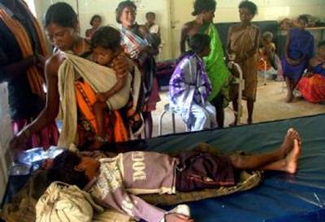
First referral unit

Slide 16

Outreach of services

Slide 17

People’s programme

Slide 18
Categories:
Differential approach
Based on CBR and female literacy rate,
Category A:58 districts
Category B:184 districts
Category C:265 districts
All the districts will be covered in a phased manner over a period of 3yrs.

Slide 19




Safe motherhood

Slide 20

Child survival

Slide 21
Immunization
Vitamin A
Oral rehydration therapy
Prevention of deaths due to pneumonia

Slide 22


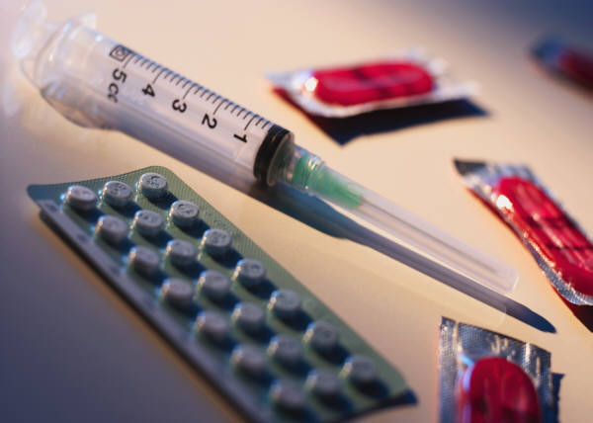

Family planning:
Target free approach

Slide 23

Birth spacing

Slide 24


IEC:

Slide 25
RTI /STD clinics
At district hospital level

Slide 26
Facilities for safe abortions at PHCs
Enhanced community participation
through panchayat ,women gps and NGOs
Adolescent health and reproductive hygiene

Slide 27
INTEGRATED SERVICES

Slide 28
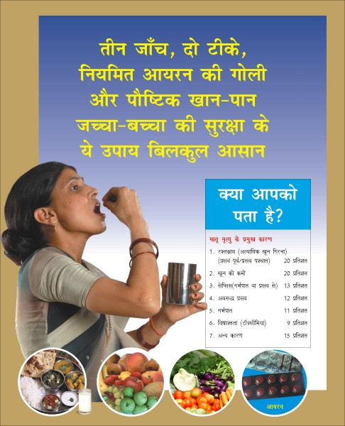
Essential obstetric care
Early registration
Minimum 3 ANC
Safe delivery
3 PNC
More relevant for Assam, Bihar, Rajasthan, Orissa, UP, MP

Slide 29
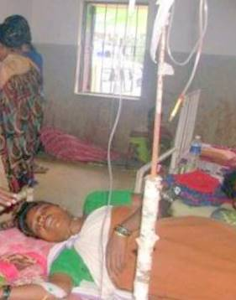
Emergency obstetric care
Strengthen FRUs
Supply of kits and skilled manpower
TBA: Dai training
NGOs involved: More local specific

Slide 30
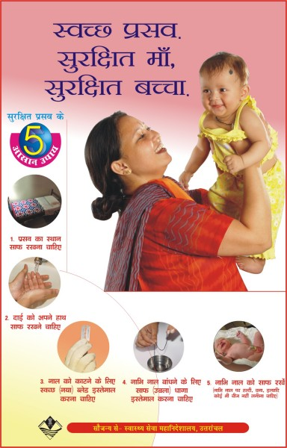
24-hr Delivery services at PHCs/CHCs
Promote institutional deliveries
Additional honorarium to staff
Safe deliveries

Slide 31
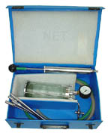
MTP
MTP act 1971
Aim: Reduce maternal morbidity and mortality
Manpower training and equipments supply
Dr.s trained in MTP visit PHCs

Slide 32

Control of RTI and STD
Collaboration with NACO
RTI/STD clinics upto district level
2 lab technicians for testing blood, urine and RTI/STD tests

Slide 33
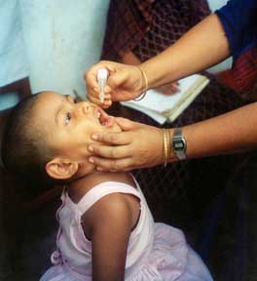
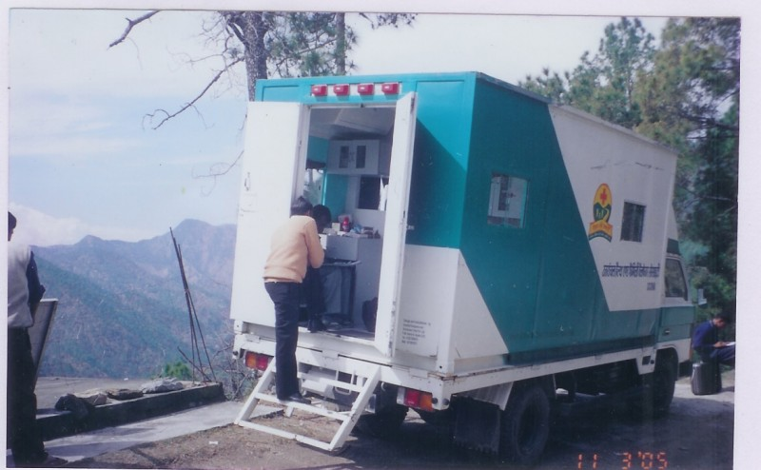
Immunization
UIP part of RCH programme
Vaccines: polio, tetanus, DPT, DT, measles and BCG
Cold chain

Slide 34
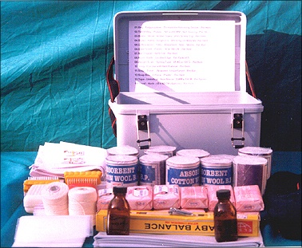
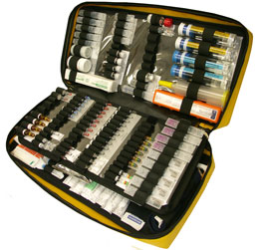
Drug and equipment kits:
Mid-wifery kit & drug kit

Slide 35
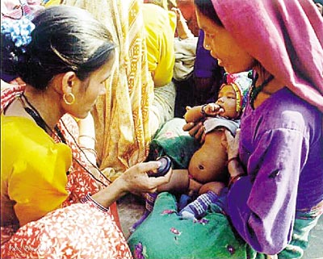
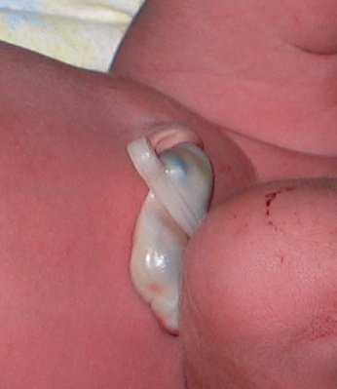
Essential new born care
Reduce perinatal and neonatal mortality
Train medical and health personnel
Newborn care at FRU

Slide 36
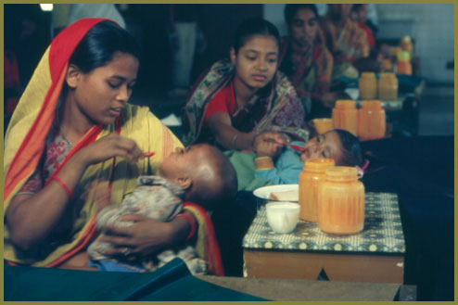
Oral rehydration therapy
ORT prog(86-87) under RCH
Twice a yr, 150 ORS packets supply
Nutritional care of child
Advice to mothers

Slide 37
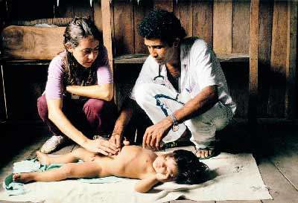
Acute respiratory disease control
Case management of ARI
PHW trained to recognise and treat pneumonia
Cotrimoxazole supply

Slide 38
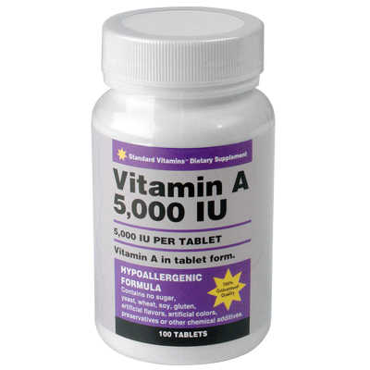
Prevention & control of Vit.A deficiency
Vit. A given upto 5years of age
1st dose:1 lakh units @ 9 months wit measles vaccination
2nd dose:2 lakh units with DPT/OPV booster doses
Next 3 doses:2 lakh units given at 6 months intervals

Slide 39

Prevention & control of anemia in children
Rural>urban
20mg elemental Fe
0.1mg Folic acid at sub-centre level
100 tab to children

Slide 40
Initiatives taken after adoption of NPP 2000

Slide 41
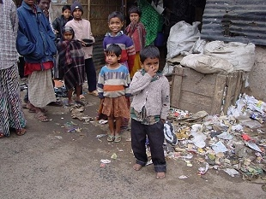

RCH out-reach scheme

Slide 42
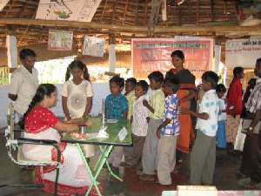
RCH camps:

Slide 43
For strengthening the immunization
And other MCH services in remote and in weaker districts and in urban slums .

Slide 44
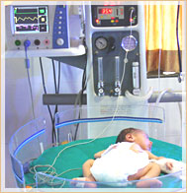
Operationalization of district newborn care

Slide 45
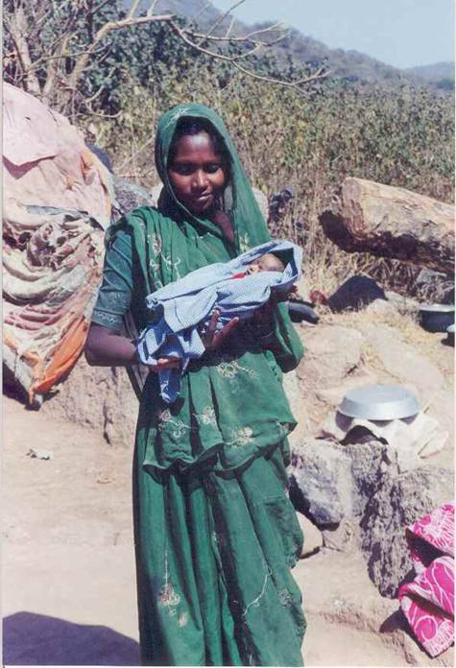
Home base neonatal care
Provision of neonatal
Care at grassroots
level

Slide 46

Border district cluster strategy
Up gradation of
PHCs /FRUs
In terms of
Infrastructure
Man power
Trainings
Equipments,drugs

Slide 47
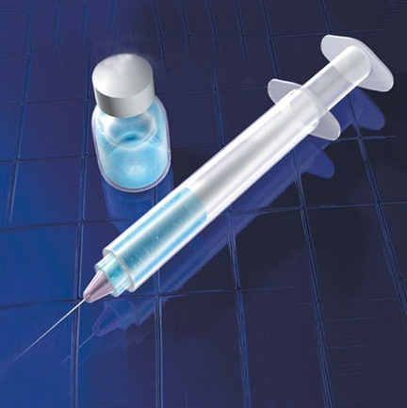
Introduction of Hep-B vaccination project

Slide 48
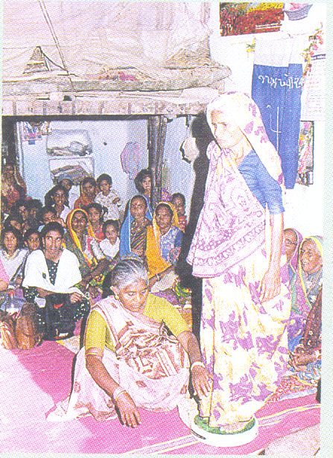
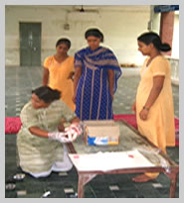
Dai training:

Slide 49
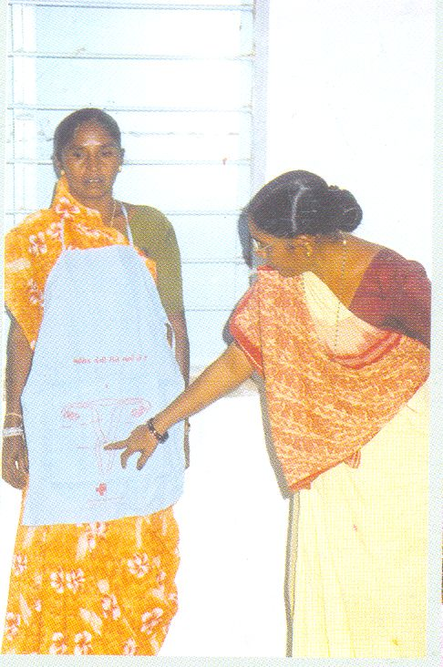
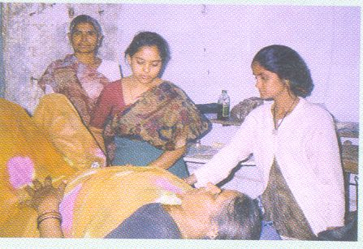
Dai training:

Slide 50
Empowered action group
More focus on Bihar,MP,Rajasthan UP,UK,Orissa ,Chhattisgarh

Slide 51
Key indicators
% of pregnant females with full ANC
% of institutional deliveries
% of home deliveries by TBA
% of Children fully immunized
% of unmet needs for FP
Current contraceptives Prevalence
% of house hold visit by health worker in previous 3 months

Slide 52
RCH Phase-2

Slide 53
RCH-2
Began from: 1st April, 2005
Focus: Reduce maternal and child morbidity and mortality with emphasis on rural health care
FRU: Availability of surgical interventions, newborn care, blood storage services on a 24 hrs basis

Slide 54
RCH-II (1st April 2005)
Aim:
Reduction of IMR,MMR and TFR
Increase of CPR and Immunization coverage
Goals:
Reduction of decadal growth to 16.2%(2001-2011)
Reduction of IMR :<30/1000 live birth by 2010
Reduction of MMR to <100/100000 live births by 2010
Reduction of TFR to 2.1 by 2010
Increase CPR to 65%, Immunization Coverage to100%,
ANC to 89%,Rural Institutional deliveries to 80%

Slide 55
Objectives of RCH-II
Immediate objective:
- Improve Routine Immunisation
- Reduce the Unmet need for Contraception
- Provide an integrated Service delivery for basic Reproductive & Child health Care
Medium Term Objective: Bring TFR to Replacement level by 2010
Long term objective: Population Stabilization

Slide 56
RCH-II: Flagship programme under NRHM launched on 1st April 2005
Special focus under RCH-II:
Essential obstetric care:
- Institutional delivery
- Delivery by SBA
2. Emergency Obstetric Care:
- Operationalizing FRU
- PHC 24 ˣ 7 delivery services
3. Essential Newborn Care / Care of the sick Newborn

Slide 57
Components of RCH II
Population stabilization
Maternal health
IMNCI
Adolescent health
Control of RTIs/STIs
Urban health
Tribal health

Slide 58
Main streaming gender and equity
Intersectoral and donor convergence
Behavior Change Communication (BCC)
Public Private Partnership (PPP)
Monitoring, Evaluation and Health Management Information System
Community Participation
Procurement and Logistics

Slide 59
NEW INTERVENTIONS
Basic Em Obstetric Care (BEmOC)
Comprehensive Em Obstetric Care (CEmOC)
Facility based Newborn Care
Janani Suraksha Yojna
Janani Sishu Suraksha Karyakram
Village Health & Nutrition Day (VHND)
Integrated Management Of Neonatal & Childhood Illness (IMNCI)

Slide 60
Major strategies:
Essential obstetric care
Emergency obstetric care
Strengthening referral system

Slide 61

ESSENTIAL OBTETRIC CARE
INSTITUTIONAL DELIVERY
24 HOURS DELIVERY CENTRES WITH EMERGENCY OBSTETRIC CARE & ESSENTIAL NEWBORN CARE AND BASIC RESUSCITATION SERVICES AROUND THE CLOCK

Slide 62

b.SKILLED ATTENDANCE AT DELIVERY
WHO HAS EMPHASIED THAT SKILLED ATTENDANCE AT DELIVERY IN ANY ESSENTIAL TO REDUCE MATERNAL MORTALITY IN ANY COUNTRY,BY ANM\LHVS

Slide 63

EMERGENCY OSTETRIC CARE
OPERATIONALISATION OF FRUs AND SKILLED ATTENDANCE AT BIRTH ARE THE ACTIVITIES THE SECOND PHASE OF RCH.

Slide 64
MINIMUM SERVICES OF FULLY FUNCTIONAL FRUs
24-Delivery services including normal & assisted deliveries.
Emergency obstetric care include caesarean section
New born care
Emergency care of sick children
Full range of family planning services includes laparoscopic services
Safe abortion services

Slide 65
Continued……..
7.Treatment of STI\RTI
8.Blood storage facility
9.Essential laboratory services
10.Referral ( transport) services
There are 3 critical determinants of facility
Availability of surgical interventions
Newborn care
Blood storage facility on a 24 hrs

Slide 66
STRENGTHENING REFERRAL SYSTEM
NEW INTIATIVES
1. TRAINING OF MBBS DOCTORS IN LIFE SAVING ANAESTHETIC SKILLS FOR EMEGENCY OBSTETRIC CARE.
GOVT .OF INDIA IS ALSO INTRODUCING TRAINING OF MBBS DOCTORS OF OBSTETRIC MANAGEMENT SKILLS,PREPARED TRAINING PLAN FOR 16 WEEKS IN ALL OBSTETRIC MANGEMENT SKILLS,INCULDING CAESERIAN SECTION OPERATION.
2.SETTING UP OF BLOOD STORAGE CENTRES AT FRUs ACCORDING TO GOVERNMENT OF INDIA GUIDELINES

Slide 67

Janani suraksha yojana

Slide 68

JANANI SURAKSHA YOJANA
THE NATIONAL METERNITY BENEFIT SCHEME HAS BEEN MODIFIED INTO A (JSY) JANANI SURAKSHA YOJANA.
IT WAS LAUNCHED ON 12TH APRIL 2005.

Slide 69
SALIENT FEATURES OF JANANI SURAKSHA YOJANA
IT IS A 100% CENTRALLY SPONSORED SCHEME
UNDER NATIONAL RURAL HEALTH MISSION ,IT INTEGRATES THE CASH ASSISTANCE WITH INSTITUTIONAL CARE DURING ANTENATAL, DELIVERY AND IMMEDIATE POST-PARTUM CARE

Slide 70
CONTINUED…
CATEGORY | RURAL AREA |  |  | URBAN AREA
 | MOTHER’S PACKAGE | ASHA ‘S PACKAGE | TOTAL Rs | MOTHER’S PACKAGE | ASHA’S PACKAGE | TOTAL Rs
LPS HPS | 1400 7OO | 600 400 | 2000 1300 | 1000 600 | 400 400 | 1400 1000

Slide 71
High Performing
BPL
More than or equal to 19
SC/ST
Upto 2 livebirths

Slide 72
1500 for cs
Home deliveries-500

Slide 73

VANDEMATARUM SCHEME
THIS IS A VOLUNTARY SCHEME WHERE IN ANY OBSTETRIC AND GYNEC SPECILAIST ,MATERNITY HOME,NURSING HOME,LADY DOCTOR MBBS DOCTOR CAN VULNTEER THEMSELVES FOR PROVIDING SAFE MOTHERHOOD SERVICES

Slide 74
CONTINUED……..
THE ENROLLED DOCTORS WILL DISPLAY “VANDEMATARAM LOGO” AT THEIR CLINIC.
IRON AND FOLIC ACID TABLETS,ORAL PILLS,TT INJECTIONS ETC… WILL BE PROVIDED BY THE RESPECTIVE DISTRICT MEDICAL OFFICERS TO THE VANDEMATARAM DOCTORS\ CLINICS FOR FEE DISTRIBUTION TO BENEFICIARIES.
SAFE ABORTION SERVICES
A.MEDICAL METHOD OF ABORTION
B. MANUAL VACUUM ASPIRATION

Slide 75

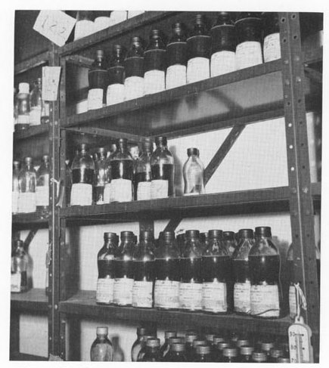
New initiatives:
Training of MBBS dr.s in life saving anesthetic skills for emergency obstetric care at FRUs
Setting up of blood storage centres at FRUs

Slide 76

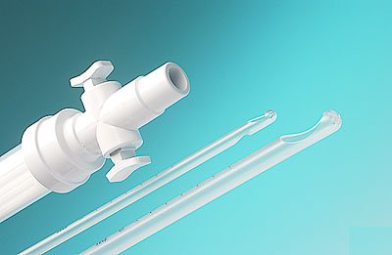
Safe abortion services
Medical method mefipristone and misoprostol
Manual vacuum aspiration

Slide 77
Village health and nutrition days
Maternal death review
Pregnancy tracking

Slide 78
JSSK
2011
Free delivery, drugs, diet
3 days –Normal delivery
7 days-Cs
Sick newborn-30 days after birth

Slide 79
NRC
24 hours care and monitoring
Treatment of medical complications
THERAPEUTIC FEEDING
Sensory stimulation and emotional care
Counselling
Demonstration

Slide 80
IMCI

Slide 81
F-IMNCI: Equipping the facilities
NCC- within delivery room
NBSU-Near ward , space of 4 bedded and 2 beds in post natal wards
SBCU- Near Labour room 3000 deliveries-12 beds

Slide 82
Triage for Sick newborn
Apnea
RR>60
Temp<35.4 or more than 37.5
Jaundice <24 hrs for more than 2 weeks
Central Cynosis
Shock
Bleeding

Slide 83
HBNC
Essential newborn care
Cre of pre-term and low birth weight
Identification of illnesses of newborn
Support the family

Slide 84
Inst deli-3,7,14,21,28 and 42
Home deli- 1, 3,7,14,21,28 and 42
Inc-250 for 5 visits 7-42
50 for LBW monthly
Two ASHAs-125 each
Twins 500 and so on
Incentive depends on record of weight, immunisation, registration and till both are safe.

Slide 85
NSSK
Train the health personnel on basic newborn care and resuscitation

Slide 86
RBSK
Feb 2013
Defect, Deficiency, Disease and Development delay
Includes:
Newborn0-6 wks-Facility and community based
6wks-6yrs-Anganwadi
6-18 yrs-School

Slide 87
RMNCH+A
What is RMNCH+A Strategic approach?
This is a comprehensive strategy for improving the maternal and child health outcomes , under NRHM
It is based on the evidence that maternal and child health cannot be improved in isolation as adolescent health and family planning have an important bearing on the outcomes.
This strategy encompasses various high impact interventions across the life cycle.
The strategy is based on the concept of ‘CONTINUUM OF CARE’

Slide 88
WHAT IS NEW IN RMNCH+A?
5x5 matrix
1. Inter-linkages between different interventions at various stages of the life cycle
2. Linking child survival to other inventions such as reproductive health, family planning , maternal health
3. focus on adolescents
4. Recognizing nurses as ‘pivots’ for service delivery
5. Expanding focus on child development and quality of life
6. Intensification of activities in High Priority districts.

Slide 89
PLUS DENOTES
Inclusion of adolescence as a distinct ‘life stage’
(2) Linking of Maternal and Child Health to Reproductive Health and other components like family planning.
(3) Linking of community and facility-based care as well as referrals between various levels of health care system.

Slide 90

What does RMNCH+A stands for
Reproductive, Maternal, New-born, Child & Adolescent Health : Links maternal and child survival to other components (family planning , adolescent health, gender & PC & PNDT)
Plus denotes
inclusion of adolescence as a distinct ‘life stage’ in the overall strategy
Links community and facility based care as well as referrals between various levels of health care system
Adolescent Health Package
Reproductive Health package
Antenatal & Intrapartum care package
Newborn care package
Post partum family planning,spacing methods
Under five child health pacakge

Slide 91
GOALS
Health outcome goals established in the 12th Five Year Plan.
Reduction of Infant Mortality Rate (IMR) to 25 per 1,000 live births by 2017
Reduction in Maternal Mortality Ratio (MMR) to 100 per 100,000 live births by 2017
Reduction in Total Fertility Rate(TFR) to 2.1 by 2017

Slide 92
Strategic RMNCH+A Interventions Across Life Stages
There are two dimensions to healthcare:
(1) stages of the life cycle
(2) places where the care is provided
These together constitute the ‘Continuum of Care’
Adolescence/
pre pregnancies
Pregnancy
Birth
Newborn/
post natal
Childhood

Slide 93

ADOLESCENT
Priority interventions:
1. Adolescent nutrition; iron and folic acid supplementation
2. Facility-based adolescent reproductive and sexual health services (Adolescent health clinics)
3. Information and counseling on adolescent sexual reproductive health and other health issues
4. Menstrual hygiene
5. Preventive health checkups

Slide 94
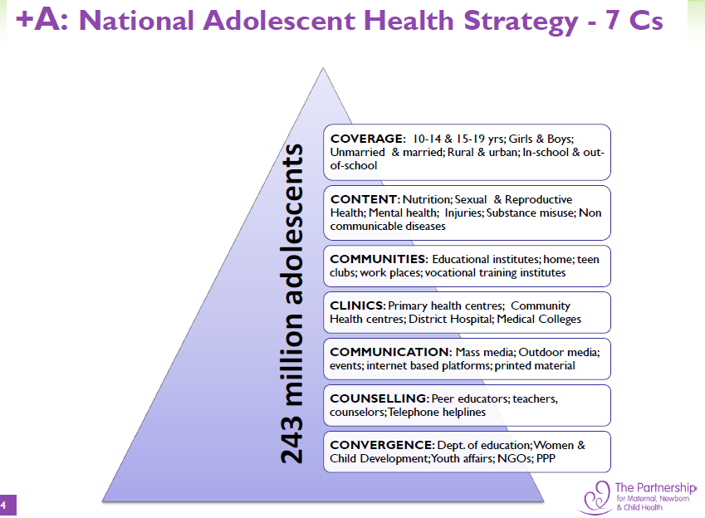

Slide 95
New Initiative: National Iron Plus Initiative
Children
6-60 months: IFA administered biweekly, on fixed days , under direct supervision of ASHAs ; 5-10 years: at AWC & through schools
Adolescent
NEW COMPONENT
Reproductive Age group
NEW COMPONENT
Pregnant & lactating women
As part of the antenatal care package, at all levels of health facilities , sub centre and outreach
IFA to be distributed by ASHA during doorstep delivery of contraceptives; IFA tablets to be given for 52 weeks each year
Weekly IFA supplementation (WIFS) for both adolescents boys & girls in Government/Government aided/municipal schools

Slide 96
Adolescent Friendly Health Services (Adolescent Health Clinics)
Services at sub centre: ANM
Adolescent Information and Counseling Centre will be made functional by MO and ANM at PHC on weekly basis.
At CHC, DH/SDH/ and Medical College: Adolescent Health Clinics(daily basis)
Special focus will be given to establishing linkages with Integrated Counseling and Testing Centres (ICTCs) and making appropriate referrals for HIV testing and RTI/STI management

Slide 97

Scheme for promotion of menstrual hygiene among adolescent girls in rural India:
This scheme promotes better health and hygiene among adolescent girls
Sanitary napkins are provided under NRHM’s brand ‘Free days’.
These napkins are being sold to adolescent girls by ASHAs
Community based health education
Ensuring regular availability,sourcing, procurement, storage ,distribution.
Training of ASHA
Safe disposal

Slide 98
Preventive health checkups and screening for diseases, deficiency and disability
Components of School Health Programme include screening, basic health services and referral
Bi-annual health screening is undertaken for students (6–18 years age group)
Implementation of School Health Programme
Team consist of:
- 2 Medical Officers
(MBBS / Dental / AYUSH qualified)
- 2 paramedics
(one ANM and any one of the following Pharmacist/ Ophthalmic Assistant/Dental assistant)

Slide 99

Pregnancy and Childbirth
Priority interventions:
1. Preventive use of folic acid in peri-conception period
2. Delivery of antenatal care package and tracking of
high- risk pregnancies
3. Skilled obstetric care
4. Immediate essential newborn care
and resuscitation
5. Emergency obstetric and
new born care
6. Postpartum care for
mother and newborn
7. Postpartum IUCD and sterilisation
8. Implementation of PC&PNDT Act

Slide 100
Preventive use of folic acid in peri-conception period
To promote use of folic acid in planned pregnancies during peri-conception phase by frontline workers and facility-based service providers.
A new scheme for delaying first birth after marriage and ensuring spacing between first and second child was launched in May 2012 and has provision for incentivizing ASHAs for their efforts

Slide 101
Delivery of antenatal care package and tracking of high-risk pregnancies
Pregnancy Testing Kits (Nishchay) to all sub centres and through ASHAs.
Universal access to full antenatal package
Mother and Child Tracking system (MCTS)
Tracking pregnant women with severe anaemia by ANM and PHC in charge
Universal confidential HIV screening

Slide 102
Skilled obstetric care and essential newborn care and resuscitation
Delivery points are to be prioritised.
Delivery points should be saturated with Skilled Birth Attendance
Janani Suraksha Yojana (JSY)
Janani Shishu Suraksha Karyakram (JSSK) is an initiative to reduce out-of-pocket expenses related to maternal and newborn care.
Newborn Care Corners are established at delivery points and providers are trained in basic newborn care and resuscitation through Navjaat Shishu Suraksha Karyakram (NSSK).

Slide 103
Emergency obstetric & new born care
Sub centres and PHC designated as delivery points
CHC (FRUs) and District Hospitals have been made functional 24 X7
MCH Wing, with integrated facilities for advanced obstetric and neonatal care & also ensure 48hrs stay for mother and newborn at hospital

Slide 104
Emergency obstetric & new born care
Multi skilling of doctors in public health system:
- 8week training programme of MBBS qualified doctors in Life Saving Anaesthetic Skills (LSAS)
- 16week training programme in Obstetric Management Skills including Caesarean section
- 10 day training for Medical Officers in Basic Emergency Obstetric Care (BEmOC)
- 3 week Skilled Birth Attendance training for ANMs/Staff Nurses.

Slide 105

Postpartum care for mother and baby
To ensure postpartum care for mothers and newborns, forty-eight hours of stay at health facility for institutional delivery
At least three postnatal visits to mother and six postnatal visits to newborn are to be made within six weeks of delivery/birth

Slide 106

Postpartum IUCD insertion and sterilization
Placement of trained providers for post-partum IUCD (PPIUCD) insertion at district and sub-district hospital level
Training of Medical Officers in ‘Minilap’ for provision of Post-Partum Sterilisation in high case load facilities
RMNCH counsellor ensure healthy timing and spacing between pregnancies

Slide 107
Implementation of preconception and prenatal diagnostic techniques (PC&PNDT) Act
Key action:
- Formation of PC&PNDT cells at state/district level,
- Strengthening of human resources as well as trainings & establishing appropriate infrastructure at all levels
- Building community opinion against sex selective abortion and foeticide by sensitising and mobilising self-help groups and empowering women

Slide 108
Newborn and Child care
Priority interventions:
1. Home-based newborn care and prompt referral
2. Facility-based care of the sick newborn
3. Integrated management of common childhood illnesses (diarrhoea, pneumonia and malaria)
4. Child nutrition and essential micronutrients supplementation
5. Immunisation
6. Early detection and management of defects at birth, deficiencies, diseases and disability in children (0–18 years)

Slide 109
Home-based newborn care and prompt referral
Home-based newborn care scheme launched in 2011 provides immediate postnatal care and essential newborn care to all newborns up to the age of 42 days
ASHAs are trained and incentivised to provide special care to pre terms and newborns
ASHA are also trained in identification of illnesses, appropriate care and referral through home visits

Slide 110
Facility-based care of the sick newborns
Special Newborn Care Units (SNCU): District Hospitals and tertiary care hospitals
Goal: one SNCU in each district of the country and in health facilities with more than 3,000 deliveries per year
Newborn Stabilisation Unit (NBSU): Community Health Centres / First Referral Units (4 beded)

Slide 111

Child nutrition and essential micronutrients supplementation
Follow up of LBW baby by ASHA and ANM
weekly iron and folic acid supplementation with 100 mg elemental iron and 500microgm folic acid
Bi-annual administration of deworming tablets/syrup combined with Vitamin A supplementation during biannual rounds.

Slide 112
Integrated management of common childhood illnesses
(pneumonia, diarrhoea and malaria
Availability of ORS and Zinc should be
ensured at all sub-centres and with all frontline workers
Timely and prompt referral
of children with fast breathing and/or lower chest in-drawing should be made to higher level of facilities.
Training of health service providers (doctors and nurses), especially those at FRUs and District Hospitals in F-IMNCI

Slide 113
Immunisation
Second dose of measles has been introduced and
Hepatitis B vaccine is now available in the entire country
To strengthen routine immunization, newer initiatives include
- provision for Auto Disabled (AD) Syringes to ensure
injection safety
- support for alternate vaccine delivery from PHC to
sub-centres as well as outreach sessions
- mobilization of children to immunization session sites
by ASHA
Coverage of vaccine beyond first year of life must be emphasised and monitored
Investigation report of every serious
‘adverse event following immunisation’ (AEFI)
case must be submitted within 15 days of occurrence to district AEFI Committees

Slide 114
Child Health Screening and Early Intervention Services
(Rashtriya Bal Swasthya Karyakram)
This initiative aims to reach 27 crore children annually in the age group 0-18 years
Child health screening and early interventions services will be provided by mobile health teams at block level
These teams will include
- at least 2 doctors (MBBS /AYUSH qualified)
- 2 paramedics
The health screening will be conducted to detect 4Ds: defects, deficiencies, diseases, development delays including disabilities

Slide 115
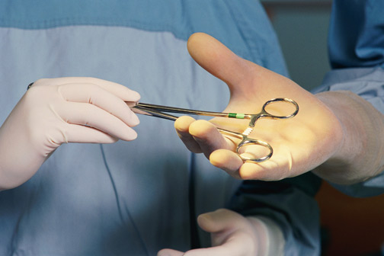
Through the Reproductive Years
Priority interventions:
1. Community-based promotion and delivery of contraceptives
2. Promotion of spacing methods (interval IUCD)
3. Sterilisation services (vasectomies and tubectomies)
4. Comprehensive abortion care (includes MTP Act)
5. Prevention and
management of
sexually transmitted
and reproductive infections
(STI/RTI)

Slide 116
Promotion of spacing methods
(interval IUCD)
Training of health personnel in IUCD insertion at all levels of health facilities
Ensure availability of IUCD CuT380 A
Ensuring IUCD services on fixed days at all sub centres and PHCs
CHC, SDH and DH will provide regular IUCD insertion services
Strengthen the counselling system at the facilities with high case load

Slide 117

STERILIZATION SERVICES
Promotion of non-scalpel vasectomy for increasing male participation
Emphasis on Minilap tubectomy services
Accreditation of private providers and NGOs for service delivery
Increasing the pool of trained
service providers
(Minilap, Laparoscopic
sterilization and
non-scalpel vasectomy)
Operationalising fixed day centers for
sterilization is an essential step in this direction

Slide 118
Comprehensive abortion care
Manual Vacuum Aspiration (MVA) facilities and medical methods of abortion in 24 X 7 Primary Health Centres.
The comprehensive Medical Termination of Pregnancy (MTP) services are to be made available at all District Hospitals and Sub-district level hospitals with priority given to ‘delivery points’.
Capacity building of Medical Officers, to equip them with skills necessary to provide safe abortion services at PHC level and above.
Medical abortion drugs (Mifepristone + Misoprostol for upto 7 weeks and Ethacridine lactate for 12 to 20 weeks)are to be included in the essential drug list

Slide 119
Management of sexually transmitted and reproductive tract infections (RTI and STI)
RTI/STI services to be provided at all CHCs and FRUs and at 24 X 7 PHCs.
For Syndromic Management availability of colour-coded kits, RPR testing kits for syphilis and HIV test should be ensured first at delivery points
Service providers should be trained in Syndromic Management of STI and RTI.
Importantly services should be made available across entire reproductive age group including adolescents, youth and adults.

Slide 120

Health Systems Strengthening for RMNCH+A Services
The key steps proposed for strengthening health facilities for delivery of RMNCH+A interventions are as follows:
a) Prepare and implement facility specific plans for ensuring quality and meeting service guarantees as specified under IPHS
b) Assess the need for new infrastructure, extension of existing infrastructure on the basis of patient load and location of facility

Slide 121
Health Systems Strengthening for RMNCH+A Services
c) Equip health facilities to support forty-eight-hour stay of mother and newborn.
d) Engage private facilities for family planning services, management of sick newborns and children, and pregnancy complications.
e) Strengthen referral mechanisms between facilities at various levels and communities.
f) Provision for adequate infrastructure for waste management

Slide 122
Resources
The creation of regular posts under state government so that contractual appointments can be slowly reduced and sustainable HR structure is developed
Strengthening sub centres through additional human resources: In sub centres of remote and hilly area, will have 2 ANMs, 1 male multipurpose worker, 1 pharmacist and 1AYUSH doctor
Capacity building of MO for reproductive, adolescent, maternal, newborn and child health
Training of nurses and ANM for SBA, IMNCI, Navjaat Shishu Suraksha Karyakram and IUCD insertion

Slide 123
Policies on drugs, procurement system and logistics management
Availability of free generic drugs for out/in patients in public health facilities is to be made by states for minimising out of pocket expenses.
Rational prescriptions and use of drugs
Timely procurement of drugs and consumables
Distribution of drugs to facilities from DH to sub centre; and uninterrupted availability to patients is to be ensured.
Placing essential drug lists (EDL) in the public domain
Computerised drugs and logistics MIS system

Slide 124

Quality assurance
Quality assurance at
all levels of service delivery
Quality certification/ accreditation
of facilities and services
- Certification for achievement of
Indian Public Health Standards
- Certification should be on comprehensive quality assurance for both infrastructure and service delivery
- Recommended that health facilities should be first certified by District and State Quality Assurance Cells

Slide 125
Community participation
Engage Village Health Sanitation and Nutrition Committees and Rogi Kalyan Samiti
Utilize the Village Health and Nutrition Days as a platform for assured and predictable package of outreach services
Social audit: social audits can be centred around activities like
i) Conduct of maternal death audits via verbal autopsies
ii) Utilization of health facility checklists

Slide 126

Monitoring, Information & Evaluation Systems
Civil registration system:
Efforts to ensure 100%
registration of births
and deaths under
Civil Registration System.
Web enabled Mother and Child Tracking System (MCTS): A more recent initiative is to link MCTS with AADHAR in order to track subsidies to eligible women

Slide 127
Monitoring, Information & Evaluation Systems
Maternal Death Review (MDR): identify causes of maternal deaths and the gaps in service delivery
Perinatal and Child Death Review: Death reports with cause of death for any child under five
Review missions: Annual Joint Review Missions by the RCH Division and Common Review Missions under NRHM

Slide 128
Monitoring, Information & Evaluation Systems
Health Management Information System (HMIS) based monitoring and review:
Following things monitored and interpreted at National, State & District levels:
Full Antenatal Care
Institutional Delivery,
Sterilization procedure
IUCD insertion
Full Immunization
Child & Maternal Death.

Slide 129
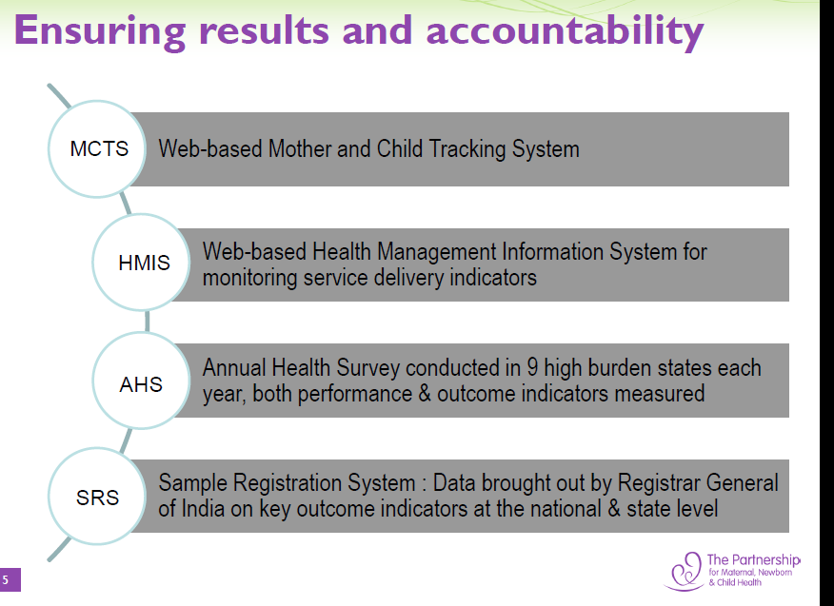

Slide 130
Score Card: HMIS Based Dashboard Monitoring System
Score card: HMIS based score card captures only service delivery indicators and assists in comparative assessment of state and district performance
16 indicators selected based on life cycle approach ( RMNCH+A) representing various phases
State average is the reference point for each indicator ; Each indicator is scored based on its contribution towards the state average: Positive scores (> state average)|Negative scores (< state average)
Indicators score aggregated as district score (all indicators given same weightage)
Districts classified into four categories based on total score ; Total score for a district can range between +64 to -64 ( 4ˣ16 indicators)

Slide 131
Score Card: Indicators across the life cycle
Proportion of:
Newborns breast fed within 1 hour to total live births
Women discharged in less than 48 hours of delivery in public institutions to total no. of deliveries in public institutions
Newborns weighing less than 2.5 kg to newborns weighed at birth
Newborns visited within 24hrs of home delivery to total reported home deliveries
Infants 0 to 11 months old who received Measles vaccine to reported live births
Proportion of:
SBA attended home deliveries to total reported home deliveries
Institutional deliveries to ANC registration
C-Section to reported deliveries
Proportion of:
Post-partum sterilization to total female sterilization
Male sterilization to total sterilization
IUD insertions in public plus private accredited institution to all family planning methods (IUD plus permanent)
Proportion of:
1st Trimester registration to ANC registration
Pregnant women received 3 ANC check-ups to total ANC registration
Pregnant women given 100 IFA to total ANC registration
Cases of pregnant women with Obstetric Complications and attended to reported deliveries
Pregnant women receiving TT2 or Booster to total number of ANC registered

Slide 132
EXAMPLE – Scoring for an indicator

Slide 133
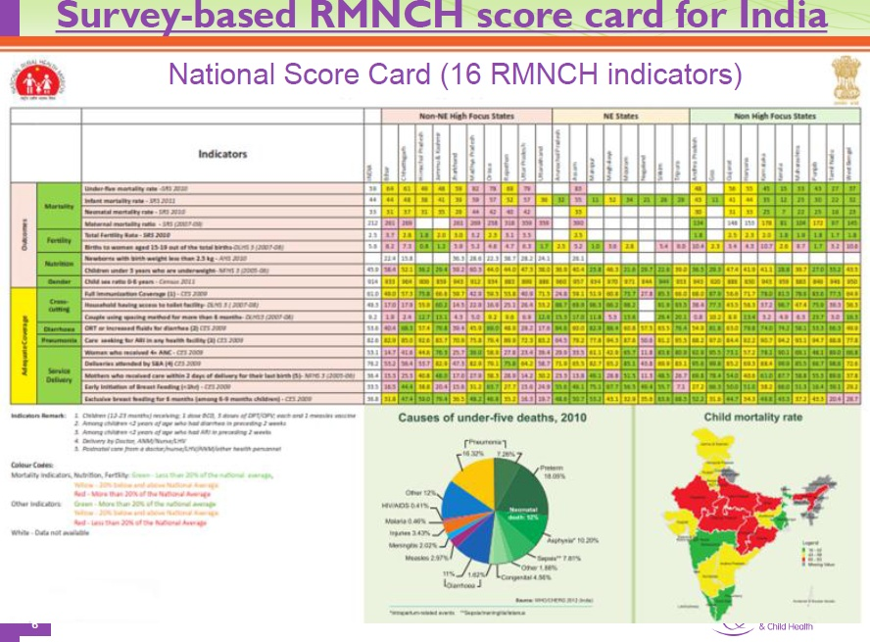

Slide 134
HIGH PRIORITY DISTRICT
Relative ranking of districts has been done within a State (based on a composite index) and bottom 25% of the districts be selected as High Priority Districts for that State.
184 High Priority Districts (HPDs) were selected in 29 states based on COMPOSITE HEALTH INDEX.

Slide 135
India Newborn action Plan
June 2014
Goal-attain Single digit Neonatal Mortality rate/ Stillbirth by 2030
6 pillars
Pre-conception and antenatal care
Care during labour and childbirth
Immediate newborn care
Care of healthy newborn
Care of small and sick newborn
Care beyond newborn survival

