Slide 1
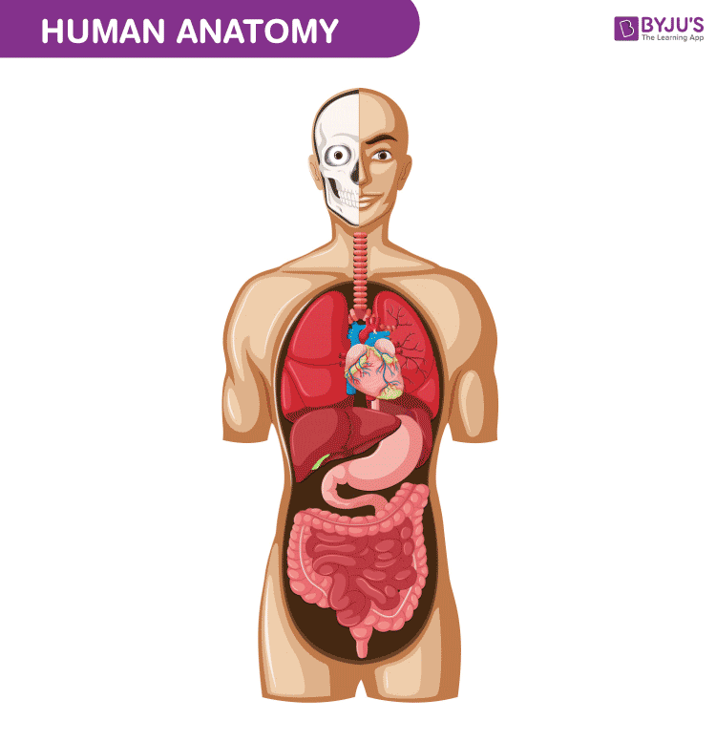
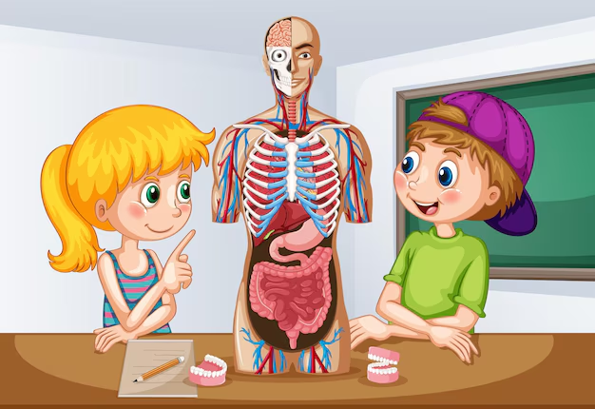
ANATOMICAL TERMS

Slide 2
OBJECTIVES
Define the terms relative to the anatomical position
Describe the anatomical planes

Slide 3
OBJECTIVES (continued)
3) Define and describe the terms used to describe movements

Slide 4
ANATOMICAL POSITION
This is the position assumed in all anatomical descriptions to ensure the accuracy and consistency.

Slide 5
Example
Body is in the upright position
Head facing forward
The arms at the sides with the palms of the hands facing forward and the feet together.

Slide 6
PAIRED DIRECTIONAL TERMS

Slide 7
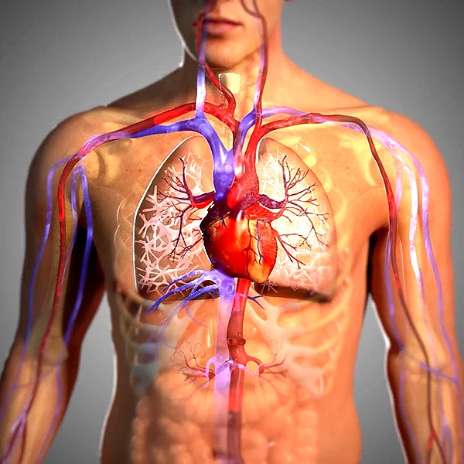
Anterior
Ventral
Posterior dorsal
Superior
Inferior

Slide 8
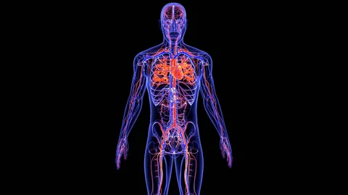
Median
Lateral
Proximal
Distal
Superficial

Slide 9
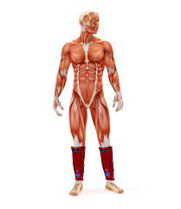
Deep
Prone
Supine
Palmar
Plantar

Slide 10
SL.NO | DIRECTIONAL TERM | MEANING
1. | Medial | Structure is nearer to the midline.
2. | Lateral | Structure is further from the midline or at the side of the body.
3. | Proximal | Nearer to a point of attachment of a limb or origin of a body part
4. | Distal | Further from a point of attachment of a limb, or origin of a body part

Slide 11
SL.NO | DIRECTIONAL TERM | MEANING
5. | Anterior/ Ventral | Part of the body being described is nearer the front of the body.
6. | Posterior/ Dorsal | Part of the body being described is nearer to the back of the body.
7. | Superior | Structure nearer to the head
8. | Inferior | Structure farther from the head

Slide 12
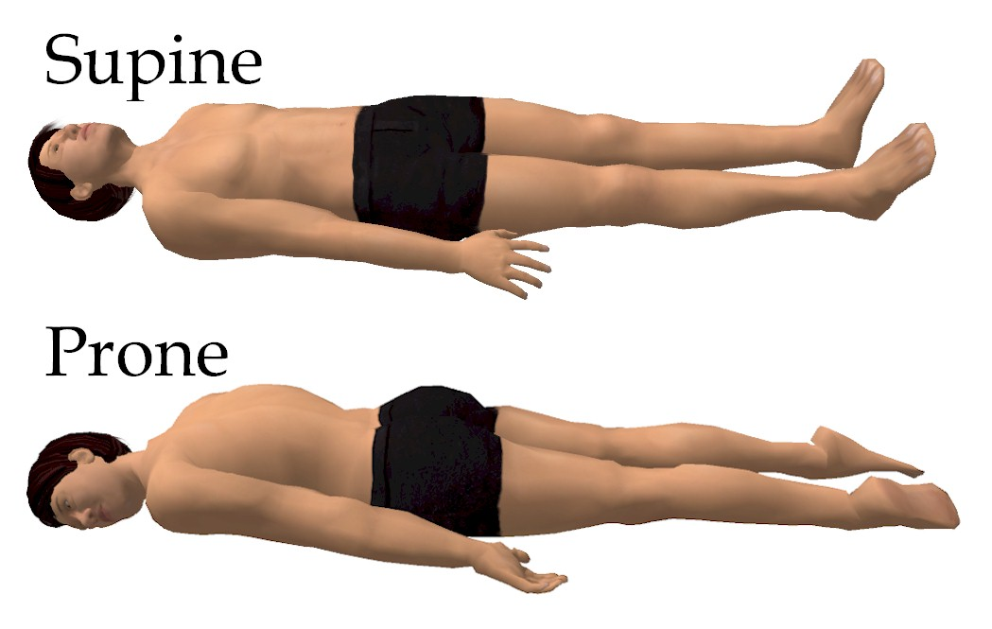

Slide 13
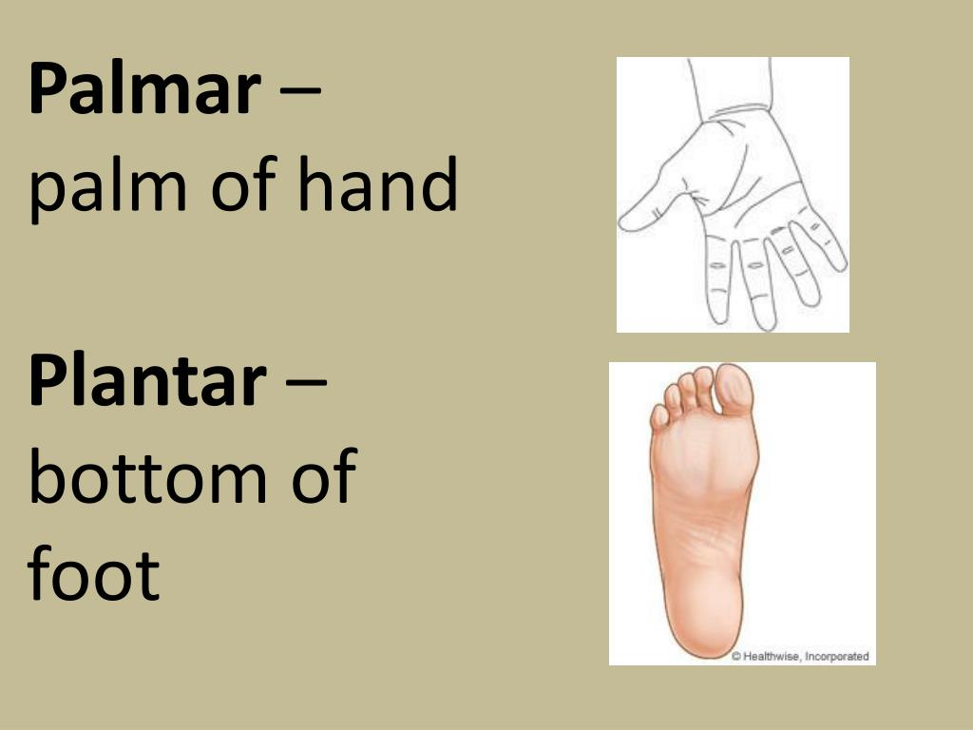

Slide 14
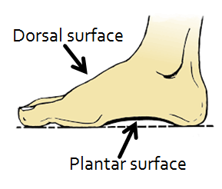

Slide 15
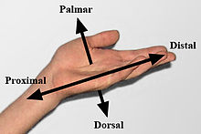

Slide 16
QUESTION
The eyes are superior to the mouth. True/ False

Slide 17
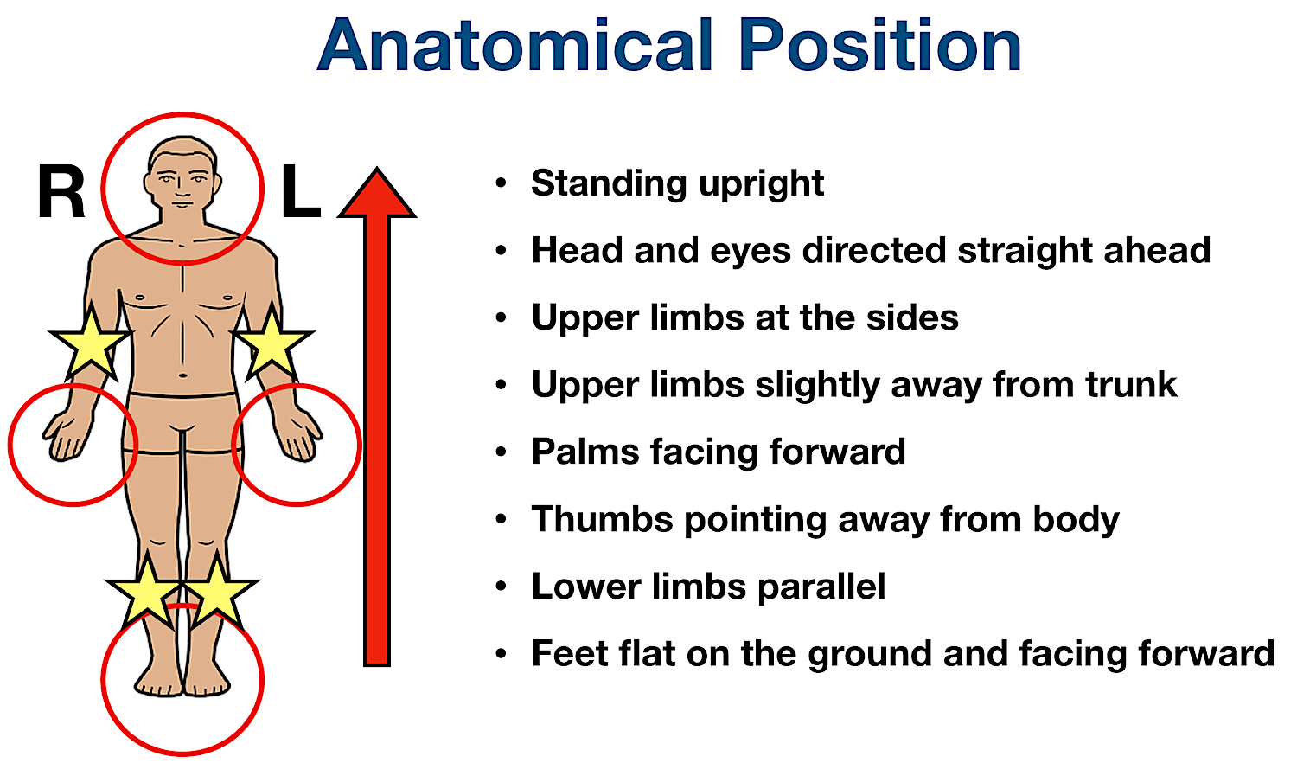

Slide 18
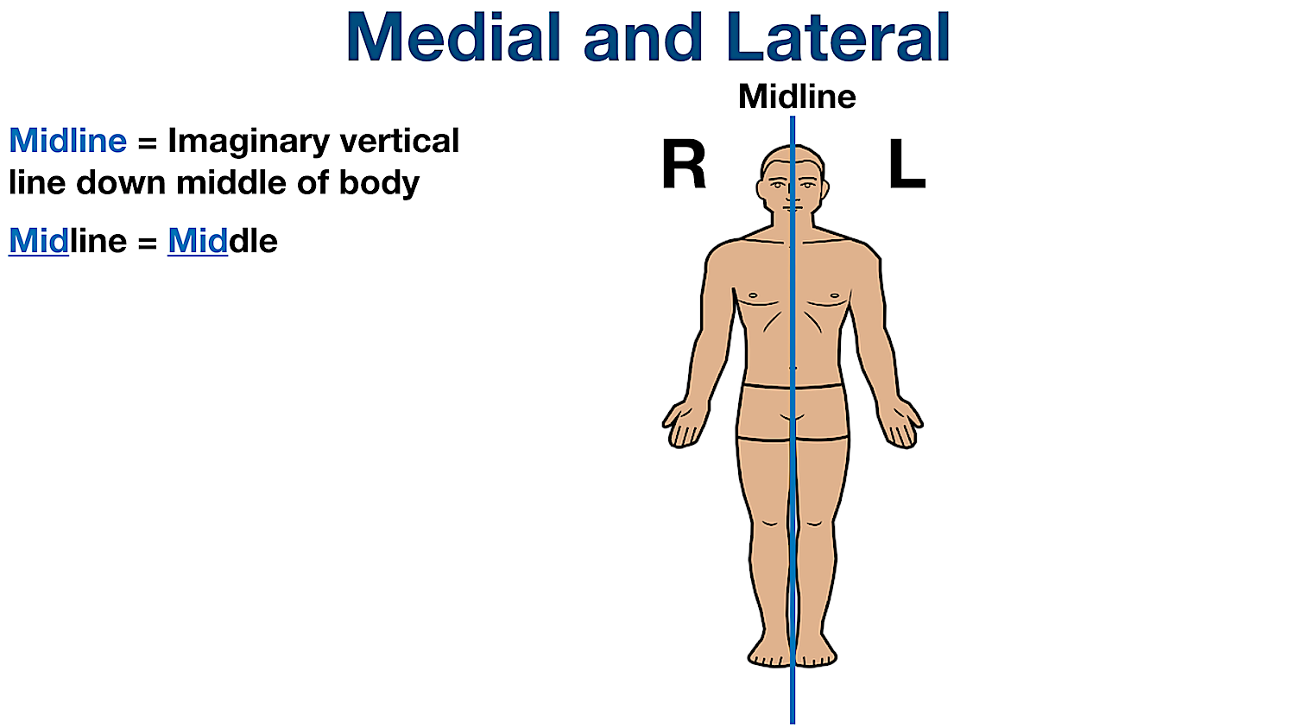

Slide 19
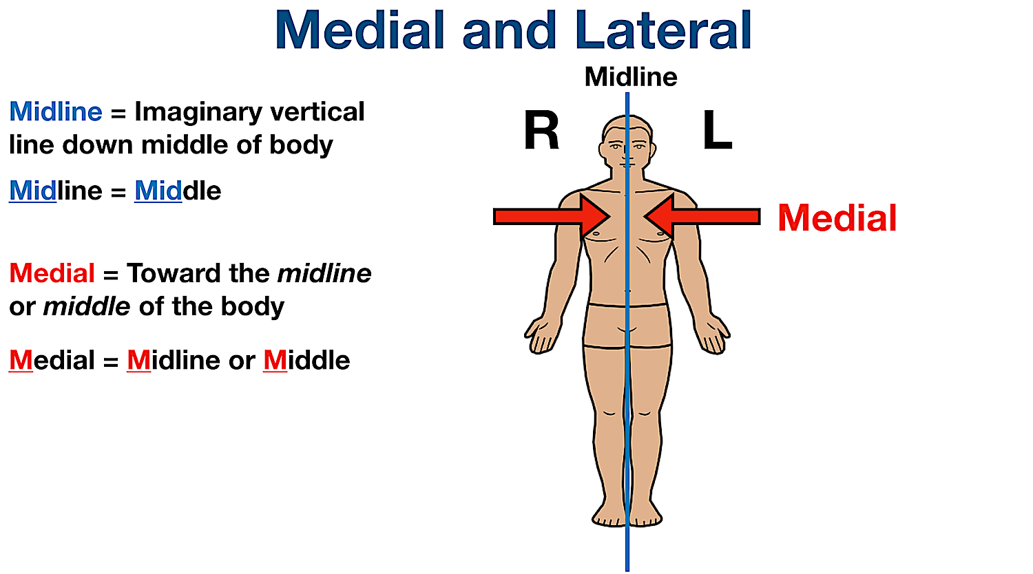

Slide 20
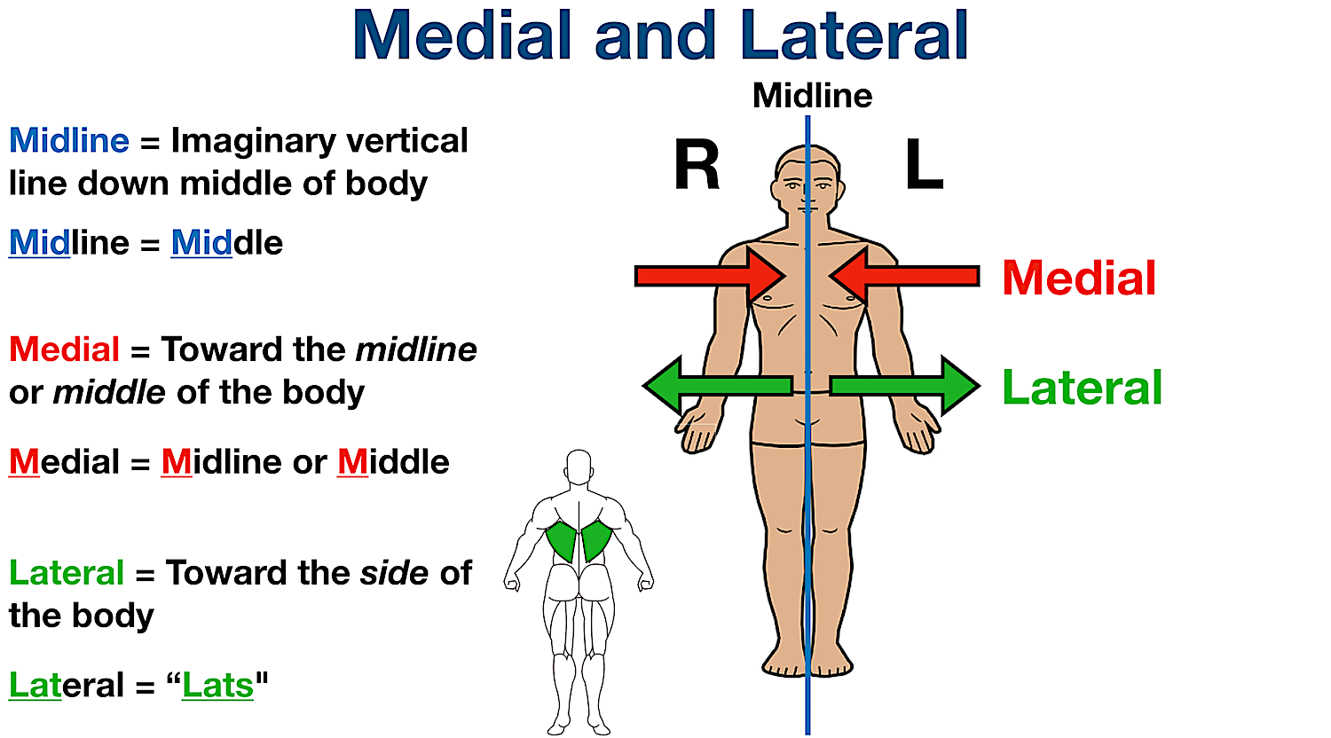

Slide 22
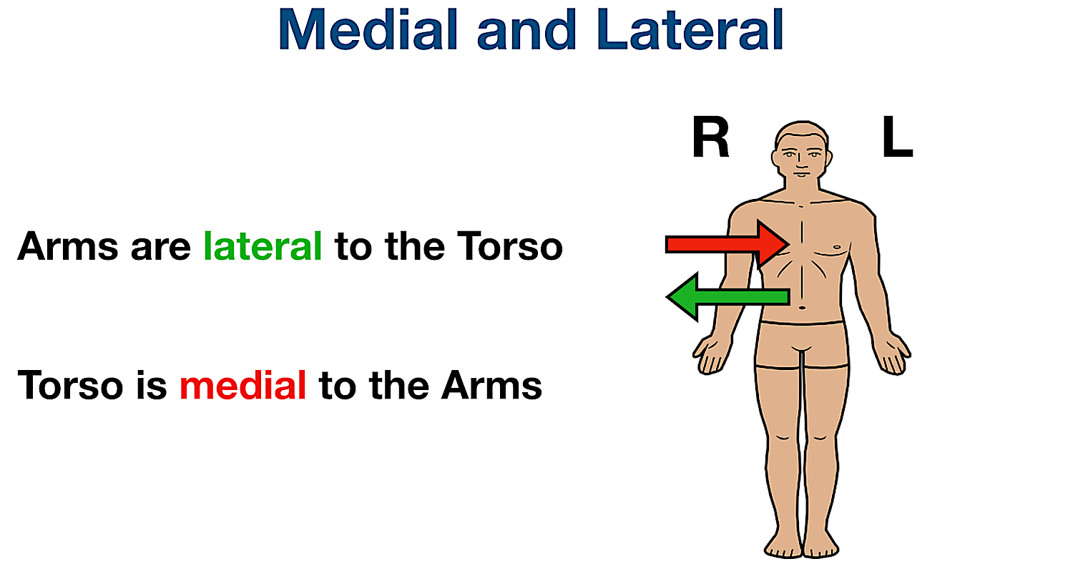

Slide 23
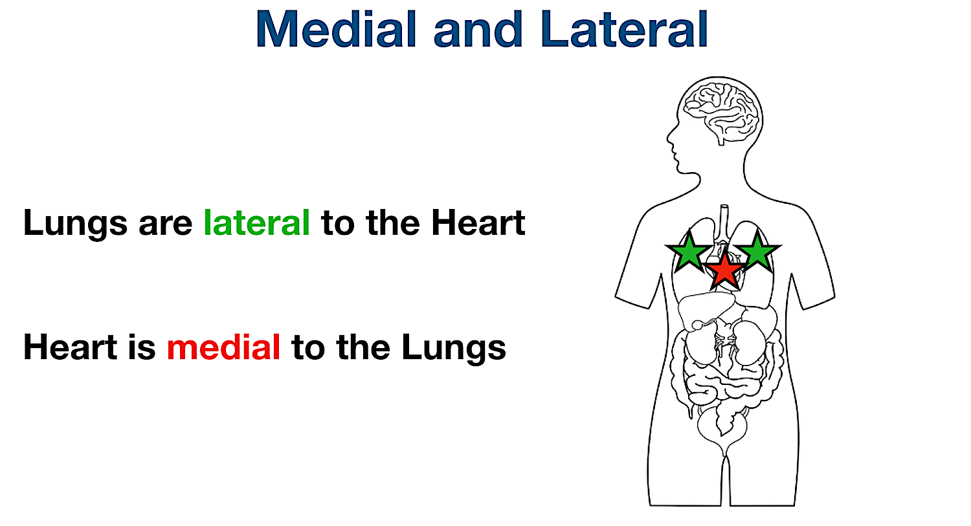

Slide 24
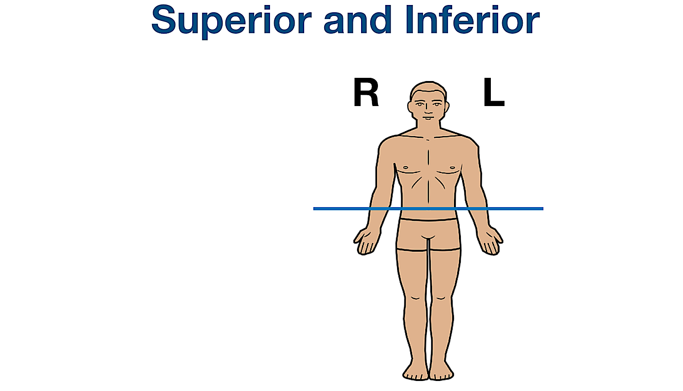

Slide 25
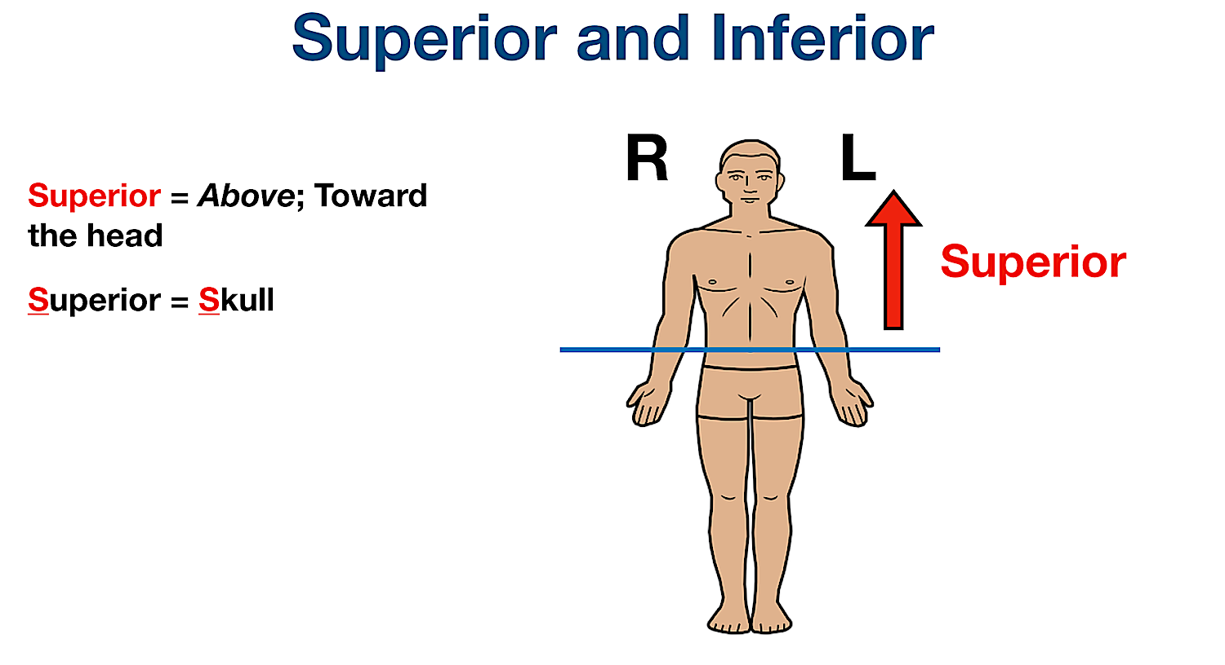

Slide 26
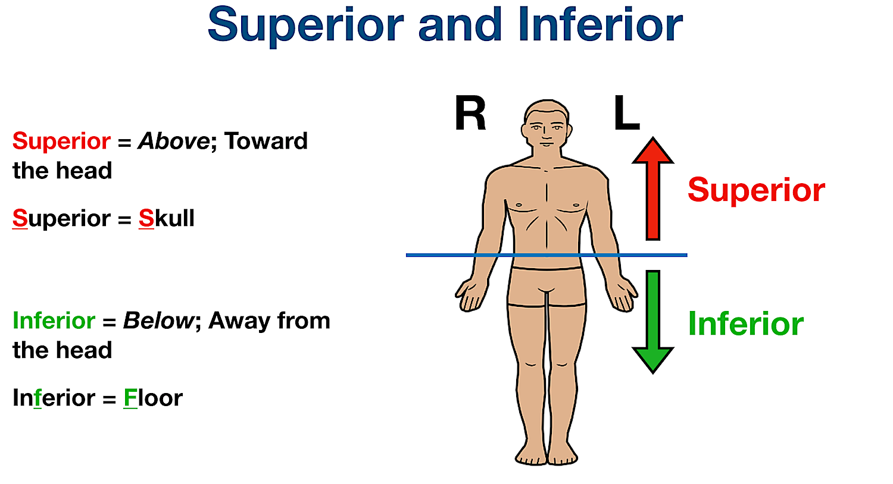

Slide 27
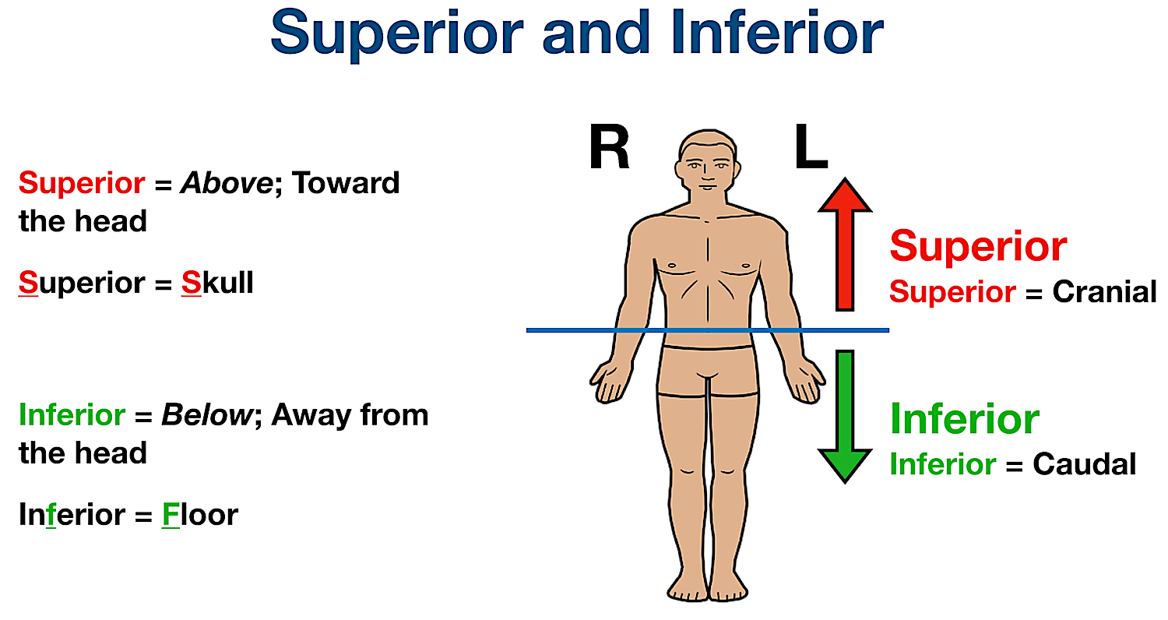

Slide 28
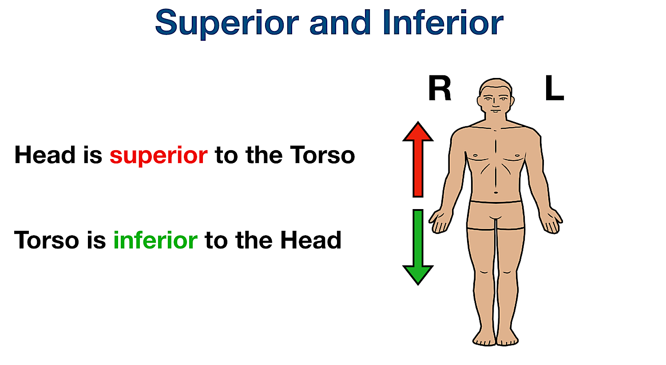

Slide 29
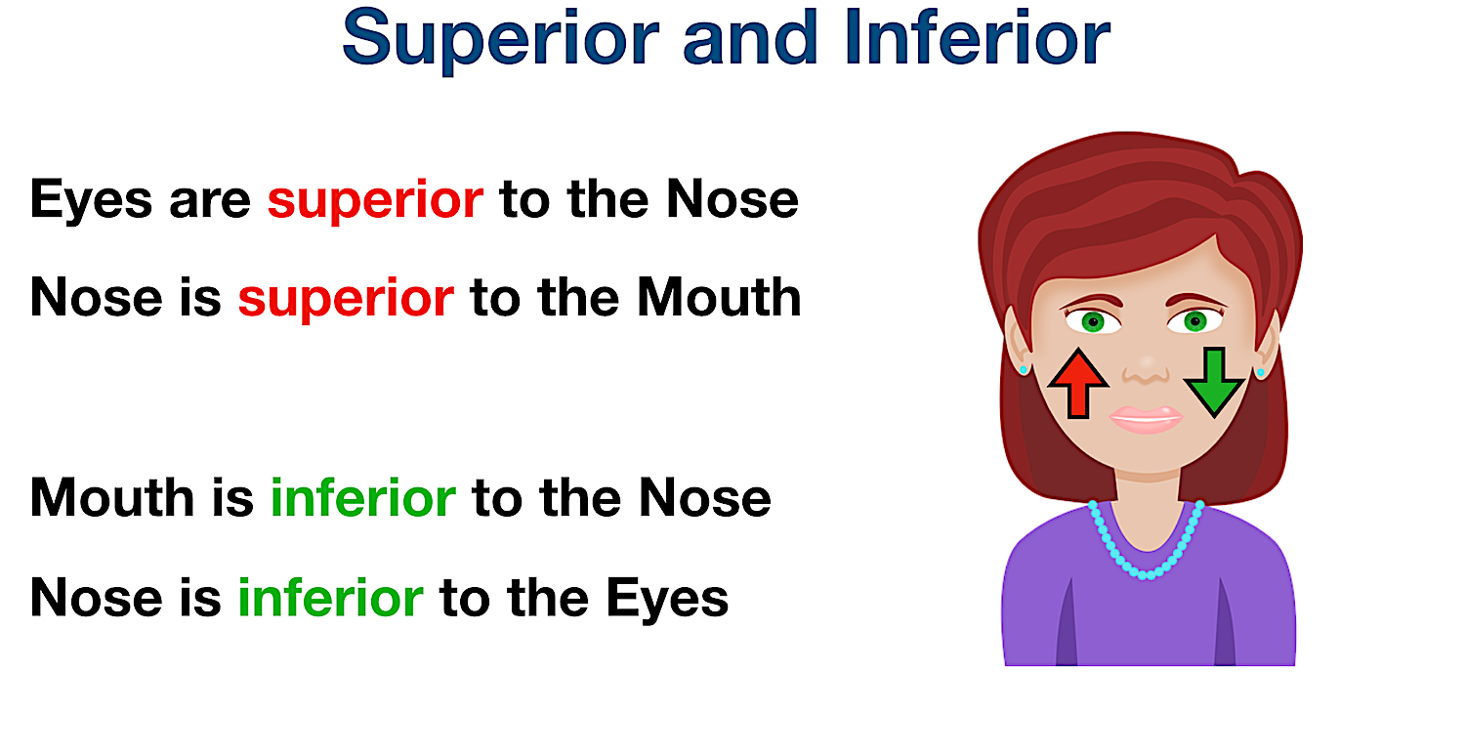

Slide 30
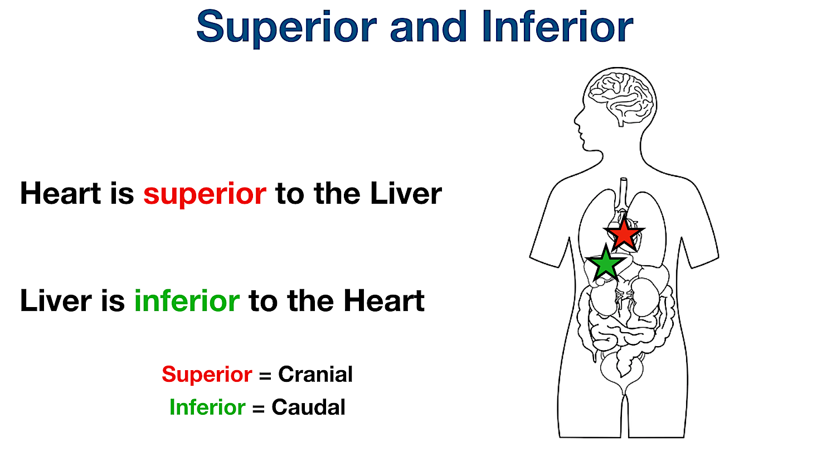

Slide 31
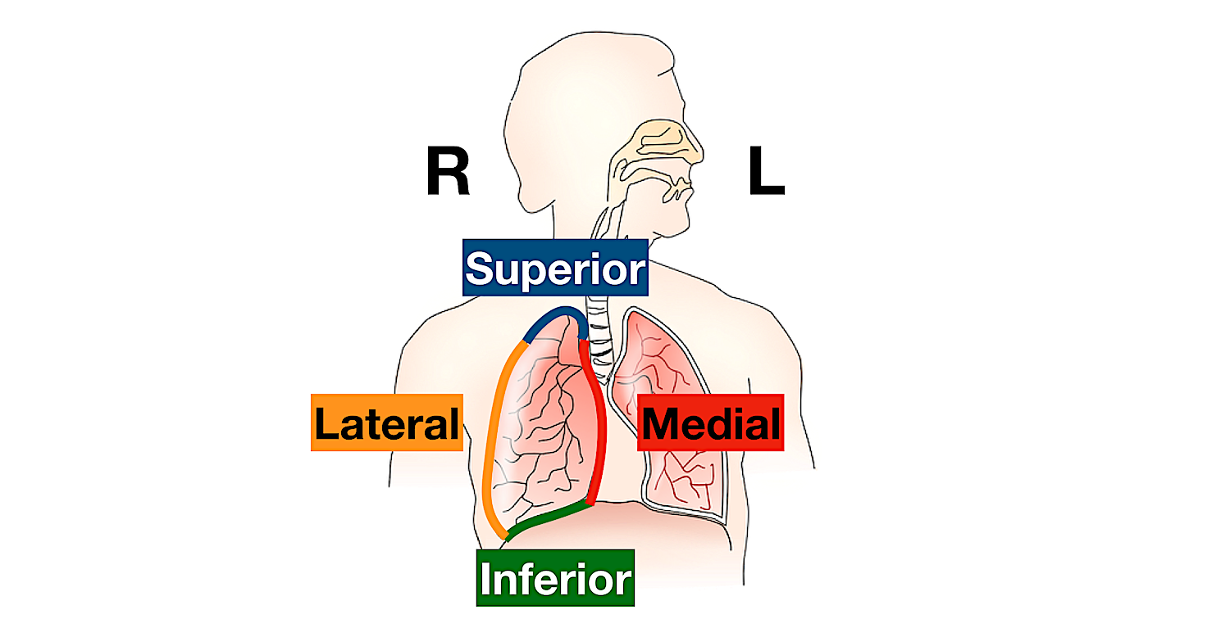

Slide 32
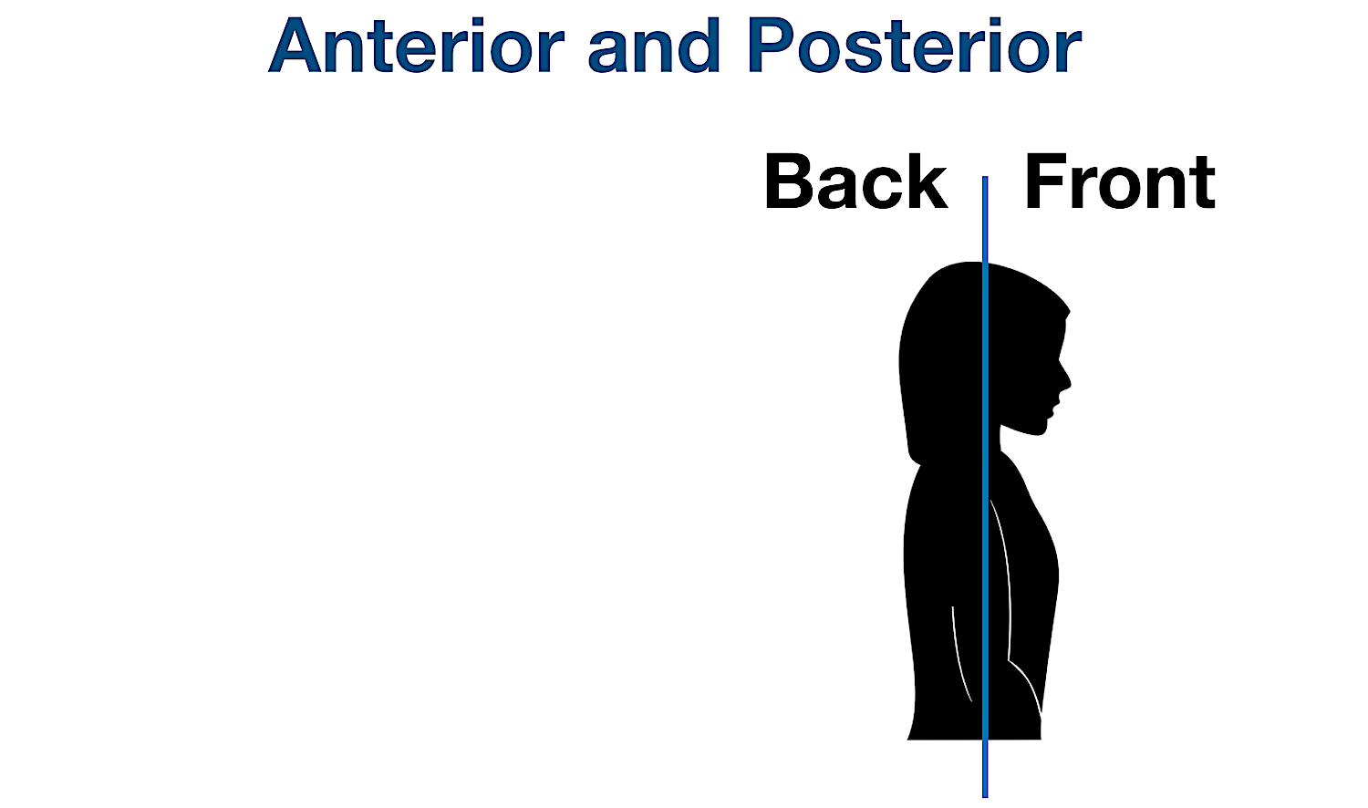

Slide 33
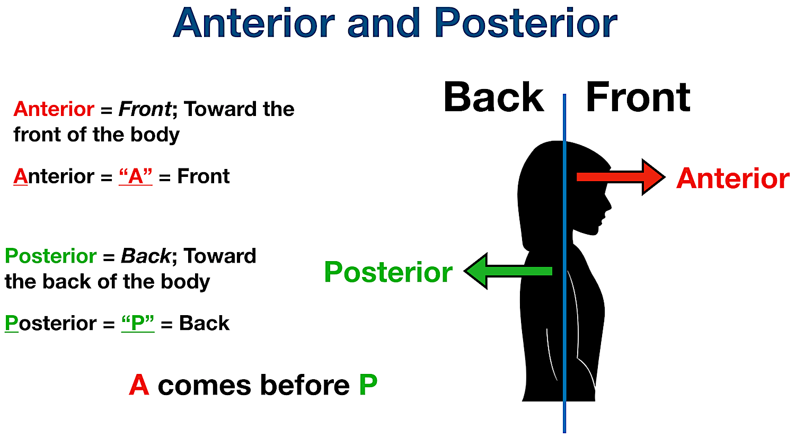

Slide 34
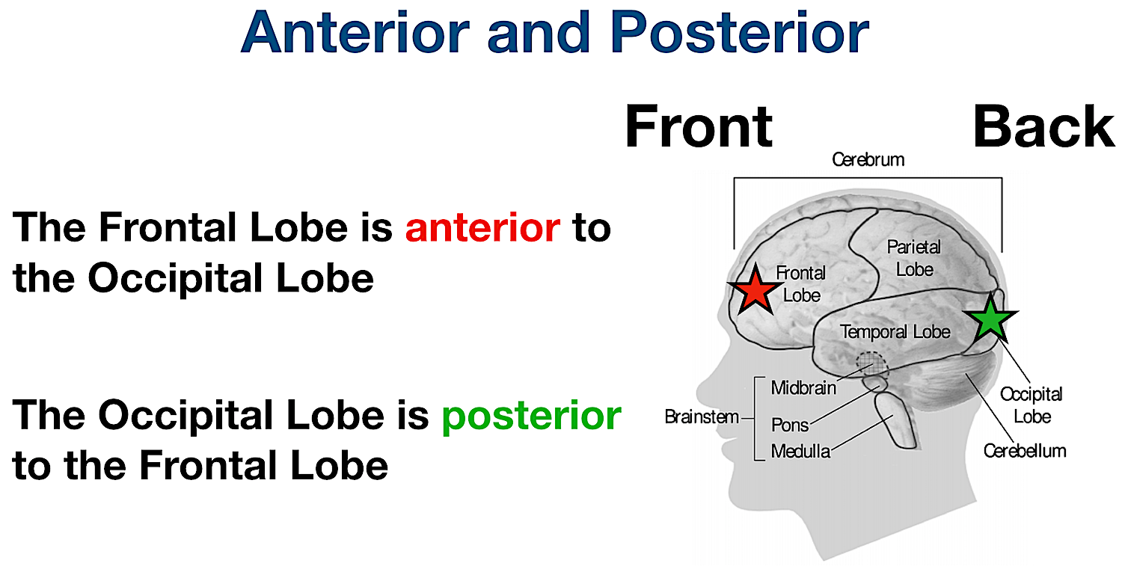

Slide 35
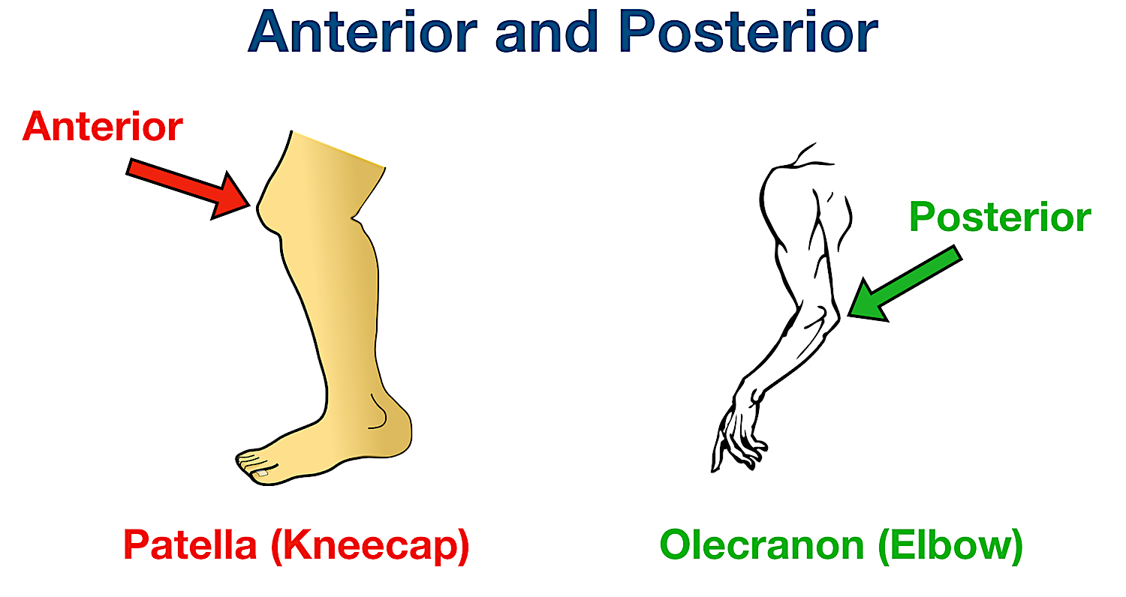

Slide 36
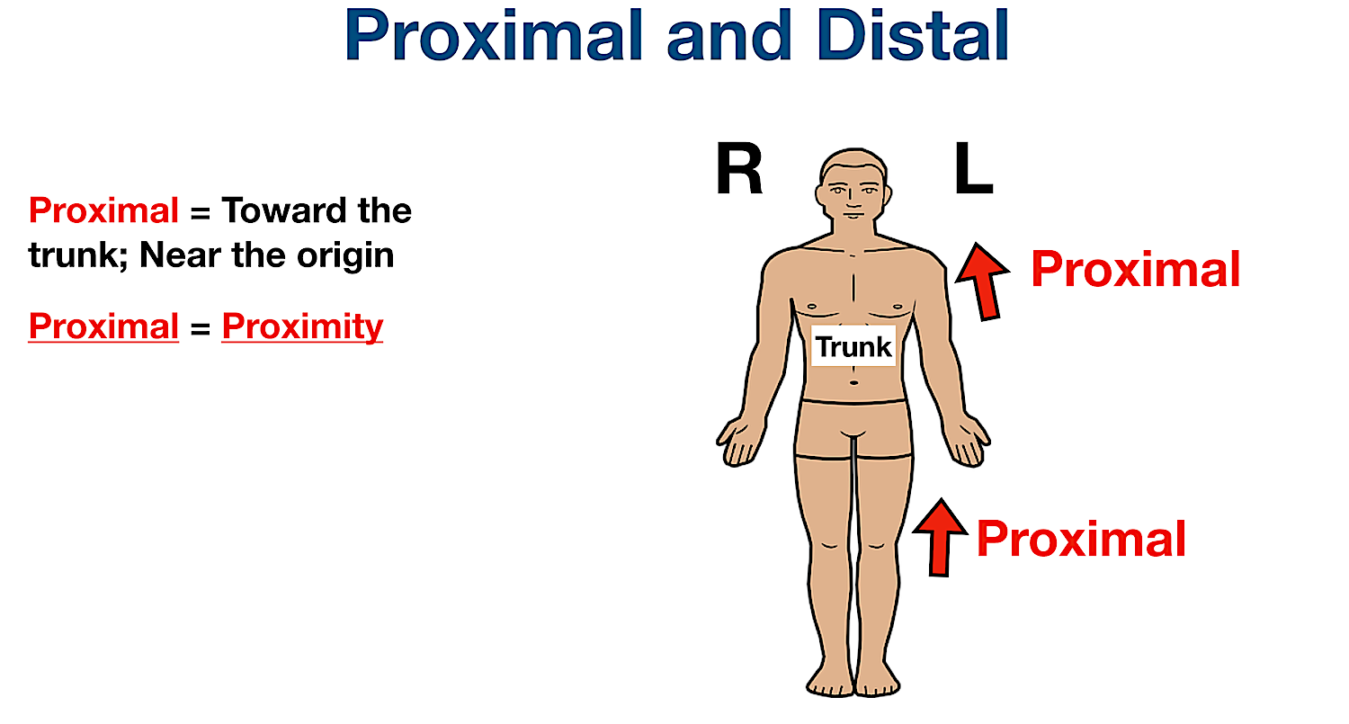

Slide 37
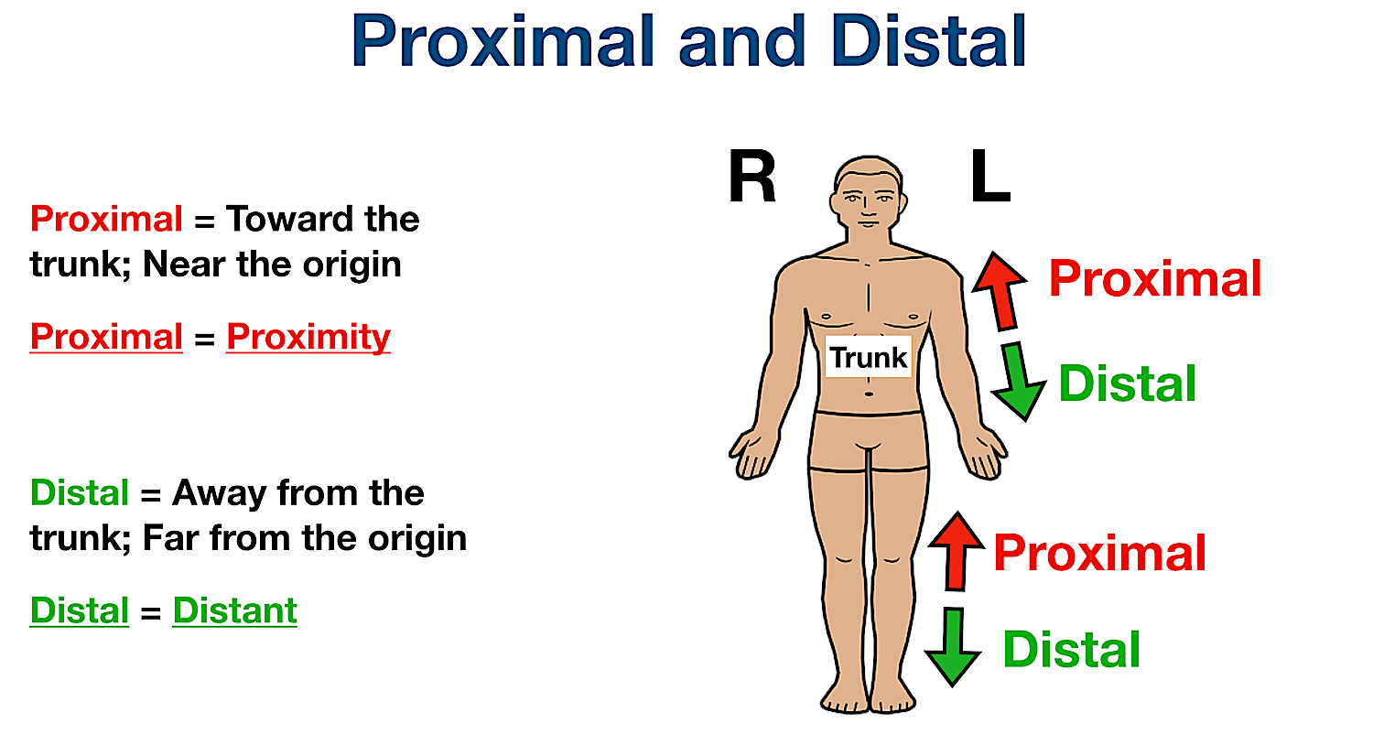

Slide 38
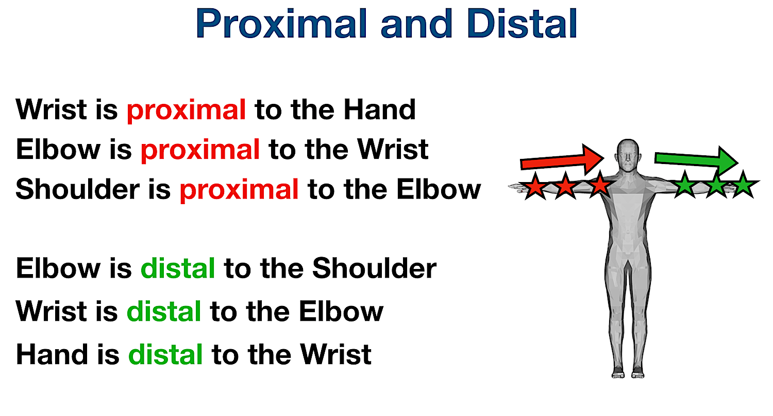

Slide 39
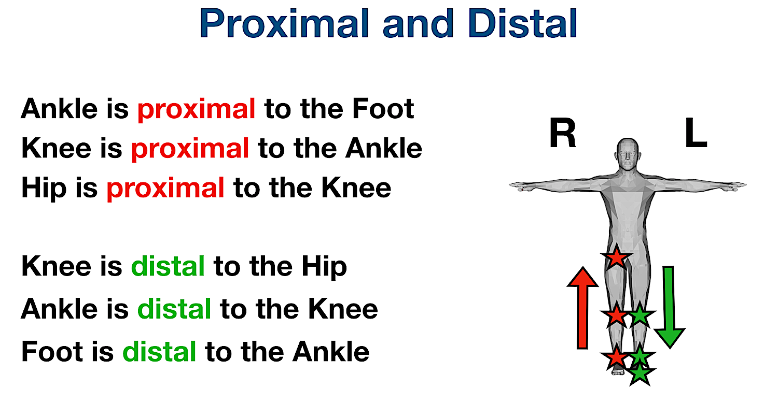

Slide 40
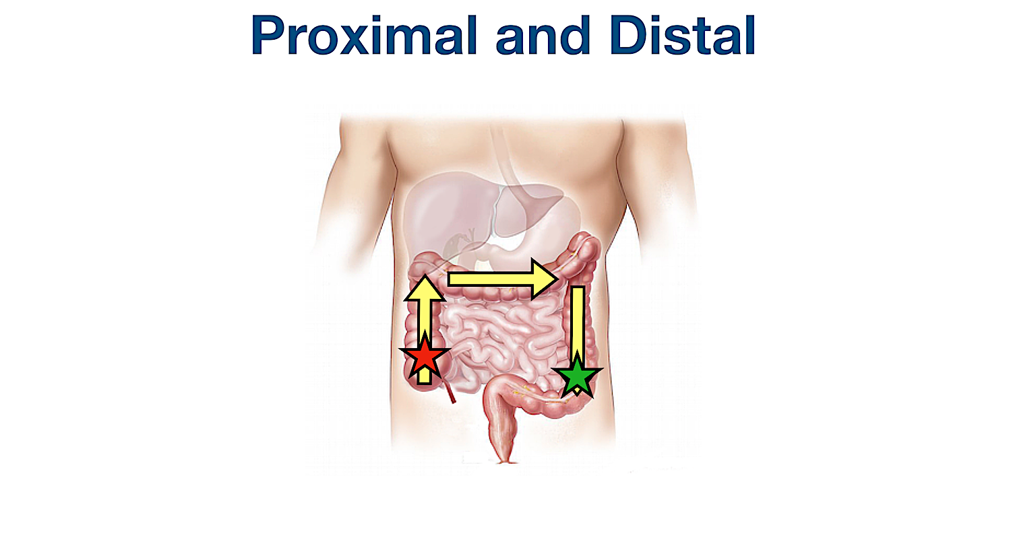

Slide 41
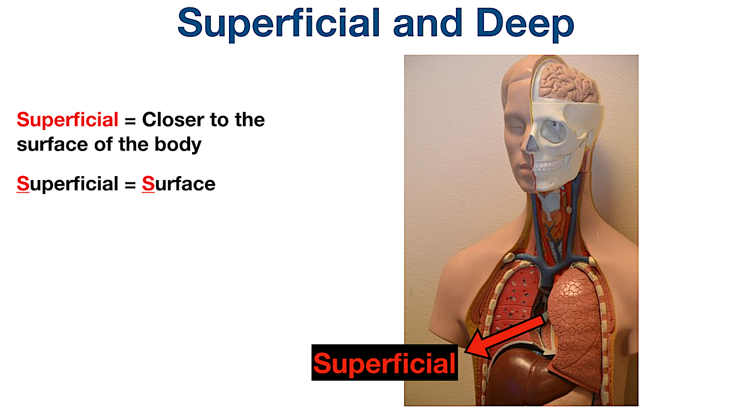

Slide 42
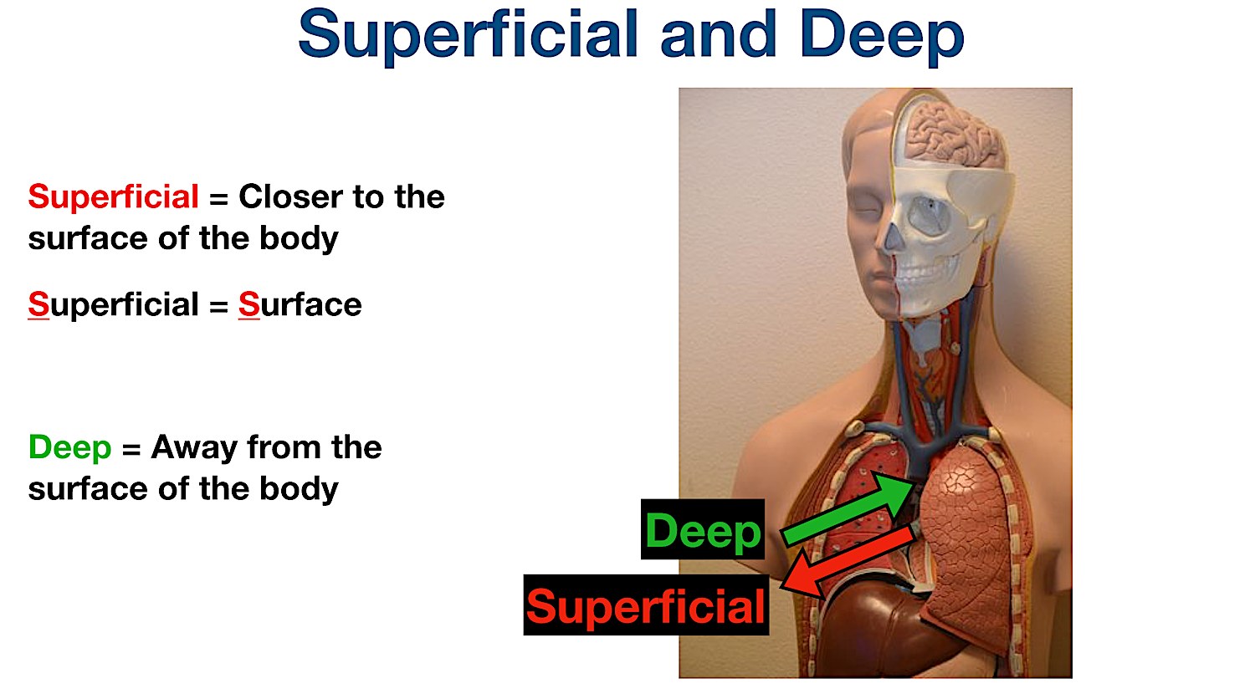

Slide 43
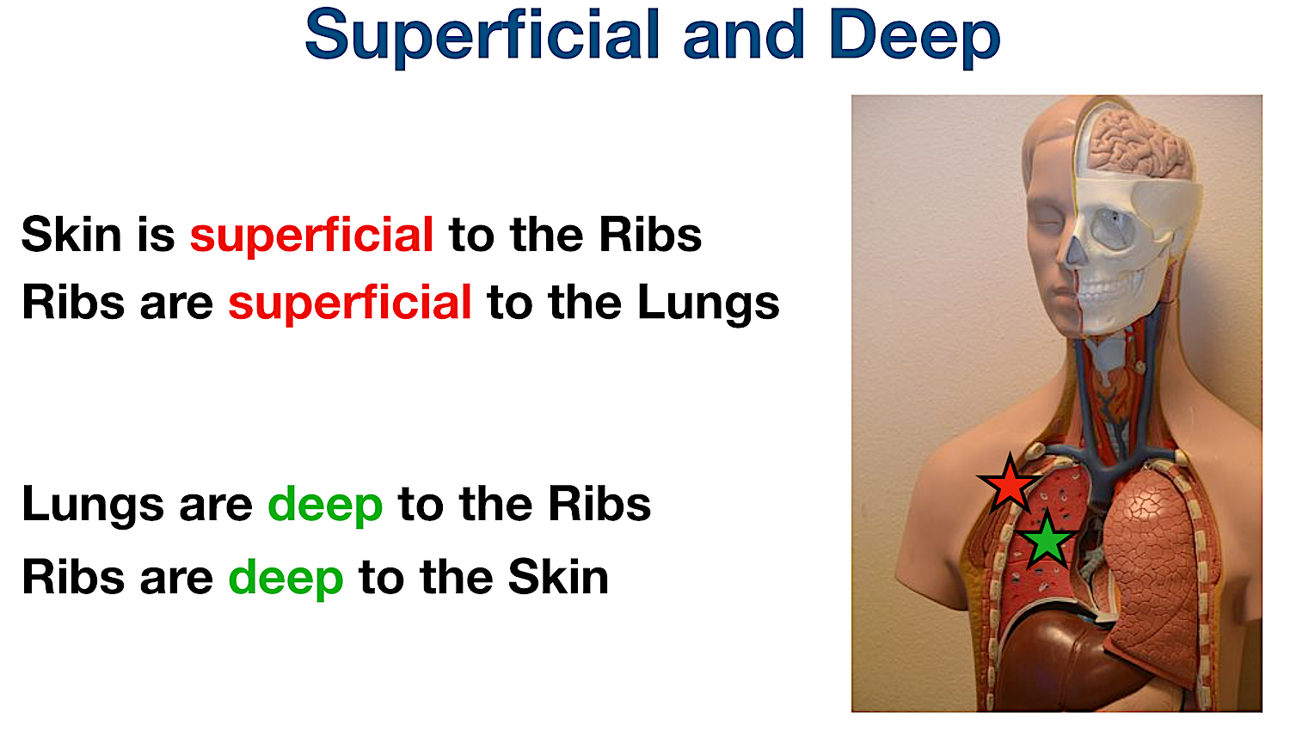

Slide 44
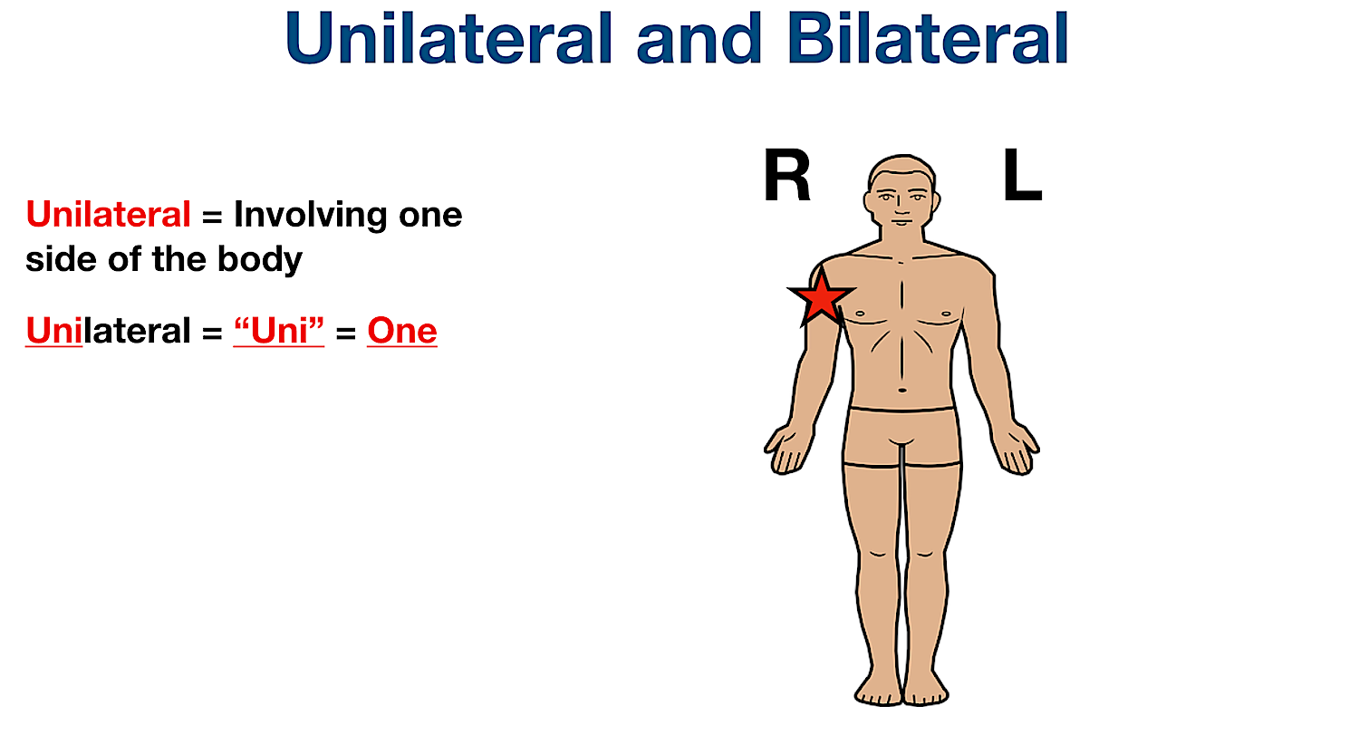

Slide 45
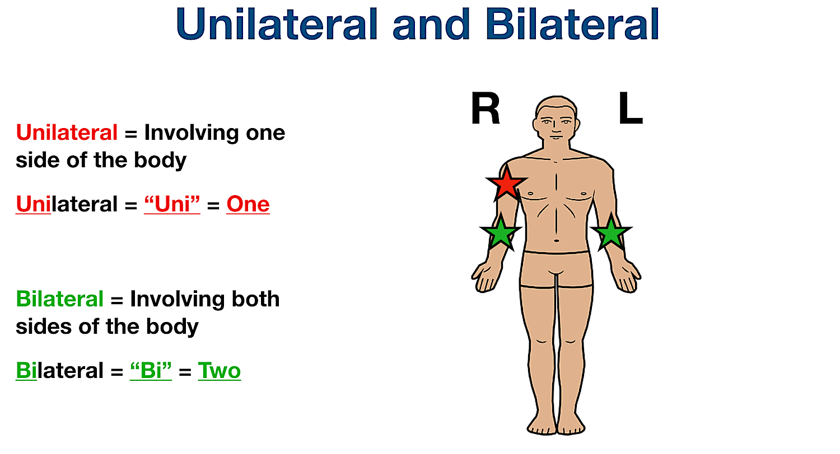

Slide 46
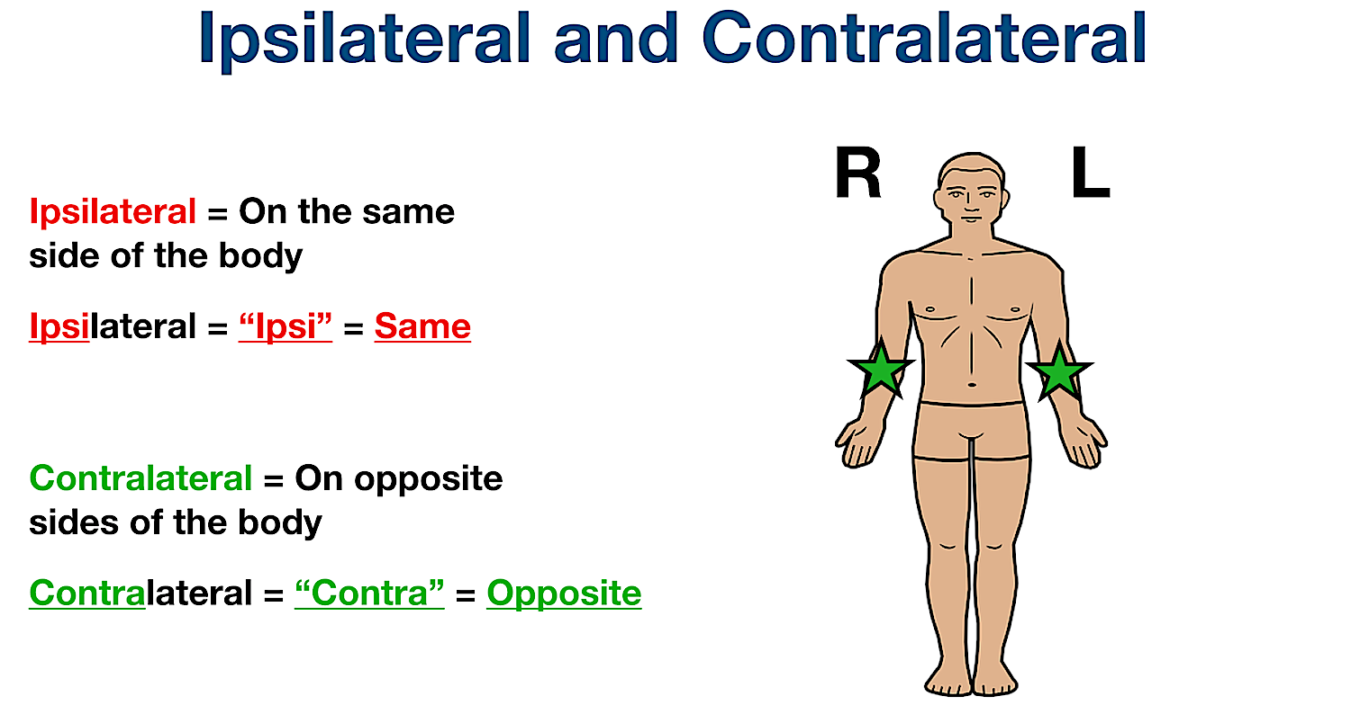

Slide 47
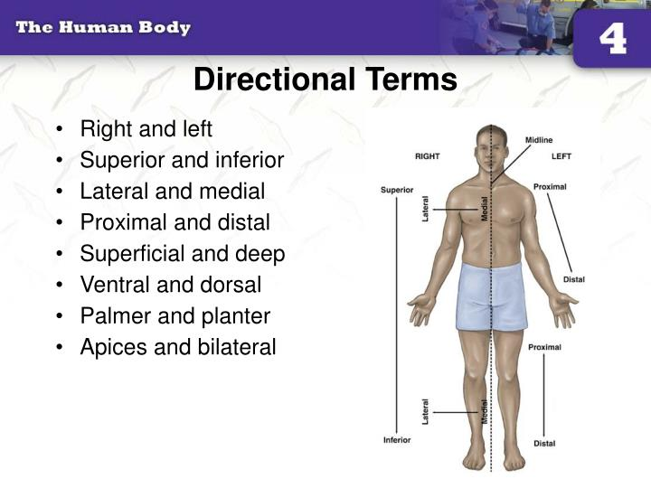

Slide 48
ANATOMICAL PLANES

Slide 49
PLANE
Is the surface on which movement occurs or takes place.

Slide 50
AXIS
Is the line around which the movement takes place.

Slide 51
AXIAL PLANE
The axial skeleton/ plane means axis of the body.
Body is 3 dimensional, so it has 3 imaginary planes/ sections that lie at right angles to each other.

Slide 52
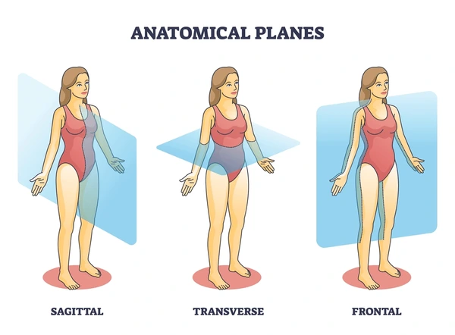

Slide 53
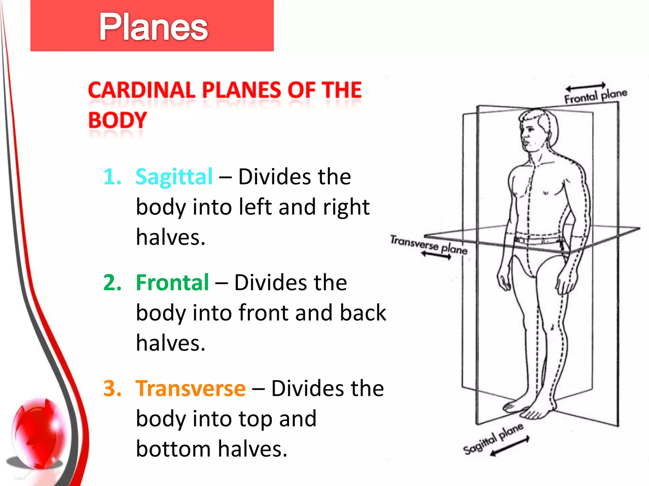

Slide 54
TRANSVERSE/ HORIZONTAL AXIAL PLANE
Also known as axial plane/ cross section divides the body into cranial and caudal portions.

Slide 55
TRANSVERSE/ AXIAL PLANE (continued)
It is parallel to the ground which separates superior from inferior.

Slide 56
Sagittal plane/ Median Plane/ Vertical Plane
Also known as longitudinal plane
Perpendicular to the ground divides the body into left and right halves.
Midsagittal or sagittal is in the median plane.

Slide 57
CORONAL /FRONTAL/ OBLIQUE PLANE
A coronal/frontal/ oblique plane is perpendicular to the ground and divides the body into dorsal (posterior or back) and ventral (anterior or front) portions.

Slide 58
QUESTION No. 1
A patient who is supine is lying
Face up
Face down
On the left side
On the right side

Slide 59
QUESTION No. 2
2) The term proximal is best described as
Closer to the joint or extremity
Further away from joint or extremity
Closer to the trunk of the body
Farther away from the trunk of the body

Slide 60
QUESTION No. 3
3) Plantar refers to
Bottom of the foot
Palm of the hand
Forehead
Buttocks

Slide 61
QUESTION No. 4
4) The anatomical position is best described as a person
Standing, facing forward, palms forward
Lying on their back, palm, facing down
Standing facing sideways, palms facing thighs

Slide 62
QUESTION No. 5
5) The term refers to a position closer to midline is
Medial
Lateral
Posterior
Anterior

Slide 63
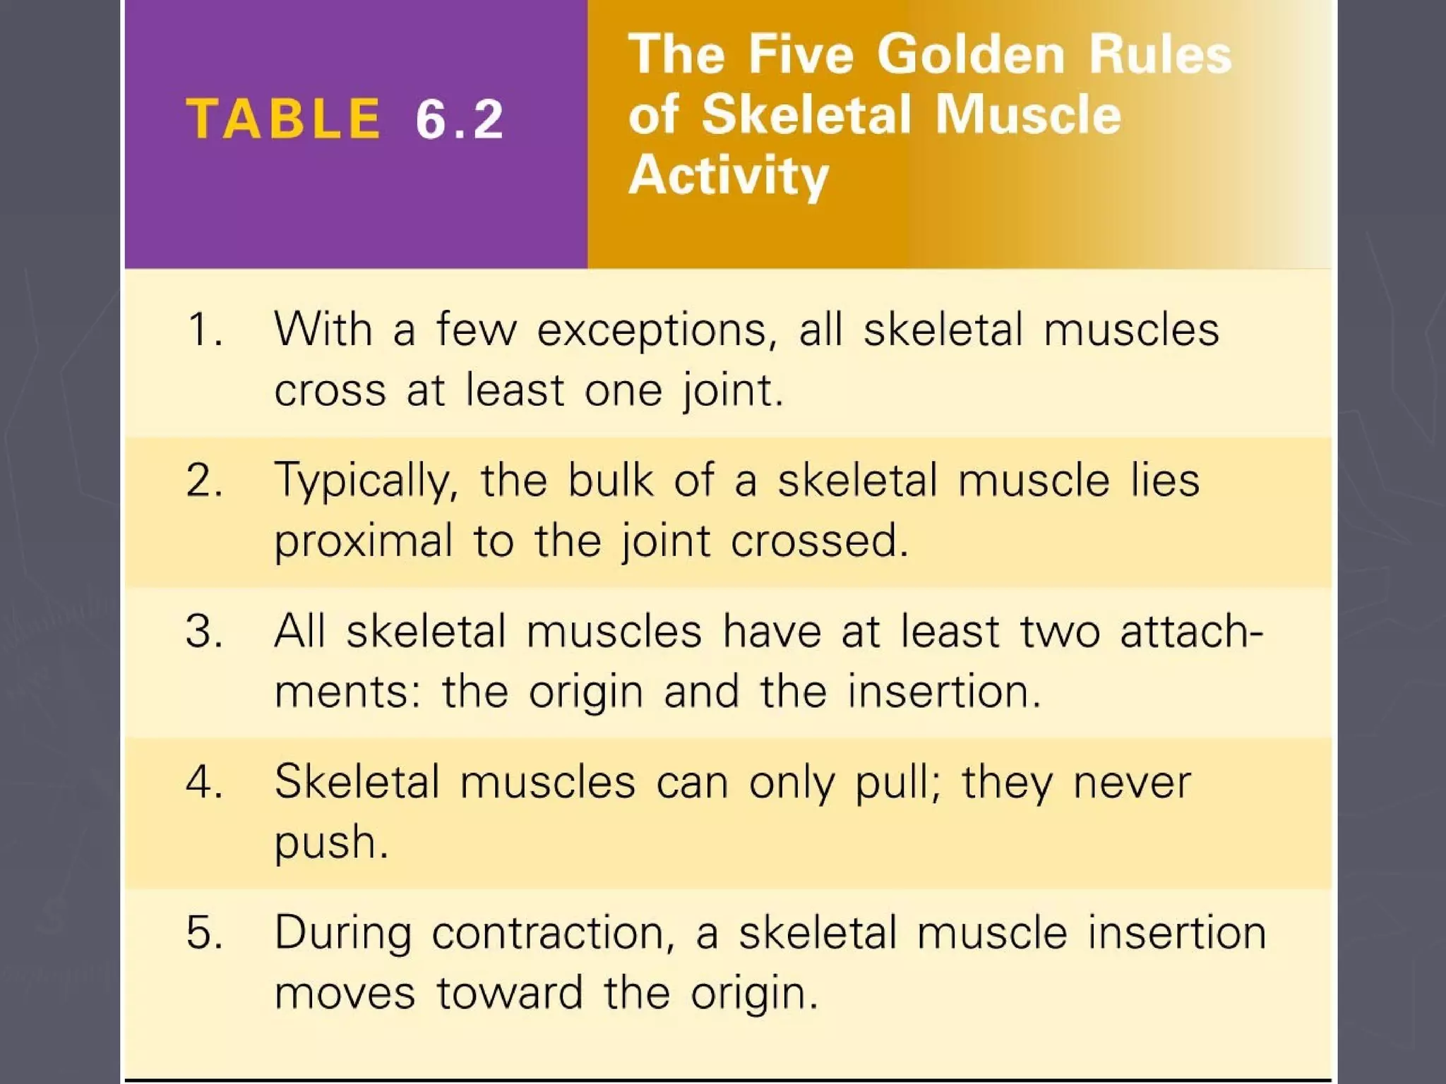

Slide 64
MOVEMENTS

Slide 65
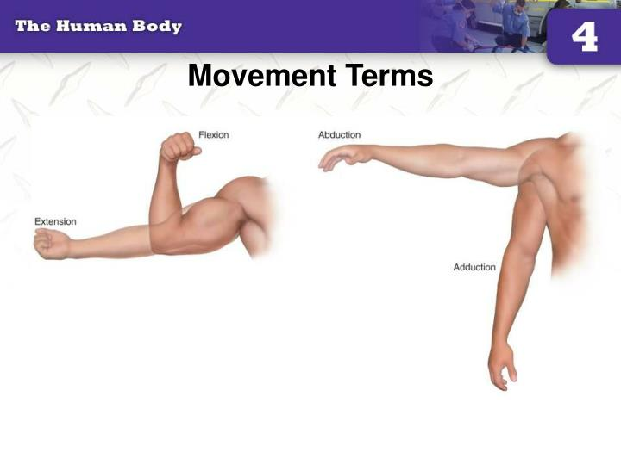

Slide 66
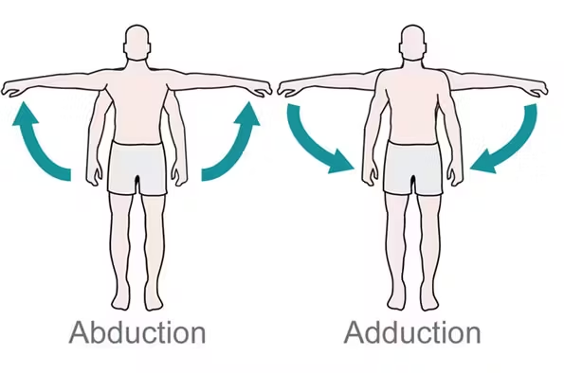

Slide 67
SL.NO. | MOVEMENT | DEFINITION
1. | Flexion | Bending, usually forward but occasionally backward.
2. | Extension | Straightening or bending backward
3. | Abduction | Movement away from the midline of the body
4. | Adduction | Movement towards the midline of the body

Slide 68
SL.NO. | MOVEMENT | DEFINITION
5. | Circumduction | Combination of flexion, extension, abduction or adduction
6. | Rotation | Movement round the long axis of the body
7. | Pronation | Turning the palm of the hand down
8. | Supination | Turning the palm of the hand up
9. | Inversion & Eversion | Turning the sole of the foot inwards & turning the sole of the foot outwards

Slide 69
TISSUES

Slide 70
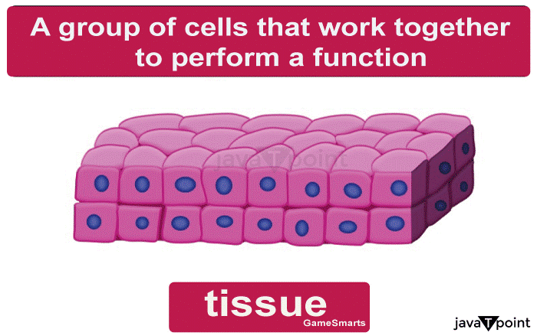

Slide 71
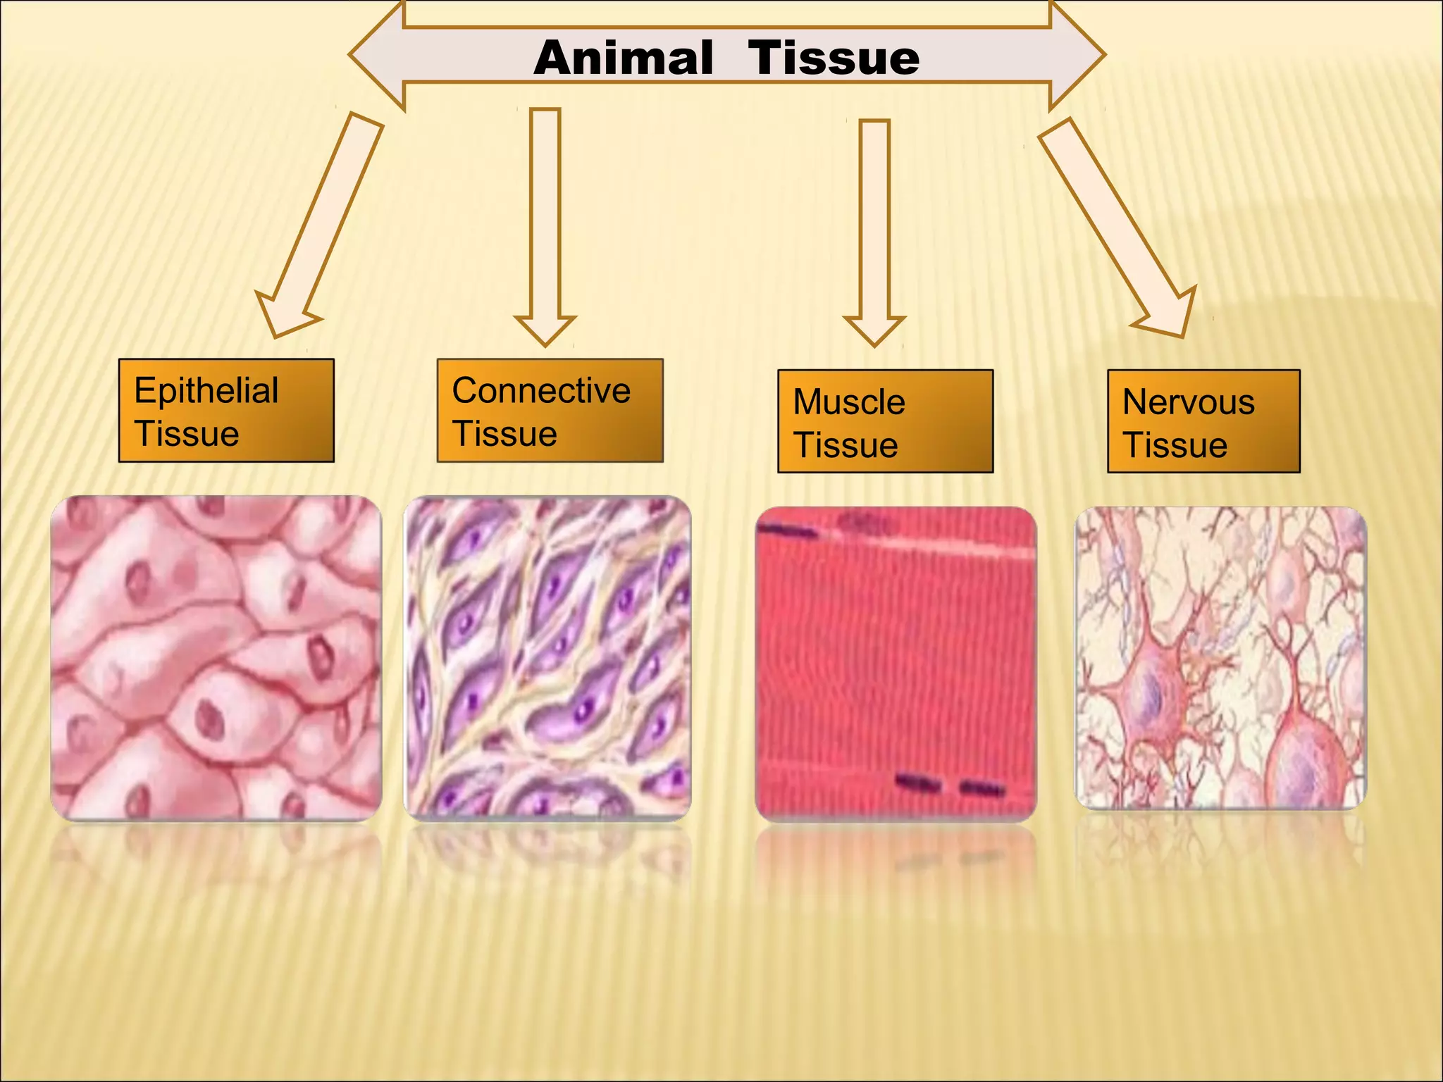

Slide 72
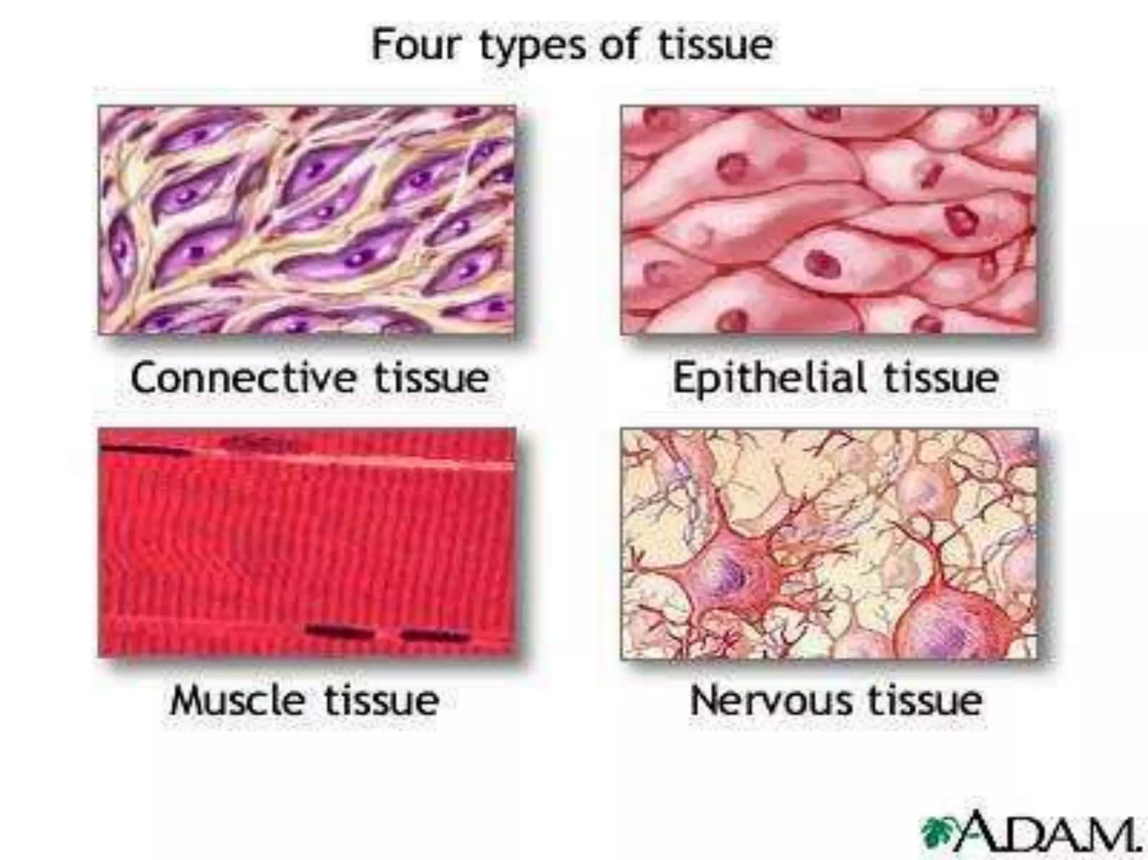

Slide 73
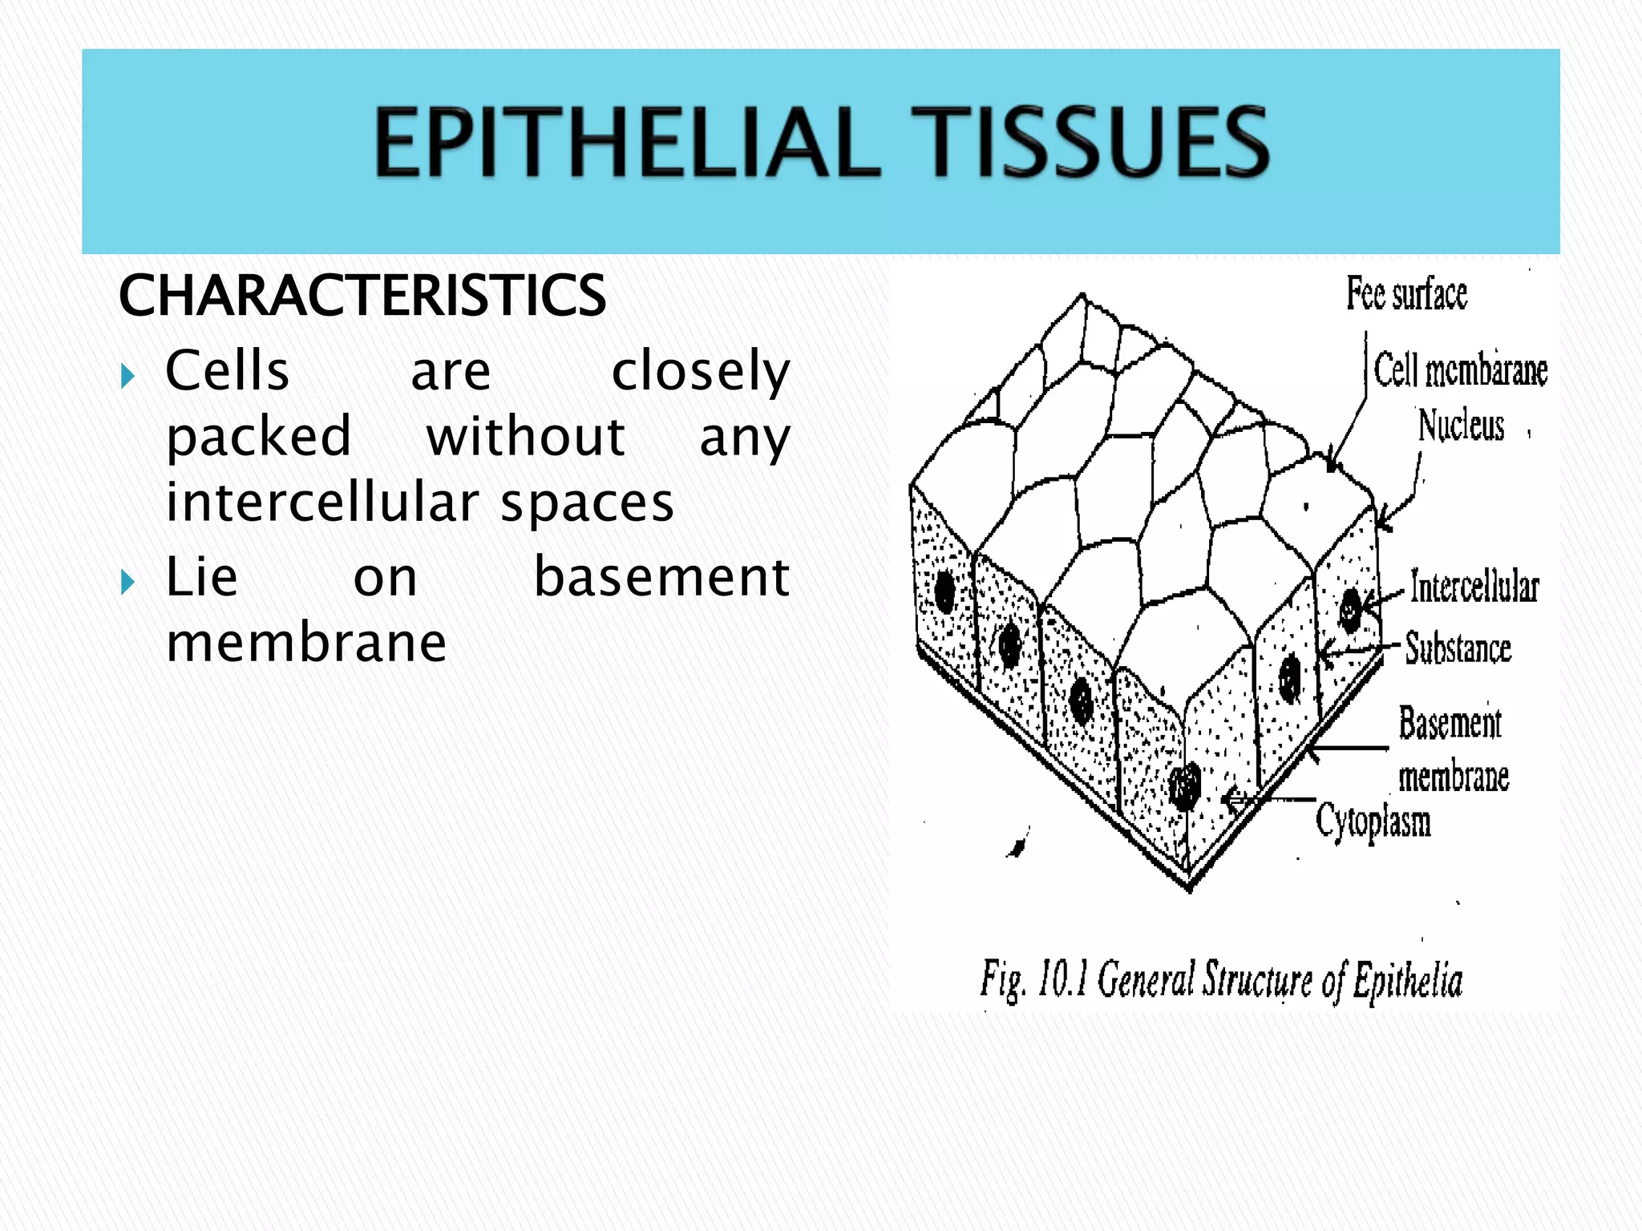

Slide 74
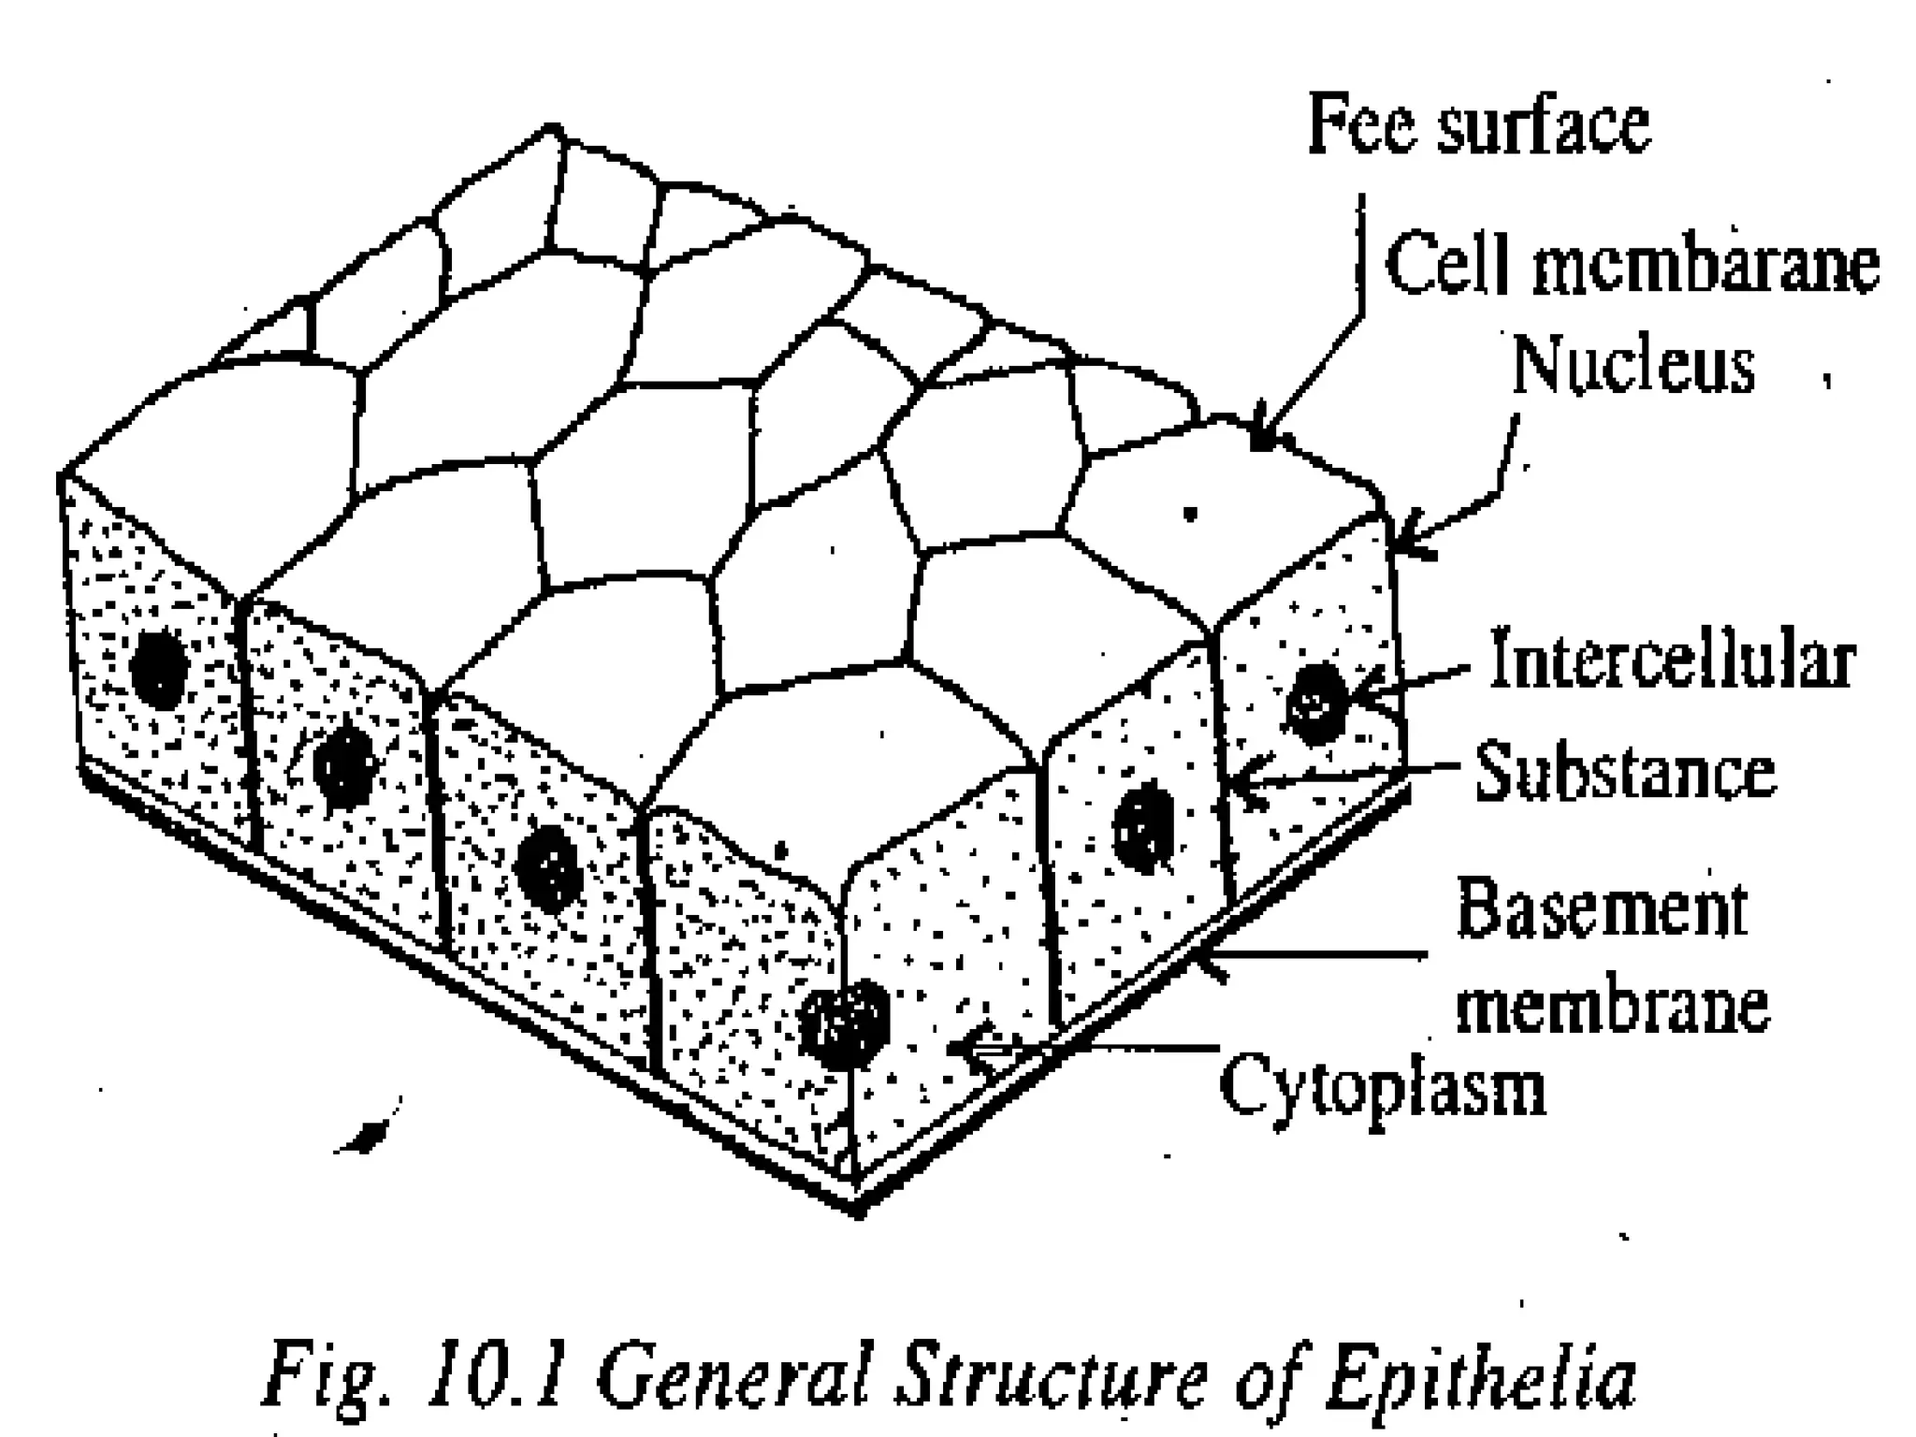

Slide 75
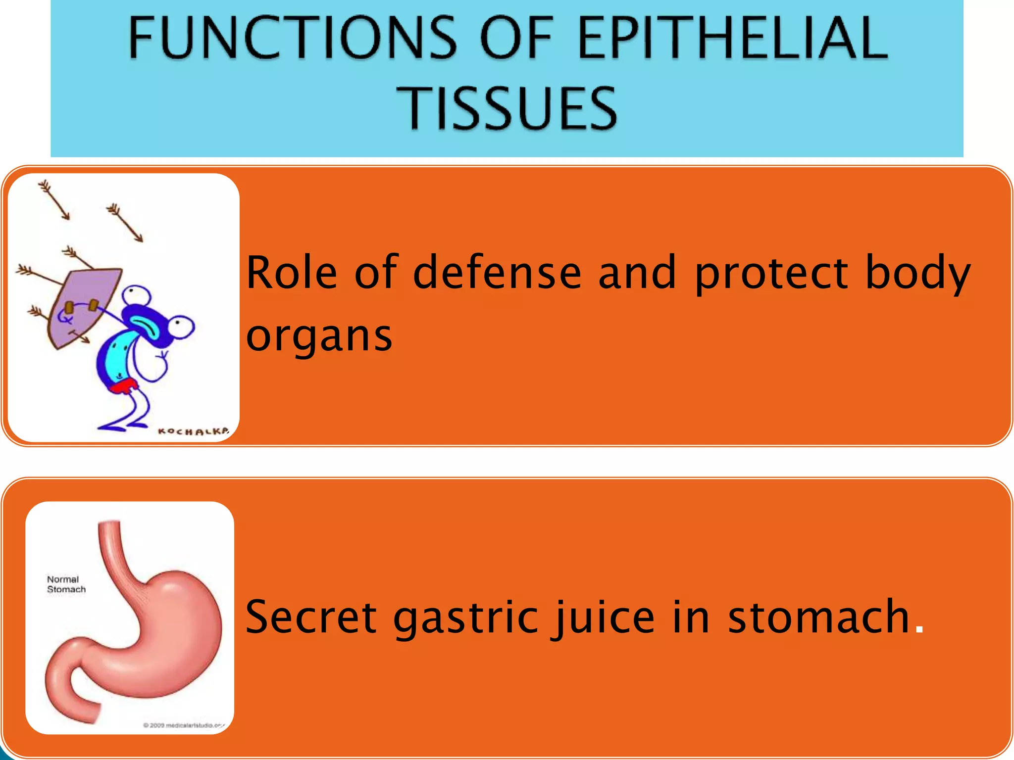

Slide 76


Slide 77


Slide 78


Slide 79


Slide 80


Slide 81

CILIATED COLUMNAR EPITHELIUM

Slide 82


Slide 83
STRATIFIED EPITHELIA
Consists of several layers of cells of various shapes.
Superficial layers grow up from below
Basement membranes are usually absent.

Slide 84
FUNCTION OF STRATIFIED EPITHELIA
Protect underlying structures from mechanical wear and tear.

Slide 85


Slide 86
STRATIFIED SQUAMOUS EPITHELIA
Composed of a number of layers of cells of different shapes.
Represents newly formed and mature cells.

Slide 87
KERATINIZED STRATIFIED EPITHELIUM
Found on dry surfaces that are subjected to wear and tear
Example: skin, hair and nails

Slide 88
KERATINIZED STRATIFIED EPITHELIUM (continued)
The surface layer consists of dead epithelial cells to which the protein keratin has been added.

Slide 89
KERATINIZED STRATIFIED EPITHELIUM (continued)
Forms a tough relatively waterproof protective layer.
Surface layer of the skin is rubbed off and is replaced from below

Slide 90
NON-KERATINIZED STRATIFIED EPITHELIUM
Found on wet surfaces that are subjected to wear and tear but are protected from drying.

Slide 91
LOCATION
Conjunctiva of the eyes
The lining of the mouth
The pharynx
The esophagus
The vagina

Slide 92
TRANSITIONAL EPITHELIUM
Composed of several layers of pear shaped cells
Found in urinary bladder and allows for stretching as the bladder fills.

Slide 93
CONNECTIVE TISSUE
Abundant tissue in the body
Semisolid jelly like consistency or dense and rigid
May or may not be fibers present in the matrix

Slide 94
FUNCTIONS OF CONNECTIVE TISSUE
Binding and structural support
Protection
Transport
Insulation

Slide 95
CELLS OF CONNECTIVE TISSUE
Found in all organs supporting the specialized tissue
Not found in blood

Slide 96
TYPES OF CELLS OF CONNECTIVE TISSUE
Fibroblasts
Fat cells
Macrophages
Leukocytes
Mast cells

Slide 97


Slide 98


Slide 99
FIBROBLASTS
Are large flat cells with irregular processes.
Produce collagen and elastic fibers and matrix of extracellular material.

Slide 100
Very fine collagen fibers are found in very active tissue.
Active in tissue repair (wound healing)
Form granulation tissue (tissue destruction)

Slide 101
Collagen formed during healing shrink as they grow older interferes with the functions of organ involved and the adjacent structures.

Slide 102
FAT CELLS
Also known as adipocytes
These cells occur singly or in groups.
Vary in size and shape according to the amount of fat they contain.

Slide 103


Slide 104


Slide 105
MACROPHAGES
Irregular in shape cells with granules in cytoplasm
Some are fixed and others are motile
Part of defense mechanisms

Slide 106
Phagocytic
Engulfing
Digesting cell debris
Bacteria
Foreign bodies

Slide 107
LOCATION
Monocytes in blood
Alveoli of lungs
Kupffer cells in liver sinusoids
Fibroblasts in lymph nodes
Spleen and microglial cells in brain

Slide 108
LEUKOCYTES
White blood cells are normally found in small numbers in healthy connective tissue.
Neutrophils migrate in significant numbers during infection.

Slide 109
Play an important role in tissue defense.
They synthesize and secrete specific defensive antibodies into the blood and tissues

Slide 110
MAST CELLS
Are similar to basophil leukocytes
Found in connective tissue under fibrous capsule of some organs.
Cytoplasm is packed with granules

Slide 111
Contains histamine, heparin and other substances which are released during tissue damage.
Release of granular content is called degranulation.

Slide 112
FUNCTIONS
Histamine – local and general inflammatory reactions
Heparin – prevents coagulation of blood

Slide 113


Slide 114


Slide 115


Slide 116
RETICULAR TISSUE
Has a semisolid matrix with fine branching reticulin fibers.
Contains reticular cells and white blood cells
Found in lymph nodes and lymphatic organs

Slide 117
DENSE CONNECTIVE TISSUE
Fibrous tissue made up of closely packed bundles of collagen fibers with very little matrix.

Slide 118
DENSE CONNECTIVE TISSUE
Fibrocytes are few in number
Found in rows between the bundles of fibers.

Slide 119
DENSE CONNECTIVE TISSUE (continued)
Forming the ligaments, which binds bones together.
As an outer protective covering for bone called periosteum.

Slide 120


Slide 121
ELASTIC TISSUE
Capable of considerable extension and recoil.
Few cells and the matrix mainly consists of masses of elastic fibers.

Slide 122
Found in organs where stretching or alteration of shape is required
Example: Large blood vessel walls, trachea and bronchi and the lungs

Slide 123


Slide 124


Slide 125


Slide 126


Slide 127


Slide 128


