Slide 1

AMBLYOPIA
BY NAVDEEP KAUR
BSc.[N] III YEAR

Slide 2
SPECIFIC OBJECTIVES
Introduction
Definition
Incidence
Causes
Risk Factors
Pathophysiology
Sign and Symptoms
Diagnostic evaluations
Treatment
Preventive Exercises
Summary
Conclusion

Slide 3
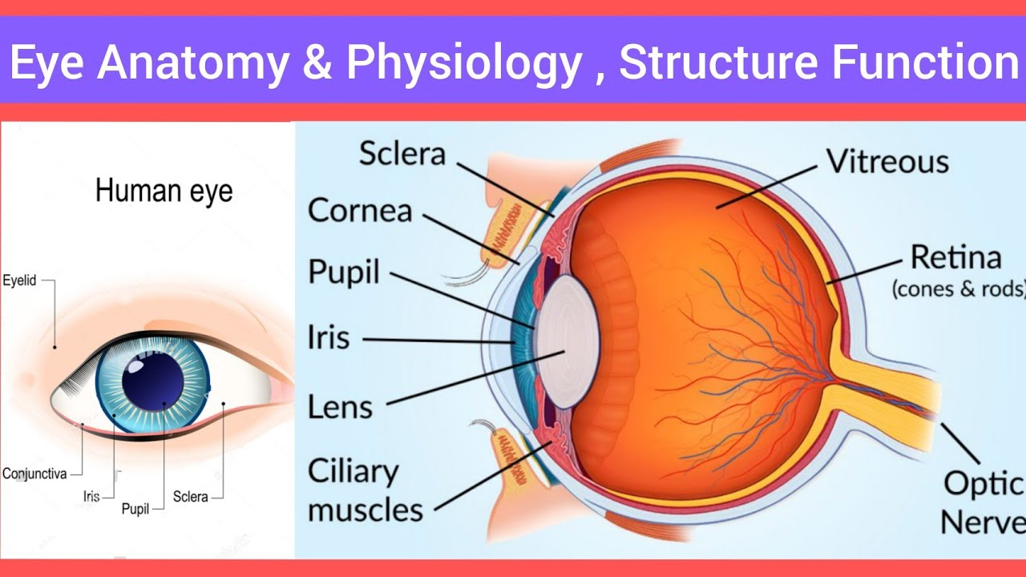

Slide 4
INTRODUCTION
Amblyopia: ( greek word means blunt eye)
Also called as: lazy eye is a disorder of sight.
Results in decreased vision in an eye that otherwise appears normal.

Slide 5
DEFINITION
Amblyopia is decreased vision in one or both eyes due to abnormal vision development in infancy or childhood.
In amblyopia, the brain receives a poor image from the eye and thus does not “learn to see well.

Slide 6
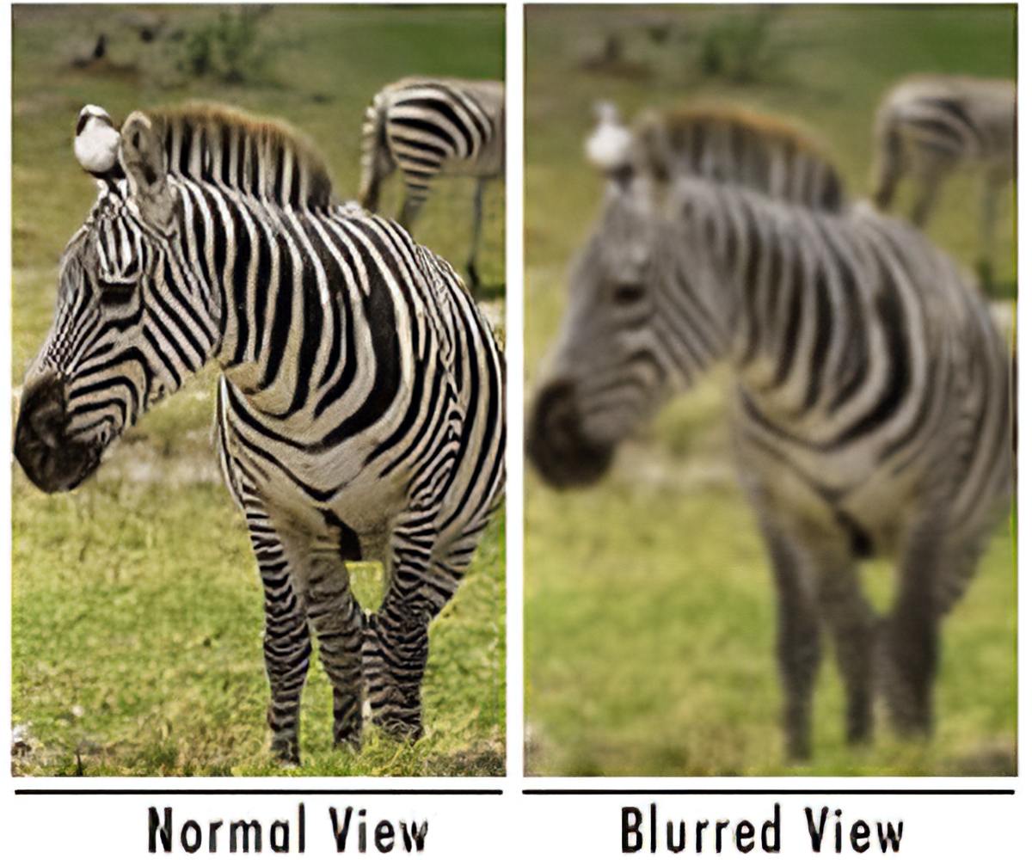

Slide 7
INCIDENCE
Amblyopia occurs in approximately 2-3% of the population in preschool age.

Slide 8
CAUSES
constant strabismus, or turning of one eye
genetics, or a family history of amblyopia
different levels of vision in each of your eyes
damage to one of your eyes from trauma
drooping of one of your eyelids
vitamin A deficiency
corneal ulcer or scar
eye surgery
vision impairment, such as nearsightedness, farsightedness, or astigmatism
glaucoma, which is high pressure in your eye that can lead to vision problems and blindness

Slide 9
RISK FACTORS
Factors associated with an increased risk of lazy eye include:
Premature birth
Small size at birth
Family history of lazy eye
Developmental disabilities

Slide 10


Slide 11


Slide 12
DIAGNOSTIC EVALUATIONS
Physical examination
visual acuity tests (by specialist)
stereopsis (perception of depth or 3-dimensionality) and binocular vision testing
assessment of fixation, ocular alignment and ocular motility
anterior segment exam using a slit lamp

Slide 13
TREATMENT
Amblyopia treatment is much more effective if it starts early, while the connections between the eyes and brain are still developing. Strategies focus on making the child’s brain use the weaker eye. Options include:
Eye patches for kids: Your child may wear a patch over the better eye for at least a few hours per day. This effective treatment can last months or even years. The patch forces the brain to use the images from the weaker eye, eventually making that eye stronger.
Glasses: Eyeglasses are also a common lazy eye treatment. They can help amblyopia by improving nearsightedness, farsightedness and eye crossing.

Slide 14
Eye drops: For mild cases, your provider may recommend eye drops (atropine) to temporarily blur vision in the better eye. The goal is the same as a patch: to force the brain to use the weaker eye.
Surgery: An operation for amblyopia is rare. Your healthcare provider may suggest surgery to fix certain causes of amblyopia, such as cataracts.

Slide 15
PREVENTIVE EXERCISES

Slide 16
SUMMARY
Amblyopia is a visual disorder due to the failure of cortical visual development in one or both eyes due to ocular pathology early in life. Consequences of amblyopia include poor stereovision, visual acuity, pattern recognition, and low sensitivity to motion and contrast.

Slide 17
CONCLUSION
Amblyopia also called lazy eye is decreased eyesight due to abnormal visual development.
Amblyopia occurs in early childhood. When nerve pathways between the brain and an eye aren’t properly stimulated, the brain favours the other eye. Exercises to treat amblyopia are reading, dot-to-dots, coloring the lines, doing puzzles and playing computer games such as video games.

Slide 18
ASSIGNMENT: Find out the nursing management of amblyopia.....
SUBMISSION DATE: 25 /06/23

Slide 19
REFERENCES
1. Sharma rimple.essentials of pediatric nursing 2nd edition.EMCA House,23/23-B ansari road,daryaganj new- Delhi 110002,India:jaypee brothers;2017.P 549
2. Sharma rimple.essentials of pediatric nursing 3rd edition.EMCA House,23/23-B ansari road,daryaganj new Delhi 110002,India:jaypee brothers:2021.P 371-372.
3. Datta parul.pediatric nursing:2nd edition.4838/24 ansari road ,daryaganj,New delhi-110002, India:jaypee brothers;2009.P 229-231
4. Piyush,essential pediatric nursing,II edition , CBC plaza , 4819/XI prahlad street, 24 ansari road , Dayaganj, new Delhi- 110002, India 2007 . P 316-317
5. Ball Jane , Binder Ruth, pediatric nursing ,II edition , four Stamford plaza , PO Box 120041, Stamford ,Connecticut 06912-0011, 1994.P 392
6. Viswanathan, Desai J. III edition , orient Longman private Limited 1/24 , Asaf Ali road new Delhi 110 002. Asaf Ali road new Delhi ,P 312.

Slide 20


