Slide 1
Integrated Management of Neonatal and Childhood Illness (IMNCI)

Slide 2
Objectives
After completing this unit, you will be able to:
Assess various signs and sickness in young infant and child
Classify illness in a sick young infant and child based on signs and symptoms
Identify treatment for various problems in young infant and child
Treat young infant and child

Slide 3
IMNCI
Almost 19,000 children under 5 yrs. of age, died everyday across the world, 50% of it occurs in India
In India, there are nearly 16.55 lakhs child deaths during 2011 and we rank top amongst the countries with highest child mortality
India : IMR-34/1000 live births in 2016, which was 47 in 2010; MP has the highest IMR followed by Assam, Orissa and UP
MP- 47, Assam & Odisha-44, and UP- 43/1000 live births
WHO and UNICEF recognized the need to strengthen child-health activities in the country and decided to launch IMCI; The generic IMCI guidelines were adapted and the Indian version was named Integrated Management of Neonatal and Childhood Illness (IMNCI)

Slide 4
IMNCI: An Introduction
IMNCI is an integrated approach to child health that focuses on the well-being of the whole child.
IMNCI aims to reduce death, illness and disability, and to promote improved growth and development among children under five years of age
IMNCI includes both preventive and curative elements that are implemented by families and communities as well as by health facilities
  The strategy includes three main components:
  Improving case management skills of health-care staff
  Improving overall health systems
  Improving family and community health practice

Slide 5
Principles of Integrated Care
All sick young infants up to 2 months of age must be assessed for “possible bacterial infection / jaundice”. Then they must be routinely assessed for the major symptom “diarrhea”
All sick children age 2 months up to 5 years must be examined for “general danger signs” which indicate the need for immediate referral or admission to a hospital. They must then be routinely assessed for major symptoms: cough or difficult breathing, diarrhea, fever and ear problems
All sick young infants and children 2 months up to 5 years must also be routinely assessed for nutritional and immunization status, feeding problems, and other potential problems

Slide 6
Principles of Integrated Care
A combination of individual signs leads to a child's classification(s) rather than diagnosis
Needs urgent hospital referral or admission (classifies as and color coded pink)
Needs specific medical intervention or advice (classified as and color coded yellow)
Can be managed at home (classified as and color coded green)

Slide 7
Goals of IMNCI
Standardized case management of sick newborns and children
Focus on the most common causes of mortality
Nutritional assessment and counseling for all sick infants and children
Home based care for newborns to:
  promote exclusive breastfeeding
  prevent hypothermia
  improve illness recognition & timely care seeking behavior

Slide 8
Elements of Case Management Process
Assess : Child by checking for danger signs by history and examination
Classify : Child's illness by color coded triage system
Identify: Specific treatments
Treatments: Instructions of oral drugs, feeding & fluids
Counsel: Mother about breast feeding & about her own health as well as to follow further instructions on further child care
Follow up care: Reassess the child for newer problems

Slide 9
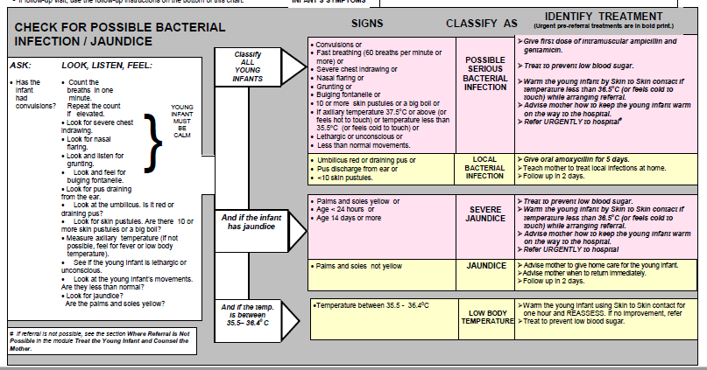
Assess and Classify the Sick Young Infant Age up to 2 Months

Slide 10
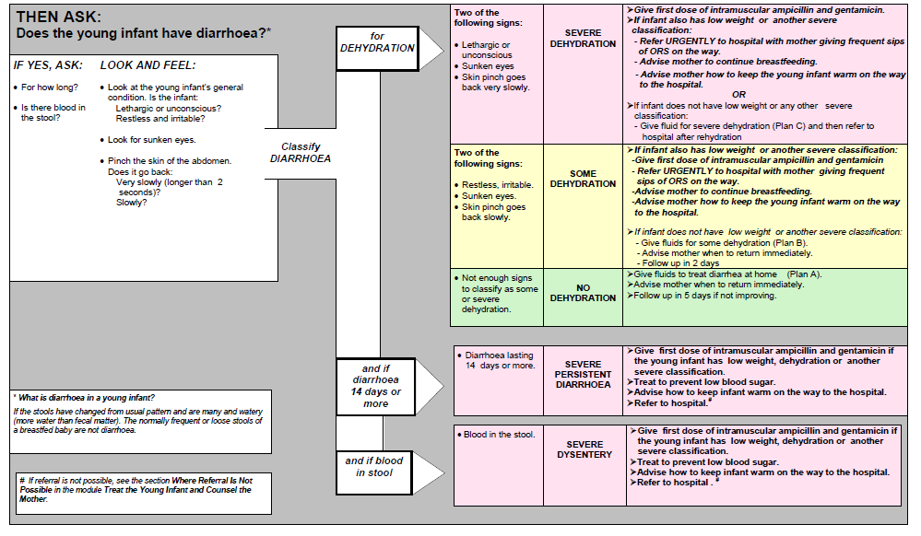
Assess and Classify the Sick Young Infant Age up to 2 Months

Slide 11
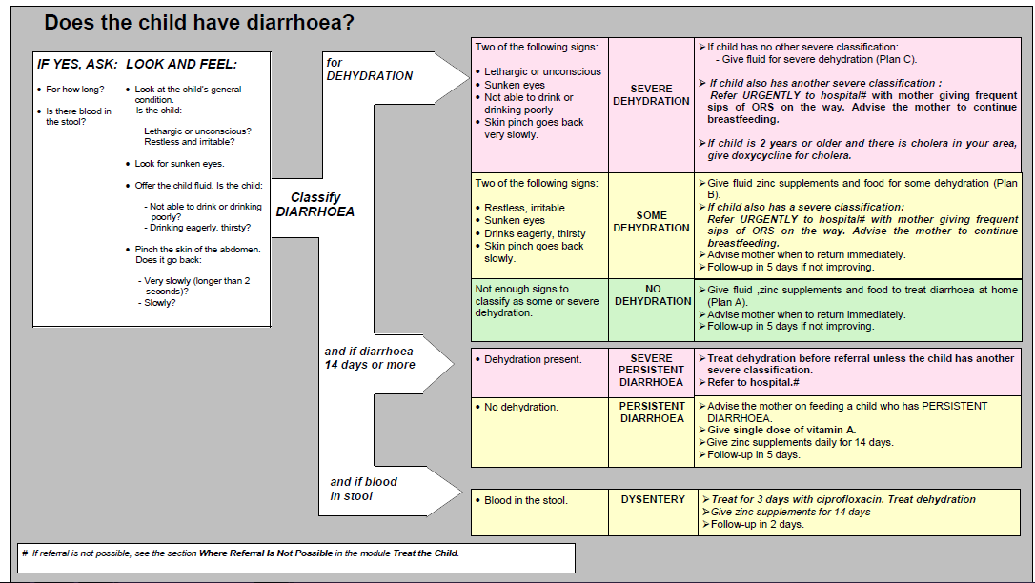
Classification of Diarrhea

Slide 12
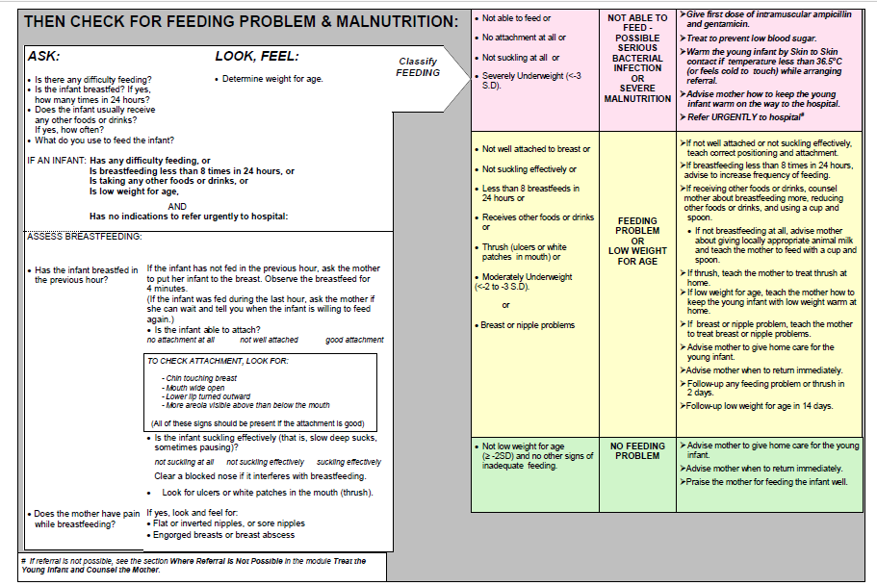
Assess Feeding Problems and Malnutrition

Slide 13
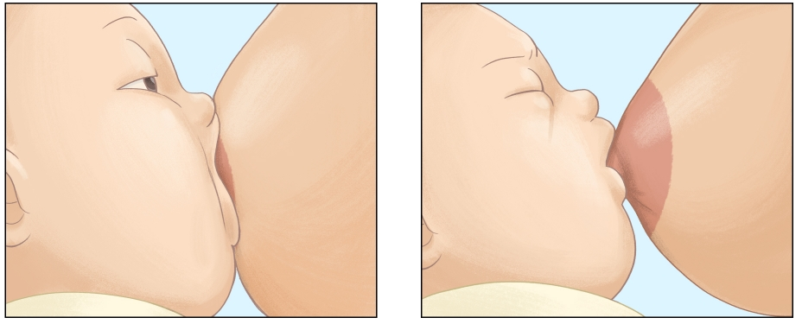
Assess Feeding Problems and Malnutrition
Breast Feeding : Signs of good attachment
  Chin touching breast
  Mouth wide open
  Lower lip turned outward
  More areola visible above than below the mouth
Good Attachment
Poor Attachment

Slide 14
Assess Immunization Status
If any immunization is due, advise the mother to get the infant immunized at the earliest
The information on immunization status of an infant is best obtained from the immunization card
Immunization Schedule | Age | Vaccine
 | Birth | BCG OPV-0
 | 6 Weeks | DPT-1, OPV-1+, Hepatitis B-1*
*Hepatitis B to be given wherever included in the immunization schedule

Slide 15
Treat the Sick Young Infant
Give one or more of the following treatments before the young infant is sent to the hospital:
  Antibiotics
  Breast milk or sugar water
  Warm the sick young infant with low body temperature by skin to skin contact and keep the young infant warm on the way to the hospital

Slide 16
Treat the Young Infant and Counsel the Mother
Child needs referral (Inpatient care)
Give first dose of IM antibiotics
Treat to prevent low blood sugar
Child needs specific treatment, provide it at home
(e.g. Antibiotics, ORS)
Teach the mother
Child needs no medicine, give home care
Home Care regarding feeds, fluids and warmth
Advise mother about the warning signs and when to return to health worker
Provide KMC and assess the baby after one hour
Refer keeping the baby warm
to treat Local infections like – skin pustules or umbilical infection; dry ear by wicking; treat diarrhea
Feeding Problems – correct positioning and attachment; feeding with a cup and spoon; Treat Oral Thrush, breast or nipple problems
Counsel the mother about her own health
to give oral drugs at home
Keep young infants warm
Immunization
Notes:
Green – emphasize on follow up visit and when to return (warning signs)

Slide 17
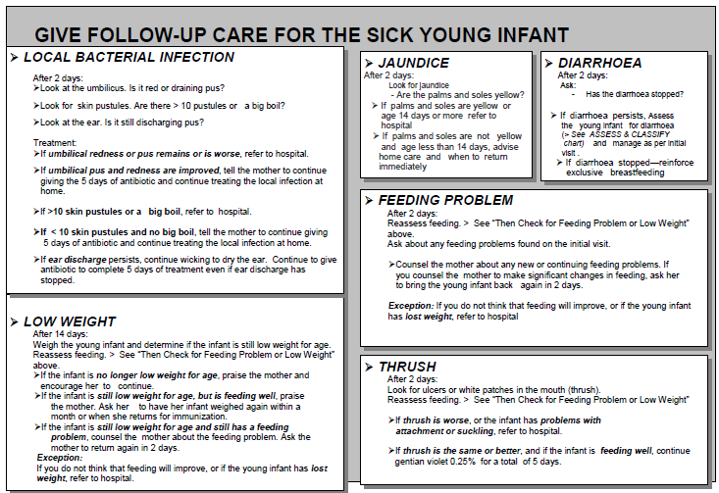
Follow Up Care

Slide 18
Assess and Classify Sick Child: Age 2 months up to 5 years
Assess General Danger Signs
  Assess all sick children for general danger signs
  Danger signs indicate serious illness
  General danger signs are:
    the child is not able to drink or breastfeed
    the child vomits everything
    the child has had convulsions
    the child is lethargic or unconscious

Slide 19
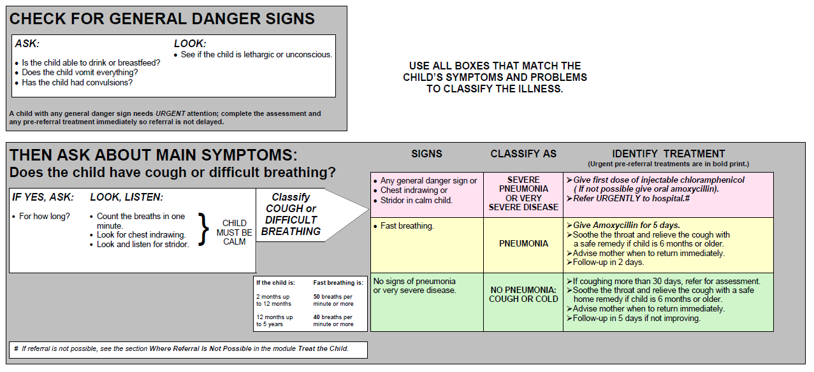
Assess and Classify Cough or Difficult Breathing

Slide 20
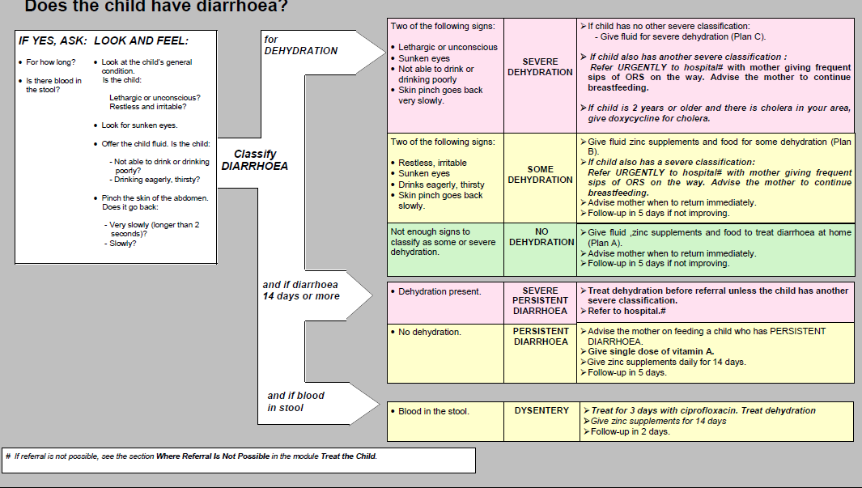
Assess and Classify Diarrhea

Slide 21
Assess and Classify Diarrhea
Remember
Classify all cases of diarrhea for dehydration. In addition also classify as severe persistent diarrhea if duration is 14 days or more and dysentry if there is blood in stool
Children with signs of severe dehydration should be referred to hospital
Children with severe persistent diarrhea should be referred to hospital
Children with dysentery should be treated with medicine at home
Children with some dehydration should be re-dehydrated with ORS
Children who are not dehydrated and have diarrhea of less than 14 days duration should be managed at home

Slide 22
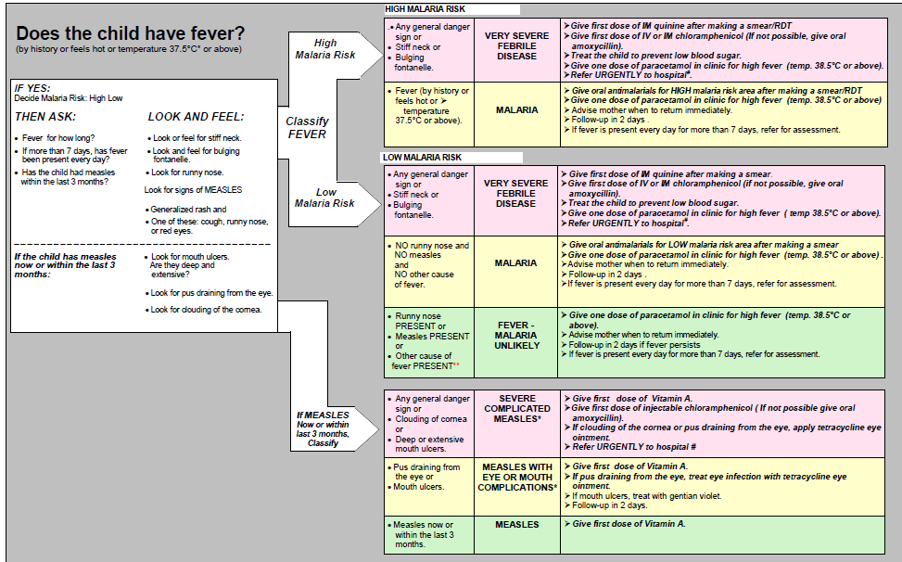
Assess and Classify Fever
Notes:
*This cutoff is for axillary temperatures; rectal temperature cutoff is approximately 0.5°C higher. ** Other causes of fever include cough or cold, pneumonia, diarrhoea, dysentery and skin infections.
*** Other important complications of measles - pneumonia, stridor, diarrhoea, ear infection, and malnutrition - are classified in other tables.
# If referral is not possible, see the section Where Referral Is Not Possible in the module Treat the Child.

Slide 23
Assess and Classify Fever
Remember:
The child does not have history of fever, does not feel hot or temperature is less than 37.5ºC. Do not assess the child further for signs related to fever. Ask about the next main symptom i.e. malnutrition
Most of the fever due to viral illnesses go away within a few days
A fever, which has been present, every day for more than 7 days can mean that the child has a more severe disease such as typhoid fever. Refer this child for further assessment

Slide 24
Assess and Classify Ear Problem
Assess Ear Problems
  Assess sick child for ear problem
  A sick child can have ear pain due to which child may cry or become irritable. He may rub his ear frequently
Look and Feel
  Look and feel for tender swelling behind the ear. Both tenderness and swelling can be felt behind the ear
Ear Discharge
  When a mother reports that child has ear pain, health worker should check ear for any pus discharge

Slide 25
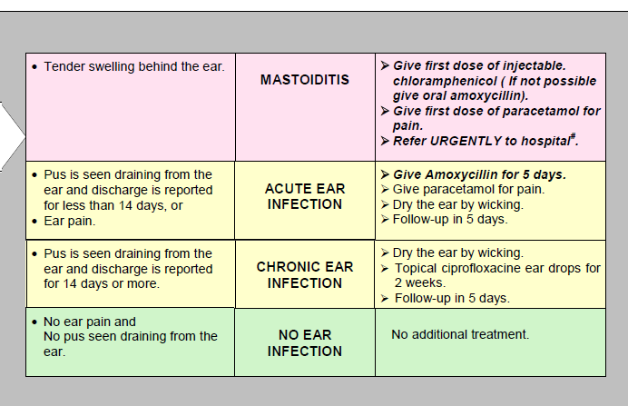
Assess and Classify Ear Problem
Classify Ear Problems

Slide 26
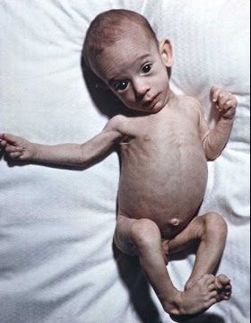
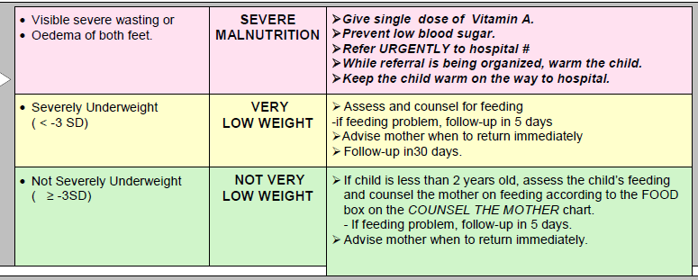
Assess and Classify Malnutrition
Assess Malnutrition
  Look and feel:
    Look for visible severe wasting
    Look for edema of both feet
    Determine grade of malnutrition by plotting weight for age
Classify Malnutrition

Slide 27
Assess and Classify Malnutrition
Remember:
A child with severe malnutrition has a serious problem and should be urgently referred to hospital
Children with very low weight should be assessed and counseled for feeding
All children less than 2 years of age and should be assessed and counseled for feeding

Slide 28
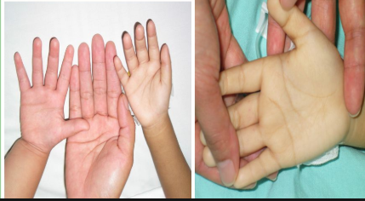
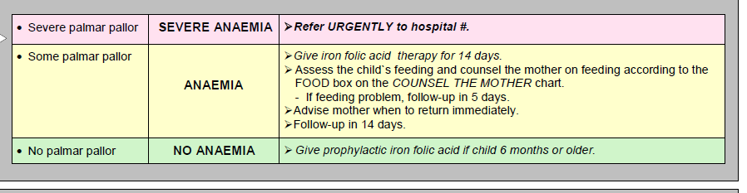
Assess and Classify Anemia
Check for Anemia. Look and feel:
  Look for palmar pallor
    Severe palmar pallor?
    Some palmar pallor?
    No palmar pallor?
Classify Anemia

Slide 29
Assess Immunization, Prophylactic Vitamin A and Iron- Folic Acid
Immunization Status
Age | Vaccine
Birth | BCG + OPV - O
6 weeks | OPT-1+ OPV-1 +HepB-1*
10 weeks | OPT-2+ OPV-2 +HepB-2*
14 weeks | OPT-3+ OPV-3 +HepB-3*
9 months | Measles OPT
16-18 months | + OPV
60 months | DPT
*Hepatitis B, if included in the immunization Schedule

Slide 30
Assess Immunization, Prophylactic Vitamin A and Iron- Folic Acid
Immunization Status
There are only three situations at present which are contraindications to immunization:
  Do not give BCG to child known to have AIDS, however asymptomatic HIV positive baby can be given BCG vaccination
  Do not give DPT-2 or DPT T-3 to a child who has had convulsions after last first dose of DPT or shock within 3 days of the most recent dose
  Do not give DPT to a child with recurrent convulsions or any active neurological disease of the central nervous system

Slide 31
Assess Immunization, Prophylactic Vitamin A and Iron- Folic Acid
Prophylactic Vitamin A Supplementation Status | Iron-Folic Acid Supplementation Status
100,000 IU (1ml) at 9 months with measles immunization 200,000 IU (2 ml) at 16-18 months with OPT Booster 200,000 IU (2 ml) at 24 months 200,000 IU (2 ml) at 30 months 200,000 IU (2 ml) at 36 months | Give one tablet of pediatric IFA (20 mg elamucural iron and 100 mg folic acid)/ 5 ml of IFA syrup or 1ml of IFA drops. For a total of 100 days in a year after the child has recovered from acute illness, if: The child is 6 months of age or older, and Has not received pediatric IFA Tablet for 100 days in last one year.

Slide 32
Identify Treatment and Treat Sick Child
Identify Treatment for Pneumonia (Cough or Difficult Breathing)
Signs | Classify as | Identify treatment
Any general danger sign or Chest in drawing or Stridor in calm child | Severe Pneumonia or Very Severe Disease | Give first dose of injectable chloramphenicol (40 mg/kg), if not possible give oral amoxicillin/ co-trimoxazole Refer urgently to hospital
Fast breathing | Pneumonia | Give co-trimoxazole for 5 day. (2 pediatric tables twice daily for a child between 2 months to 12 months, and 3 tablets twice daily for a child 12 months up to 5 years Advise mother when to return immediately Follow up in 2 days
No sign of pneumonia or very sever disease | No Pneumonia : Cough or Cold | Advise home care for cough or cold with safe home remedy, if child is 6 months or older if coughing for more than 30 days, refer for assessment Advise mother when to return immediately Follow up in 5 days

Slide 33
Identify Treatment and Treat Sick Child
Identify Treatment for Diarrhea and Dehydration
Signs | Classify as | Identify Treatment
Two of the following signs: Lethargic or unconscious. Sunken eyes Not able to drink or drinking poorly Skin pinch goes back very Slowly | Classify as severe Dehydration | If child has no other sever classification. Give fluid for severe dehydration (plan C) If the child has another severe classification, refer urgently to hospital Advise mother to continue breastfeeding, If child is 2 years or older and there is cholera in your area give doxycycline for cholera
Two of the following signs: Restless, irritable Sunken eyes Drinks eagerly, thirsty Skin pinch goes back slowly | Some Dehydration | Give fluid and food for some dehydration (Plan B) Follow-up in 5 days if not improving Advise mother when to return immediately If child has another severe classification, refer child urgently to hospital

Slide 34
Identify Treatment and Treat Sick Child
Identify Treatment for Diarrhea and Dehydration
Signs | Classify as | Identify Treatment
Not enough signs to classify as some or severe dehydration. Classification of some persistent diarrhea | No dehydration | Give fluid and food to treat diarrhea at home (Plan A) Follow-up in 5 days if not persistent diarrhea Advise mother when to return immediately
Dehydration Present | Severe Persistent Diarrhea | Treat dehydration before referral unless the child has another severe\ classification Refer to hospital
No Dehydration | Persistent Diarrhea | Advise mother on feeding a child with persistent diarrhea
Blood in the stool | Dysentery | Give single dose of Vitamin A Give Zinc Sulphate 20 mg daily for 14 days Follow up in 5 days Give cotrimoxazole for 5 days (2 pediatric tablets twice daily for a child 2 months up to 12 months and 3 tablets twice daily for a child 12 months up to 5 years) Follow-up in 2 days

Slide 35
Identify Treatment and Treat Sick Child
Identify Treatment for Fever
Age of the Child | Paracetamol (500 mg tablet)
2 months up to 3 years | ¼
3 years up to 5 years | ¼
Remember:
If fever persists every day for more than 7 days refer the child for additional assessment, as it could be typhoid fever
Give paracetamol to the child with high fever if axillary temperature is 38.5°C or more
Advise the mother to return for follow-up in two days if the fever persists

Slide 36
Identify Treatment and Treat Sick Child
Identify Treatment for Ear Problem
Signs | Classify as | Identify Treatment
Tender swelling behind the ear | Mastoiditis | Give first dose of injectable Chloramphenicol (if not possible - give oral amoxicillin) Give first dose of paracetamol for pain Refer to hospital urgently
Pus is seen draining from the ear and discharge is reported for less than 14 days or Ear pain Pus is seen draining from the ear and discharge is reported for 14 days or more | Acute Ear Infection Chronic ear Infection | Give cotrimoxazole for 5 days Give paracetamol for pain Dry the ear by wicking Follow up in five days
No ear pain and no ear discharge seen draining from the ear | No ear infection | No additional treatment

Slide 37
Identify Treatment and Treat Sick Child
Identify Treatment for Malnutrition
Signs | Classify as | Identify Treatment
Visible severe Wasting Edema of both feet | Severe Malnutrition | Give single dose of vitamin A Prevent low blood sugar by breast milk, other milk/water with sugar (4 TSF sugar per cup) Keep the child warm Refer urgently to hospital
Very low weight for age | Very low weight | Asses and counsel for feeding Advise mother when to return immediately Follow-up in 30 days (if feeding problem, follow-up in 5 days)
Not very low weight for age and no signs of severe malnutrition | Not very low weight | If child is less than 2 year old, assess and counsel for feeding If feeding problem, follow-up in 5 days Advise mother when to return immediately

Slide 38
Identify Treatment and Treat Sick Child
Identify Treatment for Anemia
Signs | Classify as | Identify Treatment
Severe palmar pallor | Severe Anemia | Refer to hospital urgently
Some palmar pallor | Anemia | Give Iron Folic Acid therapy for 14 days Assess and counsel for feeding Follow-up in 5 days in case of feeding problem otherwise in 14 days
No palmar pallor | No Anemia | Give prophylactic iron folic acid if the child 6 months or older

Slide 39
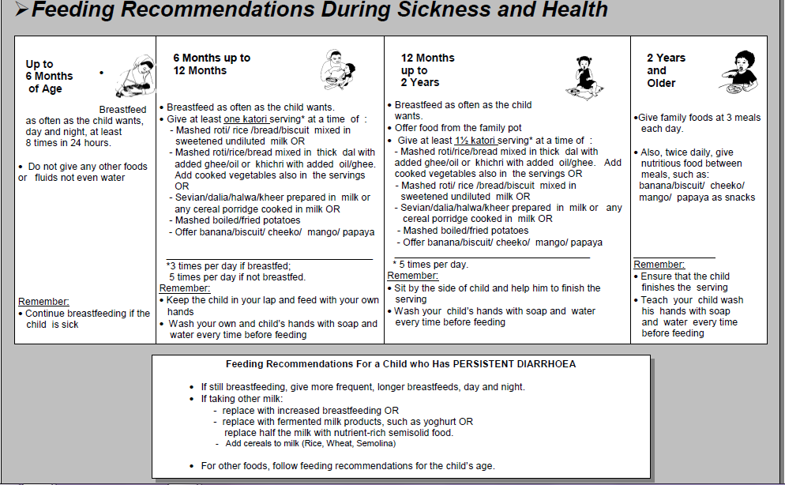
Counsel the Mother

Slide 40
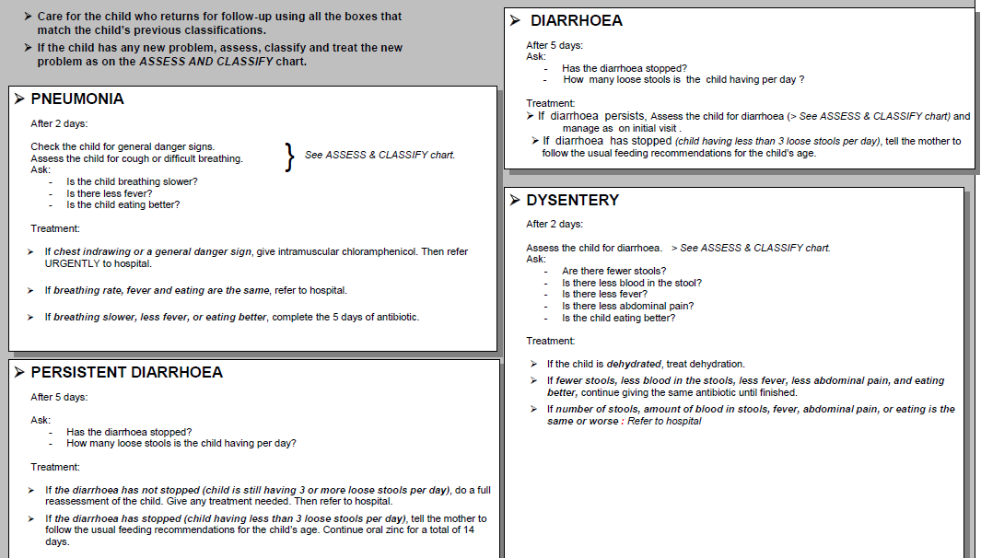
Follow-up Care for Sick Child

Slide 41
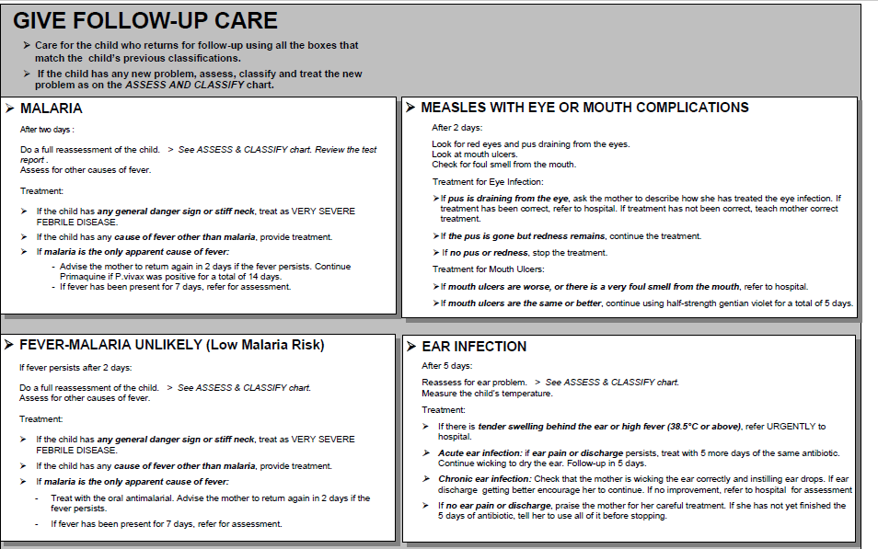
Follow-up Care for Sick Child

Slide 42
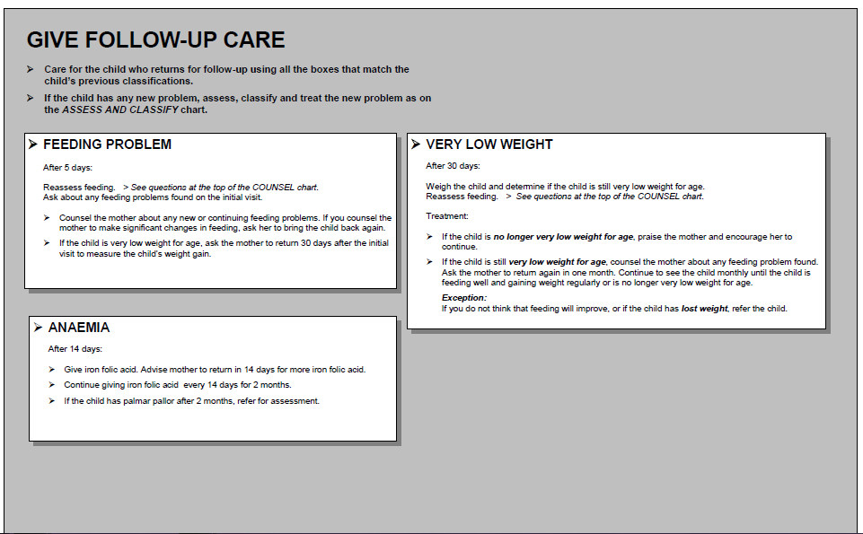
Follow-up Care for Sick Child

Slide 43
Model Question
List the signs you will look for possible bacterial infection in a young infant?
List the treatment required for a young infant with Severe Dehydration and Possible Serious Bacterial Infection.
List the three possible classifications of dehydration in a child with diarrhea.
Enumerate three classifications for a child with Malnutrition
List down two possible classification of fever in a child
Select the correct dose of oral drugs time schedule in the following cases:
  A six months old child needs the first dose of an antibiotic for severe pneumonia.
  A two-year-old child needs an antibiotic for pneumonia

Slide 44
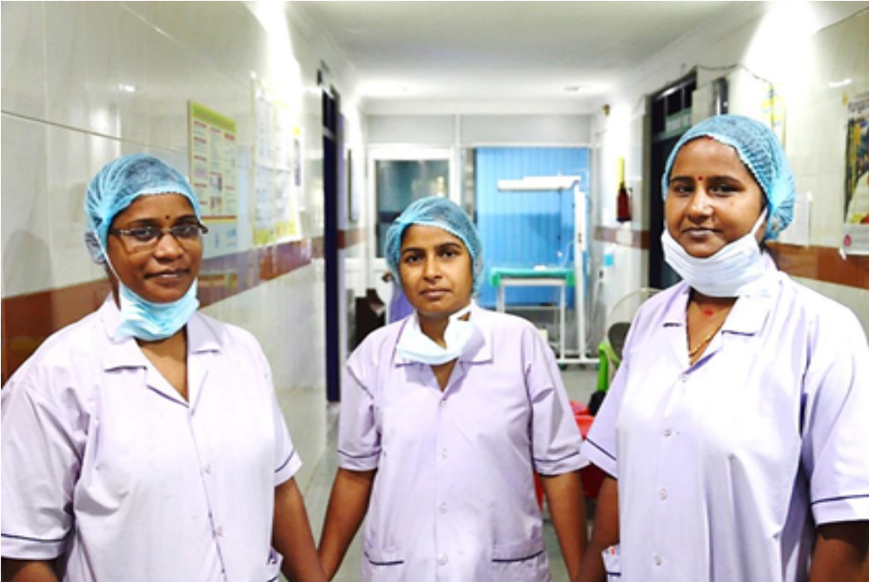
THANK YOU

