Slide 1

ANAL FISSURE
MR. DINESH SINGH
P.G. NURSING TUTOR
ROHILKHAND COLLEGE OF NURSING

Slide 2
OBJECTIVES
Introduction of the Anal fissure.
Define the Anal fissure.
Explain the causes of Anal fissure.
State the clinical manifestations of Anal fissure.
Elaborate the diagnostic evaluation of Anal fissure.
Discuss the management of Anal fissure.
Describe the prevention of Anal fissure.

Slide 3
INTRODUCTION
An anal fissure is a small tear in the thin, moist tissue that lines the anus. The anus is the muscular opening at the end of the digestive tract where stool exits the body. Common causes of an anal fissure include constipation and straining or passing hard or large stools during a bowel movement.

Slide 4
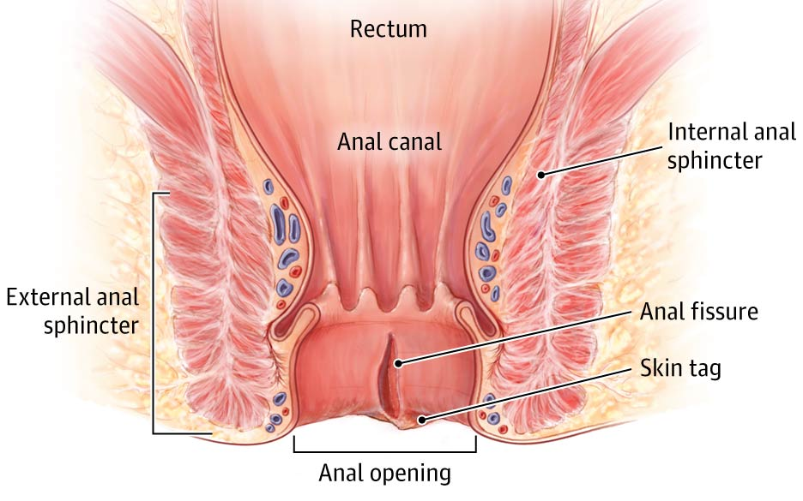
DEFINITION
Anal fissure is linear laceration of anal epithelium associated with constipation.

Slide 5
ETIOLOGY
Common causes of anal fissures include:
Passing large or hard stools.
Constipation during bowel movements.
Long-lasting diarrhea.
Childbirth.

Slide 6
Cont…
Less common causes of anal fissures include:
Crohn's disease or another inflammatory bowel disease.
Anal cancer.
HIV.
Tuberculosis.
Syphilis.

Slide 7
PATHOPHYSIOLOGY
Constipation
Hard faces
Tear in anal canal mucosa (fissure) Severe anal pain
Spasm of the internal sphincter
Impairment of intersphincteric blood circulation
Impaired healing
Chronic anal Fissure

Slide 8
CLINICAL MANIFESTATION
Pain during bowel movements.
Pain after bowel movements that can last up to several hours.
Bright red blood on the stool or toilet paper after a bowel movement.
A visible crack in the skin around the anus.
A small lump or skin tag on the skin near the anal fissure.

Slide 9
DIAGNOSTIC EVALUATION
Anoscopy. An anoscope is a tubular device inserted into the anus to help your provider see the rectum and anus.
Flexible sigmoidoscopy. health care provider inserts a thin, flexible tube with a tiny video into the bottom portion of the colon. This test may be done if patient younger than 45 and have no risk factors for intestinal diseases or colon cancer.
Colonoscopy. This test involves inserting a flexible tube into your rectum to inspect the entire colon. Colonoscopy may be done.

Slide 10
MANAGEMENT
Externally applied nitroglycerin: This can help increase blood flow to the fissure and promote healing. It also can help relax the anal sphincter.
Topical anesthetic creams such as lidocaine (Xylocaine) may help relieve pain
OnabotulinumtoxinA (Botox) injection, to paralyze the anal sphincter muscle and relax spasms.
Antibiotics
Stool softeners or laxatives, e.g., bisacodyl

Slide 11
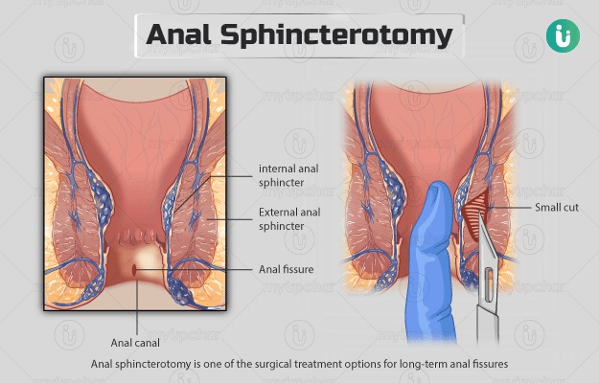
SURGICAL MANAGEMENT
Sphincterotomy: Doctors usually perform a procedure called lateral internal sphincterotomy (LIS). LIS involves cutting a small portion of the anal sphincter muscle. This technique may help promote healing and reduce spasm and pain.

Slide 12
SUMMARY

Slide 13
REFERENCES

Slide 14


