Slide 1

TUBERCULOSIS OF ABDOMEN
MR. DINESH SINGH
P.G. NURSING TUTOR
ROHILKHAND COLLEGE OF NURSING

Slide 2
OBJECTIVES
Introduction of the Gastric cancer.
Define the Gastric cancer
Explain the causes of Gastric cancer
State the clinical manifestations of Gastric cancer.
Elaborate the diagnostic evaluation of Gastric cancer.
Discuss the management of Gastric cancer.
Describe the prevention of Gastric cancer.

Slide 3
INTRODUCTION
Tuberculosis of the gastro intestinal tract (digestive system) and abdominal cavity is known as abdominal tuberculosis. Ingestion of the tuberculosis pathogen by drinking unpasteurised milk of a cow, infected with TB is one of the mechanisms of abdominal TB. Abdominal TB can also occur by spread of TB bacillus from the lungs to the intestines by the blood stream.

Slide 4
DEFINITION
Abdominal tuberculosis is a chronic infectious disease caused by mycobacterium tuberculosis and characterized by the formation of tubercles (round nodules, warty outgrowth) or granulomas in abdominal organs, including the stomach, intestines, liver, and spleen.
Granulomas means localized collection of cells usually produced in response to an infectious process. It may be transmitted to other body part parts such as meningitis, bones, kidneys, lymph nodes.

Slide 5
ETIOLOGY
Pathogen involved are mycobacterium tuberculosis
By air droplets.
By exposure with person who is infected to prolonged and close frequent.

Slide 6
CLINICAL MANIFESTATION
Pain in abdominal cavity
Loss of weight
Anorexia
Diarrhea
Low grade fever
Cough
Abdominal distension
Night sweates

Slide 7
DIAGNOSTIC EVALUATION
History collection, Physical examination
To confirm the diagnose, isolating the TB germ from the digestive system by either a biopsy or endoscopy.
Mantoux test
Chest X-ray, Abdominal X-ray
Ultrasound and CT scan
Haemoptysis
Quantiferon-TB

Slide 8
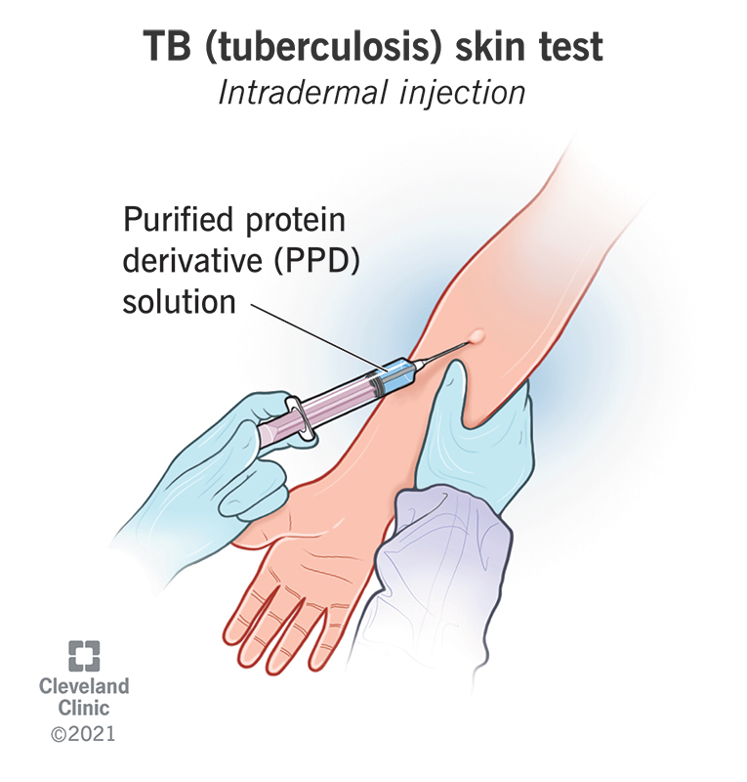
MANTOUX TEST
The test is performed by injecting 0.1 ml of tuberculin Purified Protein Derivative (PPD) into the inner surface of the forearm. The test is an intradermal injection. When placed correctly, the injection should produce a pale elevation of the skin (a wheal) 6 to 10 mm in diameter.

Slide 9
MANAGEMENT
MEDICAL MANAGEMENT
Primary agent ( first line drugs)
Isoniazid 5mg
Rifampicin 10mg
Ethambutol
Streptomycin 15mg
Pyrazinamide 20mg

Slide 10
Secondary agents ( second line drugs)
Capreomycin
Kanamycin
PASA
Cycloserin

Slide 11
COMPLICATIONS
Untreated TB of the intestine may be lead to intestinal obstruction, fistula or even abscess and perforation with peritonitis.

Slide 12
COMPLICATIONS
The patient with TB should be monitored regularly.
No interruptions occur in treatment
Serious side effects from the treatment are quickly identified.
Ensure that patient’s are given correct medication and can provide support for patient and their relatives or cases to prevent lapses in treatment.
DOTS must be given because of the risk to the wider population. This involves a nurse visiting the patient at home three times a week and administering the treatment.

Slide 13
SUMMARY

Slide 14
REFERENCES

Slide 15


