Slide 1

FISTULA
MR. DINESH SINGH
P.G. NURSING TUTOR
ROHILKHAND COLLEGE OF NURSING

Slide 2
OBJECTIVES
Introduction of the fistula.
Define the fistula.
Explain the causes of fistula.
State the clinical manifestations of fistula.
Elaborate the diagnostic evaluation of fistula.
Discuss the management of fistula.
Describe the prevention of fistula.

Slide 3
INTRODUCTION
A fistula is an abnormal connection between two body parts, such as an organ or blood vessel and another structure. Fistulas are usually the cause of an injury or surgery. Infection or inflammation can also cause a fistula to form.

Slide 4
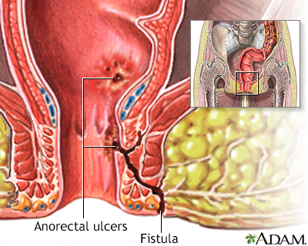
DEFINITION
It is a tube like linkage between the body cavity.
Fistula is abnormal tube-like connections or passages between organs.

Slide 5
TYPES OF FISTULA
Rectovaginal fistula: Develops between the the rectum or and the vagina. Bowel contents can leak through the fistula, allowing gas or stool to pass through the vagina.
Vasico Vaginal fistula: Develops between the vagina and another organ, such as the bladder, colon or rectum. Your health care provider might describe a vaginal fistula as a hole in the vagina that allows urine, gas or stool to pass through the vagina.

Slide 6
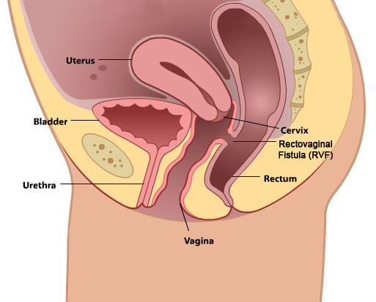
Rectovaginal Fistula

Slide 7
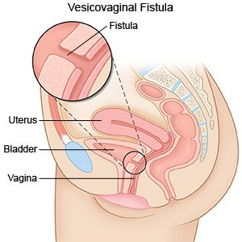
Vasico Vaginal Fistula

Slide 8
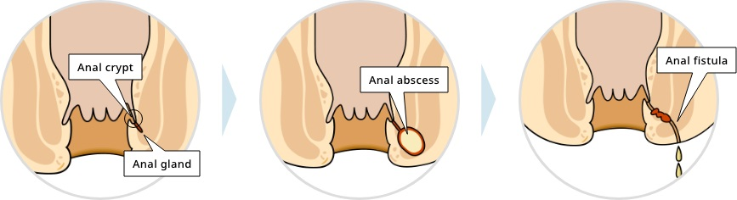
CAUSES
ANAL ABSCESS: is the primary cause of an fistula. If the abscess is not properly treated, it can develop into a fistula.

Slide 9
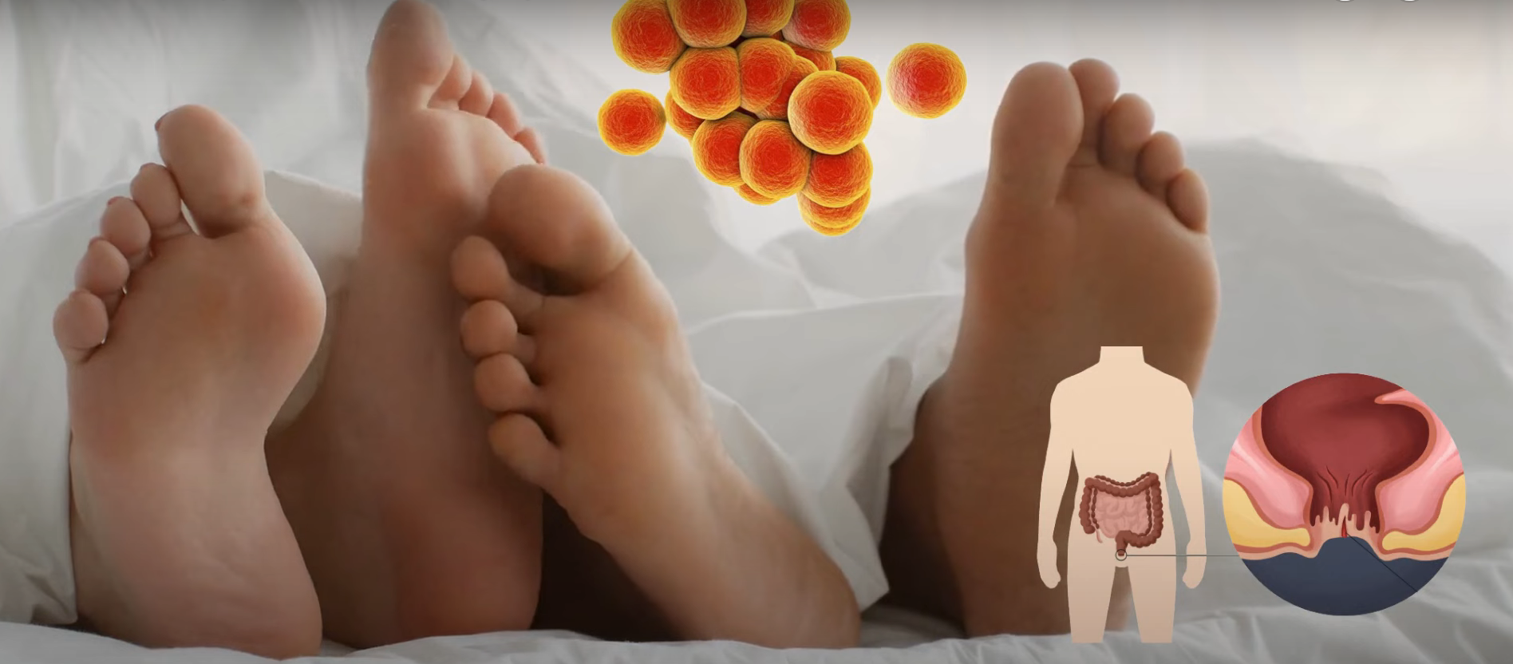
CONTI…
INFECTION: Certain bacterial or sexually transmitted infections can lead to the formation of an anal fistula.

Slide 10
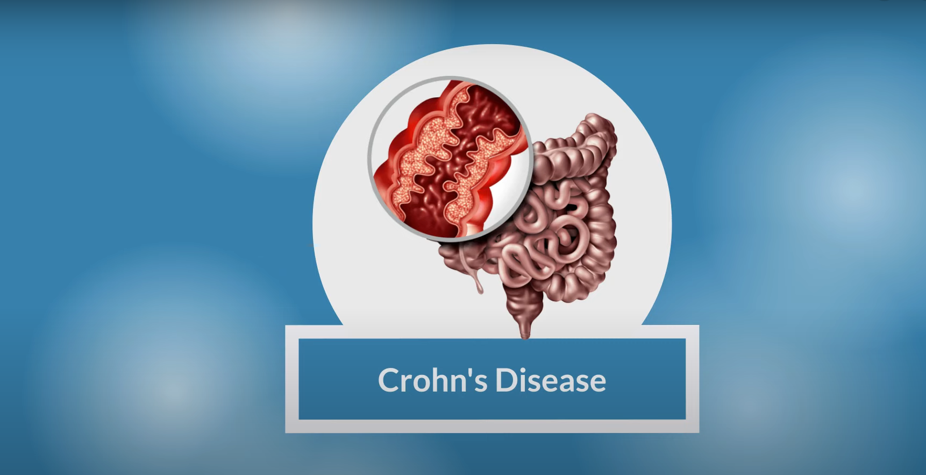
CONTI…
Crohn’s Disease: individual with Crohn’s disease, a chronic inflammatory bowel disease. Are at an increased risk of developing anal fistula.

Slide 11
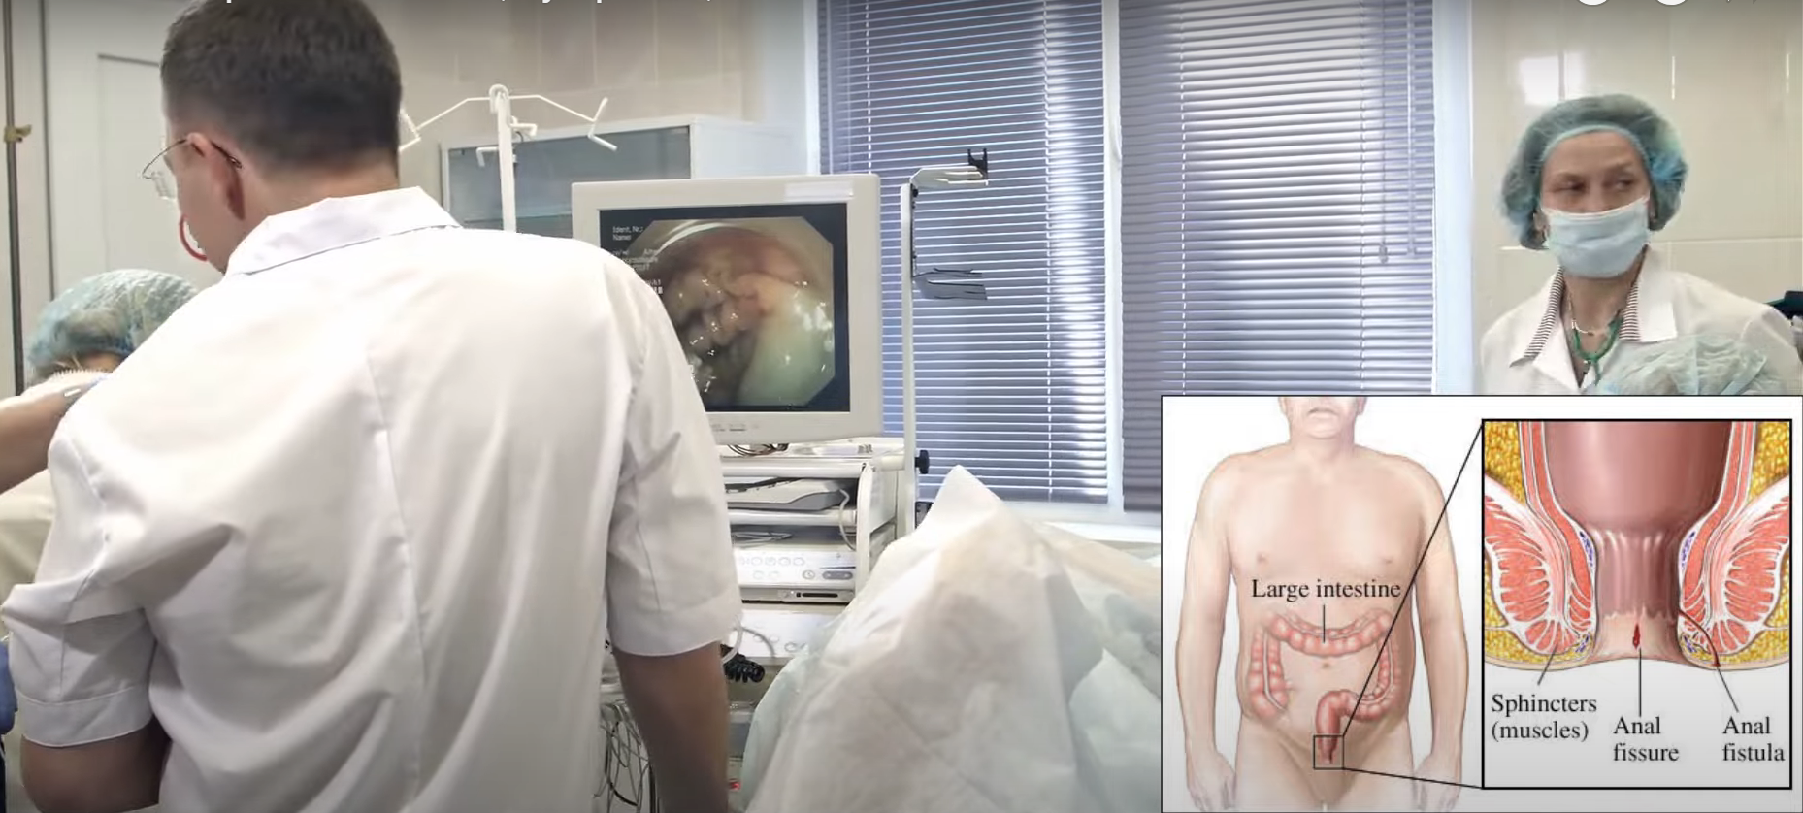
CONTI…
PRIOR ANAL SURGERY: Previous surgery or interventions in the anal area can sometimes result in the formation of a fistula.

Slide 12
PATHOPHYSIOLOGY
Due to etiological factors
Infection & Inflammation of the anal gland
Abscess formation
Spread of the infection through all layers of the wall of the anal canal
Perianal abscess formed
Abscess bursts to the exterior at the perianal region
Connection established

Slide 13
CLINICAL MANIFESTATION
Persistent Pain during bowel movements
Purulent discharge: A recurring discharge of pus or blood from the opening near the anus is another typical sign of an anal fistula.
Swelling and Redness: The presence of swelling, redness, tenderness around the anal opening may indicate presence of a fistula.
Recurrent Abscess: Frequent development of anal abscesses. May be an indication of an underlying anal fistula.
Pruritus (Itching) surrounding the anal fistula.

Slide 14
DIAGNOSTIC EVALUATION
Physical Examination: A Health care professional will perform a physical examination such as an opening or discharge.
Proctoscopy or Anoscopy: These procedures involve using a thin, flexible tube with a camera (proctoscope or anoscope) to examine the rectum and anal canal.
Imaging Tests: In some cases, imaging tests like an MRI. Or ultrasound may be recommended to obtain a more detailed view of the fistula tract.

Slide 15
MANAGEMENT
Fistulectomy
Fistulotomy
Surgical blocking of fistula

Slide 16
NURSING MANAGEMENT
General pre-post operative care.
Special post operative care
-Regular assess of wound and drainage
-Pain management by analgesics
-Dressing with sanitary pads
-Health education.

Slide 17
SUMMARY

Slide 18
REFERENCES

Slide 19


