Slide 1

HAEMORRHOID
MR. DINESH SINGH
P.G. NURSING TUTOR
ROHILKHAND COLLEGE OF NURSING

Slide 2
OBJECTIVES
Introduction of the Haemorrhoids.
Define the Haemorrhoids.
Explain the causes of Haemorrhoids.
State the clinical manifestations of Haemorrhoids.
Elaborate the diagnostic evaluation of Haemorrhoids.
Discuss the management of Haemorrhoids.
Describe the prevention of Haemorrhoids.

Slide 3
INTRODUCTION
Haemorrhoids also called piles, are swollen veins in your anus and lower rectum, similar to varicose veins. Haemorrhoids can develop inside the rectum (internal haemorrhoids) or under the skin around the anus (external haemoeehoids).

Slide 4
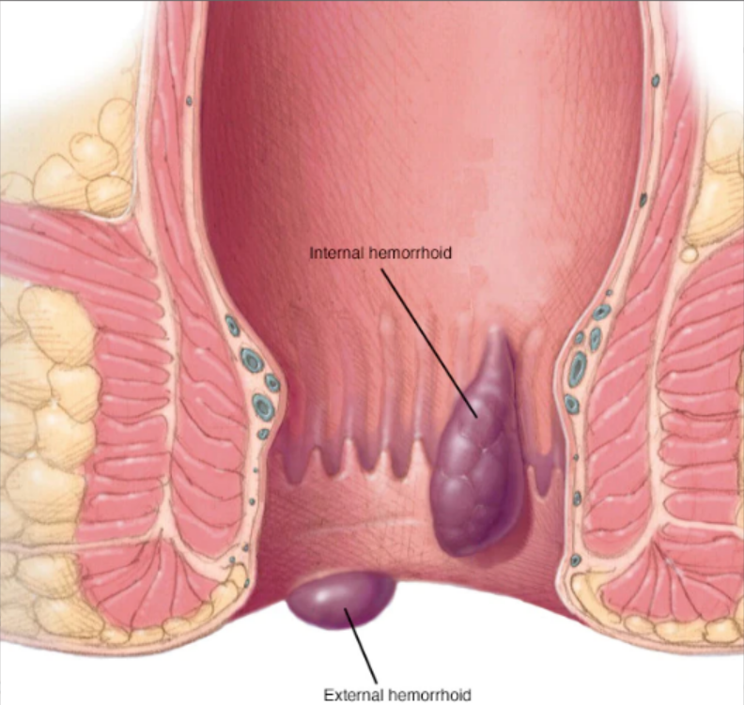
DEFINITION
It is an enlargement of normal spongy blood filled cushions in the walls of anus or dilation of anal veins and lower rectum.
Types: it is of two types
External: Always visible
Internal: Not visible

Slide 5
CAUSES
Chronic constipation
Prolong standing and sitting
Pregnancy
Tumor in colon
Due to rectal surgery or infection
Increase intra abdominal pressure
Portal hypertension
Obesity

Slide 6
PATHOPHYSIOLOGY
Increase abdominal pressure
Dilation of anal vein
Chronic constipation
Abdominal pressure till long time
Permanent dilation of anal vein
Bleeding from vein

Slide 7
CLINICAL MANIFESTATION
Pain
Constipation
Bright red bleeding from the anus
Itching surrounding anal area (pruritus)
Melaena (blood in stool)
Anemia
Rectal pain

Slide 8
DIAGNOSTIC EVALUATION
Presence of signs and symptoms
Barium enema for internal digital palpation
Anoscopy
Sigmoidoscopy
Proctoscopy

Slide 9
MANAGEMENT
Stool softener: Eg. Docusate sodium, Magnesium Sulphate.
Steroids ointments or creams: Eg. Fucibet, Betamethasone and clioquinol
NSAID Drugs
Increase dietary fiber
Rest

Slide 10
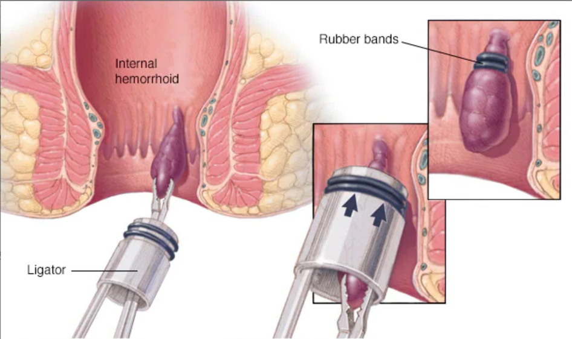
SURGICAL MANAGEMENT
Haemorrhoidectomy (Surgical removal of haemorrhoid)
Rubber bend ligation

Slide 11
PREVENTION
Drink plenty of water, at least eight glasses per day
Eat high fiber diet of fruits, vegetables, and whole grains
Empty bowels as soon as possible after the urge occurs
Regular exercise

Slide 12
SUMMARY

Slide 13
REFERENCES

Slide 14


