Slide 1

MR. DINESH SINGH
P.G. NURSING TUTOR
ROHILKHAND COLLEGE OF NURSING

Slide 2
OBJECTIVES
Introduction of the Gastric cancer.
Define the Gastric cancer
Explain the causes of Gastric cancer
State the clinical manifestations of Gastric cancer.
Elaborate the diagnostic evaluation of Gastric cancer.
Discuss the management of Gastric cancer.
Describe the prevention of Gastric cancer.

Slide 3
INTRODUCTION
Gastric cancer refers to malignant lesions found in the stomach.
It is more common in men than women.
The most common cause is infection by the bacteria HELICOBACTER pylori.
Most cases of the stomach cancers are gastric carcinomas.

Slide 4
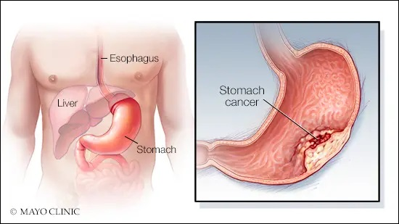
DEFINITION
Stomach cancer also called as GASTRIC CANCER.
Gastric cancer refers to the malignant neoplasms found in the stomach, usually adenocarcinoma.

Slide 5
ETIOLOGY

Slide 6
CLINICAL MANIFESTATION

Slide 7
DIAGNOSTIC EVALUATION

Slide 8
MANAGEMENT

Slide 10
COMPLICATIONS

Slide 11
SUMMARY

Slide 12
REFERENCES

Slide 13


