Slide 1

DIVERTICULAR DISEASE
MR. DINESH SINGH
P.G. NURSING TUTOR
ROHILKHAND COLLEGE OF NURSING

Slide 2
OBJECTIVES
Introduction of the
Define the
Explain the causes of
State the clinical manifestations of
Elaborate the diagnostic evaluation of
Discuss the management of
Describe the prevention of

Slide 3
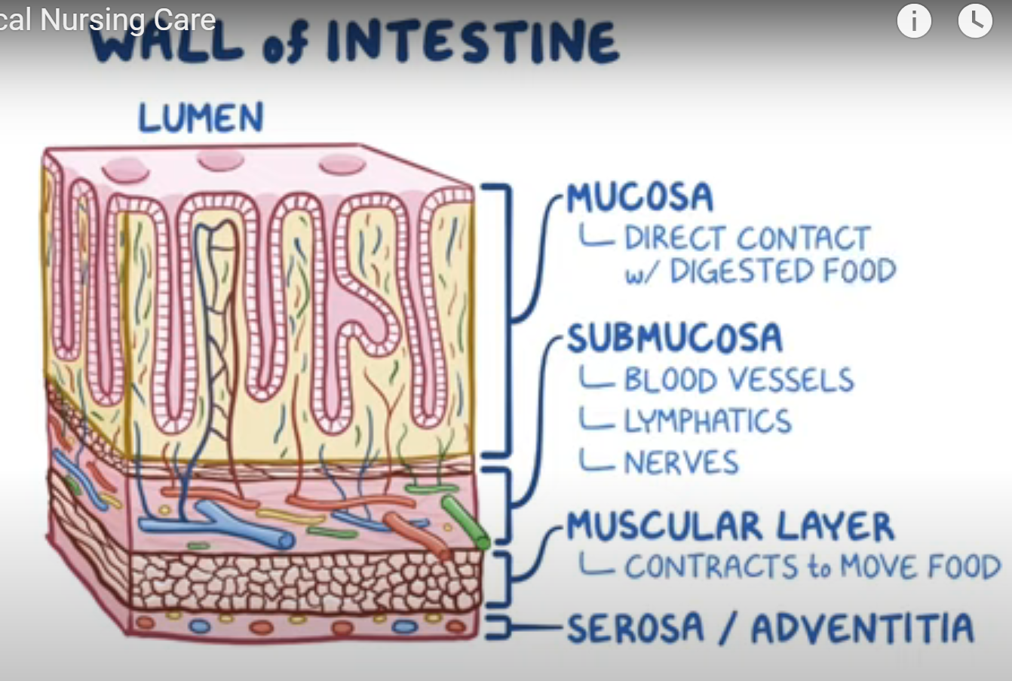
INTRODUCTION

Slide 4
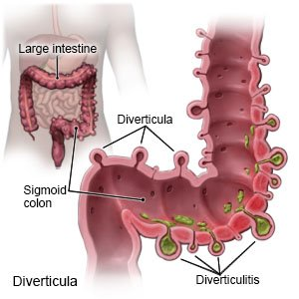
DEFINITION
Diverticula: small pouch like protrusions along walls of a Hollow structure.
Diverticulosis: Multiple diverticula in colon.
Diverticulitis: Diverticula become inflamed.

Slide 5
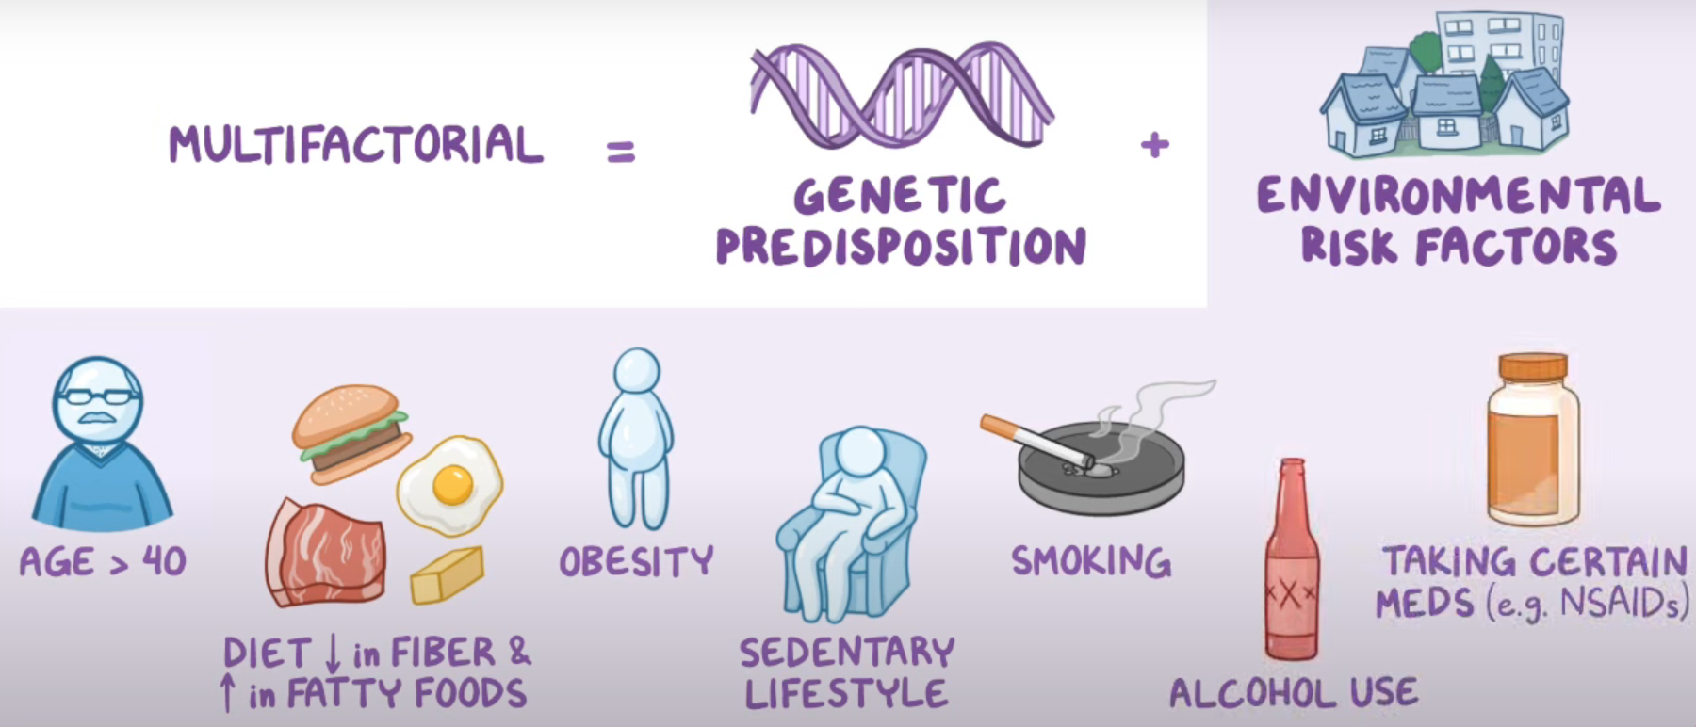
CAUSES & RISK FACTORS

Slide 6
Pathophysiology
Pressure increased inside the colon
Mucosa and submucosa bubble out through weak spots (eg. Where blood vessel penetrates muscle layer)
Blood vessels rupture. Eg. GI bleeding
Bacteria and undigested food stuck in protrusions ( infection Diverticulitis)
Bowel obstruction
Abscess (Pocket of infected pus)
Fistulae (Abnormal connections of organ or structure) Peritonitis

Slide 7
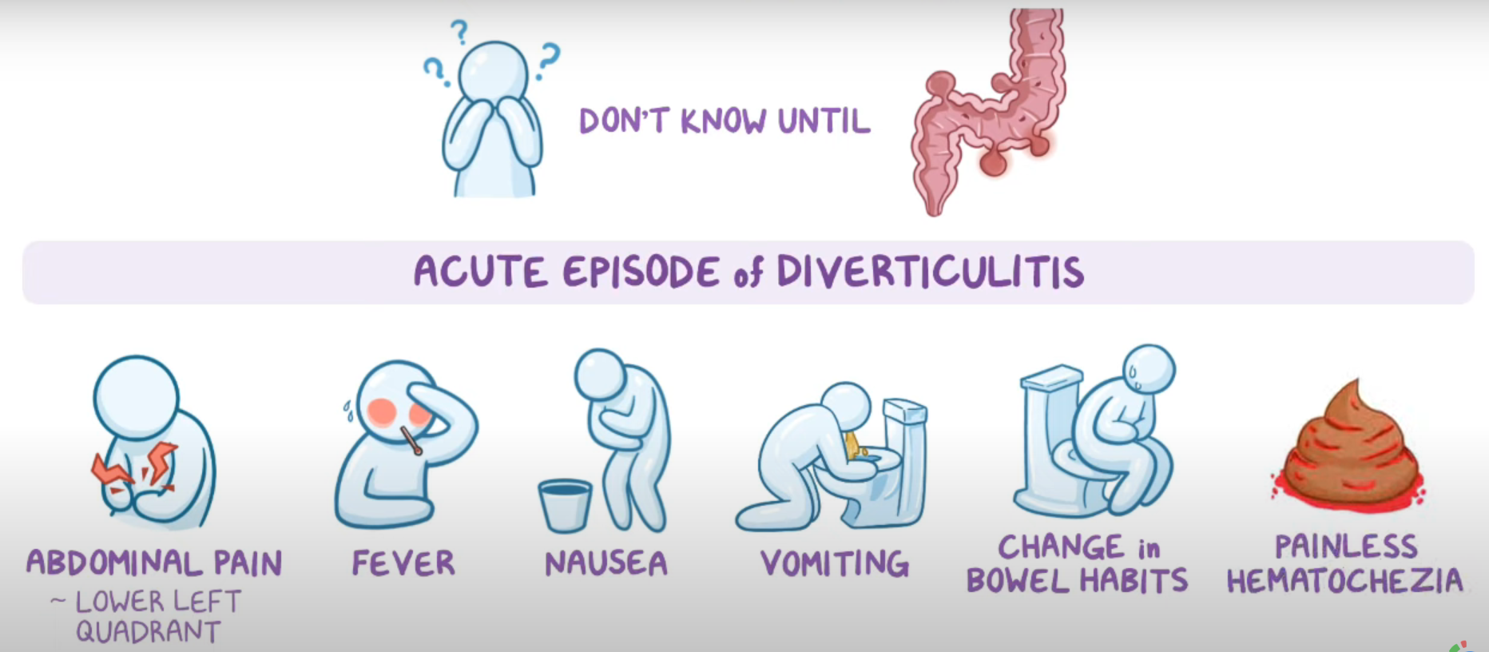
CLINICAL MANIFESTATION

Slide 8
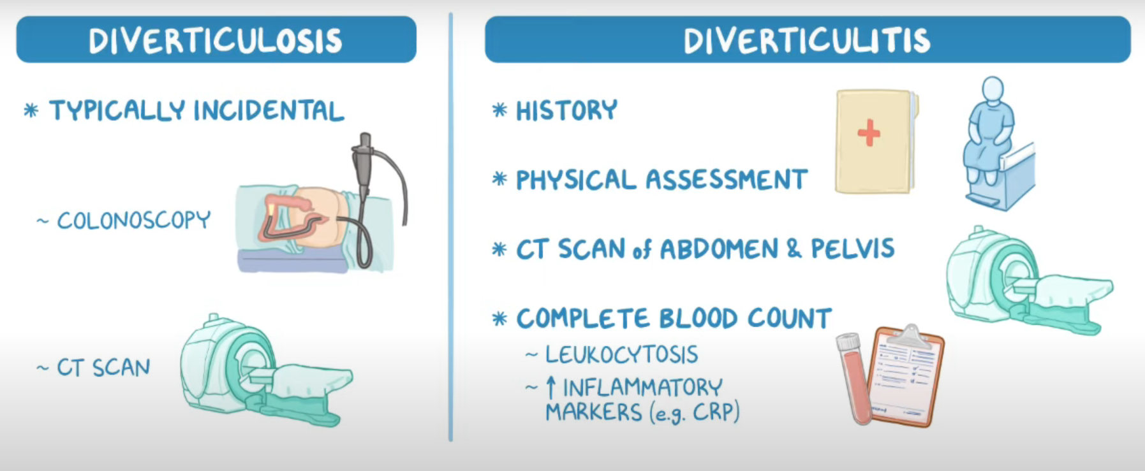
DIAGNOSTIC EVALUATION

Slide 9
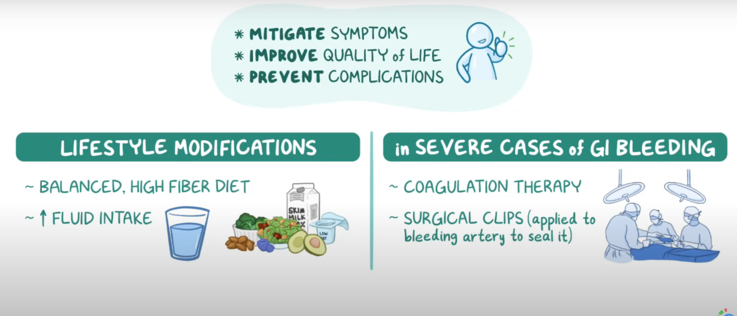
MANAGEMENT

Slide 10
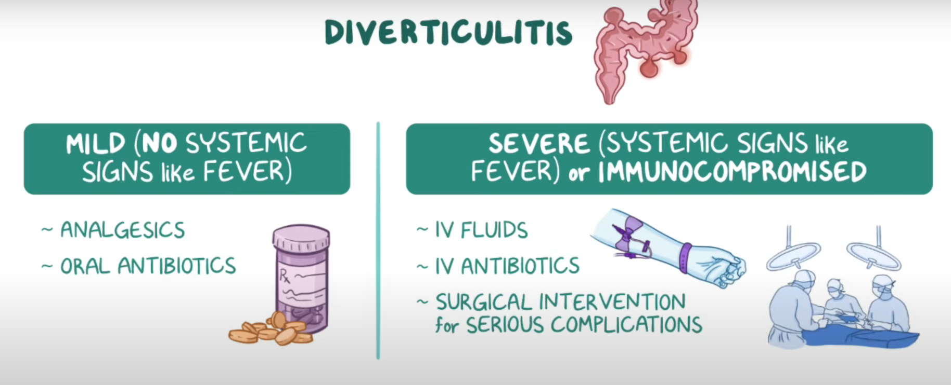
Conti…

Slide 11
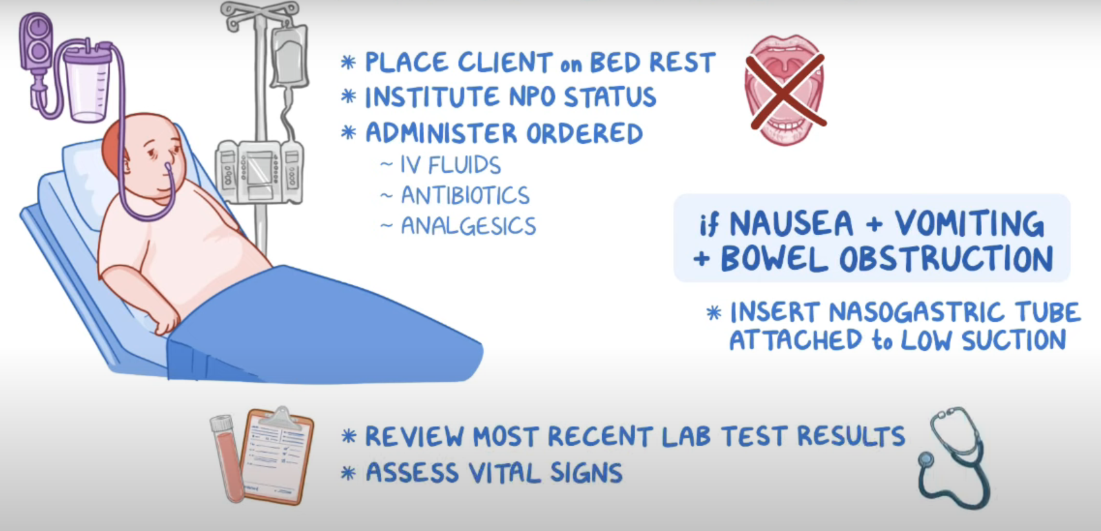
NURSING CARE
PRIORITY GOALS
Improve Gastro-intestinal function
Monitor for complications
Provide supportive care

Slide 12
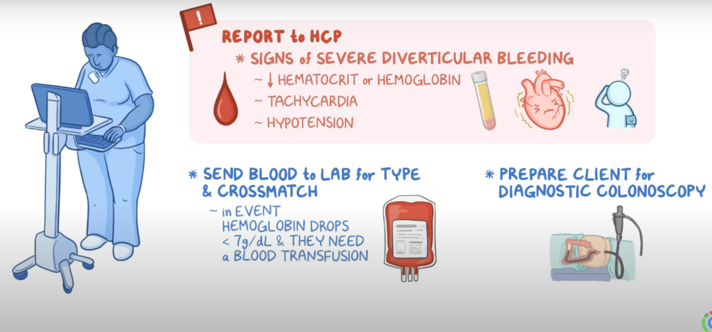
CONTI…

Slide 13
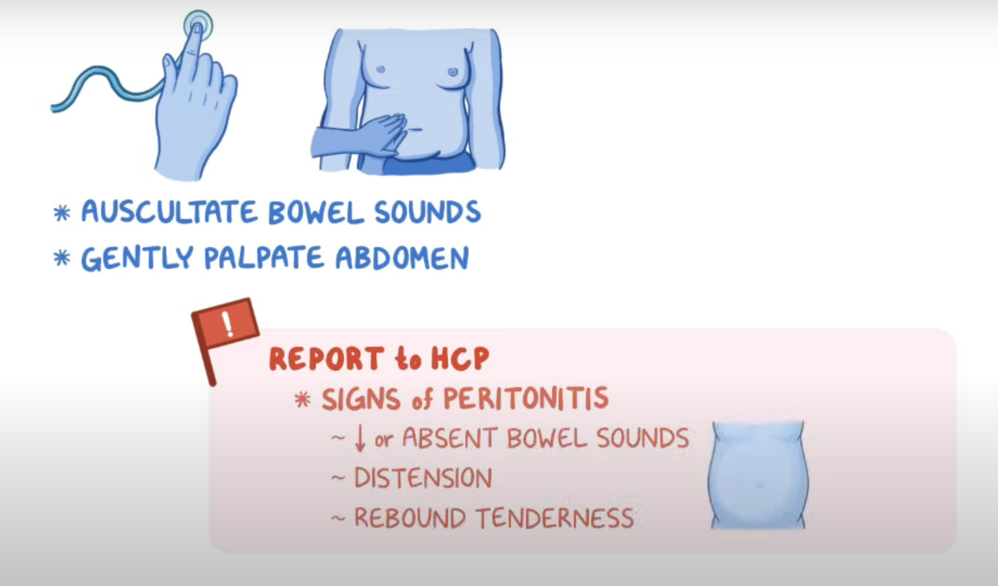
CONTI…

Slide 14
REFERENCES

Slide 15


