Slide 1

CROHN’S DISEASE
MR. DINESH SINGH
P.G. NURSING TUTOR
ROHILKHAND COLLEGE OF NURSING

Slide 2
OBJECTIVES
Introduction of the Peritonitis.
Define the Peritonitis.
Explain the causes of Peritonitis.
State the clinical manifestations of Peritonitis.
Elaborate the diagnostic evaluation of Peritonitis.
Discuss the management of Peritonitis.
Describe the prevention of Peritonitis.

Slide 3
INTRODUCTION
Crohn's disease is a type of inflammatory bowel disease (IBD). It causes swelling of the tissues (inflammation) in your digestive tract, which can lead to abdominal pain, severe diarrhea, fatigue, weight loss and malnutrition.

Slide 4
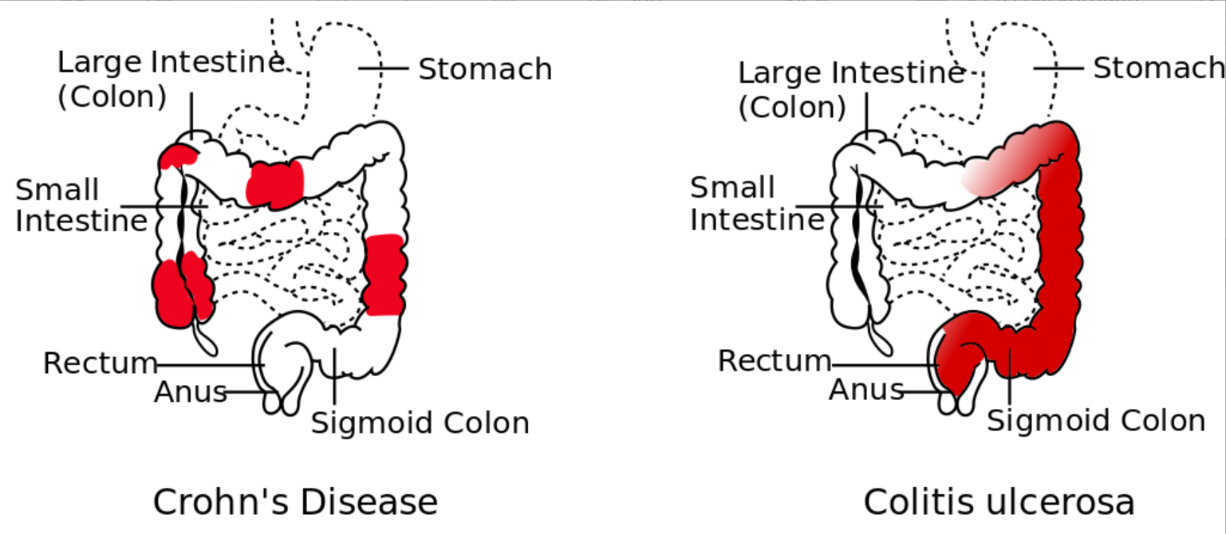
DEFINITION
It is an idiopathic, chronic, inflammatory process of the bowel that can affect any part of the gastro intestinal tract from the mouth to anus.

Slide 5
ETIOLOGY
Genetic
Autoimmune
Smoking
Microbes, Eg. Mycobacterium avium

Slide 6
CLINICAL MANIFESTATION
Abdominal pain
Diarrhea
Bloating
Perianal discomfort
Ileitis result in large volume watery feces and colitis result smaller volume feces in higher frequency
Weight loss due to malabsorption of carbohydrates, lipids.

Slide 7
DIAGNOSTIC EVALUATION
A barium X-ray
Colonoscopy
CT scan
Endoscopy
Blood test (to detect ESR, C-reactive protein, haemoglobin)

Slide 8
MANAGEMENT
Antibiotics used to reduce inflammation
Corticosteroids- Prednisone, methyl prednisolone
Immunomodulators- Azathioprine, methotreaxate

Slide 9
NURSING MANAGEMENT
Fluid volume deficient related to diarrhea
Imbalanced nutrition related to nausea, pain
Chronic pain related to inflammatory disease of small intestine.

Slide 10
DIETARY MANAGEMENT
Drink lot of fluids to keep body hydrated and prevent constipation
Take multivitamin-mineral supplement to replace lost nutrients
Eat a high fiber diet
Take small frequent meals
Eating a high protein diet with eats meats, fish and eggs may help relieve symptoms of crohn's disease.
Avoid to take caffeine, alcohol
Avoid gas producing food such as broccoli, cabbage, cauliflower, dried peas, onions and carbonated drinks.
Reduced fat intake if part of intestines has been surgically removed.

Slide 11
SUMMARY

Slide 12
REFERENCES

Slide 13


