Slide 1

ULCERATIVE COLITIS
MR. DINESH SINGH
P.G. NURSING TUTOR
ROHILKHAND COLLEGE OF NURSING

Slide 2
OBJECTIVES
Introduction of the Ulcerative Colitis.
Define the Ulcerative Colitis.
Explain the causes of Ulcerative Colitis.
State the clinical manifestations of Ulcerative Colitis.
Elaborate the diagnostic evaluation of Ulcerative Colitis.
Discuss the management of Ulcerative Colitis.
Describe the prevention of Ulcerative Colitis.

Slide 3
INTRODUCTION
Ulcerative colitis is one of the inflammatory bowel disease (IBD) that leads long lasting inflammation and ulcers (sores) formation in GI tract. It affects the inner-most lining of large intestine (colon) and rectum; sometimes it can lead to life threatening complications.

Slide 4
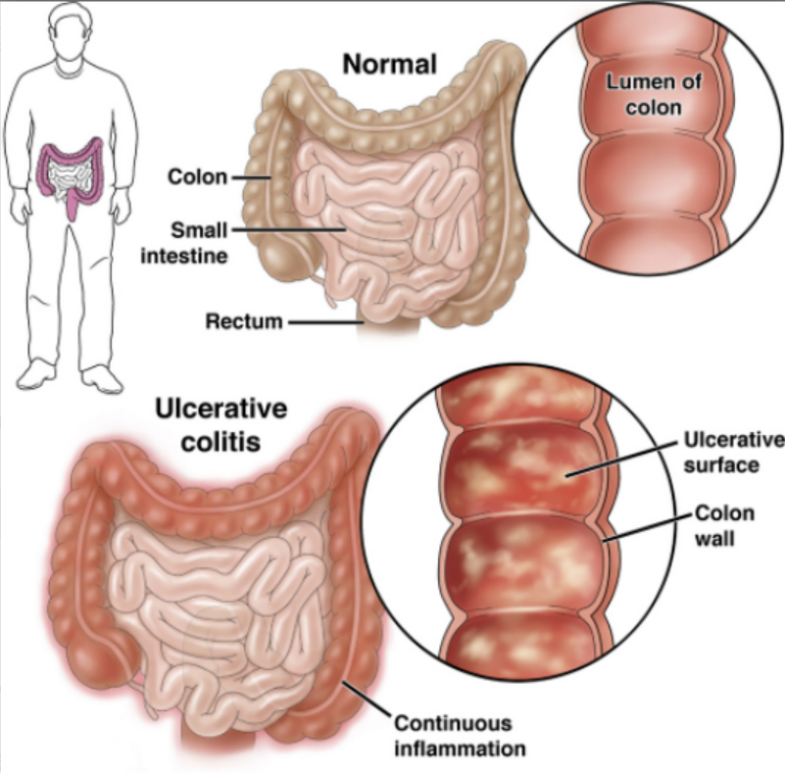
DEFINITION
It is an inflammation of colon. Which is usually starts from rectum and spreads to colon and slowly it involves intestinal membranes and all the layers of intestine (large) and cause ulcers

Slide 5
ETIOLOGY
Stress
Bacterial and viral infection
Allergic
Auto immune reaction

Slide 6
PATHOPHYSIOLOGY
Inflammationof rectal mucosa
Swelling or ulcer formation
Collection of fibrous tissue around the ulcer
Due to scar, disturb absorption ability of mucosa

Slide 7
CLINICAL MANIFESTATION
Melaena (Diarrhea with blood)
Weight loss
Colicky pain
Rectal bleeding
Painful straining
Vitamin K deficiency
Low grade fever
Anorexia
Tenesmus (cramping pain in stomach)
Tachycardia

Slide 8
DIAGNOSTIC EVALUATION
History collection
Physical examination
Stool examination
Abdominal X-ray
Sigmoidoscopy
Colonoscopy
Blood test- Decrease Hb, RBS and Increase WBC, ESR
CT Scan and MRI

Slide 9
MANAGEMENT
Antidiarrheal Eg. Metronidazole, Tindazole
Antiemetic Eg. Domperidone
Antibacterial Eg. Ciprofloxacin, Sulfasalazine
Corticosteroids (to reduce inflammation) Eg. Prednisone
Immunomodular agents Eg. Azathioprine, Cyclophosphamide

Slide 10
SURGICAL MANAGEMENT
Proctosigmoidectomy
Restorative proctocolectomy with ileal pouch and anastomosis
Ileostomy

Slide 11
COMPLICATIONS
Hemorrhage
Abscess formation
Anal fistula
Colon malignancy
Malnutrition
Anaemia

Slide 12
NURSING MANAGEMENT
Discuss dietary modifications related to nutritional status and presence of ileostomy. Provide referral to dietitian for diet planning and teaching.
Administer total parenteral nutrition as ordered.
Administer anti-inflammatory medications as per Doctor ordered.
Provide intravenous therapy.
Provide opportunities for patient to deal with ostomy through participation in selfcare.

Slide 13
SUMMARY

Slide 14
REFERENCES

Slide 15


