Slide 1




Slide 2

EPIDIDYMITIS
MR. DINESH SINGH
P.G. NURSING TUTOR
ROHILKHAND COLLEGE OF NURSING

Slide 3

OBJECTIVES
Introduction of the .
Define the .
Explain the causes of .
State the clinical manifestations of .
Elaborate the diagnostic evaluation of .
Discuss the management of .
Describe the nursing management of .

Slide 4

INTRODUCTION
An infection of tissues/tubes that lead to the testicles is called epididymitis. It can be caused by spread of bacterial in infection from the bladder or urethra (tubes which carries urine).

Slide 5

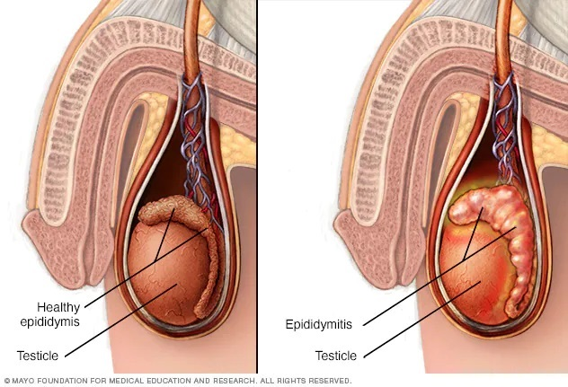
DEFINITION
Epididymitis is an infection of the epididymis that usually spreads from the urethra or bladder

Slide 6
ETIOLOGY
UTI (Urinary tract infection)
Urethral stricture disease
Bacterial prostatitis
Gonococcal and non-gonococcal bacterial urethritis
E.coli.

Slide 7

CLINICAL MANIFESTATION
Scrotal pain or tenderness
Oedema
Redness
Dysuria
Frequency
Fever
Nausea
Vomiting
Pyuria (presence of pus in urine)
Leukocytosis (increase blood cells)

Slide 8

DIAGNOSTIC EVALUATION
Physical examination
Ultrasound
Urine culture and sensitivity.

Slide 9

MEDICAL MANAGEMENT
Antimicrobial therapy: ceftriaxone 250 mg IM with Doxycycline 100 mg orally B.D. for 10 days.
Analgesics for pain relief.
Cold compressing to scrotum.

Slide 11
SUMMARY

Slide 12
REFERENCES

