Slide 1

FAECAL INCONTINENCE
MR. DINESH SINGH
P.G. NURSING TUTOR
ROHILKHAND COLLEGE OF NURSING

Slide 2
OBJECTIVES
Introduction of the Peritonitis.
Define the Peritonitis.
Explain the causes of Peritonitis.
State the clinical manifestations of Peritonitis.
Elaborate the diagnostic evaluation of Peritonitis.
Discuss the management of Peritonitis.
Describe the prevention of Peritonitis.

Slide 3
INTRODUCTION
Fecal incontinence is not being able to control bowel movements. Stool leaks from the rectum without warning. Fecal incontinence ranges from an occasional leakage of stool while passing gas to a complete loss of bowel control. Fecal incontinence is sometimes called bowel incontinence.

Slide 4
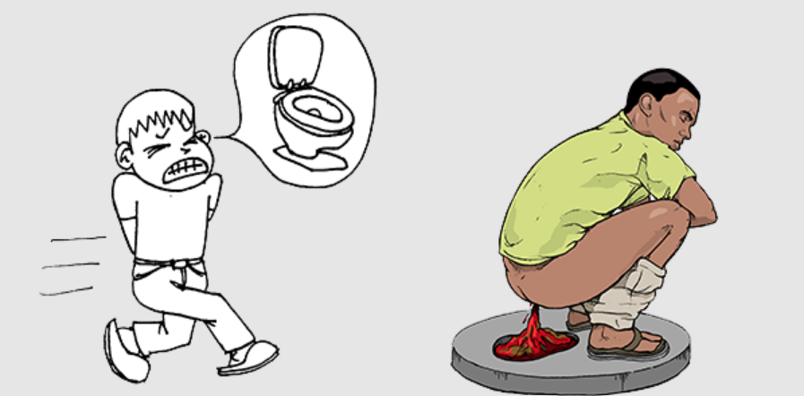
DEFINITION
Involuntary or the uncontrolled passage of stool may be due to multiple causes.
Also called bowel incontinence, fecal incontinence ranges from an occasional leakage of stool while passing gas to a complete loss of bowel control.

Slide 5
CAUSES
The most common cause of bowel incontinence is damage to the muscles around the anus (anal sphincters)
Vaginal childbirth can damage the anal sphincters or their nerves.
Anal surgery can also damage the anal sphincters or nerves.

Slide 6
Other causes
Diarrhea (often due to an infection or irritable bowel syndrome)
Impacted stool (due to severe constipation, often in older adults)
Inflammatory bowel disease (Crohn’s disease or ulcerative colitis)
Nerve damage (due to diabetes, spinal cord injury, multiple sclerosis, or other conditions)
Radiation damage to the rectum (such as after treatment for prostate cancer)
Cognitive (thinking) impairment (such as after a stroke or advanced Alzheimer’s disease)

Slide 7
CLINICAL MANIFESTATION
Urgency and loss of control
Poor control of fetus
Diarrhea
Gas and bloating
Constipation

Slide 8
DIAGNOSTIC EVALUATION
Rectal examination
Endoscopic examination
Sigmoidoscopy
Barium enema
X-rays
Anorectal manometry

Slide 9
MANAGEMENT
Anti-diarrheal drugs such as loperamide (Imodium A-D) and those containing diphenoxylate and atropine (Lomotil).
Bulk laxatives such as methylcellulose (Citrucel) and psyllium (Metamucil), if chronic constipation is causing your incontinence.

Slide 10
SURGICAL MANAGEMENT
Sphincteroplasty. This procedure repairs a damaged or weakened anal sphincter that occurred during childbirth.
Treating rectal prolapse, a rectocele or hemorrhoids: Surgical correction of these problems will likely reduce or eliminate fecal incontinence.
Colostomy, also called bowel diversion: This surgery diverts stool through an opening in the abdomen. Doctors attach a special bag to this opening to collect the stool. Colostomy is generally considered only after other treatments haven't been successful.

Slide 11
NURSING MANAGEMENT
Minimize the soft drinks, beverages such as coffee, tea, alcohol, fried foods, meat etc.
Recommend for low fat, high protein diet, fibrous foods and green leafy vegetables etc.
Encourage to take balance diet to fulfill nutritional requirements.
Encourage for lifestyle medication, e.g. cessation of smoking and tobacco, weight loss, red meat, smoked fish, pickle, highly condimental foods.
Advise to take small, frequent meals to relieve abdominal discomfort.

Slide 12
Conti…
Encourage to take high intake of fluids at least 2 liters per day.
Assess the color of steatorrhea, episodes of vomiting and diarrhea.
Take proper rest and sleep to relieve the abdominal pain.
Avoid such activities which increase intra- abdominal activity.
Monitor vital signs to prevent from shock, assess characteristics of the pain.
Replacement of parenteral nutrition, IV fluids to maintain fluid volume.
Assess the skin color, skin turgor, to identify anemia and other complications.

Slide 13
SUMMARY

Slide 14
REFERENCES

Slide 15


