Slide 1



Slide 2
BENIGN PROSTATE HYPERPLASIS
MR. DINESH SINGH
P.G. NURSING TUTOR
ROHILKHAND COLLEGE OF NURSING

Slide 3
OBJECTIVES
Introduction of the .
Define the .
Explain the causes of .
State the clinical manifestations of .
Elaborate the diagnostic evaluation of .
Discuss the management of .
Describe the nursing management of .

Slide 4
INTRODUCTION
BPH is the condition when the prostate gland is increasing in size that leads to compression and then obstruction of the urethra, which affects urinary flow. BPH is the 4th most commonly diagnosed disorder among patient’s 50 years after CAD, HTN and type-2 diabetes.

Slide 5
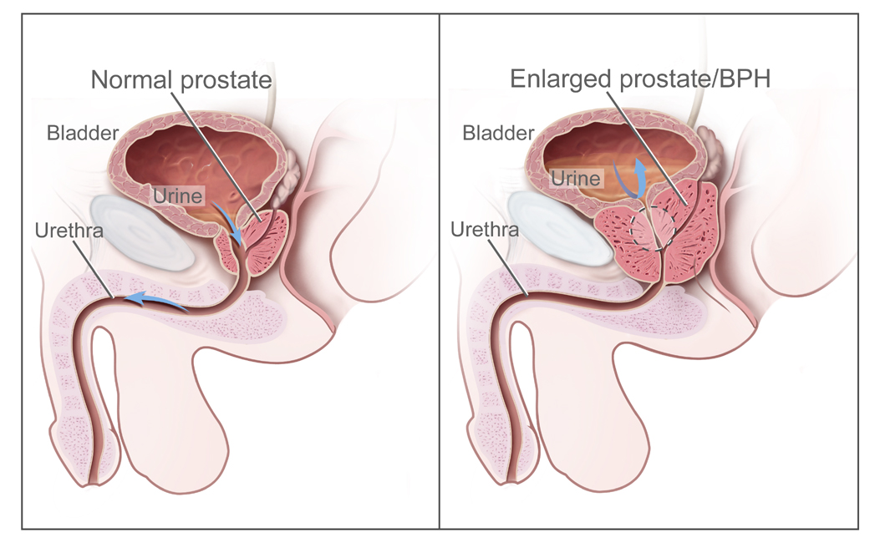
DEFINITION
BPH is enlargement of prostate gland that constricts the urethra, causing urinary symptoms (urinary retention).

Slide 6
ETIOLOGY
Unknown cause
Old age above 50 years

Slide 7
RISK FACTORS
Chronic infection
Hereditary
Hormonal alteration (increase androgen)
Prolonged obstruction.

Slide 8
PATHOPHYSIOLOGY
Due to increase level of 5 alpha Dihydrotesterone
Hyperactivity of testosterone
Hyperplasia (Overgrowth) of prostate tissue
Prostatic urethra becomes compressed and narrowed
Prolonged obstruction

Slide 9
CLINICAL MANIFESTATION
In early stage , there may be no symptoms.
In later stage
  Urinary obstruction/ retention
  Increase frequency in night (nocturia)
  Dysuria
  Incomplete bladder emptying
  Decrease force of urinary stream
By forcefully ejaculation of urine

Slide 10
DIAGNOSTIC EVALUATION
Urinalysis
Serum test (BUN increase)
Serum creatinine increase
Cystourethroscopy
USG
Serum PSA (Prostate Specific Antigen) elevates.

Slide 11
MEDICAL MANAGEMENT
Alpha – adrenergic blockers
Action: Relax smooth muscle of bladder base and prostate to facilitate voiding.
Example: Tamsulosin, Terazosin, Alfuzosin.
Antiandrogenic agents
Action: They prevent hyperplasia of prostate cells
Example: Finasteride, Dutasteride.

Slide 12
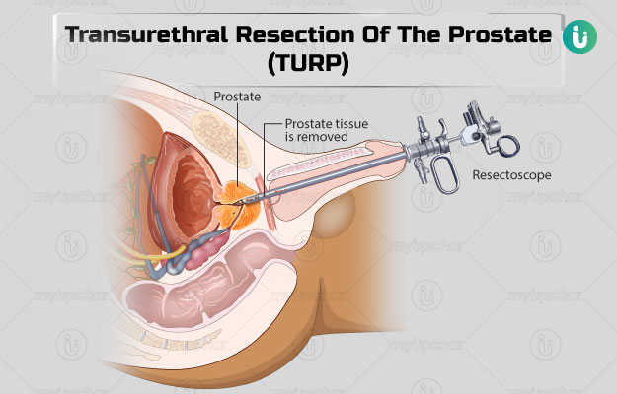
SURGICAL MANAGEMENT
TURP (Transurethral Resection of Prostate): Technique is performed by inserting a resectoscope through the urethra, the surgeon is able to visualize the inside of bladder by inserting a telescope through rectoscope.

Slide 13
CONTI…
Prostatectomy:
Suprapubic Prostatectomy: Suprapubic prostatectomy is surgery to remove part or all of your prostate gland.
Retropubic Prostatectomy: Surgery to remove the entire prostate and some of the tissue around it, including the seminal vesicles (a gland that helps make semen).
Perineal Prostatectomy: Surgery to remove the entire prostate and some of the tissue around it, including the seminal vesicles (a gland that helps make semen).

Slide 14
NURSING MANAGEMENT
Administer medications as prescribed, e.g. 5 –reductase inhibitors, to reduce size of prostate and decrease symptoms.
  Alpha adrenergic antagonists to decrease adverse urinary tract symptoms and increase urinary flow.
  Antispasmodics to relieve bladder spasms related to irritation.
  Antibiotics to treat infection.
Prepare the patient for diagnostic tests and surgery as appropriate.
Obtain a urine culture if UTI is suspected.

Slide 15
CONTI…
If urine retention occurs, insert an indwelling catheter.
Monitor and record the patient’s vital signs, intake, output, and daily weight.
Advice the patient that it may take several months of medical therapy before symptoms improve.
Identify bowel /bladder elimination patterns. Recommend adequate hydration and intake of fiber. Use of stool softeners, laxatives and bowel use of stool softeners, laxatives and bowel training program to avoid constipation

Slide 16
SUMMARY

Slide 17
REFERENCES

Slide 18


