Slide 1

PERITONITIS
MR. DINESH SINGH
P.G. NURSING TUTOR
ROHILKHAND COLLEGE OF NURSING

Slide 2
OBJECTIVES
Introduction of the Peritonitis.
Define the Peritonitis.
Explain the causes of Peritonitis.
State the clinical manifestations of Peritonitis.
Elaborate the diagnostic evaluation of Peritonitis.
Discuss the management of Peritonitis.
Describe the prevention of Peritonitis.

Slide 3
INTRODUCTION
Peritonitis is inflammation of the peritoneum, which is a silk-like membrane that lines inner abdominal wall and covers the organs within the abdomen due to a bacterial or fungal infection. Peritonitis can result from any rupture (perforation) in the abdomen, or as a complication of other medical conditions.

Slide 4
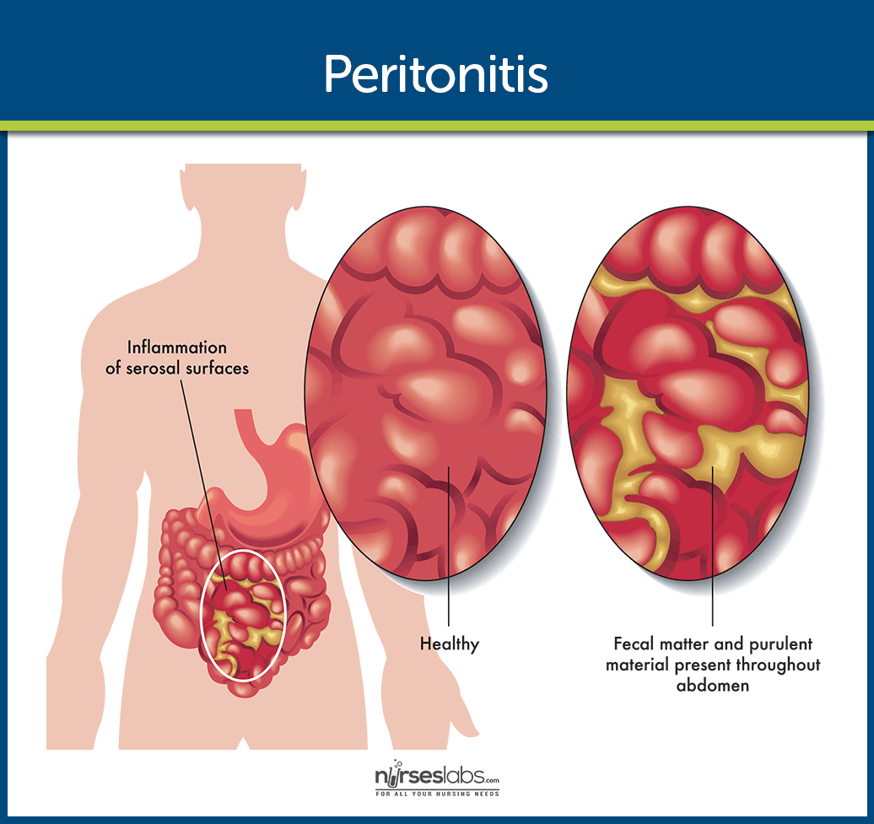
DEFINITION
An acute or chronic inflammation of peritoneum layer and peritoneal cavity.
Peritonitis is an inflammation of the peritoneum (thin membrane that lines that abdominal wall and covers the organs inside) caused by a bacterial or fungal infection.

Slide 5
ETIOLOGY
Bacterial infection
Mycoplasma infection
Syphilis
Gonorrhea
Fungal infection
Herpes simplex virus infection
Varicella or herpes zoster infection
Enterovirus infection
Measles

Slide 6
CLINICAL MANIFESTATION
Red patches
Mouth ulcers
Blisters
Swelling
Oral dysesthesia (numbness)
Burning mouth syndrome- soreness despite normal appearance.

Slide 7
DIAGNOSTIC EVALUATION
History collection
Physical examination: find the significant signs and symptoms related to peritonitis.
Abdominal X-ray: X-ray to check for holes or other perforations in the gastrointestinal tract.
Ultrasonography (USG)
Peritoneal Fluid Analysis: show as increased white blood cell count, which typically indicates an infection or inflammation and culture of the fluid may also reveal the presence of bacteria.

Slide 8
MANAGEMENT
Broad spectrum antibiotic for infection, e.g., amoxycillin, streptomycin, ciprofloxacin.
Replacement of fluid and electrolytes.
Analgesic for pain
Antiemetics for vomiting.
Suctioning by N.G. tube.
Abdominal paracentesis to remove the fluid.

Slide 9
Conti…
Blood transfusion, if appropriate.
Operation procedure for close perforations, remove infection source (inflamed organ, necrotic tissue).
Provide bed rest.
Provide laxative or stool softener.

Slide 10
COMPLICATIONS
Bacteremia
Shock may be present due to hypovolemia or septicemia.
Two common complications are abscess formation and wound formation.

Slide 11
SUMMARY

Slide 12
REFERENCES

Slide 13


