Slide 1



Slide 2
ORCHITIS
MR. DINESH SINGH
P.G. NURSING TUTOR
ROHILKHAND COLLEGE OF NURSING

Slide 3
OBJECTIVES
Introduction of the .
Define the .
Explain the causes of .
State the clinical manifestations of .
Elaborate the diagnostic evaluation of .
Discuss the management of .
Describe the nursing management of .

Slide 4
INTRODUCTION
Orchitis (or-KIE-tis) is an inflammation of one or both testicles. Bacterial or viral infections can cause orchitis, or the cause can be unknown. Orchitis is most often the result of a bacterial infection, such as a sexually transmitted infection (STI). In some cases, the mumps virus can cause orchitis.

Slide 5
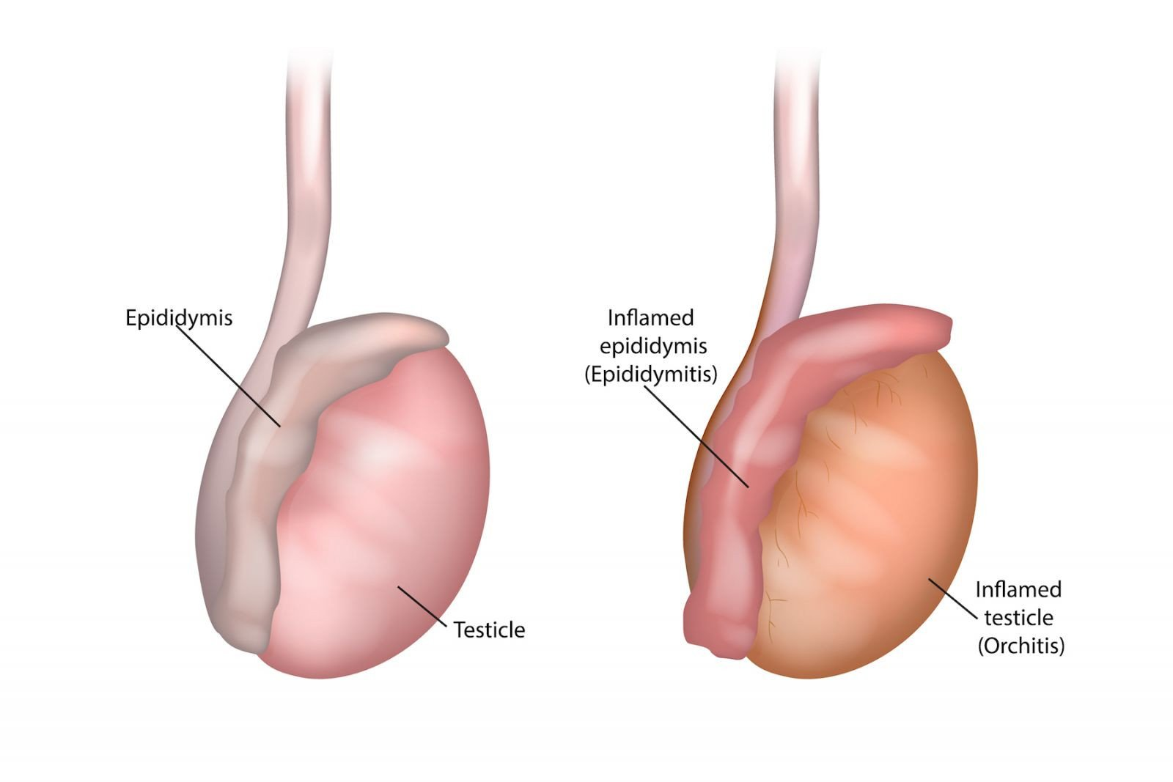
DEFINITION
It is an inflammation of the testicles. It can be caused by either bacteria or a virus. Both testicles may be affected by orchitis at the same time. However, symptoms are usually in just one testicle.

Slide 6
ETIOLOGY
Bacterial infection
Viral infection
Injury

Slide 7
RISK FACTORS
Having sexual intercourse without condoms
History of sexually transmitted infections
Having a partners who has an Sexually transmitted infections
Congenital urinary tract abnormalities.

Slide 8
CLINICAL MANIFESTATION
Pain in the testicles and groin is the primary symptoms of orchitis.
Tenderness and swelling on scrotum
Painful urination
An enlarged prostate
Fever
Painful ejaculation

Slide 9
DIAGNOSTIC EVALUATION
Physical examination
By sign and symptoms
Culture and sensitivity test.

Slide 10
MEDICAL MANAGEMENT
Antibiotics (to stop infection)
Analgesics
Complete bed rest
Local heat application to the scrotum

Slide 11
SUMMARY

Slide 12
REFERENCES

Slide 13


