Slide 1



Slide 2
PHIMOSIS
MR. DINESH SINGH
P.G. NURSING TUTOR
ROHILKHAND COLLEGE OF NURSING

Slide 3
OBJECTIVES
Introduction of the .
Define the .
Explain the causes of .
State the clinical manifestations of .
Elaborate the diagnostic evaluation of .
Discuss the management of .
Describe the nursing management of .

Slide 4
INTRODUCTION
Phimosis is the inability to retract the foreskin behind the head (glans) of the penis. A balloon like swelling under the foreskin may occur with urination. In teenagers and adults.
It may result in pain during an erection.

Slide 5
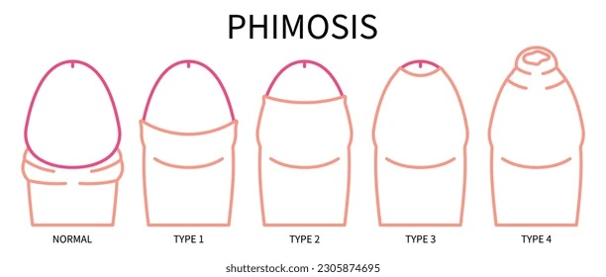
DEFINITION
Phimosis is a condition of the penis where the foreskin cannot be fully retracted over the glans penis.

Slide 6
ETIOLOGY
Physiologic Phimosis: It is the normal condition in which children are born with a tight foreskin, and separation occurs during late childhood and early adolescence.
Pathologic Phimosis: It happens because of an infection, inflammation, or scarring and usually found in uncircumcised adult.

Slide 7
CLINICAL MANIFESTATION
Painful urination
Painful erection
Irritation
Paraphimosis
Erythema

Slide 8
DIAGNOSTIC EVALUATION
History collection
Physical examination

Slide 9
MEDICAL MANAGEMENT
Depends on the age of male, severity and resulting symptoms:
Steroid ointment is locally applied
Antimicrobial drugs
If medical treatment is not successful, circumcision might be beneficial.

Slide 10
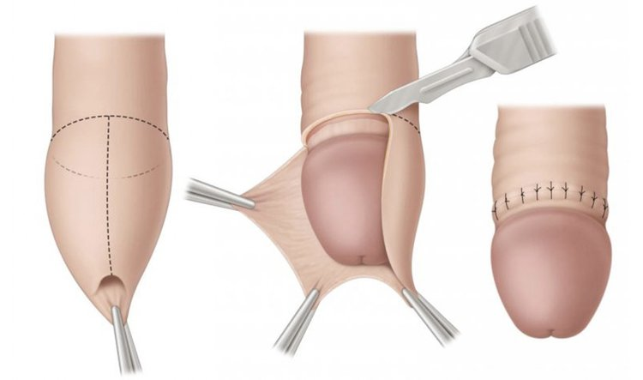
SURGICAL MANAGEMENT
Ventral Slit:
Is an incision along with the lower length of the foreskin from the tip of the frenulum to the base of the glans, removing the furnulum to the base of the glans removing the frenulum in the process.

Slide 11
CONTI…
Preputioplasty:
In which a limited dorsal slit with transverse closure is made along the constricting band of skin, can be an effective alternative to circumcision. It has the advantages only for limited pain and short time healing related to circumcision and avoids cosmetic effects.

Slide 12
COMPLICATIONS

Slide 13
SUMMARY

Slide 14
REFERENCES

Slide 15


